Slide 1
The Environmental Transformation
Shaun de Witt, UKAEA

Slide 2
But what is the environmental footprint? … and don’t forget ethics!
No clear definition
Mining:
Removal of land for food production? Forest clearing? Mining Machine manufacture & transport?
Displacement of people? Indentured labour?
Extraction & Manufacture:
Primary energy source? Process efficiency? Waste product disposal/reclamation?
Water usage? Hazardous Chemicals?
Use
Primary energy source? Efficiency of use?
Can I offset some impact if I am designing a more efficient wind turbine/fusion plant compared to bitcoin mining?
Do I *need* to use a chip or is it a convenience (do I need a bluetooth enabled washing machine?)
Recycle/Reclaim
Cost to reclaim raw materials? Cost of “dumping”?
What do I care more about:
Total environmental cost of IT sector → Which none of us can control, but is more globally important
Total environmental cost per server → Which we can address

Slide 3
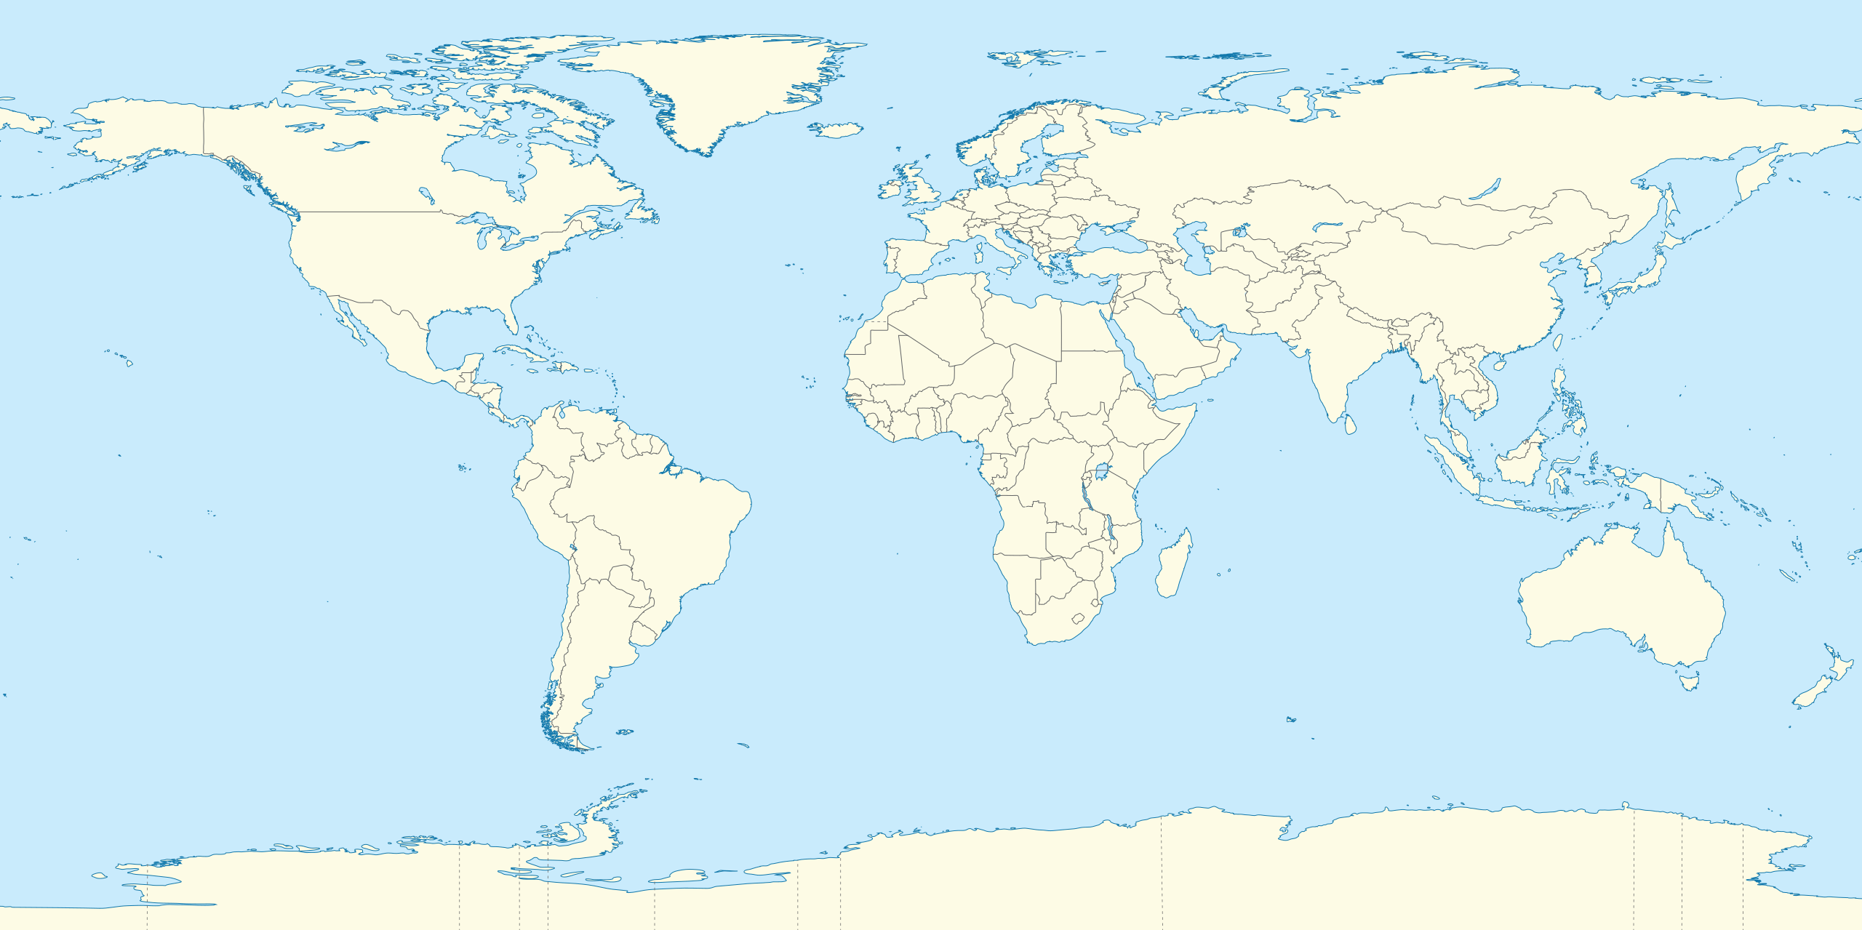
Environmental Impact of Computing…
Mining
Extraction
Manufacture
Use
Recycle/Reclaim
Silicon Mining
Semiconductor
Manufacture
Most electronic
Devices
Largest Data
Centres
Just Silicon is a global industry!!!
What about boron? Silver? Gold?
Where does the power come from in the manufacturing process?

Slide 4
Manufacturers are Starting to Address This
HPe: https://www.hpe.com/us/en/living-progress/carbon-footprint.html
DELL: https://www.dell.com/en-us/dt/corporate/social-impact/advancing-sustainability/sustainable-supply-chain/environment.htm
ATOS: https://atos.net/en/about-us/corporate-responsibility-and-sustainability
Fujitsu: https://www.fujitsu.com/global/about/resources/reports/sustainabilityreport/
Nvidia: https://www.nvidia.com/en-us/csr/
Intel: http://csrreportbuilder.intel.com/pdfbuilder/pdfs/CSR-2020-21-Full-Report.pdf
AMD: https://www.amd.com/en/corporate-responsibility/environmental-stewardship
Many go further than simply reducing CO₂ emission including other atmospheric pollutants, water usage, harmful chemicals, net-zero targets (whatever they are)…
With this information we CAN look at favouring suppliers who have a green policy and we can discriminate between then based on this

Slide 5
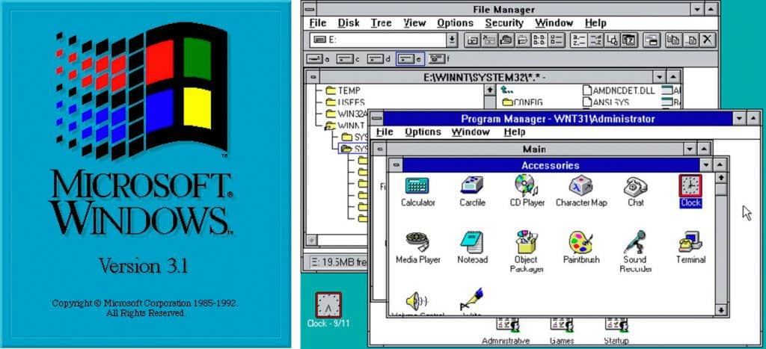
Current IT Status
Lots of old inefficient legacy hardware
Which we can’t get rid of (probably) – some dating back to the 1980’s!
Some running insecure versions of windows….
Bought before “green” became as relevant as it is today
Newer systems
Most desktops replaced by laptops as we adopt hybrid working
Increasingly moving away from tape to cloud (economics) for archival
But tape likely to remain in place for JET data
Moving to the cloud?
Is this just making it someone else’s problem?
The major hyperscalers have tools to show your carbon footprint, but this is only for use
Are tools like Google Earth Engine (https://earthengine.google.com) just greenwashing or do they allow us to look at details at an unprecedented scale without borders?

Slide 6
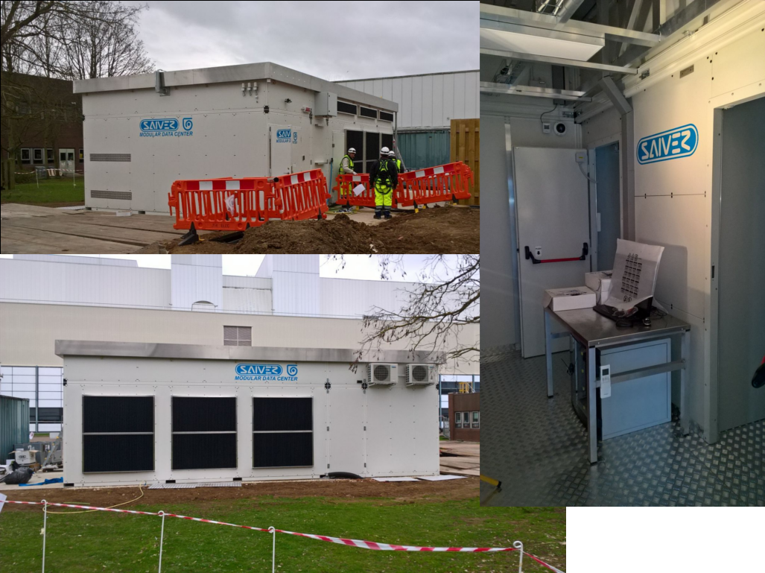
PUE Targets
Reduce JET data centre PUE by 10% year-on-year until 2024
KPI
Many legacy systems
Achieved through more efficient CRAC units, hot/hold aisle separation, improved rack layout
Invest in more efficient systems
Our Mobile data centre runs at a typical PUE of 1.02
6000 cores, 8xP100 8 card GPU nodes
FDR IB network
Built by Savier SrL (http://www.saiver.com)

Slide 7
Existing IT Procurements & Procedures
Procurements
PDUs must be at least 80plus Bronze certified with extra weighting for higher standards
All PDUS must be ”Smart”
Energy Star ratings for “office IT”
But currently a gap in EU regulation since 2019
All servers must be able to automatically clock down when idle
Procedures – around decommissioning
Ruled by government compliance (WEEE – implementation of EU wide WEEE directive
Shred hard storage media
3rd party contractor for recycling
at least 80% reuse and recycling of components, materials and substances by the average weight in tonnes

Slide 8
What more can we do
At the moment we evaluate tenders based on:
Technical solution, procurement cost, warranty, ability to deliver, experience
with various weightings
But why not include environment (and ethics) policy?
The supplier must have a publicly accessible environmental policy
The supplier must demonstrate adherence to the Modern Slavery Act (2015) <== Note no EU equivalent, but there are various national laws such as the French Duty of Vigilance Law and Dutch Child Labour Due Diligence Law
The supplier should publicly demonstrate progress against their environmental targets (if any)
The suppliers environmental policy should address one or more of the following: net-zero, increase in use of renewable energy, environmental improvements in the supply chain, reduced water usage, reduction in the use of harmful chemical, ….
Individually all we can do is make suppliers aware of their responsibilities and the responsibility of their entire supply chain

