Slide 1
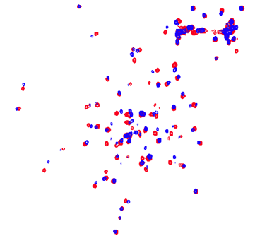
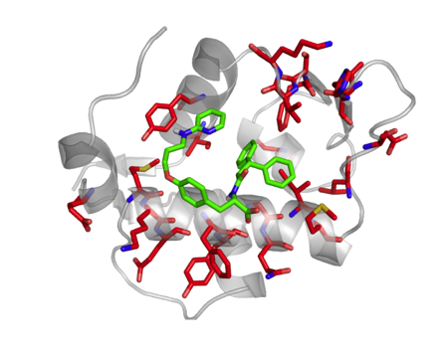
A drug discovery pipeline integrating the processing and analysis of NMR spectra and the identification of lead compounds.
Andrea Giachetti
Magnetic Resonance Center (CERM), CIRMMP, University of Florence, giachetti@cerm.unifi.it
EGI Conference 2022

Slide 2
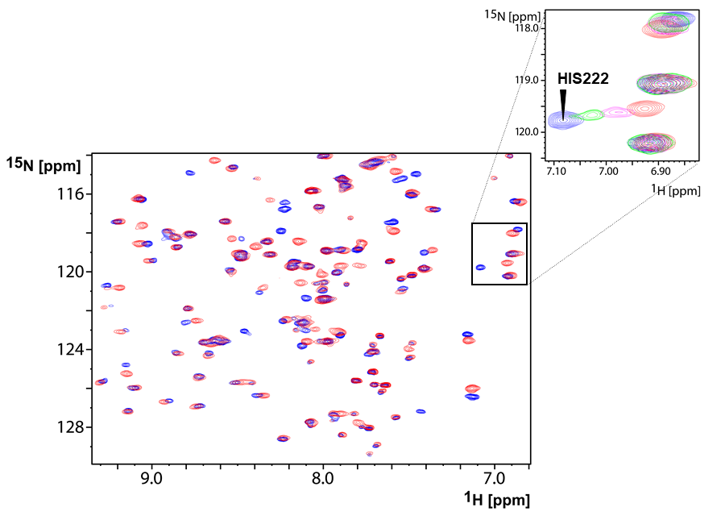
NMR spectroscopy in drug discovery: the protein-based approach
In the protein-based approach, 2D NMR spectra are recorded on uniformly ¹⁵N-labeled proteins to screen libraries of chemicals
Ideally, a screening methodology should answer the following questions
Does the ligand bind?
How strongly does the ligand bind?
Where does the ligand bind?
How does the ligand bind?

Slide 3
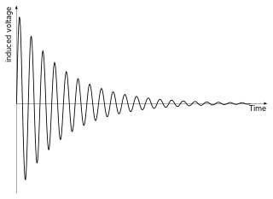
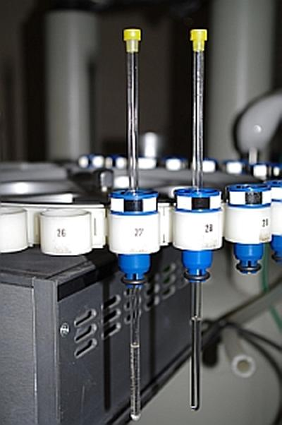
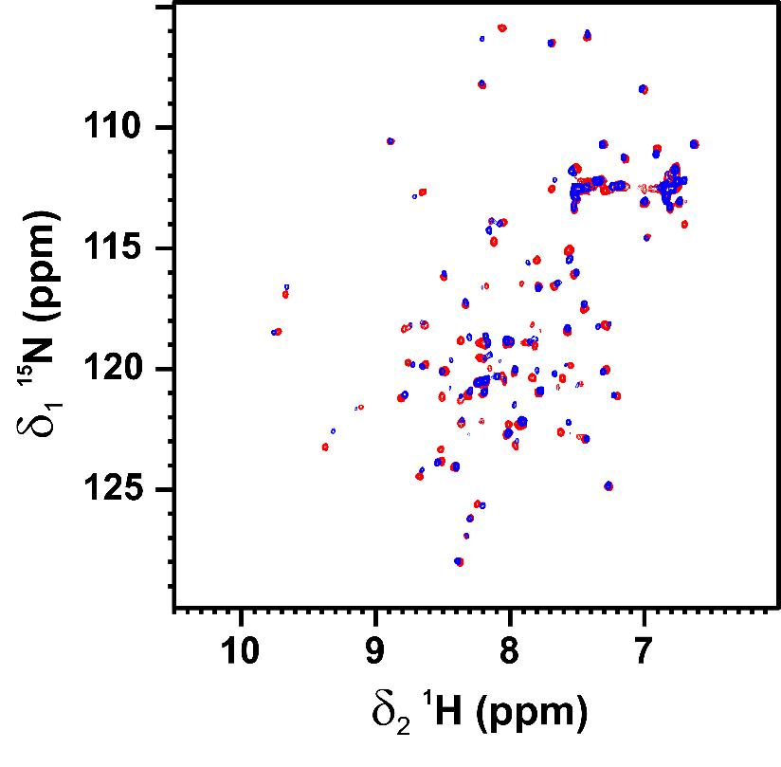
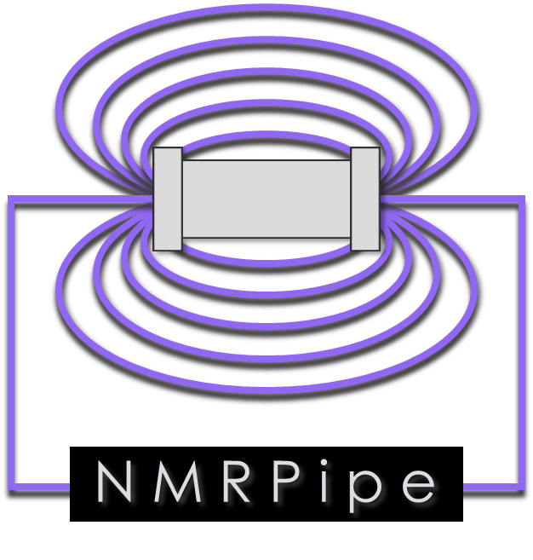
Pipeline description
Protein target
Library of
chemicals
Automatic peak-picking
of ¹H-¹⁵N HSQC spectra
Automatic uploading and processing
By NMRPipe of raw data
List of the residues experiencing
the largest chemical shift variation for each compound of the library
(CSV or JSON format)
Database

Slide 4
NMR studies on MDM2
HSQC spectrum
Chemical shift perturbation
Free MDM2
MDM2 in the presence of a ligand
Residues experiencing a statistically meaningful chemical shift perturbation

Slide 5
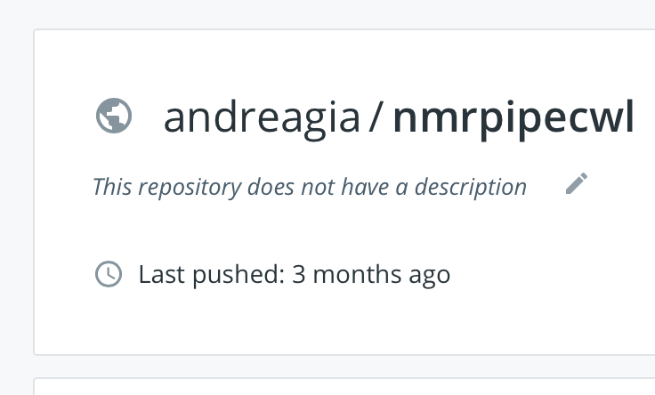
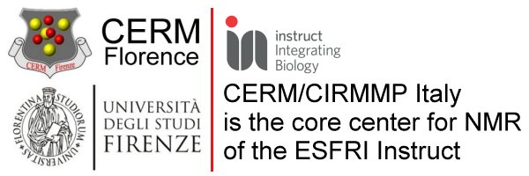
Software used in workflow
NMRPipe is an extensive software system for processing, analysing, and exploiting multidimensional NMR spectroscopic data.

Slide 6
Run NMRPIPE without workflow
Run nmrpipe locally
Downlaod and compile NMRPipe in your local computer
bruker
sh fid.com
nmrDraw
basicFT2.com -xP0 auto -yP0 90 -list > nmr.com
csh nmr.com
nmrDraw
pkDetect2D.tcl -in test.ft2

Slide 7
Run Workflow
git clone https://github.com/andreagia/CWL_dem1_NMR_Peak_Picking.git
Install Docker
Create venv
python -m venv /Volumes/SSDesterno/test/cwl
source /Volumes/SSDesterno/test/cwl/bin/activate
Install cwl-runner
pip install cwlref-runner
source /Volumes/SSDesterno/test/cwl/bin/activate
cd CWL_dem1_NMR_Peak_Picking
cwl-runner nmrpipe_workflow.cwl nmrpipe_workflow.yml

Slide 8
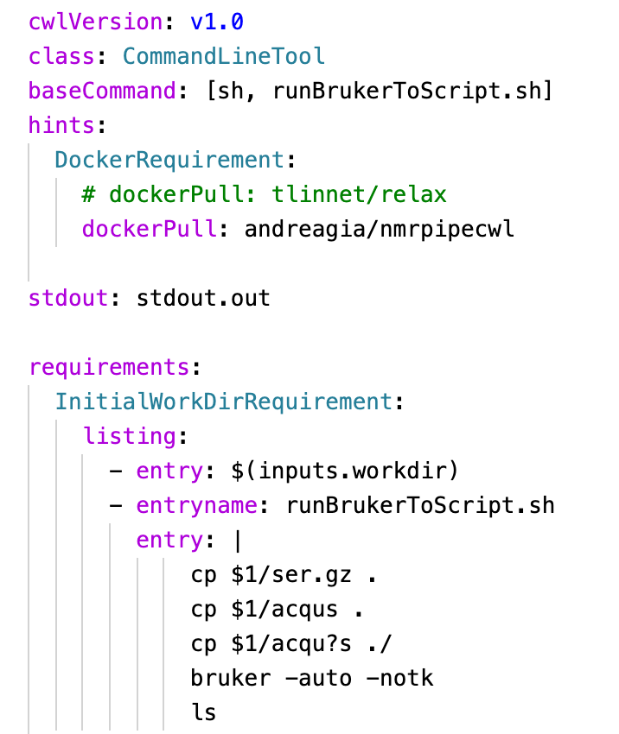
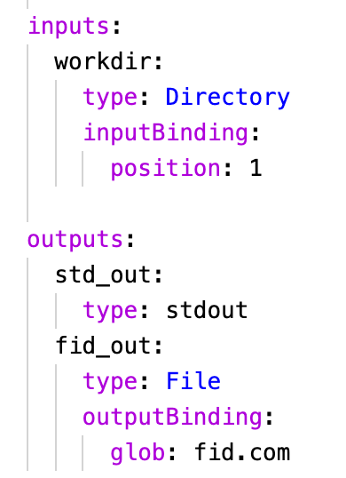
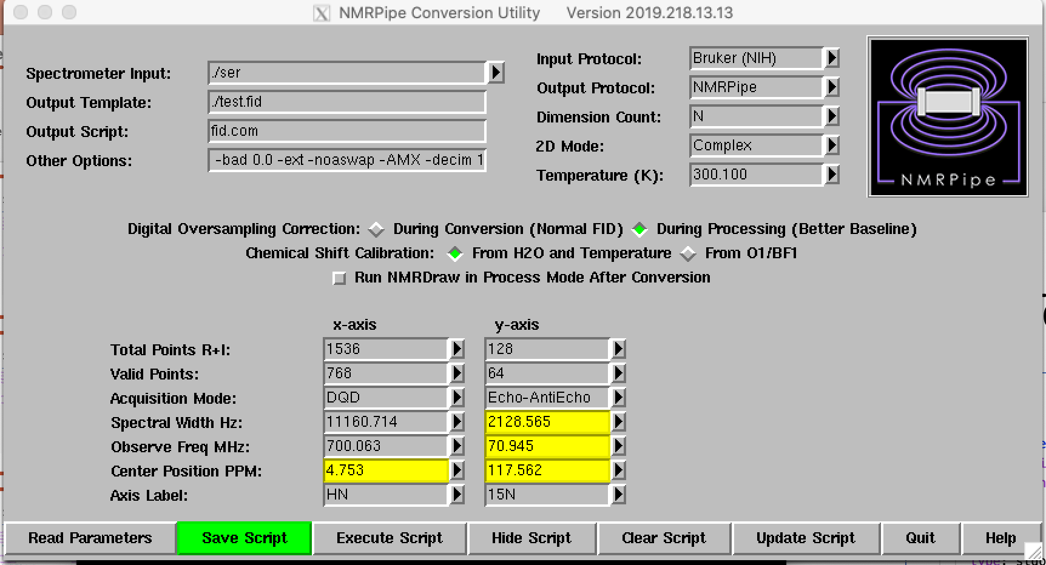
Step 1/4 – (Bruker To Script)
.cwl
.yml
Conversion of raw data from Bruker Spectrometer proprietary format, to NMRPipe format.
1) Extracting NMRPipe conversion parameters and script creation
The script file

Slide 9
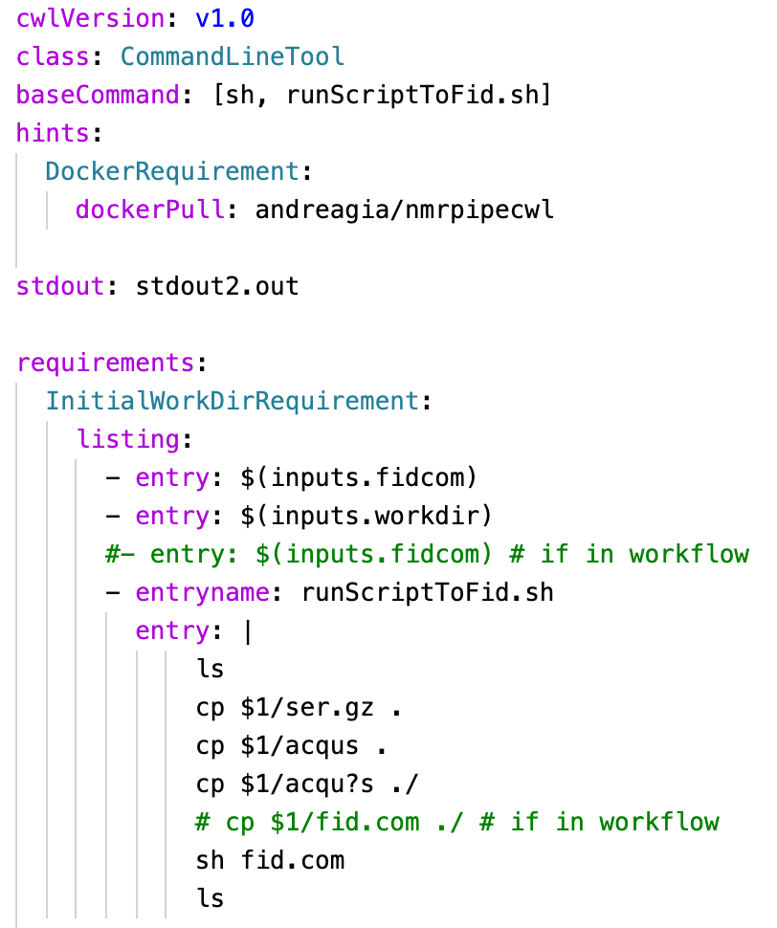
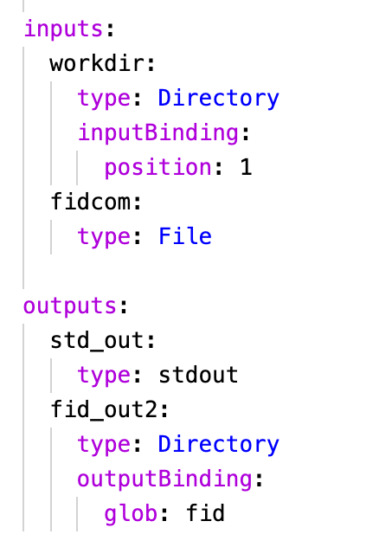
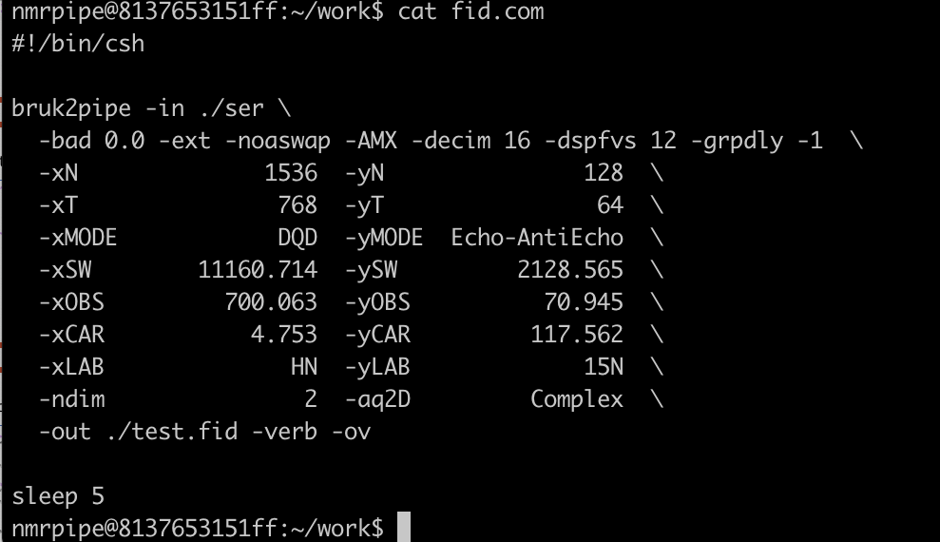
Step 2/4 – (Script To Fid)
.cwl
.yml
Conversion of raw data from Bruker Spectrometer propetary format, to NMRPipe format.
2) Script execution
Directory containing the converted files

Slide 10
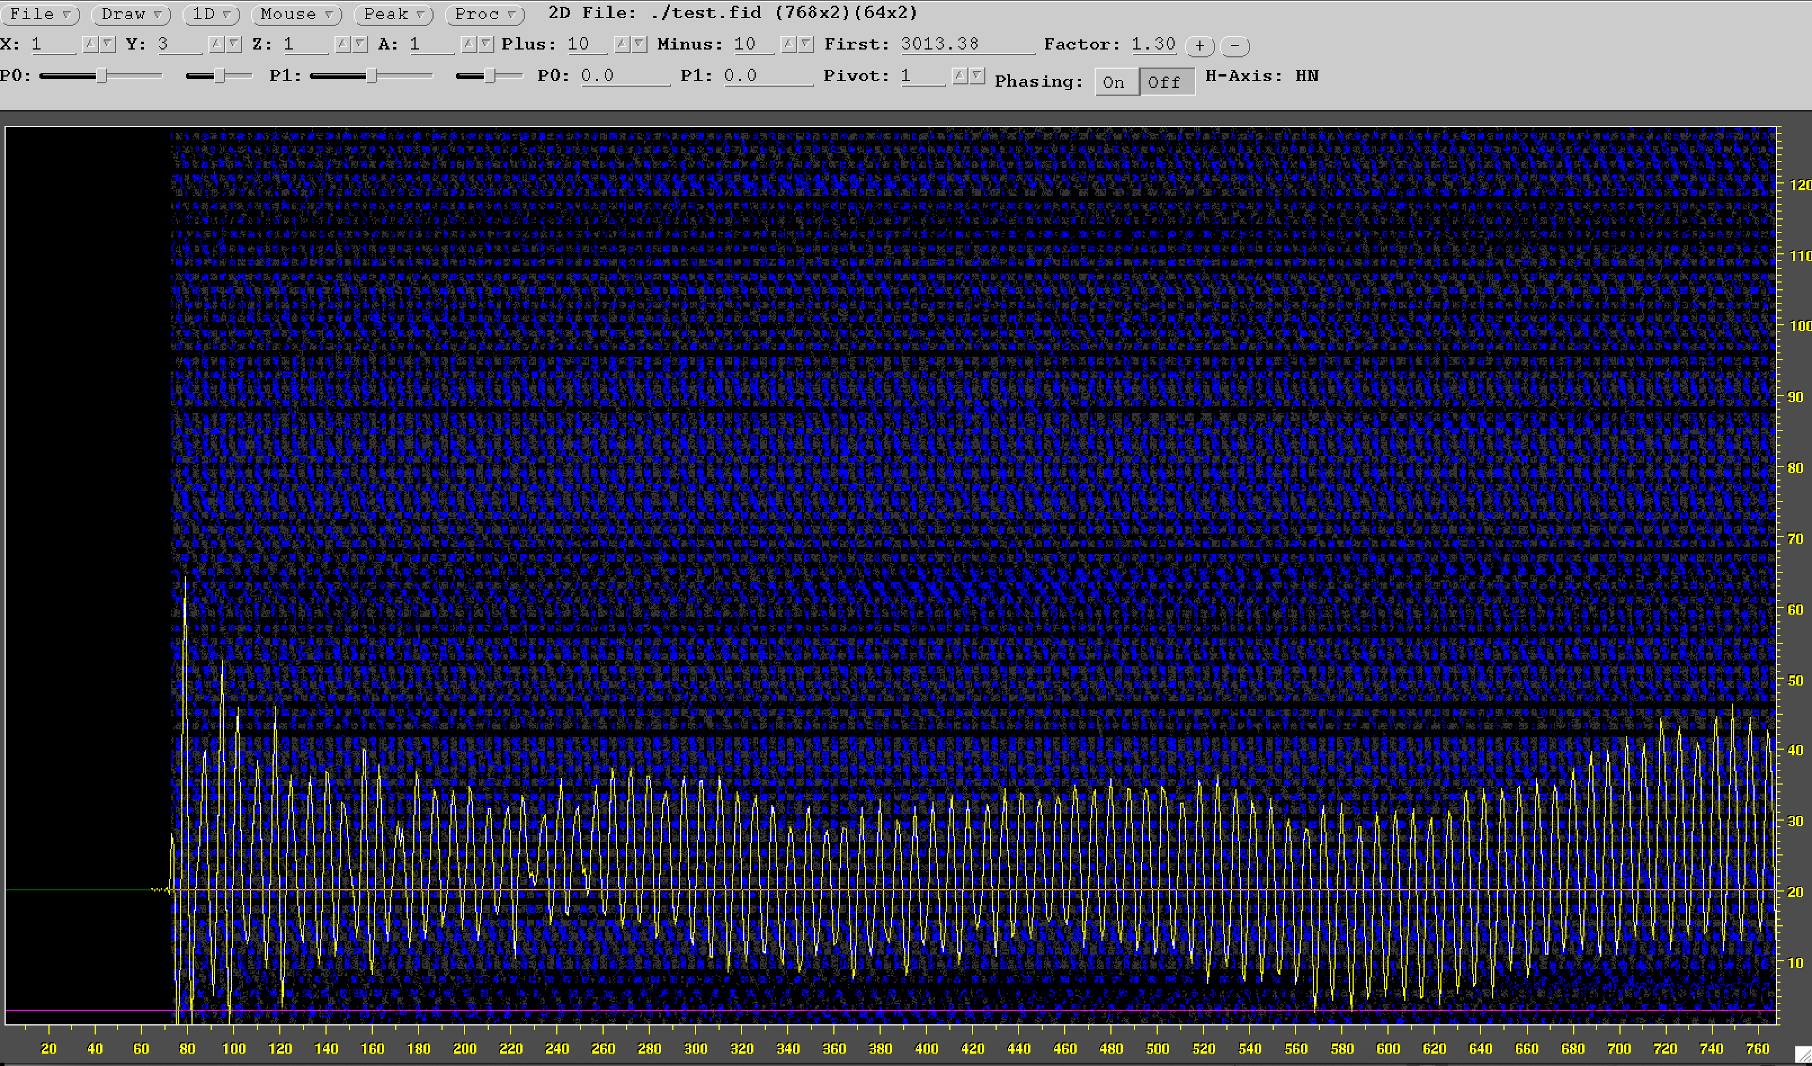
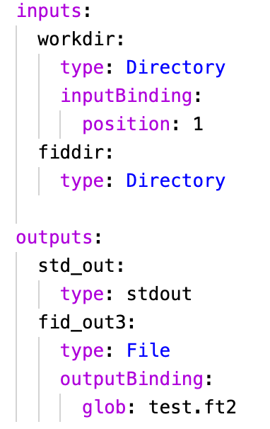
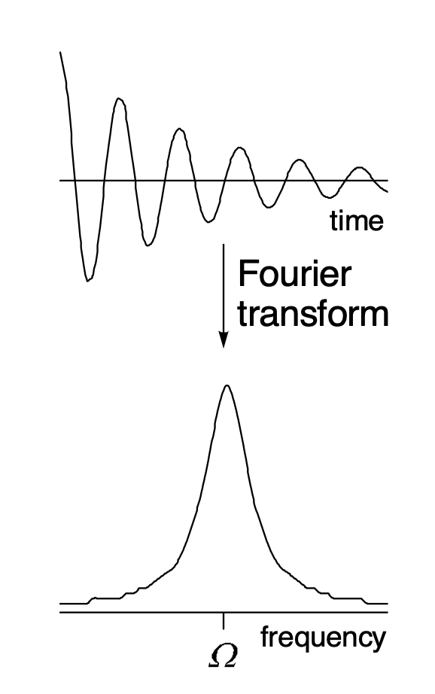
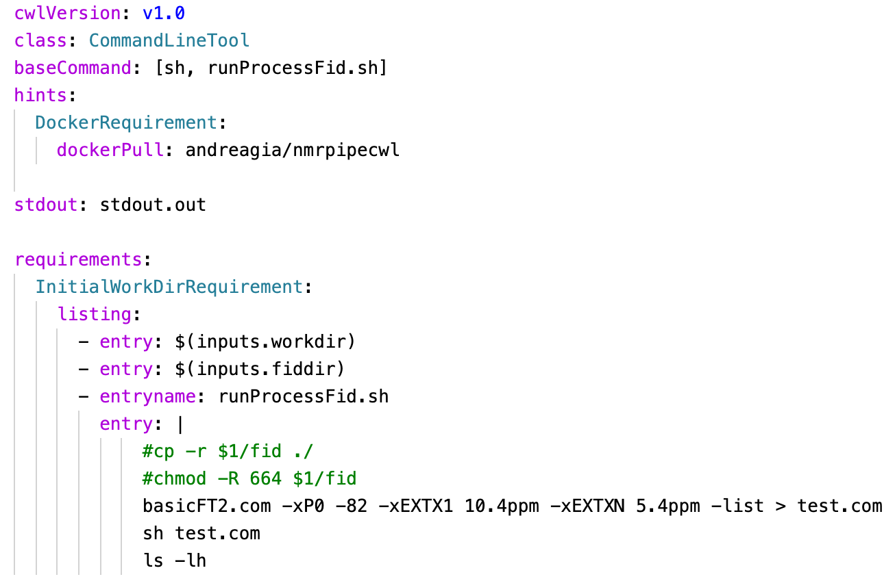
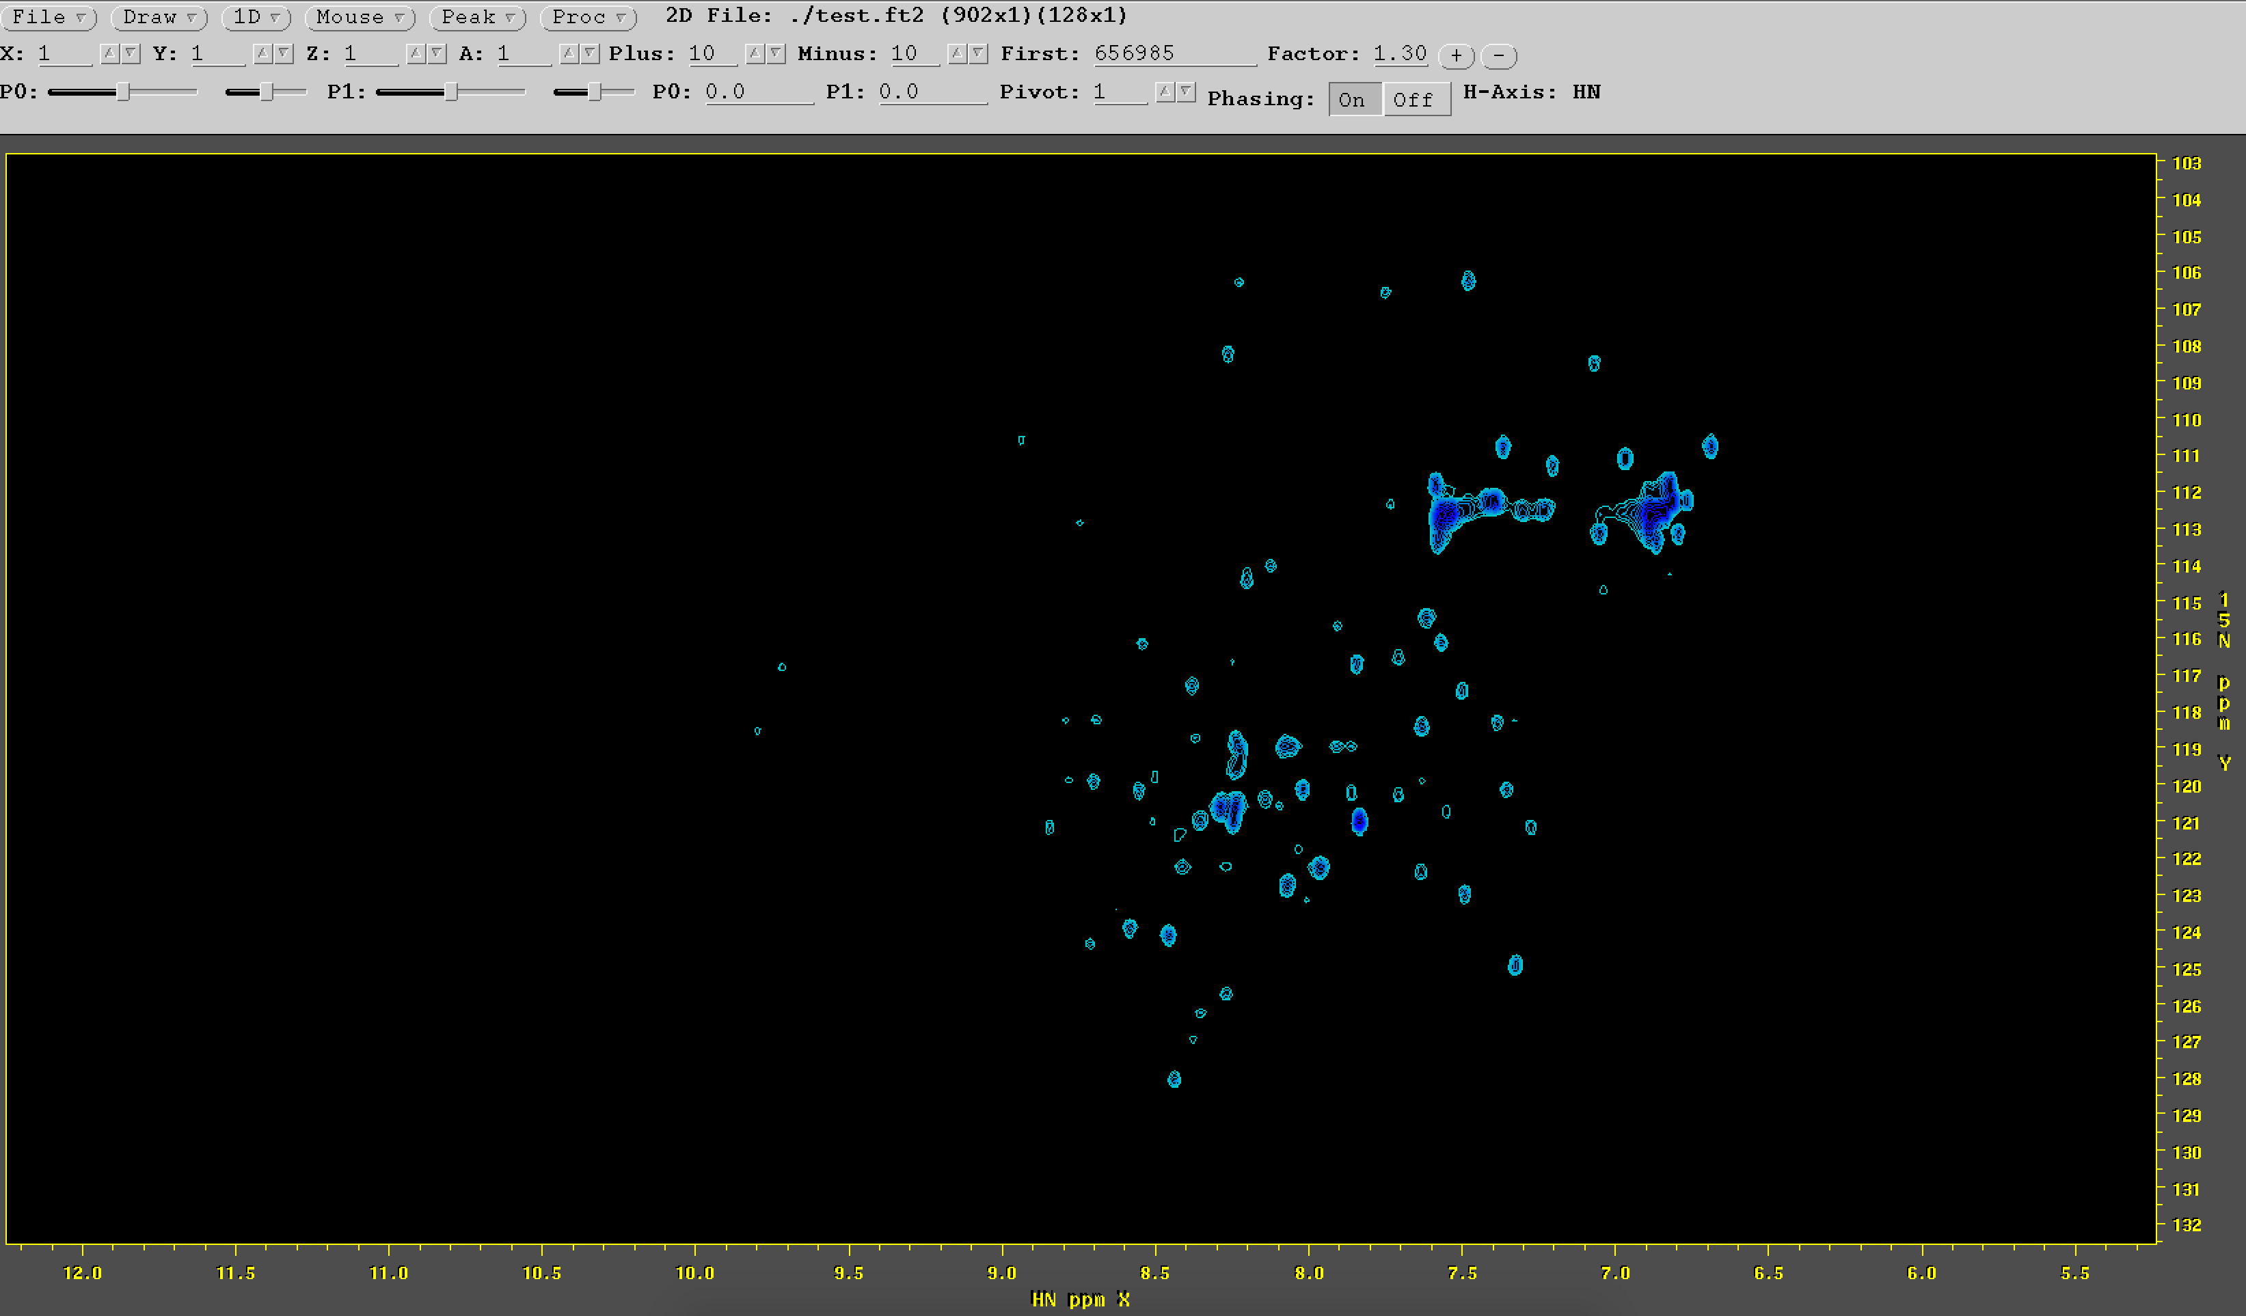
Step 3/4 – (Fid To Pipe)
.cwl
.yml
test.ft2 contains signals in frequency domain
Notes:
Perchè non lanciamo direttamente il comando, invece di metterlo prima nel file test.com ???
Che si intende per PIPE ???

Slide 11
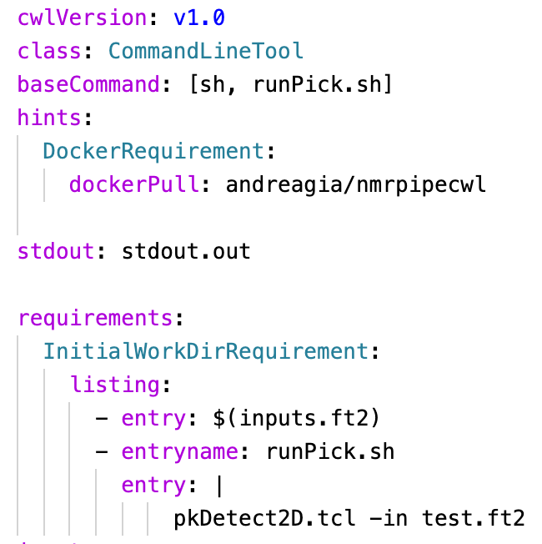
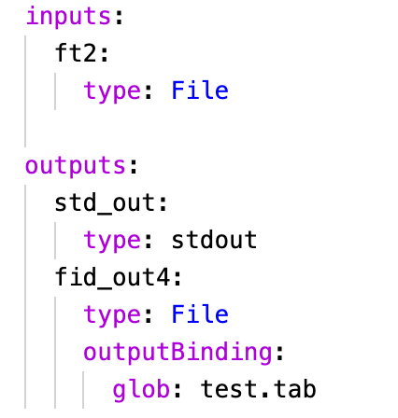
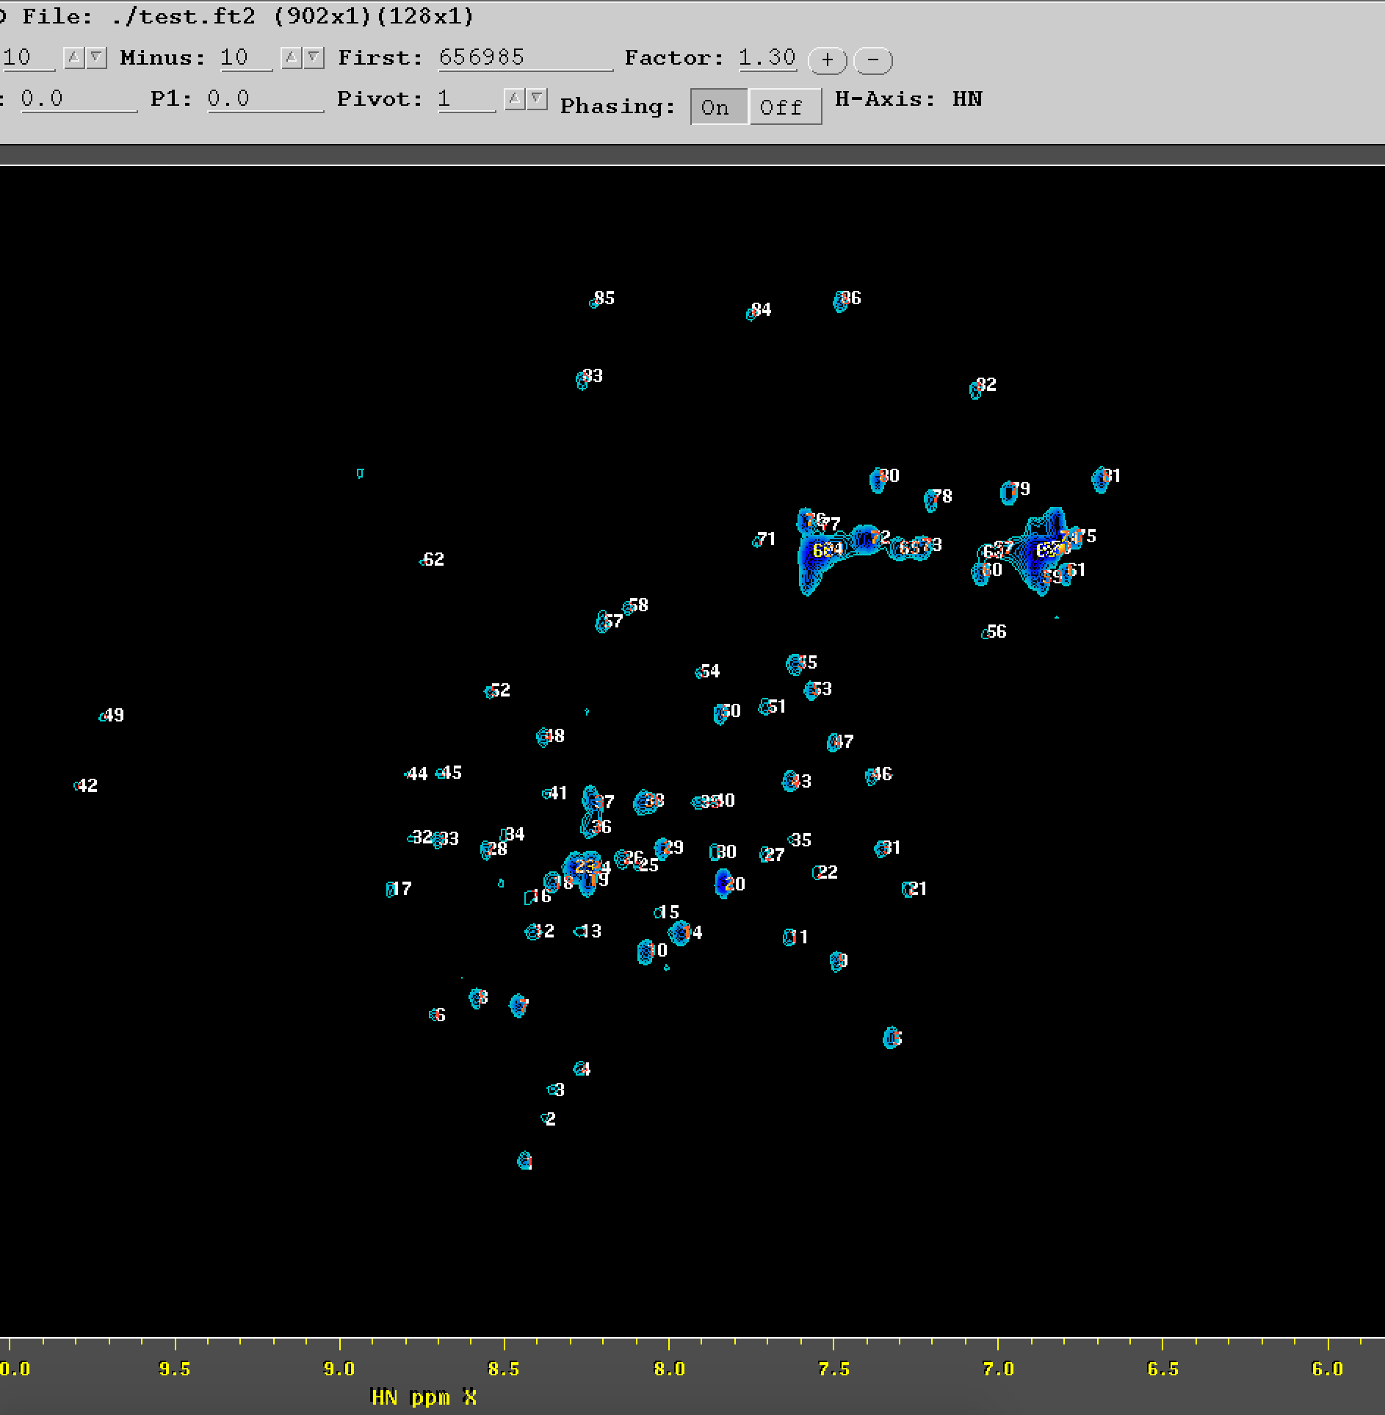
Step 4/4 – (Pipe To Peak)
.cwl
.yml
Identification and assignement of peaks in the spectra.
A text file containing the peak coordinates will be created.
Peacks coordinates

Slide 12
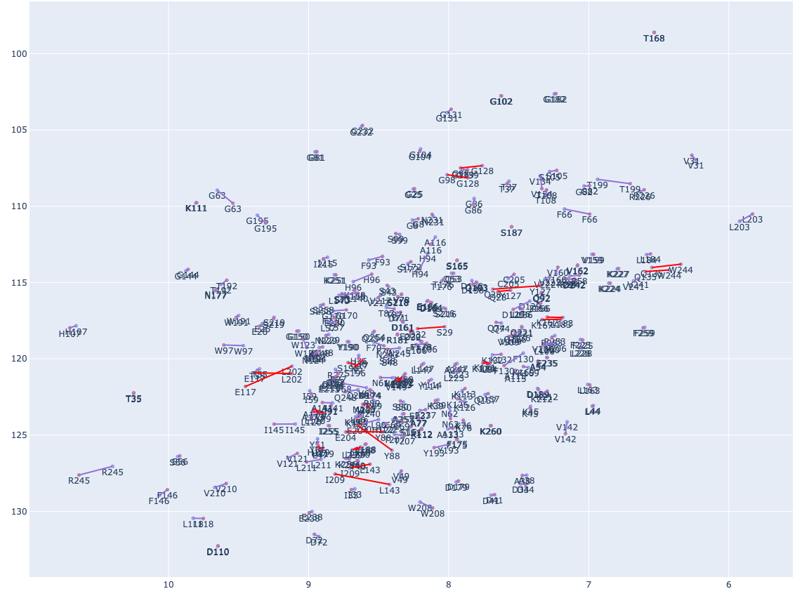
Peak picking automated assignment
carbonic anhydrase 2, furosemide

Slide 13
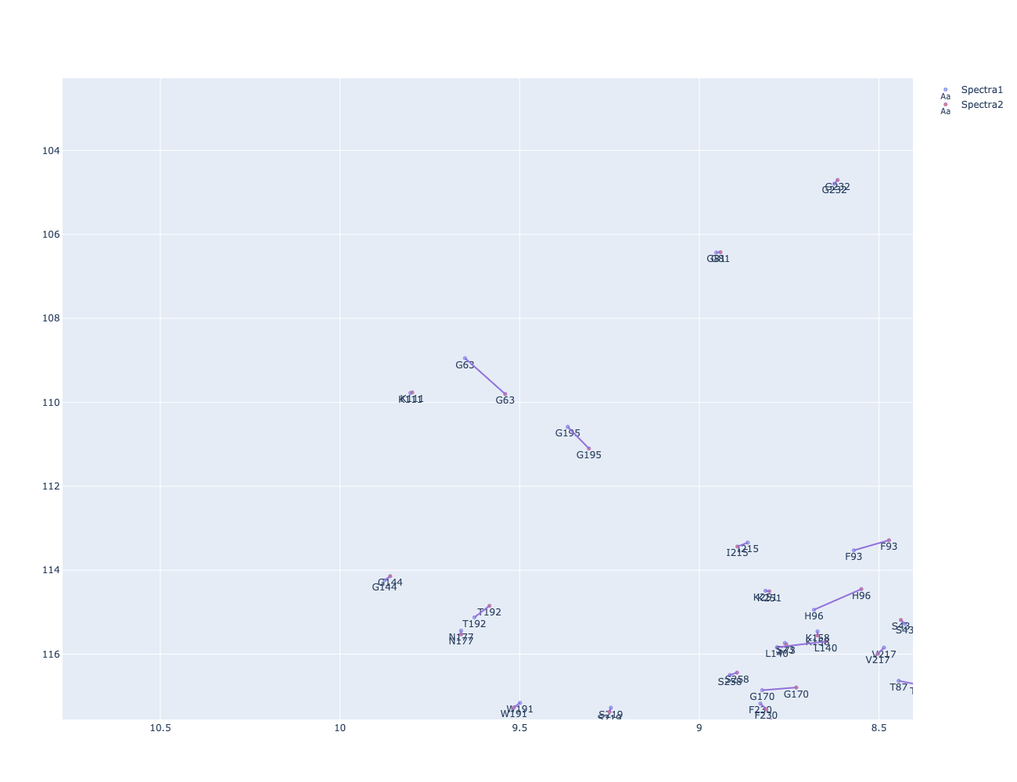
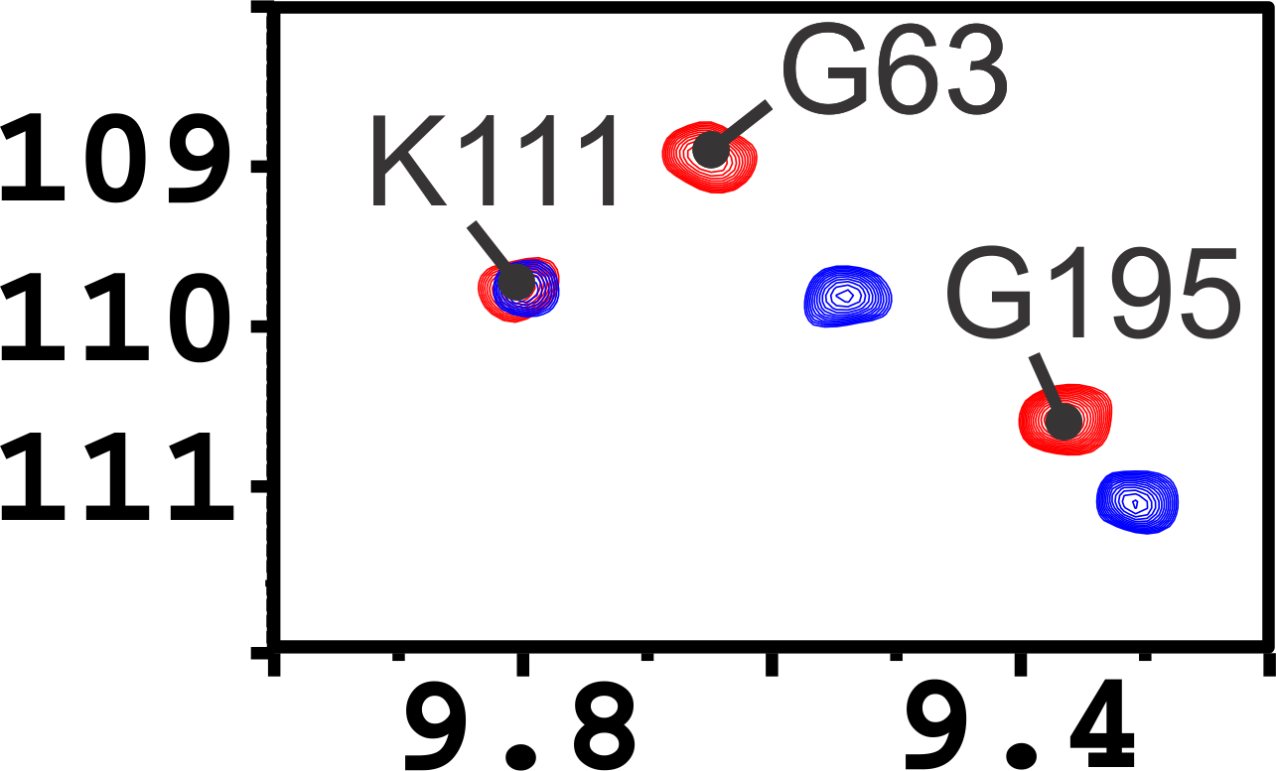
Peak picking with automated assignment

Slide 14
Through an automated peak assignment solution
The ration behind the proposed algorithm
How this technique performs on real data
Some interesting outcomes
Notes:
The first is an automated method for peak shift identification, and the second is the development of a machine learning model for the Physio-Random metal binding site classification.

Slide 15
Web Service for automated peak assignment solution (under development)
SSE (Server-Sent Events)
Router
Components
Service
Controller
Service
EventSource
SseEmitter
HTTP
Picasso Service
http://150.217.163.155:8080/frontend
Picasso web service

Slide 16
Thank you for your attention
Thank also to:
Antonio Rosato
Fragai Marco
Linda Cerofilni
Vincezo Laveglia
Massimo Lucci

