Slide 1
A Brief Overview
of Token Based AAI Development at STFC
Tom Dack,
STFC Scientific Computing
Notes:
The abstract pattern can be removed or repositioned if required. Be careful to ‘Send to Back’ so that it does not obscure any important information.

Slide 2
Moving away from User Certificates
There is a landscape shift away from X.509 user certificates
Security impact if compromised (and frequently compromised)
Not user friendly
Mobility issues
Shift towards OAuth2 and OpenID Connect (Tokens)
Tokens widely accepted
Easy to implement – used by major industry players
Links directly to home institutions

Slide 3
Token based work underway within…
IRIS
eInfrastructure for Research and Innovation for STFC
IRIS IAM service
WLCG
Worldwide LHC Computing Grid
Design and development of a token-based AAI service for WLCG
SKA SRCNet
Square Kilometre Array Science Resource Centre Network
AAI Prototyping work within the SRCNet

Slide 4
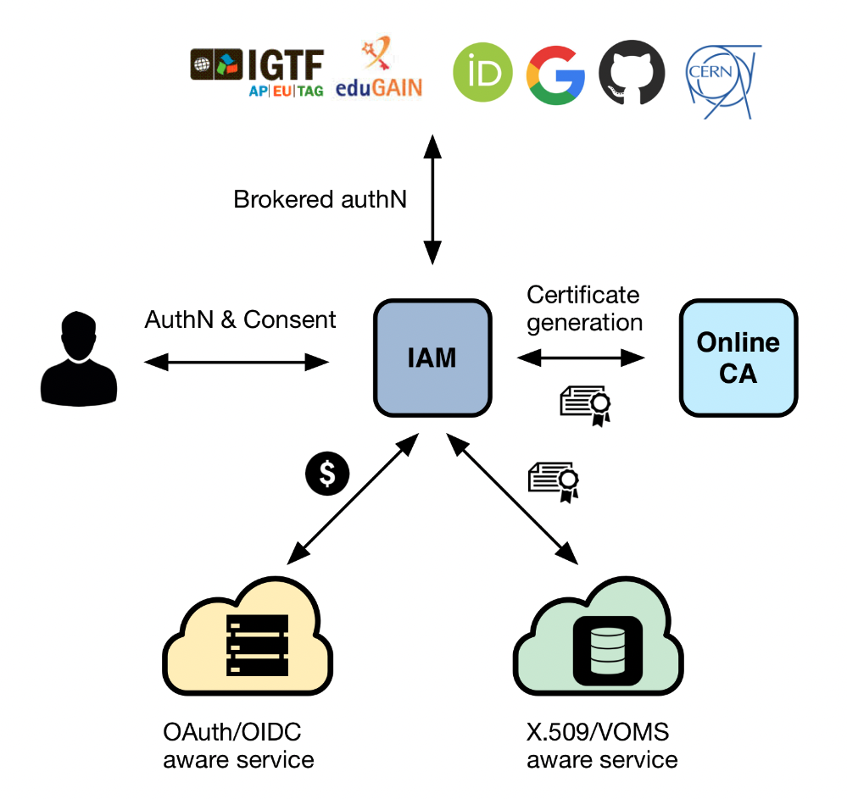
STFC uses INDIGO IAM
An authentication and authorization application that
supports multiple authentication mechanisms
provides users with a persistent, organization scoped identifier
exposes identity information, attributes and capabilities to services via JSON Web Tokens and standard OAuth & OpenID Connect protocols
can integrate existing VOMS-aware services
supports Web and non-Web access, delegation and token renewal

Slide 5
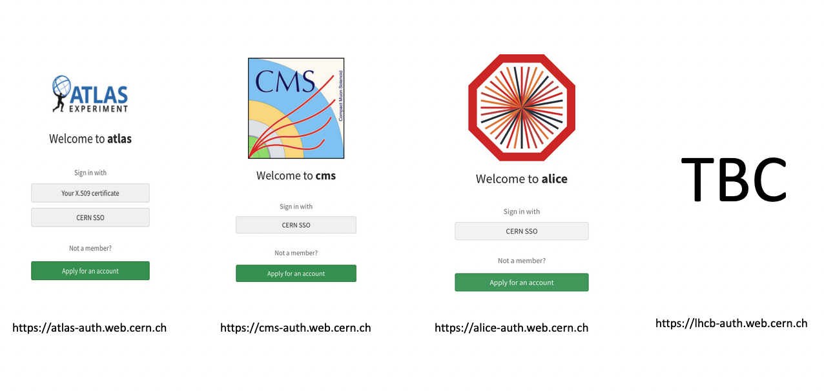
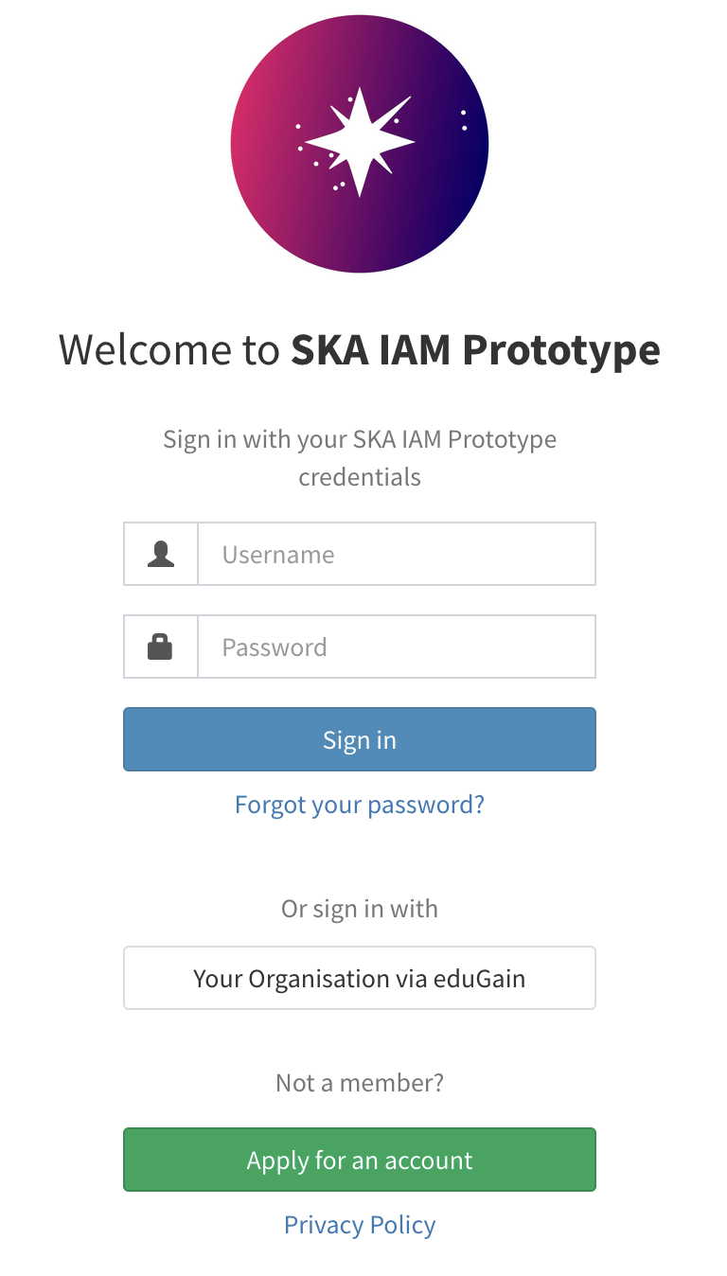
… as will WLCG, and the SKA Prototype
https://ska-iam.stfc.ac.uk

Slide 6
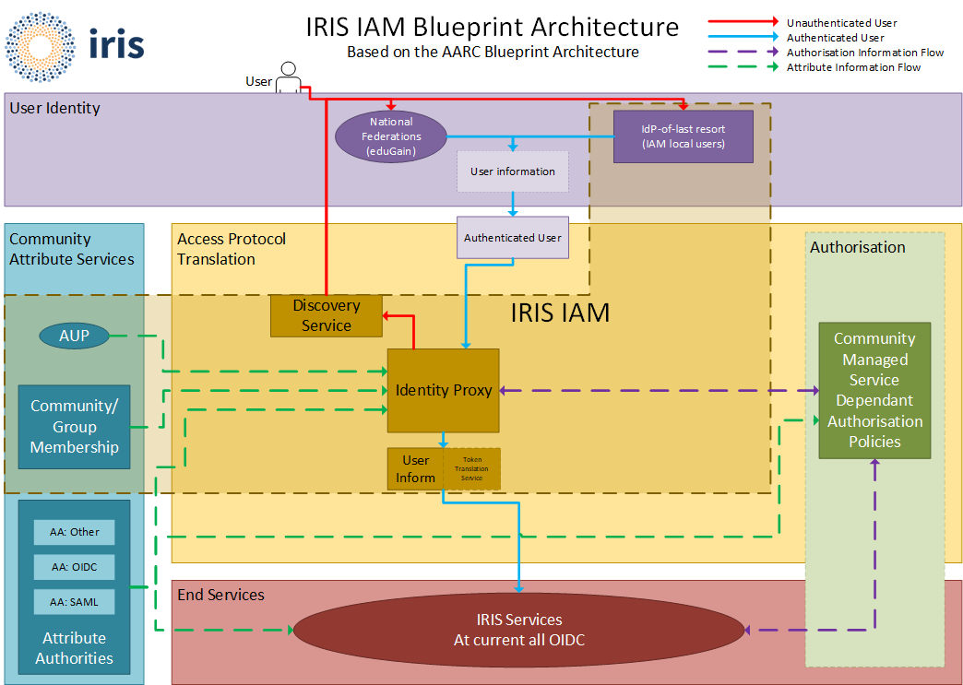
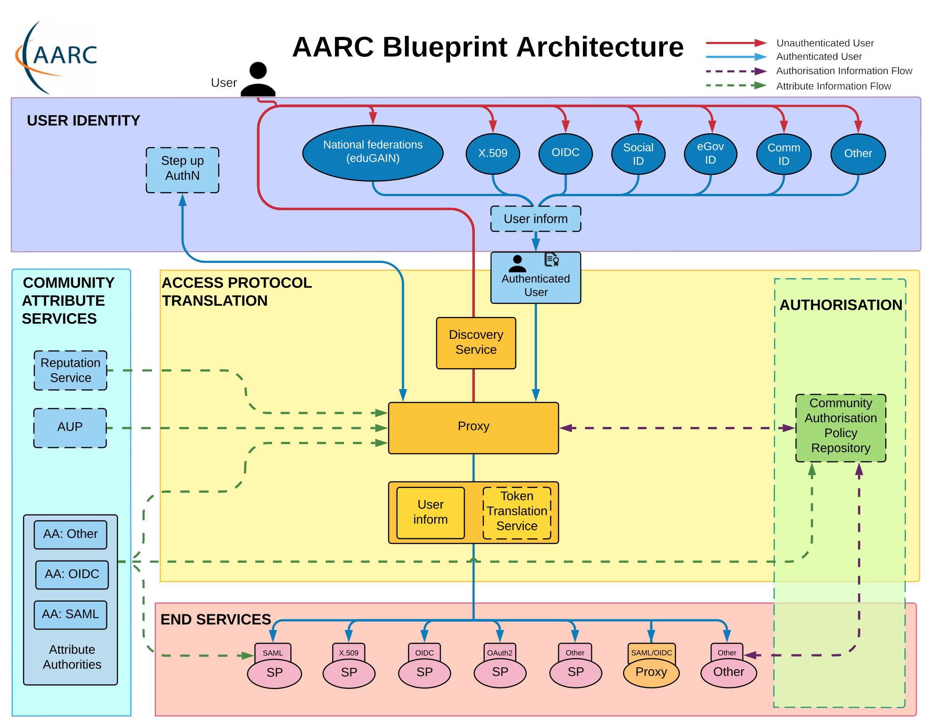
INDIGO IAM and the AARC Blueprint Architecture for Infrastructures
Authentication and Authorisation for Research and Collaboration (AARC)

Slide 7
Challenges with Token Transition
How to provide access to services which operate only over command line
OAuth Device Code PAM with Group Authorization
https://github.com/stfc/pam_oauth2_device
Assurance for users who do not have an eduGAIN IdP
Using the AAI platform as an Identity-Provider-of-last-resort
”Community” IAM instances with local credentials acting as IdPs
Tokens and long-running jobs
Token lifetime is typically short for security reasons – what happens with a job longer than the token
Refresh Tokens – Security Concerns

Slide 8
Want to know more?
Attend the WLCG Pre-GDB (Grid Deployment Board) Meeting in October @ CERN – WLCG AuthZ and IAM Workshop
10th & 11th October at CERN
https://indico.cern.ch/event/1185598/
Check out the WLCG Token Transition Timeline to get an idea of how things will shape up
https://zenodo.org/record/7014668#.YxkaxCFBzVE
Thank you for listening!
Any Questions?

Slide 9
Science and Technology Facilities Council
@STFC_matters
Science and Technology Facilities Council
Notes:
The abstract pattern can be removed or repositioned if required. Be careful to ‘Send to Back’ so that it does not obscure any important information.

Slide 10
Backup
Notes:
The abstract pattern can be removed or repositioned if required. Be careful to ‘Send to Back’ so that it does not obscure any important information.

Slide 11
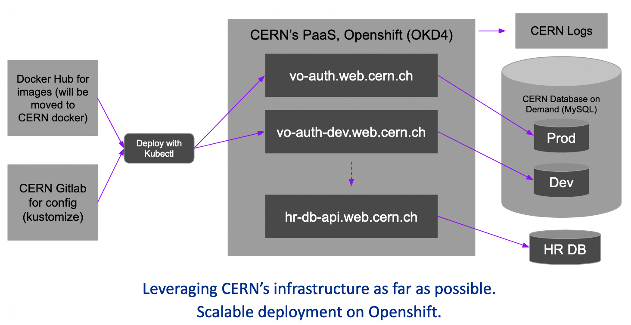
WLCG IAM - Infrastructure
Utilises the CERN shared infrastructure, using standard services and tools
One project for each VO on CERN Openshift
Will also have a Dev instance for each VO
Openshift also hosts an API for interfacing with CERN HR DB
Logs are pushed to the CERN Logs service, giving Kibana and E-Search
CERN Database on Demand for backend
Notes:
IAM images come from GitHub, will move to the CERN docker in the future
CERN Gitlab for the configuration
Deployed with Kubectl
Instances can interface with the CERN HR DB with a standard API call
This is why IAM needs to be hosted at CERN – can only access the CERN HR DB from services at CERN, or hosted on CERN resources
Openshift makes the service scalable, allowing things to ramp up with usage.

Slide 12
WLCG IAM - Authentication
Each LHC Vos have two login options
CERN SSO
Certificate Login
Expected that a user will register with the CERN SSO and then may add a certificate later
The CERN SSO ID token is used to validate VO membership
Additional admin login (username/password) hidden for normal workflows
Notes:
Different to other implementations as it does not allow external user identities, but for CERN users it makes sense as all will have a CERN account and ensures that identity vetting is all done through CERN
The CERN sso will also be used to validate VO membership

Slide 13
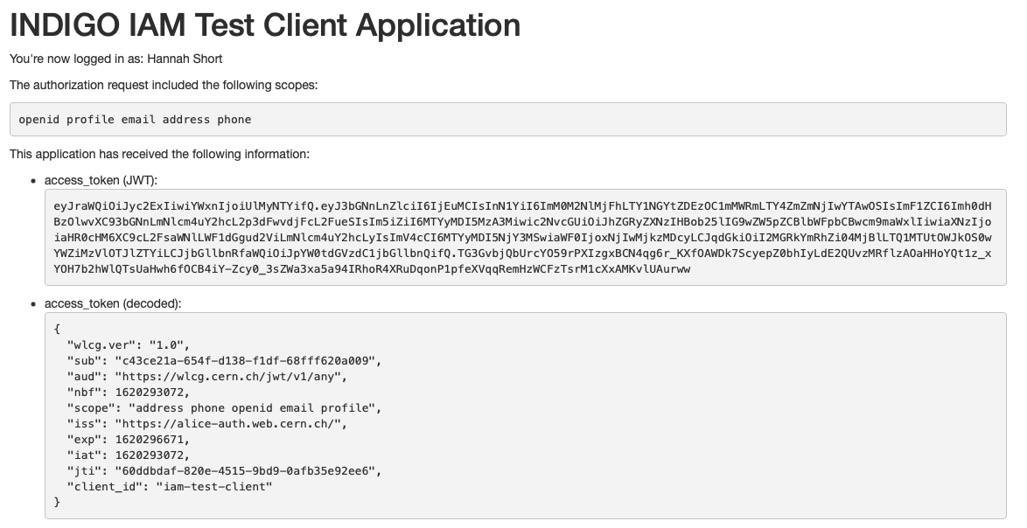
WLCG Token Schema
Contains identity and authorisation information from issuer (VO)
Groups and/or Capabilities
Follows the WLCG Token Schema (https://zenodo.org/record/3460258)
Example token from the IAM Test Client
Notes:
WLCG authorization will use JSON Web Tokens, following the WLCG token schema first published in 2019. The schema enabled people to begin enhancement work and can be viewed in more detail on Zenodo. The token schema largely sticks to standards and is based upon the schema used by SciTokens. However the WLCG schema importantly addresses some WLCG specific requirements by defining additional claims to communicate identity and authorization information from the VO and issuer. Alongside defining the content of the JWTs, the schema also defines recommended lifetimes for different tokens in the ecosystem.

Slide 14
Token Claims
Common Claims
ID Tokens
Access Tokens
iss+sub used to uniquely identify a user, e.g. for blocking
sub
exp
iss
acr
aud
iat
nbf
jti
eduperson_assurance (REFEDS)
wlcg.ver (WLCG)
wlcg.groups (WLCG)
auth_time
general OIDC Claims
scope (RFC8693)
Access tokens should include at least scope (capabilities) or group for authorization
wlcg prefix added to avoid collisions with other schemas
Note: Where unspecified, the origin is RFC7519 or OpenID Connect core

Slide 15
WLCG Token Discovery
If a tool needs to authenticate with a token and does not have out-of-band WLCG Bearer Token Discovery knowledge on which token to use, the following steps to discover a token MUST be taken in sequence, where $ID below denotes the process’s effective user ID:
1. If the BEARER_TOKEN environment variable is set, then its value is taken to be the token contents.
2. If the BEARER_TOKEN_FILE environment variable is set, then its value is interpreted as a filename. The contents of the specified file are taken to be the token contents.
3. If the XDG_RUNTIME_DIR environment variable is set1, then take the token from the contents of $XDG_RUNTIME_DIR/bt_u$ID2.
4. Otherwise, take the token from /tmp/bt_u$ID
Many tools will rely on tokens being stored in the local environment
Token discoverability specification v1.0 published https://zenodo.org/record/3937438
Logic of where to search for (or place) tokens locally
Notes:
Whilst browsers internally manage tokens, terminal-based tools will rely on finding tokens stored in local environment, and so it was important to define where tokens should be stored within those environments, as well as whether they should be as environment variables, files, or otherwise. The WLCG token discovery specification was published in 2021, and defines logical steps of where a tool should look for a token – if it is not found in the first place, it should move to the second and so on. This allows tools to know where to expect a token and allows clients know where they should be stored. Full details on the defined logic flow can be found in the paper for this talk

Slide 16
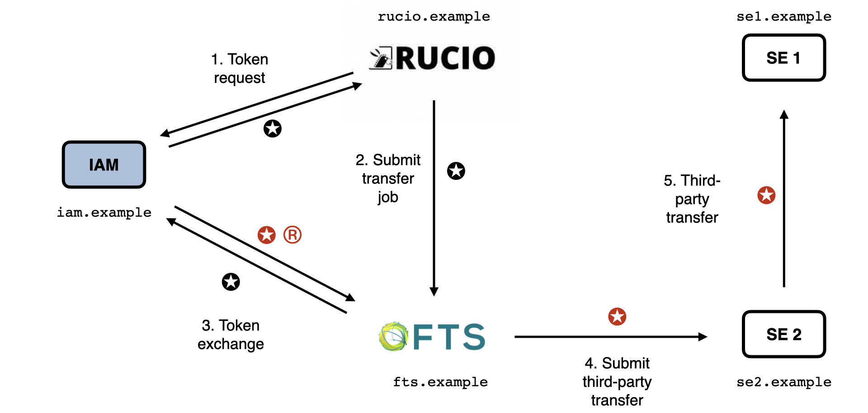
Rucio-FTS-SEs flow
Rucio and FTS are registered IAM Clients
Rucio requests token for FTS from IAM
Rucio submits job to FTS and includes token
FTS exchanges token for one for target third-party
Third-party transfer submitted along with new token
Token can be reused among instances of third-party
Storage Elements are unregistered Resource Servers that trust IAM
Notes:
In order to test the previously discussed concepts and support DOMA activities, the first scenario focussed on was the RUCIO managed data transfer, which is common to many LHC experiments and depicted here.
In this scenario, the identity RUCIO obtains from IAM will be delegated to FTS in order to manage a third-party transfer between two storage elements.
The flow begins with RUCIO submitting a token request to the IAM via the client credentials floq, specifically requesting that the audience claim in the token be restricted to the FTS service. Once RUCIO obtains the token from IAM, it will then submit a transfer job to FTS whilst including the token in the request.
When FTS creates the transfer job, it must then in turn start a new token exchange with the IAM, as the FTS audience from the token from RUCIO may not grant the permissions required for read and write at the storage elements. FTS therefore exchanges the received token at the IAM for an access token and a refresh token, which it will use then to manage the transfer. In this step, FTS requests the scopes required to access the data and restricts the audience to of the issued tokens to the target storage elements. The obtained access token is used to submit the thurd-party transfer to one storage element and throughout the process for the data transfer amongst the elements. The refresh token can be used by FTS throughout the process to obtain a fresh access token from the IAM should it be needed, for example if the process takes longer than the lifetime of the original access token.
The successful testing of this flow and publication of the discoverability schema demonstrate the significant progress made towards the goal of submitting jobs authorised with WLCG tokens within 2021. Whilst much work remains to align the community on a realistic timeline for a full transition, this will be the focus of work over the coming months whilst in parallel the development and testing of these token based workflows will continue.

Slide 17
Lifetimes
Token Type | Recommended Lifetime | Minimum Lifetime | Maximum Lifetime | Justification
Access Token & ID Token | 20 minutes | 5 minutes | 6 hours | Access token lifetime should be short as there is no revocation mechanism. The granted lifetime has implications for the maximum allowable downtime of the Access Token server.
Refresh Token | 10 days | 1 day | 30 days | Refresh token lifetimes should be kept bounded, but can be longer-lived as they are revocable. Meant to be long-lived enough to be on a “human timescale”.
Issuer Public Key Cache | 6 hours | 1 hour | 1 day | The public key cache lifetime defines the minimum revocation time of the public key. The actual lifetime is the maximum allowable downtime of the public key server
Issuer Public Key | 6 months | 2 days | 12 months | JWT has built-in mechanisms for key rotation; these do not need to live as long as CAs. This may evolve following operational experience, provision should be made for flexible lifetimes.

