Slide 1
Introduction to Authentication and Authorization Infrastructure
Valeria Ardizzone
EGI Foundation
EGI Conference 2022,
20.09.2022, Prague
TLP: WHITE Public

Slide 2
Why Digital Identity?
Everything revolves around identity in our life!
Identity:
Who a person is, or the qualities of a person or group that make them different from others.
Tea
---
Name
Reputation
Digital Identity:
Is the body of information about an individual, organization or electronic device that exists online.
Address
Physical
Description
BENEFITS
Real time identity verification & authentication process
Improved overall user experience
Fully digitised processes
Reduced user onboarding time and costs
Date of Birth
Qualifications
Place of Birth
Group Membership
Identity 1
Identity 2
Identity 3
Tea
---
Tea
---
Tea
---
Name
Date of Birth
Place of Birth
Name
Date of Birth
Physical
Description
Name
Address
Qualifications
Job recruitment service
Administrative service
Fitness and Wellness service
Notes:
Like everything, we always start with the smallest entity, in this case, identity. Among the various definitions of this word, the one I prefer is the following:
Who a person is, or the qualities of a person or group that make them different from others.
I get help from my friend Tea in this slide:
Multiple different features together create a unique identity for Tea: name, address, etc..
As Tea navigates through life, she relies on different aspects of her identity to access various services. Select features of Tea’s identity can be captured, stored and accessed to verify her eligibility for receiving different services.
A digital identity is a collection of information about a person that exists online. When this information is grouped together it can provide a digital representation of an individual. There are many unique identifiers that can make up a digital identity. These include personal information, like name and date of birth, Email addresses, Usernames and passwords, Social Security numbers, Passport numbers, Online search activities, Purchasing history or behavior
These unique identifiers and behaviors make it possible for businesses to determine who individuals are.

Slide 3
Identity and Access Management (IAM)
Identity and Access Management:
Is the discipline that enables the right individuals to access the right resources at the right time for the right reasons.
Q: Why do I need IAM?
A: You need IAM to provide online security and to increase productivity
Q: How does IAM work?
A: IAM solutions generally perform two tasks
AUTHENTICATION
AUTHORIZATION
Q: What does IAM do?
A: IAM systems provide these core functionality
MANAGE USER IDENTITY
PROVISIONING AND DEPROVISIONING USERS
AUTHENTICATING USERS
AUTHORIZING USERS
REPORTING
SINGLE SIGN ON
Q: What technology should IAM support?
A: Standard or technology all IAM solutions are expected to support are
SAML
OIDC
Notes:
Security. Traditional security often has one point of failure - the password. If a user's password is breached - or worse yet, the email address for their password recoveries - your organization becomes vulnerable to attack. IAM services narrow the points of failure and backstops them with tools to catch mistakes when they're made.
Productivity. Once you log on to your main IAM portal, your employee no longer has to worry about having the right password or right access level to perform their duties. Not only does every employee get access to the perfect suite of tools for their job, their access can be managed as a group or role instead of individually, reducing the workload on your IT professionals.
Authentication. IAM confirms that the user, software, or hardware is who they say they are by authenticating their credentials against a database. IAM cloud identity tools are more secure and flexible than traditional username and password solutions.
Authorization. Identity access management systems grant only the appropriate level of access. Instead of a username and password allowing access to an entire software suite, IAM allows for narrow slices of access to be portioned out, i.e. editor, viewer, and commenter in a content management system.
Manage user identities: IAM systems can be the sole directory used to create, modify, and delete users, or it may integrate with one or more other directories and synchronize with them. Identity and access management can also create new identities for users who need a specialized type of access to an organization's tools.
Provisioning and deprovisioning users: Specifying which tools and access levels to grant a user is called provisioning. IAM tools allow to provision users by role, department, or other grouping. Since it is time consuming to specify each individual’s access to every resource, identity management systems enable provisioning via policies defined based on role-based access control (RBAC). Users are assigned one or more roles, usually based on job function, and the RBAC IAM system automatically grants them access. Provisioning also works in reverse; to avoid security risks presented by ex-employees retaining access to systems, IAM allows your organization to quickly remove their access.
Authenticating users IAM systems authenticate a user by confirming that they are who they say they are.
Authorizing users Access management ensures a user is granted the exact level and type of access to a tool that they're entitled to. Users can also be portioned into groups or roles so large cohorts of users can be granted the same privileges.
Reporting IAM tools generate reports after most actions taken on the platform (like login time, systems accessed, and type of authentication) to ensure compliance and assess security risks.
Single Sign-On Identity and access management solutions with single sign-on (SSO) alllow users to authenticate their identity with one portal instead of many different resources. Once authenticated, the IAM system acts as the source of identity truth for the other resources available to the user, removing the requirement for the user to remember several passwords.
An IAM system is expected to be able to integrate with many different systems. Because of this, there are certain standards or technologies that all IAM systems are expected to support: Security Access Markup Language, OpenID Connect, and System for Cross-domain Identity Management.
Security Access Markup Language (SAML) SAML is an open standard used to exchange authentication and authorization information between an identity provider system such as an IAM and a service or application. This is the most commonly used method for an IAM to provide a user with the ability to log in to an application that has been integrated with the IAM platform.
OpenID Connect (OIDC) OIDC is a newer open standard that also enables users to log in to their application from an identity provider. It is very similar to SAML, but is built on the OAuth 2.0 standards and uses JSON to transmit the data instead of XML which is what SAML uses.

Slide 4
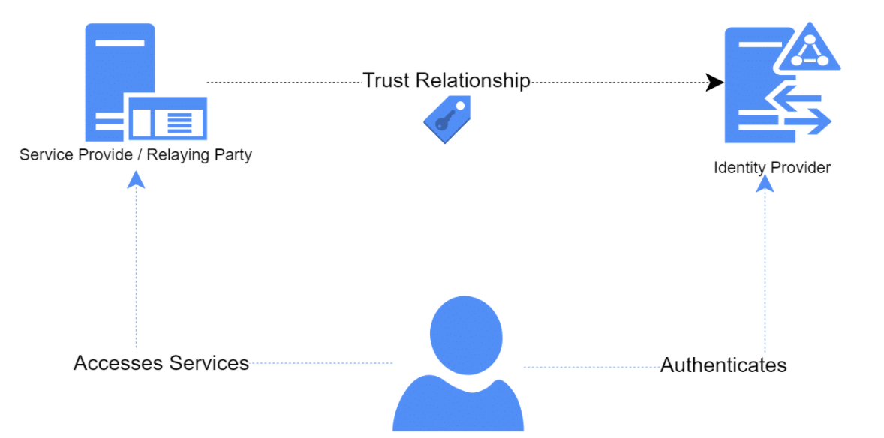
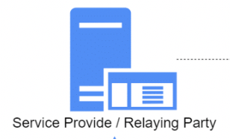
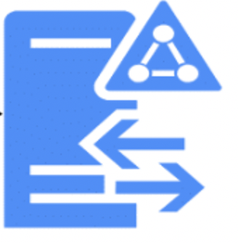
Federated Identity Management
Federated Identity Management:
Is an arrangement between multiple partners (domains) that enables their users to use the same identification data (Digital Identity) to access all their networks. These partners are also known as Trust Domains.
Notes:
Our digital identity is made up of attributes that define we as a unique person moving through the landscape.
Federated identity is an agreement between entities about the definition and use of those attributes.
Agreements allow we to sign on in one place and then jump to another asset without signing in again. An Identity Federation is a collection of IdPs and SPs that have agreed to work together and trust each other.
Typically this trust is made explicit by signing policies and contracts that describe the requirements and responsibilities of the IdPs and SPs.

Slide 5
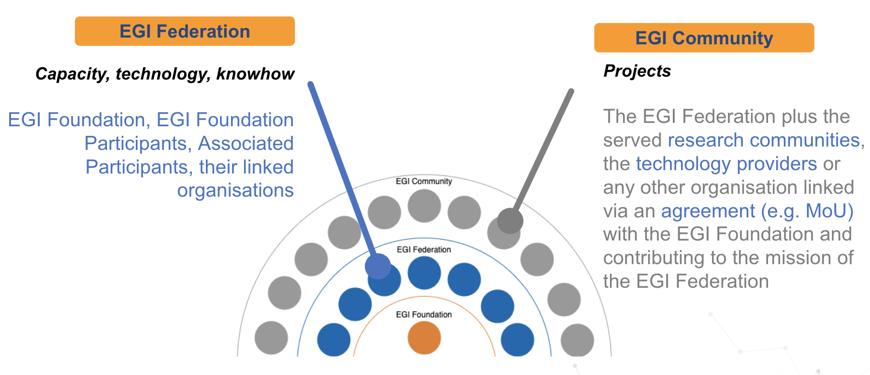
The EGI Federation, EGI Community and Access policies
EGI is a federation of computing and storage resource providers united by a mission to support research and development. The EGI Federation is governed by its participants represented in the EGI Council and coordinated by the EGI Foundation.

Slide 6
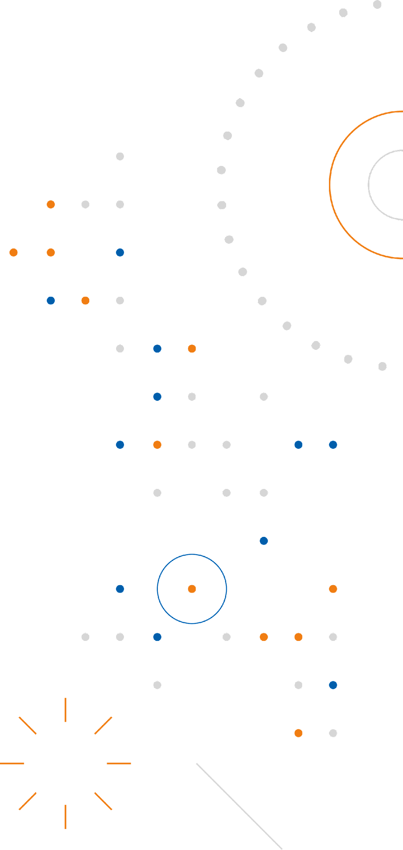
EGI Authentication and Authorization Infrastructure
Check-in
Identity and Access Management Proxy
Discover
GRNET team
Perun
Attribute Management service
Discover
CESNET team

