Slide 1
HPC in EGI-ACE
Enol Fernández (EGI Foundation) with input of the EGI-ACE T73.4 partners: CERN, CESGA, CMCC, ICT-BAS, INFN, LIP, IFIN-HH, TUBITAK & UKEA
Public
T7.3
EGI Conference 2022

Slide 2
EGI-ACE
Implement the Compute Platform of the European Open Science Cloud and contribute to the EOSC Data Commons by delivering integrated computing, platforms, data spaces and tools as an integrated solution that is aligned with major European cloud federation projects and HPC initiatives.
Start: January 2021
Duration: 30 months
Consortium: 33 participating partners, 23 third-parties
Budget: 12 Million EUR

Slide 3
Task 7.3 - HPC integration in EGI-ACE
Objective: Provide interoperability guidelines for HPC systems with the EOSC Compute Platform delivered by EGI-ACE
Explore the usage and integration of HPC guided by 4 scientific pilot use cases with combined cloud and HPC needs, focusing on the areas of:
Access federation: Federated Authentication and Authorization
Application federation: Portable execution of container-based workloads
Data federation: Data transfers between systems
Operation federation: Presence in EOSC Portal, A/R monitoring, Usage accounting, Resource allocation, CRM…

Slide 4
Pilots
ELI-NP (IFIN-HH): deployment of HPC-capable systems on IaaS clouds (HPC as a Service)
HEP (CERN): benchmarking, data transfer and execution of codes using federated authentication
ENES (CMCC): execution of container-based climate data analytics and visualization jobs on HPC
PROMINENCE (UKAEA): facilitate running containerised workflows on HPC resources from the PROMINENCE service

Slide 5
Integration scenarios
HPC as a Service
Build elastic virtual HPC clusters on demand, with access to specialized hardware (e.g. infiniband). Integration as part of the EGI Cloud
Access via ssh + federated identity
Enable used of OpenID Connect to access ssh login nodes of HPC systems + integration of accounting and monitoring
HTC middleware/Gateways
Reuse HTC middleware so HPC systems can be integrated into existing research workloads.

Slide 6
HPC as a Service
Use existing cloud APIs to create virtual infrastructures with HPC Capabilities
PCI Passthrough for specialised hardware like GPU and infiniband
Tools developed for proper configuration of devices at nodes
Deploy elastic clusters with EC3
SLURM + shared filesystem
Automatic elasticity of worker nodes based on load (e.g. number of pending jobs)
Ideal for testing & development, training environments
Fine tuning requires expertise!
EC3 https://servproject.i3m.upv.es/ec3/

Slide 7
Access via ssh + federated identity
ssh-oidc: use ssh with OIDC access tokens
Login to HPC (and VMs) with existing AAI
Don’t modify ssh or sshd
Architecture discussed (and approved) by security experts
Straightforward authorisation model
Allow members of supported Virtual or individual users
Automatic user creation available
VOs are mapped to Unix Groups
No need for user passwords or ssh keys
1. Obtain access token
2. Get user name
Motley-cue
3. Login
> _
SSH
Map
users
https://github.com/EOSC-synergy/ssh-oidc

Slide 8
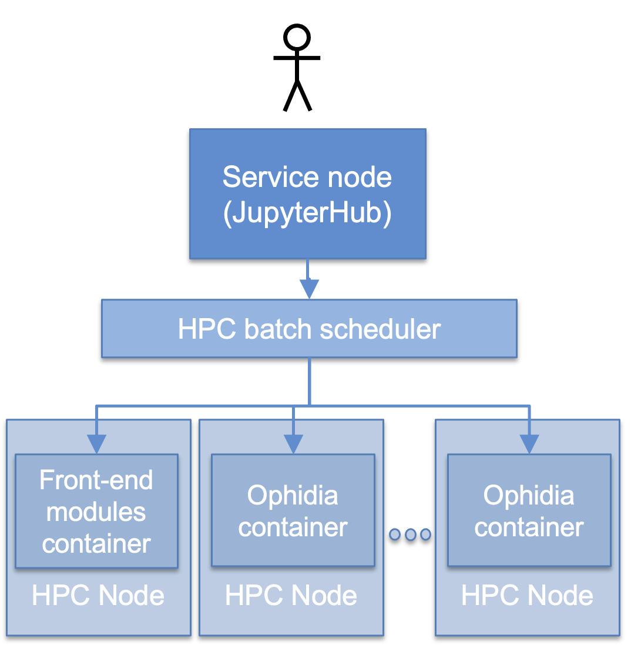
ENES HPC pilot
Portability on HPC infrastructures
The ENES HPC pilot aims to address services and usage scenarios relevant to the European Network for Earth System modelling (ENES) community
Use of containers as a layer to enhance HPDA applications portability and usage across different infrastructures:
easy and transparent portability and deployment of the Ophidia framework on HPC (Singularity and udocker) and Cloud (Docker)
ready-to-use integration of the framework computing components and high-level software (PyOphidia, Jupyter, visualization libraries) for user productivity
execution of container-based climate data analytics and visualization jobs on HPC
Leading to novel service models: HPDA as a Service
Notes:
High-level interfaces (Python-based) and easy-to-use environments (Jupyter) to support climate scientists productivity
Abstracting from the data and infrastructure complexity and promoting scientist collaboration
Reduce data movement shifting the analysis closer to the data
Move the analysis from the client-side to the server-side
In-flight, in-transit and in-situ analysis techniques
Use of novel data formats, I/O and storage solutions to overcome POSIX I/O scalability limitation and cope with the increasing climate data volumes
Object store, NoSQL data stores
Easier portability and deployment of the HPDA software on HPC infrastructures
Transparent usage of scientific HPDA applications/workflows across different infrastructures

Slide 9
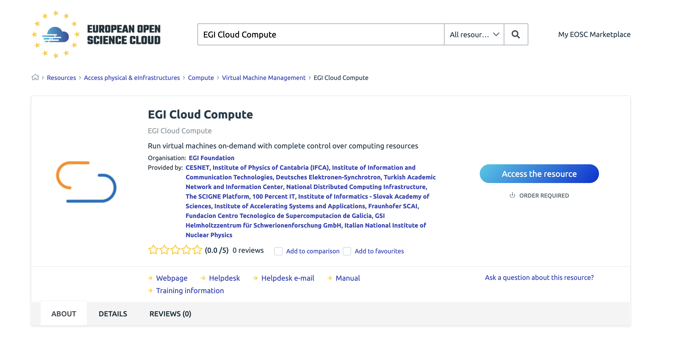
EGI Accelerated cloud
New service offer to be added to the EOSC Portal
Offer access to cloud IaaS infrastructures + HPC
Hosting long-running services as cloud VM, data transfer using cloud storage, spawning jobs to HPC as needed
4 initial providers:
LIP/INCD (PT), CESGA (ES), TUBITAK (TR), IICT-BAS (BG)

Slide 10
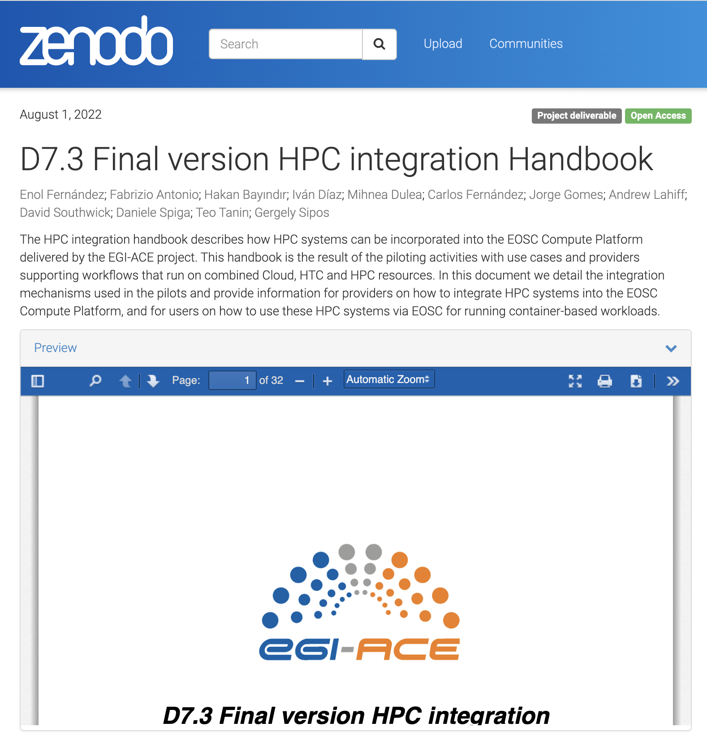
Learn more
Experience of the HPC integration is available as D7.3 – Final version of the HPC integration handbook
https://go.egi.eu/hpc-integration/
TOC:
Requirements from pilots
Access to HPC Systems
HPC security guidelines
Operational integration
Data Transfers
Application support
EOSC Marketplace integration

Slide 11
HPC integration WG
Group formed in late 2020 to assess and plan the technical integration of HPC systems into the EGI Federation
Served as initial seed for the EGI-ACE HPC integration pilots
Main activities:
Technology scouting to identify available technical solutions to integrate HPC with Cloud and HTC for enabling the execution of user workloads on top of heterogeneous resources;
Deal with user communities to gather requirements and recurrent use cases;
Identify gaps of the current solutions with a focus on those from the technology providers participating in the WG;
Discuss and plan enhancements for technical providers
Interested? Join us!

Slide 13
Challenges for HPDA in Climate Science
High-level interfaces (Python-based) and easy-to-use environments (Jupyter) to support climate scientists productivity
Abstracting from the data and infrastructure complexity and promoting scientist collaboration
Reduce data movement shifting the analysis closer to the data
Move the analysis from the client-side to the server-side
In-flight, in-transit and in-situ analysis techniques
Use of novel data formats, I/O and storage solutions to overcome POSIX I/O scalability limitation and cope with the increasing climate data volumes
Object store, NoSQL data stores
Easier portability and deployment of the HPDA software on HPC infrastructures
Transparent usage of scientific HPDA applications/workflows across different infrastructures
24/05/2022
13

Slide 14
HPC as a Service
Configuring InfiniBand networks as PCI Passthrough devices for HPC
A method of automatic creation of InfiniBand clusters using EC3
EC3 creates elastic virtual clusters including job management systems such as SLURM.
EC3 configures the VMs, not the compute nodes.
At present EC3 works with Ethernet network devices only.
The attachment of the IB virtual functions (VF) is done on the compute nodes.
Thus
It was necessary to develop a tool for attaching IB virtual interfaces on VMs, and then use EC3 for cluster reconfiguration.

Slide 15
HPC as a Service
Configuring InfiniBand networks as PCI Passthrough devices for HPC
Solution
Playbook-type files for Ansible were defined for initializing VMs, installing IB drivers, and bringing IB interfaces up.
A python tool has been developed, that uses libvirt module, for attaching an IB VF to any new virtual machine. This runs on the compute node as a daemon and is independent of the EC3.
If another VM is running on the same compute node, the tool is attaching the next available IB VF to the new VM. Even if IB allows tens of VFs per device, for performance reasons the number of available VFs should be limited to a lower value.
This solution was successfully implemented on the CLOUDIFIN site.

Slide 16
HPC Integration – TUBITAK ULAKBIM
2 node experimental cluster installation.
CentOS 7 based
One UI, One Worker Node. Storage on UI.
User/group synchronization via lsyncd.
Slurm Scheduler
NFS based shared storage for home folders.
Multiple ways for authentication.
Standard user via SSH
OIDC based authentication via SSH-OIDC.

Slide 17
HPC Integration - TUBITAK ULAKBIM
SSH-OIDC deployment, test and feedback.
Allow selected VOs to login.
User generation at first login
Persistent users & home folders.
Add users to relevant groups on login for added capabilities.
Containers support
Udocker backed, container based workflows.

