Slide 1
Interoperability & standardisation
Prof. dr. Barbara Koroušić Seljak
Jožef Stefan Institute, WP3 leader

Slide 2
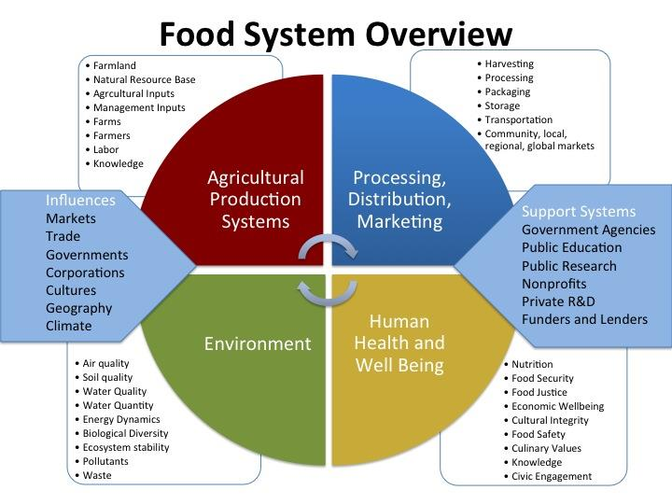
Complexity from the content point of view
The domain of Food and Nutrition Security (FNS) is complex as it addresses so many different aspects.
https://foodsystems.wsu.edu/foodsystemsprogram/

Slide 3
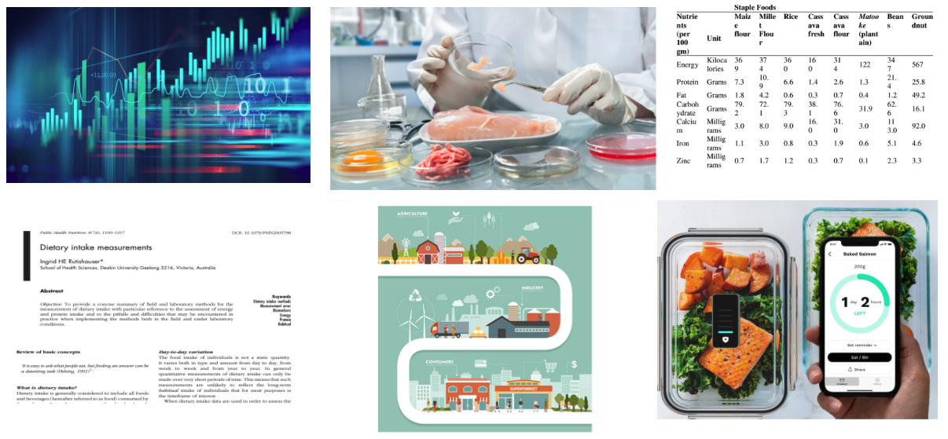
Heterogenous FNS data
This wide spectrum of FNS disciplines collects
different types of data in
various formats being
described & classified using several, already well established, systems, such as LanguaL (FAO, EuroFIR), FoodEx2 (EFSA) etc.

Slide 4
FNS Interoperability & Standardisation - relatively new research area
In the past two decades, the biomedical domain has made a great progress in the development of methodology and semantic resources required for data interoperability and standardisation, while the FNS domain is still in the relatively early stage of the development:
Pioneering projects in this domain including but not limited to:
H2020 FNS-Cloud
H2020 Blue-Cloud
ESFRI Metrofood
EFSA Cafeteria
ELIXIR Food & Nutrition Use Case

Slide 5
What has been achieved in FNS Cloud so far?
Semantic resources
FNS Harmony ontology
Knowledge graph (food-chemical-disease)
Methods
Missing data imputation
NER-based information extraction
Named-entity linking
Relation extraction
Services & ML pipelines (workflows)
Food matching
Data analysis
Tools
FoodViz
FairSpace
Food image recognition
FNS Catalogue
FNS Cloud Metadata API

Slide 6
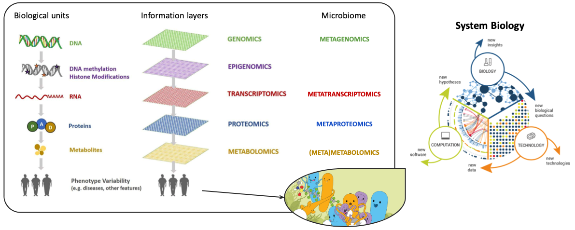
FNS ontology
Describing metadata of samples from food intake & consumption & ‘omics studies

Slide 7
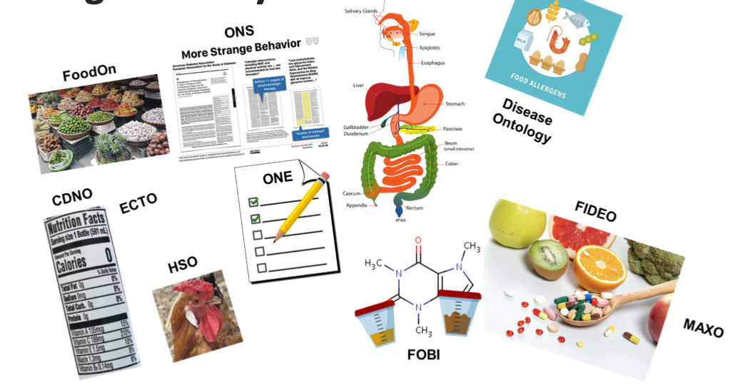
The FNS Harmony ontology

Slide 8
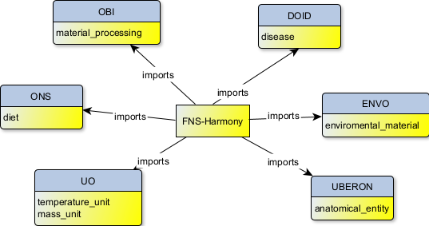
The FNS Harmony ontology
Available at: https://github.com/panovp/FNS-Harmony
PURL: https://purl.org/fns-h

Slide 9
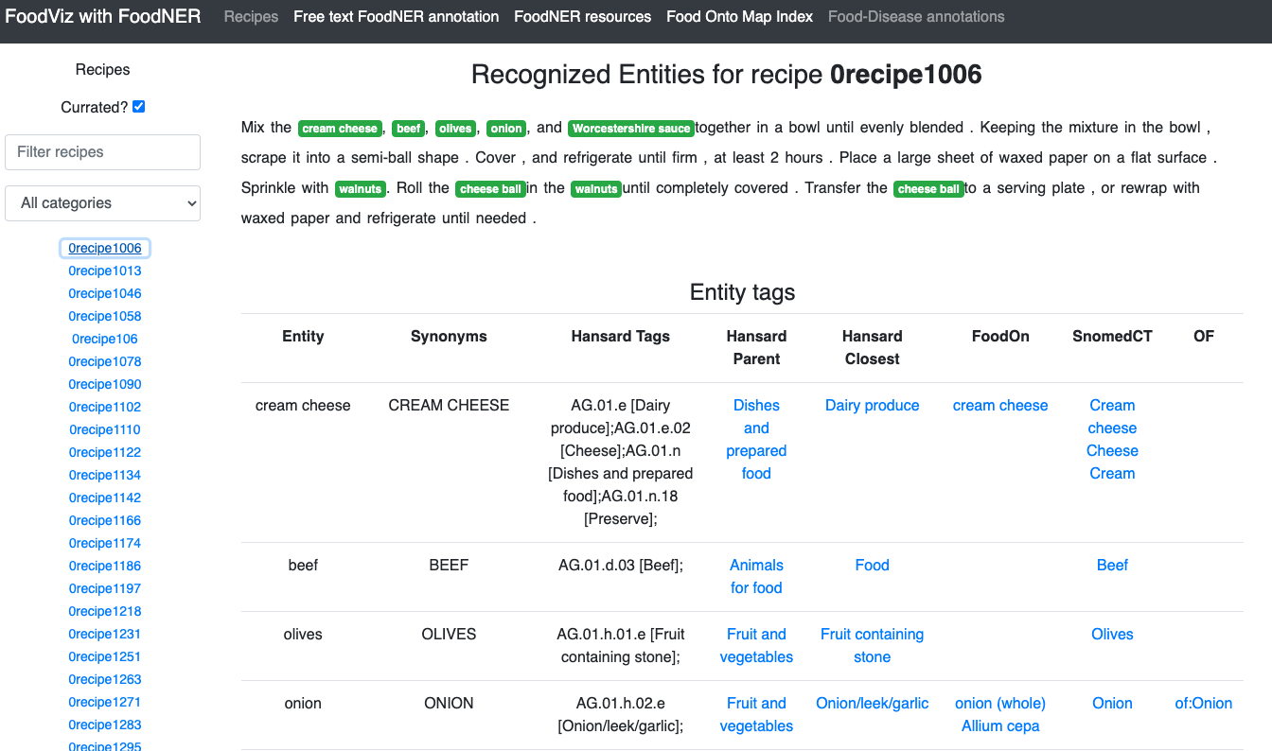
FoodViz – annotation and linkage via semantic sources
Notes:
Semantic interoperability

Slide 10
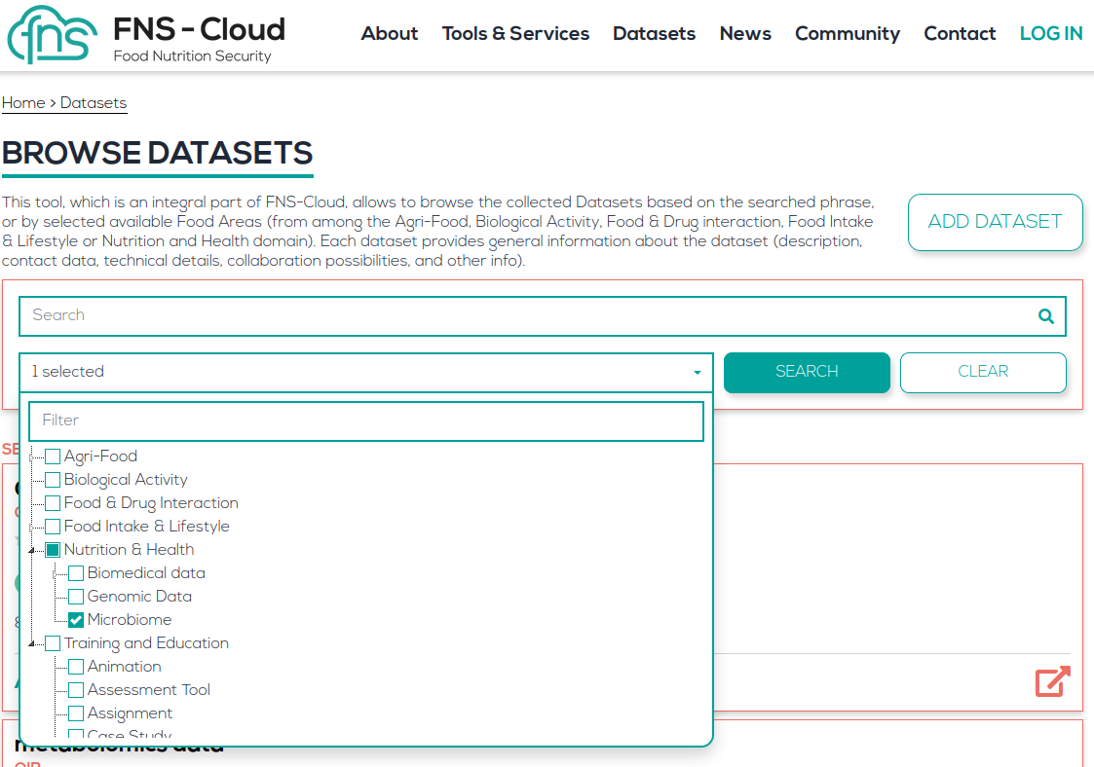
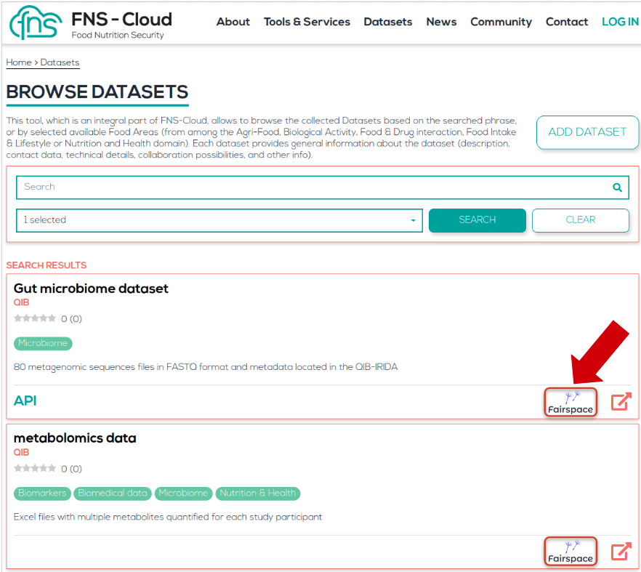
FNS Catalogue

Slide 11
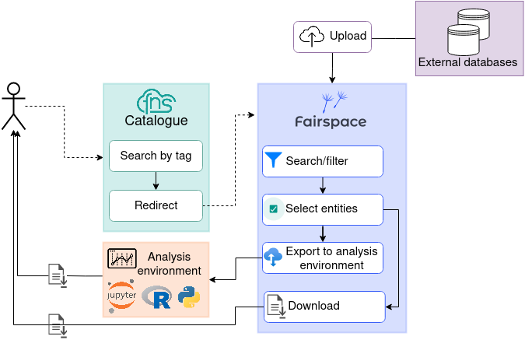
FairSpace
Notes:
Data interoperability

Slide 12
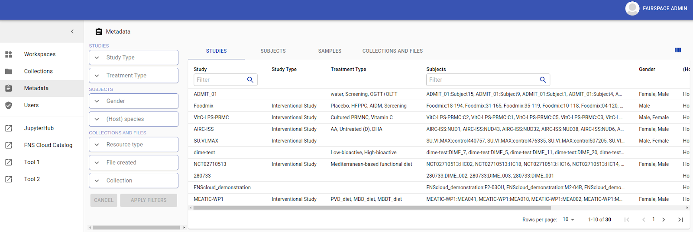
Analysis environment

Slide 13
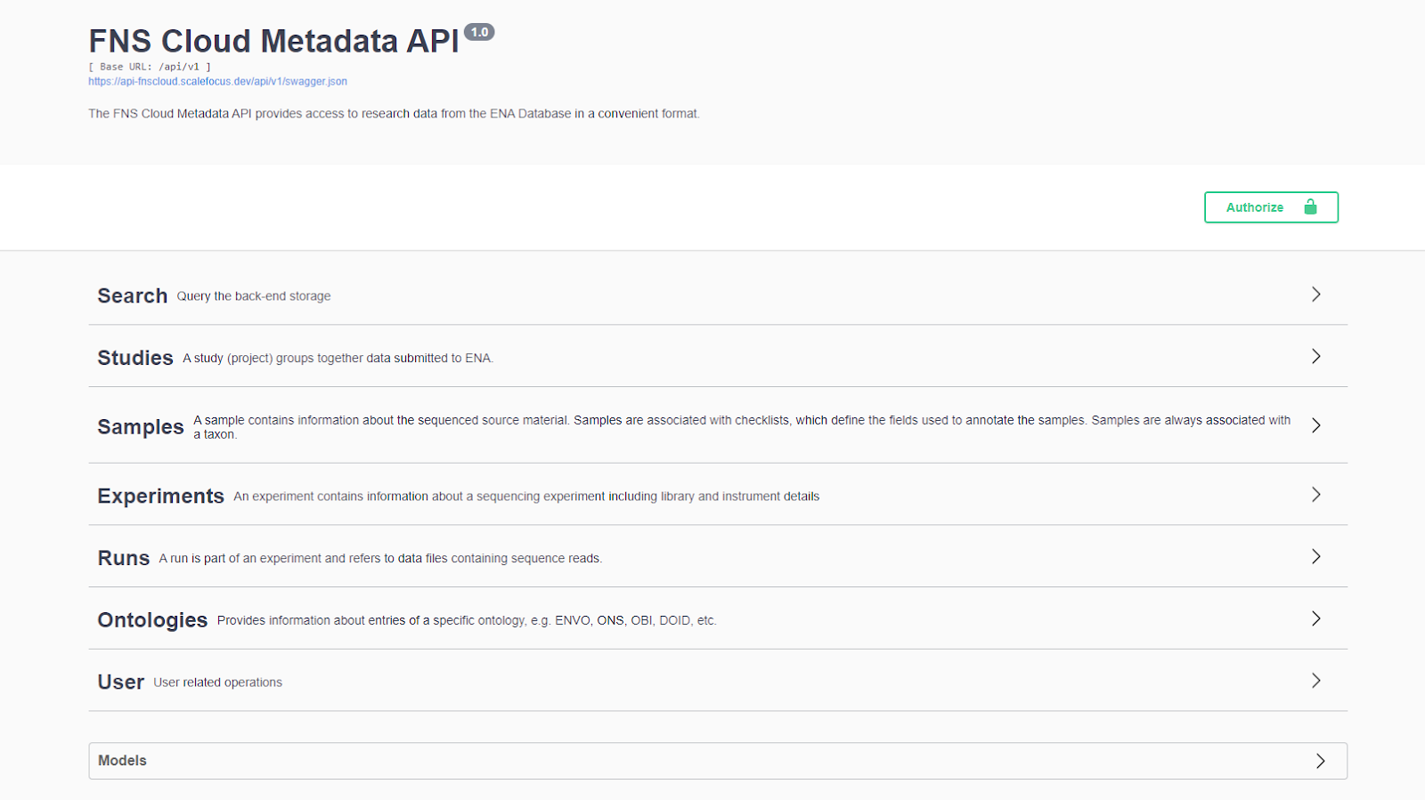
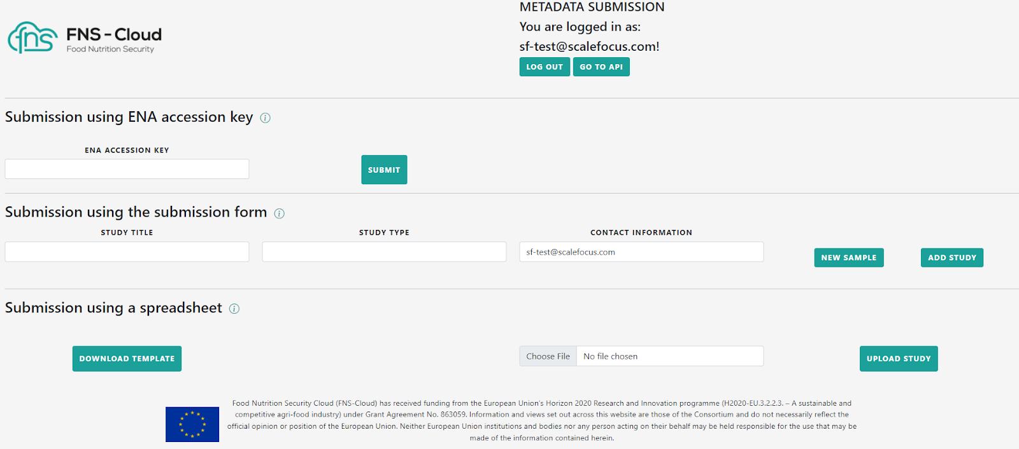
FNS-Cloud Metadata API & submission form

Slide 14
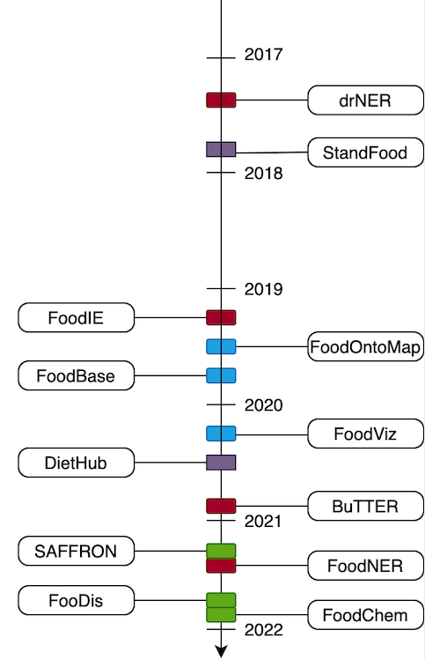
References
Tome Eftimov
Gjorgjina Cenikj
Gordana Ispirova
Barbara Koroušić Seljak
More at: https://www.fns-cloud.eu/outputs/publications/

Slide 15
Thank you for your attention
Team work:
Jožef Stefan Institute
University of Florence
The Hyve
ScaleFocus
University of Maastricht
Premotec
Don’t forget to follow us:
@FNSCloudEU
FNSCloudEU
FNS-Cloud
@FNSCloudEU2019
www.fns-cloud.eu

