Slide 1
Blue-Cloud – FNS Cloud Interoperability
FNS-Cloud EGI Meeting 2022
What’s in a fish (name)
Anton Ellenbroek, FAO of the UN (Italy)
Anton.ellenbroek@fao.org

Slide 2
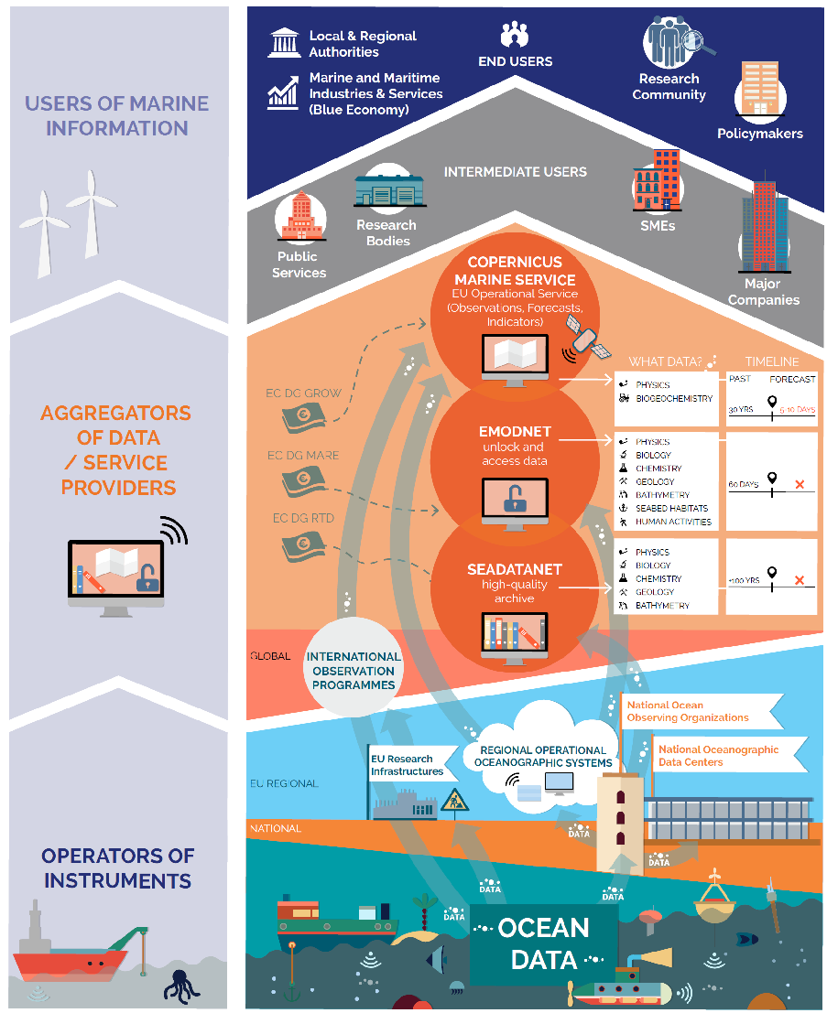
Blue-Cloud federates data in the FAIRly Blue European Marine Data Landscape
Notes:
The Blue Cloud projects federates data in the blue domain, from genetic data to fisheries data
the Marine Strategy Framework Directive (MSFD)
the Water Framework Directive (WFD) .

Slide 3
Blue-Cloud VRE concept A SoS to support and promote Open Science
Scientific Result
Enable
Repeat, Reproduce, Reuse, Evaluate
Active collaboration
Effective sharing
Provenance and attribution
Adopt
As-a-service approach
Standards
Economy-of-scale to reduce operational costs
Research
data
Research
data
01101010
01100001
11010010
Blue-Cloud VRE
01101010
01100001
11010010
Research
Process
Research
Software

Slide 4
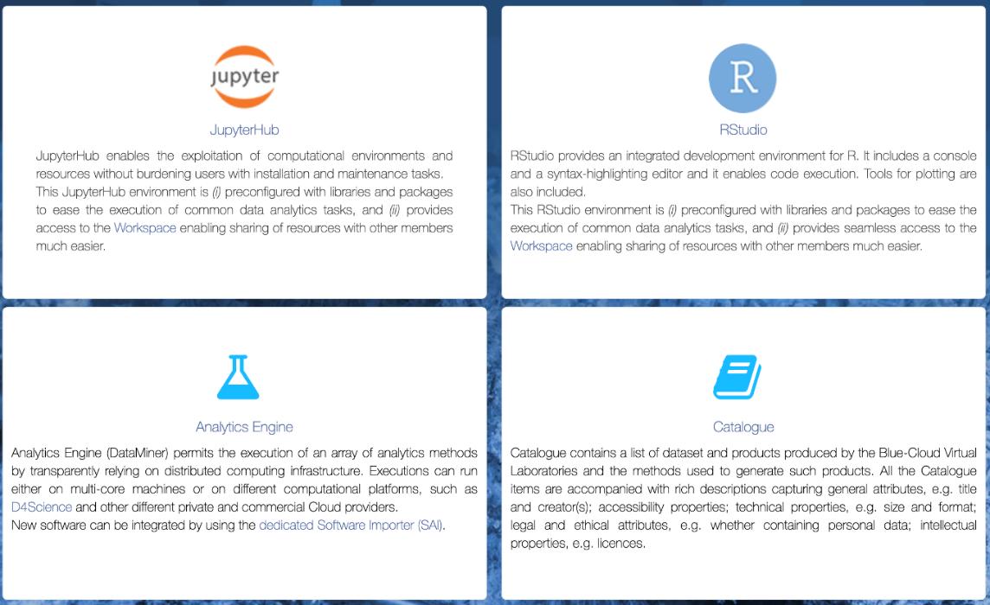
VRE’s allow to execute analysis and processes on top of blue Cloud
FAO Fisheries and Aquaculture Division uses VRE’s for capacity development, atlases, registries, literature and publications management. FAIRly straightforward IT, complex data harmonization processes
With FNS-Cloud we tested the interoperability of DATA in a specific sub-domain: Fisheries Food composition data

Slide 5
FNS-Cloud – Blue-Cloud
What’s in a fish-name – an interoperability test
Fish labels – what do they cover?
Product / process descriptions – the same cook and recipes?
Methods and references
Reliability and provenance
Why is it needed
SDG 2 and 14; we want to understand the contribution of fish to local diets, but there is a large variety of fish and fish products
SDG 13; climate impact on seafood quality and distribution

Slide 6
From uFish FAO dataset to uFish2 Online
uFish is FAO’s – INFOODS food composition table
uFish2 – the collaboration results online; have a look
Still in validation phase – can reproduce all results, but …
A JAVA/Angular application (some 100 developers days)
Deployed in D4Science as Docker container (a few hrs of work)
With api’s to read from e.g.
FNS-Cloud Food Explorer (for codes and food labels)
FAO’s Global Record of Stocks and Fisheries UUID’s
FAO’s OPENASFA for literature references
GeoNames, WORMS, etc. for ancillary data

Slide 7
uFish2 – Food composition preparation

Slide 8
uFish2 – data flow
Steps to add food compositions data (Simplified)
1. Select your reference from OpenASFA VRE
2. Select the species or species group (3-alfa code)
3. Select the part consumed
4. Select the processing
5. Select the preparation (Validate against Foodexplorer)
6. Enter the food composition values
7. Validate and publish a dereferencable FAIR composition

Slide 9
uFish2 – FNS-Cloud interoperability
Consult FNS-domain when adding food compositions
Is there a similar preparation in Foodexplorer??
If yes, get the FoodID => Test result: FAIRly ok

Slide 10
EGI key relevance
For future EU and global data platforms that aim to support data from the fishnet to the internet:
We tested interoperability at DATA level, but much more is needed => Start with vocabularies like FAO AGROVOC
Reliable digital objects are needed to make reliable errors.
The ocean is like programming; garbage in – garbage out; Keep the oceans clean!!!!

Slide 11
Save a food preparation - EUROFIR
Preparation - Food ID - from FNS-Cloud - EuroFIR
When a preparation is saved, the following API is called up to fetch the Food ID associated with the preparation:
https://eurofir.org/FoodEXplorer/API/rest?query=GetFoodName&param={param}
In uFish2 prototype to find the match of a FoodID, the parameter used for the search is the English name of the species. Only the first result is taken.
https://eurofir.org/FoodEXplorer/API/rest?query=GetFoodName&param=Nile_tilapia

Slide 12
Objective 2030 – More context

Slide 13
Objective 2030 – More context
Our aim is to add meta-contexts to food-composition data
Spatial – Atlantic vs. Mediterranean stocks
Seasonal - North Sea herring fat percentages
Production methods – Wild vs cultured salmon
Fishing areas – “you are what you eat” is very true for fish
With this better context we can:
Find reliable proxies for missing species / food compositions
Better understand contribution of fish to local food systems
Improve risk analysis (events) and resilience (cc changes)

Slide 14
blue-cloud.d4science.org

