Slide 1
Challenges and solutions; Fairification of Food & Health Data
Prof. Eileen Gibney
UCD Institute of Food and Health, UCD Ireland

Slide 2
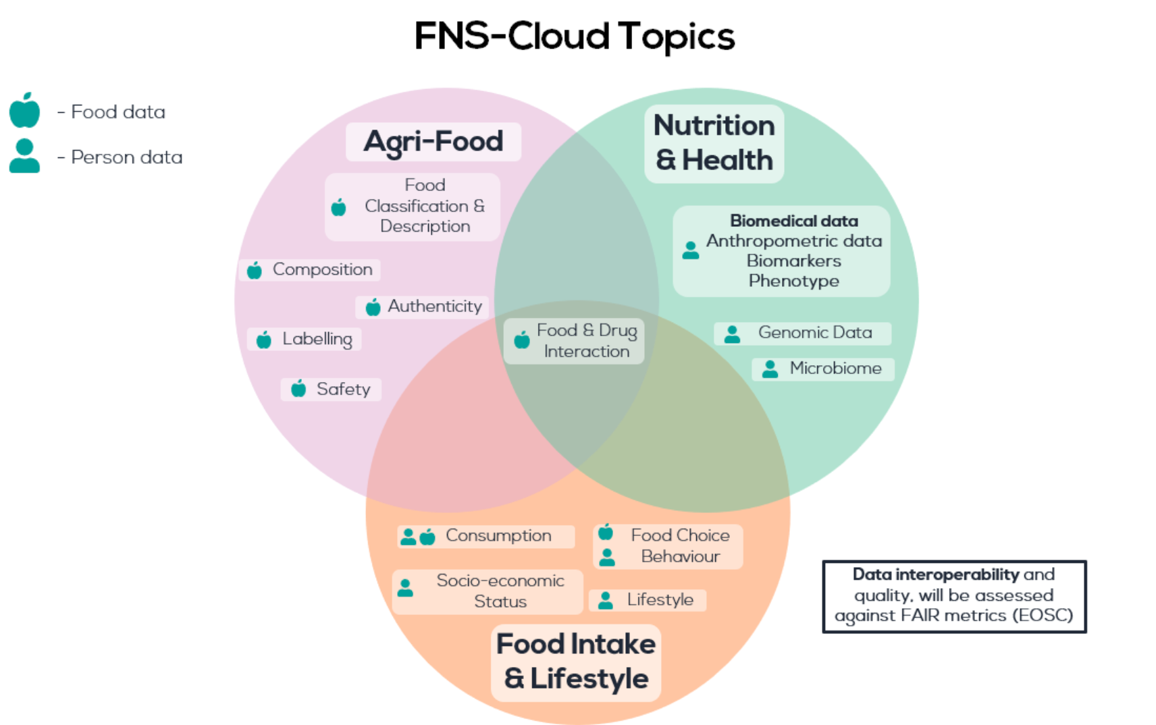
What is Food & Health data?

Slide 3
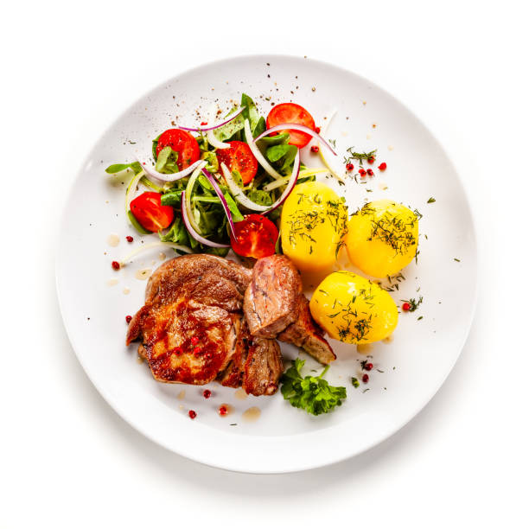
Food intake and lifestyle data?
WHAT and HOW?
Foods consumed, cooked, portions, nutrients
WHY
Food Choice
WHO
Demographic & Lifestyle information
HEALTH
Link to health, participant diagnosis

Slide 4
Why assess dietary intake?
Estimate intake of foods & food groups
(e.g. g/d of fruit)
Estimate daily intake of nutrients
(e.g. protein, vitamin C, calcium)
Identify adherence to population-based dietary recommendations
(e.g. DRVs, 5-a-day for fruit & vegetables)
Identify dietary behaviour
(e.g. skipping breakfast)
Quantify diet quality (“healthiness”)
(e.g. Mediterranean Diet Score)
Provide personalised dietary advice
Notes:
Dietary intake data is used to ascertain food, nutrient and ingredient intakes at both an individual and population level ⁽¹⁾. Dietary data can be assessed in clinical settings to support personalised care, or within population groups for research purposes and to develop government policy and public awareness campaigns (REFS). Analysis of dietary intake data can inform on dietary and meal patterns, food contaminants and residues as well as the association of dietary intake with health outcomes
Dietary intake analysis can be done at an individual level (used in clinical setting by dietitians) or for specific groups- consider by sex/age group/other characteristic. Can look at whether population/individual/cohor are meeting specific guidelines for individual nutrients or look at which food groups are contributing most to intake of certain nutrients.
Can be useful for identifying where reformulation strategies should be targeted e.g bread is food group that contributes most to salt intake in Ireland NANS data. Or for identifying where public health strategies/advice should focus % infants not achieving recc iron levels

Slide 5
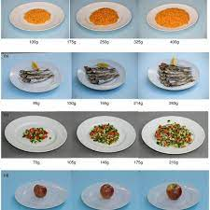
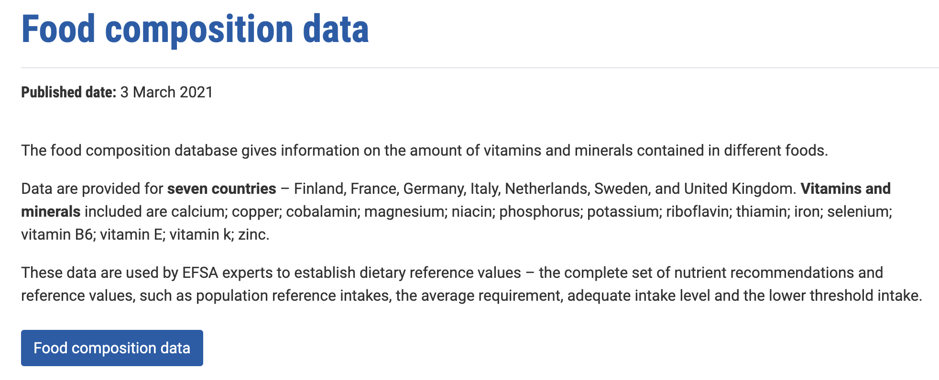
Foods to nutrients
Nutrient intake
Food description
Portion size
Composition
Composition of foods integrated dataset (CoFID)
Notes:
OK, so we have discussed why the description of the food is important – we need to know what food to choose when analyzing the data
We have discussed portion size – again its importance in terms of accuracy…
We combine these with the composition of the food to give nutrient intake.
So what do we mean by ‘Composition of Food’ –Food composition data (FCD) are detailed sets of information on the nutritionally important components of foods and provide values for energy and nutrients including protein, carbohydrates, fat, vitamins and minerals and for other important food components such as fibre. They are simply long lists of foods, with information of what is in them, in terms of nutrients.

Slide 6
Challenges
Methodology
Level of detail, type of data
Timeline
Data Handling
Data full of errors (under-reporting)
Mapping & Merging
Single, multiple timepoints
Output
Anonymisation (consent)
Aggregation
Analysis
Anonymisation

Slide 7
Methodology
Diet Diaries/ Food record
Prospective
Weighed, estimated, image
24 h Diet Recalls
Retrospective
Food Frequency Questionnaires (FFQ)
Retrospective
Previous month to year
Previous 24 hours
Multiple recalls per person
Interview-based or participant led
20-200 food & drink items
Participant led (training, checks)
Frequency only or semi-quantitative
Often 3-7 days
What was eaten in a week
What was eaten yesterday
What was eaten last month / year
For further information: https://dapa-toolkit.mrc.ac.uk/
Notes:
Accurately assessing dietary intake is challenging.
There are three primary methods of subjective dietary assessment that are used frequently in research and by nutrition professionals.
The first is the diet diary or food record. This is a prospective method, meaning that foods and drinks are recorded at the time of eating. Individuals can either weigh their food (which is often considered to be the most accurate method) or estimate their portion sizes using descriptions (such as 1 medium apple), and they are usually recorded between 3 and 7 days.
Next are the 24h dietary recalls. This is a retrospective method, where users recall what they ate and drank during the previous 24 hours. To increase accuracy, they are often performed in multiples. Traditionally, these are interview-based and follow a protocol such as the multiple pass method to ensure nothing is forgotten.
Finally are the food frequency questionnaires (or FFQs). These retrospectively record habitual diet over a longer period of time, often between a month and a year, although some record intakes for a shorter duration.
Each FFQ differs, often including between 20 to 200 food and drink items. These items vary between FFQs and depend on whether the FFQ is designed to give an overview of the whole diet or whether it is focussed on specific nutrients or food groups.
They can record frequency only (for example, how often did you eat carrots) or they can be semi-quantitative with an estimation of portion sizes (for example, did you typically have a small, medium or large portion of carrots).
If you’d like further information about traditional dietary assessment methods and the strengths and limitations of each, the DAPA Toolkit is very useful. You’ll find the link at the bottom of the screen.

Slide 8
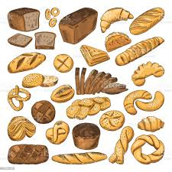
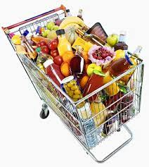
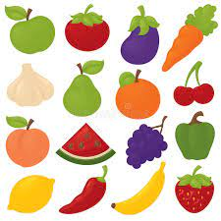
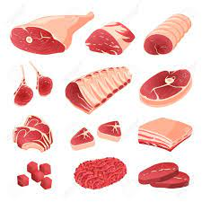
Dietary intake data – different sources but the same output
g / day
Notes:
Accurately assessing dietary intake is challenging.
There are three primary methods of subjective dietary assessment that are used frequently in research and by nutrition professionals.
The first is the diet diary or food record. This is a prospective method, meaning that foods and drinks are recorded at the time of eating. Individuals can either weigh their food (which is often considered to be the most accurate method) or estimate their portion sizes using descriptions (such as 1 medium apple), and they are usually recorded between 3 and 7 days.
Next are the 24h dietary recalls. This is a retrospective method, where users recall what they ate and drank during the previous 24 hours. To increase accuracy, they are often performed in multiples. Traditionally, these are interview-based and follow a protocol such as the multiple pass method to ensure nothing is forgotten.
Finally are the food frequency questionnaires (or FFQs). These retrospectively record habitual diet over a longer period of time, often between a month and a year, although some record intakes for a shorter duration.
Each FFQ differs, often including between 20 to 200 food and drink items. These items vary between FFQs and depend on whether the FFQ is designed to give an overview of the whole diet or whether it is focussed on specific nutrients or food groups.
They can record frequency only (for example, how often did you eat carrots) or they can be semi-quantitative with an estimation of portion sizes (for example, did you typically have a small, medium or large portion of carrots).
If you’d like further information about traditional dietary assessment methods and the strengths and limitations of each, the DAPA Toolkit is very useful. You’ll find the link at the bottom of the screen.

Slide 9
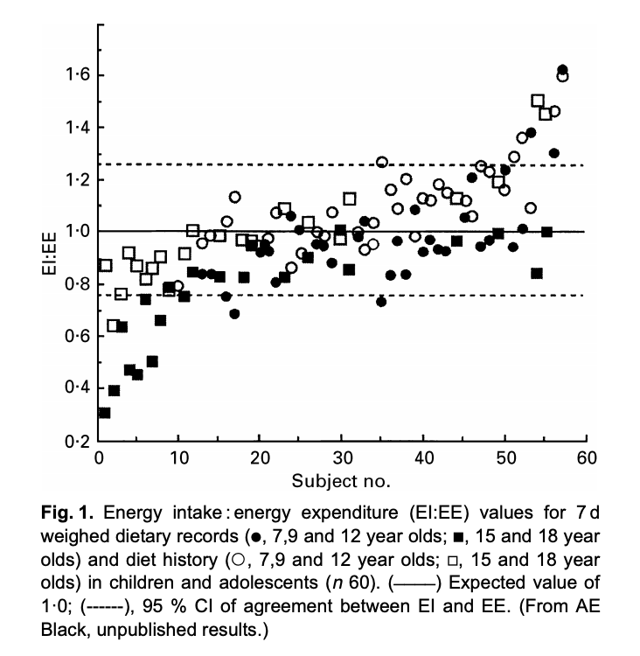
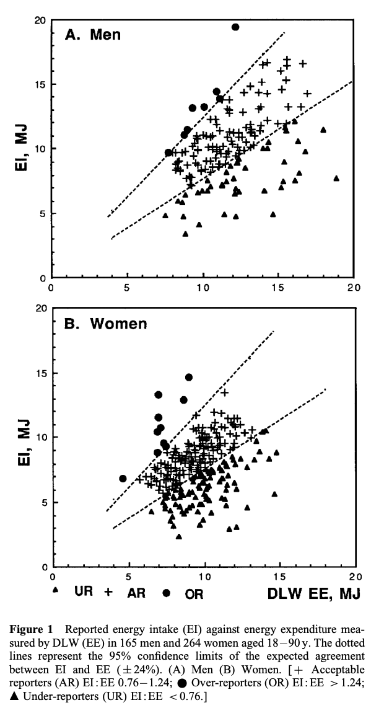
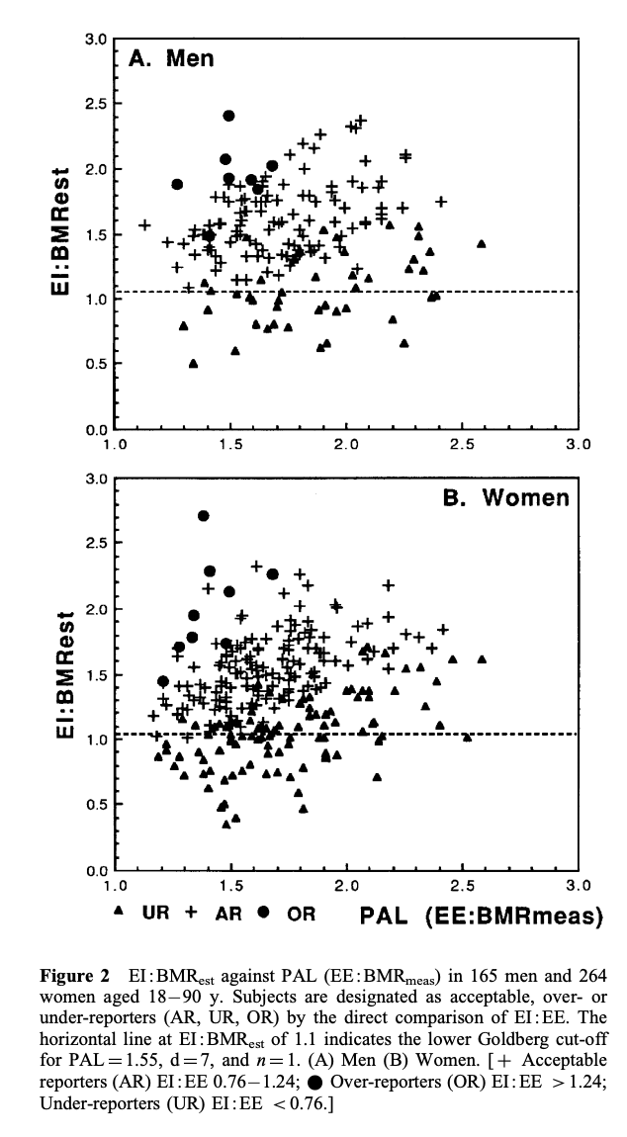
Dietary intake data – full of errors
Notes:
One of the key issues with dietary data is that it is considered to be inherently full of errors!
How do we know this, or presume this – well we compare reported intakes, which are subjective, coming from an individual to various objective markers, such as Energy expenditure measures using reliable methods such as doubly labelled water – as an example here. I could use other examples such as N as a marker of protein and it would show somewhat the same picture
If the reported intake is reliable the reported energy intake should somewhat equal energy expenditure – allowing for usual error, but what we see time and time again is that reporting intakes do not match - some over report, some under report – and we usually end up classifying individuals as Under reporters, adequate reporters or over reporters. And within any given dataset you can lose up to 30% or more of reported intakes to mis reporting in this way

Slide 10
Challenges – descriptions & coding
Food description
pasta in tomato-based sauce, homemade
Food Code
Study / Nationally specific
pasta in tomatensaus, huisgemaakt
FoodEx2
Langual
pâtes à la sauce tomate, maison

Slide 11
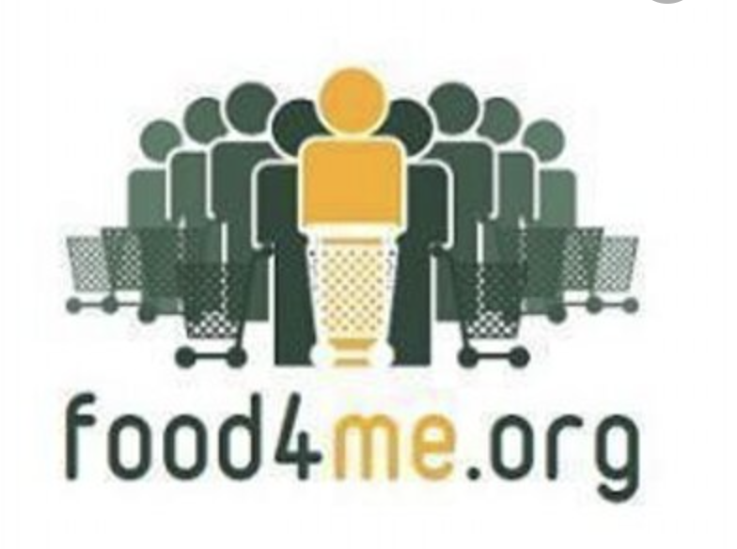
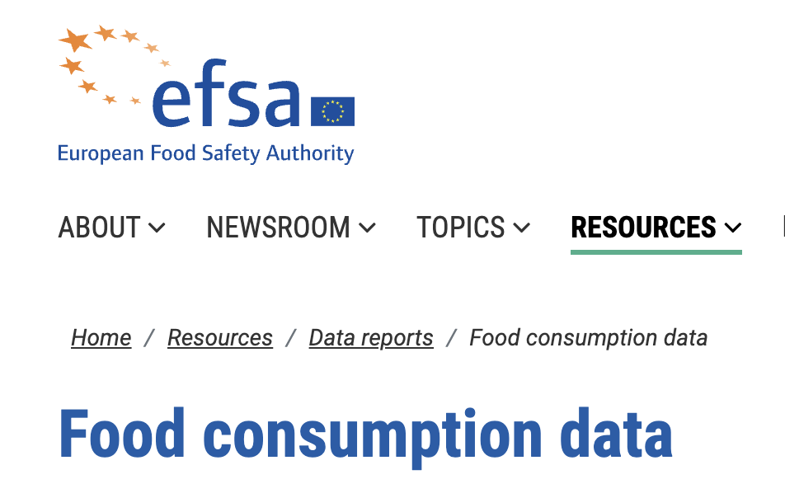
Many datasets exist… need tools, support to use
EU MENU

Slide 12
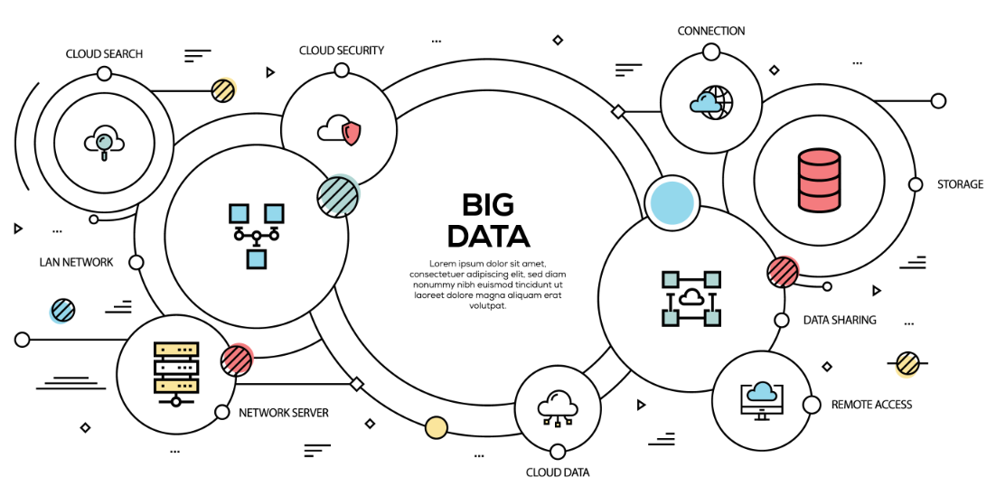
Develop Solutions

Slide 13
1
Fairification of Food & Health data in FNS-Cloud
FIND DATASETS – Use FNS catalogue to find relevant datasets for the specific research question – Catalogue search
IDENTIFY potential datasets containing parameters of interest
USE new dataset to ANSWER research question
UPLOAD datasets to FNS Cloud –
Catalogue
USE FNS tools & services to MERGE & HARMONISE datasets – FFQ mapping, StandFood, others?
OBTAIN access to datasets- FoodCASE and other repositories, FNS catalogue, IP permissions etc.
7
2
3
Determine if selected datasets are suitable for use in the specific research question
- UCD Quality Framework
6
4
Example research question: Assess factors which influence dietary patterns & adherence to sustainable healthy eating guidelines
5

Slide 14
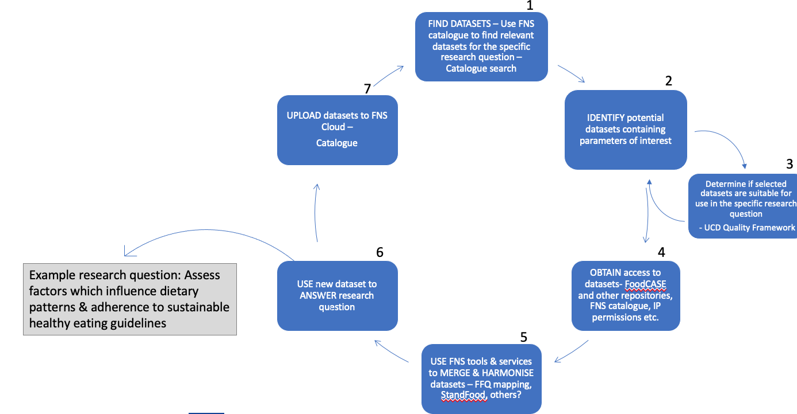
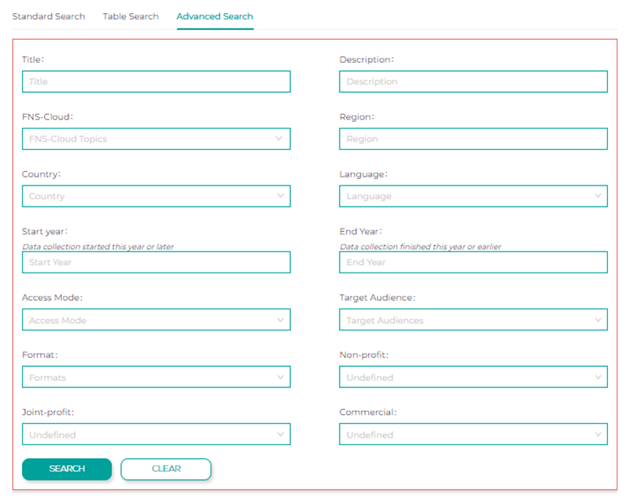

Slide 15
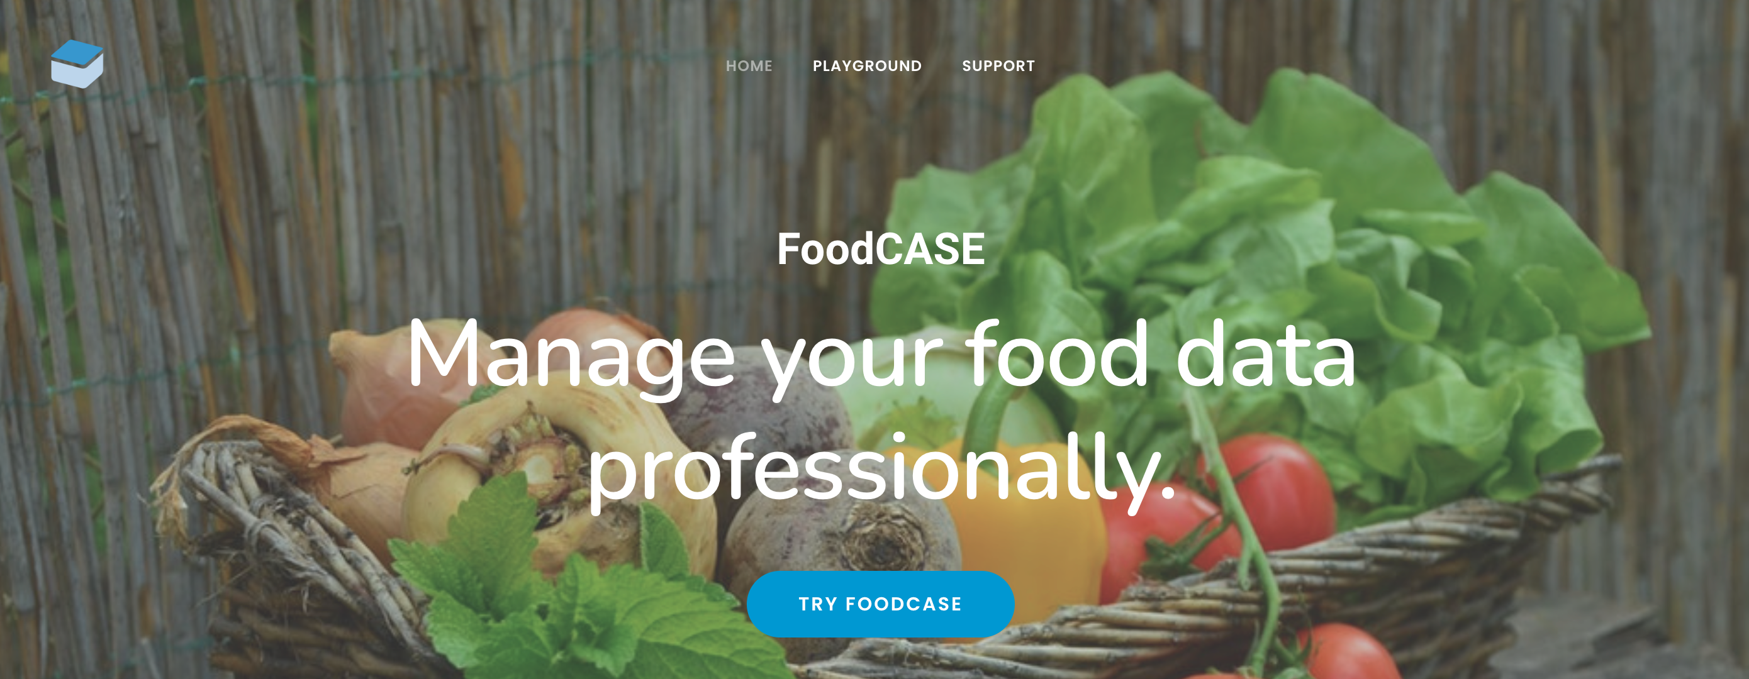
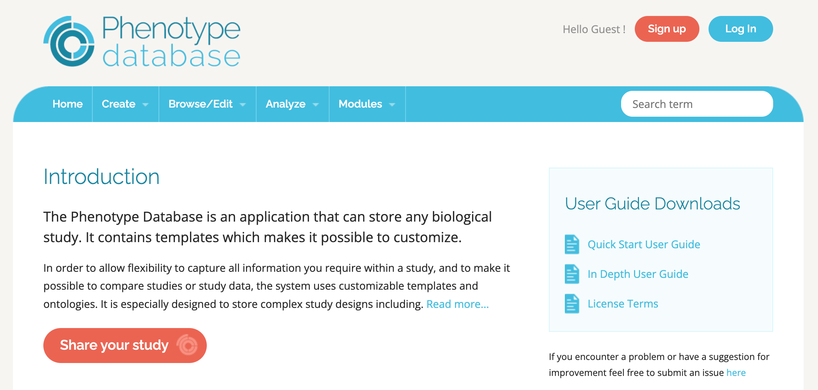

Slide 16
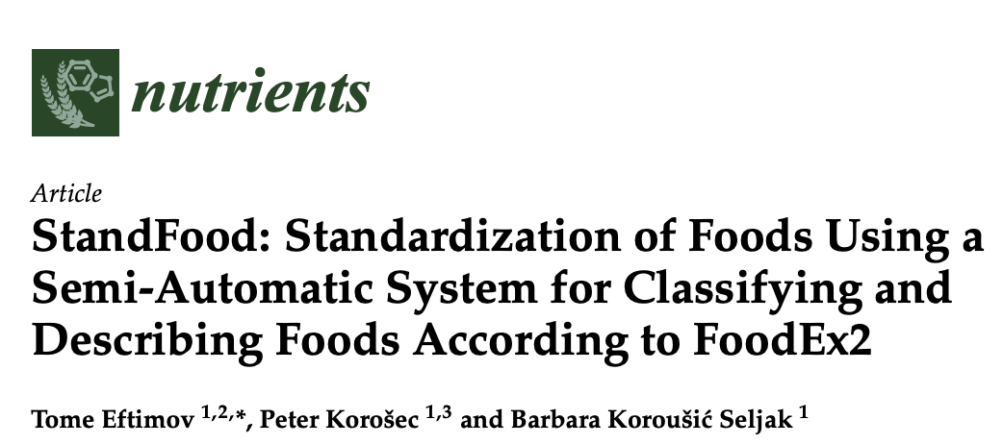
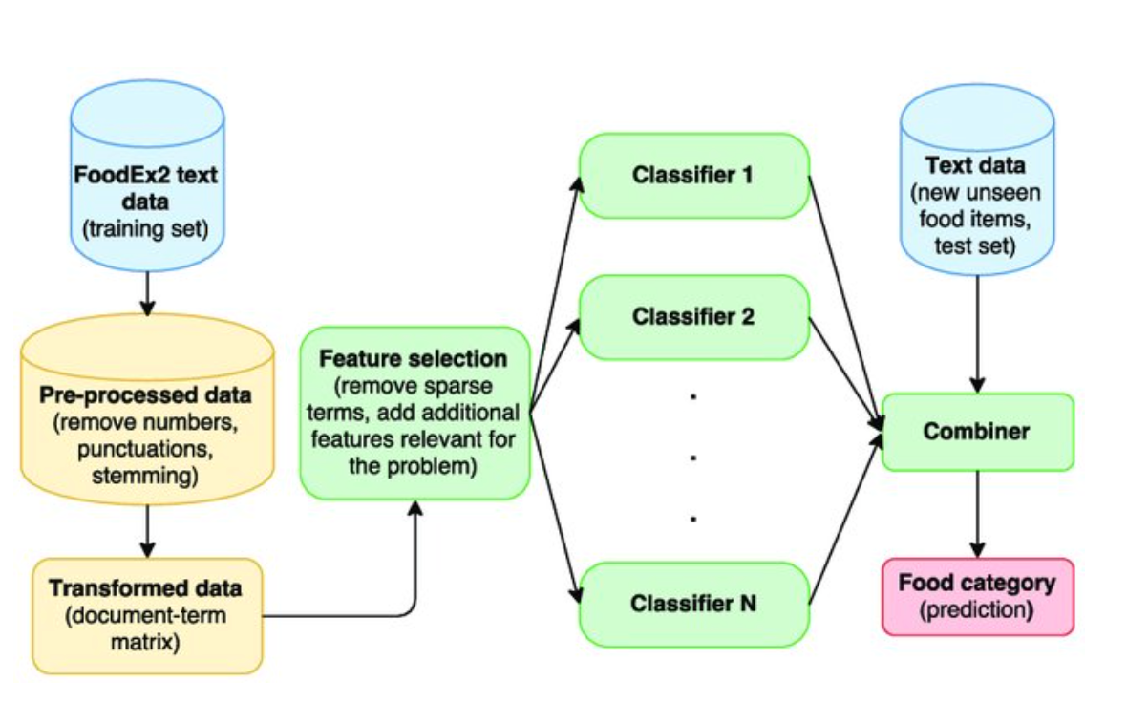
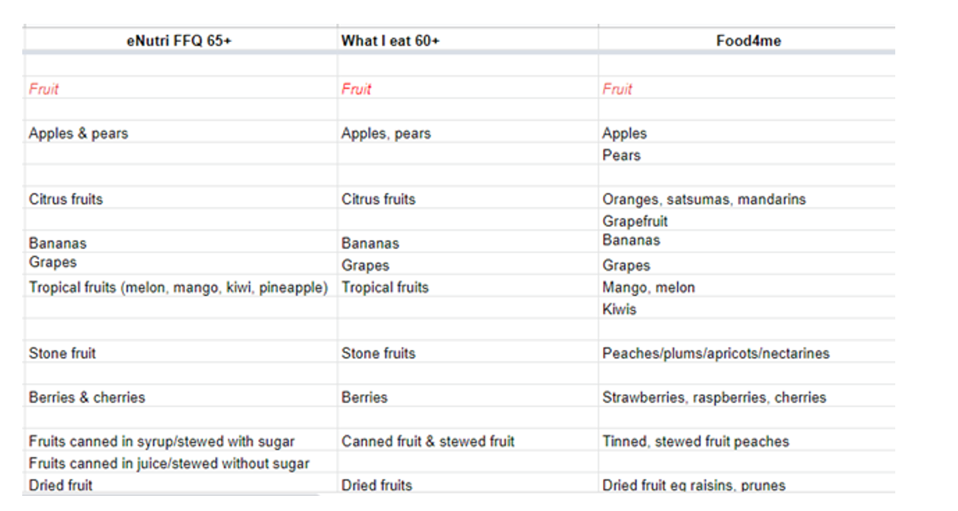
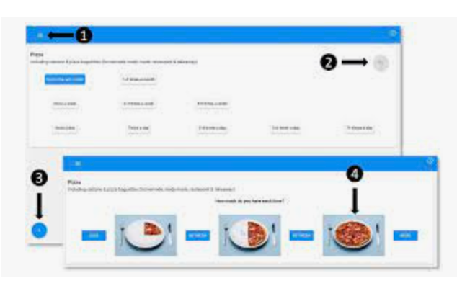

Slide 17
1
Fairification of Food & Health data in FNS-Cloud
FIND DATASETS – Use FNS catalogue to find relevant datasets for the specific research question – Catalogue search
IDENTIFY potential datasets containing parameters of interest
USE new dataset to ANSWER research question
UPLOAD datasets to FNS Cloud –
Catalogue
USE FNS tools & services to MERGE & HARMONISE datasets – FFQ mapping, StandFood, others?
OBTAIN access to datasets- FoodCASE and other repositories, FNS catalogue, IP permissions etc.
7
2
3
Determine if selected datasets are suitable for use in the specific research question
- UCD Quality Framework
6
4
Example research question: Assess factors which influence dietary patterns & adherence to sustainable healthy eating guidelines
5

Slide 18
Thank you
Eileen Gibney
eileen.gibney@ucd.ie

