Slide 1
EC commitment to Open Science EGI Conference 2022 Prague, 21/09/2022
Christian Cuciniello
Open Science Unit, DG R&I
European Commission

Slide 2
Science in digital transition
Re-inventing the scientific process?
Is the system fit-for-purpose?

Slide 3
Some of the challenges for science today
Skewed perceptions of quality; reproducibility, replicability
Focus on ‘stars’ rather than collaboration
Publishing in a market where client is not the king; closed access
Obsession with rankings
Risk-averse research
Hyper-publishing and hyper-authorship
Fight for funding
Wasting (data) resources, repeating doomed research
Gaming the system
Is this the research culture we want?
Slide adapted from a presentation by Danny Kingsley, Flinders University

Slide 4
Is Open Science (part of) the answer?
Open science: sharing knowledge, data and tools as early as possible in the research process in open collaboration with all relevant knowledge actors
Open science can increase
Quality & efficiency of R&I, if all the produced results are shared, made reusable, and if collaboration, reproducibility and openness are rewarded
Creativity, through collective intelligence and enabling cross-disciplinary research that does not require laborious data wrangling
Trust in the science system, engaging both researchers & citizens

Slide 5
The European Commission commitment to Open Science
Improve the practice of R&I
Openly accessible scholarly publications
Institutional publishing models, open review
Early sharing of all research outputs
All data FAIR, Research Data Management
Reproducible results
Societal engagement and responsibility
…
Develop proper enablers
Rewards and incentives to adopt Open Science practices, with appropriate metrics
Appropriate skills and education, including for research integrity
Open Research Infrastructures including the European Open Science Cloud (EOSC)
Legal and regulatory environment for data and copyright
Provisions on Open Science under Horizon Europe
European Research Area
Reform of research assessment
European Open Science Cloud
Open Research Europe publishing platform

Slide 6
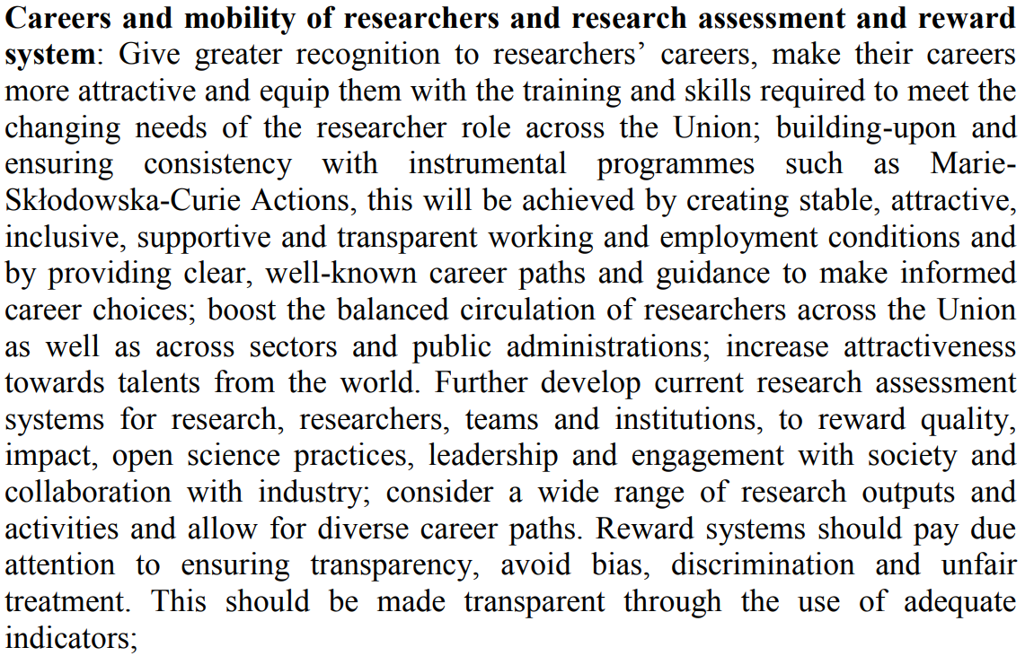
Council Recommendation on a Pact for R&I in Europe
Open science central to the values and principles for R&I in the Union
Priority areas for joint action in support of the ERA include:
https://data.consilium.europa.eu/doc/document/ST-13701-2021-INIT/en/pdf

Slide 7
Council Conclusions on the Future Governance of the ERA ERA Policy Agenda 2022-24
ERA action 1: Enabling the open sharing of knowledge and the re-use of research outputs, including through the development of the EOSC
Deploy the core components and services of EOSC and federate existing data infrastructures in Europe, working towards the interoperability of research data
Establish a monitoring mechanism to collect data and benchmark investments, policies, digital research outputs, open science skills and infrastructure capacities related to EOSC
Deploy Open Science principles & identify best practices

Slide 8
Council Conclusions on the Future Governance of the ERA ERA Policy Agenda 2022-24
ERA action 2: Propose an EU copyright and data legislative and regulatory framework that is fit for research
Goal: Identify barriers, challenges and potential impacts on research & proposing legislative and non-legislative measures
Ongoing EC analysis of EU copyright and data legislation
Independent experts´ studies to support the EC analysis on:
-copyright and related rights and access to and reuse of scientific publications
-copyright and related rights and access to and reuse of data
-the Open Data Directive, the Data Governance Act and the Data Act and their possiblevimpact on research
-the Digital Services Act and the Digital Markets Act and their possible impact on research
Online workshops (20/06 & 23/06)
Finalising the identification of barriers, challenges and potential impacts on research, and developing proposals for possible legislative and non-legislative measures (Autumn 2022).

Slide 9
Main legislative instruments concerned
EU copyright legislation
Database Directive | InfoSoc Directive | Copyright in the Digital Single Market Directive
Adopted in 1996. | Adopted in 2001. | Adopted in 2019. Transposition was due by 7 June 2021.
EU data and digital legislation
Open Data Directive | Data Governance Act | Data Act | Digital Services Act | Digital Markets Act
Adopted in 2019. Transposition was due by 17 July 2021. | Published in the EU Official Journal on 3 June 2022. It will apply from 24 September 2023. | EC proposal adopted on 23 February 2022. | Provisional agreement reached by the Co and EP on 23 April 2022. IMCO endorsed the agreement on 16/06. The DSA is expected to be put for a final vote in Parliament in July before being formally adopted by Council and published in the EU Official Journal. | Provisional agreement reached by the EP and Co on 22 March 2022. The DMA is expected to be put for a final vote in Parliament in July before being formally adopted by Council and published in the EU Official Journal.

Slide 10
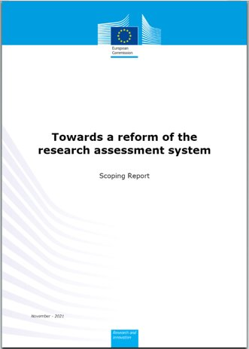
Council Conclusions on the Future Governance of the ERA ERA Policy Agenda 2022-24
ERA action 3: Reforming research assessment
Towards research assessment that rewards intrinsic quality and impact:
Relies on qualitative judgement with peer-review, supported by responsible use of quantitative indicators;
Values a diversity of research outputs and their impact;
Rewards the diversity of tasks of researchers, and supports team science;
Incentivises open collaboration and early knowledge and data sharing.
Way forward: Creation of a stakeholder-owned coalition and implementation plan, bringing together all research organisations willing to take the lead in reforming the current research assessment system
Complemented by an analysis of national & transnational legal and administrative barriers
Scoping report: https://data.europa.eu/doi/10.2777/707440

Slide 11
Open Science under Horizon Europe
Evolution of OS policies across FPs
Under Horizon Europe (2021)
Open Science (OA, RDM, Citizen Engagement, etc.) embedded across the FP
Evaluation of proposals (excellence –methodology-, quality & efficiency of implementation )
Grant Agreement, guidelines
Reporting—during the project’s lifetime
Work programmes
Strengthening of the obligations with respect to open access and focus on responsible RDM in line with FAIR
FP7
OA Pilot
Deposit and open access
H2020
OA Mandatory
Deposit and open access
& ORD/DMP Pilot
H2020
OA Mandatory
Deposit and open access
& ORD/DMP by default
(exceptions)
2017
2014
2008

Slide 12
Scholarly communication fit for modern research
The problem: large percentage of publications and outputs locked behind paywalls and not accessible early or to all; largely controlled by few publishers; lack of transparency; loss of copyright
The future we see:
Immediate open access; early sharing of outputs; open peer review
Research actors (authors, institutions) taking ownership of their scientific production
Retention of copyright
Diversification of publishing with participation of institutions and/or funders
Publishing infrastructures and services;
Affordable, sustainable and equitable system

Slide 13
Open Research Europe (ORE)
What is Open Research Europe?
An open access peer-reviewed publishing platform (Not a repository)
Post-publication open peer-review model: First you publish, then review takes place
Articles and reviews open access under CC BY licenses
Optional service for our beneficiaries at no cost to them during and after end of their projects
Rapid and transparent service
Currently 214 publications; celebrated 1 year of operation on 24th March
Why Open Research Europe?
Lead by example in operationalising open science principles within scientific publishing
Contribute to transparency and cost-effectiveness
Support Horizon Europe open access policy and compliance to it; enable publishing post-grant
Vision beyond 2024
Inclusion of other funders?
A pan-European publishing service?

Slide 14
Open Research Europe (ORE)
What is Open Research Europe?
An open access peer-reviewed publishing platform (Not a repository)
Post-publication open peer-review model: First you publish, then review takes place
Articles and reviews open access under CC BY licenses
Optional service for our beneficiaries at no cost to them during and after end of their projects
Rapid and transparent service
Currently ~300 publications; celebrated 1 year of operation on 24th March
Why Open Research Europe?
Lead by example in operationalising open science principles within scientific publishing
Contribute to transparency and cost-effectiveness
Support Horizon Europe open access policy and compliance to it; enable publishing post-grant
Vision beyond 2024
Extension to other funders
Towards a pan-European publishing service?

Slide 16
A vision beyond 2024
A top quality trusted pan-European publishing service
Managed collectively by European funders (and maybe institutions) for all researchers
No author-facing fees (i.e. no APC)
Technological autonomy secured for the long-term, and open source
Political support
ORE is part of the European Research Area priorities
June Council Conclusions on Open Science

Slide 17
Next steps (tentative)
2022
2023
2024
2025
2026
.
ORE 2021-2024 (current FWC)
ORE 2024-20226 (new FWC business as usual)
Development of a OSS publishing solution (tech autonomy) HE action
In case of ORE will not expand beyond EC → the OSS solution will be used by the EC
Case studies / Liaise with funders & institutions/ Legal, organizational financial implementation
ORE as the ERA publishing platform multi funder / shared / transparent

Slide 18
Why promote citizen and societal engagement?
Contributes to excellence
Enlarges the scope of R&I and the quality and quantity of data collected, discussed and analysed
Increases the robustness of the outcomes
Enables innovative and creative approaches
Leverages collective intelligence (often excluded from contributing to R&I)
Contributes to effectiveness
Aligns outcomes with the needs, values and expectations of society, ensuring greater relevance and uptake
Reduces time-to-market of innovative products and services
Triggers behavioural changes
Contributes to trust of society in science
Increases openness, transparency, and ‘co-ownership’ of society
Often leads to more inclusive outcomes
Encourages mutual learning between science and society

Slide 19
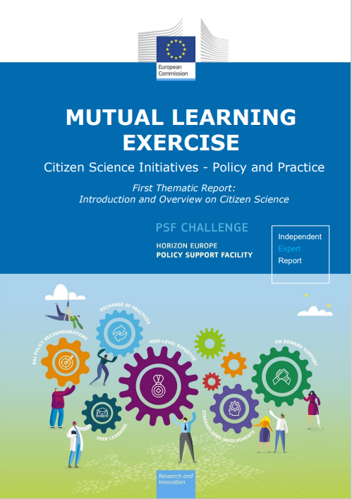
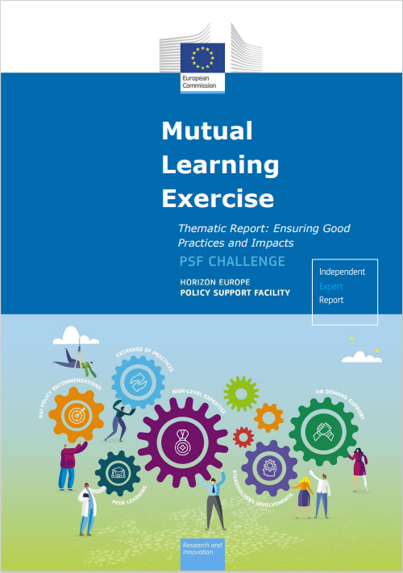
Mutual Learning Exercise: policy initiative on Citizen Science
MLE on Citizen Science (CS) proposed from MSs to
strengthen their CS national policies and initiative by exchanging lesson learnt and best practice
exploit synergies and upscale suitable (cross-) national CS initiatives across the ERA
CS MLE Topics:
Introduction and overview on citizen science
Ensuring good practices and impacts
Maximizing the relevance and excellence of citizen science
Enabling environments and sustaining citizen science
Scaling up citizen science
11 MSs/ACs: Germany, Slovenia, Austria, Belgium, France, Hungary, Portugal, Romania, Italy, Sweden and Norway
https://ec.europa.eu/research-and-innovation/en/statistics/policy-support-facility/mutual-learning-exercise-citizen-science-initiatives-policy-and-practice

Slide 20
Open Science: what’s next
Overarching challenge: A cultural shift to openness, collaboration and responsibility enabled by digital means
EOSC must deliver its promise and assessment of research must be reformed
Policy gaps and uncertainties:
Equity and inclusion, also at the global level
Legal and regulatory environment for data; AI
Improving reproducibility
At institutional, national, funder, European and global levels

Slide 21
EOSC and digital infrastructures for OS
Means and support:
To embrace open science as the modus operandi for researchers
digital transition of the research process
collaboration and openness
Diversity of outputs
OS enabler
HE Co-Programmed partnership
CORE FAIR enabling EXCHANGE more FAIRenabling
European/ National/ Institutional
New gen. metrics
Reforming Research Assessment
[Systemic Change]
Future of Scholarly Communication
OA
Open Research Europe
Towards Diamond OA
EU Publicly funded research should adhere to standards of research integrity
R&I results should be reproducible
Training
Skills
Support
to OS practices
Citizen Science Engagement
Recognition as science knowledge producers
DATA
OpenData
FAIR principles
FAIR RDM Culture
[HE conditions]

Slide 22
Thank you
© European Union 2022
Unless otherwise noted the reuse of this presentation is authorised under the CC BY 4.0 license. For any use or reproduction of elements that are not owned by the EU, permission may need to be sought directly from the respective right holders.

