Slide 1
EGI Service Strategy 2022-2024
Sergio Andreozzi
EGI Conference
Head of Strategy, Innovation and Communications, EGI Foundation
21 Sep 2022

Slide 2
Outline
Overview of EGI Service Portfolios
For Federation (“internal”)
For Research (“external”)
From the Community
EGI Service Strategy 2022-2024
5 strategic objectives
Highlights on progress

Slide 3
EGI Service Portfolios
From EGI Community
Services for research and innovation From the EGI Community (own brand)
EGI for Research
Services for research and innovation From the EGI Federation (EGI-branded)
EGI for Federation
Services needed to enable the EGI federation

Slide 4
EGI Services for Federation
Services needed to enable the federation
Service owner: EGI Foundation
Supplied also by some EGI Participants selected via periodic bid process
Access: available to the EGI Federation
Publicly-funded organisations represented in the EGI Council
Commercial providers as “Federation” partner in the EGI DIH
Organisations collaborating via MoUs or other agreements
Funding model: combination of
Fees to be part of the EGI Federation
In-kind contributions
EC-funded projects
Coordination
Security
Operations
https://www.egi.eu/services/federation/

Slide 5
EGI Services for Federation
Service catalogue overview
COORDINATION SERVICES
TECHNICAL TOOLS
SECURITY AND IDENTITY
Operations Coordination and Support
Accounting
Check-in
Community Coordination
Collaboration Tools
Attribute Management
ITSM Coordination
Configuration Database
Technical Coordination
Operational Tools
Project Management and Planning
Helpdesk
Security Coordination
Service Monitoring
Strategy and Policy Development
Validated Software and Repository
Communications
Marketplace
Industry Engagement
https://www.egi.eu/services/federation/

Slide 6
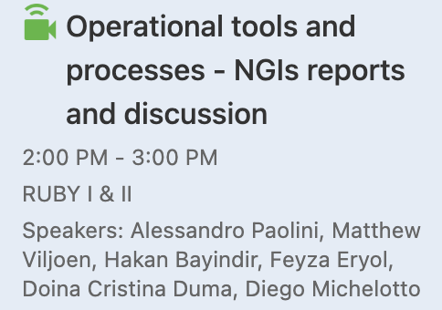
EGI Services for Federation
Progress update: Highlights
EGI Service Monitoring
Adding Service Trends and Service Pages
Easier definition of new metrics
All-inclusive reports generation
– See Poster –
Accounting
Adding accounting records for storage, GPU and datasets
New protocol for data transfer
Configuration Database
Support authentication with new IdPs
Extending support for different DBMS
Check-in
Adoption of Keycloak
– Want to know more? –

Slide 7
EGI Services for Research
EGI-branded services delivered by the EGI Federation that researchers and communities can order individually
Service owner: EGI Foundation
Supplied mostly by EGI Federation members
Access: orderable
Via EGI channels
Simple request
Application in Open Call
Order via EGI marketplace
Via EOSC Portal
Funding model: combination of
In-kind
Grants from projects
Pay for use
Compute
Training
Storage & Data
Applications
Security & Identity
https://www.egi.eu/services/research/

Slide 8
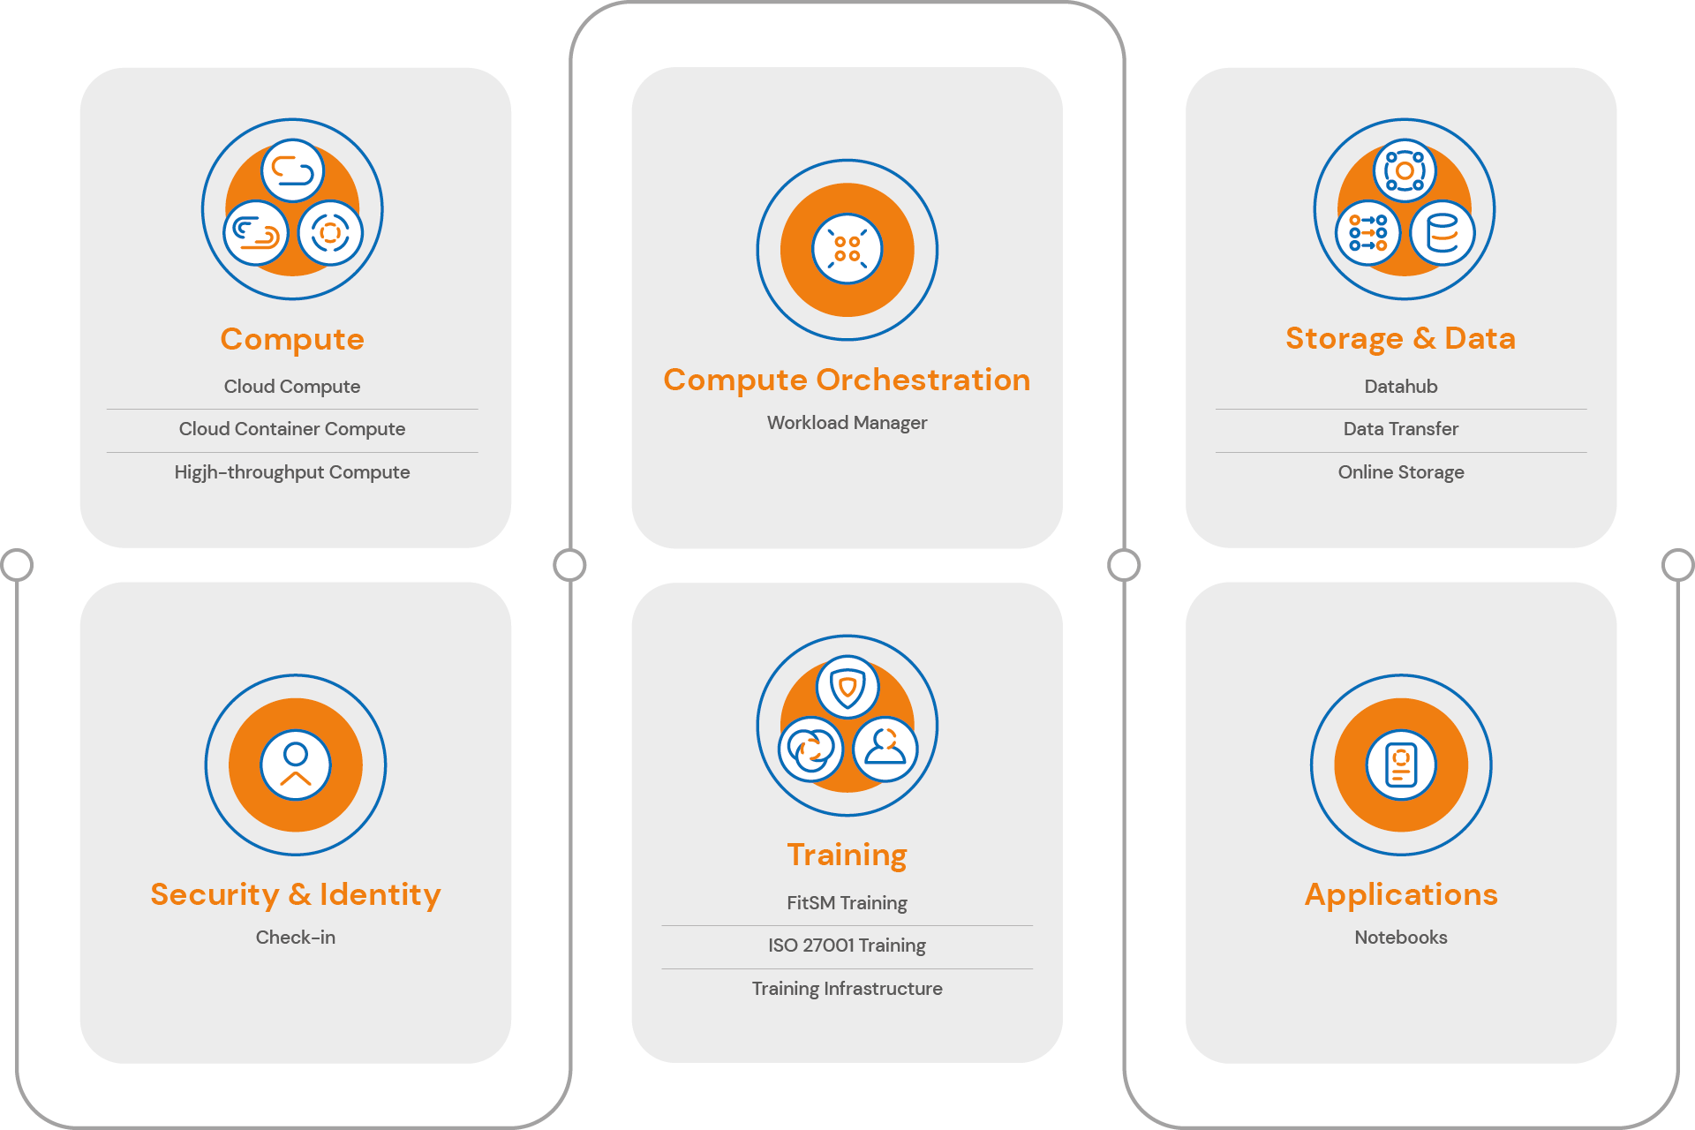
Services for Research
Service catalogue overview

Slide 9
Services for Research
What’s New
Discovery
Planning
Alpha
Beta
Production
Workload Manager
Software Distribution
Data Orchestrator
Replay
Infrastructure Manager

Slide 10
EGI “Community” Service Portfolio
Services offered by organisations part of the EGI community under their own brand
Service owner: service provider
Requirements to join this portfolio (initial ideas)
Some level of integration with EGI services
Compliance to EGI policies
Sign some form of collaboration agreement
Different levels of partnership may be defined, e.g.
EGI as promotion channel
EGI as support for tech integration
EGI as front-end negotiation
Plan
Q4/2022: develop the concept and requirements
Q1/2023: update EGI SPM process and launch and onboarding of initial services
Q2/2023: interested services from EGI-ACE onboarded + open to other community members
Scientific Applications
…
Science
Gateways
Research Platforms
Data Spaces

Slide 11
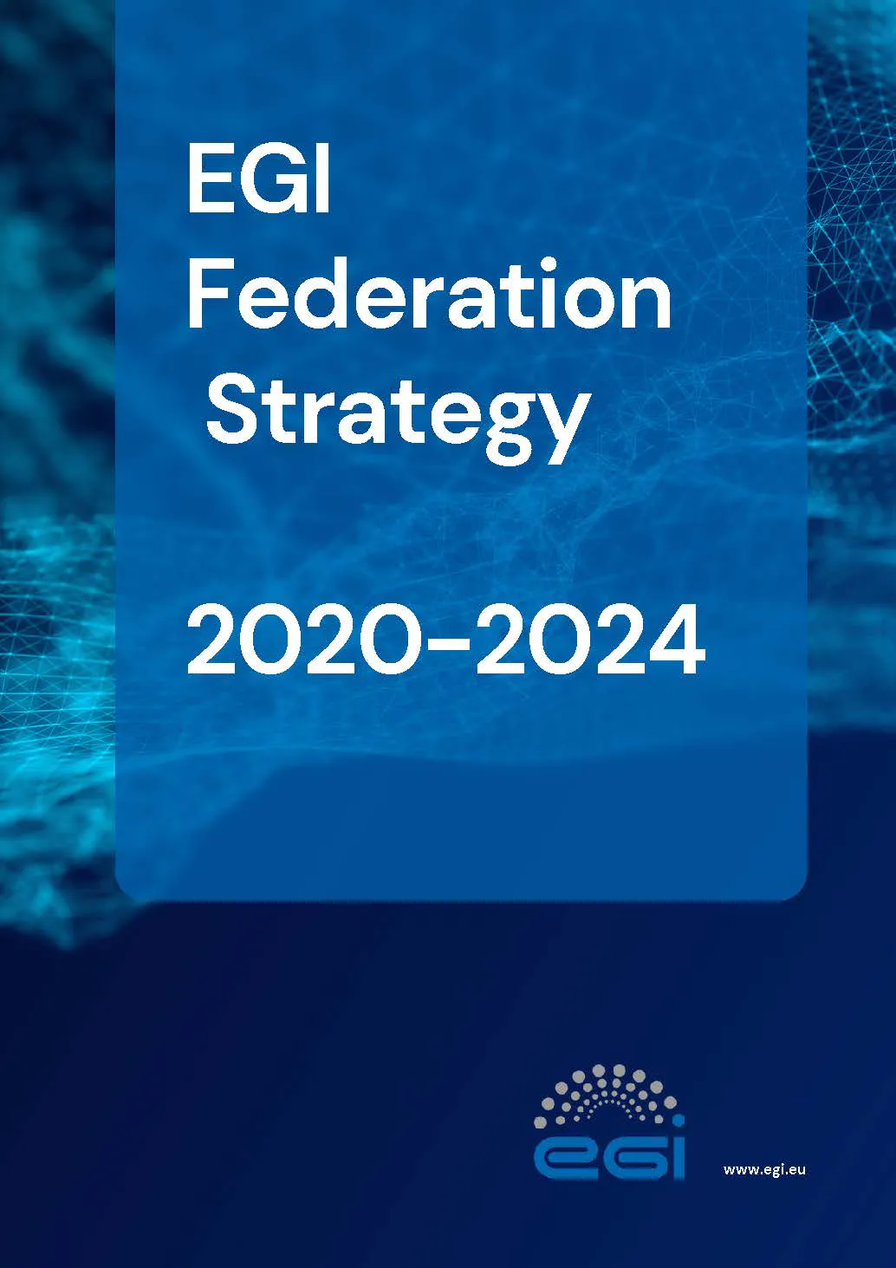
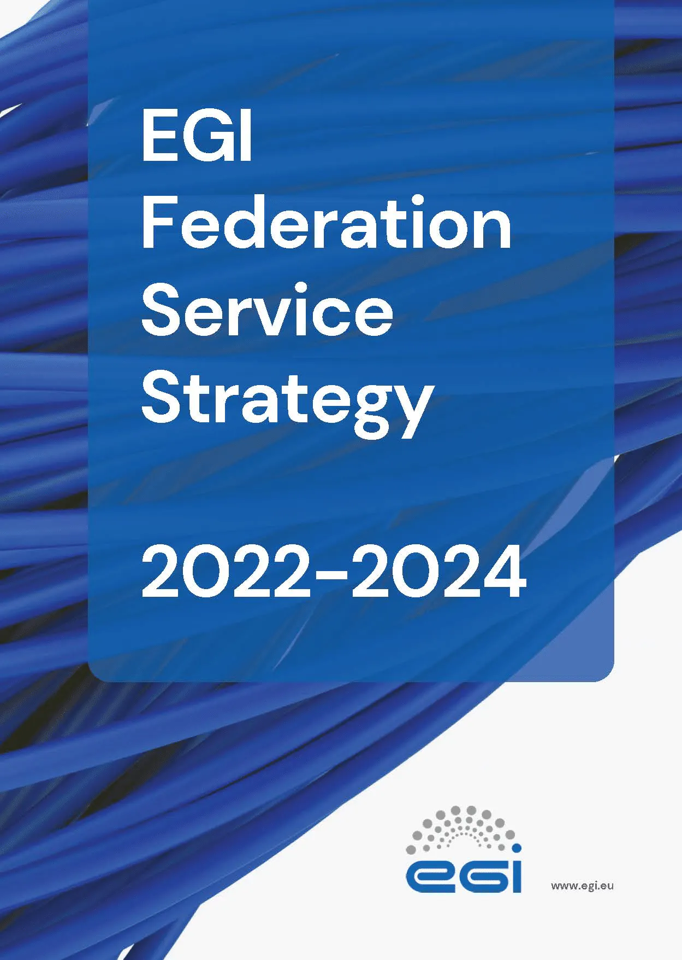
https://go.egi.eu/strategy
EGI Federation
Service Strategy 2022-2024
https://go.egi.eu/service-strategy

Slide 12
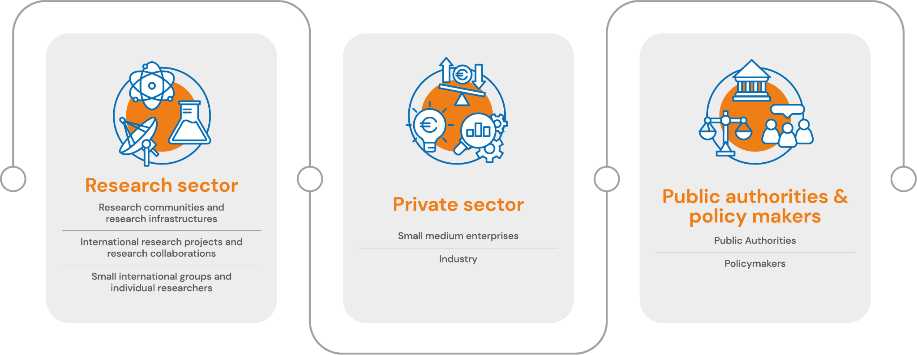
Target groups
Primary groups

Slide 13
Service Strategy 2022-2024
5 Strategic Objectives
SO1 Federated compute continuum
SO2 Federated data lakes and repositories
SO3 Data analytics and scientific tools including AI
SO4 Professional support and consultancy
SO5 Investigation of a trusted compute platform for sensitive data processing

Slide 14
SO1 Federated compute continuum
Equip researchers with a federated hybrid compute infrastructure for convergent use of HTC, HPC, Cloud and Edge
Motivations
For users: complexity of computing workflows and data needs heterogeneous architectures
For EGI: strategic alignment, technical, economic
Key results
Run/scale up workflows on heterogeneous resources from edge to HPC
Distributed data processing model including where data is generated
Areas of work
Advancement of solutions for federation
Harmonisation of security and access policies
Evolution of EGI solutions (e.g. workflow management, data transfer)

Slide 15
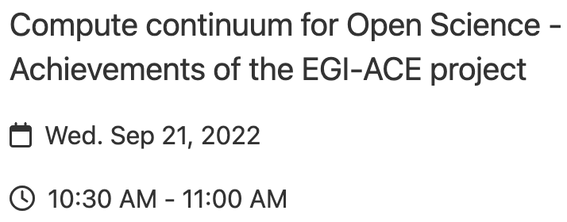
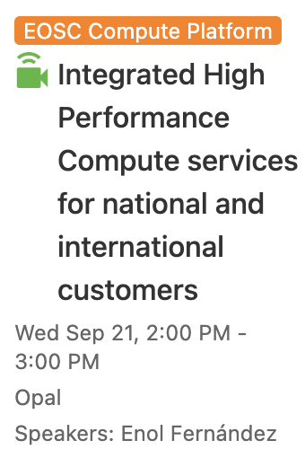
SO1 Federated compute continuum
Progress update: Highlights
HPC Integration
Scientific use cases with combined cloud and HPC needs:
Access with Check-in credentials
Portable container execution with udocker
Data access via Datahub
Integration into the federation: accounting, monitoring
New service to be developed: EGI Accelerated Cloud
Access to cloud IaaS + HPC
Compute Continuum WG
Create metadata schema as extension of the EOSC profile to describe the compute resources in the EOSC resource catalogue See info page
Diego/Enol?

Slide 16
SO2 Federated data lakes and repositories
Equip European researchers with shared and federated high quality research object data lakes for storing and analysis integrated with big data processing, real-time analytics, and machine learning solutions
Motivations
For users: integration of data providers with EGI processing, reduction of barriers in big data science
For EGI: leveraging national initiatives, expand capabilities
Key results
National and thematic data repositories usage increases via EU-wide infrastructures
Data processing workflows are more efficient
Areas of work
Collaborate on data spaces, architectures, interoperability and business models
Establish partnership agreements with data provider and national or community initiatives
Repurpose existing solutions for access to big data

Slide 17
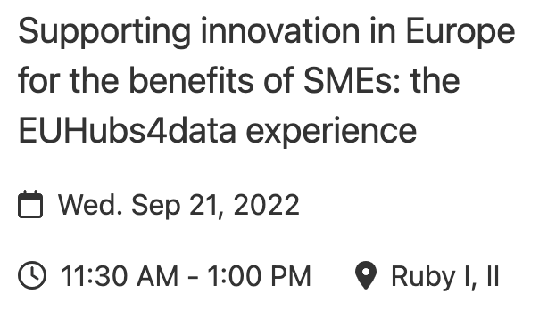
SO2 Federated data lakes and repositories
Progress update: Highlights
Setup of federated data catalogue (DIHs and other initiatives)
Integrating EGI DataHub with the International Data Space (IDS) connectors for data sovereignty and interoperability
Federating data catalogues
Deliver GDDS MVP
Reference blueprint of the technical architecture
Roadmap for future implementation
Governance
Community of Practice
GREAT Project
Green Deal Data Space (GDDS)

Slide 18
SO3 Data analytics and scientific tools including AI
Equip researchers with scientific applications, data analytics tools and AI applications that provide an integrated point of access to European core data resources and computing
Motivations
For users: access AI/ML applications and receive support for their development and operations
For EGI: add bespoke solutions and innovative products for ML/AI
Key results
Large portfolio of scientific applications integrated with EGI Fed
EGI Notebooks access data + tools for AI/deep learning on GPUs
Users can share models and exploit them in the cloud
Areas of work
Collaborate with members offering AI/ML analytics for researchers
Provide adequate resources for AI/ML algorithms/platforms/training
Create a Competence Centre on AI/ML in EGI

Slide 19
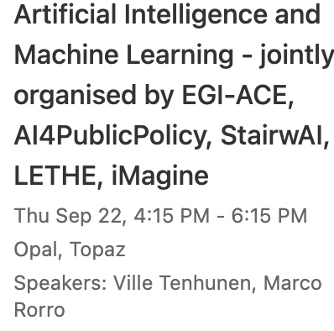
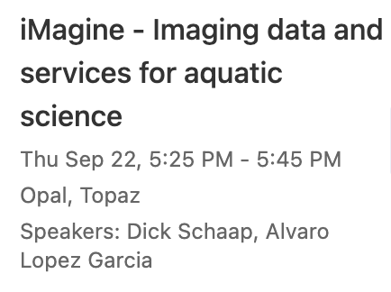
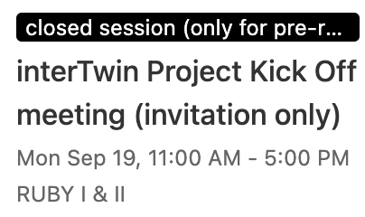
SO3 Data analytics and scientific tools including AI
Progress update: Highlights
Development of the EGI Community Service portfolio
Onboarding of existing application-level services and tools
AI/ML for image analysis in aquatic sciences
Digital Twin Engine (DTE) for complex application specific Digital Twins
Tools to manage AI workflows and the model lifecycle while reinforcing open science practices

Slide 20
SO4 Professional support and consultancy
Users receive professional consultancy and technical support for their complex digital needs
Motivations
For users: complexity of computing workflows and the data models requires expert support
For EGI: strategic alignment, skills development
Key results
Increase awareness of EGI expert support
Wider involvement of EGI participants in technical support
Areas of work
Increase participation of EGI Federation in user community projects
Develop a network of experts for consultancy and support
Create a sustainable model that is not dependent on projects
Improve training resources

Slide 21
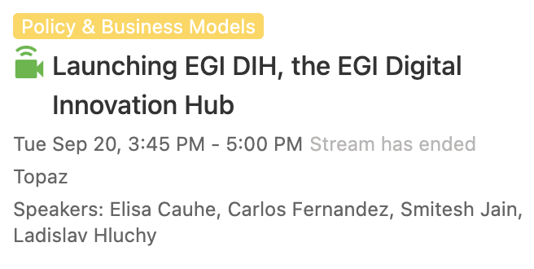
SO4 Professional support and consultancy
Progress update: Highlights
Established shepherd role with responsibilities to:
Clarify requirements with PI
Enable capacity allocation
Maintain CRM entry
Monitor progress
Write case study with PI
…
(see Sheperd Handbook)
Launched the EGI DIH to support companies in the adoption/ test/ validation of advanced computing technologies to become more competitive

Slide 22
SO5 Investigation of a trusted compute platform for sensitive data processing
Investigate the cross-border demand for sensitive data processing services, existing solutions, EGI federation data centre capabilities
Motivations
For users: growing need for secure processing of sensitive data vs access to shared infrastructures
For EGI: strategic alignment
Key results
Awareness of cross-border sensitive data management reqs
Awareness of distributed sensitive data management solutions and capabilities of EGI data centres
Areas of work
Scouting of production ready solutions for cross-border sensitive data processing
Exploration of approaches such as secure VMs for data transfer
Collaborations with support activities to the health and social science communities

Slide 23
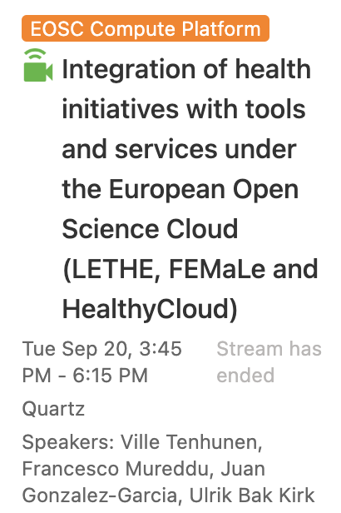
SO5 Investigation of a trusted compute platform for sensitive data processing
Progress update: Highlights
Main goal: define a Strategic Agenda for the European Health Research and Innovation Cloud
EGI contributed to a landscape of European computational infrastructures for a health data space
Architecture for the health data management and processing has created with project partners
Trusted platform for the project applications and workflows based on the EGI services (e.g. Check-In, Cloud Compute, DataHub)

Slide 24
Summary
EGI Service Portfolios
Many innovations in the existing service portfolios
Adding the “Community” layer
Major shifts
5 top-objectives identified in the 3-year service strategy
Implementation supported by current and future projects

Slide 25
Thank you

