Slide 1
Asia Regional Collaborations on
Disaster Mitigation & Agriculture
Eric Yen
1Academia Sinica Grid Computing Centre (ASGC), Taiwan
On behalf of this collaboration
EGI Conference 2022
22 September 2022

Slide 2
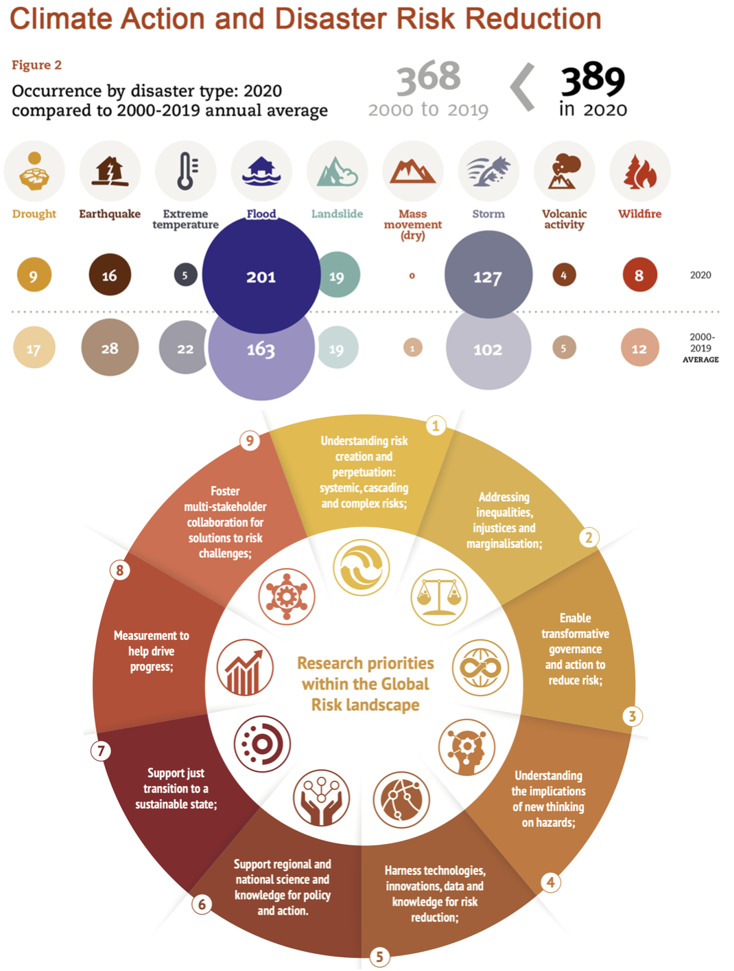
Disaster Risks Reduction Is Crucial to
Sustainability of the Humanity and Earth
“The number of weather, climate and water extremes are increasing and will become more frequent and severe in many parts of the world as a result of climate change”
Strategy is to reduce the impact by turning down any of the key parameters
Disaster risk = Hazard x Exposure x Vulnerability
Targeting on this pivotal common concerns of almost every Asia countries, the collaboration aims to develop the capacity of hazard risk analysis by high-performance accurate numerical simulations, based on deeper understanding to the physical mechanisms behind
This collaboration serves as a Data Space of EGI-ACE (unfunded)
Disaster Mitigation Competence Centre was supported since EGI-Engage in 2015 (unfunded)
This regional collaboration was initiated from EUAsiaGrid project in 2008
Source: UNDRR, https://www.undrr.org/climate-action-and-disaster-risk-reduction
Source: ISC-UNDRR-IRDR. 2021. A Framework for Global Science in support of Risk Informed Sustainable Development and Planetary Health [eds Handmer et al]

Slide 3
Introduction
Objectives: by sharing case studies, supported with regional e-Infrastructure
Capacity development of hazard risk analysis
Engagement of local user communities
Facilitate regional collaborations and Resource sharing
Expected Outcomes
Reproducible case studies and open access data and services
Catalog of shared resource (data, experts, institutes, knowledge, etc.), applications and services
Training and promotion activities: Training, workshop, master class, etc.
Collaboration Framework: APAN, ISGC, ASEAN and project-based events
Partners meet up at these events, at least 3 times a year
DMCC/EGI-ACE, DMWG/APAN, and other regional collaborations/projects

Slide 4
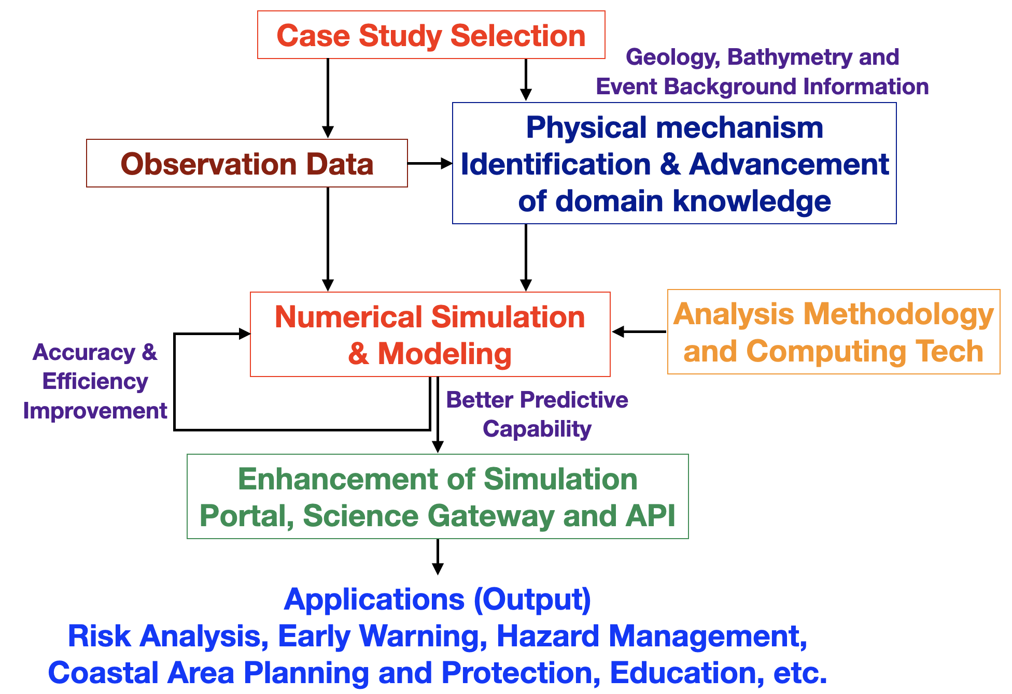
Building Hazard Risk Analysis Capacity by Deeper Understanding Approach
Deeper understanding approach: Quantify risks and Reduce risk factors (Vulnerability x Exposure x Hazards) by evolved knowledge of physical processes behind the disaster events, as well as by improved numerical simulations
Improving accuracy and efficiency of numerical simulations according to the knowledge of root cause and drivers of target hazards, as well as ITs
Deeper quantitative understandings such as possible weather and disaster patterns are crucial to develop strategies against natural hazards

Slide 5
Case Study by Deeper Understanding Approach
Realize Best Practices for Capacity Building
18 case studies of 6 types of hazards in 8 partner country had been Conducted during 2015 - 2020
Tsunami, Typhoon & Storm surge, Dust transportation of biomass burning, Flood, Fire/Haze/Smoke monitoring, Lightning
Values of Case Study commented by Prof. JN Liew (UKM, MY)
Case studies are important in meteorology
as integral component to improve weather forecast
Reveal processes that were not understood previously
Assist in future field programs and numerical experiments design
Contribute to meta-analysis
Deeper understanding approach:
Translate evolving scientific advancement into accurate numerical simulations
Understand the trends of changes of hazard impacts
Develop risk analysis and mitigation capability
Buildup flexible/dynamic collaboration models of all parties
Improve the infrastructure to support all these actives and required resources federatedly
More case studies of various types of hazards in different countries and more new partners as well as more engaged local user communities are happening
More data/analysis methods/simulation engine/knowledge resulted from case studies will be shared

Slide 6
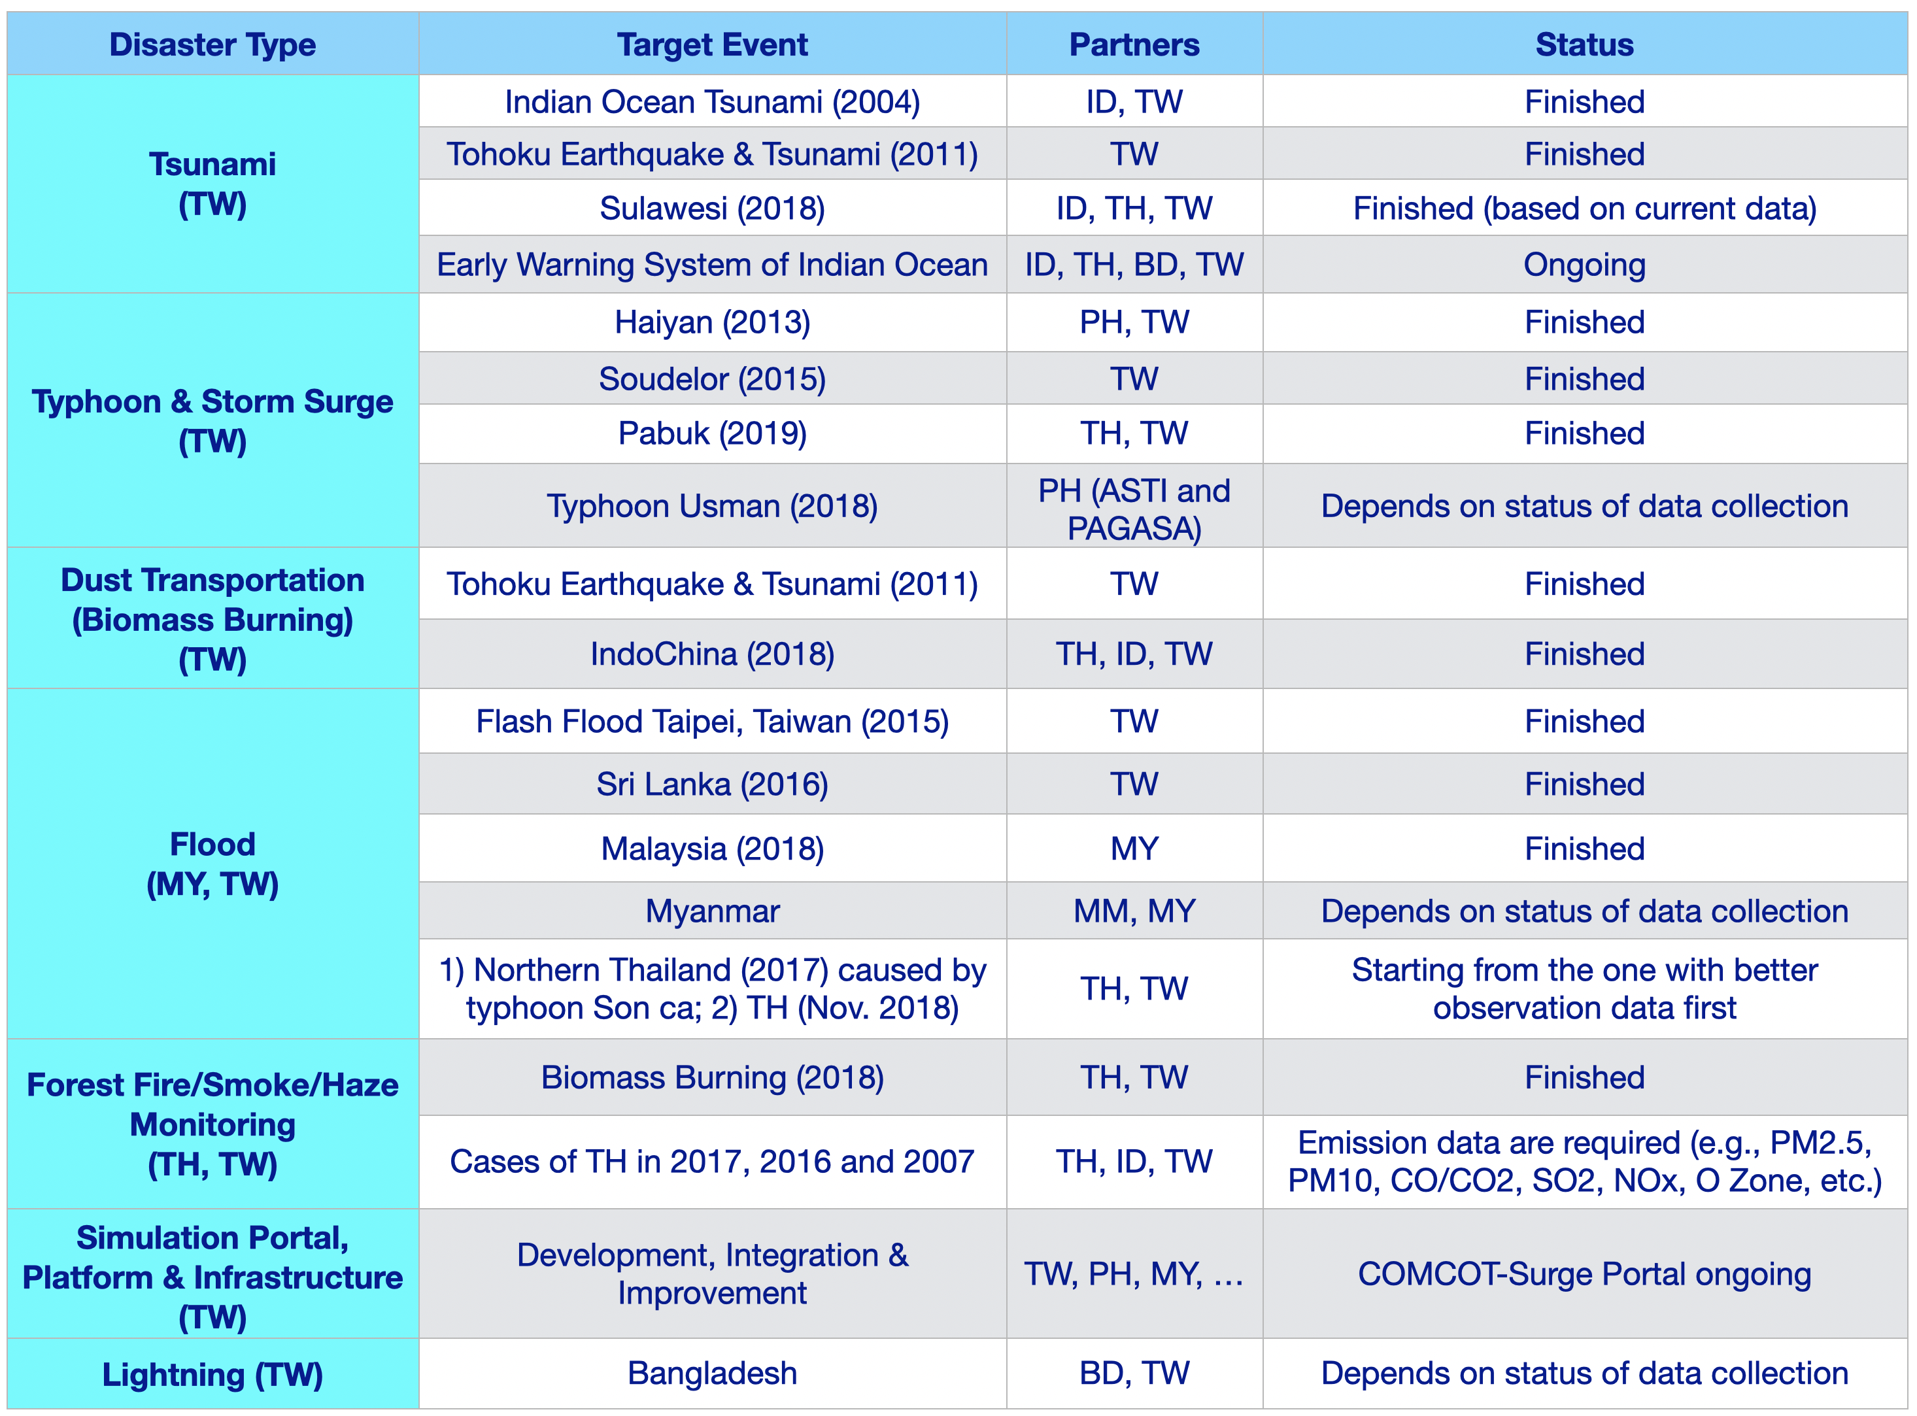
Case Study is a core component of Deeper Understanding Approach

Slide 7
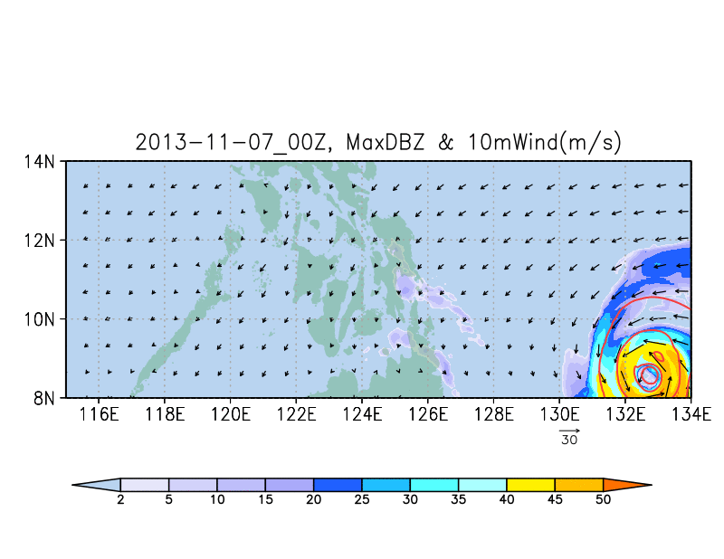
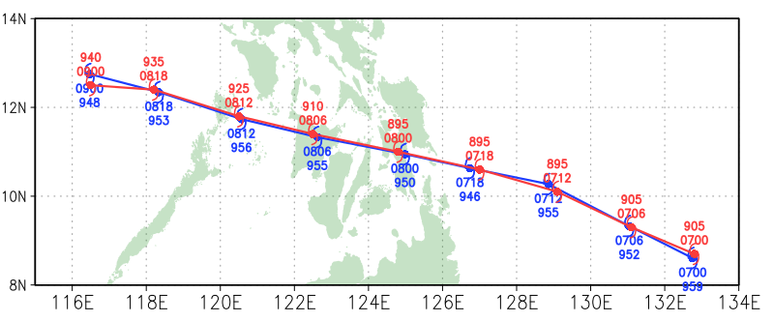
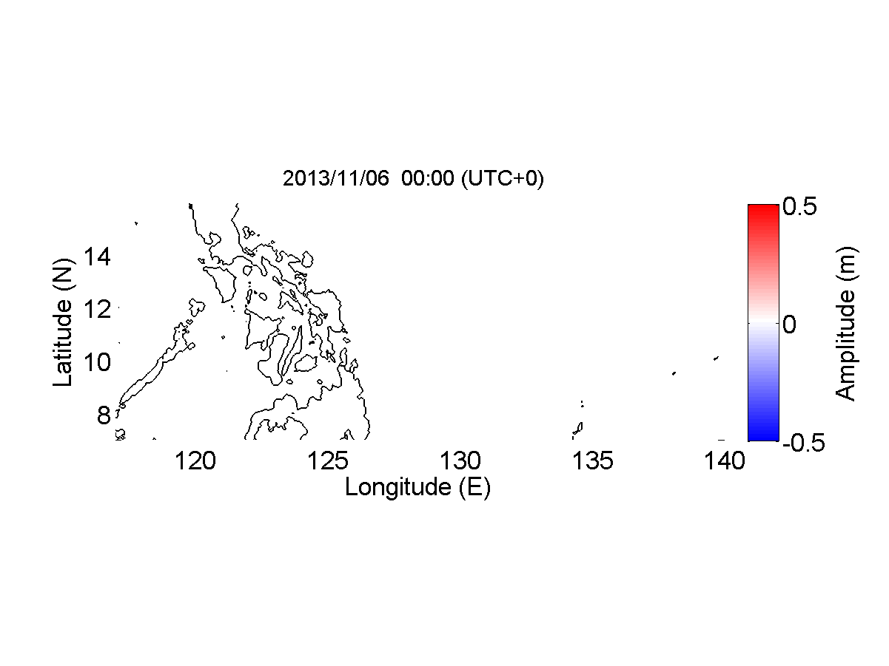
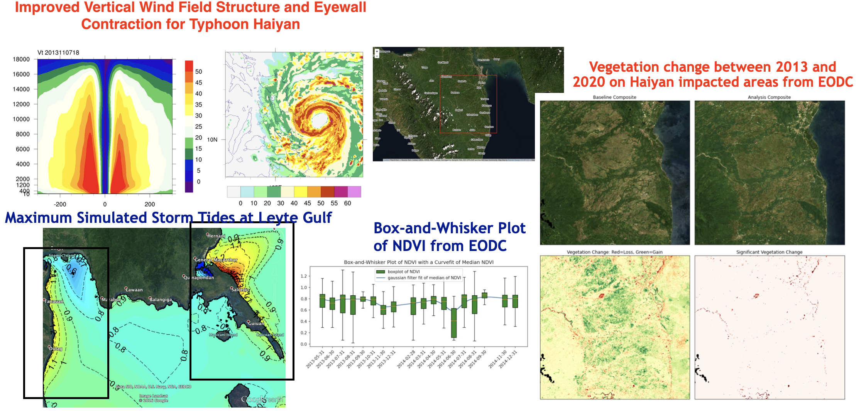
2013 Super Typhoon Haiyan (Yolanda)
Typhoon Life Cycle: November 3rd – 11th
Simulation of impacts from Storm surge caused by super typhoon by combining atmospheric model and oceanic model

Slide 8
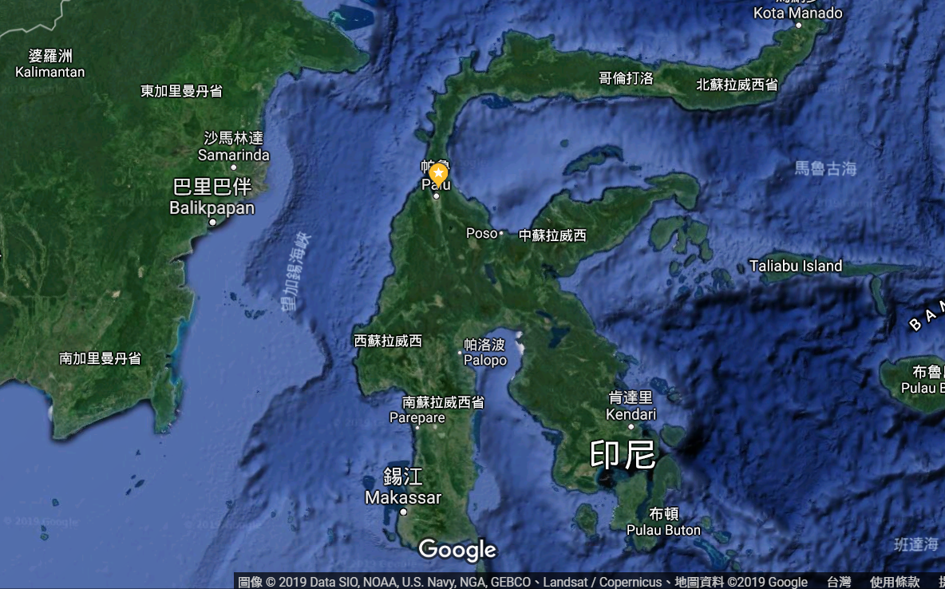
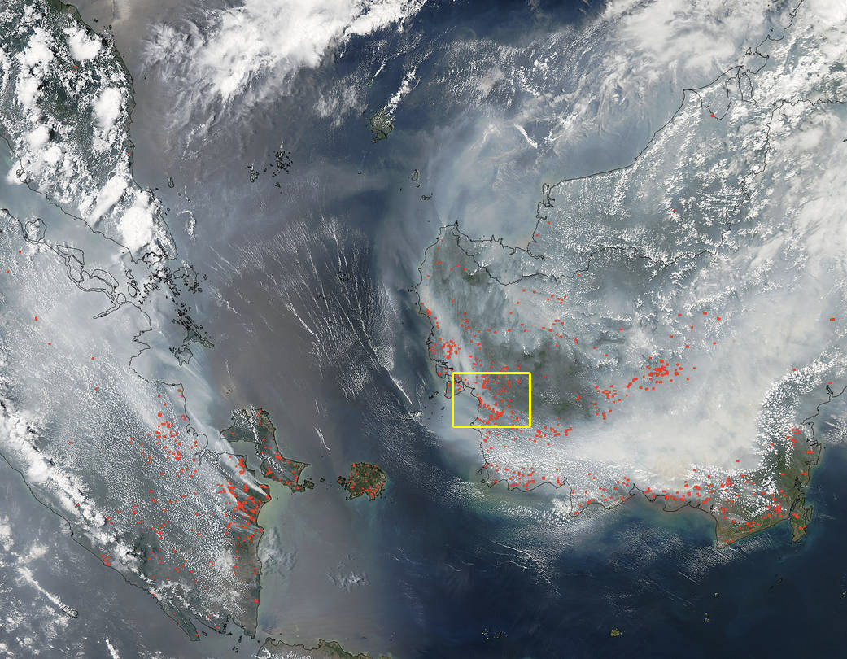
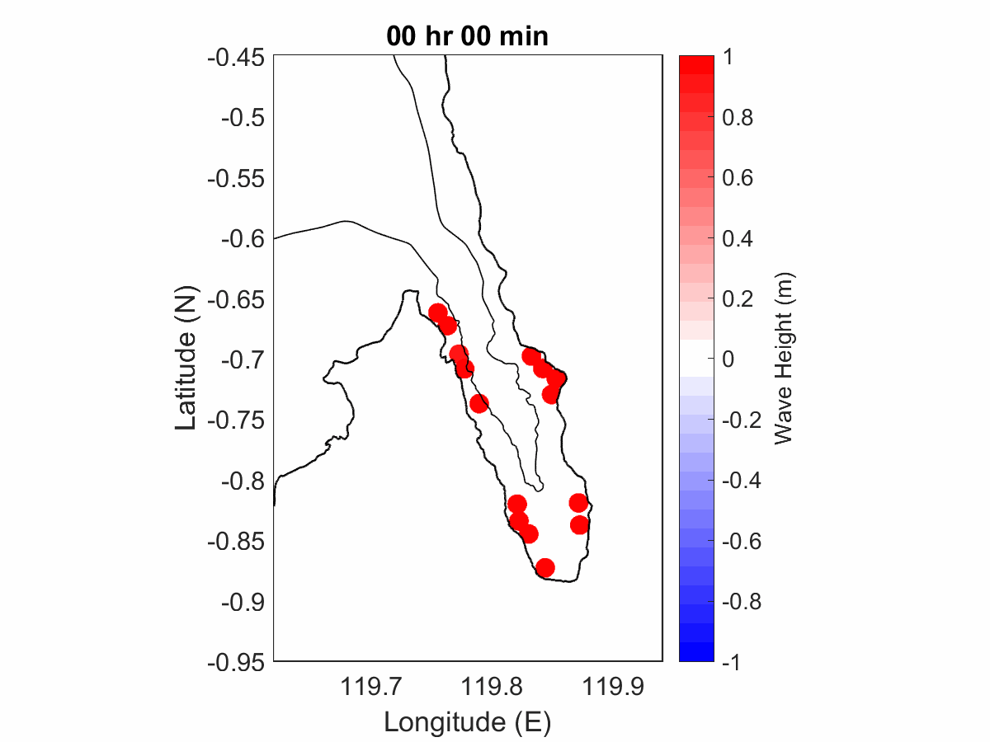
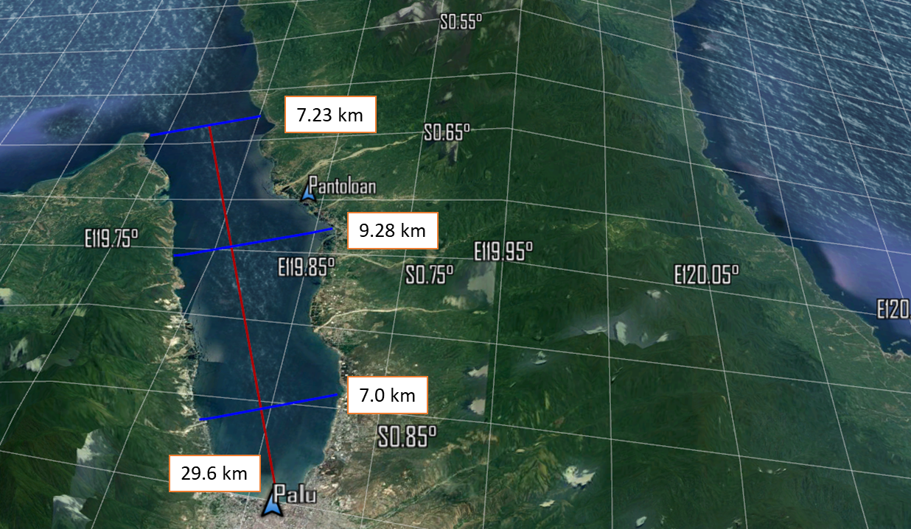
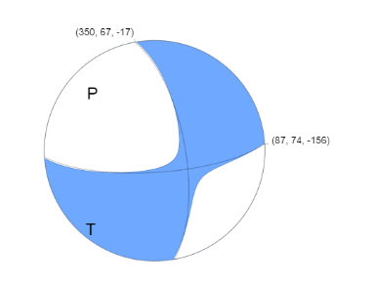
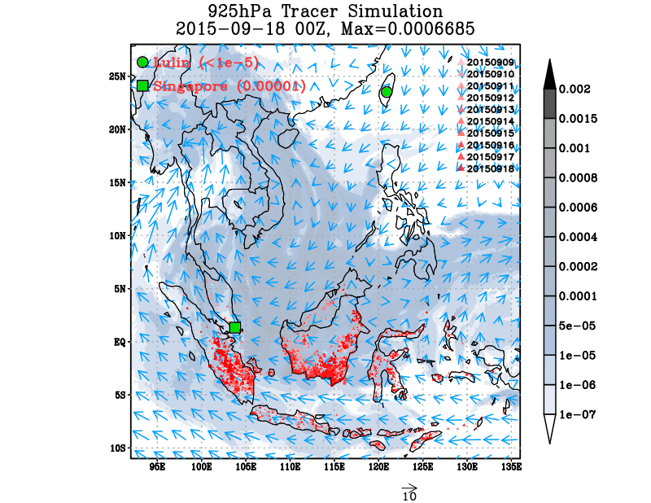
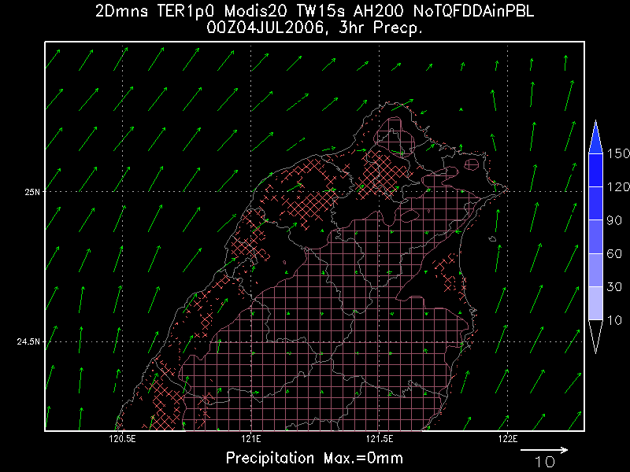
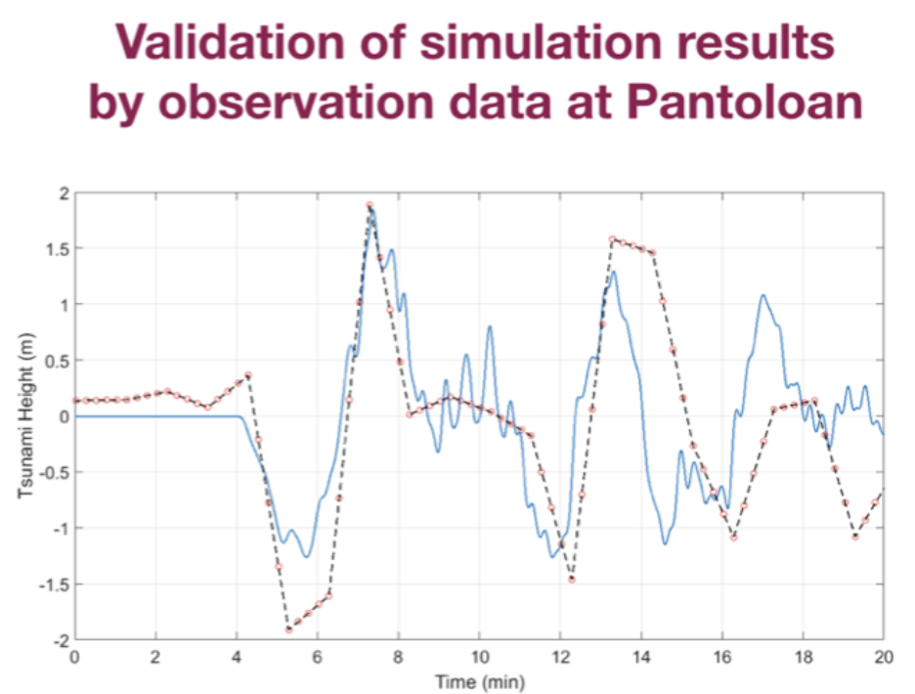
Ground movement: A Strike-Slip Fault “Tracking surface features in satellite imagery, we see up to 7 metres of displacement in opposite directions across the sharp fault surface break,”
South East Asia haze 2015
2018 Sulawesi earthquake and tsunami M 7.5 - 78km N of Palu, Indonesia
2018/09/28 UTC10:03
NASA's Aqua satellite collected this natural-color image with the Moderate Resolution Imaging Spectroradiometer, MODIS, instrument on September 22, 2015.
Simulation of summer thunderstorm
Composited atmospheric conditions (78 cases)
Resolution: 10 km

Slide 9
iCOMCOT Tsunami Wave Propagation Simulation portals
Core tool of the tsunami early warning system in Taiwan
Based on COrnell Multi-grid COupled of Tsunami Model
Tsunami Propagation and Maximum Wave Height with Associated Arrival Time are provided
9 parameters of Epicenter location, Depth, Fault Size and Direction are needed input
Usages
O(100) users from 10+ countries, mostly in Asia
O(1000) simulation jobs supported from 2017
https://icomcot.twgrid.org

Slide 10
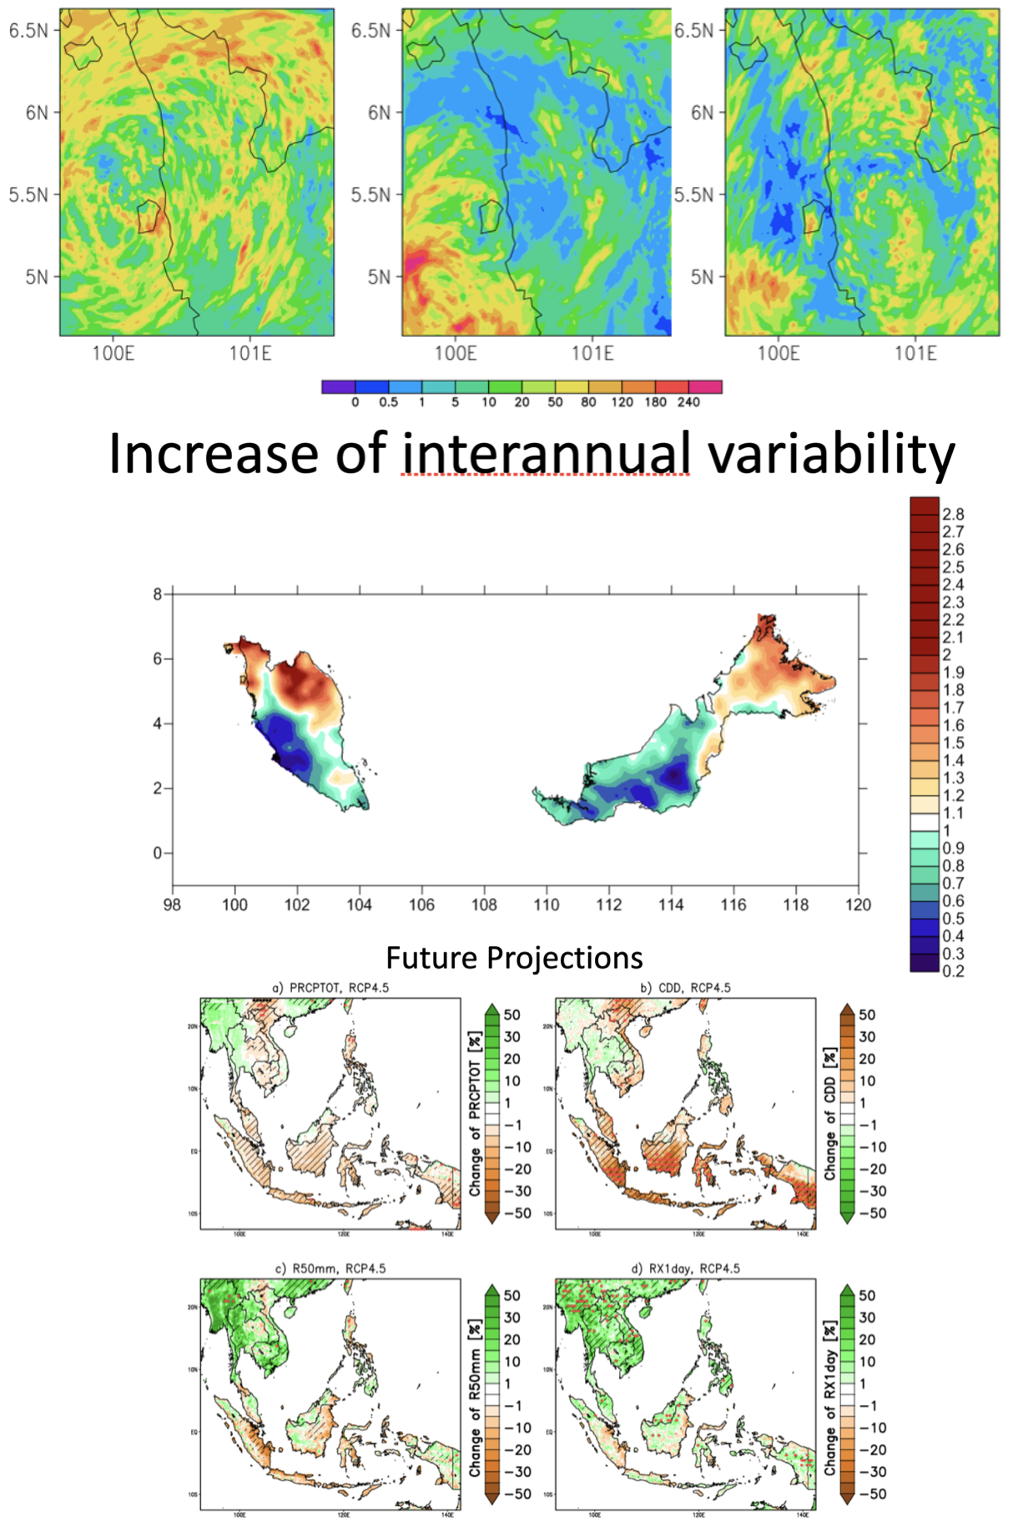
Summary on Flood Case (4-5 Nov. 2017) in Malaysia
Conducted by Prof. JN Liew, UKM, MY
More test cases are needed to understand various extreme rainfall producing mechanism at different part of Malaysia
Northern part of Peninsular Malaysia and Sabah has experienced increase in interannual variability. In certain area, the interannual variability has doubled.
Accurate forecast of different time-scales is expected to become more crucial for disaster mitigation purpose.
Questions of interest which require further analysis:
How is the quality of the simulations affected by model resolutions and moisture schemes?
How is the local topography influence the rainfall intensity?
Where does the system obtain its moisture from?
How does the Typhoon Damrey affected the events?

Slide 11
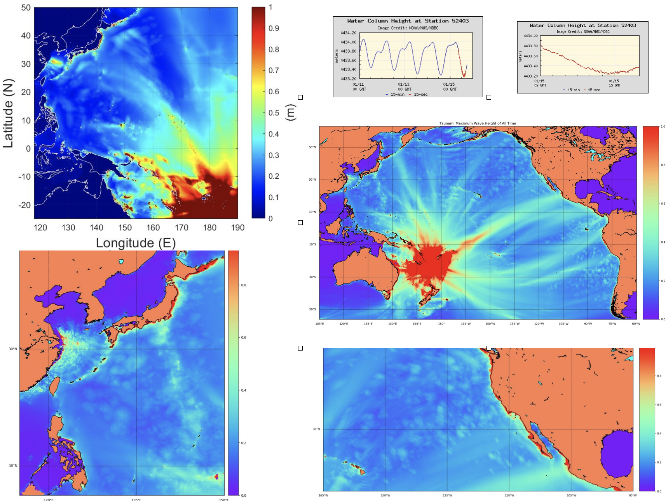
2022 Hunga Tonga Volcano Eruption and Tsunami
Tsunami triggered by volcano eruption on 15 Jan. 2022. Shockwave from the eruption caused abnormal high waves along the coast of Peru and Japan.
Details, as a case study, was introduced by Prof. TR Wu at ISGC2022

Slide 12
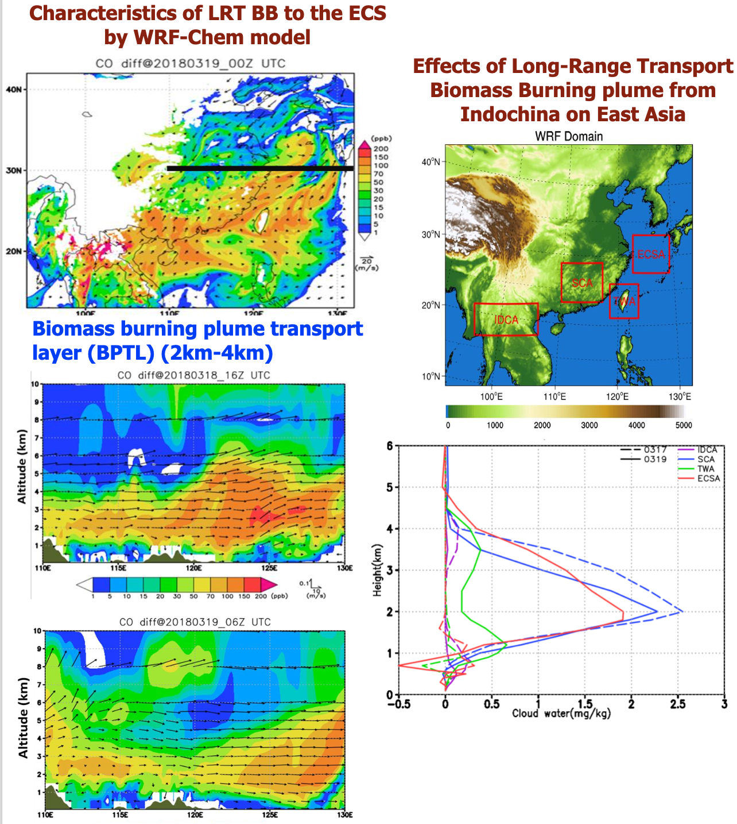
Effects of biomass burning transport from Indochina during EMeRGe-Asia identified by WRF-Chem
The Indochina biomass burning season in springtime has a substantial environmental impact on the surrounding areas in Asia. This study evaluated the environmental impact of a major long-range BB transport event on 19 March 2018
Contribution of long-range transported biomass burning plume was 30–80 %, or even higher, for many of the trace constituents (NO_{y}, NO_{x}, CO, OH, O₃, BC and PM_{2.5}) in the altitude range between 2000 and 4000 m for SC, Taiwan, and the ECS.
BB aerosols were identified as a potential source of cloud condensation nuclei, and the simulation results indicated that the transported BB plume had an effect on cloud water formation over SC and the ECS. The combination of BB aerosol enhancement with cloud water resulted in a reduction of incoming shortwave radiation at the surface in SC and the ECS which potentially has significant regional climate implications.

Slide 13
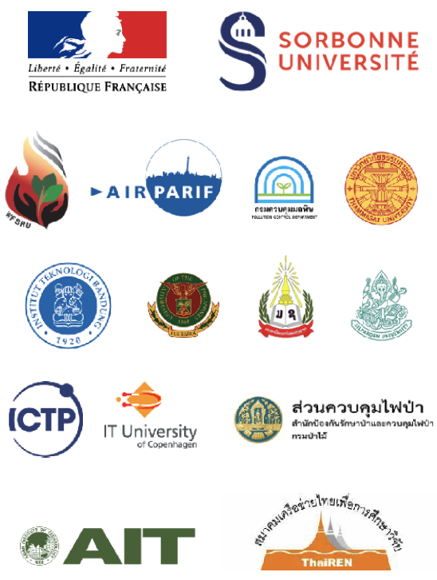
SEA-HAZEMON: Active Forest Fire and Haze Monitoring Platform
From 2016, low-cost real-time monitoring of haze air quality disasters in rural communities in TH and southeast Asia was conducted by UPMC (FR) and AIT
SEA-HAZEMON was funded by Asi@Connect from 2019 for:
Development fo real-filed air quality sensor network
Large scale deployment of low-cost IoT sensors in Thailand and SEA region
Post and Real-Time Data Analysis for environment research
Capacity building through intensive hands-on training IoT and Data analytics
SEA-HAZEMON keeps going with improved models, sensors, communications and collaborations

Slide 14
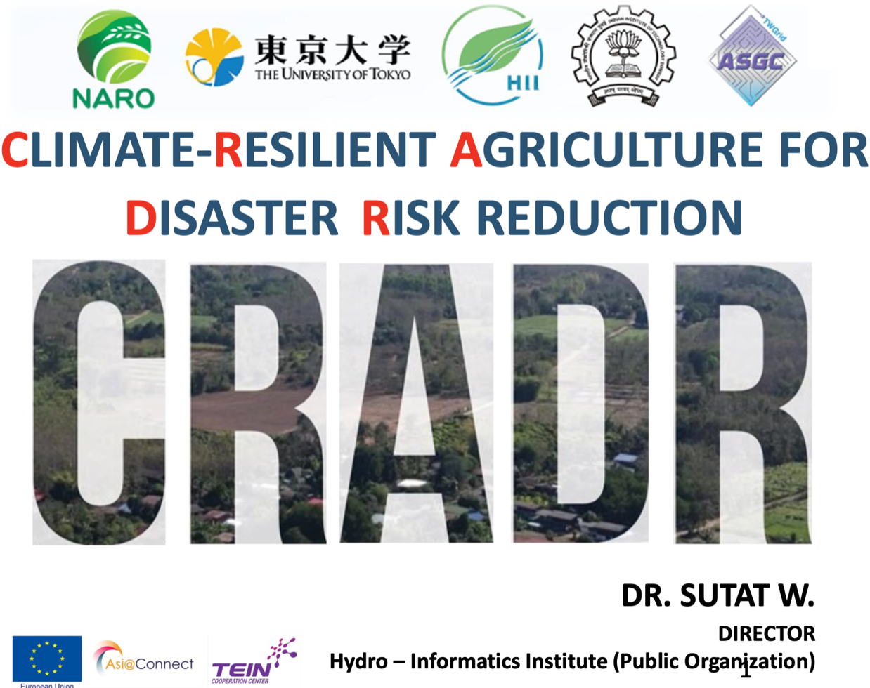
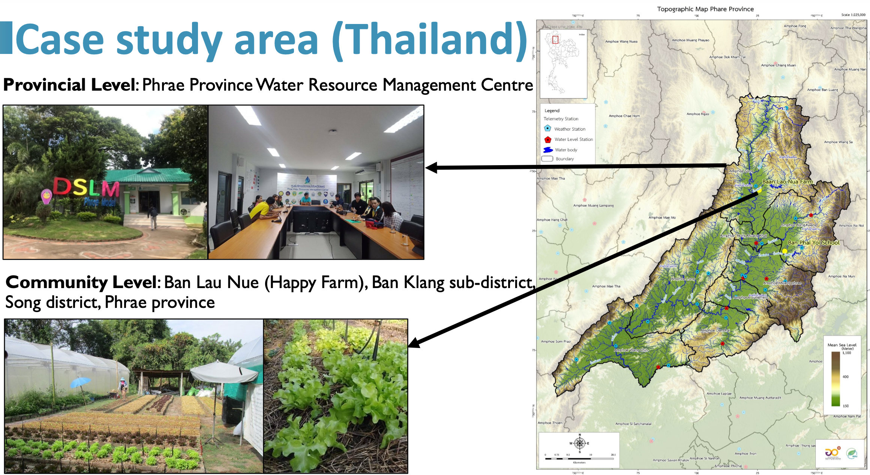
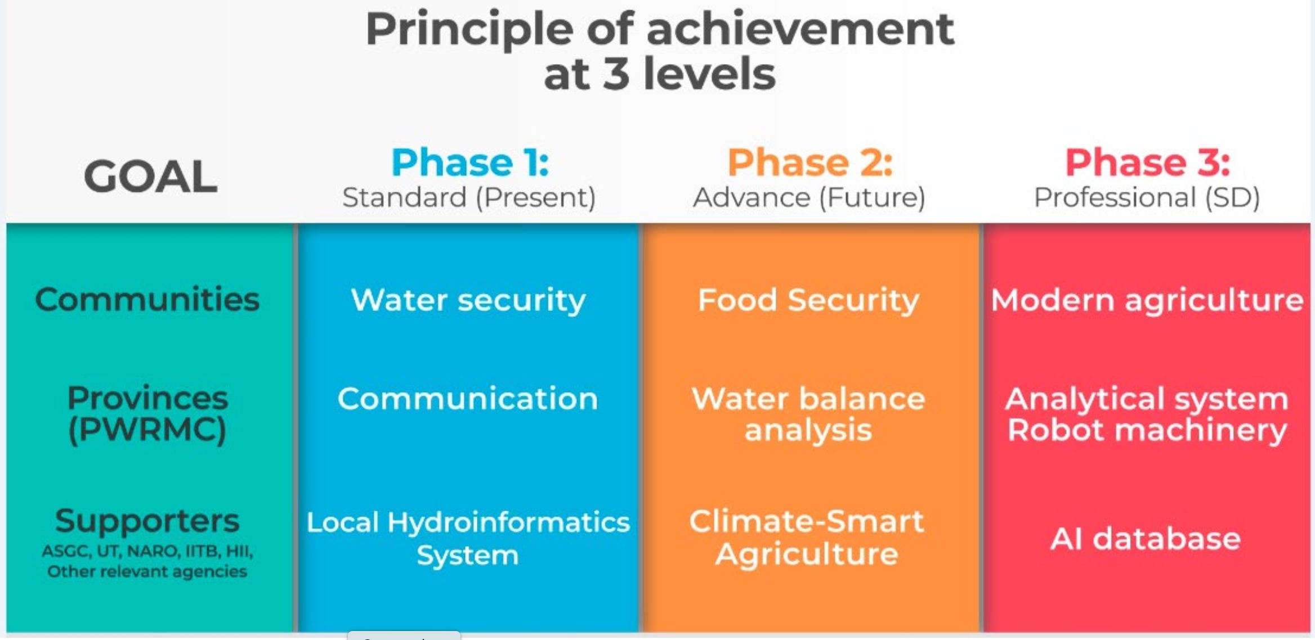
Conclusion
Heading towards smart agriculture is a consensus
Systematic data management and common information platform is core to the supporting infrastructure – an existing infrastructure is the key for successful Provincial Water Resource Management
Capacity building for climate-resilient agriculture is instrumental to all Asia partners and shouldbe supported at all levels (individual, organization, and society) by any means
Case study is a valuable approach for capacity building for technical application and direct experience from the field
Open data principles and open science mechanism is a necessary roadmap
Project duration: 6 months (Dec 2020 - May 2021)
1x Online Training and 3 Workshops: 190 participants from 12 countries
Outcomes
Online Training of how to access and utilize District Real-time Information
Evaluation of Meteorological Parameters Impact on Agricultural Production for Climate-resilience Agriculture (Fact finding)
Evaluation of Science, Technology, and Innovation for Climate-Smart Agriculture at the Case Study Area

Slide 15
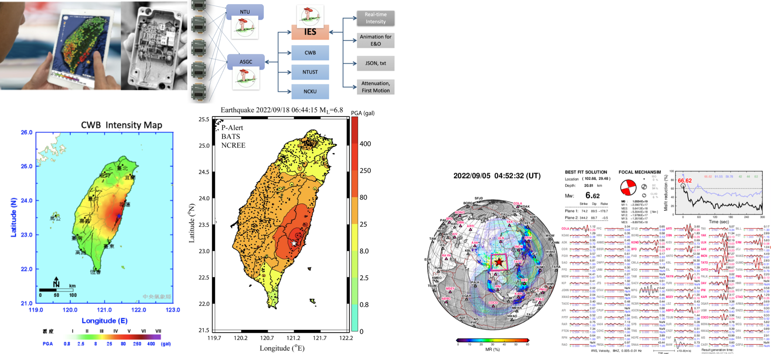
Earthquake Applications
P-Alert onsite warning system: Strong Motion Network
P wave brings information and S wave brings energy —> gaining warning time in the blind zone
700+ sites installed mostly in elementary schools
Applications
Real-time observed shakeup
PGA attenuation relationship
Scientific and educational applications
https://palert.earth.sinica.edu.tw
Global Real-Time Moment Tensor Monitoring System (GRMT)
Updated in every 2 seconds
Best fit solution in real-time
provides all the point source information automatically in real time, including event occurrence time, hypocentral location, moment magnitude, moment tensor and focal mechanism simultaneously once the earthquake is detected.
Performance improved by DB search and HPC
Helpful for fast assessment and response to seismic hazards
Combining RMT with a real-time online earthquake simulation (ROS) system, the real-time earthquake simulation has been feasible.
http://grmt.earth.sinica.edu.tw

Slide 16
Real-time Online Earthquake Simulation System (ROS)
Generating the shake movie and shake map of an seismic event according to user-provided source parameters, in < 5 min
High-performance spectral-element method (SPECFEM3D) based simulation
Applications: education, real-time ground motion prediction
http://ros.earth.sinica.edu.tw/

Slide 17
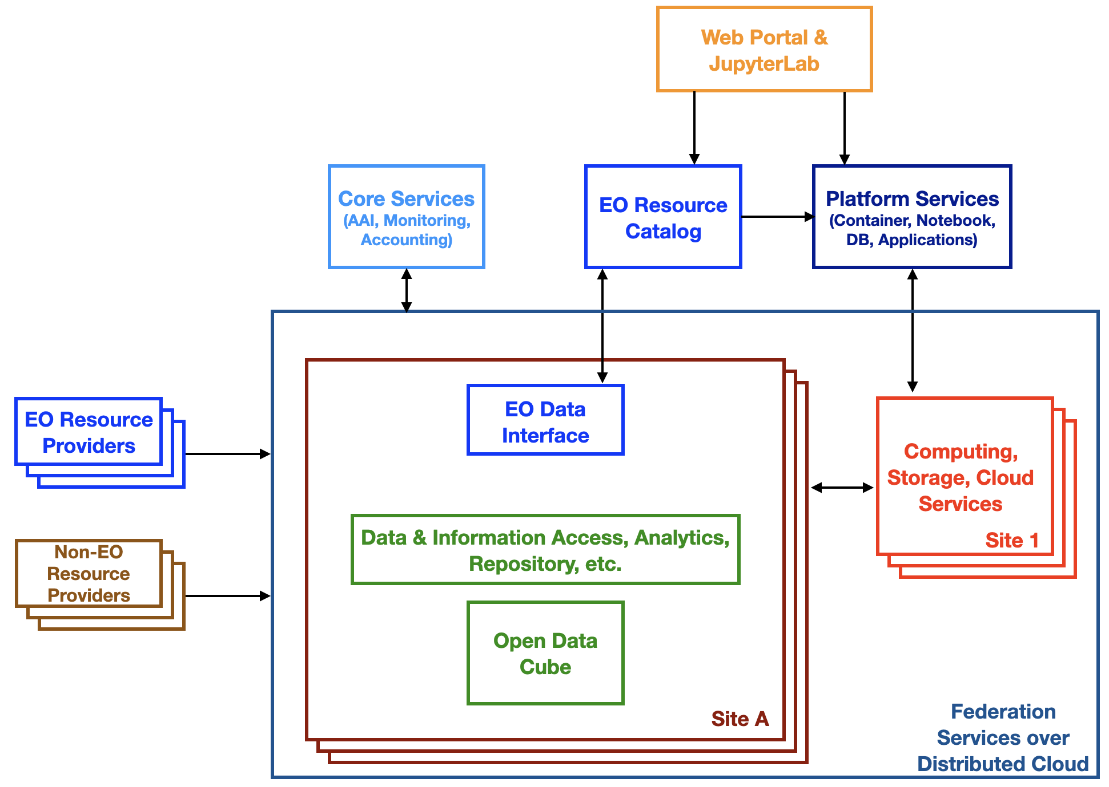
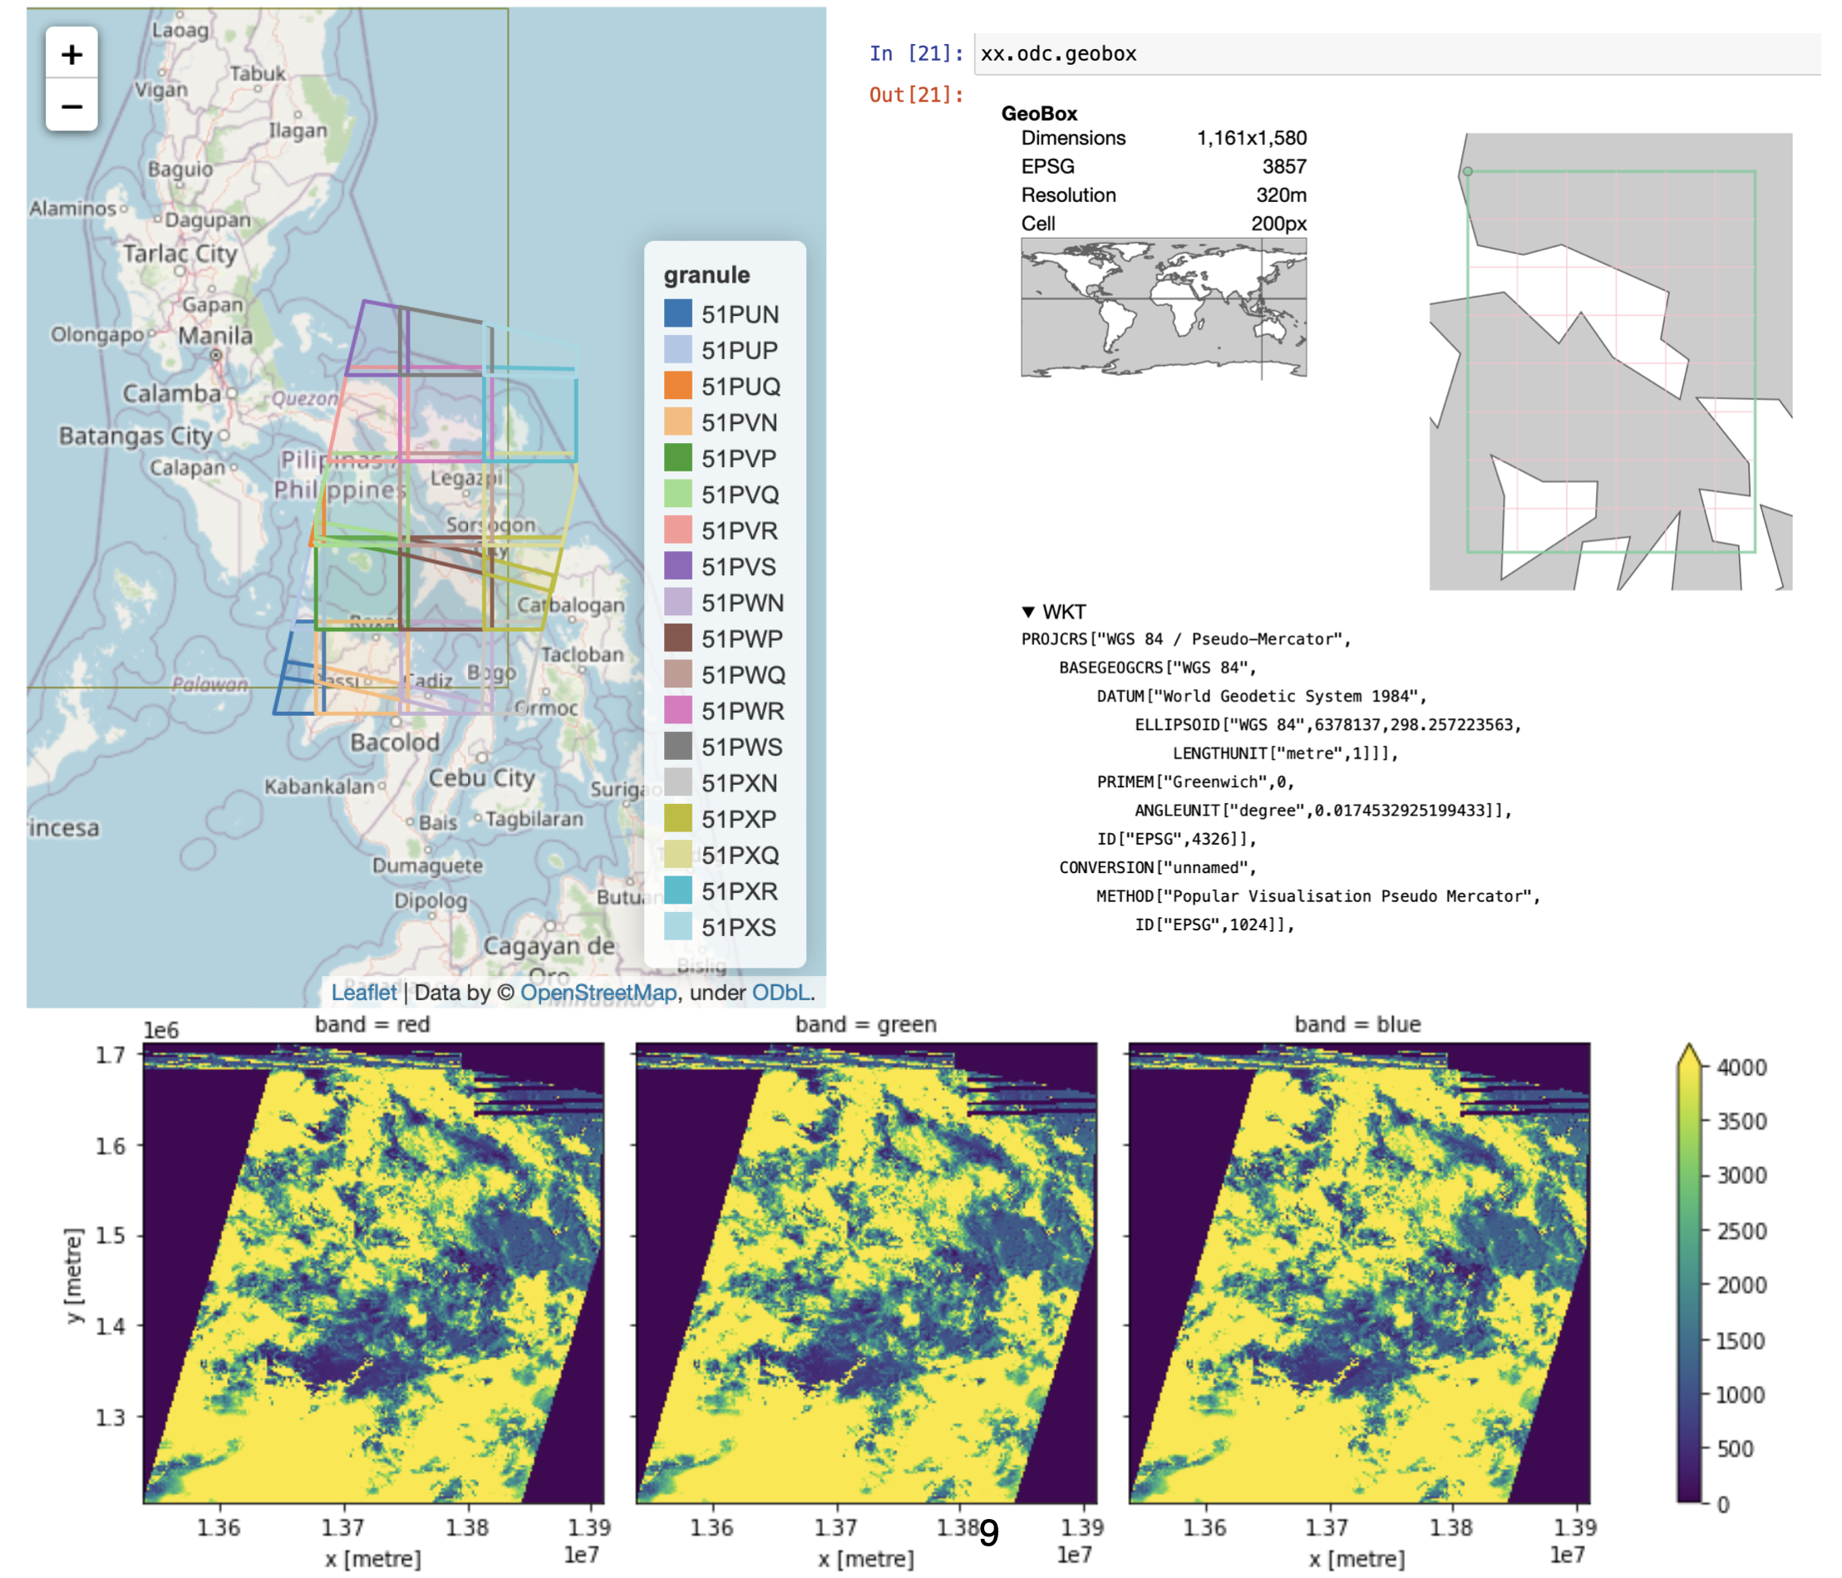
EODC-enabled Spatiotemporal Information Infrastructure
Support gaining insights from big data of heterogeneous resources effectively and leverage the values of big EO data
Coverage of whole workflow according to applications - including data collection, access, management, simulation, analysis
Merging insights from ML-enabled BDA and domain knowledge
Earth Observation Data Cube (EODC) serves as an open integration platform of heterogeneous data sources by coordinates, time and themes.

Slide 18
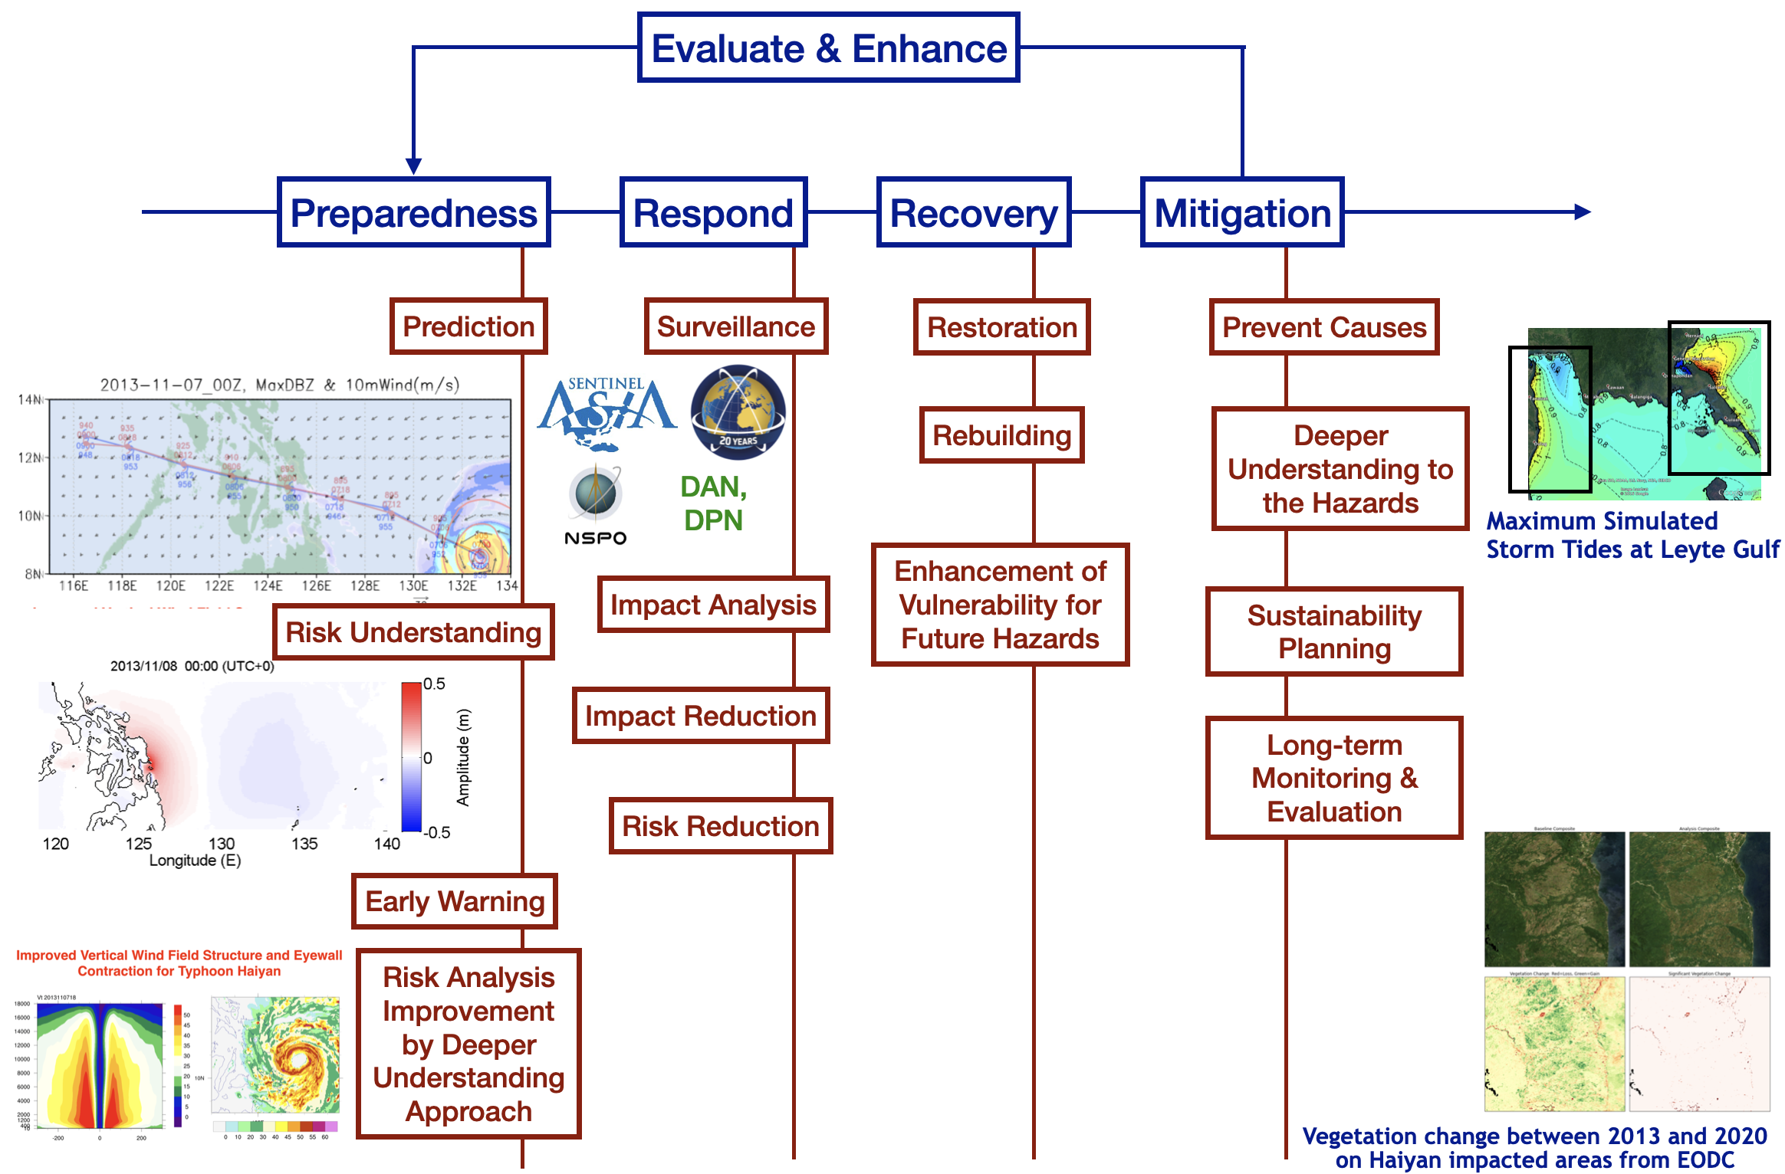
Supporting Disaster Management Workflow in collaboration with Sentinel Asia, DMCC and NSPO

Slide 19
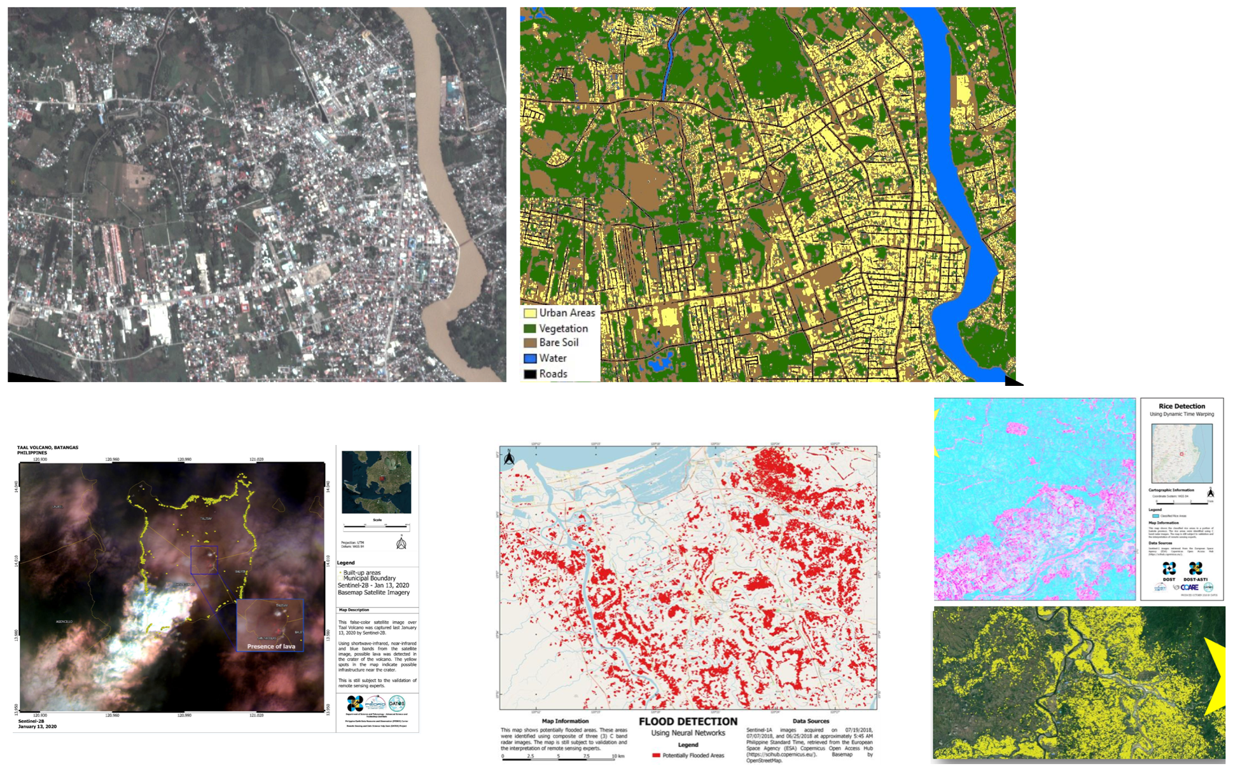
DATOS (The Remote Sensing and Data Science) Project of PH (ASTI)
Making sense of disaster data
Patched land cover prediction from individual planet land class AIs
Mapping, change detection and prediction of specific type of crops (rice, sugarcane, corn, etc.)
Taal Volcano Eruption Monitoring and Risk Analysis
Disaster mapping and damage detection

Slide 20
Research Data Management - Depositar
Deposit, Discover and Reuse - An extensible and programmable research data repository (based on CKAN)
Features: file preview (CSV, WMTS, Shapefile, ...), Wikidata as control vocabularies, Archival Resource Keys (ARKs) for PIDs, data catalogs in DCAT, etc.
Sample datasets:
ark:37281/k5d515442 (Coral Reef Soundscapes off Sesoko Island, Okinawa, Japan)
ark:37281/k507h112r (Cultural Landscapes in Emerging Digital Scholarship)
https://data.depositar.io

Slide 21
Collaboration Framework
Regional collaboration platform: APAN, ASEAN and ISGC
More new partners as well as more engaged local user communities involved in new case studies as well as services support etc. are happening
Coordinators of Disaster Mitigation Working Groups, Agriculture WG and Open & Data Sharing WG in APAN, and related initiatives in ASEAN are also co-leaders of this collaborations
Collaborations with EGI and WLCG are the primary drivers of e-Science and e-Infrastructure in Asia —> community-based solution —> infrastructure and scientific services
Activities
Joint workshop on disaster mitigation (together with Environmental Computing leading by LRZ-DE) @ISGC (2018 - 2022)
Disaster Mitigation Working Group meetings @APAN (twice a year, 2018 - )
3 masterclass conducted @ID, SG and NZ (2016 - 2018)
UND project meeting and training @NZ, MM, BD, MY, TH (2018 - 2020)
CRADR Workshop - 3 events in 2021
Agriculture Working Meeting @APAN (2018 - )
Open & Sharing Data Working Group Meeting @APAN (2020 - )
Future events: APAN55 (Nepal, Feb. 2023), ISGC2023 (Taiwan, 19-24 March 2023)
Notes:
In terms of the model of collaborations

Slide 22
ISGC 2023
Accelerating time-to-science through computing
20th anniversary of ISGC
International Symposium on Grids and Clouds (ISGC) 2023
19~24 March 2023, Academia Sinica, Taipei, Taiwan
Call for Abstract
On-line Submission: https://indico4.twgrid.org/event/25/abstracts/
Submission Deadline: Monday, 31 October 2022
Acceptance Notification: Friday, 16 December 2022
Notes:
Your participation is the best support to this collaboration.

Slide 23
Moving Towards open Science
In collaboration with Open and Sharing Data WG
Open Data Common document (white paper) is at open comment stage now (until when ? Should be finalized by/in APAN55 ?)
Partnership with European Open Science Cloud (through collaborations with EGI and EGI-ACE)
Approaches: basic level of sharing (v1 is planned to be released after APAN55), case-based open access and reproducibility
Generic data management plan for each case study has to be in place
All publication-related data are openly available at time of publication
For outreach and education, simplified data sets are available
Release full data sets and analysis tools of a case study with the level of detail useful for algorithm, performance and scientific studies
Support reproduction, reuse, repurpose of all materials from case studies
Based on FAIR (Findability, Accessibility, Interoperability, and Reusability) principles
Implemented over EOSC interoperable cloud infrastructure - regional infrastructure federated by ASGC and partners, leveraging EGI services.
Science Gateway: Support reproducibility/reusability/repurposing by integrating data analysis pipeline and e-Infrastructure
Web portal based
Community-wide or generic resource sharing & openness
Identify requirements & challenges (gap analysis) from case studies
e-Infrastructure: distributed cloud, AAI, FAIR, data infrastructure

Slide 24
Challenges & Lessons Learned
Expected outcomes: Case studies, Services, collaboration framework
E-infrastructure and collaboration framework keep growing according to the needs of user communities as well as technology evolution
Extending case studies based on deeper understanding approach - types of hazards; local user communities; analysis methodologies
Observation data (ground truth), domain knowledge & scientists, models and simulation tools/methods are the core components
Every hazard event could contribute to the physical mechanism behind or the characteristics of earth systems.
For instance, identification of initial condition, boundary condition and right resolution for each simulation is essential for weather & climate simulation
Effective data sharing and engagement of domain scientists in general is still a barrier.
Data-centric, machine learning-enhanced approach by taking advantages of huge data from historical events should be available soon
Tools, methods, data and knowledge from each case study will be FAIR.
e-Infrastructure has to uphold all these and support services and collaborations
EGI services and interoperable infrastructure help tremendously !
Significant duplicate efforts and investments in partner institutes would be saved

Slide 25
Future Works
More case studies are happening in next few years: domain scientists + user communities + service/application providers
Scientists: Tsunami(ID, TW)), Forest fire/haze/smoke(TH), Floods(MY, VN), Storm Surge(PH, TW), Extreme weather (MY, TW), Volcano (PH), and Agriculture (JP, IN, TH, TW)
Satellite images: (Himawari, Sentinel Asia, JAXA, NSPO-TW)
Infrastructure and platform: TW, ASTI, MY, ID, TH, …
EGI-ACE/EOSC interoperable infrastructure, based on APAN - EGI collaboration framework
Moving towards open data and open science (interoperable with EGI/EOSC services, guidelines and e-Infrastrcuture)
Capacity building for dealing with more complex multi-hazard scenarios by advanced analysis possibilities
With support of accurate hazard risk assessment by numerical simulation, correlation analysis between potential threats and types of interactions between hazards as well as patterns of combination of geophysical environment and triggers would be useful for new discoveries and better predictability with ML methodologies
Topographical structure might be changed after a disaster. Related data has to be updated accordingly in time. Such changes should be all managed by the open application framework.

Slide 26
Summary
Collaboratively, we are able to achieve bigger goals - beyond the limits of resource and knowledge of each individual
Targeting on the commons is a good strategy of collaboration across boundaries
Through case study and deeper understanding approaches, capacity is growing systematically according to partners needs
Partners are able to conduct their own case studies and establish their best practices
More open resource and materials are available from increasing case studies for training, sharing, reuse and repurposing
Regional infrastructure and supporting facility are advanced
Deeper understanding approach: from data-driven, science-driven towards ML-enabled
Attaining actionable insights from big data analytics and scientific computing efficiently
APAN & ISGC - the active open collaboration platform
Foster collaborations on regional commons and capacity building, from infrastructure to sustainability development
Encourage interactions and cooperations of Working Groups
Engage user/expert/support communities from all partners around the world
Promote open and sharing resources by Open Science paradigm
Collaboration with and support of EGI is essential
Build up the interoperable infrastructure in Asia
Contribute to EOSC Data Space and Marketplace, as an instance of disaster mitigation community
Extending and promoting EGI services to Asia partners (broader user communities of Asia)
Collaboration is always OPEN !

Slide 27
Acknowledgement
Special thanks to great supports from EGI, Asi@Connect, NSPO and Academia Sinica
Grateful for the scientific groups and user communities
Also appreciate all contributions from partners - BD, ID, IN, JP, MM, MY, NZ, PH, TH, TW, VN, DE, CZ and other ASEAN countries

