Slide 1
EGI support for global science - approaches and experiences
Giuseppe La Rocca
Community Support Lead
EGI Conference 2022, Prague

Slide 2
Challenges (and Science) are global!

Slide 3
Vision
All researchers have seamless access to services, resources and expertise to collaborate and conduct world-class research and innovation
Mission of the EGI Federation
Mission of the EGI Foundation
Deliver open solutions for advanced computing and data analytics in research and innovation
Enable the EGI Federation to serve international research and innovation together

Slide 4
The were born as a global infrastructure
We provide advanced computing and data analytics for research and innovation
2010
From the high-energy physics compute grid
(WLCG)
2022
To a multi-disciplinary, multi-technology infrastructure

Slide 5
EGI’s response to Global Science

Slide 6
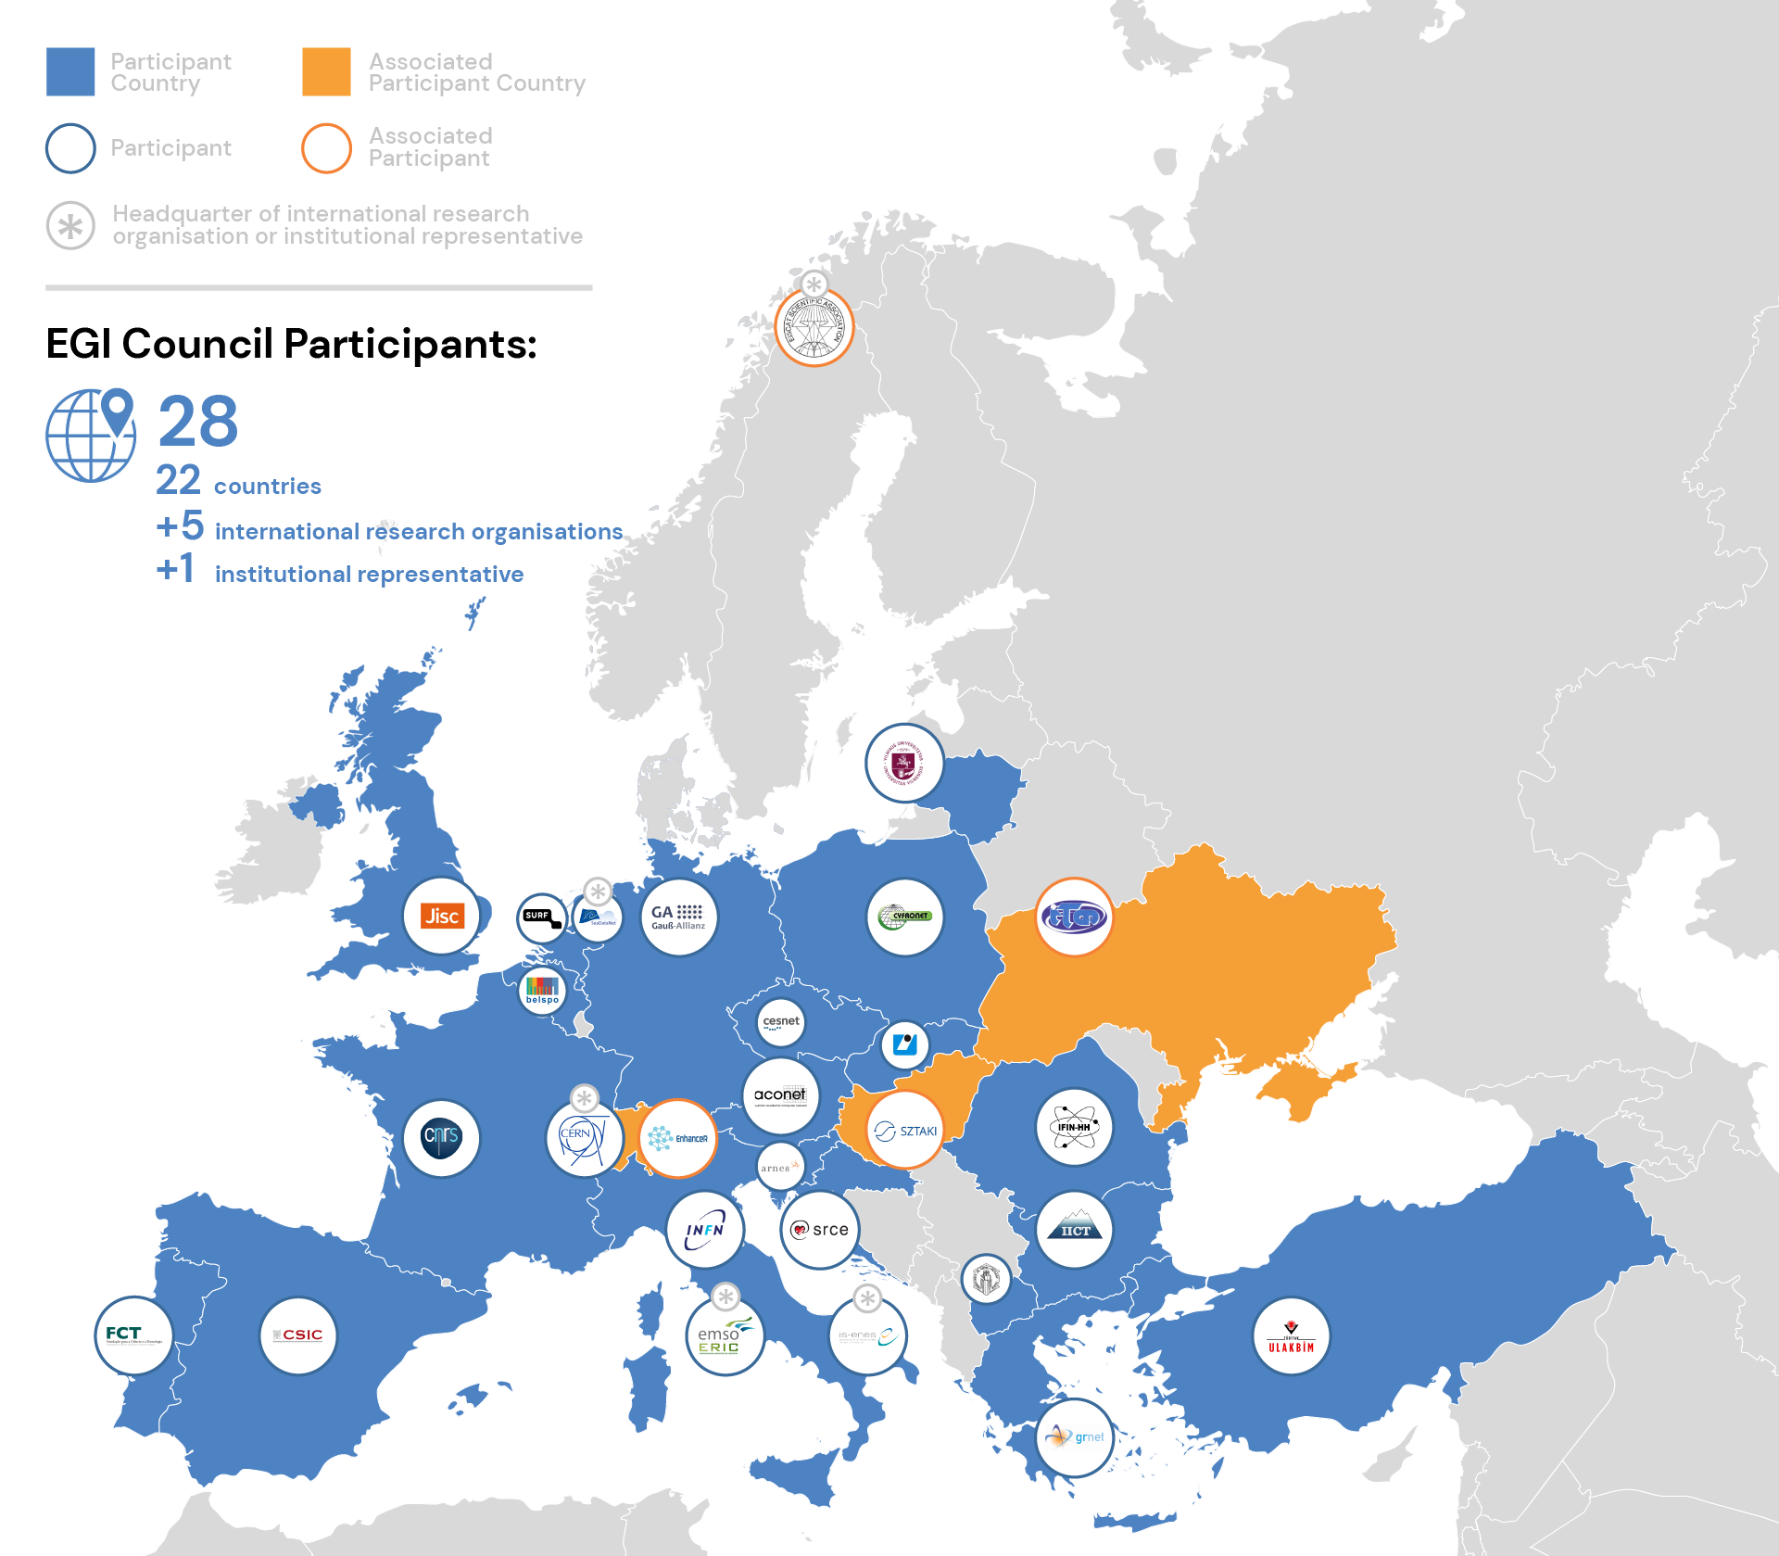
Highlights 2021 - 4 new members 2022 - 2 new members

Slide 7
1/ International Partnerships programme

Slide 8
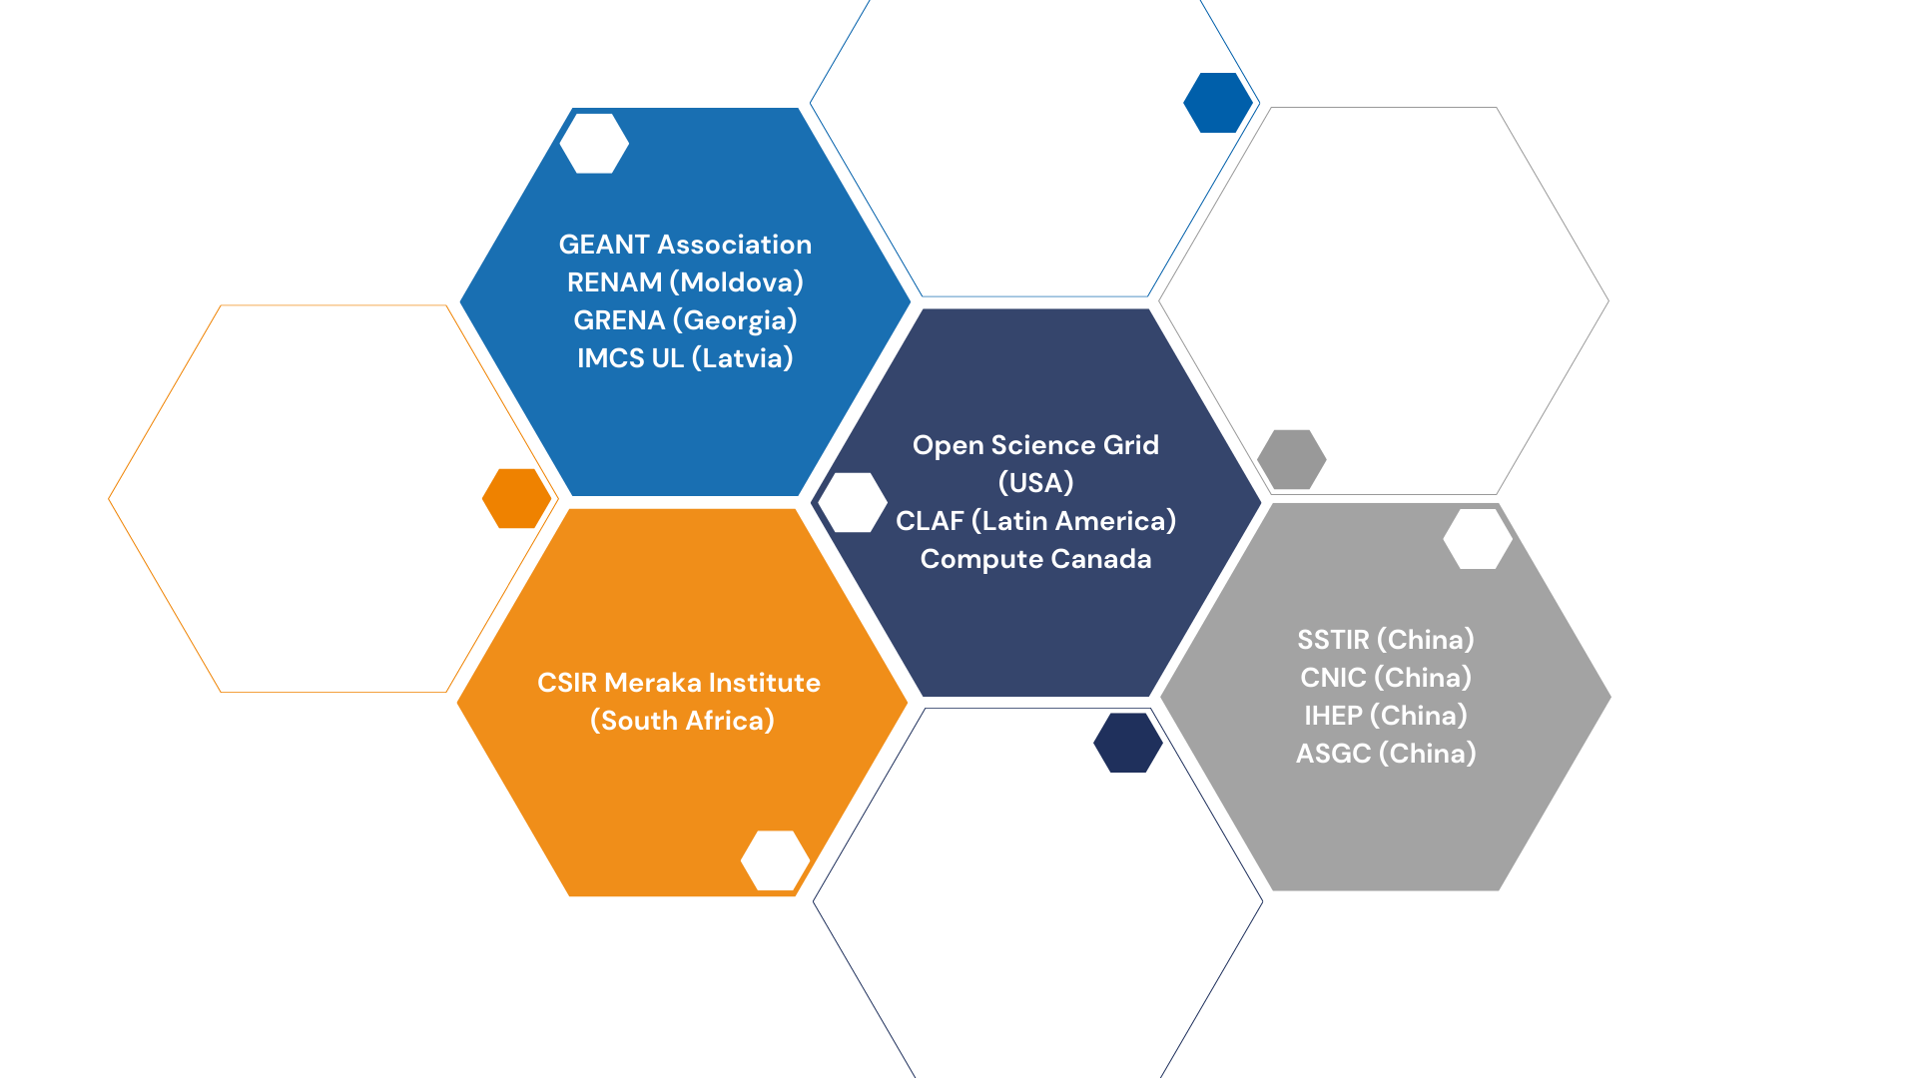
Memorandum of Understandings (MoUs)
e-Infrastructure Partnerships
With peer e-infrastructures from other regions
Global Open Science Cloud (GOSC) workshop
Thu 22/09 11:00-13:00, and 15:30-17:30

Slide 9
Memorandum of Understandings (MoUs)
Research Community Partnerships
With scientific (user) communities for long-term partnership
Business Partnerships
Companies/SMEs with business collaboration (--> Moving to DIH membership)
Technical Partnerships
Specifically for joint software/service delivery

Slide 10
2/ Technical integration activities (w. e-Infrastructures)

Slide 11
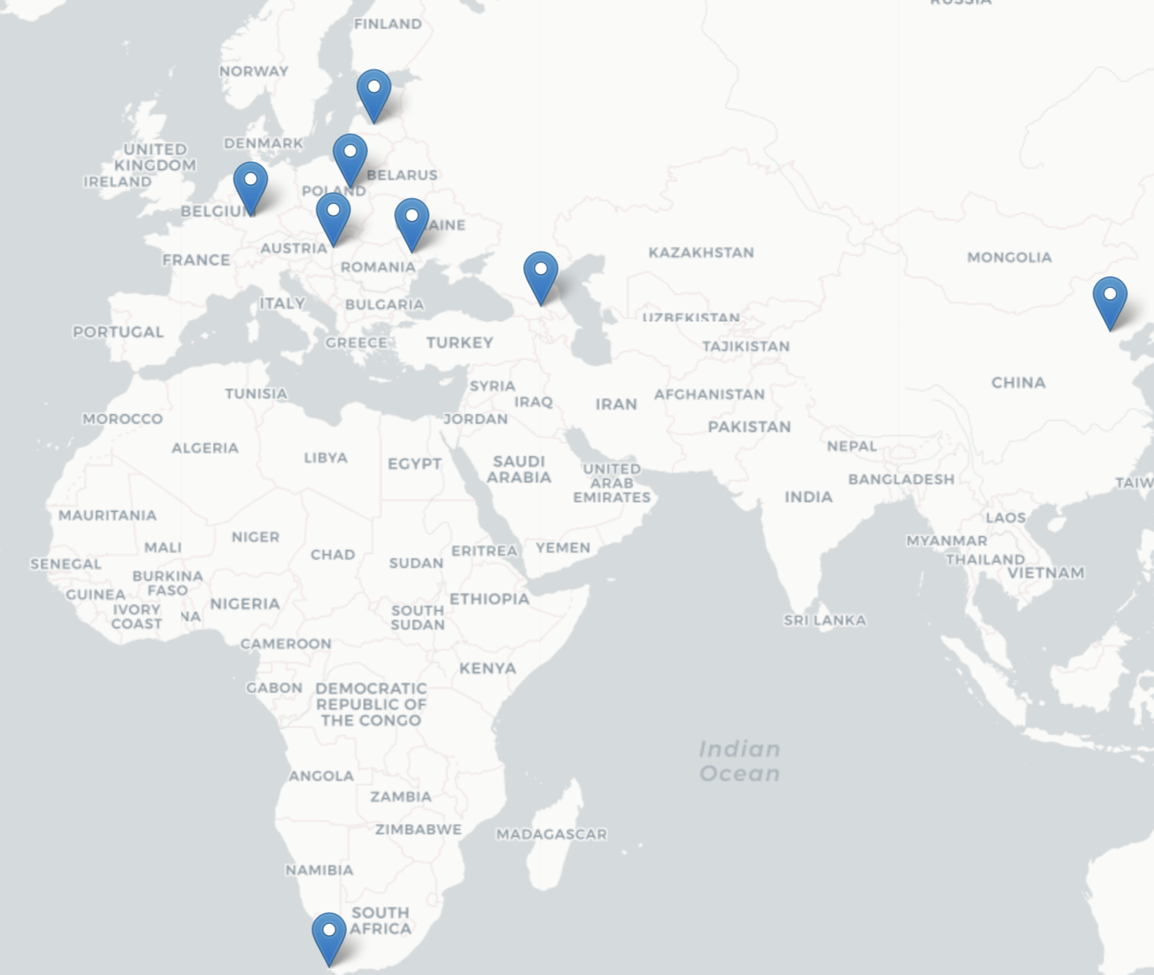
Cloud Integration Programme
Check-in – Single Sign On across services and providers
DataHub – Replication of scientific data to national/community clouds
AppDB – Distribution of applications & services to national/community clouds

Slide 12
Serving International Communities
International research infrastructures and projects
Service Level Agreement
Resource brokering and access management process
Technical Federation
Single Sign On + Data replication + Application distribution
Operation Level Agreement
National cloud infrastructures

Slide 13
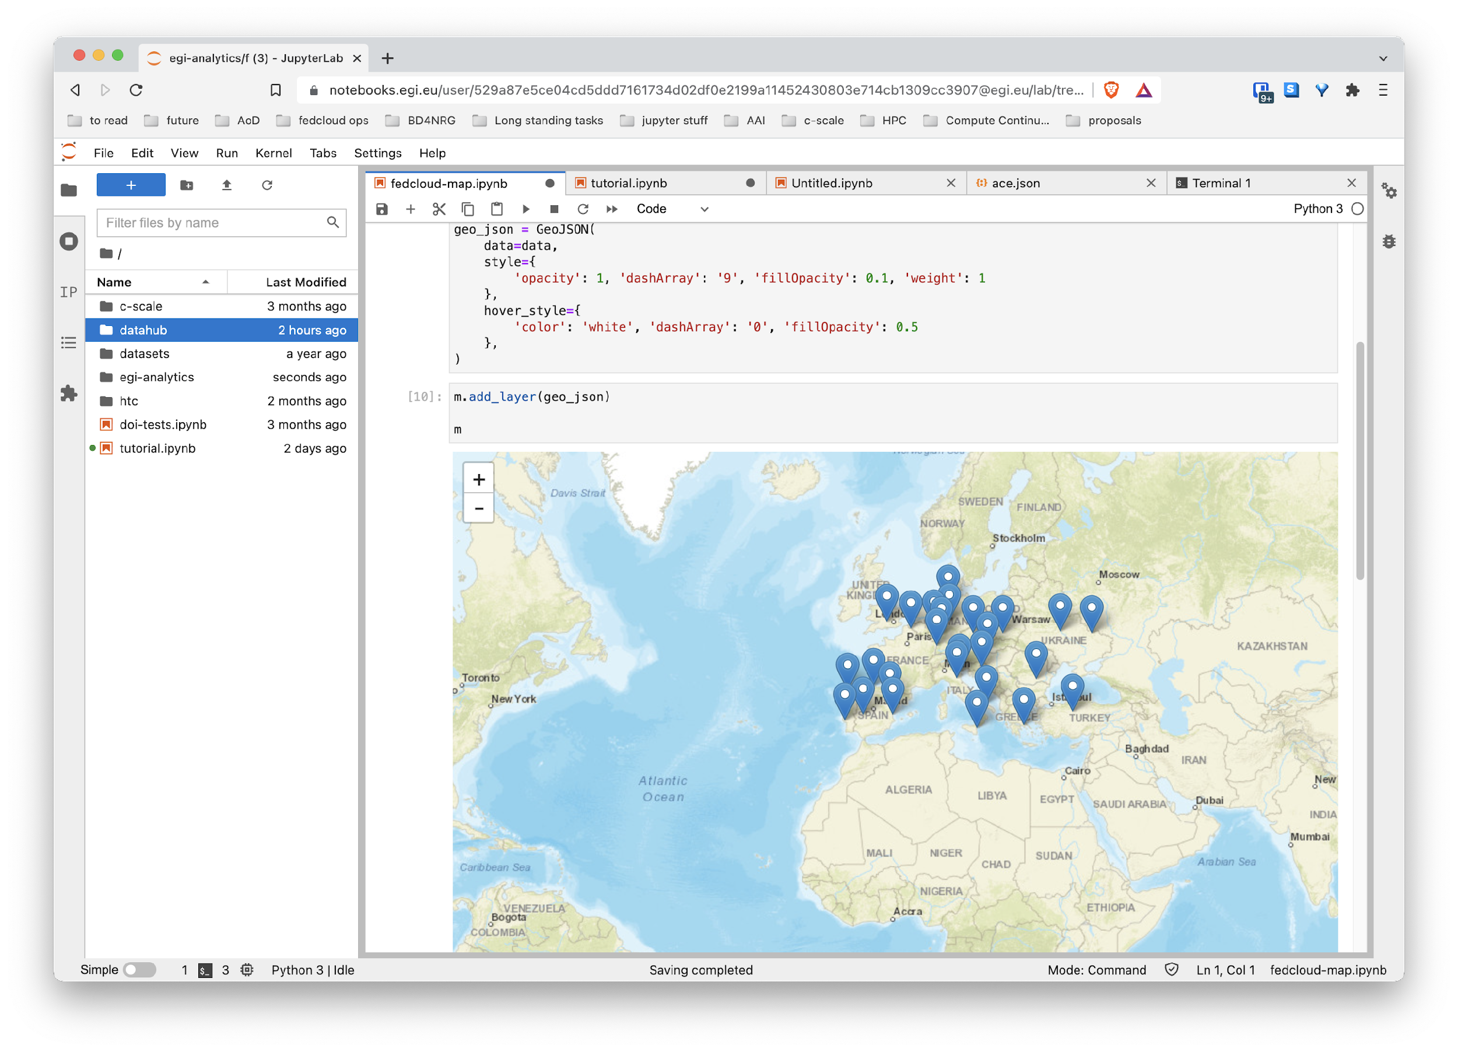
Notebooks & Binder: reproducible Open Science
Access shared data
Run Data Analytics
Share and reproduce
Share notebooks with just a link, reproduce with binder
DataHub integration for transparent access to distributed data
Create documents with code, visualisation and text that run on cloud providers
Access EGI Federation and national infrastructure from your web browser
TUTORIAL: Reproducible Open Science With Big Data - The EGI Notebooks and Binder services - Fri 23/09 11:30 AM

Slide 14
Community Support activities

Slide 15
Open Software and Applications
The structural biology success story

Slide 16
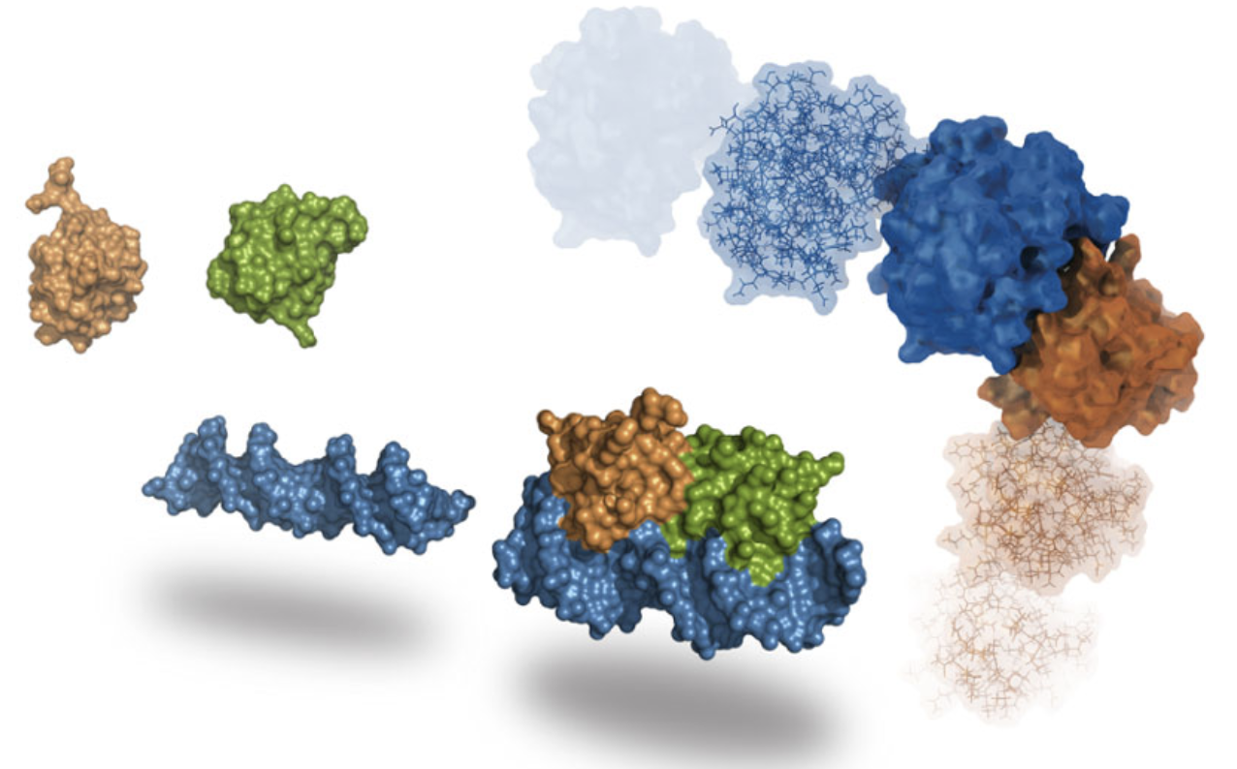
The WeNMR international community
Mission
Study of the molecular structure and dynamics of biological macromolecules, particularly proteins and nucleic acids
Understand how alterations in their structures affect their functions.
Collaboration with EGI
> Support the structural biology community to drive modelling process
> Contribute to operate the thematic services for the community > Scale up resources and facilitate the dispatch of computing jobs

Slide 17
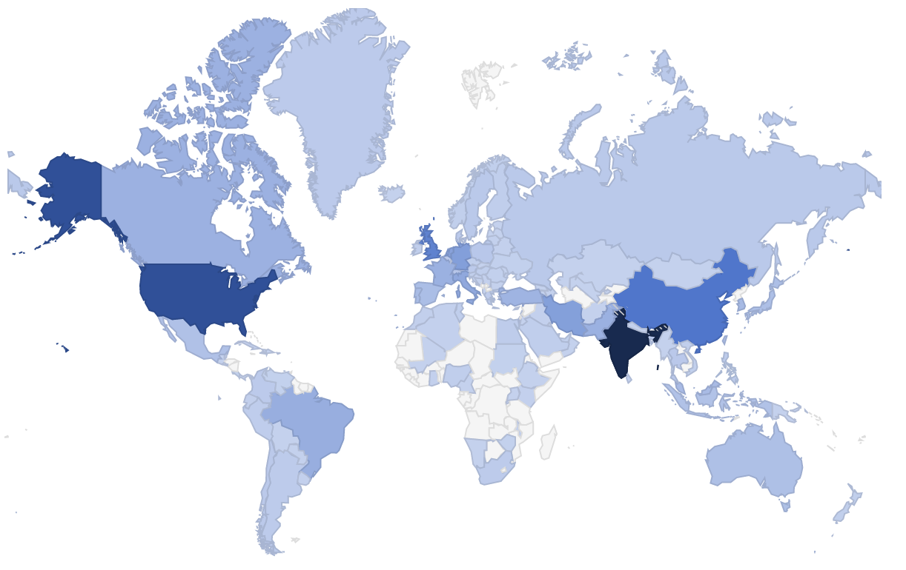
The WeNMR international community
From https://wenmr.science.uu.nl/user_map
+31,000 researchers across 136 countries
Millions of CPU hours delivered

Slide 18
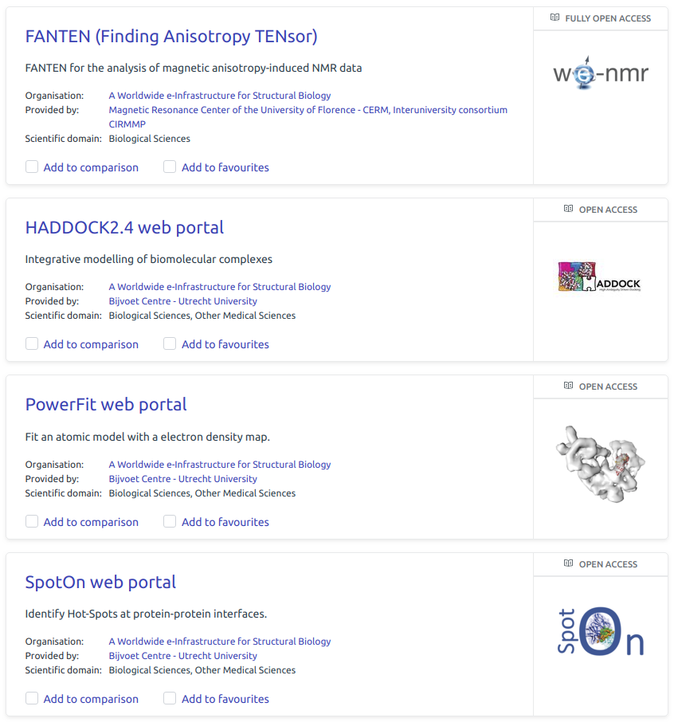
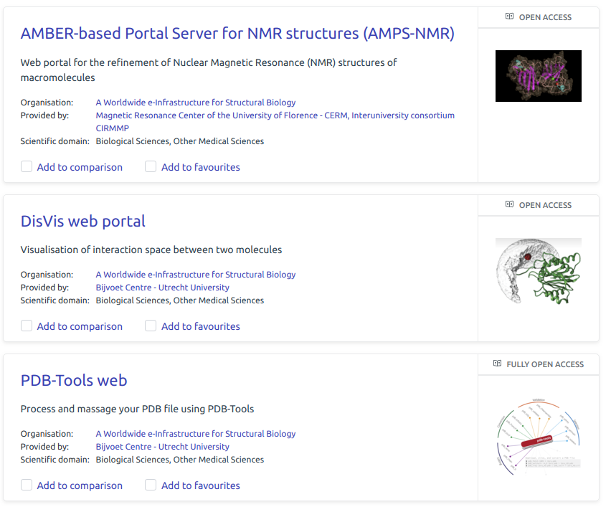
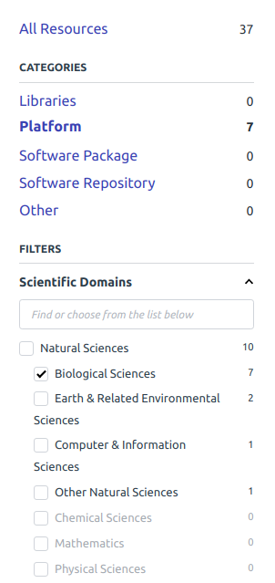
The WeNMR services portfolio in EOSC
From: https://marketplace.eosc-portal.eu/

Slide 19
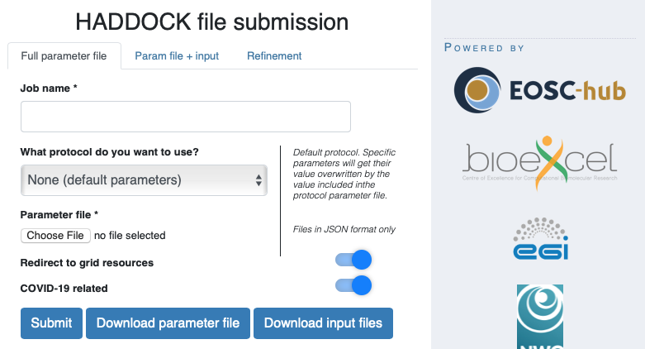
Supporting COVID-19 related research
HADDOCK can be used to model interactions between virus and human proteins and for drug screening
Increased number of registrations since the lockdown measures in March 2020
Additional HTC resources were allocated to WeNMR from the WLCG and OSG HTC resource providers via the EGI Workload Manager
Mechanism in place to tag COVID-related jobs

Slide 20
The IceCube Neutrino Observatory
Mission
Observe cosmic rays interactions with the Earth’s atmosphere
Address several big questions in physics, like the nature of dark matter and the properties of the neutrino itself.
About the Collaboration
Approximately 300 physicists from 53 institutions in 12 countries make up the IceCube Collaboration.
Collaboration with EGI
> Support to IceCube computing needs in Europe for running scientific workflows
> Promote technical and procedural alignment of federating services including AAI, accounting, helpdesk

Slide 21
GPU cloud burst
HTCondor used to integrate all purchased GPUs into a single resource pool to which IceCube submitted their scientific workflows
Additional GPU resources from the IFCA-LCG2 and CESNET-MCC were included in the resource pool and used by the collaboration.
SLA agreed on Aug. 2022; MoU in progress
621,939 CPU/h consumed in 2022

Slide 22
Open Data
European Multidisciplinary Seafloor and water column Observatory (EMSO) success story

Slide 23
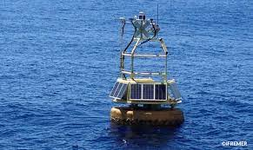
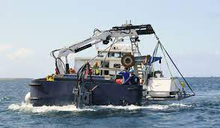
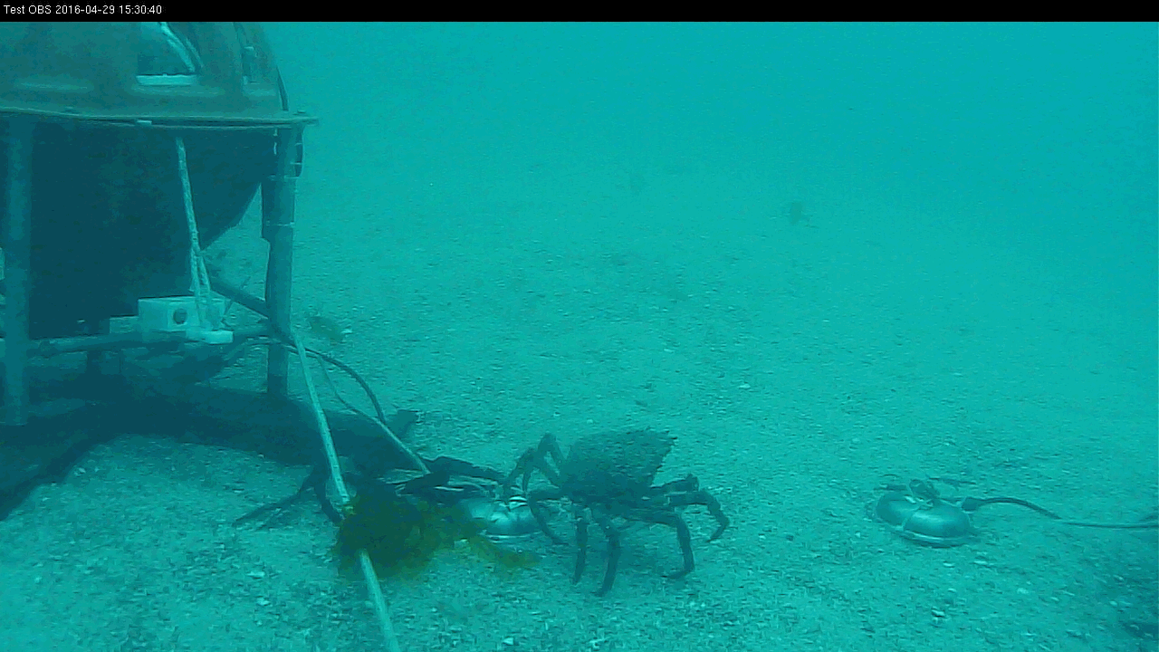
The EMSO-ERIC challenge
Goal:
Explore the oceans to gain a better understanding of phenomena happening within and below them, and
Explain the critical role that these phenomena play in the broader Earth systems.

Slide 24
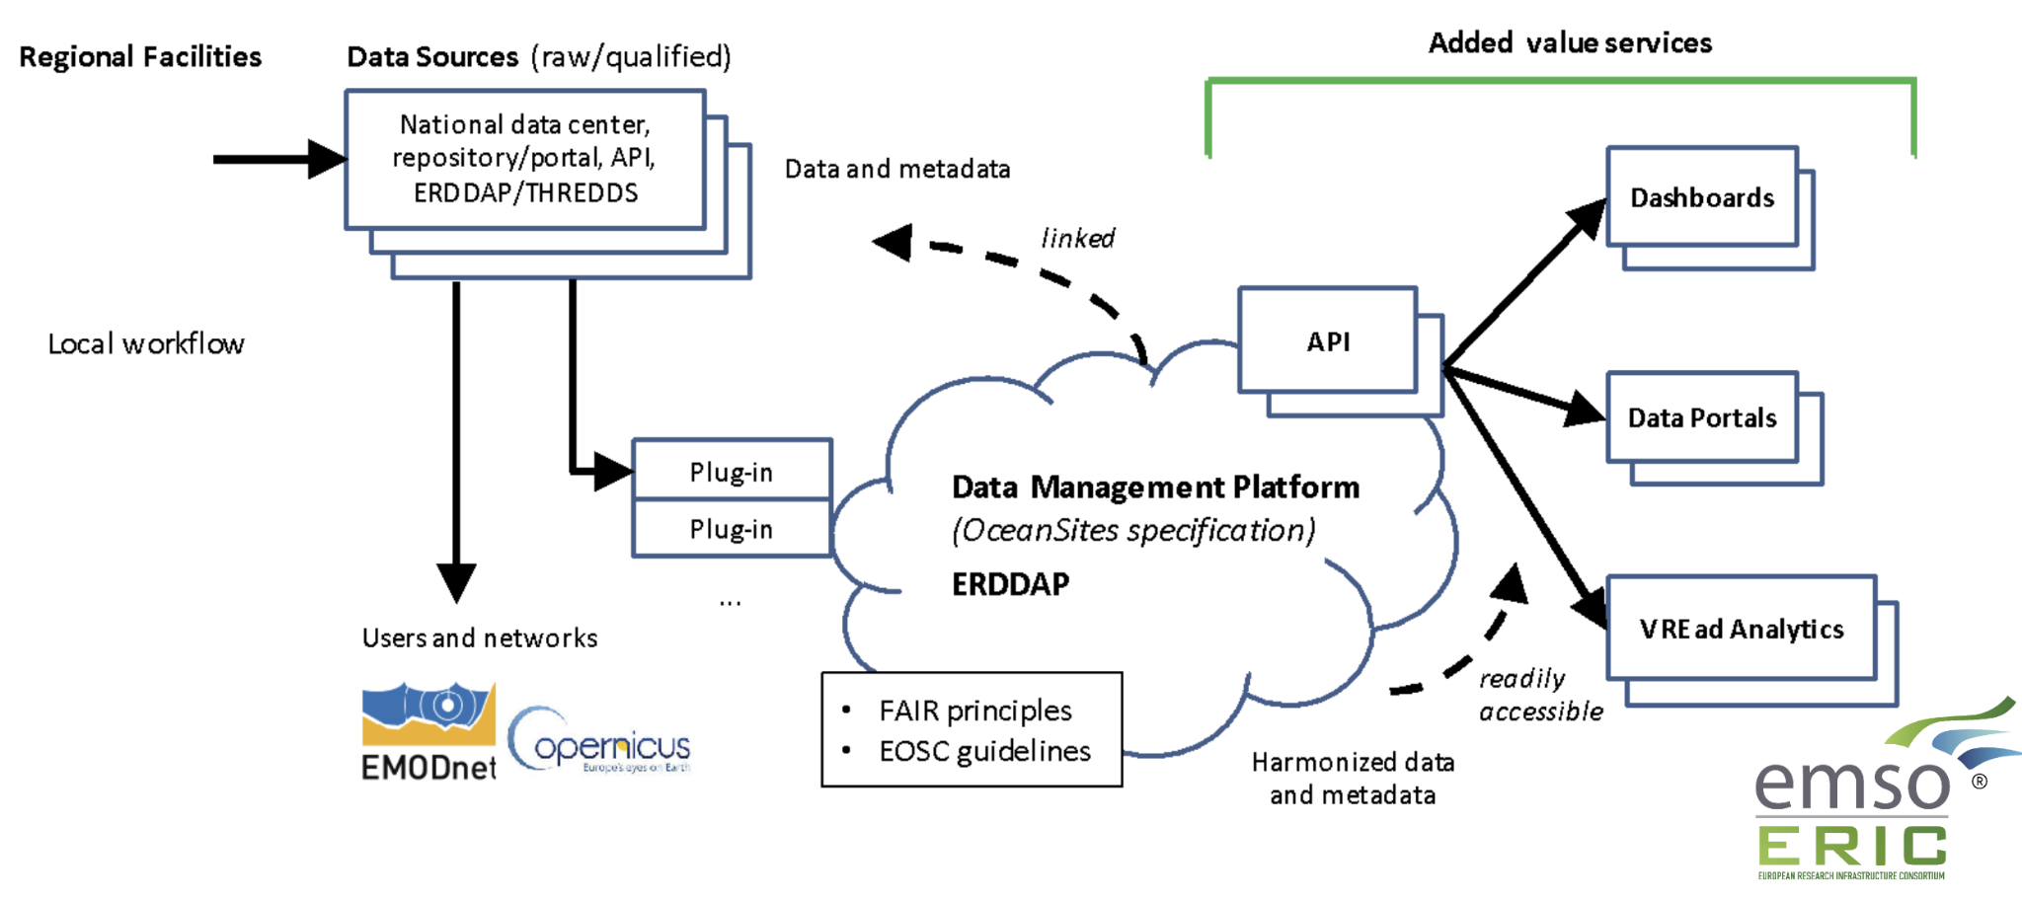
The EMSO-ERIC Data Management Platform
Read the full story: https://www.egi.eu/case-study/emso-eric/

Slide 25
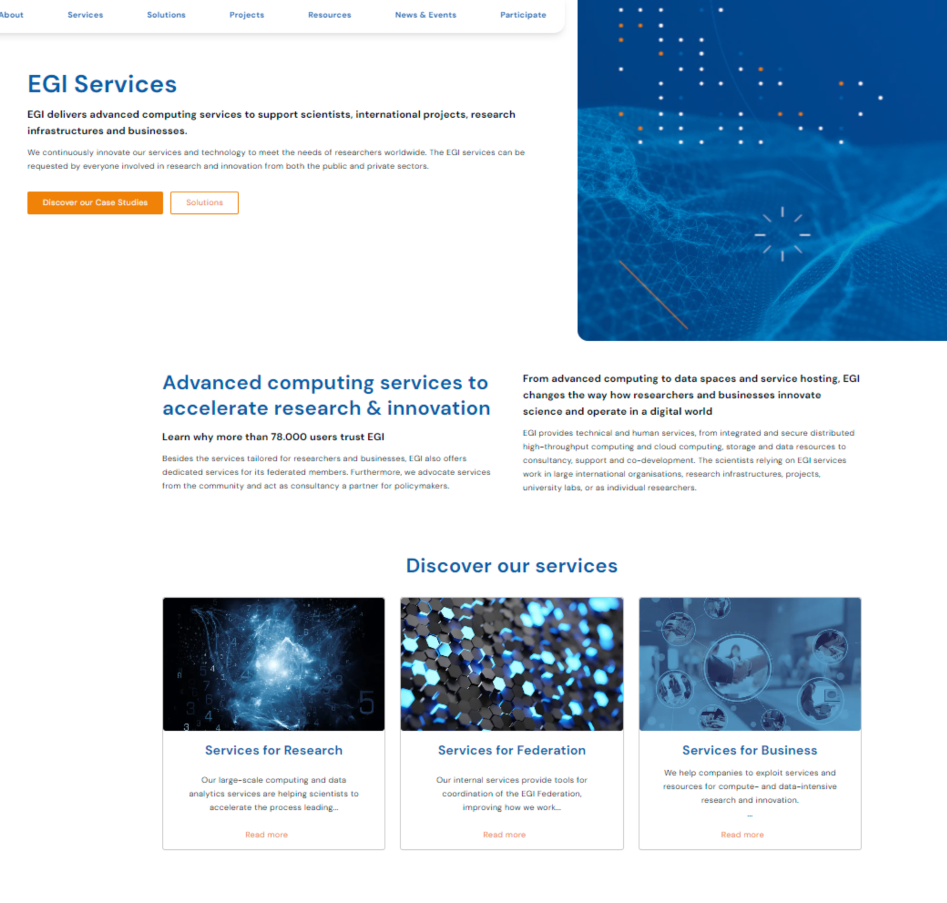
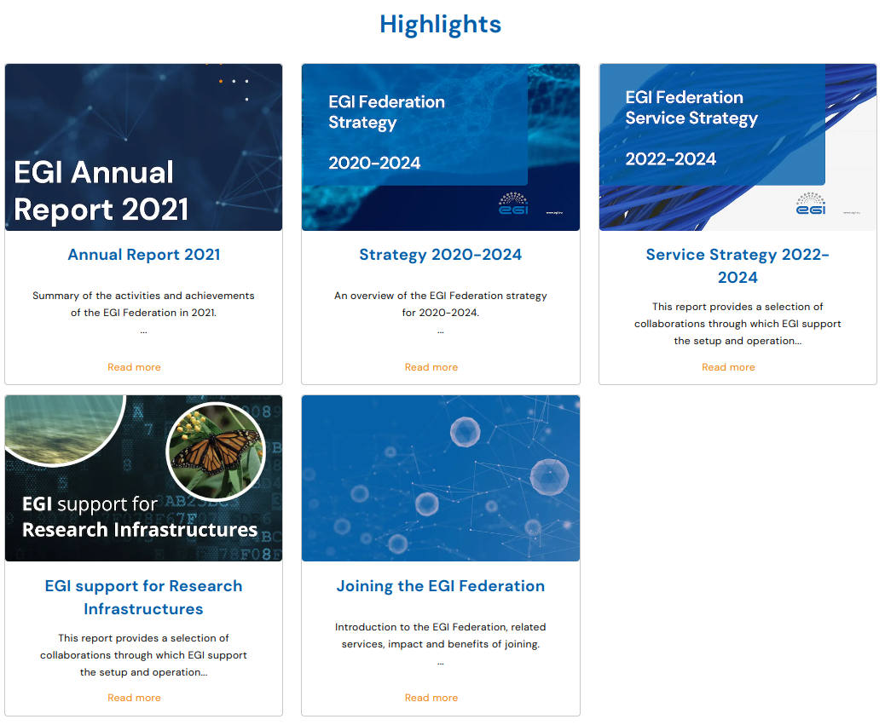
Learn more about EGI
From https://www.egi.eu/publications/
https://www.egi.eu/services/

Slide 26
Open Data
The European Network for Earth System Modelling success story

Slide 27
European Network for Earth System Modelling (ENES)
Mission
Accelerate progress in climate and Earth system modelling
Foster the common development of models and tools and efficient use of HPC
Support the exploitation of model data by the Earth System science
Collaboration with EGI
> Support the climate modelling community
> Scale up services to new user communities
> Federation

Slide 28
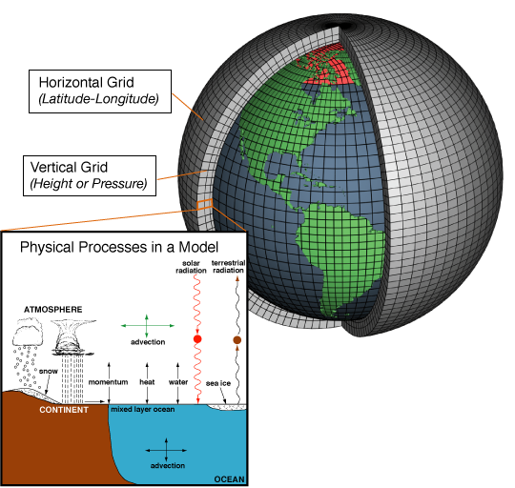
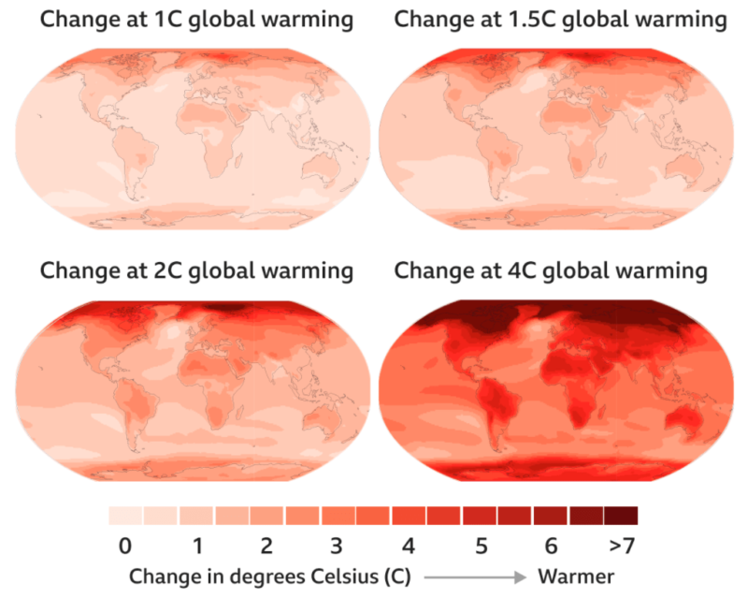
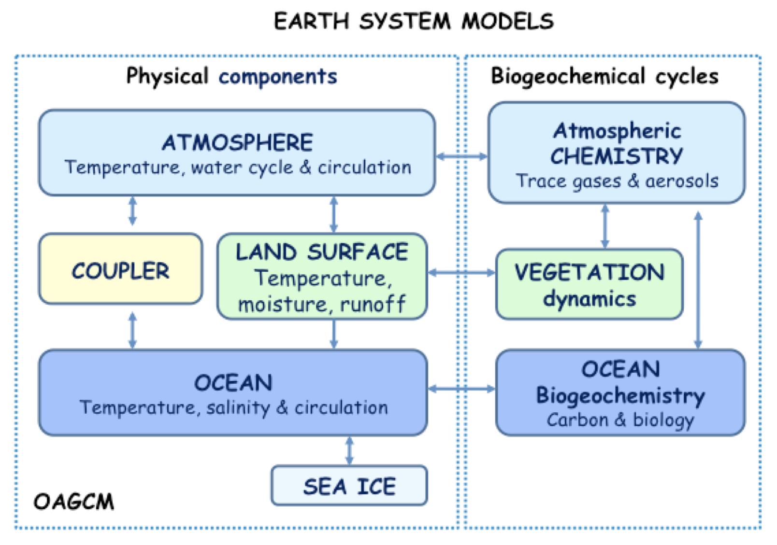
Climate modelling: from Science to society
A long data journey
Notes:
Climate modelling take into consideration information from atmosphere, the cloud, the winds, temperature of oceans and salinity, land representation with vegetation, and the greenhouse gases emission.
These models are quite keen to understand what’s happening and also predict how climate can vary and change considering different scenarios

Slide 29
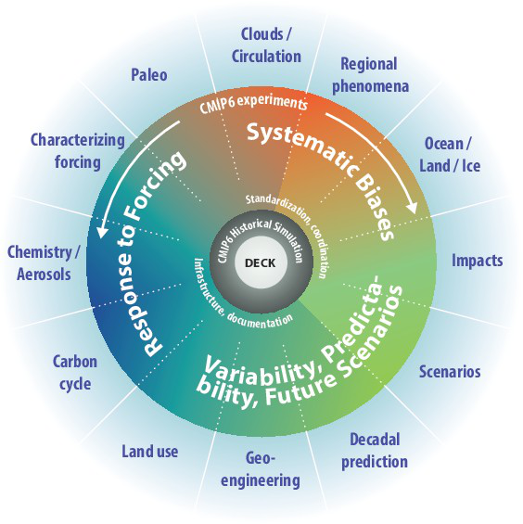
The World Climate Research Programme
The World Climate Research Programme (WCRP) coordinates and facilitates international climate research to develop, share, and apply the climate knowledge that contributes to societal well-being.
Coupled Model Intercomparison Project (CMIP)
CMIP6:
23 endorsed MIPs
20 to 50K simulated years / model
100M CPU/h
1-10 PB produced / model
Notes:
There are phases organized by WCRP to use the results of the simulations of the different assessment reports.
The objective of the Coupled Model Intercomparison Project (CMIP) is to provides insight to understand the past, the current situation and predict the future. CMIP began in 1995. CIMP6 is the last phase.
CIMP6 encompases 23 different Modelling Intercomparison Projects which incorporate 20 to 50K simulated years. We reached 100M CPU/h, 1-10 PB produced / model

Slide 30
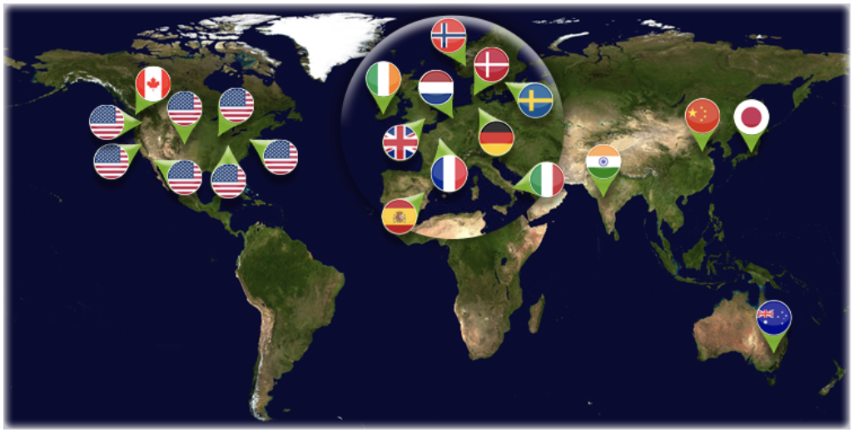
Earth System Grid Federation and CIMP6
From https://esgf.llnl.gov/
CMIP6: 7 Millions datasets, 22PB (12PB w/o replica)
Notes:
The huge amount of data sets available by CIMP6 pose serious data management challenges for processing, archiving and data sharing.
In the climate change domain, to support large scale climate modelling has let to the development of the Earth System Grid Federation (ESGF). ESGF is a federation infrastructure to facilitate the access and the management of large data volume for climate change research. Several providers around the world are involved.

Slide 31
The ENES Data Space
From https://marketplace.eosc-portal.eu/services/enes-data-space
Deliver an open, scalable and cloud-enabled data science environment for climate data analysis on top of the EOSC Compute Platform
The ENES Data Space aims at providing an entry point to:
Datasets (e.g. CIMP6) => most relevant, open, pre-staged
Storage and compute resources
Data Science Software Stack: to address a wide spectrum of analysis needs
IDE and applications: to develop/share/(re-)use apps (FAIR principles)
PaaS for data analysis services

Slide 32
Back-up slides
Contact: support@egi.eu

Slide 33
Allocating services and resources
Negotiate access to resources
Taking into consideration user requirements (type, number, size, cost, availability, ++)
Type, number, size, cost, availability, etc.
Applic. provider
Instance requirements
Conditions
Storage provider
Cloud provider
Negotiator
HTC provider
Project/Community representative
Service Level Agreement
Operation Level Agreement
Training
Support
Regular satisfaction interviews
Regular service delivery reports
Ensure satisfaction, capture achievements,
record feedback
Ensuring that agreed targets are met
Notes:
Motivations of providers – National/institutional mission vs. pay for use

Slide 34
Access policies
Wide access
Users can freely access scientific data and digital services provided by EGI resource providers
Policy-based
Users are granted access based on policies defined by the EGI resource providers or by the EGI Foundation
Market-driven
Users can negotiate a fee to access services either directly with EGI resource providers or indirectly with the EGI Foundation
Example:
EGI Notebooks open instance
EGI Cloud pool for application piloting
Example:
Biomed HTC pool for life sciences
INFN-CLOUD-BARI (IT), IN2P3-IRES (FR), ULAKBIM (TR) provide Clouds for the National Bioinformatics Infrastructure of Sweden
Example:
FitSM training by EGI Foundation
4 EGI Cloud providers deliver to Exprivia

Slide 35
Who do we serve
Data and compute services for the food sector - Thu 15:30
EGI for Earth Observation - Thu 15:30
Posters, lightning talks…
Size of individual groups
WLCG
EMSO-ERIC
CTA
CLARIN-ERIC
EISCAT_3D
VIRGO
LIGO
LOFAR
ELIXIR
INSTRUCT
LifeWatch
BELLE-II
OPERAS
SoBigData
EMPHASIS e-RIHS
…
WeNMR
LSGC
NextGEOSS
PolicyCloud
TRIPLE
DIGITbrain
C-SCALE
LETHE
EOSC-Synergy
ExTraS
DECIDO
PITHIA
NBIS
PaNOSC
OpenRiskNet OBSEA PHIRI IceCube
Pangeo
NEANIAS
…
Terradue
100% IT
Exprivia
ESA Benchmark
CFD Support
CloudEO
CloudSME
Ecohydros
Numeca
Peachnote
RHEA
SixSq
UberCloud Binarè Oy Mathworks ARTICONF Digifarm.io Inteligg OiPub
…
Lisbon Council
Città di Torino
Kajaanin Kaupunki
FUNDACION IBERCIVIS (Aragon)
Sustainable Cities (Greek Municipalities)
Camden Council
Municipality of Sofia
Sociedad Aragonesa de Gestión Agroambiental
Maggioli S.p.A.
City of Athens IT Company
City of Genoa
Nicosia Municipality
Burgas Municipality
…
PeachNote
CEBA Galaxy eLab
Semiconductor design
Main-belt comets
Quantum physics studies
Virtual imaging (LS)
Bovine tuberculosis spread
Geography evolution
Seafloor seismic waves
3D liver maps with MRI
Metabolic rate modelling
Genome alignment
Tapeworms infection on fish Phenotyping community
…
Research infrastructures
Multinat. communities (often H2020 projects)
Public authorities
Industry, SMEs
‘Long tail of science’

Slide 36
EGI value propositions
Services for research
Services for federation
Services for Business
Our large-scale computing and data analytics services are helping scientists to accelerate their research.
Our internal services provide tools for coordination of the EGI Federation, improving how we work together.
We help companies to exploit and provide services and resources for compute- and data-intensive research and innovation.

Slide 37
EGI services for Federation
Offered by the EGI Foundation to the members represented in the EGI Council
COORDINATION
Operations Coordination and Support
Community Coordination
ITSM Coordination
Technical Coordination
Project Management and Planning
Security Coordination
Communications
Strategy and Policy Development
Industry Engagement
TECHNICAL TOOLS
Accounting
Collaboration Tools
Configuration Database
Operational Tools
Helpdesk
Service Monitoring
Validate Software and Repository
Marketplace
SECURITY & IDENTITY
Check-in
Attribute Management
https://www.egi.eu/services/federation/

Slide 38
Technical tools for the Federation
Usage Accounting
Monitoring
Validated Software and Repository
Compute usage records (accounting.egi.eu)
Operations Portal
Unified Middleware Distribution
Configuration Database
Information about sites and hosted services
Helpdesk

Slide 39
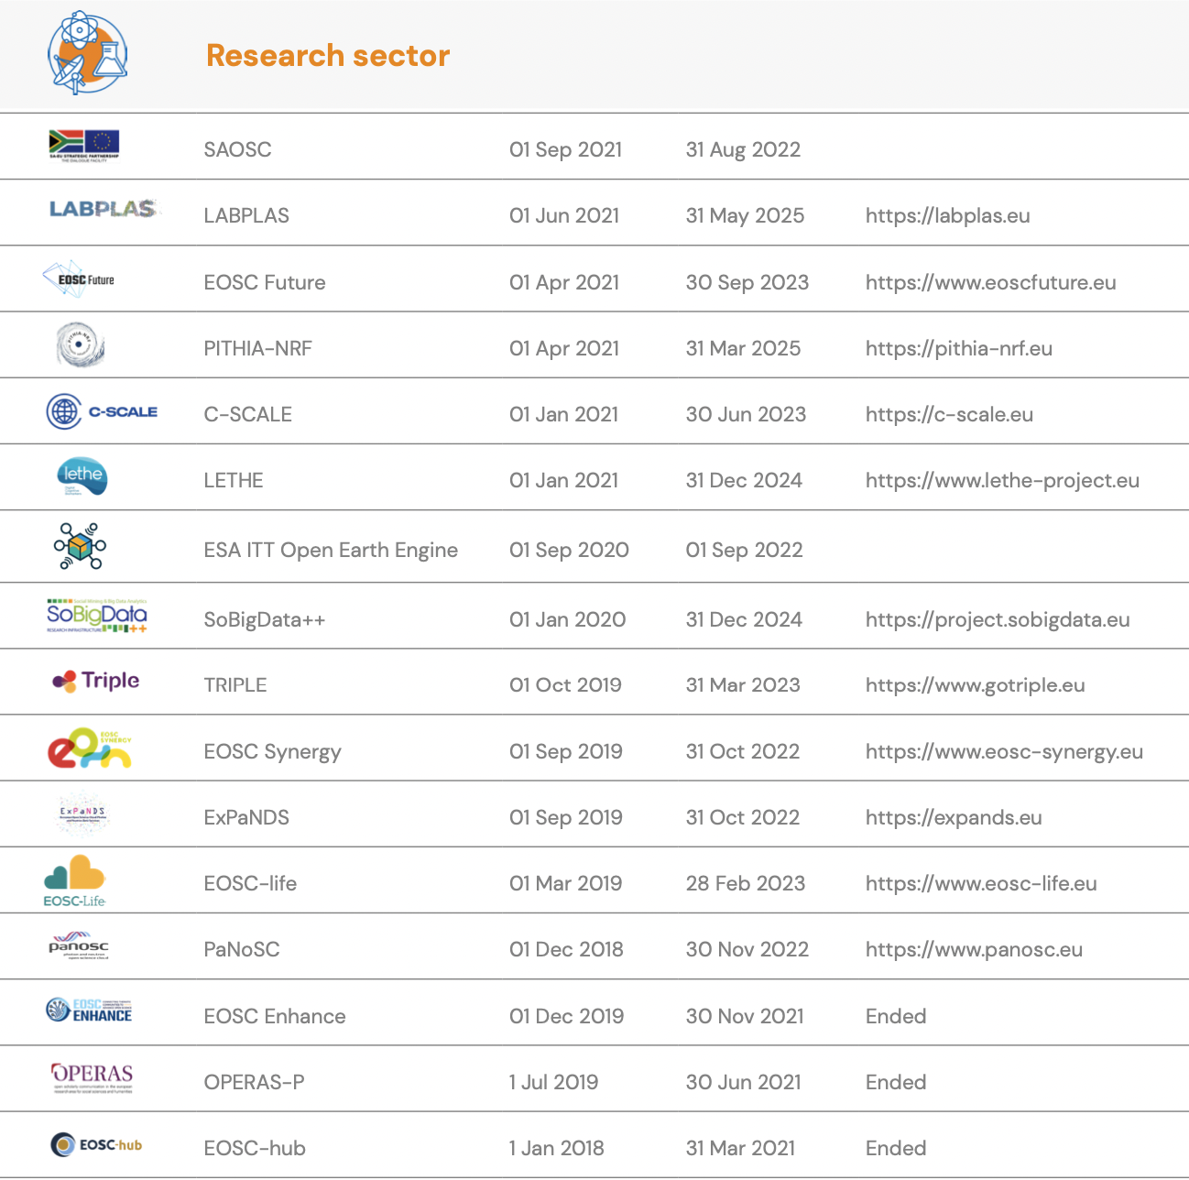
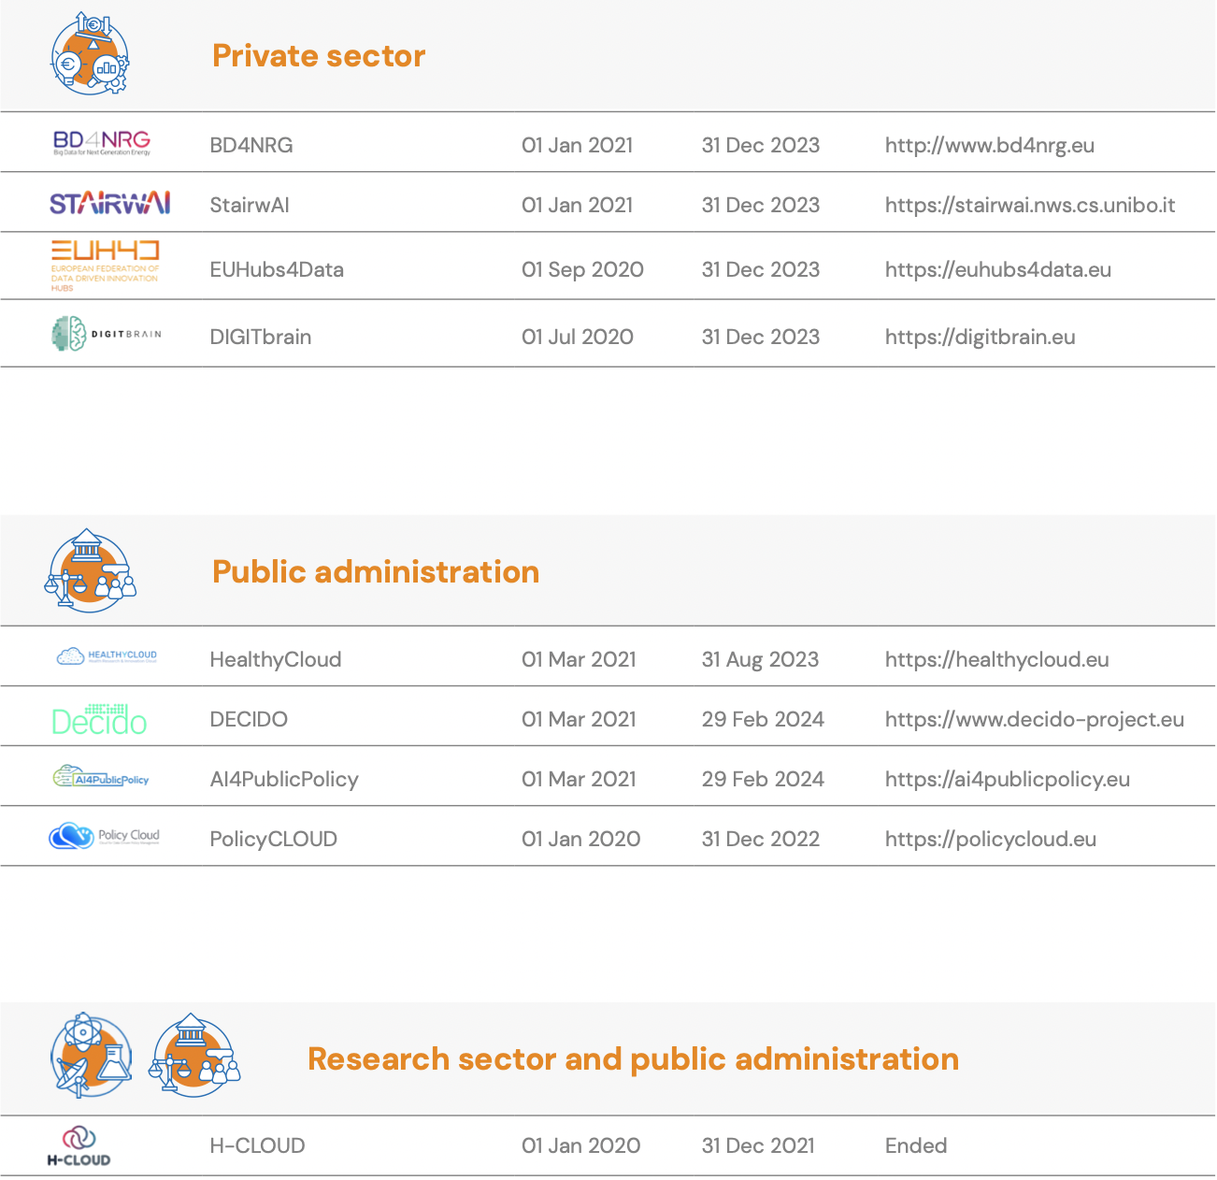
‘Project management and planning’ for the Federation
EGI project portfolio (2021)

Slide 40
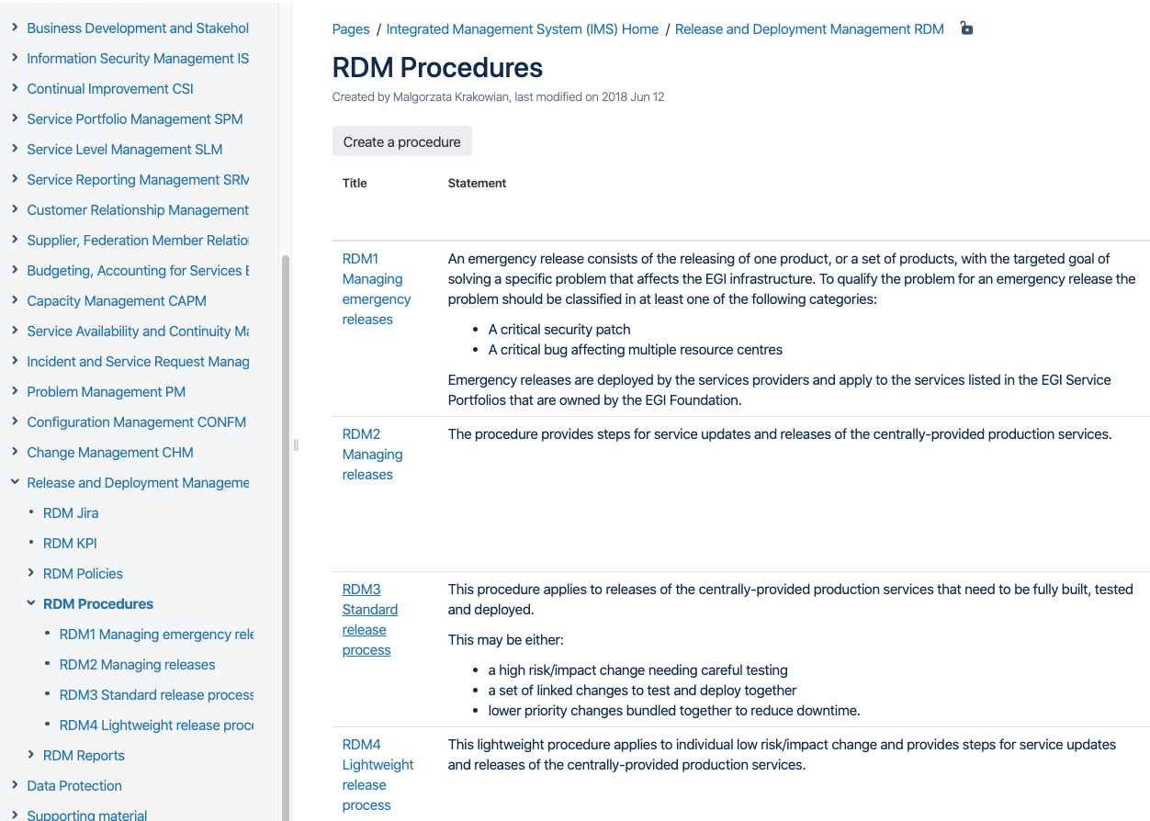
IT Service Management
IT service management
Focuses on the provision of high quality IT services
Defines, documents and maintains service management processes
ITIL, ISO20k, COBIT, …
EGI Service Management is Based on the open FitSM standard
85 requirements that should be fulfilled by an organisation (or federation)
16 general requirements; 69 process-specific requirements
14 processes
FitSM training
Example – Release and Deployment Management:
PR13.1 A release policy shall be defined.
PR13.2 The deployment of new or changed services and service components to the live environment shall be planned with all relevant parties including affected customers.
PR13.3 Releases shall be built and tested prior to being deployed.
PR13.4 Acceptance criteria for each release shall be agreed with the customers and any other relevant parties. Before deployment the release shall be verified against the agreed acceptance criteria and approved.
PR13.5 Deployment preparation shall consider steps to be taken in case of unsuccessful deployment to reduce the impact on services and customers.
PR13.6 Releases shall be evaluated for success or failure.
Service portfolio management
Service level management
Incident management
Change management
Capacity management
Release and deployment mgm
…
https://www.fitsm.eu

Slide 41
EGI and the European Open Science Cloud
“… a virtual environment with free at the point of use, open and seamless services for storage, management, analysis and re-use of research data, across borders and scientific disciplines”
Achievements of the EGI-ACE project - Wed 10:30
EGI contributions to the EOSC-Core - Thu 11:00
Closing plenary: Pathways for improved coordination among e-infrastructures - Thu 14:30
2016 Communication on the “European Cloud Initiative
EOSC phase 1: Until end of 2020
EGI coordinated the EOSC-hub project
Setup core elements of EOSC – Portal; Helpdesk; Monitoring; Accounting
Design and operate a service mgm system (Service onboarding; Incident mgm;…)
Contribute to the EOSC service portfolio (compute, data, thematic services)
EOSC phase 2: From 2021 – EOSC Association
EGI continues to provide core services (EOSC Future project)
EGI provides the EOSC Compute platform (EGI-ACE project)
EGI supports various thematic services (DECIDO, EOSC-Synergy, …)
EGI members are/will be part of national OSC nodes

Slide 42
EGI value propositions
Services for research
Services for federation
Services for Business
Our large-scale computing and data analytics services are helping scientists to accelerate their research.
Our internal services provide tools for coordination of the EGI Federation, improving how we work together.
We help companies to exploit and provide services and resources for compute- and data-intensive research and innovation.

Slide 43
Services for business
EGI DIH supporting SMEs and Industry with Digital Transformation
Test before you invest
Skills and training
Technical facilities to support companies and SMEs test before investing or to validate services or solutions.
Provide knowledge on the technical offer through webinars or consultancy services.
Networking and community
Find funding
Bring SMEs and communities together with the EGI community and facilitate the interaction and open new market opportunities.
Facilitate the access to funding opportunities and investment mechanisms to sustainable support the innovation.
Read about our services for business: https://www.egi.eu/services/business/
Launching the EGI Digital Innovation Hub - Tue 15:45

Slide 44
Modelling the Earth’s climate system
Climate science:
Understand and predict past, present and future climates Climate impacts:
Sectors (agriculture, hydrology, energy, health …)

Slide 45
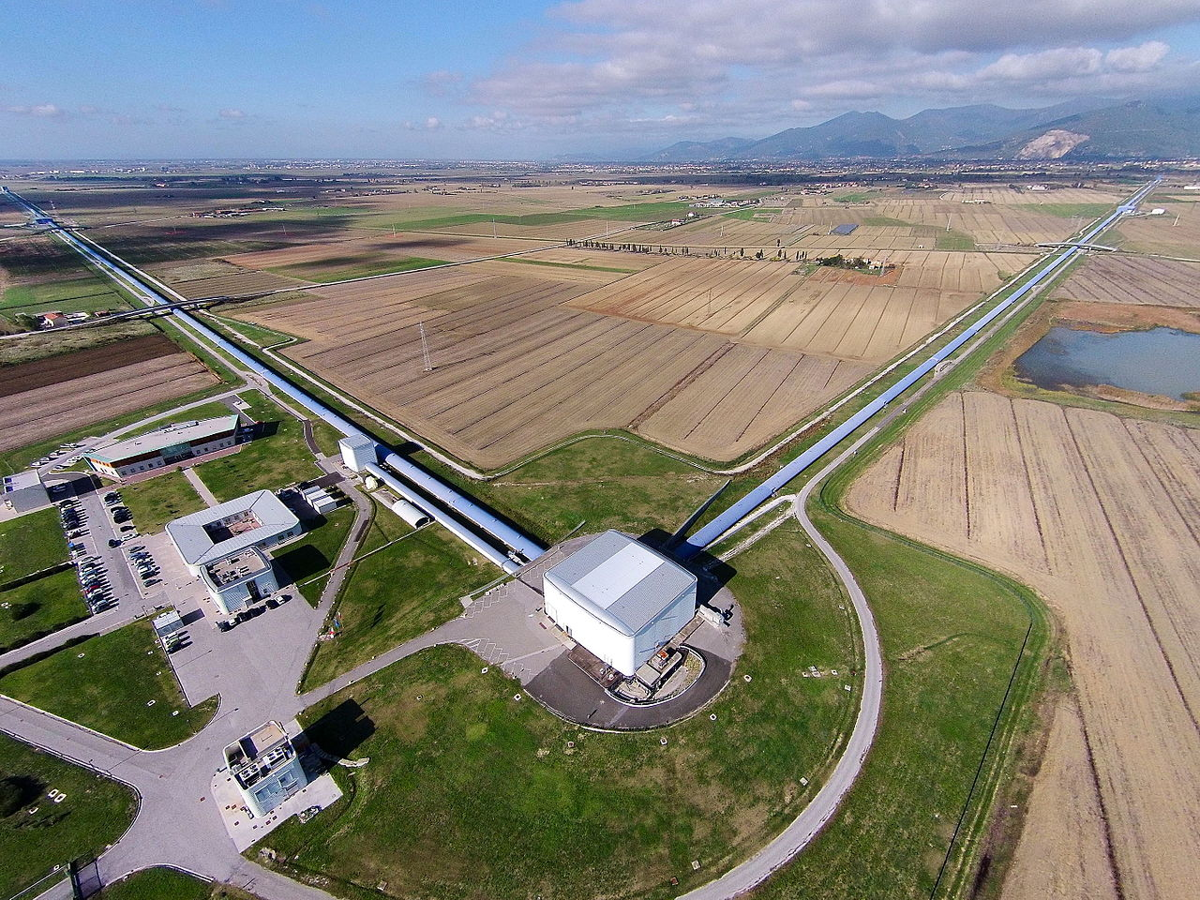
Gravitational Wave research
To better understand the Universe it is necessary to interpret all the messages coming from distant space
The observation of gravitational waves provides crucial and complementary information to the observation of electromagnetic waves
The VIRGO experiment in Cascina, IT

Slide 46
Gravitational Wave research
To better understand the Universe it is necessary to interpret all the messages coming from distant space
Gravitational-wave discovery opens a whole new window on the universe
Computing for Gravitational Wave started small, but is coming of age
Upgraded detectors will raise the stakes
Computing for the 3G era will be challenging
Not for data size, but for the analysis challenges
Much work will be needed to quantify and optimize the computing needs
Gravitational Wave research will be a major player in the 2030’s computing landscape
Even if not one of the largest

Slide 47
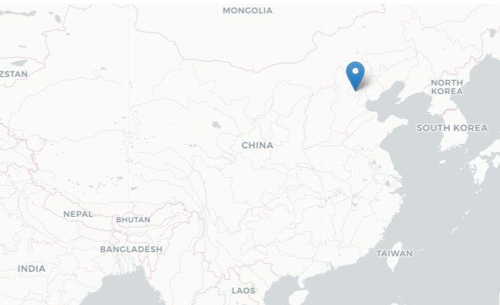
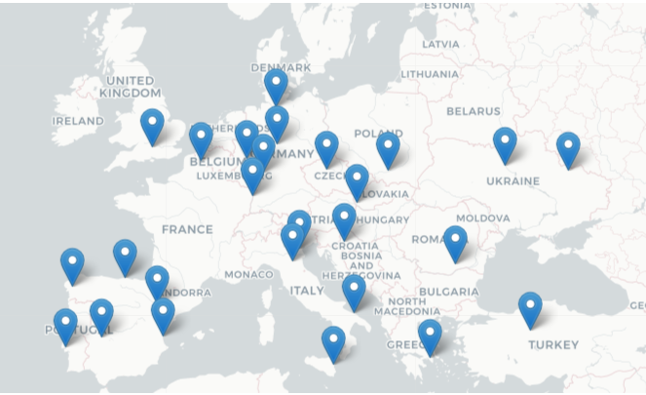
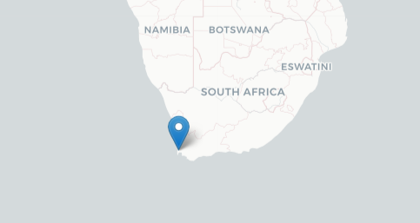
Towards a Global Open Science Cloud
27 cloud providers
New global providers in 2022

Slide 48
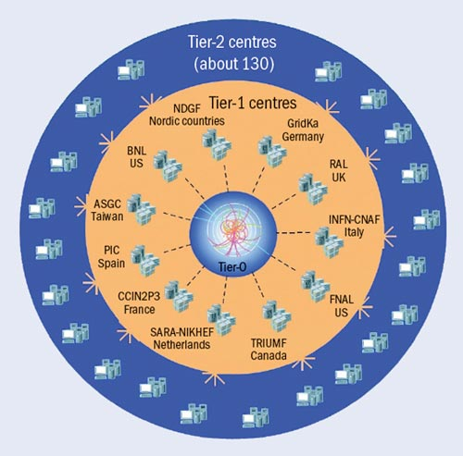
WLCG - The Worldwide LHC Compute Grid challenge
Usage Accounting
Monitoring
Validated Software and Repository
Compute usage records (accounting.egi.eu)
Operations Portal
Unified Middleware Distribution
Configuration Database
Information about sites and hosted services
Helpdesk
LHC generates 50 PB/year
ALICE: ~10 GB/s
ATLAS: >1 GB/s
CMS: >1 GB/s
LHCb: ~700 MB/s
Notes:
Largest scientific apparatus ever build
27km around
2 general purpose detectors: Huge microscopes – to explore the very small – using a long lever arm
2 specialized detectors
The process to transform raw data into useful physics datasets. This is a complicated series of steps
Requiring a distributed and well-managed IT infrastructure.

Slide 49
International Partnerships
Global Open Science Cloud (GOSC) workshop
Thu 22/09 11:00-13:00-15:30-17:30

Slide 50
Open Data
The European Network for Earth System Modelling success story

Slide 51
European Network for Earth System Modelling (ENES)
Mission
Accelerate progress in climate and Earth system modelling
Foster the common development of models and tools and efficient use of HPC
Support the exploitation of model data by the Earth System science
Collaboration with EGI
> Support the climate modelling community
> Scale up services to new user communities
> Federation

Slide 52
Climate modelling: from Science to society
A long data journey
Notes:
Climate modelling take into consideration information from atmosphere, the cloud, the winds, temperature of oceans and salinity, land representation with vegetation, and the greenhouse gases emission.
These models are quite keen to understand what’s happening and also predict how climate can vary and change considering different scenarios

Slide 53
The World Climate Research Programme
The World Climate Research Programme (WCRP) coordinates and facilitates international climate research to develop, share, and apply the climate knowledge that contributes to societal well-being.
Coupled Model Intercomparison Project (CMIP)
CMIP6:
23 endorsed MIPs
20 to 50K simulated years / model
100M CPU/h
1-10 PB produced / model
Notes:
There are phases organized by WCRP to use the results of the simulations of the different assessment reports.
The objective of the Coupled Model Intercomparison Project (CMIP) is to provides insight to understand the past, the current situation and predict the future. CMIP began in 1995. CIMP6 is the last phase.
CIMP6 encompases 23 different Modelling Intercomparison Projects which incorporate 20 to 50K simulated years. We reached 100M CPU/h, 1-10 PB produced / model

Slide 54
Earth System Grid Federation and CIMP6
From https://esgf.llnl.gov/
CMIP6: 7 Millions datasets, 22PB (12PB w/o replica)
Notes:
The huge amount of data sets available by CIMP6 pose serious data management challenges for processing, archiving and data sharing.
In the climate change domain, to support large scale climate modelling has let to the development of the Earth System Grid Federation (ESGF). ESGF is a federation infrastructure to facilitate the access and the management of large data volume for climate change research. Several providers around the world are involved.

