Slide 1
e-IRG White Paper 2022
Pathways for improved coordination and cooperation among e-Infrastructures
Fotis Karayannis, Innov-Acts, e-IRGSP7

Slide 2
‘whoami’
Working in e-Infrastructures since year 2000 - Thanks to V. Maglaris!
,
(@fkarayan)

Slide 3
e-Infrastructure Reflection Group (e-IRG)
e-IRG is a self-regulated and independent policy advisory body
Operates on consensus-based decision-making;
it decides when, where and what it will discuss
e-IRG advises national authorities and the EC on electronic Infrastructures (e-Infrastructures)
Networking-, Computing-, Data Infrastructures and related services (middleware/AAI, software, tools, etc.)
On national and international initiatives of EU significance
http://e-irg.eu/bylaws
Notes:
Primary audience: is policy makers and funders, but also e-Infrastructure providers and ultimately users!
e-IRG has no influence to funding decisions, so it is purely advisory.

Slide 4
e-IRG Mission and Vision
Vision:
To facilitate integration in the area of EU e-Infrastructures and connected services, within and between Member States, at the EU level and globally
Mission:
To support both coherent, innovative and strategic European e-Infrastructure policy-making for convergent and sustainable e-Infrastructure services
http://e-irg.eu/about
https://zenodo.org/record/5567014

Slide 5
The e-IRG e-Infrastructure Commons → Foundation of EOSC
Notes:
e-Infrastructure Commons is the political, technological, and administrative framework for an easy and cost-effective shared use of distributed electronic resources across Europe.
e-IRG outlines Europe's need for a single "e-Infrastructure Commons" for knowledge, innovation and science [e-IRG Roadmap, 2012]

Slide 6
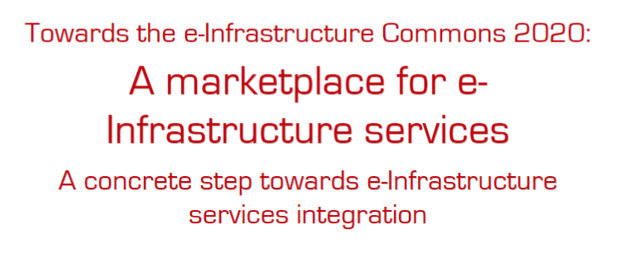
EOSC= e-IRG Commons + Open Science
In Dec 2014, I drafted the doc:
https://zenodo.org/record/406356
Expanding the e-IRG Infrastructure Commons idea
Contributing to the definition of EOSC and several of its key concepts (portal)
Point of access, catalogue of services, search, research + commercial services, compliance (rules of participation), AAI, multiple views (national, regional, EU..)
Notes:
Augusto and Carlos Moreis-Pires

Slide 7
Users
Users
Users
AAI
AAI
AAI
Thematic Cluster
Integrated core services
Thematic Cluster
Thematic core services
Cross-thematic/ integrated Data
Metadata Integration
S/W
Cross-thematic/integrated Services
Thematic core services
Data
Data Products
S/W
Services
Data
Data Products
S/W
Services
AAI
Users
Virtual Research Environments (EU/National)
Data infrastructures (EU/Regional/National)
including Scholarly Communitations
Centralised RI1
Centralised RI4
Users
Multi-site
RI2
..
Multi-site
RI2
Multi-site
RI5
..
Multi-site
RI5
AAI
Distributed RI6
Distributed RI3
Distributed RI3
Distributed RI6
..
..
..
AAI
Computing infrastructures (EU/National)
Users
AAI
Other Services Infrastructures (AAI, Middleware/) (EU/National)
Users
AAI
Network Connectivity Infrastructures (EU/National)
Users

Slide 8
Users
Users
Users
AAI
AAI
AAI
EOSC
Thematic Cluster
Integrated core services
Thematic Cluster
Thematic core services
Cross-thematic/ integrated Data
Metadata Integration
S/W
Cross-thematic/integrated Services
Thematic core services
Data
Data Products
S/W
Services
Data
Data Products
S/W
Services
AAI
Users
Virtual Research Environments (EU/National)
Data infrastructures (EU/Regional/National)
including Scholarly Communitations
Centralised RI1
Centralised RI4
Users
Multi-site
RI2
..
Multi-site
RI2
Multi-site
RI5
..
Multi-site
RI5
AAI
Distributed RI6
Distributed RI3
Distributed RI3
Distributed RI6
..
..
..
AAI
Computing infrastructures (EU/National)
Users
AAI
Other Services Infrastructures (AAI, Middleware/) (EU/National)
Users
AAI
Network Infrastructures (EU/National)
Users

Slide 9
About cooperation & coordination: Competitive Council conclusions (1)
On EOSC (2018)
Encourages Member States (MS) to invite their relevant communities, such as e-infrastructures, RIs, Research Funding Organisations and Research Performing Organisations, to get organized so as to prepare them for connection to the EOSC,
CALLS ON the EC to make optimal use of ongoing projects, existing expertise and knowledge available via existing initiatives, such as ESFRI, eIRG, GO FAIR and others;”

Slide 10
About cooperation & coordination: Competitive Council conclusions (2)
On the new ERA (2020)
encourages the EC and the MSs/ACs “to increase the level of national and European coordination, in particular on RIs and e-infrastructures”.
On the Pact for R&I (2021)
“connection of existing and new European and national research infrastructures, including e-infrastructures”
On ERA Future Governance & Policy Agenda → ERA Action 8 on RIs
“increased cooperation between RIs, e-infrastructures and stakeholders, including through EOSC”

Slide 11
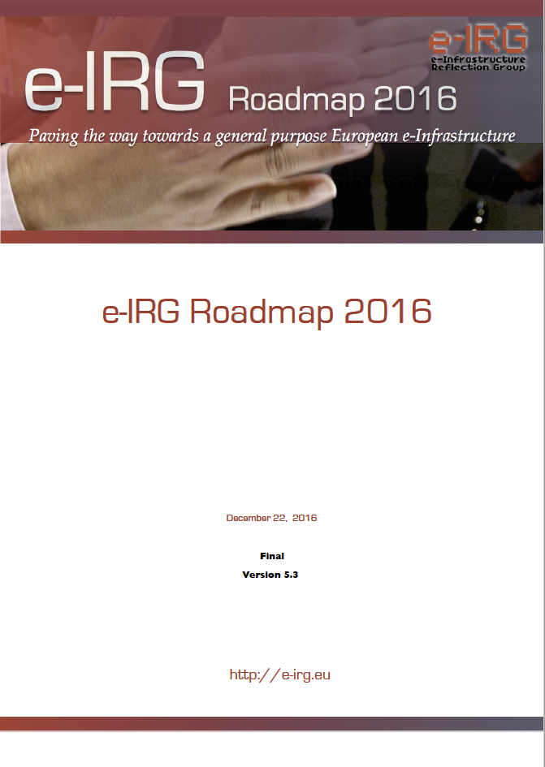
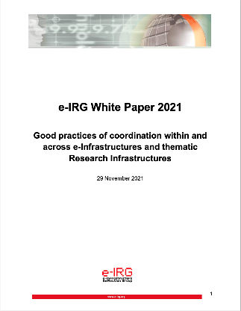
e-IRG advice on coordination & cooperation
e-IRG stresses the need for e-Infrastructure coordination at the national level and strong national building blocks, enabling coherent and efficient participation in European efforts [e-IRG Roadmap, 2016]
Role of National Nodes, in the implementation of the e-Infrastructure Commons and its instantiation as the European Open Science Cloud [National Nodes, 2019]
Good practices of coordination within and across e-Infrastructures and thematic Research Infrastructures [e-IRG White Paper 2021]
Realisation and enhancement of coordination and collaboration in the e-Infrastructure landscape covering the full spectrum of e-Infrastructures (networking, computing, data infrastructures) and related services [e-IRG White Paper 2022] planned for Dec’ 2022

Slide 12
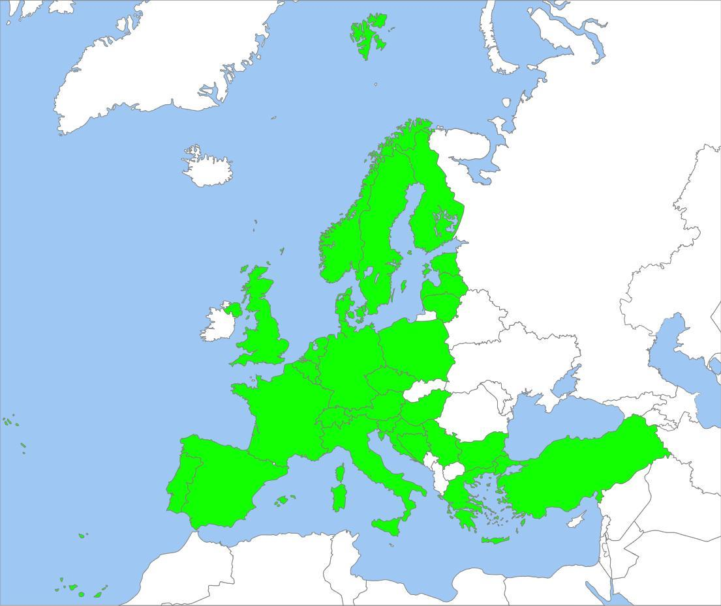
National Nodes – Getting organised; how far are we?
In response to the Council Conclusions:
e-IRG report published in June 2019
Based on analysis of the responses by 28 countries on related questionnaire (on coordination, governance, funding, access, etc.)
→
Diversity among countries; still patterns and approaches identified
https://zenodo.org/record/3608075
Notes:
Diversity across EU: no one size fits all, although it was possible to identify some common approaches based on the size or country organisation

Slide 13
e-IRG White Paper 2021 Coordination at institutional, national and regional level(s)
Main message
Coordination is continuously needed at national level among all players
Both among generic (horizontal) e-Infrastructure providers
Across generic (horizontal) and thematic (vertical) RI providers
Coordination should be expanded within and across countries
At institutional level
At regional level
At EU level (already treated at multiple fora, but only within an area, e.g. GEANT, EOSC, EuroHPC)
Coordination across GEANT, EOSC, EuroHPC is part of White Paper 2022
https://zenodo.org/record/5741971 (two files, main part + annexes)
Notes:
Following-up the work from the e-IRG National Nodes document

Slide 14
e-IRG White Paper 2022 Coordination at EU-level
Background
Some e-Infrastructures are in production for decades
Considerable developments in computing/data infrastructures in the last 5-15 years
Two significant initiatives have been launched → well underway
European Open Science Cloud (EOSC)
EuroHPC Joint Undertaking
Still coordination across all major EU players is in an early stage
Notes:
Moving from national coordination to the European coordination

Slide 15
e-IRG White Paper 2022 Coordination at EU-level
Topic
Bridge the identified cooperation/coordination gaps:
reflecting on the above issues
providing concrete advice and recommendations to all stakeholders
contributing towards increasing cooperation and coordination
Envisaged outcome (in the long run)
Provide integrated user-friendly services, easing the work of researchers
So that they can focus on the disciplinary or cross-disciplinary research, not on the infrastructures and tools!
Notes:
Moving from national coordination to the European coordination

Slide 16
e-IRG related past recommendations! (1)
e-IRG White Paper 2013
Proposed approach
“In the 2020 vision, providers have the freedom to innovate, and users enjoy the freedom to choose the services they need from a mix of public e-Infrastructure and commercial services. In order to enable this vision, we need an ecosystem of different organisations, at the national and international levels, each with their own focus but also with effective coordination between them.”
https://zenodo.org/record/4049675

Slide 17
e-IRG related past recommendations! (2)
e-IRG White Paper 2013
e-IRG believes this challenge can be met by maintaining a clear separation between the three core functions:
1. Community building, high-level strategy and coordination in Europe: for each type of e-Infrastructure service, a single coordinating organisation with a central role for user communities. These bodies, in turn, will need a forum for coordination between them across the different e-Infrastructure types.
2. Service provision: flexible, open, and competitive approach to national, European, and global service provision; with advanced collaboration among the interested public and commercial service providers.
3. Innovation: Implementation of major innovation projects through the best consortia including e-Infrastructure suppliers, industry, users and academia with a dedicated management structure comprising the partners per project.
Notes:
This approach is also followed by the EC calls

Slide 18
e-IRG related past recommendations! (3)
e-IRG White Paper 2013
The e-IRG sees a clear need for a single e-Infrastructure umbrella forum for community building, high-level strategy setting and coordination for the entire e-Infrastructure.
This umbrella forum is not a separate organisation, but a forum in which the strategy and coordination bodies for the different parts of the European e-Infrastructure and user communities work on a common strategy.

Slide 19
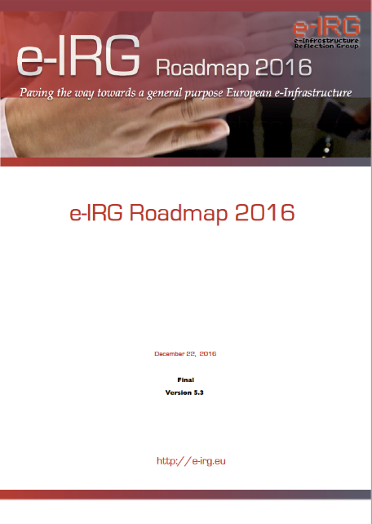
e-IRG related past recommendations! (4)
e-IRG Roadmap 2016
“..an emphatic co-operation among all main stakeholders is required: the providers (the e-Infrastructure developers and operators), the users (the scientific communities, both big users including Research Infrastructures and the long tail), and the funders (the EC and the national governments and their agencies).
A joint EU e-Infrastructure ERIC still seems to be far away, and thus the only way forward is good coordination through a formal coordination platform among all stakeholders in-line with the Commons, implementing a distributed multi- stakeholder model of governance”.
https://zenodo.org/record/4048805
Notes:
A bit like the tri-partite partnership…

Slide 20
e-IRG White Paper 2022 Coordination at EU-level
Process:
Dedicated meeting with EC (DG Connect and DG RTD) in Dec ‘21
Established informal link with EOSC Steering Board
Organised related sessions at May ‘22 e-IRG workshop under French EU Presidency
Session I: Towards a sustainable EOSC - The role of e-Infrastructures
Session III: Cross-e-Infrastructure collaboration and coordination
Prepared a questionnaire sent to all major e-Infra stakeholders – Aug ‘22
A set of first answers received last and this week – Sept ‘22
GEANT, PRACE, EOSC Steering Board, EUDAT, OpenAIRE

Slide 21
Dedicated e-IRG meeting with EC (DG Connect and DG RTD) in Dec ’21 (1)

Slide 22
Dedicated e-IRG meeting with EC (DG Connect and DG RTD) in Dec ’21 (2)
e-IRG in the EOSC context
Increased cooperation between research infrastructures, e-infrastructures and stakeholders in the ERA shall notably take advantage of the EOSC tripartite governance (EC, MS/AC, service providers and the research community).
An impactful eIRG should develop the proper interfaces with the EOSC-SB, its members and the EOSC-A (participating NRENs in the General Assembly but also in the Task Forces).
Such interfaces could hopefully help convergence within MS and across the EU, expressed ideally in the form actionable recommendations.

Slide 23
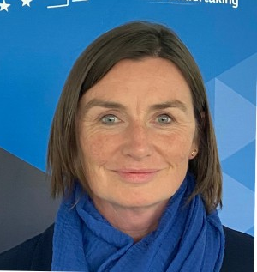
e-IRG May Workshop on cooperation Panel 1
Panelists:
Ute Gunsenheimer (EOSC Association)
Joséphine Wood (EuroHPC)
Cathrin Stöver (GÉANT)
Tiziana Ferrari (EGI Foundation)
Natalia Manola (OpenAIRE)
Debora Testi (EUDAT)

Slide 24
e-IRG May Workshop on cooperation Panel 2
Moderator:
Ignacio Blanquer (e-IRG delegate ES)
Peter Brönnimann (e-IRG delegate CH)
Speakers:
Sergej Mozina (ERA-Forum)
Gareth O‘Neill (Technopolis)
Pablo de Castro (EuroCRIS)

Slide 26
e-IRG White Paper 2022 Questions brief analysis(1)
2. Governance of EU e-Infrastructures (strategy setting-coordination):
How does the European e-Infrastructure organisation/initiative you represent perceive the idea of an e-Infrastructure umbrella Forum for community building, high-level strategy setting and coordination for the entire e-Infrastructure landscape
The vast majority of answers received so far is positive (covering all e-Infrastructures, including open scholarly communications) but clear definition of roles and coordination with existing bodies is required
EOSC SB proposes existing channels, e.g. EOSC-A, ESFRI SHF or upcoming ESFRI-EOSC TF. Also get advice from ERAC.
Some form of representation of users is also favoured, possibly advisory and domain-agnostic/neutral (however this is not easy)
Do you believe that besides a strategy / coordination forum a technical / operational forum across all e-Infrastructures would be beneficial
Mixed answers, some positive, some negative..
Notes:
Mention that 1. was administrative question about the responding organisation and responsible person

Slide 27
e-IRG White Paper 2022 Questions brief analysis (2)
3. Compatible policies/interoperable services/operational aspects:
Do you believe that the EOSC and EuroHPC (federation and sharing) paradigms should be expanded to federate data/services across all major European e-Infrastructures?
Mixed answers. EOSC and EuroHPC coordination should happen, but possibly a bit later
What about (EOSC and EuroHPC) compatible policies and interoperable services, so that they can be integrated in a federated portal?
Mixed answers, priority on each of the two first, before attempting to work together…
AAI paradigm: is this a success story?
Rather positive, although multiple providers and slow progress. Still quite some work to make it more user friendly and transparent when using services across different service providers.
Notes:
Note: This does not mean that one of them should integrate the other, rather coordinate their strategies and harmonise their policies (as peers) to be able to federate and share the data/services/software etc. for the benefit of the users

Slide 28
e-IRG White Paper 2022 Questions brief analysis (3)
3. Compatible policies/interoperable services/operational aspects:
Coordination to bridge the gap between resource access models in HPC and HTC?
Still early, but there is some work from PRACE on this. E.g. light weight peer-review evaluation for AI resources.
Contribution of the e-Infra Forum in the EU Charter of Access for RIs including e-Infrastructures
Very positive!
Coordination with industry (e.g. GAIA-X)?
Mixed answers, some positive, some negative (not a priority)
Other?
Yes, need for a cross eInfra helpdesk and training capacity
Notes:
Note: This does not mean that one of them should integrate the other, rather coordinate their strategies and harmonise their policies (as peers) to be able to federate and share the data/services/software etc. for the benefit of the users

Slide 29
e-IRG White Paper 2022 Questions brief analysis (4)
4. Cost and Business Models, Funding/Sustainability:
Does your infrastructure have a cost model and methodology to track its costs? If a federated e-Infrastructures, is there a common cost model/ methodology across the national components?
Mixed answers, some ongoing efforts but more work required.
Collecting and sharing different approaches (around methodologies and cost models) across Europe could provide value to the EU or national actors?
Very positive!
Business model and sustained funding?
Most say that they are working in this direction!
Notes:
Note: This does not mean that one of them should integrate the other, rather coordinate their strategies and harmonise their policies (as peers) to be able to federate and share the data/services/software etc. for the benefit of the users

Slide 30
e-IRG White Paper 2022 Questions brief analysis (4)
5. Other points :
Main barriers/obstacles for cross-e-Infra activities?
Different legal and funding environments, dependencies on projects
Administrative barriers rooted in the funding of resources that govern their usage
Fragmented environment (many e-Infras/services), different types of actors (from network, to hard core computing, to scholarly communication), different priorities/policies
Different or lack of common/coordinated business models
Other?
Common challenge for all e-Infrastructures: Talent shortage, keeping high-talented personnel (lower salaries compared to industry)
Ease of use / user-friendly services
Notes:
Note: This does not mean that one of them should integrate the other, rather coordinate their strategies and harmonise their policies (as peers) to be able to federate and share the data/services/software etc. for the benefit of the users

Slide 31
e-IRG White Paper 2022 Coordination at EU level
Next steps:
Feedback today (from panel and via Whova questions)
Proper analysis of questionnaire answers
Discussion at 70th e-IRG meeting (tomorrow!)
Analysis to be presented at e-IRG White Paper 2022 by Dec’2022
It will be prepared by e-IRG and include some recommendations
Contributions from e-Infrastructures to be included as annexes
To be discussed with e-Infrastructures (e.g. either include their answers (if agreed) and/or provide a summary position statement for the e-IRG White Paper)
Next e-IRG Workshop here in Prague: 12-13 December 2022 (Hotel Vienna House Diplomat)
One session on coordination and the White Paper finalisation
Notes:
December e-IRG Workshop will be acting as final consultation…

Slide 32
1st ESFRI Stakeholder Forum last week
Main topic: Cooperation among ESFRI and its stakeholders
ESFRI Chair: RIs should go beyond their “comfort zones” to cooperate with all stakeholders and perform cross-disciplinary research
Similar approach from e-Infrastructures?

Slide 33
e-IRG White Paper 2022
Preliminary Conclusions:
Cooperation and coordination is required at/and across all levels:
Federation Chain: Institutional/National (/Regional)/EU
First answers to questions indicate that e-Infrastructures appear to be willing to discuss the idea of an e-Infrastructure Umbrella Forum for coordination and strategy setting
Ultimately, this will benefit the end users
e-Infrastructures may need to go beyond the vested interests and comfort zones?
Is federation enough, or start talking about some more integration by 2030?
White Paper 2022 planned to be concluded by the end of the year!

Slide 34
Thank you!
Questions?
@eirgeu, #eIRG e-IRG community
www.e-irg.eu

