Slide 1
iMagine Administrative KO meeting
Sept 14, 2022

Slide 2
Agenda
20’
Project Overview
Speakers: Gergely (Project director), Dick (Project scientific director)
Project management, Finance, Administration
20’
Speaker: Mandy (Project manager)
10’
Virtual Access
Speaker: Mandy
Communication, outreach, and Event
20’
Speaker: Ilaria (Project communication lead)
20’
Q&A

Slide 3
Project Overview
Gergely Sipos (project director)
Dick Schaap (project scientific director)

Slide 4
Key Facts
OBJECTIVE:
To deploy, operate, validate, and promote a dedicated iMagine AI framework and platform, connected to EOSC and AI4EU, giving researchers in aquatic sciences open access to a diverse portfolio of AI based image analysis services and image repositories from multiple RIs, working on and of relevance to the overarching theme of ‘Healthy oceans, seas, coastal and inland waters.
36 project months
From Sept. 2022 until Aug. 2025
€4.5 million EC funding
24 participants (19 beneficiaries + 5 affiliated partners)
18 service installations (Virtual Access)

Slide 5
Specific Objectives and indicators
O1
Objective 1. Deliver a scalable, shared IT platform for image analysis in marine and freshwater research
Operational iMagine platform with common AI development framework from TRL 7 to 9
O2
Objective 2. Advance existing image analytical services to increase research performance in aquatic sciences
Launch of 5 aquatic AI image services, running operationally at the iMagine platform
O3
Objective 3. Develop & prototype new image analytical services and datasets that can accelerate progress towards healthy oceans, seas, coastal and inland waters
Set of AIS-based imaging processing services of relevance to research for healthy oceans, seas, coastal and inland waters
O4
Objective 4. Capture and disseminate development and operational best practices to imaging data and image analysis service providers
Best Practices documentation, interaction with EOSC and AI4EU platforms.
Training programme
O5
Objective 5. Deliver a portfolio of scientific image and image analytics services targeting researchers in marine and aquatic sciences
Portfolio: operational services, image repositories, Best Practices, iMagine framework and platform

Slide 6
Consortium Overview
Notes:
24 institutes
AI/ML technical experts (5): LIP, CSIC, IISAS, KIT, UPV
Infrastructure providers (6): TUBITAK, CSIC, INCD, Walton, GRNET, EGI
Research services and use cases (13)

Slide 7
Scientific relevance
Relevant EU Directives and initiatives for aquatic domain, such as:
· Marine Strategy Framework Directive (MSFD)
· Water Framework Directive (WFD)
· European Green Deal
· Mission Starfish 2030 “Healthy oceans, seas, coastal and inland waters”
· United Nation’s 2030 Agenda for Sustainable Development
· United Nation’s Decade of Ocean Science (2021-2030)
Their implementation requires an increase of our overall knowledge, demanding more science and improved access to observation data and analytical processing.
Europe already has developed an impressive capability for aquatic environmental observation, data-handling and sharing, modelling and forecasting, second to none in the world. This builds upon national environmental observation and monitoring networks and programs, complemented with EU initiatives such as the Copernicus programme (CMEMS) and EMODnet, and European Research Infrastructures (RIs).
Great additional potential in collecting and processing image data using high-performance image analysis tools, including Artificial Intelligence (AI) techniques, and in more sharing of image repositories.

Slide 8
Overall approach to achieve impact
iMagine will explore and exploit this potential further by developing:
1. A common iMagine AI framework and computing platform, based upon earlier DEEP developments and to be built on EGI resources, connected to EOSC, facilitating researchers in development, testing, training, hosting, and operating of AI based image analysis services, following FAIR practices.
2. Five operational and three prototype AI based image analysis services with image repositories, highly relevant for aquatic sector, to be deployed at the iMagine AI platform for open access and exploitation by researchers. These will demonstrate value and foster further uptake.
3. Best Practices consisting of documentation and training materials, giving practical guidance and examples to end-users on how to exploit image datasets and analysis applications offered by the iMagine portfolio, and to research engineers who wish to develop and deliver similar services, making use of the facilities of the iMagine AI platform.
Combined with Dissemination, Exploitation & Communication strategy and activities programme, this will maximise impact.

Slide 9
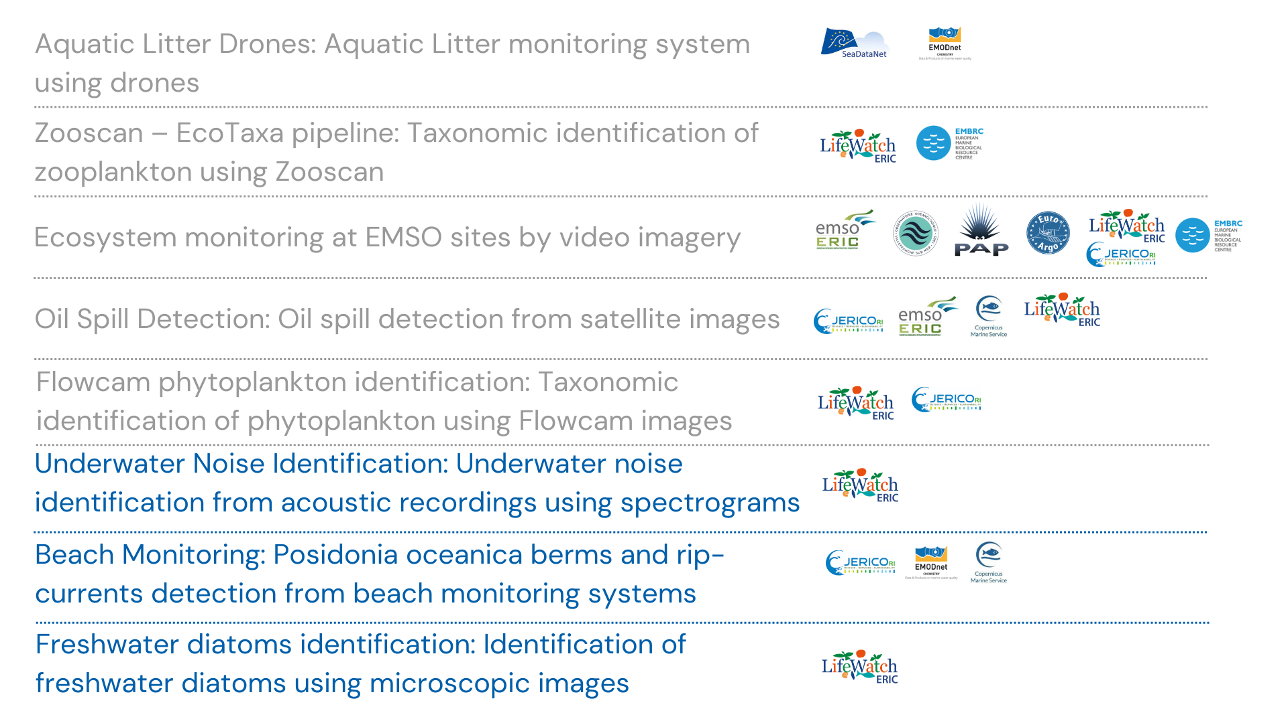
Use Cases & Their Link to RIs and Initiatives
WP5
WP3

Slide 10
Key Exploitable Results (KERs), Target groups
Service and content providers
Researchers
EOSC, AI4Europe and other AI communities
Private Companies
Policy Makers
Environmental and other Governmental Agencies
NGOs and other organizations
KER2: A portfolio of new, validated AI services
KER1: A portfolio of proven, operational, AI services
KER3: A large collection of high-quality image repositories
KER4: Federated IT platform for developing, testing, training, deploying, and running AI-based imaging applications.
KER5: Lessons learnt and best practice documentation.

Slide 11
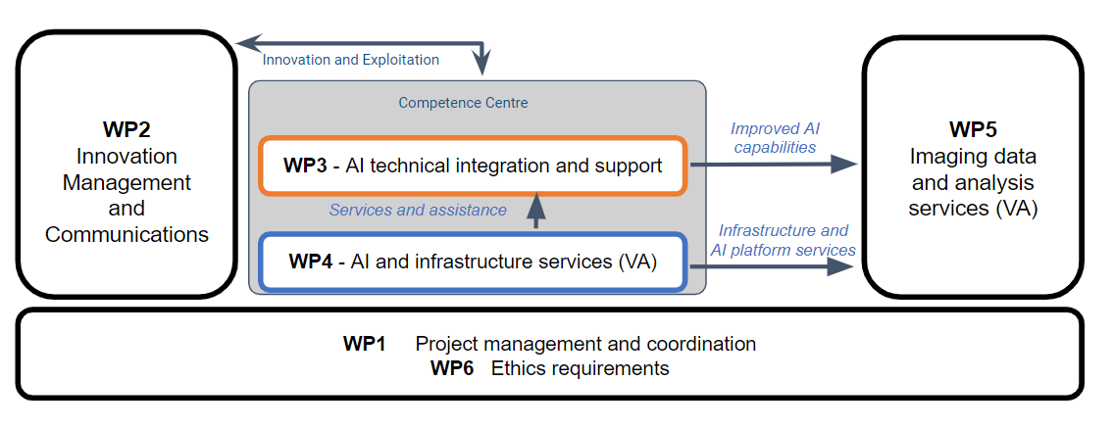
WP structure and coordinators
KIT (Valentin Kozlov)
MARIS (Dick Shaap)
EGI (Smitesh Jain)
CSIC (Álvaro López García)
EGI (Mandy Lin)

Slide 12
18 Virtual Access Infrastructure developed and maintained by 18 Partners
WP4 VA access provisioning: AI and Infrastructure Services (13) | WP5 VA access provisioning: Imaging data and analysis tools (5)
DEEP - AI Application (PARTNER’S NAME) DEEP - AI Application Development Service DEEP - AI Applications as a Service iMagine AI framework INCD - CPU INCD - GPU INCD - Storage TopCloud - CPU TopCloud - GPU TopCloud - Storage TR-FC1-ULAKBIM WaltonCloud - CPU WaltonCloud - Storage | Flowcam phytoplankton identification Marine ecosystem monitoring service Marine litter assessment service Oil spill detection service Zooscan taxonomic identification service
Scalable AI/ML
Scientific image databases and AI/ML services
Federated compute & storage
(Portugal, Spain, Turkey, Ireland)

Slide 13
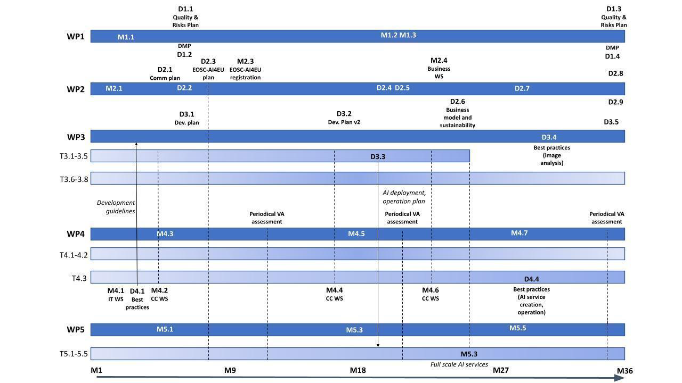
High level timeline
Imaging services plans
AI/ML service setup
Notes:
Table 3.1

Slide 14
Project Management, Finance, Regporting

Slide 15
Grant Agreement and Consortium Agreement
Grant Agreement Signed: https://confluence.egi.eu/display/IMP/Official+Documents
Consortium Agreement 2nd version:
Final version by the end of September
CA background
Activate signing process: in October
Notes:
Background in Horizon Europe CA: In Horizon Europe, Background is not just limited to just Intellectual Property Rights. Background means any data, know-how or information, including any rights such as IPR that is held by the beneficiary before they acceded to the Agreement, and is needed to implement the action or exploit the results”. Therefore, the background can take many forms, not only the form of intellectual property rights, it could be information, databases, tangible assets, trade secrets, know-how..."
So, we suggest including even the expertise or know-how or databases that you will bring to the table during the project that will be needed for implementing the project actions or for exploitation of the results.
Another thing to be noted is that an intellectual asset should be included in the background even if they are open access as long as it is owned (or partly owned) by you.

Slide 16
DoA changes
During Grant Agreement Preparation:
STFC withdrew the consortium during Grant Agreement Agreement
Ethic management is added by default upon the request from EC into project workplan as WP6 with D6.1 is expected at M6
Amendment:
Organization change: WIT merged as SETU
Budget alignment: CMCC, UNITN, Ifremer

Slide 17
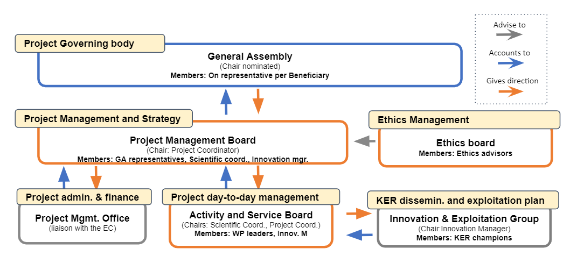
Management structure
Boards
Notes:
To update image (Coordinator → Director, sci coord → sci coord, Ethics board)
Add key members’ names to boards
To announce: Looking for volunteers for
Ethics board members (3)
GA chair volunteer (1)

Slide 18
Funding breakdown and allocation- by cost category
Cost Category | EC Funding | Notes
Direct personnel | 3,319,729 | 74% of total funding supporting 552PM
Travel | 74,950 | €62K within partners own pocket, reserved international travels, WS participation (WP4, WP5)
Other cost | 89,519
project management | 27,519 | CFS, financial reporting tool
communication & dissertation | 55,040 | KoM events, publication fee, dissemination materials
exploitation & innovation | 6,960 | Business model & sustainability workshops
Subcontracting | 89,000 | IPR consultancy, Code development
Unit Cost | 55,752 | WaltonCloud, TR-FC1-ULAKBIM
Indirect cost | 871,050
Total | 4,500,000
Notes:
OC- c&d under BE01, 08, 18

Slide 19
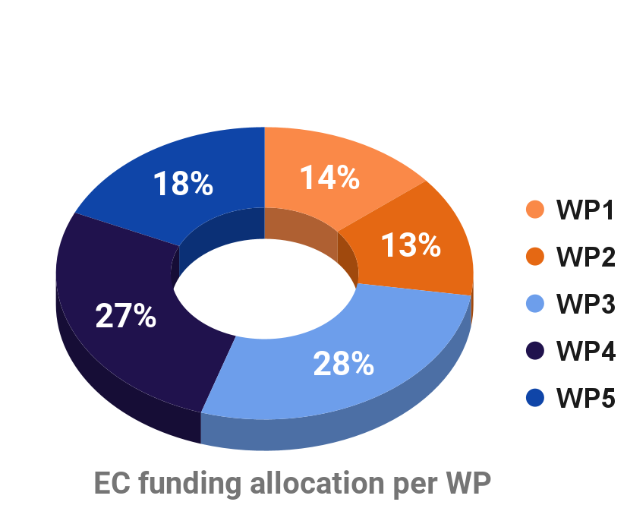
Funding breakdown and allocation - by work package
WP | Total PMs | Total Eligible costs
WP1: Project Coordination and Management | 56 | 633,336
WP2: Exploitation and Innovation Management | 55 | 602,008
WP3: AI technical integration and support | 155 | 1,236,477
WP4: VA AI and Infrastructure Services | 186 | 1,209,792
WP5: VA Imaging data and analysis services | 100 | 818,388
Grand Total | 552 | 4,500,000
**Ethic management required by EC was added by default as a new WP during GAP currently without efforts allocated.
Notes:
WP3: 8 user cases
WP5: 5 mature cases

Slide 20
WP6 Ethics
Deliverable D6.1
“iMagine does not limit itself to federating existing research infrastructures, but may also develop new images repositories and AI-based image processing techniques. It aims to disseminate the datasets and AI-based image processing techniques it develops as widely as possible. Such innovations in AI-based image processing, within the wider field of computer vision, may lead to potential ethical issues of misuse in relation to surveillance, security and intelligence gathering applications. Further, it will develop 5 mature (TRL7 ) use cases, one of which, an aquatic litter monitoring system using drones, could raise ethical issues.
This use case will establish an operational service at the iMagine platform for ingestion, storage, analysis and processing of drone images, observing litter floating at surface waters in seas, rivers and lakes, and lying at beaches and shores. Littering is directly related to human activities.
This could raise personal data issues, as drone-captured images of beaches and other aquatic litter areas may include humans (at-risk humans even like migrants).It is unclear in the documentation if the planned standard protocols for drone observation and for classifying observed litter objects will address this issue, and if and how it will be included in the planned guidance and training material. There is a near-absence of provisions for ethics management in the documentation, where the (unspecified) ethical management of the project rests with the administration and finance management task (T1.2), with no hint that someone with expertise in ethical issues associated with such emerging AI-based technological systems will be involved.
For these reasons, the project should include an Ethics Advisor to ensure that iMagine has appropriate ethics governance processes in place to prevent misuse of new advances in AI-based image processing techniques and to accompany its aquatic litter monitoring using drones application.”

Slide 21
Prefinancing Schedule
Timeline | % grant total | EC payments | Partners payments | Dates
Total budget | 100% | 4,500,000.00
EC payment initial pre-financing | 48% | 2,174,850.00 |  | 22-08-2022
advance N1 (14.4M equivalent) | 40% |  | 1,800,000.00 | CA signed
advance N2 (3M equivalent) | 8% |  | 374,850.00 | M13
EC interim payment | 37% | 1,650,150 |  | RP1 (M12) and RP2 (M24)
Final Payment EC | 10% | 450,000
Payment MIM 5% | 5% | 225,000
Final payment partners
Balance | 100% | 4,500,000 | 2,174,850

Slide 22
Reporting

Slide 23
Reporting Calendar & Timeline
3 Financial periodic reports: M1-12, M13-24, M25-36
3 Project periodic reviews by EC: M15, M27, M39
Intermediate reports (every 6 months and validated by ASD/PMB):
Financial data -effort and costs used
VA metrics

Slide 24
Financial Reporting
M1
M12
M24
M36
Reporting period
P1
P2
P3
Intermediate report (Financial data and VA metrics)
M1-6
M7-12
M13-18
M19-24
M25-30
M31-36
Usage report is an important input of ADS (Activity Service Board):
Mandatory from EC
Impact on activities plan, services delivery and WP2 (Support, Dissemination and Communication)
Notes:
Show ASB as ‘user’ of the service usage report - Show that their analysis feeds back to the activity plans, esp to WP2 (comm, outreach, support) and service delivery tasks

Slide 25
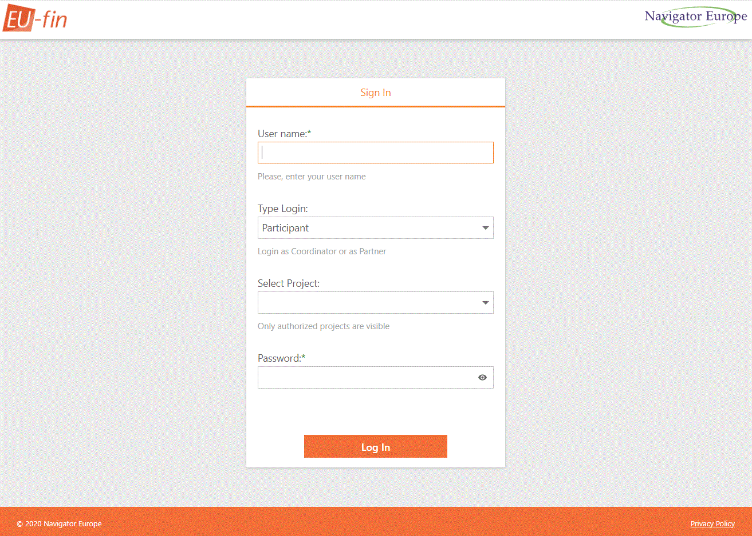
Finance management tool
Each Beneficiary will receive an user activation notification.
Instruction will be available at Confluence

Slide 26
18 Virtual Access Infrastructure developed and maintained by 18 Partners
WP4 VA access provisioning: AI and Infrastructure Services (13) | WP5 VA access provisioning: Imaging data and analysis tools (5)
DEEP - AI Application (PARTNER’S NAME) DEEP - AI Application Development Service DEEP - AI Applications as a Service iMagine AI framework INCD - CPU INCD - GPU INCD - Storage TopCloud - CPU TopCloud - GPU TopCloud - Storage TR-FC1-ULAKBIM WaltonCloud - CPU WaltonCloud - Storage | Flowcam phytoplankton identification Marine ecosystem monitoring service Marine litter assessment service Oil spill detection service Zooscan taxonomic identification service
Scalable AI/ML
Scientific image databases and AI/ML services
Federated compute & storage
(Portugal, Spain, Turkey, Ireland)

Slide 27
VA Report main steps
Validate
Measure
Report
Agreed measure- ment methods, usage metrics
Measure the usage by new users
Report in the spreadsheet every 6 months
Actions ongoing among providers and work package leaders
approve/change onboarding proposal
confirm the contacts, responsible person and method of metrics collection
Notes:
via Open Call, users have access to services
steps: metrics,

Slide 28
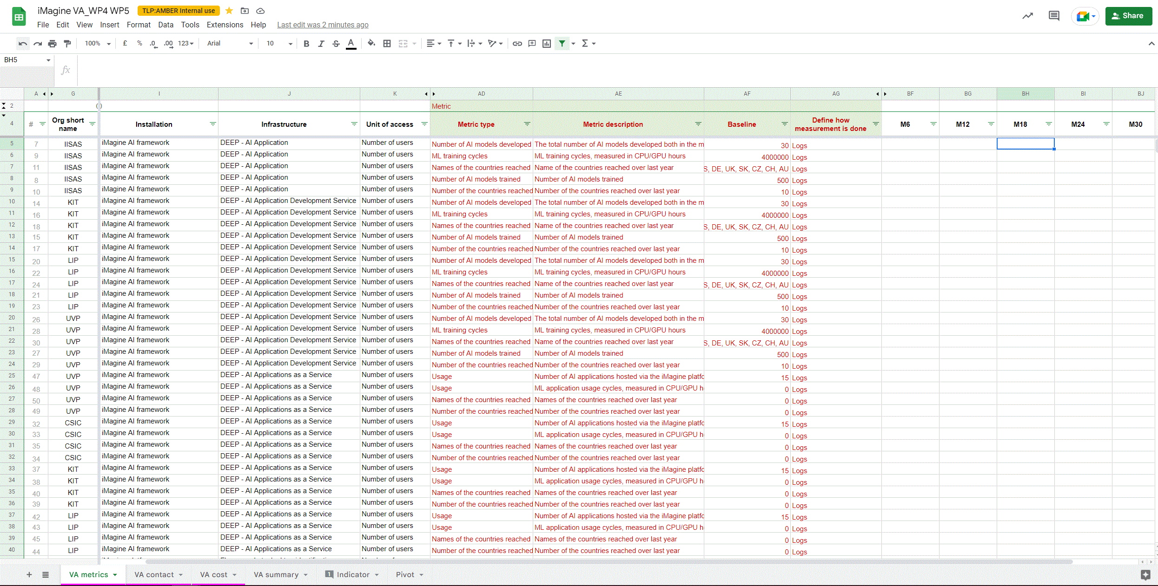
VA Metrics reporting
Speadsheet: https://shorturl.at/GPXY3
Validation:
VA contact person for collecting metrics
VA metric type, description, baseline, way of measurement
Target prediction
ACTION FOR WP4 & 5 members:
Check you RED rows
Change values if needed
Change colour to BLACK

Slide 29
Collaboration Tools

Slide 30
Collaboration space
Intranet - Confluence: https://confluence.egi.eu/display/IMP/iMagine+project+Home
E.g. for deliverables, presentation slides
Status: in preparation
Access: everyone in the consortium
To get an access to internal pages please contact
imagine-po@mailman.egi.eu
WP-specific email lists:
Under setup

Slide 31
Task tracking
Jira: jira.egi.eu
Status: in preparation
By default: boards
New jira projects request: please contact iMagine-po@mailman.egi.eu
Access: everyone in the consortium
To get an access to internal pages please contact
iMagine-po@mailman.egi.eu

Slide 32
Other tools
Other tools:
Mailing lists
https://confluence.egi.eu/display/iMagine/iMagine+mailing+lists
By default: boards, all WPs
New mailing lists request, please contact iMagine-po@mailman.egi.eu
Indico:
https://indico.egi.eu/category/367/
Main project events
WP/task leaders can use for internal events
More will be defined in quality and risk management plan

Slide 33
Communication, outreach, events

Slide 34
Logo and elements
All assets available at https://confluence.egi.eu/display/IMP/Communication+Toolkit
The logo elements can be used separately and are also available in white/orange
The logo is also available in white/orange for coloured backgrounds

Slide 35
Online Presence
Web address
Twitter
LinkedIn
https://www.imagine-ai.eu
https://twitter.com/eu_imagine
https://www.linkedin.com/company/imagine-aquatic-science/

Slide 36
Upcoming deadlines
M1 project branding package
Logos, font and brand guidelines
M3 - website release
see structure in the next slide
M3 - brochure with use cases
description of the use cases - will feed the dedicated section on the website
M5 - D2.1 Communication, Dissemination and Engagement Plan
Dissemination plan for project results, developments and branding; engagement plan with the targeted audiences, clear dissemination strategy, description of promotion, consultancy, outreach, training and co-design activities.

Slide 37
Website structure - proposal
due in M3
About
objectives, KERs
partners (institutions and roles in the project)
contact info
stay in touch: spot highlights that are worth direct contacts
Case studies
sub page for each of them describing the case study, progress and results
News and events
Resources
Publications, deliverables, best practices and guidelines

Slide 38
Target groups
Users
Similar AI initiatives
Decision makers
e.g. research infras, user communities
e.g. AI4EU platform, AI activities under Pillar II of Horizon Europe
e.g. policy makers, local authorities
Private sector
Organisations/
agencies from different disciplines
e.g. environment monitoring companies
e.g. NGOs, specialised training centres

Slide 39
Monitoring indicators
 | Activity | Measure
Users | Create and maintain (online) engagement channels | # Page visits, engagement rate on social media, # clicks on project related content in EGI newsletter, # attendees during presentations at events leading to an indication (e.g., feedback, low # requests for more information) that the audience understands the project.
 | Promote use cases | # Use cases clicked on website, # times use cases brochures downloaded, leading to an indication (e.g., feedback, presentations) that the audience understands and exploits the use cases.
 | Inform users how to access and use the outputs of the project (services, IT platform, image repository etc.) | # Page visits, engagement rate on social media, # attendees during presentations at events, # attendees at webinars and training, leading to an indication (e.g., new use cases) that the audience uses the outputs of the project correctly.
Similar AI initiatives | Share news items on project objectives and activities | # Clicks on newsletter item, interaction during events/email, leading to an indication (e.g., request for collaboration/more information) that the audience understands the benefits of the project for the (shared) AI environment.

Slide 40
Monitoring indicators
 | Activity | Measure
Decision makers | Inform about project and its importance for the environment and society | # Page visits, # clicks on relevant items in newsletter, leading to an indication (e.g., request for impact reports) that the audience will exploit the project outcome to influence policies.
Service and content providers | Communicate about possibilities to offer/highlight services | # Page visits, # clicks on item in newsletter, # responses to call/informal inquiries to onboard service, leading to an indication (e.g., request to offer service) that the audience understands the opportunities.
General public | Raise visibility of the project, by creating a brand identity and media pack | # Downloads on communication material/media pack, # page visits on the ‘about’ page, leading to an indication (e.g., recognition, request for media pack) that the audience knows what the project looks like and where to find the branding/communication material.

Slide 41
Stakeholders engagement timeline
M1
M3
Users: Social media accounts set up
Similar AI Initiatives: start creating awareness through social media
Decision-makers: start relevant impact campaigns to create awareness on social media
Users: website launched. Newsletters
input into EGI newsletter on a monthly basis.
Anytime there is a relevant event, the project will raise awareness of the engagement channels. A list of 8 use cases is ready to be published on the website. Brochure with use cases
Similar AI Initiatives: show relevance to similar AI initiatives through website
Decision-makers: specific content to target this audience anytime there are relevant events to contribute to
Service providers: provide information on the project website anytime there are services to showcase
Users: Inform users how to access and use the outputs of the project
Similar AI Initiatives: showcase project impact and relevance to similar AI projects via webinars and events
M2
from M4

Slide 42
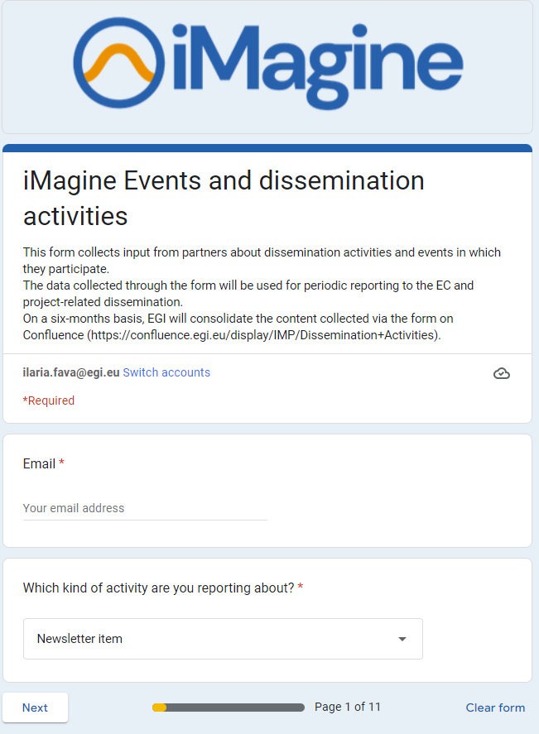
Dissemination activities
ongoing exercise for all partners
Available in the shared folder: https://docs.google.com/forms/d/e/1FAIpQLSdYSS0sClyu4cLczfEtuc6T0YKW_6ExVxrZBzKJumpa6CigvA/viewform
All partners: report your activities here!
Every 6 months, the content is consolidated on Confluence

Slide 43
Planned events
Event description | Responsible WP | Due date | Description
Workshop on IT federation and AI platform installation for adopter sites | WP4 | M2
Competence Centre workshop | WP5 | M5, M16, M22
Business Model and Sustainability workshop | WP2 | M22
Notes:
https://docs.google.com/spreadsheets/d/1FkEwuIBUsQWFMIDuL2MxY2AlKWMMR4rF_dENsrTq-LM/edit#gid=1364179614

Slide 44
Upcoming events
Presentation at 4th Marine Imaging Workshop, 3-6/10/22 Brest (France)
National event at CSIC, Spain (date TBD)
If you’re going to participate in or present iMagine in any other events, share the details in the chat!

Slide 45
Project technical kickoff
23 Sept, Prague
AI/ML session on the 22nd (Dick and Alvaro to present iMagine)
Dinner on the 22nd
Technical meeting on the 23rd (9-15)
Partner self introduction (slide template to be sent today)
WP3, 4, 5 presentations (input requested by WP leaders these days)
Status of registration
Still missing: CMCC, TUBITAK, MI, OrbitalEOS, University of Trento, UPV, VLIZ, INCD
Please let us know if you can’t participate ftf. If you’re coming but forgot to register, do that ASAP and inform us about your participation to the social dinner!

Slide 46
Thank you!

