Slide 1
iMagine Imaging data and services for aquatic science
Kick-off meeting
HORIZON-INFRA-2021-SERV-01-06 - Enabling research infrastructure services for better use of imaging data to address challenges in thematic research areas
Pierre Quertenmont
Project Officer
REA C.4

Slide 2
Role Distribution
DG Research and Innovation
-> Definition of Policies
-> Drafting the Work Programme
European Research Executive Agency (REA)
‘Reforming European Research & Innovation and Research Infrastructures’, Unit C4
-> Implementation of calls for proposals
-> Grant Management
Coordinator
-> Monitor that the action is implemented properly
-> Act as the intermediary for all communications with REA
-> Distribution of payments

Slide 3
Main objectives and expected impact as per Work Programme
Aim: offer services, including AI-based services for improved analysis of imaging data in different thematic areas. Appropriate links and complementarities with the existing AI4EU platform and relevant activities under Pillar II of Horizon Europe.
AI-based tools and services will make use of the EOSC commons as working environment where these tools, services and relevant data sets will be made findable and accessible for use, thus making EOSC operational for the delivery of research infrastructure data services for thematic research challenges.
Expected outcomes:
improved acquisition, quality, interoperability and analysis of imaging data from different disciplines;
wider use of image analysis services based on AI in different scientific areas.

Slide 4
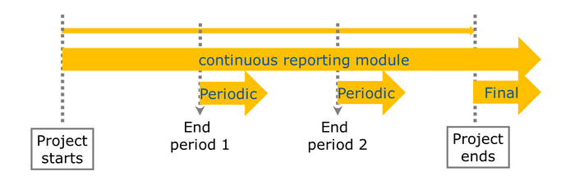
Reporting guidelines

Slide 5
Periodic report iMagine: period 1 M1-12, period 2 M13-24, period 3 M25-36
WHEN
60 days after reporting period end
WHAT
Periodic Report:
HOW
via Portal
1. Technical report
- Prepared by the Coordinator
* What was done and achieved?
* Which problems were encountered?
* How can progress so far be assessed?
* Were there any deviations or corrective actions?
2. Financial report
- Individual financial statement
- Explanation of the use of resources and information on subcontracting
- The certificates on the financial statements (CFS)

Slide 6
Periodic reporting: reviews
Reviews planned at the end of final reporting period (1 month after submission of reports). Article 21 of the GA
iMagine: months 15, 27, 39
Present the work carried out, main achievements and use of resources.
Participation of the coordinator and WP leaders.
REA is assisted by external expert(s)

Slide 7
Overview: Reporting and Monitoring
End of reporting period
Revisions and explanations
End of reporting and payment
Within 60 days
DELIVERABLES submitted
Periodic REPORT
submitted (technical and financial)
Submission of revised version of reports (technical and financial)
ALL documents received, correct and accepted
Comments from
Project Officer and Financial Officer – clarifications and modifications may be requested
ONE iteration for intermediate reports; more than one iteration may be necessary for final report
Initiation payment
Review meeting
Review report submitted

Slide 8
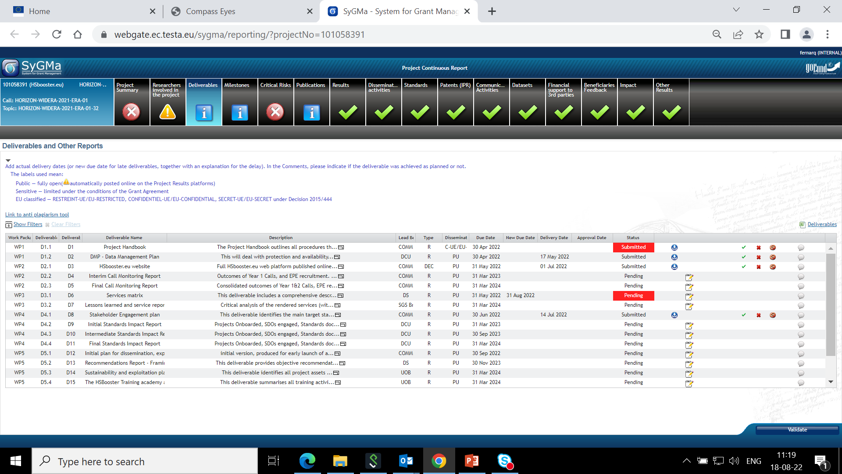
Continuous Reporting – deliverables
!!!!! All HE deliverables flagged as 'PUBLIC' will be published in Cordis
Be particularly attentive to quality of all public deliverables!

Slide 9
Trans-national and Virtual access – reporting
How is the access advertised?
Description of the selection procedure: be mindful that
the selection panel is 50% outside of the consortium
the proposals are judged on scientific excellence
the selected groups are outside of the country where the RI is based
Description of the TA/VA activity
Scientific output of the users at the facilities
User feedback meetings

Slide 10
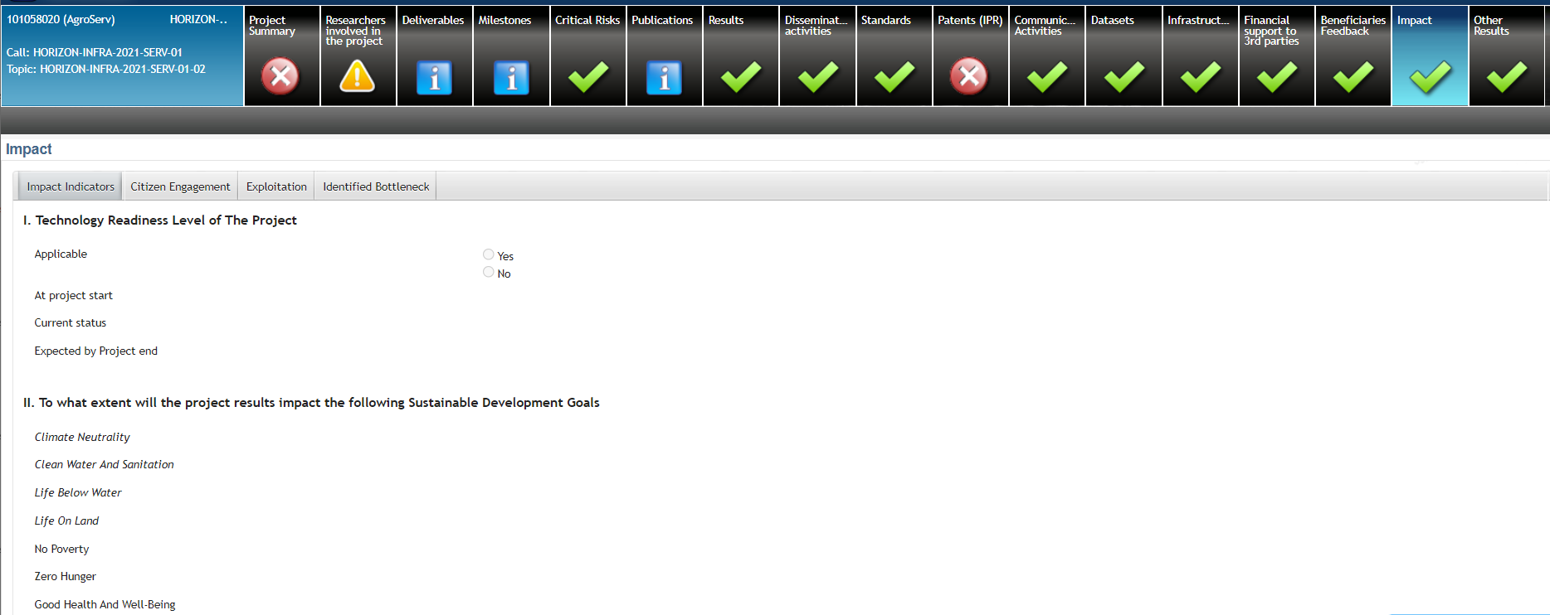
Novelties in continuous reporting - HE
Coordinators’ day autumn 2022 !!
Title: Horizon Europe Coordinators’ Day on Grant Management
Date: 04 October 2022, from 09:30am to 12:40am (CET, Brussels time)
Event website: https://ec.europa.eu/research/participants/docs/h2020-funding-guide/other/event221004.htm

Slide 11
Financial management: some advice
Personnel Costs: KEEP TIME RECORDS of the hours worked on the action (if not working full time on an EU project)
Meetings: collect participants’ signatures (especially if you reimburse or claim travel costs)
Any subcontracting?
If you need a subcontract which is not planned in the Description of Action, ask approval to the REA project officer beforehand as this may require an AMD
Note to the coordinator if one partner overspends, it is up to the coordinator with the Consortium to decide internally how the EU contribution will be distributed (i.e. full amount if the overspending is due to anticipated work, or only the budget share agreed for the reporting period).

Slide 12
Amendments

Slide 13
Amendments
Amendment needed if:
Change of the coordinator’s bank account for payments
Addition/removal of linked third party
Change of action’s title, acronym, duration, reporting periods
Change of Annex 1 (description of action)
Change of Annex 2 estimated budget
Change of coordinator or its legal status
Change of dissemination status of a deliverables (PU→SEN or SEN→PU)
Budget transfer is allowed between beneficiaries and among existing budget categories without filing an amendment
Action to be implemented as described in Annex I
If the change is significant, an amendment to the GA is needed
Grant agreement duration is, as a rule, not extended (except Force Majeure)
TIP
Always contact the REA PO (Coordinator – PO) to discuss the typology and impact of change

Slide 14
Communication, Dissemination, Exploitation

Slide 15
Communication, dissemination and exploitation

Slide 16
Acknowledge EU Funding
Make sure to display the European flag (emblem), do not use the European Commission logo!
Find guidance and download the EU emblem: https://europa.eu/!m83Myq

Slide 17
Disclaimer
Disclaimer GA art . 17.3 must be added in any publication/output:
” Funded by the European Union. Views and opinions expressed are however those of the author(s) only and do not necessarily reflect those of the European Union or [name of the granting authority]. Neither the European Union nor the granting authority can be held responsible for them.”

Slide 18
How can REA support you?
Has your project won an important scientific award? Have you made a ground-breaking discovery and are featured in the press?
Don’t forget to inform your project officer!
REA’s Communication team can help promote by:
• Highlighting & multiplying your news and results through our own and the Commission’s social media channels (please tag us!)
• Proposing your project’s success story for inclusion in the European Commission’s free-of-charge communication channels.

Slide 19
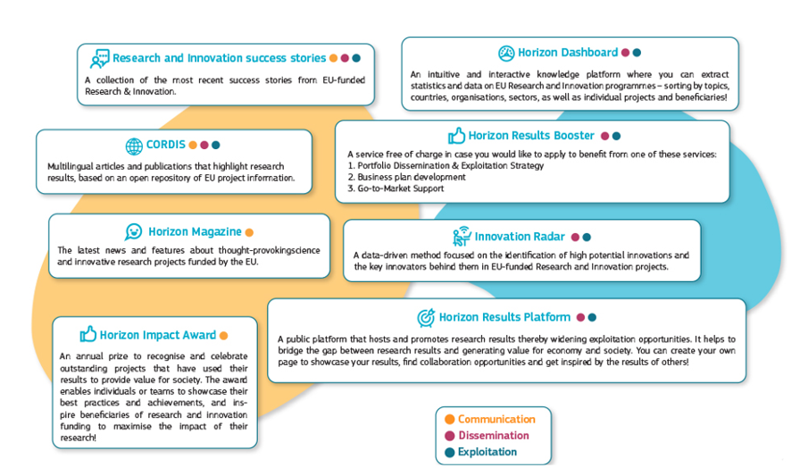
Free-of-charge European Commission dissemination tools

Slide 20
Open Science
Model Grant Agreement requirements
1. Open access to scientific publications
2. Research Data Management

Slide 21
Key points on open science in Horizon Europe
Beneficiaries must manage the digital research data generated in the action responsibly, in line with the FAIR (“Findable”, “Accessible”, “Interoperable”, Reusable”) principle
Establish + regularly update a data management plan (‘DMP’) for generated (and/or collected) data (M6)
Ensure open access ‘as open as possible, as closed as necessary'
Useful resources
Horizon Europe Annotated Model Grant Agreement (Annex 5, section 2 -pg 154)
Horizon Europe Data Management Plan Template (under reference documents of the Funding and Tenders portal).

Slide 22
1. Open access to publications (1/2)
Beneficiaries must ensure open access to peer-reviewed scientific publications relating to their results. In particular, they must ensure:
at the latest upon publication, deposition of the Author Accepted Manuscript or Version of Record in a trusted repository + immediate open access via the repository under a Creative Commons Attribution license (CC BY) or equivalent (Creative Commons Attribution Non Commercial/Non Derivatives licenses or equivalent are allowed for long-text formats)
information via the repository about any research output/tools/instruments needed to validate the conclusions of the scientific publication
Metadata must be open under a Creative Commons Public Domain Dedication (CC 0) or equivalent, in line with the FAIR principles and provide information about the licensing terms and persistent identifiers, amongst others.

Slide 23
Open access to publications (2/2)
Beneficiaries (or authors) must retain sufficient intellectual property rights to comply with the open access requirements
Publication in venue of their choice but publication fees are reimbursable only if publishing venue is full open access (publication fees in hybrid venues are not reimbursed)
Beneficiaries have the possibility to publish at no costs in Open Research Europe, the European Commission open access publishing platform

Slide 24
2. Research data management (1/2)
Beneficiaries must manage the digital research data generated in the action responsibly, in line with the FAIR (“Findable”, “Accessible”, “Interoperable”, Reusable”)principles and:
establish + regularly update a data management plan (‘DMP’) for generated (and/or collected) data
as soon as possible and within the deadlines set out in the DMP, deposit the data in a trusted repository (federated in the EOSC if required in the call conditions) + ensure open access under CC BY, CC 0 or equivalent, following the principle ‘as open as possible as closed as necessary’
provide information via the repository about any research output/tools/instruments needed to re-use or validate the data
Metadata must be open under CC 0 or equivalent (to the extent legitimate interests or constraints are safeguarded), in line with the FAIR principles and provide information about the licensing terms and persistent identifiers, amongst others.

Slide 25
Research data management (2/2)
There are exceptions to open access to research data.
Data may be kept closed if:
providing open access is against the beneficiary’s legitimate interests, including regarding commercial exploitation;
it is contrary to any other constraints, such as data protection rules, privacy, confidentiality, trade secrets, Union competitive interests, security rules, intellectual property rights or would be against other obligations under the Grant Agreement.

Slide 26
Trusted repositories under Horizon Europe
Trusted repositories are either certified repositories (e.g. CoreTrustSeal, nestor Seal DIN31644, ISO16363) and/or disciplinary/domain repositories that are commonly used/endorsed by the research communities (e.g. ELIXIR deposition databases).
General-purpose repositories and institutional repositories are, in general, also acceptable.
Trusted repositories share essential properties:
Mechanisms to ensure integrity and authenticity of contents.
Offer clear information about their policies/services.
Provide broad, and ideally open access to content (consistent with legal and ethical constraints).
Assign PIDs, ask for detailed metadata in a standardized (e.g. Dublin Core) and machine-readable way.
Ensure mid- and long-term preservation of contents, expert curation, quality assurance.
Meet national and/or international security criteria

Slide 27
Open Research Europe
Why Open Research Europe?
Support our open access policy and beneficiary capacity to adhere to it and also enables publishing post-grant
Leading by example in operationalising open science principles within scientific publishing and enabling the European Research Area
Contribute to transparency and cost-effectiveness and explore sustainable open access publishing business models
What is Open Research Europe?
A peer-reviewed publishing platform. Not a repository. Post-publication peer-review model. First you publish, then review takes place. Publication and review reports open access under CC BY licenses. Optional service for our beneficiaries at no cost to them.

Slide 28
Audits

Slide 29
Audits
Keeping records: Keep a clear account of the project activities during the reporting period (Article 20 Grant Agreement).
Beneficiaries must keep records and other supporting documentation up to 5 years in order to prove the proper implementation and the costs declared as eligible.
Audits can be carried out during the entire lifetime of the project, by the European Commission, not later than 2 years after the payment of the balance.
Two types of audits: financial and/or technical audits

Slide 30
Links and useful information

Slide 31
HE Online Manual
https://webgate.ec.europa.eu/funding-tenders-opportunities/display/OM/Online+Manual
Grant management
Keeping records
Amendments
Reports & payment requests
Deliverables & milestones
Dissemination & exploitation
Communicating your project
Acknowledgement of EU funding
Checks, audits, reviews & investigations

Slide 32
Useful links
HE Annotated Model Grant Agreement
Guidance on social media for EU funded R&I projects
Horizon Europe – Funding Programme for Research and Innovation
Factsheet ‘Open Science in Horizon Europe’
Communication on ‘A new ERA for Research and Innovation’
Pact for Research and Innovation in Europe

Slide 33
Keep in touch
ec.europa.eu/info/research-and-innovation_en
europeancommission
rea.ec.europa.eu
@EuropeanCommission
@REA_research
EUTube
European Research Executive Agency (REA)
EU Spotify

Slide 34
Thank you
© European Union 2020
Unless otherwise noted the reuse of this presentation is authorised under the CC BY 4.0 license. For any use or reproduction of elements that are not owned by the EU, permission may need to be sought directly from the respective right holders.

