Slide 1
EGI-ACE Open Call no.5
Checkpoint meeting with Shepherds
IOT-SESOD
Andrea Manzi/EGI Foundation
Levente Farkas/EGI Foundation

Slide 2
Outline
Background about the use case
Current status

Slide 3
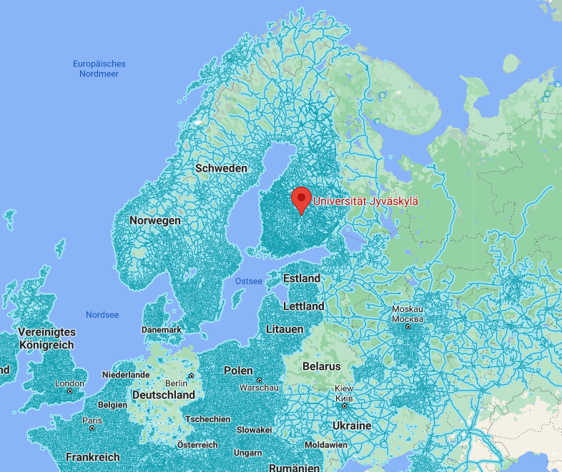
Binare is a finnish cybersecurity deep-tech spin-off from the University of Jyväskylä (JYU)
Where is Jyväskylä?

Slide 7
Current status
Deployment of the platform for the generation of the SBoMs already started for EUHubs4data project in May 2021
vo.binare-oy.eu VO available in Comanage
OLA updated with INFN-CLOUD-BARI till the end of the year with the new quota requested, SLA updated
https://documents.egi.eu/public/ShowDocument?docid=3762
384 vCPU cores, 768 GB RAM, 10 TB storage
EOSC MP orders created
Under discussion for the next period
Possibility to use EGI DataHub for datasets publication and the PaaS orchestrator to deploy the software
Integration of the platform with EGI Check-in
Registration of the platform in EOSC MP

