Slide 1
EGI-ACE Open Call no.5
Checkpoint meeting with Shepherds
GRAPEVINE
Ignacio Lamata Martinez / EGI Foundation
TLP:AMBER

Slide 2
Outline
Background about the scientific use case
Ambition, Impact and Challenges
Integration Support
Capacity Requirements
Timeline

Slide 3
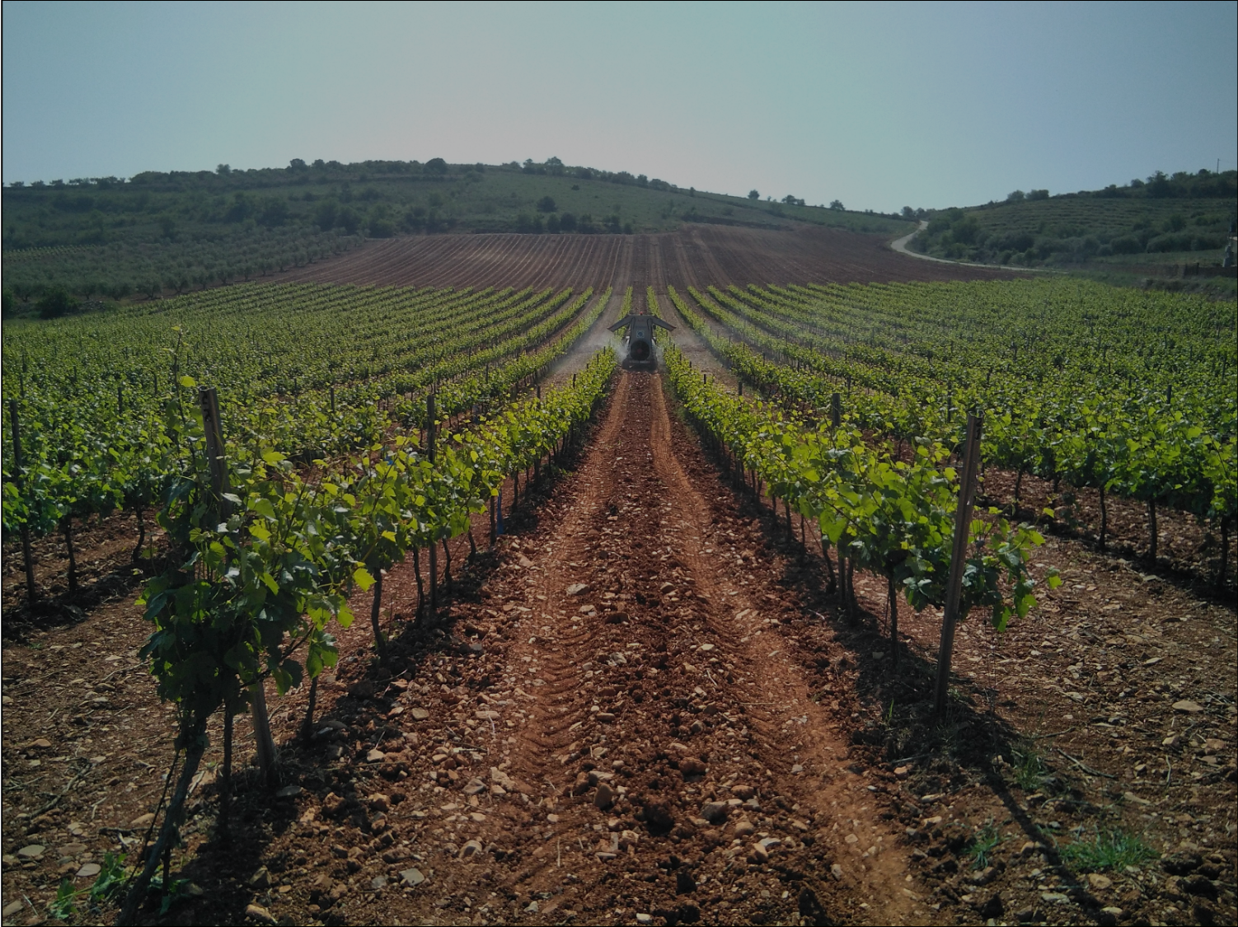
Background about the scientific use case
GRAPEVINE (hiGh peRformAnce comPuting sErvices for preVentIon and coNtrol of pEsts in fruit crops) is an initiative to improve current pest prediction and control systems in the wine sector, with the support of Machine Learning techniques.
Objectives:
Reduce the environmental impact by optimising the use of phytosanitary products and increasing biodiversity.
Provide an intelligent decision support tool for grape growers, adaptable to other regions.
Improve farms sustainability.
21/06/2022

Slide 4
Background about the scientific use case (cont)
Duration: 01 Oct 2019 - 30 Sep 2022 (applied for extension: 28 Feb 2023)
Key people:
PI: Rafael del Hoyo Alonso (ITAINNOVA)
Project coordinator: Ricard Munne Caldes (ATOS)
Partners (~70% Spain, 30% Greece):
Instituto Tecnológico de Aragón (ITAINNOVA)
ATOS SPAIN S.A (Atos)
ARISTOTLE UNIVERSITY OF THESSALONIKI- SPECIAL ACCOUNT FOR RESEARCH FUNDS (AUTH-ELKE)
Fundación Pública Galega, Centro de Supercomputación de Galicia (CESGA)
UNIVERSIDAD DE ZARAGOZA (UNIZAR)
SOCIEDAD ARAGONESA DE GESTIÓN AGROAMBIENTAL S.L.U. (SARGA)
AGRO APPS I.K.E. (AGROAPPS)
21/06/2022

Slide 5
Ambition, Impact, Challenges
Adapt a set of phenological, disease and meteorological models to the field of viticulture, with the ultimate goal of training a predictive model based on Machine Learning techniques to improve the prevention and control of grape diseases in the wine industry.
Provider (initial):
Reduce environmental impact.
Improve farm sustainability, food safety and consumer protection by improving existing predictive Machine Learning models.
Provide a Decision Support tool for winegrowers.
Testing the developed services for the forecast of grapevine diseases in the region of Aragon (Spain) and in the Protected Denomination of Origin region of Goumenissa (Greece).
This effort is intended to be adaptable to other regions, other types of fruit crops and other pests.
21/06/2022

Slide 6
Integration Support
vo.grapevine.eu
No need for Check-in, IM, additional services / storage.
No major support is expected, as it is a continuation of previous work.
Platforms considered: GRAPEVINE Website, Zenodo and the Open Data platform of the Government of Aragon (https://opendata.aragon.es).
Open to consider EOSC to increase the visibility of the project results.
21/06/2022

Slide 7
Capacity Requirements
Requires HPC time.
CESGA provides 1,075,000.
Not enough CPU/h available in CESGA to satisfy full request:
Exploring possible resource reallocation to CESGA. Slow and may not suit timeline.
Evaluating other providers. Currently, CYFRONET.
CESGA would still provide VMs and storage for results.
DataHub/OneProvider would be needed to transfer data.
 | Six months | One year
Minimum | 775,000 | 1,550,000
Optimum | 2,150,000 | 4,300,000
21/06/2022

Slide 8
Timeline
Currently: 468,349 CPU/h spent
Remaining: 606,651 CPU/h.
If necessary, start second provider ~SEP.
Project will finish at the end of FEB.
21/06/2022

