Slide 1
EGI-ACE Open Call no.5
Checkpoint meeting with Shepherds
I-NERGY
Artificial Intelligence for Next Generation Energy
Marco Rorro / EGI Foundation
Marta Gutiérrez David - EGI Foundation

Slide 2
Outline
Background about the scientific use case
Ambition, Impact and Challenges
Capacity Requirements
Current Status

Slide 3
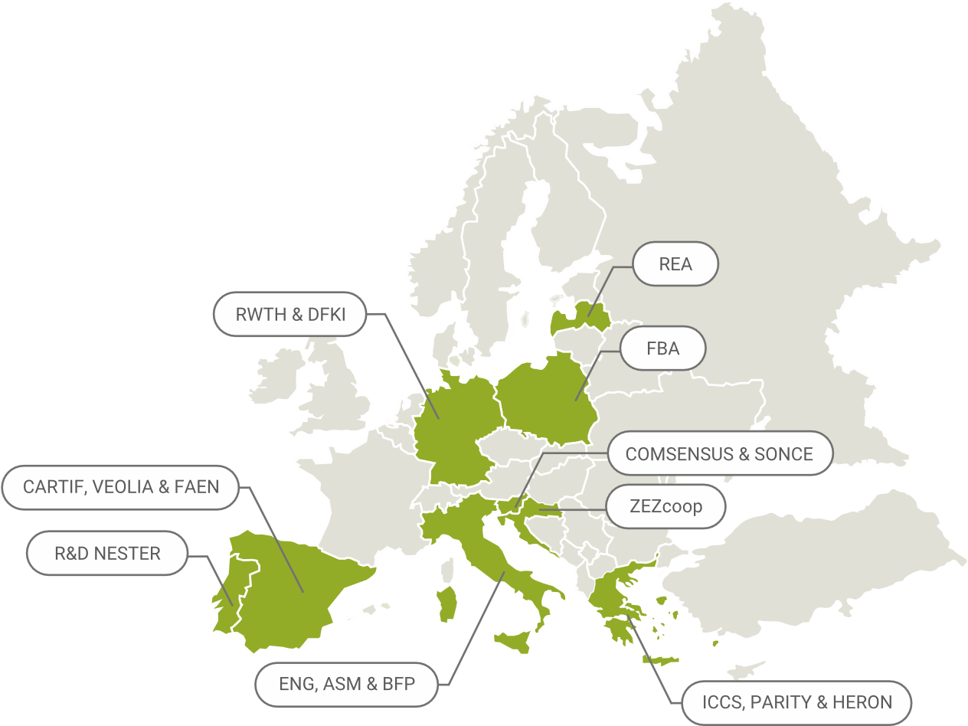
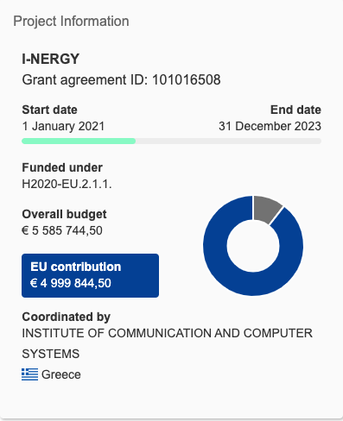
Background about the scientific use case
I-NERGY - Artificial Intelligence for Next Generation Energy
Website: i-nergy.eu
Coordinated by: Institute of Communication and Computer System
17 partners: i-nergy.eu/partners
ICCS (NTUA)
ENGINEERING
CARTIF
…

Slide 4
Ambition, Impact, Challenge(s)
One of the six ICT-49 aiming to consolidate the European AI on-demand platform
in the energy sector
providing an energy-aware approach
contributing to the greening objectives
financing through open call SMEs for new energy use cases
Delivering an open modular framework for supporting AI-on-Demand in the energy sector
Evolving, scaling up and demonstrating innovative AI-as-a-Service (AIaaS) Energy Analytics Applications
Notes:
RES (Renewable Energy System)
AAL (Ambient Assisted Living)

Slide 5
Capacity Requirements
Cloud computing resources
3 VMs for APACHE NiFI Cluster
3 VMs for Confluent Kafka Cluster
3 VMs for MongoDB installation
3 VMs for Blockchain based notarisation
1 VM for evaluating ML/DL Models
1 VM for serving ML models
1 VM for the marketplace
1 VM with GPUs for training AI models
Total: 16 VMs for a total of 88 VCPUs, 184 GB of RAM, 4TB of storage and 1 or 2 GPU (under assessment, further resources are needed)
INFN-CLOUD-CNAF is supporting the requested resources until the end of the EGI-ACE project with 16 VMs for a total of 100 VCPUs, 200 GB of RAM, 4.4 TB of storage and 1 V100 GPU

Slide 6
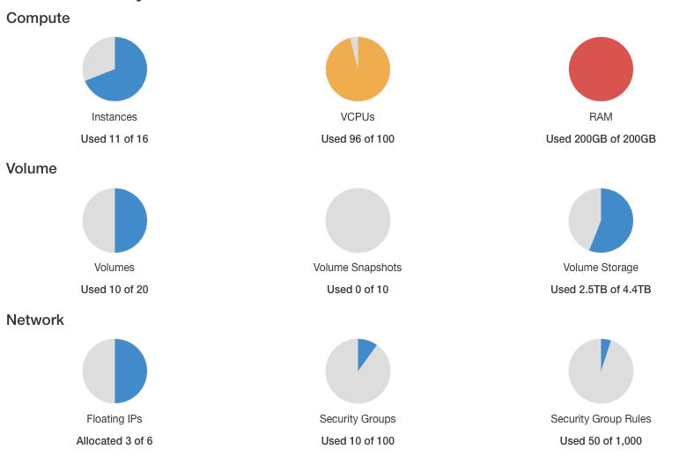
Current Status
A dedicated VO is now in production in the EGI Operations Portal (#GGUS 156425)
2 VO manager and 12 users
Resources allocated @ INFN-CLOUD-CNAF
Data service layer
Interoperability and Homogenization
3 VMs for APACHE NiFI Cluster
Streaming module
3 VMs for Confluent Kafka Cluster
Data storage
1(3) VMs for MongoDB installation
DLT/Blockchain Hybrid data sharing
0(3) VMs for Blockchain based notarisation
AI Trained models
1 VM with GPUs for training AI models
Auxiliary service (reverse proxy)

