Slide 1
EGI-ACE Open Call no.6
Checkpoint meeting with Shepherds
ISPRAVision
Ignacio Lamata Martinez / EGI Foundation
Sebastian Luna Valero / EGI Foundation
Marco Rorro / EGI Foundation
TLP:AMBER

Slide 2
Outline
Background about the scientific use case
Ambition, Impact and Challenges
Integration Support
Capacity Requirements and Current Status

Slide 3
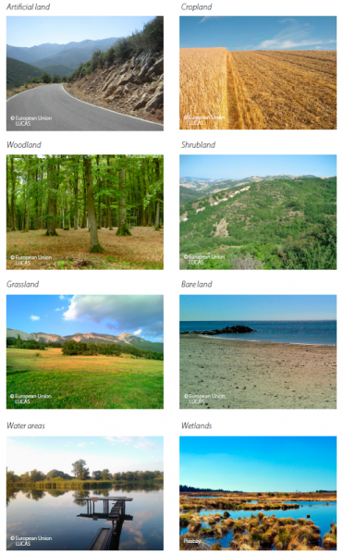
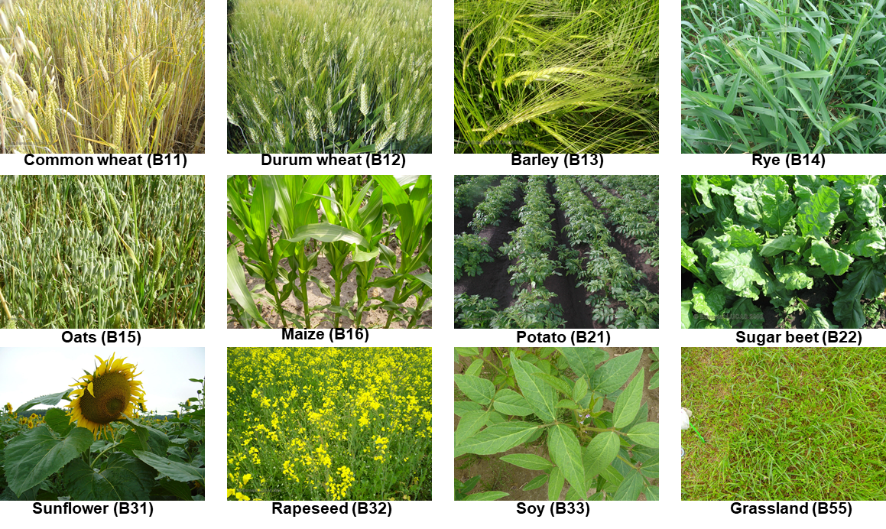
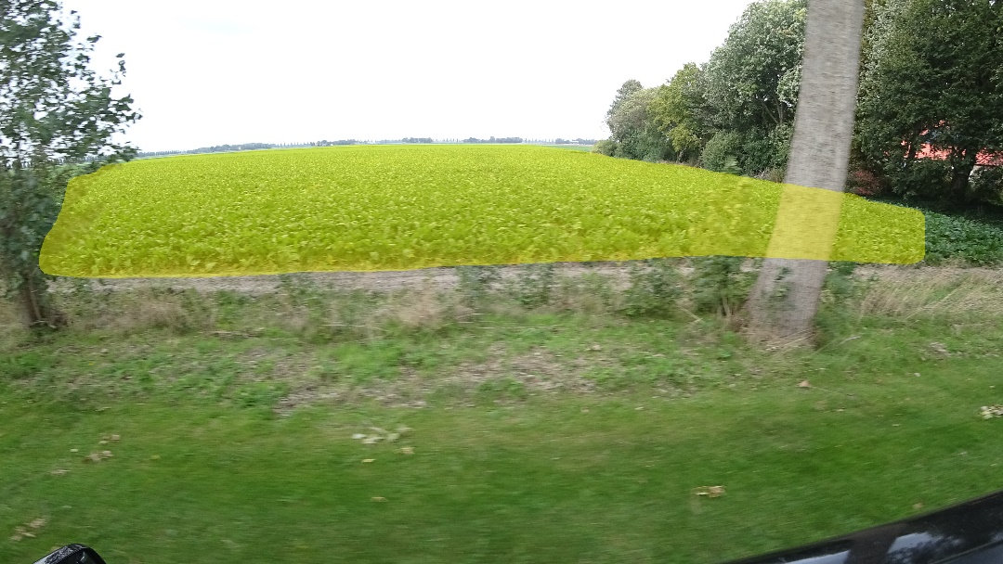
Background about the scientific use case
ISPRAVision (In Situ Photo Recognition and Augmented Vision) is an initiative to use photo recognition for the evaluation of landscape features.
It aims to address the issues related to the scarcity of complex agri-environmental practices and robust in-situ information, especially for the quantitative evaluation of landscape features, by using in-situ photography.
21/06/2022

Slide 4
Background about the scientific use case (cont)
General objectives:
Support the 70 Paying Agencies in the EU Member States, which implement CAP monitoring and controls, and which face the lack of efficient handling of increasing streams of geo-tagged photography. They will benefit from efficient tools that categorise incoming streams for compliance confirmation, relegating visual inspection to a minimum set of cases.
Support scientists, NGOs and private citizens, including farmers and other rural actors, with a keen interest in agronomic and environmental evidence on the impact of the CAP and rural policies will benefit from systematic information derived on observed phenomena and trends.
Contribution to Open Access: Trained models will be released as open data (e.g. to support third party real-time detection apps).General objectives:
Use Case objectives:
To scale-up current work, by deploying larger sets on multiple-GPU instances to be able to cross-validate amongst data sources (e.g. LUCAS versus local surveys and street-view data) and to integrate the higher complexity of CAP specific evidence (e.g. grassland management, recognition of special flower mixes, new inter-row cropping practices).
Demonstrate the feasibility of European Cloud infrastructures and EOSC resources to support the JRC in the long term.
21/06/2022

Slide 5
Ambition, Impact, Challenges
Duration: 04 May 2022 – Not defined yet
Key people:
PI: Guido Lemoine (JRC)
Project scientist: Laura Martinez Sanchez (JRC)
Provider:
Resource Provider
DEEP Training Facility Support
Storage support in the DEEP Training Facility
21/06/2022

Slide 6
Integration Support
Ispravision.vo.egi.eu
GPU – Deep Learning
Check-in 🡪 Laura Martinez Sanchez is VO Manager
Maybe Infrastructure Manager
21/06/2022

Slide 7
Capacity Requirements and Current Status
Request:
MD Radeon Pro V520 GPUs / NVIDIA T4 GPUs.
Minimum RAM capacity: 128 GB for SLI .
Estimation of GPU h: 800 (estimation can vary depending on GPU efficiency and data throughtput latency).
Training (multiple GPU use skills, GPU efficiency analysis (cost and energy) and the use of the latest AI libraries).
Current status:
Provided JRC access to IFCA
JRC is testing and evaluating the resources offered by IFCA (V100 and T4).
Preference: 2 x NVIDIA V100 with 32GB RAM.
Once evaluation is finished 🡪 formal resource allocation and define next steps.
21/06/2022

