Slide 1
EGI/EOSC Federation Services
and Service Delivery
Matthew Viljoen
Service Delivery and Information Security Lead
EGI Foundation

Slide 2
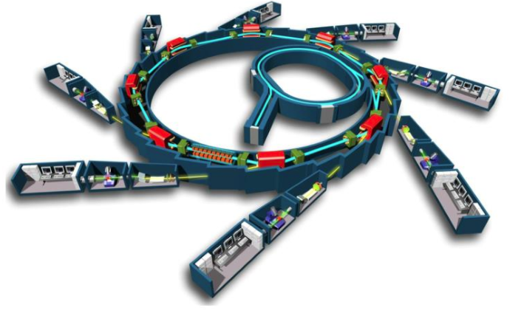
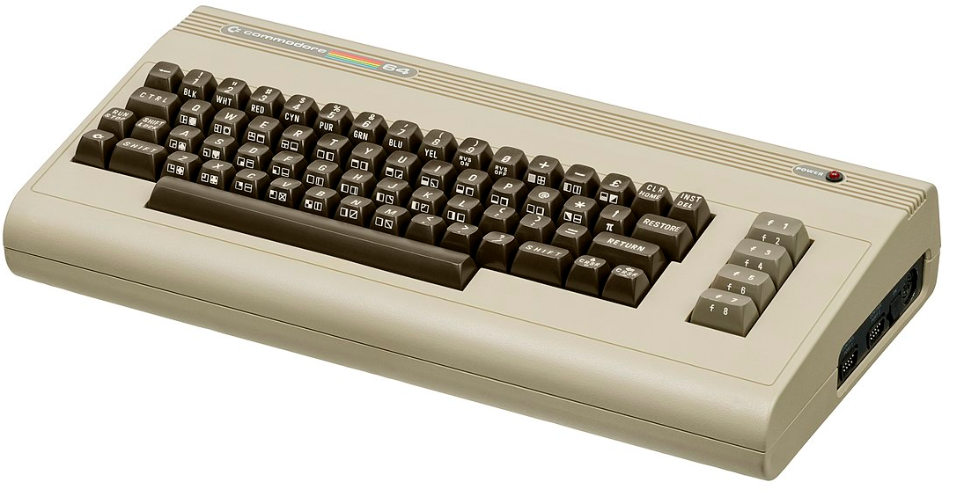
Typical Federation and Requirements
Typical Federation
Common Requirements
Users
Easy access to services without barriers (registration, policies, security…)
Single point of help/support
Trusted, reliable services
Country A
Country B
Research community B
Research community A
Resource Providers
Service health and status
Extent of service usage
Ease of providing help/support
Scientific Discipline
Funders
Extent of service usage
Achievement of service levels
Country C
Country D

Slide 3
EOSC Exchange
Another e-Infrastructure Federation - EOSC
Execution Framework
Community A
Cluster B
Community C
Regional D
EOSC Core
Thematic resources
Thematic resources
Thematic resources
Regional resources
Thematic service
Thematic service
Thematic service
Thematic service
Thematic service
Thematic service
Thematic service
Thematic service
Thematic Resources
Thematic Resources
Thematic Resources
Regional Resources
Horizontal services
Generic services
(inc. cloud compute, data transfer)
EOSC Support Activities
EOSC Interoperability Framework
Core coordination functions
Core technical platform
Federating
services

Slide 4
Typical e-Infrastructure Federating Services
Software Distribution
Trusted software testing and distribution
Workflow and Data Management
Support for complex processing & data
movement
Collaborating Tools
Communication, wikis, mailing lists,
ticketing systems etc.
EGI Operations Portal
Overview of resources and status, Broadcast tool
Information System of Resources
What, Where, Who
Monitoring Infrastructure
Is it working? OLAs/SLAs being met?
Helpdesk (Single point of support, multiple tiers behind)
Reaching the right people & providing timely help
Usage Accounting
Who’s using what?
Security – Monitoring & Incident Response
Keeping the bad guys out
AAI (Authentication + Authorization Infra.)
Enabling easy & appropriate access to the services

Slide 5
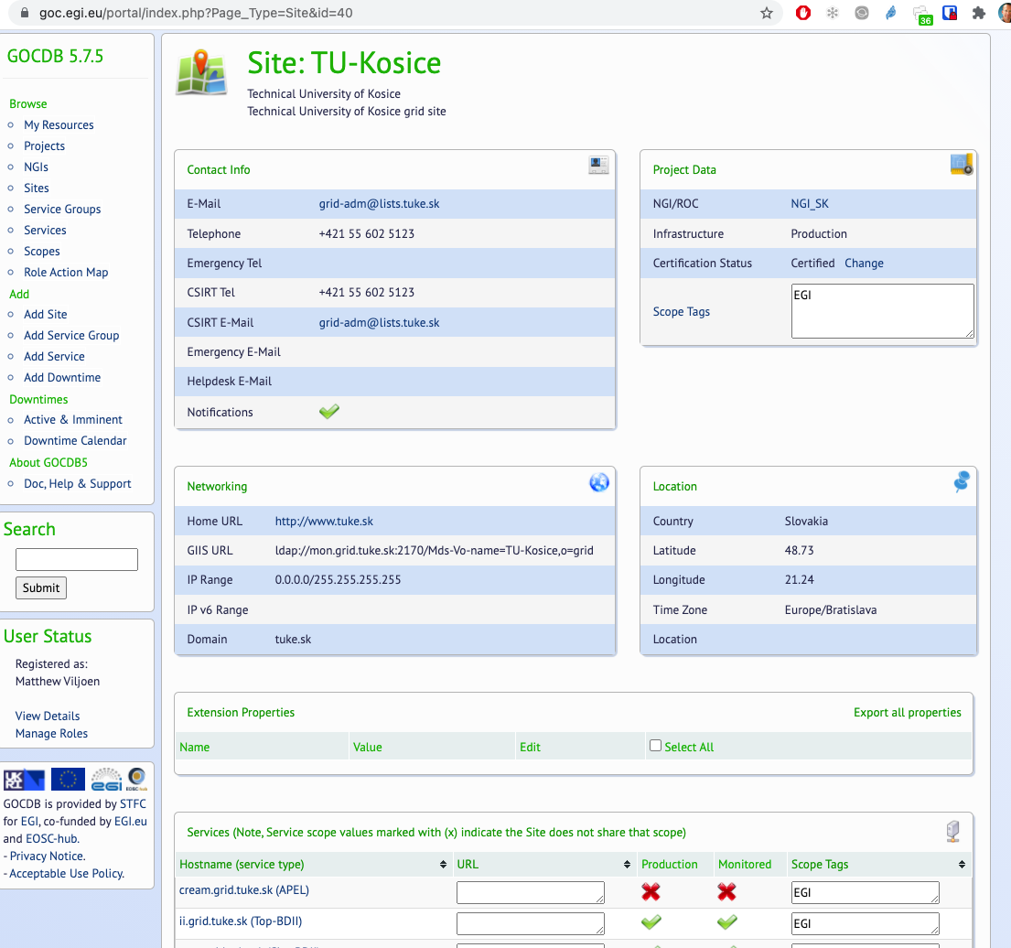
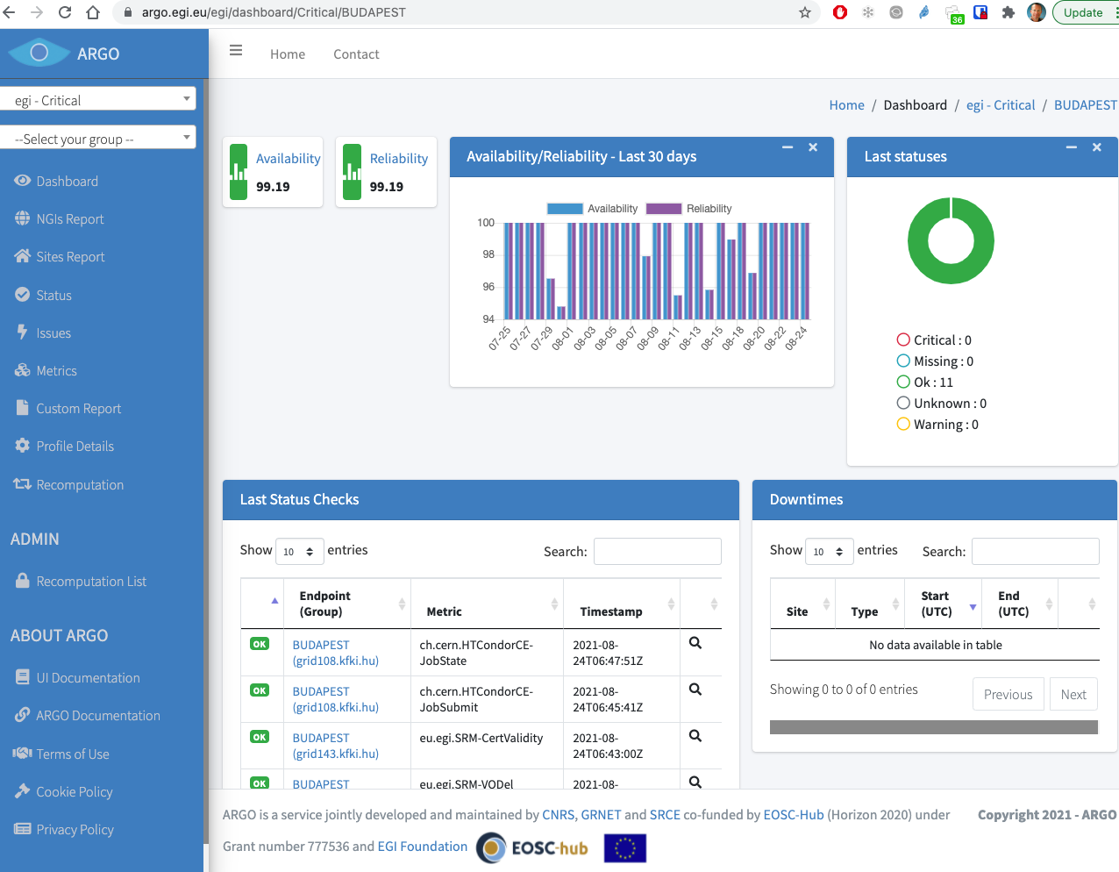
EGI Information System and Monitoring
Information System
GOCDB – The current state of the infrastructure
Resources, production status, service types, endpoints, sysadmins + contacts, security contacts etc.
Monitoring
ARGO – Functional testing infrastructure.
Predefined probe types per service type. Support for SLA/OLA availability/reliability pledges

Slide 6
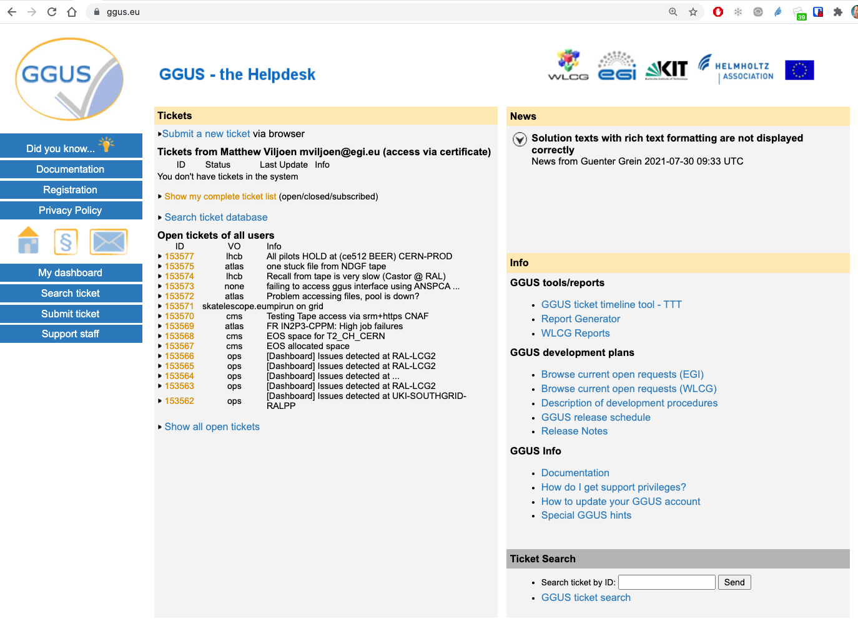
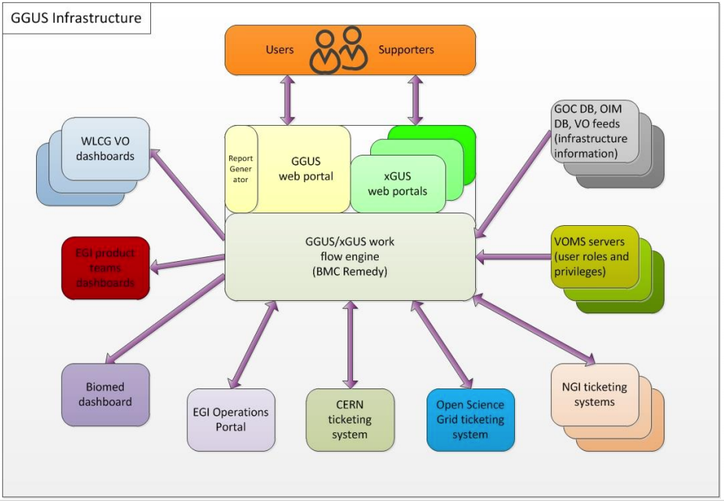
EGI Helpdesk
EGI(EOSC) Helpdesk – Single point of support – GGUS(will be Zammad)
Seamless routing to correct team. Multiple lines of support.

Slide 7
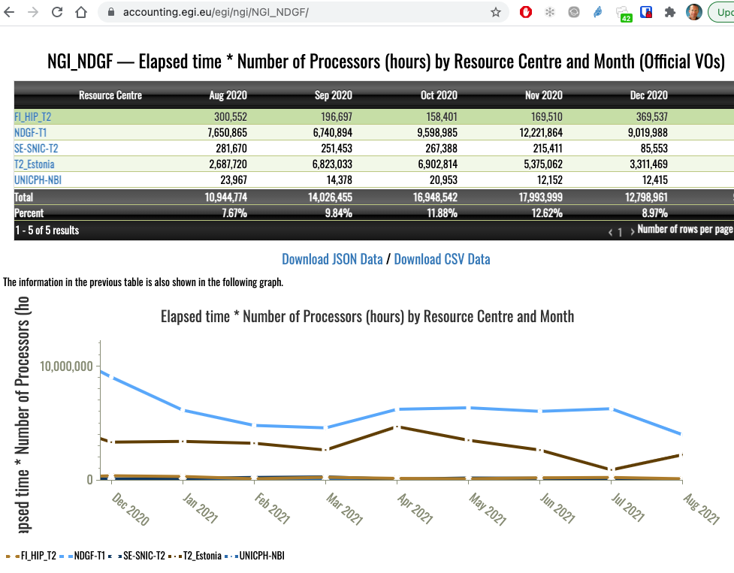
EGI User Accounting (APEL)
How much are users making use of resources?
Information for funding, planning future usage, capacity planning
Interactive statistics - views for end users, project managers, anonymous users
Records
Accounting
Portal
Accounting
DB

Slide 8
EGI Security – Incident Response and AAI
Computer Security Incident Response Team (CSIRT)
Establishment & Maintenance of Trust
Understanding, managing & mitigating threats
Incident support by experts within EGI and worldwide
Security monitoring infrastructure
Authentication and Authorization Infrastructure (AAI)
Ready-to-use, scalable, SSO, community management solution using CheckIn proxy. Implements the AARC Blueprint.
Institutional ID, social ID (Google, Facebook etc.)
Support for multiple technologies
abuse@egi.eu
abuse@eosc-security.eu

Slide 9
Federating Services – The complete package
Centrally managed and provisioned designed to meet requirements of all
Avoids duplication of effort. Economy of scale
Sustained by long term funding of provision and development
Pooling of expertise with international cooperation
Continuous improvement & interoperability

Slide 10
Service Delivery in a Federated Environment
Service = A means of delivering value to customers by facilitating outcomes customers want to achieve, but without the ownership of specific costs and risks. (ITIL)
Service Delivery = Process of providing a service to the customers/internal clients of an organisation
Understanding stakeholders &
their requirements
Regular reviews
Managing expectations
Defining metrics &
Measuring/reporting them
Effective communication

Slide 11
Formalising Service Delivery (ITIL/FitSM)
Customers
Customer Management
OLA
SLA
UA
Internal Suppliers
External Suppliers
Service Level Management
Supplier Management

Slide 12
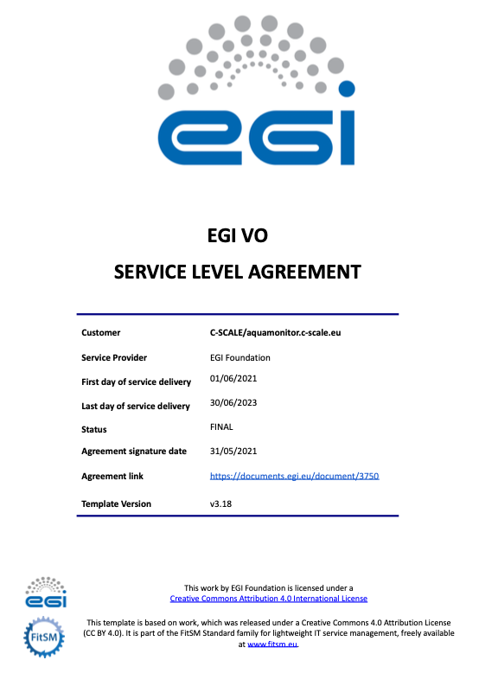
Example SLA
Based on FitSM template
Description of service
Service hours, exceptions
Support
Incident handling
Service requests
Service level targets
Limitations, constraints
Communication, reporting, escalation
General communication
Regular reporting
Violations, escalations, complaints
Information Security and Data Protection
Responsibilities
Of service provider
Of customer
Review, extension, termination

Slide 13
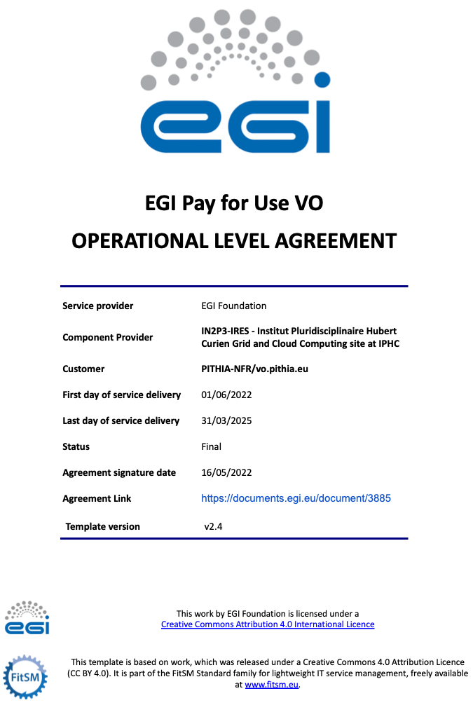
Example OLA
Based on FitSM template
Description of service
Service hours, exceptions
Support
Incident handling
Service requests
Service level targets
Limitations, constraints
Communication, reporting, escalation
General communication
Regular reporting
Violations, escalations, complaints
Information Security and Data Protection
Responsibilities
Of service provider
Of customer
Review, extension, termination

Slide 14
Finally…Joining EGI/EOSC
EGI/EOSC is open to new services/resources
EGI: adding resources to Cloud Compute/Data Federation or joining as a software/service provider (see: EGI Documentation)
EOSC: Rules of Participation/Inclusion Criteria and onboard via the Providers Portal
Learning about mature service delivery via ITIL/FitSM Get certified by signing up to the FitSM Foundation Training this week!

Slide 15
Thank you
Questions?
matthew.viljoen@egi.eu

