Slide 1
Using the DEEP-Hybrid- Datacloud platform
Remote webinar for iMagine
15 December 2022
Ignacio Heredia
iheredia@ifca.unican.es
Instituto de Física de Cantabria (CSIC-UC)

Slide 2
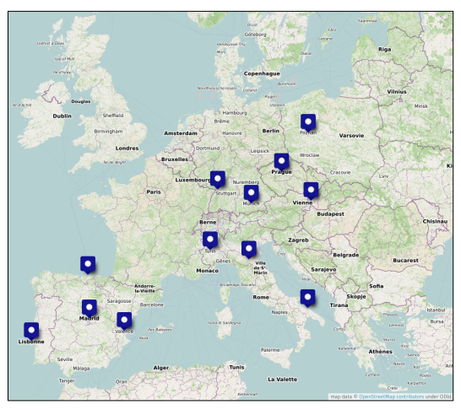
Introduction - DEEP-Hybrid-Datacloud project
The project was carried out with European Horizon 2020 funds.
The project provides new generation of e-infrastructures that harness latest generation technologies, supporting deep learning and other intensive computing techniques to exploit very large data sources.
It aims to lower the adoption barriers for new communities and users, satisfying the needs of both research, education communities and citizen science.
Project partners:

Slide 3
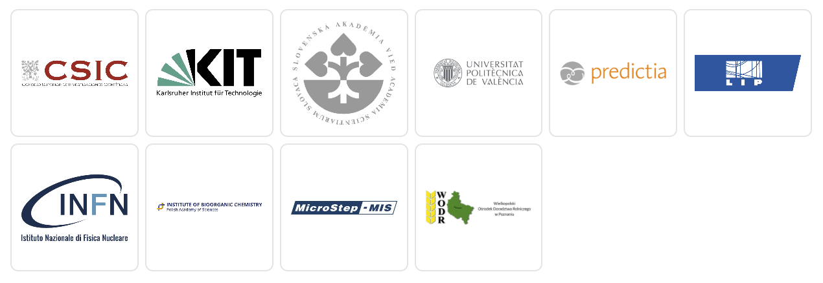
Introduction - AI4EOSC follow-up project
AI4EOSC will deliver an enhanced set services for the development of AI, ML and DL models and applications in the EOSC. The services will make use of advanced features such as distributed, federated and split learning; provenance metadata; event-driven data processing services or provisioning of AI/ML/DL services based on serverless computing.
Project partners:
https://ai4eosc.eu/

Slide 4
Introduction - The users
Basic
Intermediate
Advanced
No machine learning knowledge. Just give me a working model to make predictions.
We offer:
a catalogue full of ready-to-use modules to perform inference with your data
an API to easily interact with the services
solutions to run the inference in local or Cloud resources
the ability to develop complex topologies by composing different modules
I want to retrain a working model on my personal dataset.
We offer:
the ability to train out-of-the-box a module of the catalogue on your personal dataset
an API to easily interact with the model
data storage resources to access your dataset (DEEP-Nextcloud, OneData, …)
the ability to deploy the developed service on Cloud resources
the ability to share the service with other users in the user’s catalogue
I want to develop my custom Deep Learning model.
We offer:
a ready-to-use environment with the main DL frameworks running in a dockerized solution running on different types of hardware (CPUs, GPUs, etc)
data storage resources to access your dataset (DEEP-Nextcloud, OneData, …)
the ability to deploy the developed module on Cloud resources
the ability to share the module with other users in the open catalogue
the possibility to integrate your module with the API to enable easier user interaction

Slide 5
Introduction - The users
Basic
Predict
Intermediate Retrain
Advanced Develop
Marketplace
Dashboard
New modules
DEEPaaS API
(serverless)
DEEPaaS API
(deployment)
Nextcloud / OneData
(storage)
JupyterLab
Cookiecutter - Github - Dockerhub
Nextcloud / Onedata
(storage)
Deep Hybrid Datacloud infrastructure
Authentication - Authorization - Storage - Computing - Orchestration

Slide 6
Introduction - Useful links
Homepage
Marketplace
Dashboard
Github
DockerHub
Documentation
NextCloud
https://deep-hybrid-datacloud.eu/
https://marketplace.deep-hybrid-datacloud.eu/
https://train.deep-hybrid-datacloud.eu/
https://github.com/deephdc
https://hub.docker.com/u/deephdc/
https://docs.deep-hybrid-datacloud.eu/en/latest/
https://data-deep.a.incd.pt/index.php/login
(* these slides are available here)
Always refer to the docs for the most updated guidelines on using the platform.

Slide 7
Introduction - Webinar outline
Exploring the Marketplace
Using the Dashboard
Deploying a module
Making inference
Retraining a module on a new dataset
Developing a new module
Deploying the DEEP development environment
Using the cookiecutter
Integrating it with DEEPaaS API
Adding the model to the CI pipeline
Adding the model to the Marketplace
What is next?
New DEEPaaS features
Training Dashboard
General changes
Under-the-hood changes

Slide 8
Exploring the Marketplace
1

Slide 9
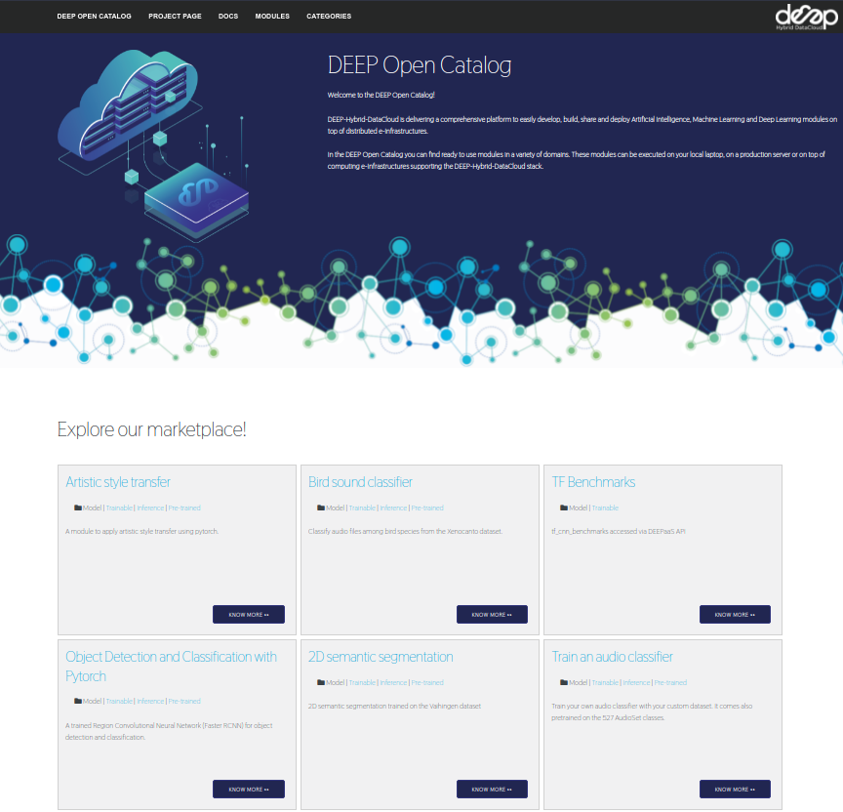
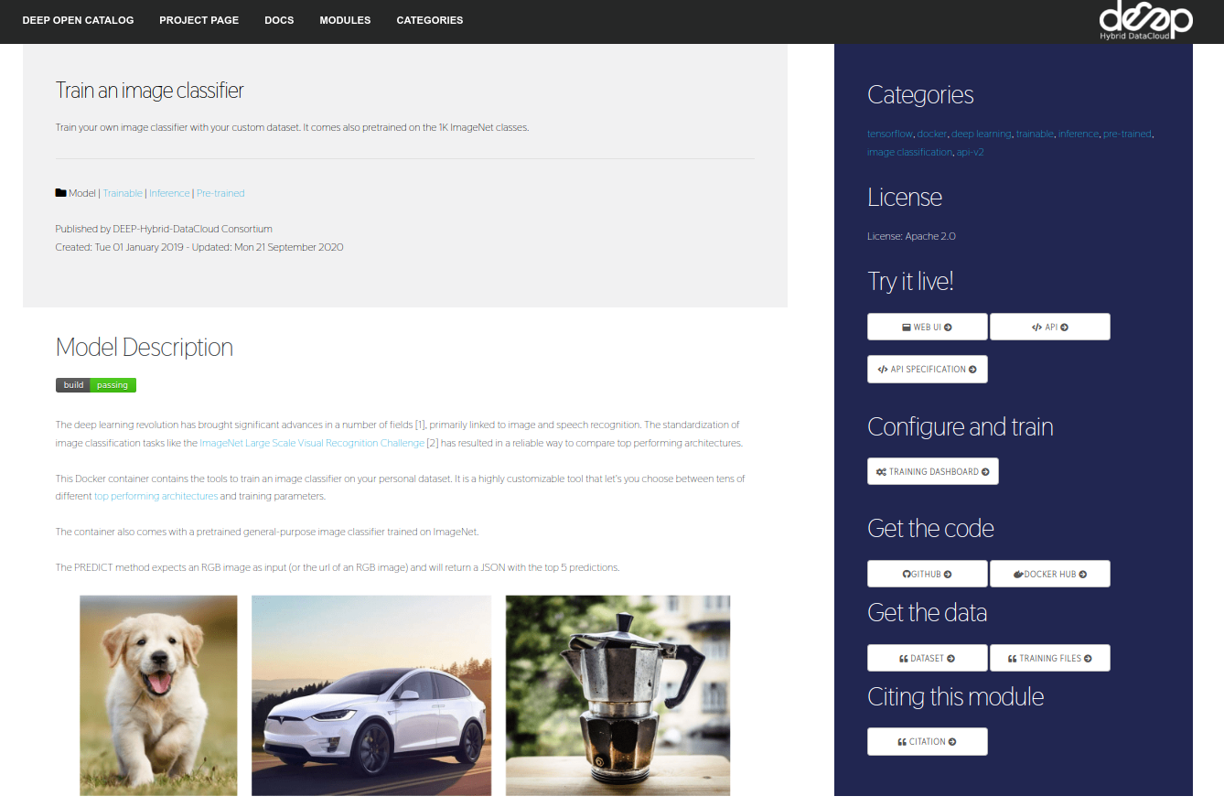
The Marketplace

Slide 10
The Dashboard
2

Slide 11
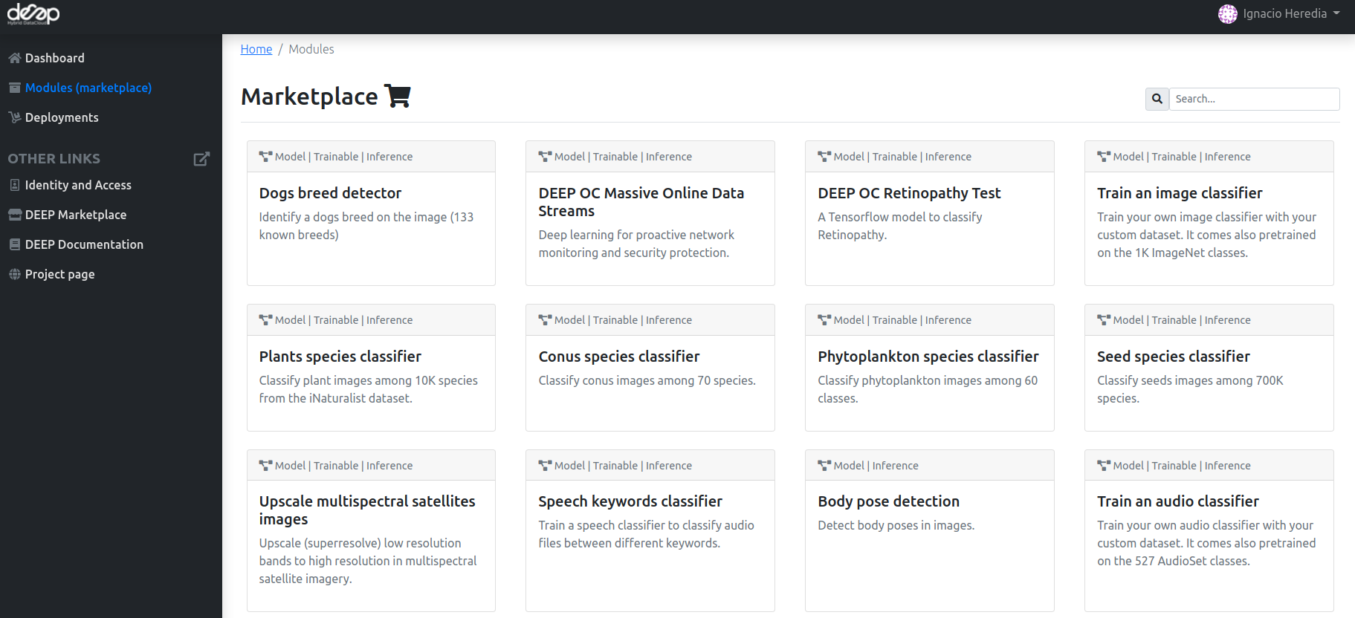
The Dashboard - Module Overview

Slide 12
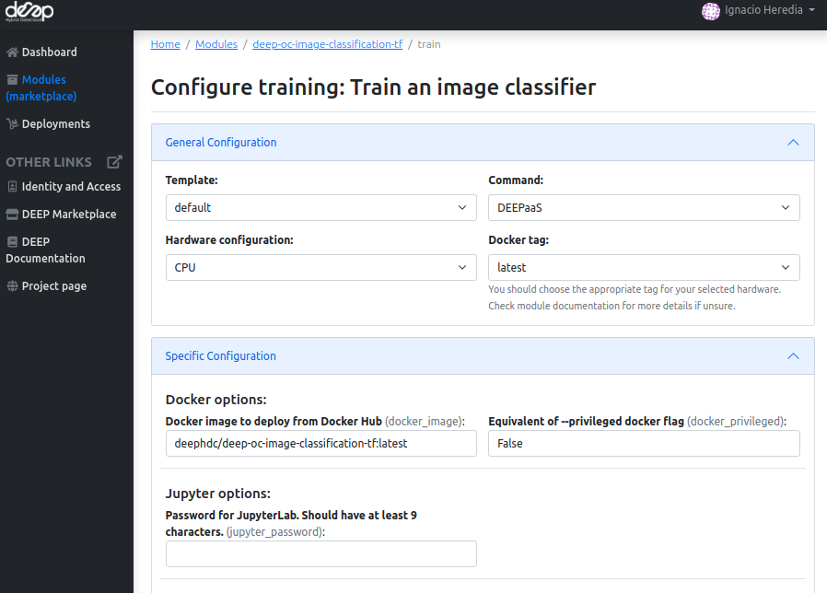
The Dashboard - Deploying a module
Configurable options
docker image (from deep-oc, but also custom docker images)
hardware (#cpus, #gpus, RAM)
storage (OneData, Nextcloud volumes)
services (DEEPaaS, JupyterLab)

Slide 13
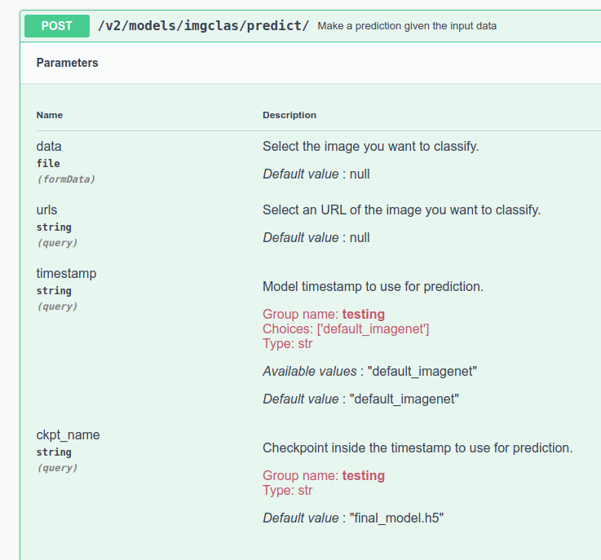
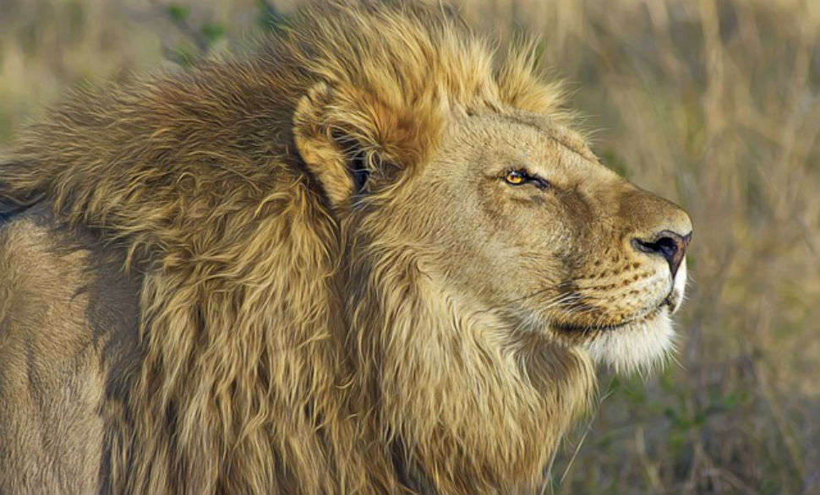
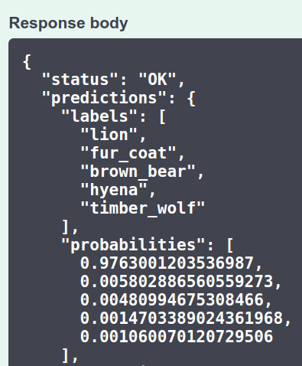
The Dashboard - Making inference
Launch image-classification-tf module with DEEPaaS.

Slide 14
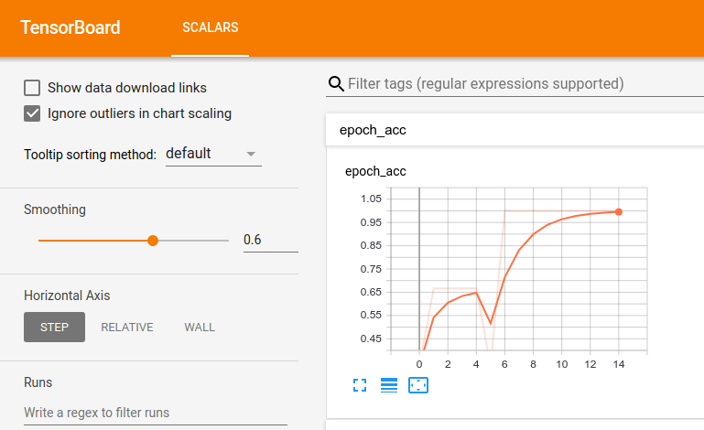
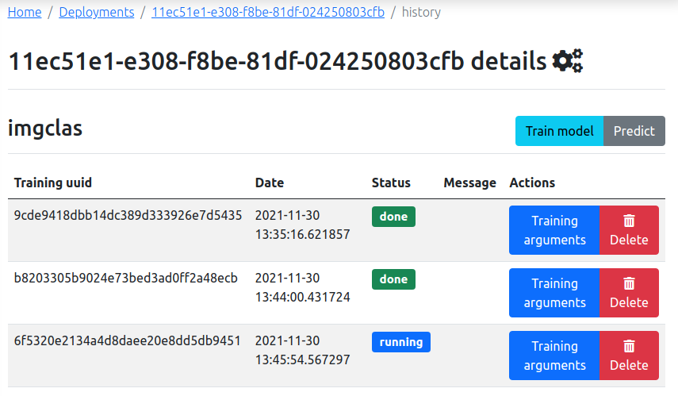
The Dashboard - Retraining a module
Launch image-classification-tf module with JupyterLab (remember adding password).
Copy some demo files to make a mock dataset.
Terminal: deepaas-run --listen-ip 0.0.0.0 to launch DEEPaaS.
A proper tutorial on how to do this with a real dataset using our remote storage will be given in January’s webinar. In the meantime, the steps are detailed in the docs.
Monitoring
Training history

Slide 15
Develop your module
3

Slide 16
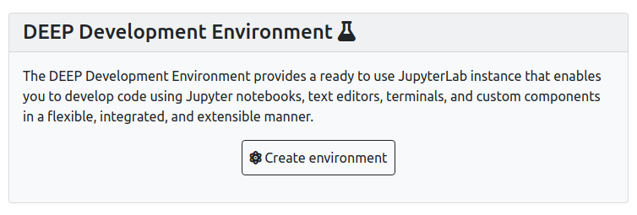
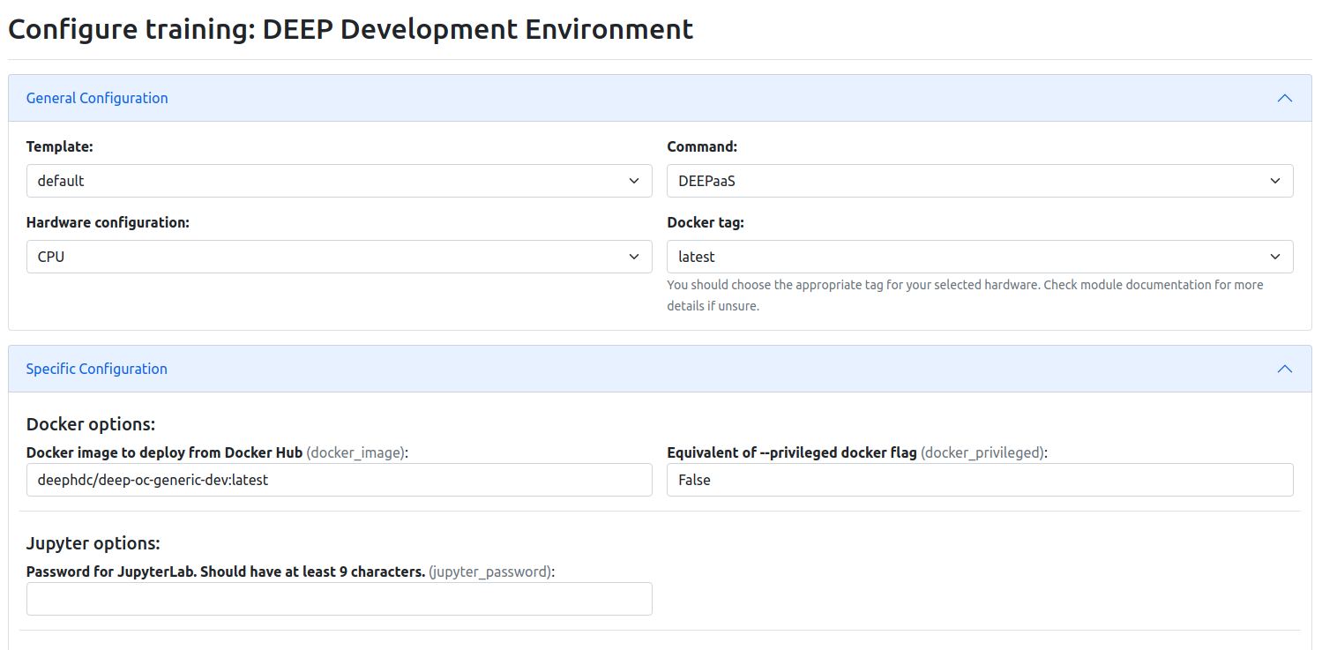
Developing - DEEP Development Environment
Configurable options
docker image (from deep-oc, but also custom docker images). Eg:
Tensorflow docker
Pytorch docker
...
hardware (#cpus, #gpus, RAM)
storage (OneData, Nextcloud volumes)
services (DEEPaaS, JupyterLab)

Slide 17
Developing - DEEP Cookiecutter
This is the easiest way to develop any new module from scratch as it will take care of generating all the nitty-gritty details that we will cover in the following slides (entrypoints, files, Jenkinsfile, Dockerfile, etc).
Use the command: cookiecutter https://github.com/indigo-dc/cookiecutter-data-science
Answer questions:
Project name, description, version, license type
Author name, email, Github account
Dockerhub account, Docker base image
This will generate two folders. Eg:
mymodule : This is where the project code is located
→ Example: https://github.com/deephdc/image-classification-tf
DEEP-OC-mymodule : This contains the Dockerfile of the project
→ Example: https://github.com/deephdc/DEEP-OC-image-classification-tf

Slide 18
Developing - Integrating with DEEPaaS
Head over to mymodule . Any module that wants to integrate with DEEPaaS should have two minimum requirements:
it should define a file (eg. mymodule/mymodule/api.py ) with the functions to interact with the module. These functions should define:
the model metadata
the input args for training
the input args for prediction
the response structure for prediction
the train function
the predict function
a model warming function for prediction
→ Minimal example: https://github.com/deephdc/demo_app/blob/master/demo_app/api.py
→ Full example: https://github.com/deephdc/image-classification-tf/blob/master/imgclas/api.py
it should define an entrypoint in mymodule/setup.cfg pointing to that file
→ Example: https://github.com/deephdc/demo_app/blob/master/setup.cfg#L25-L27
get_metadata()
get_train_args()
get_predict_args()
schema
train()
predict ()
warm()

Slide 19
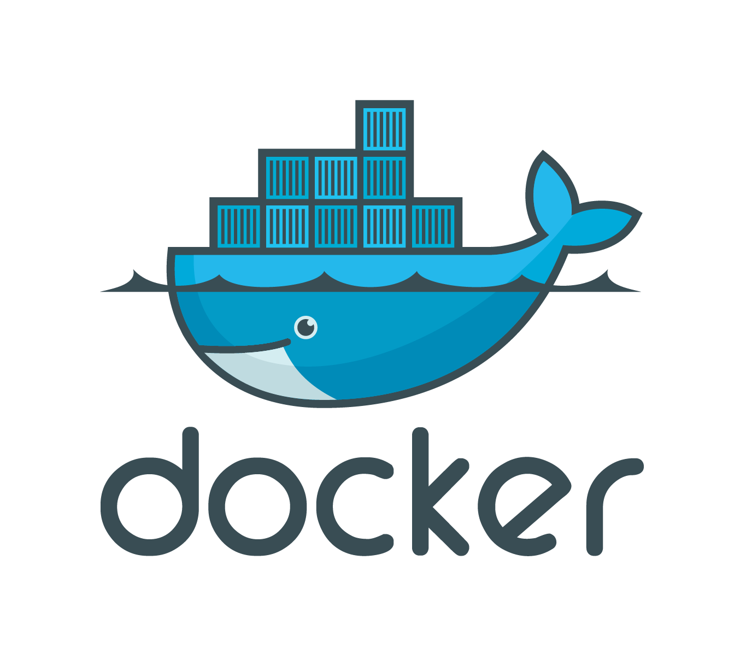
Developing - Customizing the Dockerfile
Head over to DEEP-OC-mymodule and modify the Dockerfile following your needs:
install additional packages,
change the base image,
etc.

Slide 20
Developing - Continuous Integration
Both mymodule and DEEP-OC-mymodule have their respective Jenkinsfile that define the actions to be taken when a change is committed to the repos.
Typical workflows:
mymodule/Jenkinsfile will:
run PEP8 style analysis
trigger of DEEP-OC-mymodule/Jenkinsfile .
→ Example: https://github.com/deephdc/image-classification-tf/blob/master/Jenkinsfile
DEEP-OC-mymodule/Jenkinsfile will:
build Docker images for different branches (train/test) and different hardware (cpu/gpu)
upload the image to DockerHub
build Docker images of other dependent modules. For example, changes in the code of image-classification should rebuild all Docker images of applications that were trained with that code (plant classifier, seed classifier, etc).
refresh the module page in the Marketplace (see next step)
→ Example: https://github.com/deephdc/DEEP-OC-image-classification-tf/blob/master/Jenkinsfile

Slide 21
Developing - Integrating to the Marketplace
Head over to DEEP-OC-mymodule and modify metadata.json with the info relevant to your module. This is the information that will appear in the Marketplace page.
Make a Pull Request to add your module here. This will create the Jenkins pipeline for your module and will add the module to the Marketplace and the Training Dashboard.
Congratulations, you’re done!

Slide 22
What is next?
4

Slide 23
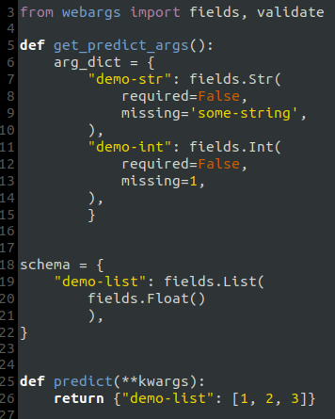
What’s next? - New DEEPaaS features
Easier module integration via decorators/hints
Computing CO2 emissions of training runs using CodeCarbon
Midterm
Midterm
Before (webargs)
After (type hints)

Slide 24
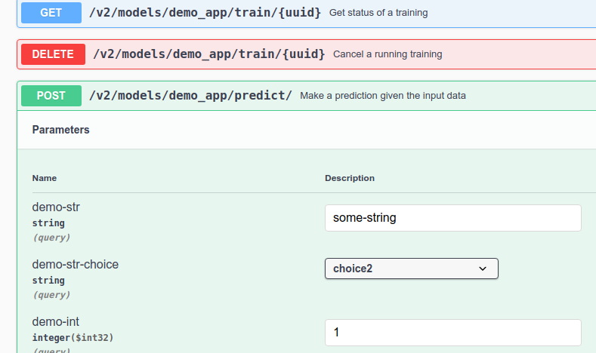
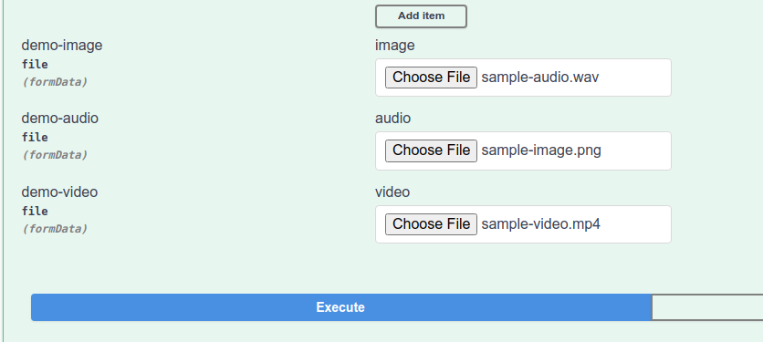
What’s next? - Friendlier inference UI
Before (Swagger UI)
After (Gradio based)
Mature
Inputs

Slide 25
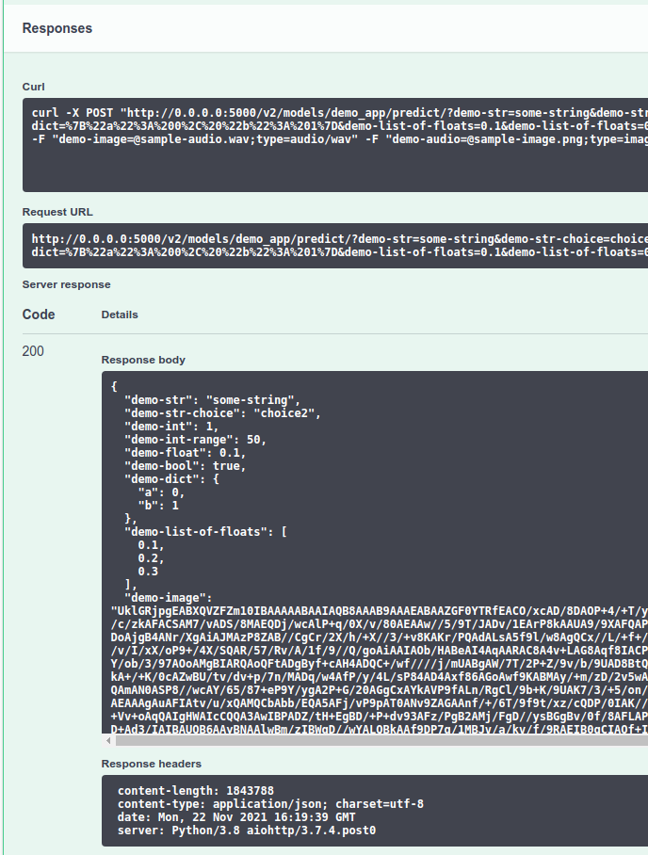
What’s next? - Friendlier inference UI
Before (Swagger UI)
After (Gradio based)
Mature
Outputs

Slide 26
What’s next? - Training dashboard
Midterm
Organizing training run in experiments
hyperparameter optimization
easier side-by-side comparison of training runs
Enable VScode IDE to develop code in the Dashboard. This will make for a more pleasant coding experience compared to JupyterLab.
Midterm

Slide 27
What’s next? - General
Longterm
Richer module metadata language, to keep track of:
training datasets
models
training execution pipelines
Run trainings in a federated manner. Data won’t leave your local resources, which is useful when dealing with sensitive data.
Longterm

Slide 28
What’s next? - Under-the-hood changes
Mature
Support Dask in DEEPaaS for better multi-platform integration (Yarn, Kubernetes, Slurm, etc).
Moving for Orchestrator to Nomad for managing deployments. This means it would be easier to integrate computing resources from external providers.
Better orchestration of pipelines using Prefect (or similar tools).
Midterm
Longterm

Slide 29
Questions
The iMagine project receives funding from the European Union Horizon Europe Programme – Grant Agreement number 101058625.
The AI4EOSC project has received funding from the European Union’s Horizon Research and Innovation programme under Grant agreement No. 101058593

