Slide 1
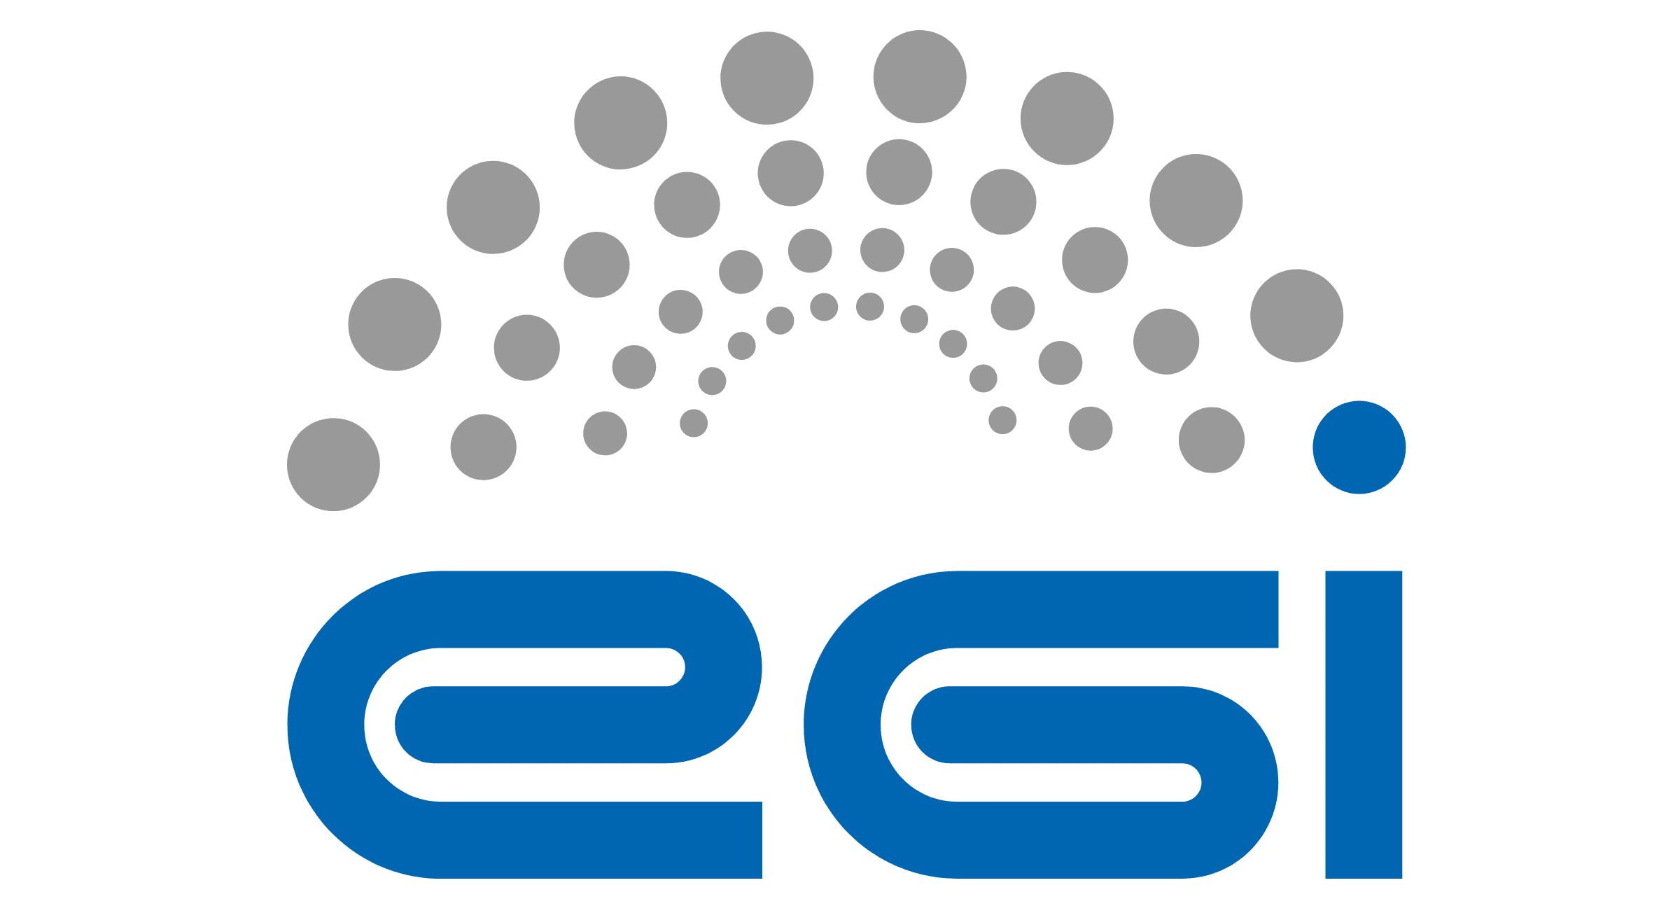
OpenStack and Identity Federation
Experience, Challenges, Solutions
21.06.2023, Poznań
Paweł Turkowski
pturkowski@cloudferro.com
Notes:
Hello Everyone,
It is my pleasure to present in this conference. I represent CloudFerro which is a Polish cloud hosting company.
We work as part of the consortium with EGI on EOSC project, and also with other topics. We were asked to share our experiences with OpenStack and Identity during this conference.

Slide 2
CloudFerro: Introduction, Services, Technology
Identity Management Tools in CloudFerro
Identity Case Study: Destination Earth Data Lake
Notes:
The agenda will be following:
I will say a few words about CloudFerro’s history and our services, I will also tell about our technology philosophy
I will give some insight about Identity management in CloudFerro, what are the solutions of choice for our clouds
And lastly, I will share some perspective about one of our recent projects: Destination Earth Data Lake, which is a large project for us and involves several Identity-related use cases

Slide 3
CloudFerro – who we are
European, private, technological company founded in 2015, leveraging over 20 years of experience of its team members in the IT industry
Provider of dedicated cloud computing services
Delivers and operates cloud platforms for demanding markets, such as the European space sector, climate research and science
Specialized at storing and processing big data sets, like multipetabyte repositories of Earth Observation satellite data
Provides flexible, open-source based, tailor made cloud solutions, matching best technical and organizational practices to business requirements
Achieved technological autonomy and guarantees reliability and independence of delivered services thanks to ful control of technology stack
Notes:
- CloudFerro is a Polish company based in Warsaw, founded in 2015.
Even though our company is young, our board and some staff have gained cloud experience since the very early days when the Polish internet was being shaped.
- We deliver full range of cloud computing and storage services.
We are focused on European market where we can guarantee compliance to required standards.
Our specialty are big, multi-petabyte datasets for industries like science, climat research and Earth Observation.

Slide 4
Company story
One of five DIAS, European platform with public cloud and integrated EO satellite data, built under Copernicus program (ESA)
EO platform for Germany (DLR), addressed to scientists and researchers
CDSE
German platform with EO data from European satellites regarding Germany; (DLR)
LTA
Long Time Archive – 1 of the 4 archives for the preservation and delivery of Sentinel EO data (ESA) – part of Copernicus Ground Segment
DataLake
Hybrid cloud to access, analyze and distribute one of the largest climate datasets worldwide (ECMWF)
EO IPT - Innovation Testbed for EO data processing (ESA)
Second DIAS based on our cloud, providing access to satellite data on climate and meteorology (EUMETSAT)
ELASTICITY
HPC
Supplier for NOR - financing for cloud and EO data projects
Pilot
CloudFerro was founded
Hybrid Cloud Infrastructure (EUMETSAT)
ESA HPC cloud
2015
2016
2017
2018
2019
2020
2021
2022
8 employees
14
24
32
56
80
120
>160
0,9 PB
of data*
1,5 PB
4,5 PB
13 PB
20 PB
25 PB
34 PB
* Amount of EO data publicly available for users
Notes:
CloudFerro has seen some very dynamic growth. The first success was winning the EO Cloud tender in 2016 issued by ESA.
Since then several large institutions have trusted us on our capability especially:
- ESA – European Space Agency
-ECMWF - European Centre for Medium-Range Weather Forecasts
-DLR – German Space Agency
Eumetsat – European satellite agency for monitoring weather, climate and the environment from space
For these companies we provide range of services:
public, private and hybrid clouds
Storage, data access interfaces

Slide 5
Our Services
Public Cloud
Private and Hybrid Clouds
IaaS for Earth Observation
Computing Services – public cloud environments providing Virtual Machines (VM), Virtual Machines with local storage (VM.local), Dedicated server virtual machines (DS), GPU, Kubernetes
Network Storage – object, block and file storage with different performance and availability tiers dependent on storage media (NVMe, SSD, HDD), replication and location
Local Storage – local NVMe and HDD drives for Virtual (VM, VM.local) and dedicated computing instances (DS, BM)
Backup and long term Storage – cost efficient storage in secure remote locations targeted for backup, archive and dark storage
Internet Access – Public Network access with geographical and carrier redundancy; direct access to GEANT academic network
Private and Hybrid Cloud Services - Cloud and storage services in private and hybrid mode, providing greater security, physical separation, guaranteed resources, independence of resources and integration with existing customers’ environments.
Multitenant private clouds - Private Clouds for service providers design, build and operated by our teams, including full billing, service provisioning and tenant management systems.
Private cloud in remote locations - Cost efficient private deployments of OpenStack Clouds in dedicated locations specified by the client, including data centers managed by our clients.
EO DATA Storage storage of high volume (tens of Petabyte) EO data in cloud related object storage; can be used as LTA or working area for cloud processing
EO DATA Processing (mass processing) processing in the cloud model “bring processing to the data”, in CSC Ground Segment, third party processors
Notes:
We deliver all range of cloud services and everything related to the cloud can be associated with our capability.
If we were to give some hint of our core capability this would be:
Public Cloud offering – which we can create for our clients with a standard set of cloud functionalities offered by Ceph and Openstack + other required customizations.
Private and Hybrid cloud offering – which is all fully custom made according to client requirments, either in our or client locations
And the third pillar is data. We need to store, transfer and move huge amounts of satellite images data. So we know quite a lot about Big Data aspect, ensuring High Availability, fast access and security. And we also strongly believe this capability is strongly transferable to other business domains,

Slide 6
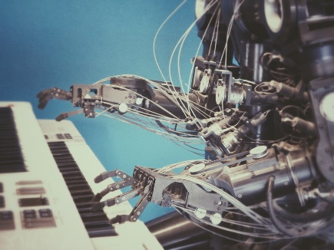
Our Technology Approach
Open-Source Focus
Automation on Every Level
Cloud-Native
Use open source
Leverage common knowledge, standards and investments
Flexibly extend and adapt the software to your needs
Guarantee transparency of used software components
Access expert communities
Avoid vendor lock-in
Contribute to open source
Work on a standard version
Gain community recognition and expert status
Ensure development and long term viability of your projects
Virtual infrastructure
OpenStack API (cloud API)
Terraform (infrastructure as a code)
Architecture deployment
Ansible (configuration management, application deployment)
Kubernetes (containers orchestration)
Operations
Rundeck
Observability (monitoring, logging, alerting)
Prometheus (metrics)
Grafana (metrics visualization, online reporting)
OpenSearch – formerly Elasticsearch (logs + dashboards)
Horizontal scalability
Distributed architecture
Concurrent access
Multi-threading
Containerization
Magnum – OpenStack Container Infrastructure
Object storage
Infinite scalability
Cost effectiveness
Performance
Affinity groups
Overcome physical infrastructure constraints
Performance
Availability
Scalability
Reusability
Notes:
Another aspect that I would like to share about CloudFerro is our Technology Approach.
We could say it is built on 3 pillars.
Firstly – we are strongly maximizing the use of Open-Source, which is foundation for our clouds. This allows leveraging the community experience, we are flexible and not locked-in for any specific solution. We treat open-source as a starting point for further modifications.
We also contribute to the community. We are valued members of Linux Foundation, OpenInfra and Ceph community. E.g. we have one of the largest Ceph repositories in the world.
Second pillar is automation –especially coming from other companies it might often be a suprise. But basically our infrastructure is code and with the scale of operations we believe this is the only valid approach.
We use both OpenStack API for automation, as well as Terraform, Ansible or Rundeck for operations. We also have automated observability that can be applied to our resources using Prometheus, Graphana and Elasticsearch.
Third pillar is about unlocking the full potential of cloud solutions – both the way we design it and advocate to our users.
Some of the key elements I would like to highlight here:
- We are heavy users of containers and Kubernetes ourselves for our internal purposes, and we enable this to our customers as well via OpenStack Magnum.
We are also ensuring optimal performant access to object storage and advocating its use as highly performant and scalable solution, which we see as truly native cloud storage, taking out the overhead to pay for unused storage resources etc.
So this is about CloudFerro, let’s move to our Identity aspect.

Slide 7
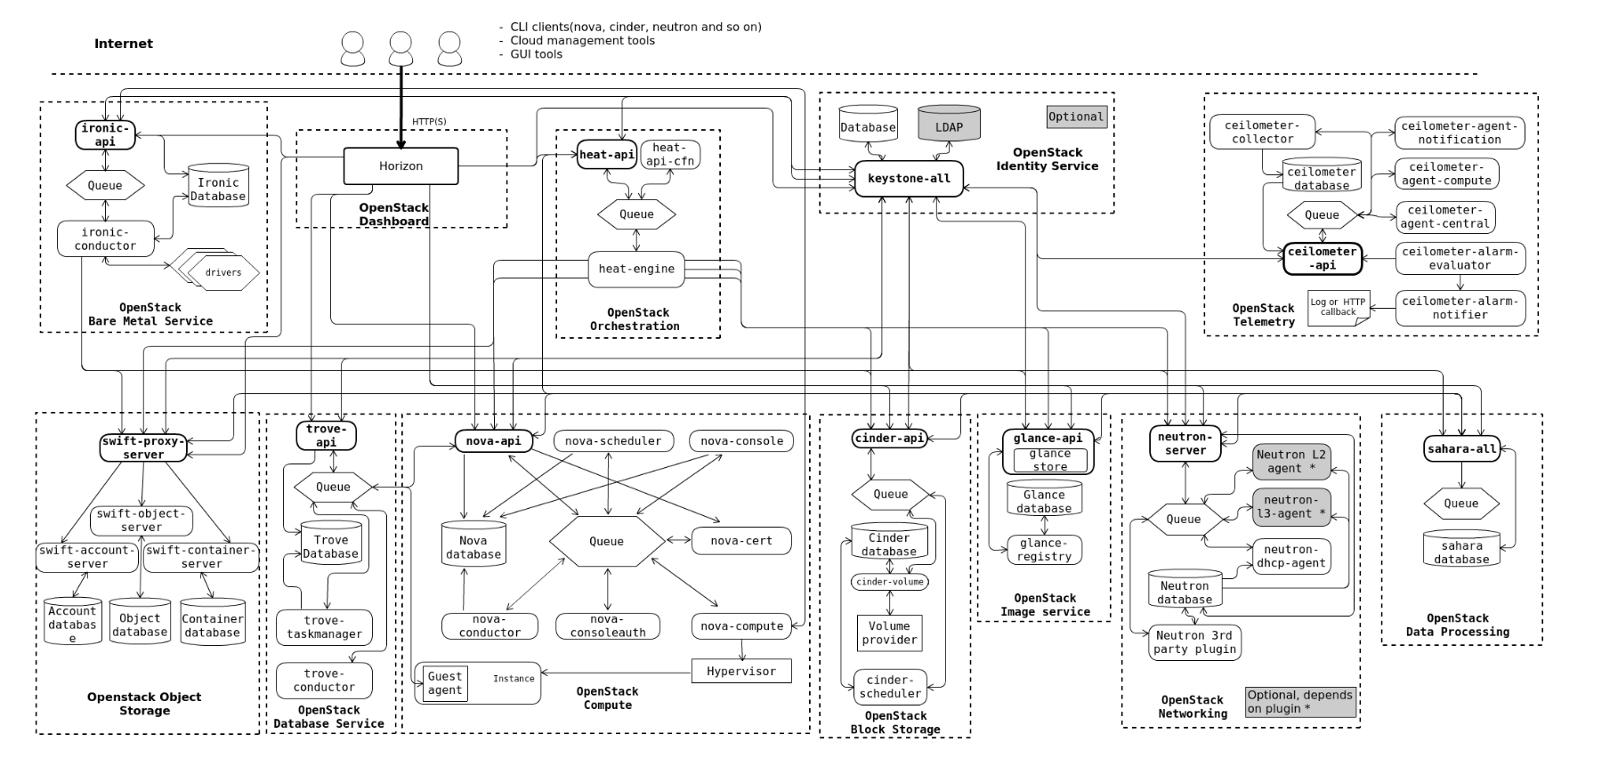
OpenStack and Keystone
OpenStack Keystone on every OpenStack cloud
Keystone as identity ServiceProvider (SP) for OpenStack
Each CF OpenStack cloud, a dedicated Keystone instance
Only limited identity features
Possibility of creating additional per-cloud Keystone users is kept (for specific use cases)
Notes:
Let’s move to the technologies, which we use for Identity Management in CloudFerro.
First of all, we utilize Keystone, which is natural choice since we run our clouds on OpenStack.
As we can see on the below image, Keystone is only part of the very complex system which is OpenStack. From our perspective it covers only some base use cases.
We do enable Keystone on every OpenStack instance. However it’s role is limited to a ServiceProvider and we do use an additional IdP.

Slide 8
Why Keycloak?
Keycloak as shared IdP across clouds
OpenSource, strong community support
Supports OpenID Connect, OAuth 2.0, SAML 2.0
Adds rich set of features for modern Identity Management (MfA, policies, other)
Enables multi-cloud capability, SSO to multiple clouds
In CF, each cloud brand is a dedicated Keycloak realm
Keycloak as Identity Broker to external providers
Extra configuration of Keycloak allows to federate further to external IdP
Currently implemented: EGI Check-In, COIH
Notes:
This IdentityProvider is Keycloak.
Keycloak, likely familiar to many of you, is a mature IdP which is built on Open Source. It supports both SAML, OpenID Connect and Oauth2.
It provides a rich set of features for modern identity management including MultiFactor Authentication, complex authorization scenarios, policy setting and further federation to external IdPs.
Keycloak in our base setup is used to provide source of user identities to cloud-local Keystones.
The core use case for Keycloak was enabling SSO to our multiple clouds.

Slide 9
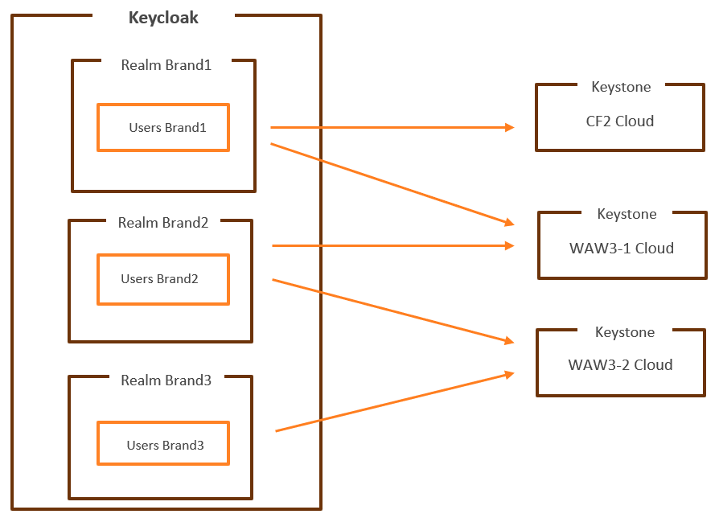
Keycloak
Keycloak in CloudFerro
Currently ~30 dedicated Keycloak servers
Loadbalancing by Haproxy
Keycloak and Keystone communication is additionally mediated by Apache
Private clouds have dedicated Keycloak instances
Public and hybrid clouds - shared instances (Xsite)
High Availability
+
CloudFerro Keycloak Xsite (simplified)
Notes:
Some key facts about Keycloak in CloudFerro. We currently run approximately 30 dedicated Keycloak servers which covers several instances of Keycloak.
The production Keycloak run in High Availability and are loadbalanced by Haproxy for further scalability.
In our public cloud setup (Xsite) we have a few brands on a single public cloud (a client brand e.g. Creodias, CloudFerro, Eumetsat Elasticity, WekeoElasticity). Each of these brands is a separate realm in Keycloak.
And these realms are configured to be providing identity to Keystone depending which brand should be connected to which cloud.
Also worth mentioning that the exchange between Keycloak and Keystone is not direct, but is mediated by Apache.

Slide 10
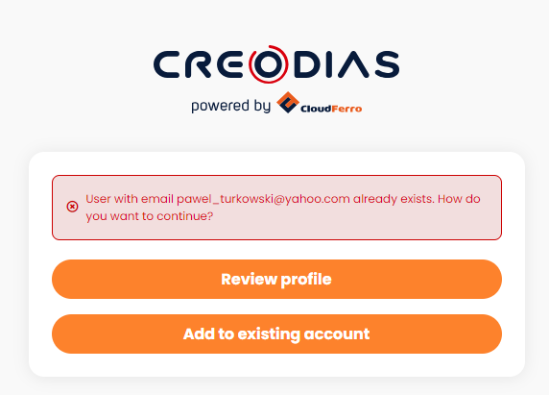
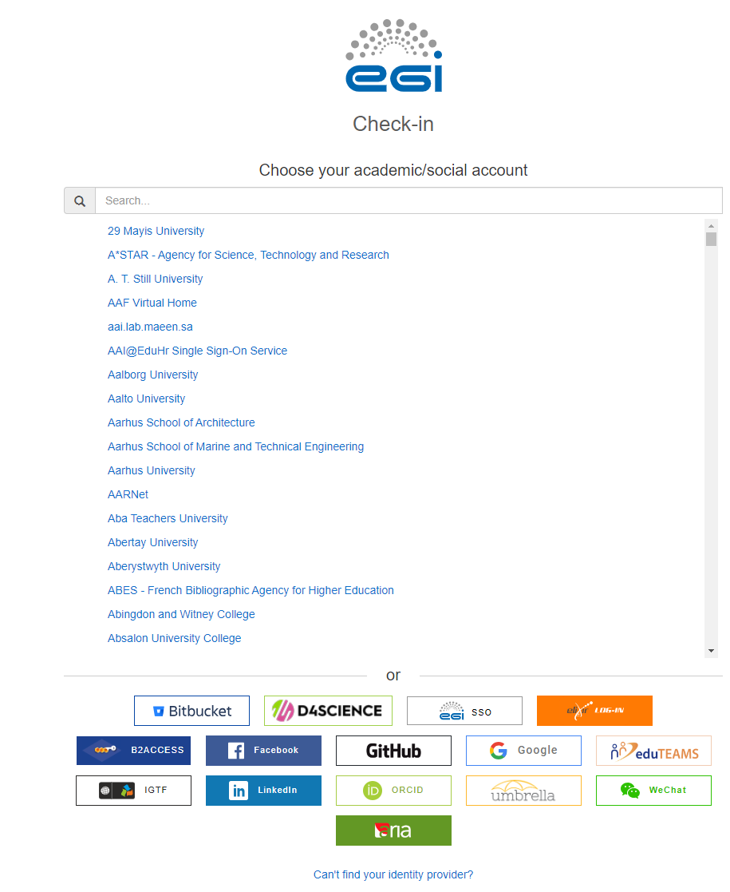
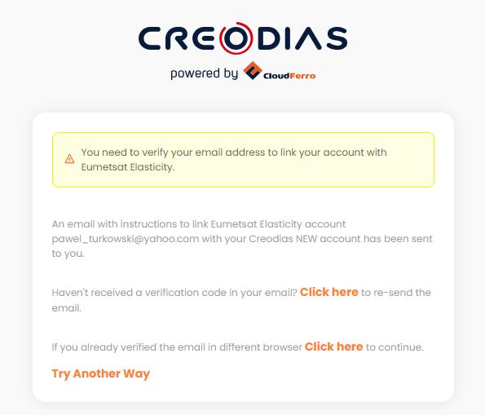
SSO and Identity Federation
SSO between cloud brands
External IdP Federeation, EGI Check-in
Notes:
Then also a few words about Identity Federation.
In the base form, we can use a Single Sign On so that users can share same account on multiple clouds, then the accounts get linked in Keycloak.
And the next level is the Identity Federation to External Providers. In the Creodias example, we use COIH (Central Operator Identity Hub) by ESA and EGI Checkin.
EGI check-in is valuable for us, since this enables logging in from multiple institutions.

Slide 11
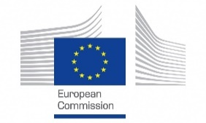
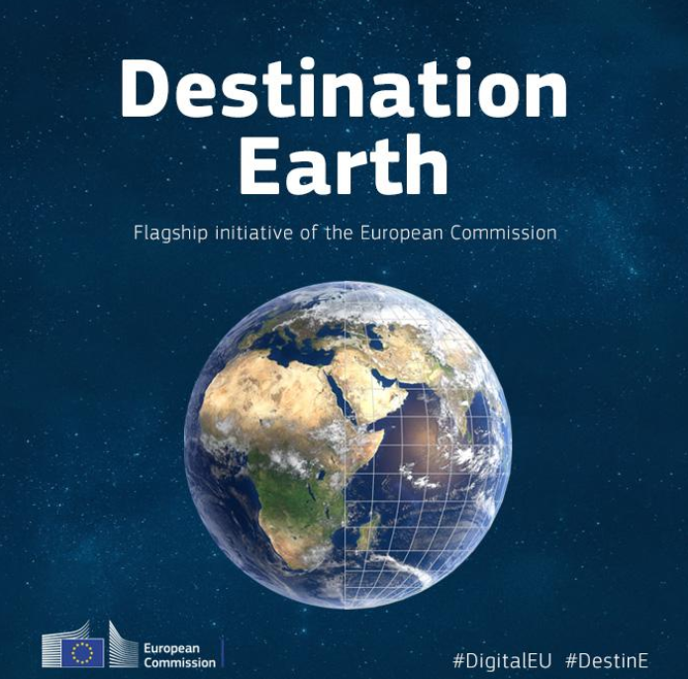
Case Study. Destination Earth (DestinE).
DestinE is a flagship European Commission initiative to develop a highly accurate digital model of Earth that will monitor, simulate and predict the interactions between natural phenomena and human activities.
The components of DestinE:
DestinE Core Service Platform (DESP) led by ESA
Ecosystem of services aimed at facilitating evidence-based decision-making and the development of applications.
DestinE Data Lake (DEDL) led by Eumetsat (fulfilled by CloudFerro)
Platform to fulfill the storage and access requirements for any data that is offered to DestinE users.
DestinE Digital Twins (DTs) led by ECMWF
Initially, two Digital Twin models (weather/geophysical extremes, climate change).
Notes:
Now, this session is about also challenges. So I would like to say about a pleasant challenge that we are working on currently.
So we were invited to participate in the project Destination Earth.
Destination Earth is an initiative of the European Comission to build a digital model of the Earth, to simulate the development of our planet.
As part of Destination Earth, there are 3 components:
DESP – provided by ESA, which we could consider a FrontEnd. This will be accessed by users to access broad range of services, applications and data sources.
DEDL – this is provided by Eumetsat, and CloudFerro is leading the consortium to deliver this component. This covers the cloud computing and storage infrastructure, as well as API to the data services.
DTs – provided by ECMWF, Digital Twins, these are the models (weather/geophysical extremes, climate change) that can be accessed by the users

Slide 12
Case Study. Destination Earth (DestinE).
Source: https://events.eodc.eu/event/7/attachments/9/42/2022_06_15_EODC_ESA.pdf
Notes:
So Destination Earth is a very large stragegic project. Our part is the Data Lake, which in itself is a large system, and on top it needs to take into accound dependencies with other subsystems.

Slide 13
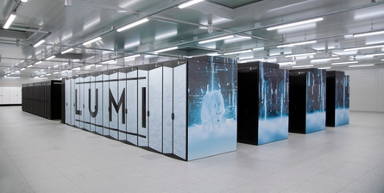
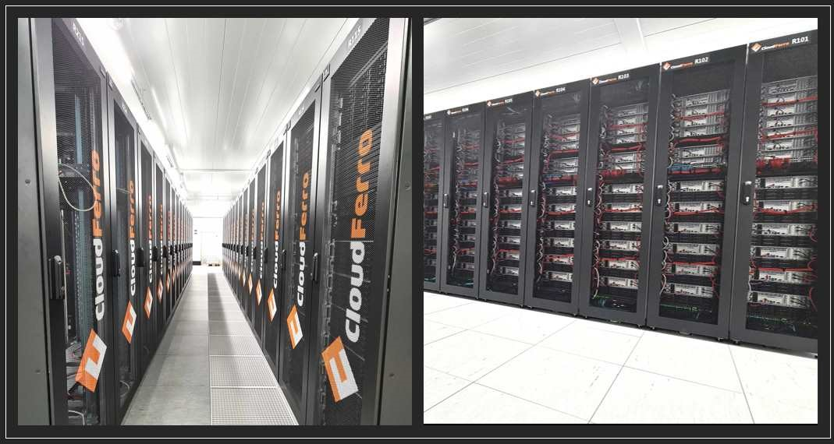
Case Study. Destination Earth Data Lake (DEDL)
Physical Infrastructure
As part of DEDL, CloudFerro to provide:
Central DEDL site in Warsaw
and Data Bridge infrastructure next to HPC datacenters:
Lumi Data Bridge (Finland)
MareNostrum Data Bridge (Barcelona)
Leonardo Data Bridge (Bologna)
Eumetsat Data Bridge (Darmstadt)
Data Bridges provide near-data processing, storage, IAAS and PAAS services built on OpenStack.
Multi-petabate storage, thousands v-core computing capacity at each location.
Notes:
As part of DEDL, first of all we will provide new cloud infrastructure. The sites in Warsaw and Finland are already delivered during past few months, the other sites are planned.
These are large clouds with multipetabyte storage and thousands of v-cores of RAM per each location. The data bridges are located next to the locations where HPC data centers are placed.
Each data bridge is an OpenStack instance.
Also the central site in Warsaw will host some of the central services, Keycloak will be one of them.

Slide 14
Case Study. Destination Earth Data Lake (DEDL).
Data Access and Identity Management
DEDL exposes API to available DestinE services, requiring well-crafted authentication/authorization.
Following features need to be guaranteed:
Standalone IdP for DEDL
DEDL as Identity Broker to DESP
Federating with additional Data Providers
Authorization scenarios for wide range of user groups / roles
Key Technologies for Identity Management:
Keycloak
Envoy as central API Gateway, redirects further to Keycloak
OPA – Open Policy Agent, for authorization scenarios
14
Notes:
But DEDL is not only about the Hardware. The hardware is there to facilitate the concrete requirements of users.
On the software/system side, key responsibility of DEDL is to ensure a common API to access the data. This of course requires fine-grained access control.
The key requirements involve that DEDL needs to be self-sufficient as an IdP. But then also it needs to serve as Identity Broker to DESP.
Additional element is that there will be 3rd party Data Providers and they also will require federation.
Also there are multiple user roles planned for DEDL and this fine-grained access control needs to be implemented.
The technologies that we plan to use for this use case are of course still Keycloak.
We also use Envoy, which serves as central API Gateway, redirects further to Keycloak. It runs on Kubernetes and includes some very relevant features e.g. built-in rate limiting.
Also we use OPA that integrates well with Kubernetes for complex authorization scenarios.

Slide 15
Paweł Turkowski
pturkowski@cloudferro.com

