Slide 1
Experience, challenges, solutions to OpenStack operations in the EGI Federation
Gianni Dalla Torre, Enol Fernández
21st June 2023
EGI Foundation
EGI Conference 2023
TLP: GREEN Limited disclosure

Slide 2
Agenda
1st part - Lightning Talks on Technical Innovations in Research/Public Cloud Providers
Integrating EGI Check-in with OpenStack alongside other Open ID Connect providers - Tom Clark (EODC)
CloudFerro. OpenStack and Identity Federation - Paweł Turkowski (CloudFerro)
Beskar Cloud: Openstack deployment on top of Kubernetes - Adrián Rošinec (CESNET)
2nd part - Future Federation Models for EGI Cloud and creation of a community of practice
EGI Cloud Federation model
Panel for federation model
Plan for the creation of a community of practice
Planel for the community of practice

Slide 3
Lightning talks

Slide 4
Future Federation Models for EGI Cloud and creation of a community of practice

Slide 5
EGI Cloud Federation model

Slide 6
EGI Cloud Federation - Principles
Enable Federated Access
Single Sign-On
Harmonised Authorisation based on VO membership
Facilitate federated usage
Application sharing: VM images available at every provider (VO scoped)
Discovery: API and GUI-based resource discovery
Common tools: fedcloudcli, IM, Workload Manager
Federated data access
Federated operations
Monitoring
Accounting
Security coordination
…

Slide 7
Evolution
Initial Federation implementation (2014)
OpenNebula and OpenStack
OCCI-based, same API for different cloud providers, extensions on top of existing APIs
X.509 + VOMS as AAI
BDII for information discovery
vmcatcher/vmcaster image distribution
Accounting records for VMs sent via SSM (stomp)
Current Status (2023)
OpenStack (but there is no mandated implementation!)
No common API, try to minimise modifications to existing deployments
OpenID Connect for AAI
Cloud-info-provider + AppDB for information discovery (run centrally)
No imposed technology for image distribution (cloudkeeper, atrope) - not the greatest software
Accounting records for VMs sent via SSM (AMS)

Slide 8
OpenStack in EGI Cloud
GOCDB
Users
ARGO
Federated Site
Keystone
Nova
Cinder
Neutron
Glance
cASO/SSM
cloudkeeper
APEL
AppDB
cloud-info-provider

Slide 9
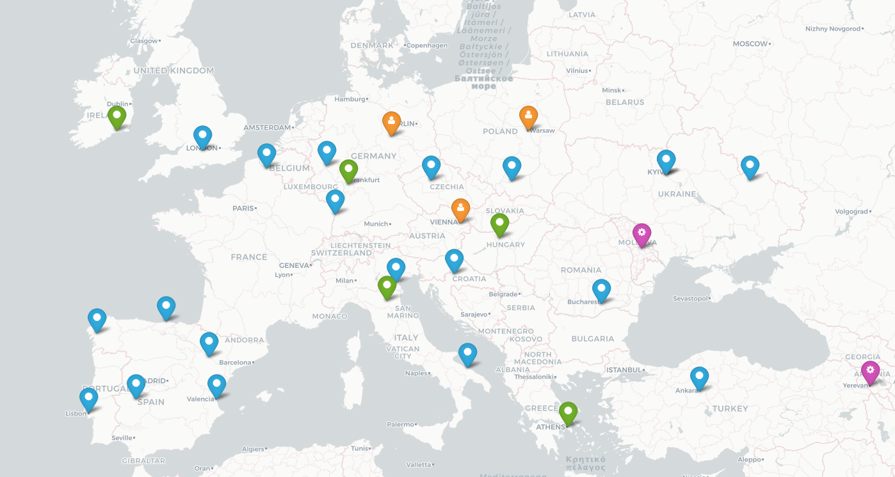
New integration levels
Federated access
Check-in, enable international users
Application sharing
Access relevant software available at AppDB/ CVMFS
Data sharing
Access data via DataHub
FTS/S3/Swift?
Full integration
Certified center of the infrastructure
Participate in EGI SLAs

Slide 10
Menti.com 2135 5399
Panel

Slide 11
The importance of collaboration and knowledge sharing among OpenStack providers in the scientific and commercial sectors.
Building a Community of Practice for OpenStack Providers

Slide 12
Goals of the Community of Practice
Help the community by providing a forum for learning from each other's experiences, successes, and challenges.
Develop and disseminate best practices and manage a body of knowledge.
Serve as a platform for professional networking, connecting individuals with a passion for OpenStack and fostering breakthrough ideas, new knowledge, and practices.

Slide 13
Structure & Benefits
Potential Activities
regular meetings
online forums
collaborative projects
Advantages of participation
professional development
access to resources
shaping the future

Slide 14
menti.com: 2135 5399
Panel

Slide 15
Thank you

