Slide 1
EOSC Exchange
Alignment with EGI business models
Ignacio Blanquer
Universitat Politècnica de València / EOSC-A
DISCLAIMER: The opinions expressed in this presentation are solely those of the presenter.

Slide 2
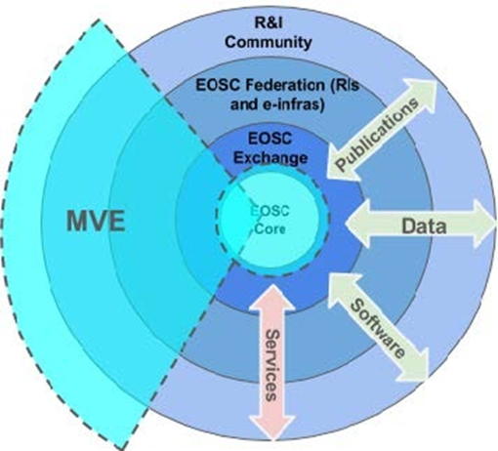
EOSC Exchange: setting the scene (I)
The set of federation services registered to the EOSC by RIs and clusters to serve the needs of research communities and the widening to the general public and private sector [1].
According to EOSC Future D2.9
MVE EOSC Exchange functions
EOSC Data Transfer
EOSC Helpdesk as a Service
EOSC Research Data as a Service
Added Value EOSC Exchange functions
Compute Infrastructures and platforms
Computing services for multidisciplinary science.
Data archive, discovery and repository.
Catch-all repository.
Dashboards
Thematic specific services
Data providers and processing services
Semantic interoperability
[1] https://eoscfuture.eu/wp-content/uploads/2022/12/EOSC-Future-WP2-TGB-D2.9-Co-designed-Architecture-Description-2022-01-14.pdf
[1] https://data.europa.eu/doi/10.2777/492370

Slide 3
EOSC Exchange: setting the scene (II)
Managed services for EOSC Procurement: Managed Container Platform and Virtual Machine Services for the EOSC Exchange (Lot 2 - Infrastructure Services)
The EOSC Exchange is the set of services and other resources registered into EOSC by Service/Data Providers (such as e-Infrastructures, Research Infrastructures, Science Clusters, Commercials) to serve the needs of research communities and will widen its offering to the public and private sector.
Generic services and resources which target heterogeneous scientific domains and research communities are identified as “horizontal services”. The following horizontal services are procured for the EOSC Node.
1. Managed Container Platform Service
Container Orchestration
Container Management
2. Managed Compute (Virtual Machines) Infrastructure Service
Compute/Storage Service
Infrastructure Management
3. Managed Bulk Data Transfer Service
High-volume data migration

Slide 4
User perspective
The Application Workflow Management (AWM) is a Lot 1 EOSC Core service that enables the researchers to deploy and compose virtual environments for scientific data.
EOSC Exchange horizontal resources clearly require funding.
Application developers and data provider should find their revenue path too.
Application marketplace
Federated Data
Data Request
Application Request
AWM
Virtual Environment
Credits
EOSC-Exchange Horizontal Resources

Slide 5
EOSC Exchange Horizontal services in the context of a federation such as EGI
Horizontal services are nationally or regionally funded
Funding the onboarding of services is a catalyser for the development of thematic services.
There should be clear sustainability plans beyond the onboarding period.
EC should focus on the EOSC interaction layer.
Cross-borders funding is always complex for MS.
Different models have been proposed
Centrally financed consumption of services.
Virtual access through better than invoicing.
Limitations beyond not-for-profit services.
Combination of service procurement with research-oriented support.
EGI provides a common federated structure to jointly provide offers.

Slide 6
EOSC Exchange community-specific services
Community-specific services cannot be procured as the horizontal IT services
Direct engagement of the community is needed.
International collaborations have their own sustainability plans.
The link to EOSC will bring
Cross-domain visibility and interoperability
Share best practices and EOSC core services
Federated AAI, PIDs, interoperability services
Jointly procure services
Especially storage and processing capabilities.
Jointly evolve core and shared services.
EOSC benefits will save innovation costs.
However, service usage comes with a cost
Public research data should not be a commercial good, but the service instead.

Slide 7
Post 2027 view
Potentially Distinguish Operational actions and Research and Innovation
Operations will focus on delivering and maintaining services
At the three levels: Core, Exchange and Data,
Research and innovation actions will focus on developing innovative services and improving existing ones.
Different scenarios may arise
Different funding instruments (e.g. procurement for operation and RIAs for new developments).
Different entities managing the calls (e.g. a European institution with the mandate - and funds for the operation and EC managing the calls)
In any case the coordination should be very tight
To ensure the handover and adoption of results.
To carefully align topics, priorities and objectives.

Slide 8
Conclusions
Different sustainability models should coexist as EOSC Exchange is a fairly heterogeneous component.
Core IT services could come from procurement and research-specialised services could combine in-kind contributions.
Innovation and operation should be closely coordinated to minimise replication of efforts.

