Slide 1
EGI101 - EGI Introduction to newbies
Giuseppe La Rocca
Community Support Team Lead
giuseppe.larocca@egi.eu
TLP: GREEN Limited disclosure
EGI 2023 Conference - Poznań, Poland

Slide 2
About me
Community Support Team Lead. @ EGI Foundation
Member of the EGI Foundation team since Dec. 2015
MSc in Computer Science Engineering from the University of Catania (Italy).
EGI-ACE Community Manager
Based on Catania, Italy
giuseppe.larocca@egi.eu
ORCID: 0000-0002-8011-1450

Slide 3
Outline
Who we are
What we do
Who do we support
Our services (value propositions)
  For Research
  For Federations
  For Business
EGI and the European Open Science Cloud

Slide 4
Who we are & What we do
EGI 2023 Conference - Poznań, Poland

Slide 5

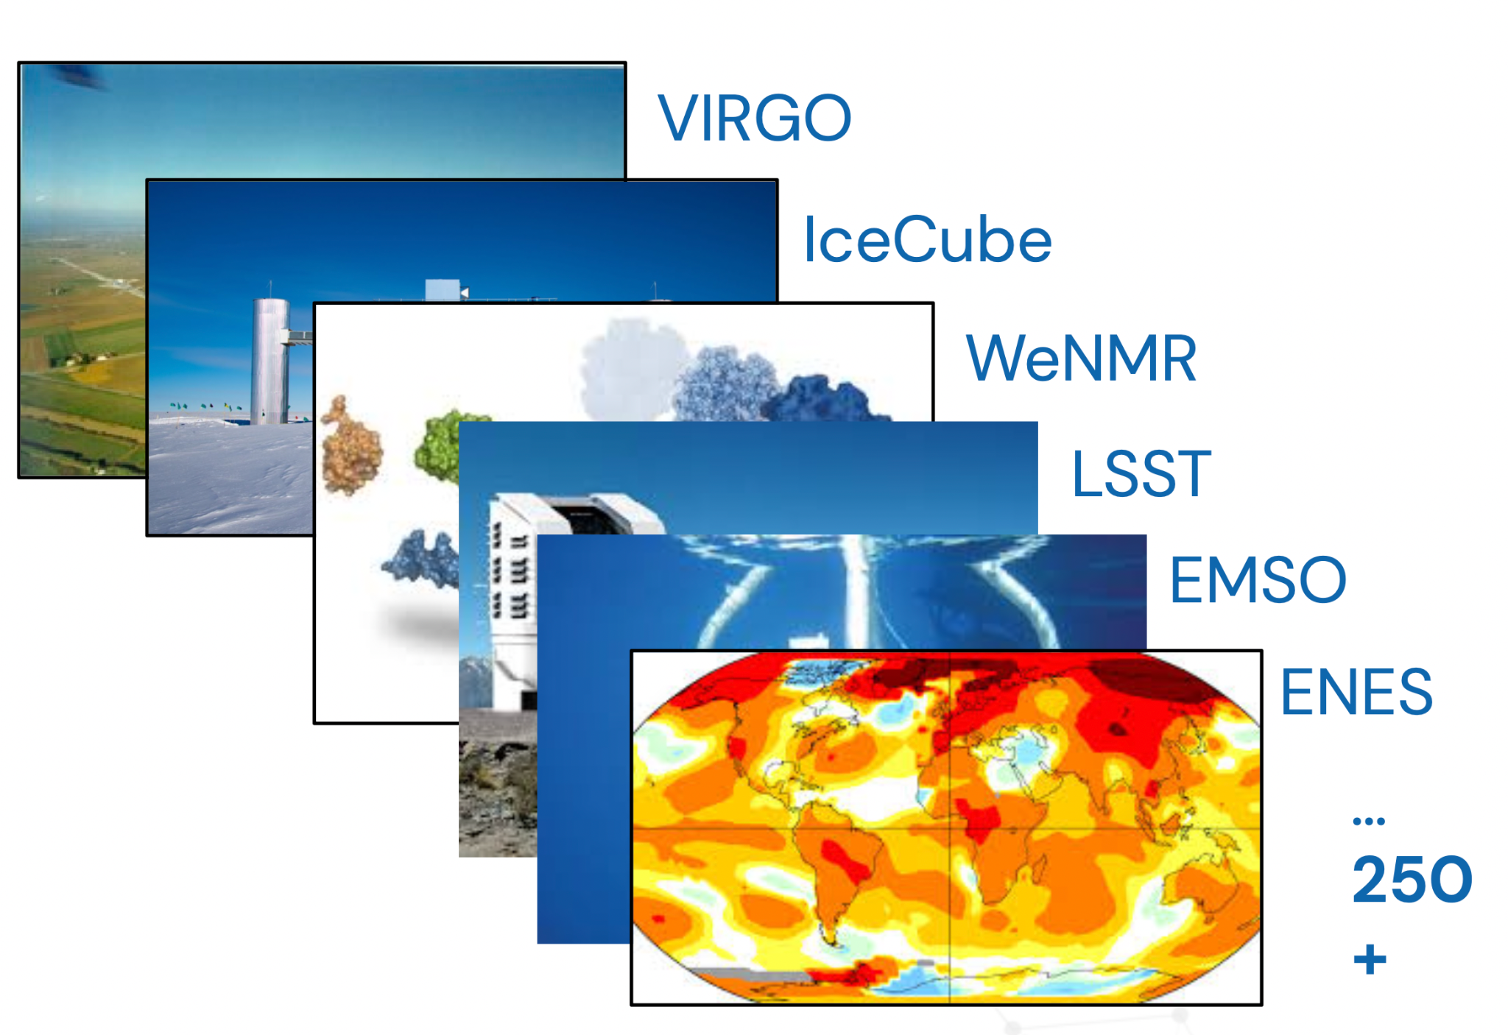
The EGI Federation is an international e-infrastructure
We provide advanced computing and data analytics for research and innovation
2010
From the high-energy physics compute grid
(WLCG)
2023
To a multi-disciplinary, multi-technology infrastructure

Slide 6
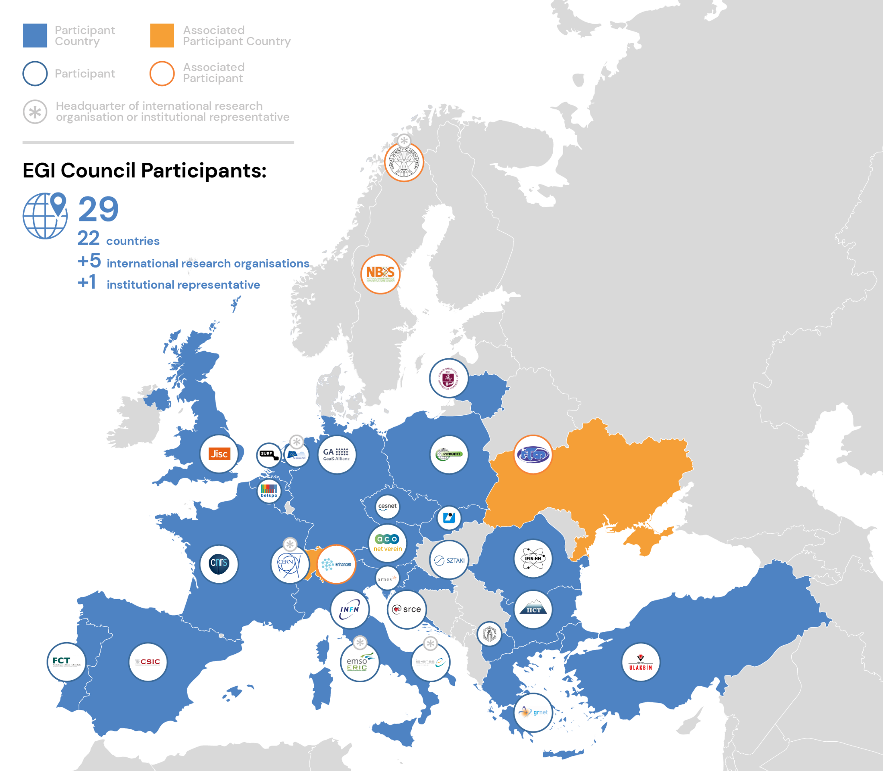
Vision
All researchers have seamless access to services, resources and expertise to collaborate and conduct world-class research and innovation
Mission of the EGI Federation
Deliver open solutions
for advanced computing and data analytics in research and innovation
Mission of the EGI Foundation
Enable the EGI Federation
to serve international research and innovation together

Slide 7
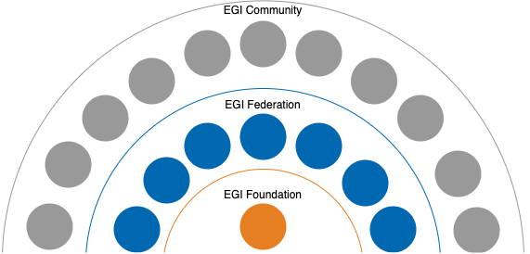
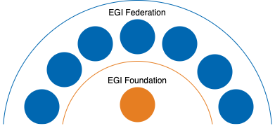

The EGI Federation and its Community
EGI Federation
EGI Community
Projects
The EGI Federation plus the served research communities, the technology providers or any other organisation linked via an agreement (e.g. MoU) with the EGI Foundation and contributing to the mission of the EGI Federation
Capacity, technology, knowhow
EGI Foundation, EGI Foundation Participants, Associated Participants, their linked organisations

Slide 8
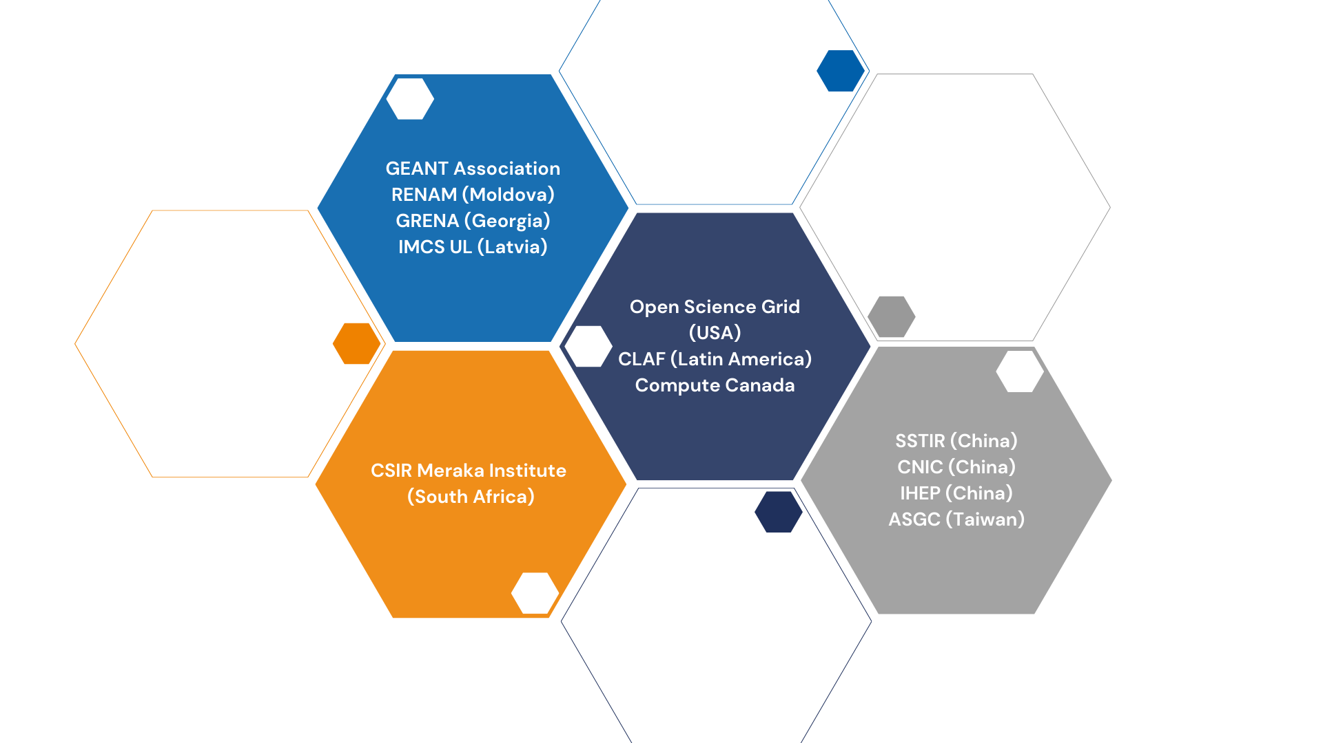
International Partnerships

Slide 9
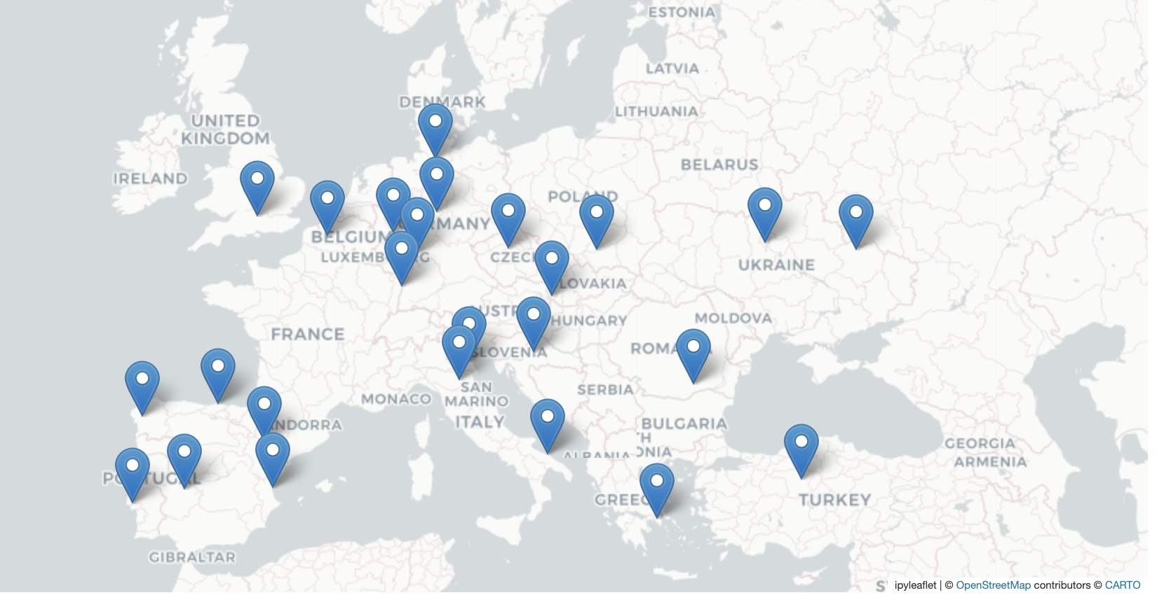
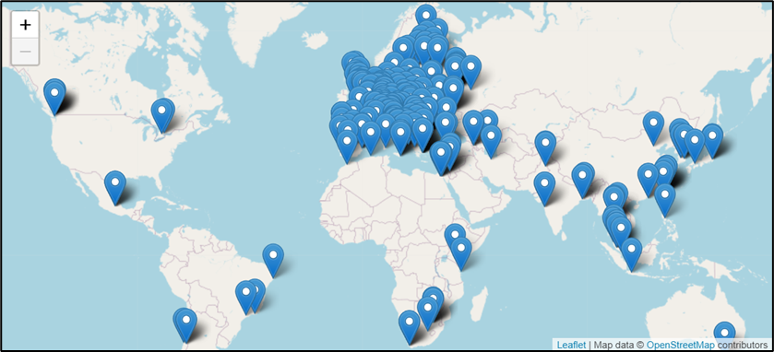
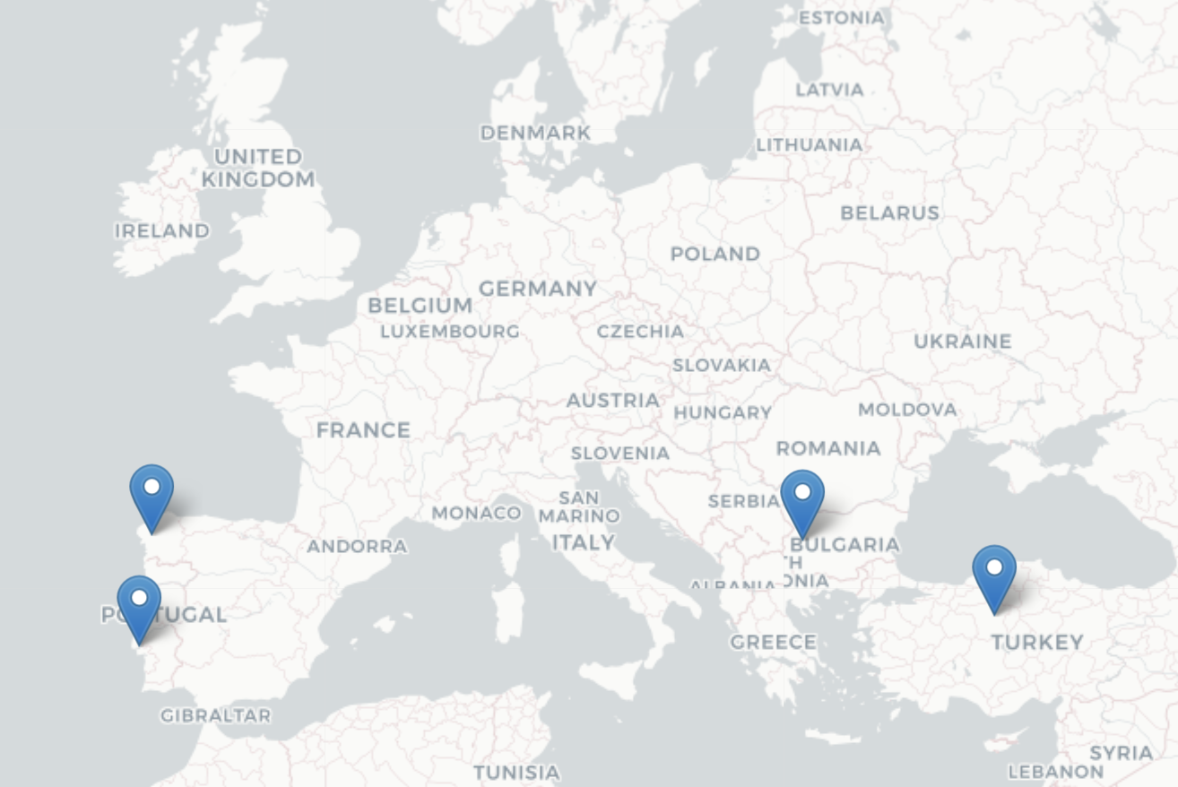
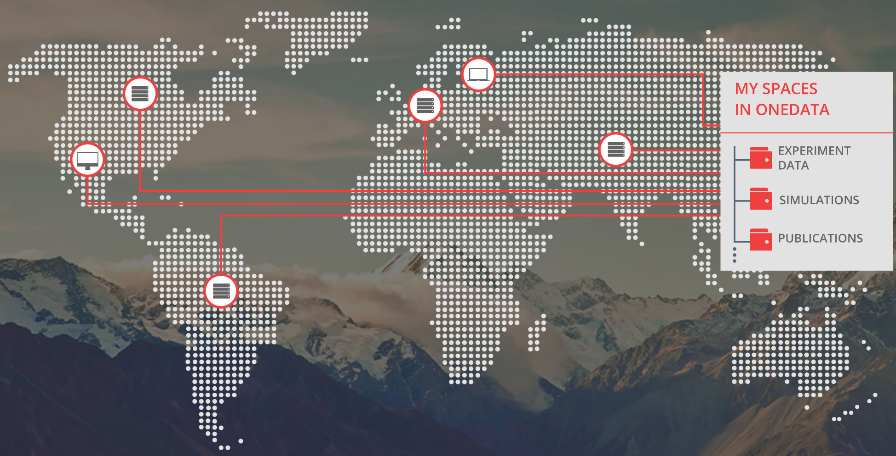
The EGI Infrastructure
Platform and community specific services built on top:
Scientific gateways, Virtual Research Environments, Application portals, etc.
High-Throughput Compute
(ARC-CE, HTCondorCE, SRM, webdav, XrootD)
Cloud Compute
(based on OpenStack. Since 2013)
EGI Federation services
Service registry
Monitoring
Accounting
Helpdesk
Single sign-in
Security oversight
Capacity management
etc.
High Performance Compute
(since 2022)
Data
(based on OneData)

Slide 10











EGI Federation services
Configuration Database
Information about sites and hosted services
Validated Software and Repository
Unified Middleware Distribution
Usage Accounting
Compute usage records (accounting.egi.eu)
Monitoring
Healthiness of our services
Operations Tools
Essential toolkit to run a core infrastructure platform in a federated ecosystem
Helpdesk
Point of contact to ask for support at EGI
Collaboration Tools
IT tools for better coordination
Marketplace
Expose your services to a broader audience
Check-In
Login with your own credentials

Slide 11
The EGI HTC Federation
>1.2 Million computing cores
> 1 EB disk & tape
816 service end-points
200+ High Throughput Compute sites
(ARC-CE, HTCondorCE, SRM, webdav, XrootD)

Slide 12




Federating HPC resources
Pilot service offer that brings EuroCC HPC providers into the federation
Access to cloud IaaS infrastructures and HPC
  Hosting long-running services as cloud VM, data transfer using cloud storage, spawning jobs to HPC as needed
  Access HPC with Check-in identities
4 initial providers:
  LIP/INCD (PT),
  CESGA (ES),
  TUBITAK (TR),
  IICT-BAS (BG)
TUTORIAL:
Installation and configuration of ARC-CE on HPC
- Mon 19, 14:00 CEST

Slide 13
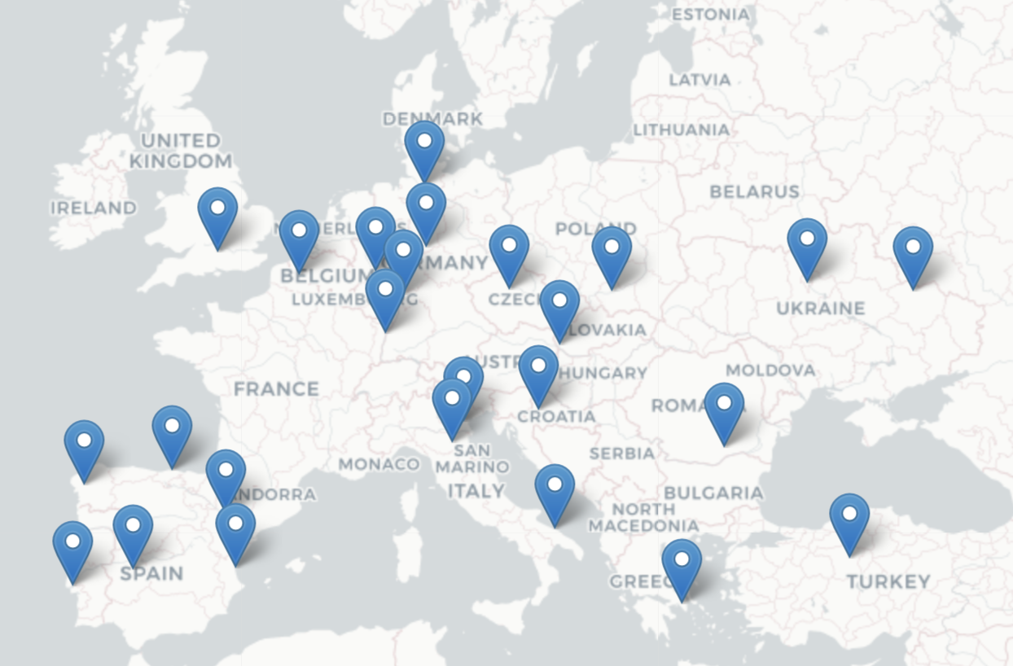
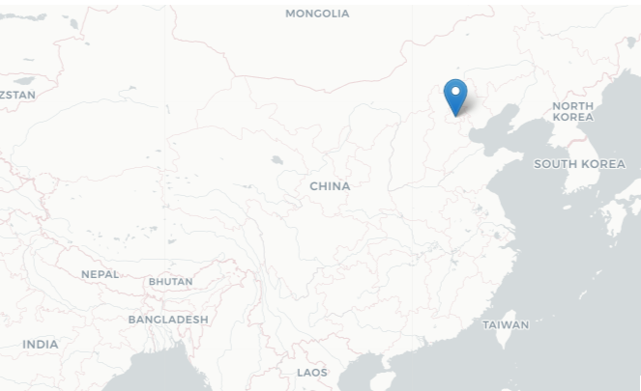
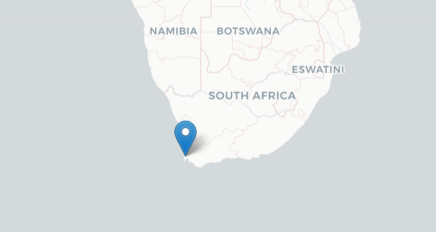
The EGI Cloud Federation
Operational since 2013
28 Cloud Providers (OpenStack)
Providing different functionalities and more dynamic platforms for scientists
70,140,605 Cloud CPU/h consumed in 2023
105 Virtual Organisations supported (Virtual Organisation = Resource pool)
Access via GUI, CLI, OpenStack native and libcloud APIs, Terraform

Slide 14
Kubernetes (Containers) in the EGI Cloud
Self-deployed by users
Spin up some VMs and deploy Kubernetes (works with existing tooling targeting OpenStack)
Automated deployment with Infrastructure Manager (IM)
Select site, size of VMs and go
Rancher-based access to managed clusters (under development)
Rancher integrated with EGI Check-in
Access to pre-configured clusters managed by expert operators
TUTORIAL: Get experience with computing on Kubernetes - Fri 23, 09:00 CEST

Slide 15

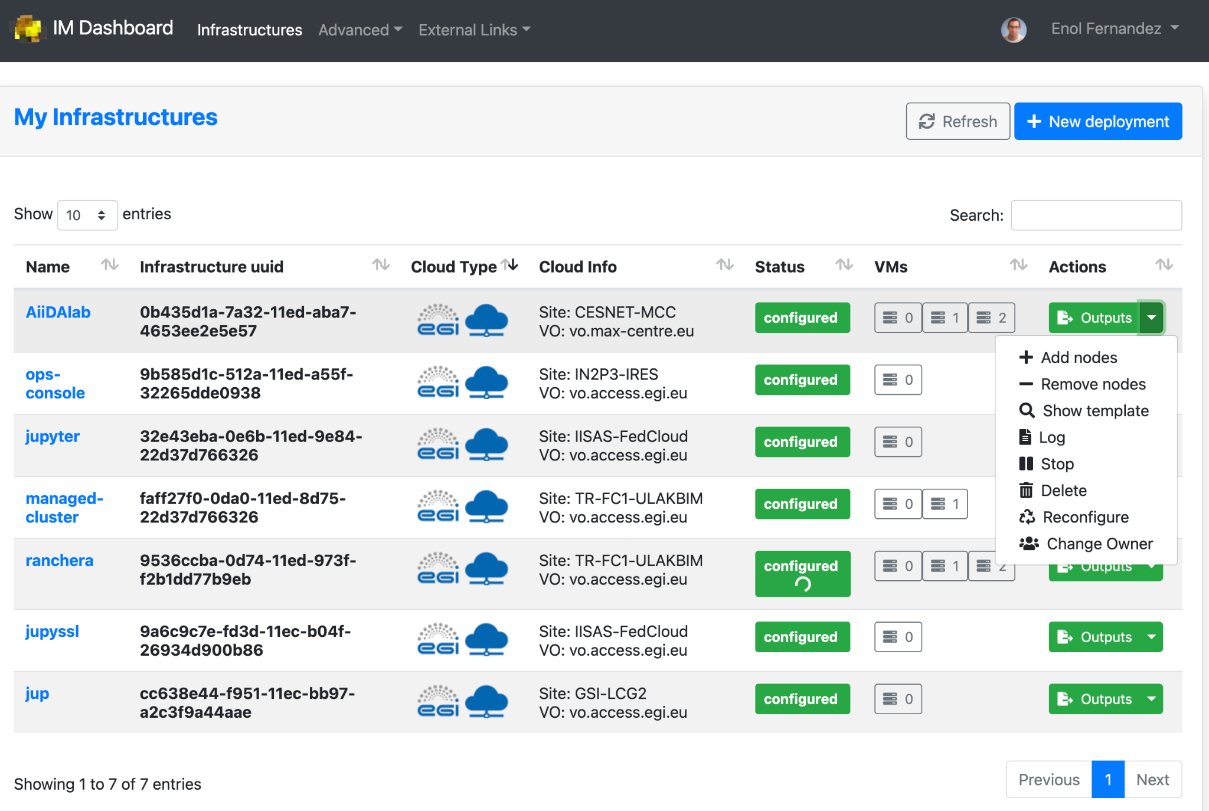
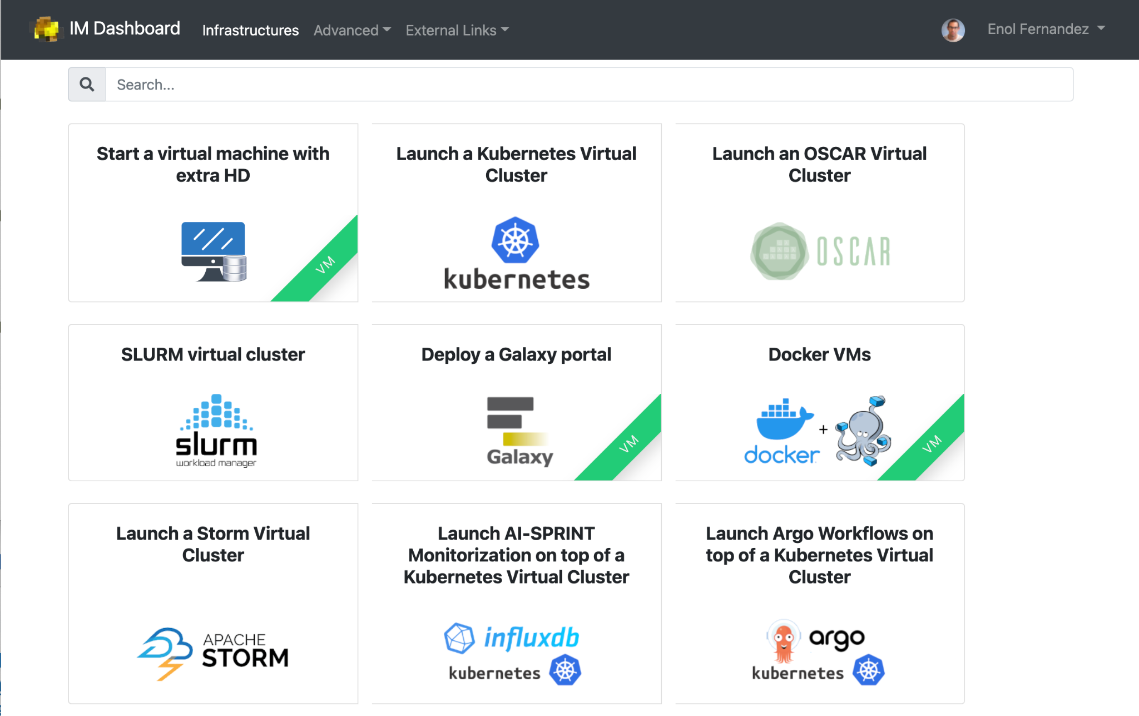
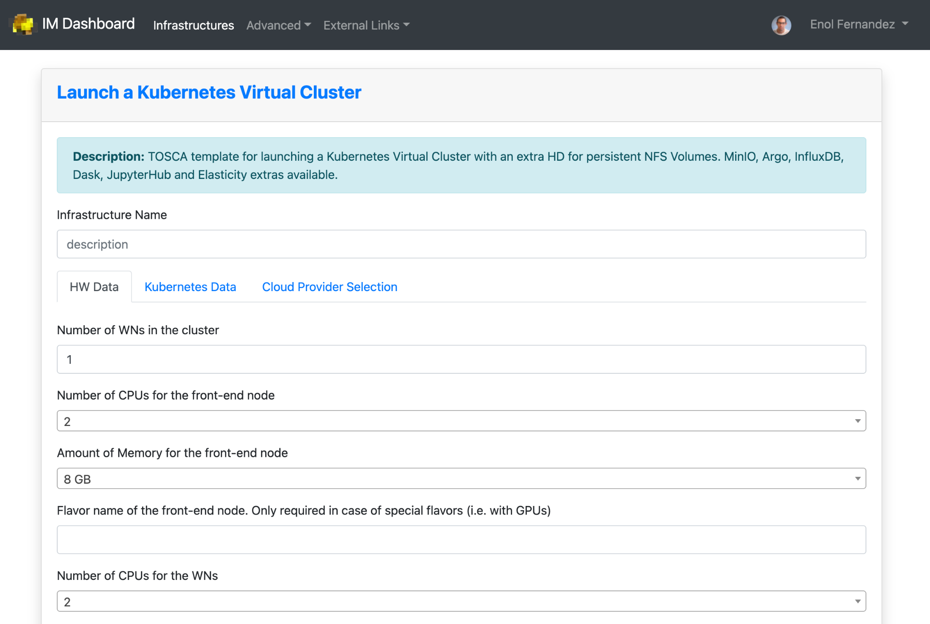
Federation services for Cloud
Infrastructure Manager orchestrates deployment of Virtual Infrastructures
Multi-cloud following Infrastructure as a Code (IaC) paradigm
Rely on Ansible and Helm to manage definition of complex infrastructure
Manages whole life-cycle: deployment, monitoring, reconfiguration (such as scaling-up or down) and removal.
Support for TOSCA
DEMO: Infrastructure Manager (IM): TOSCA deployment and orchestration in the Cloud Continuum - Wed. 21, 15:30 CEST

Slide 16
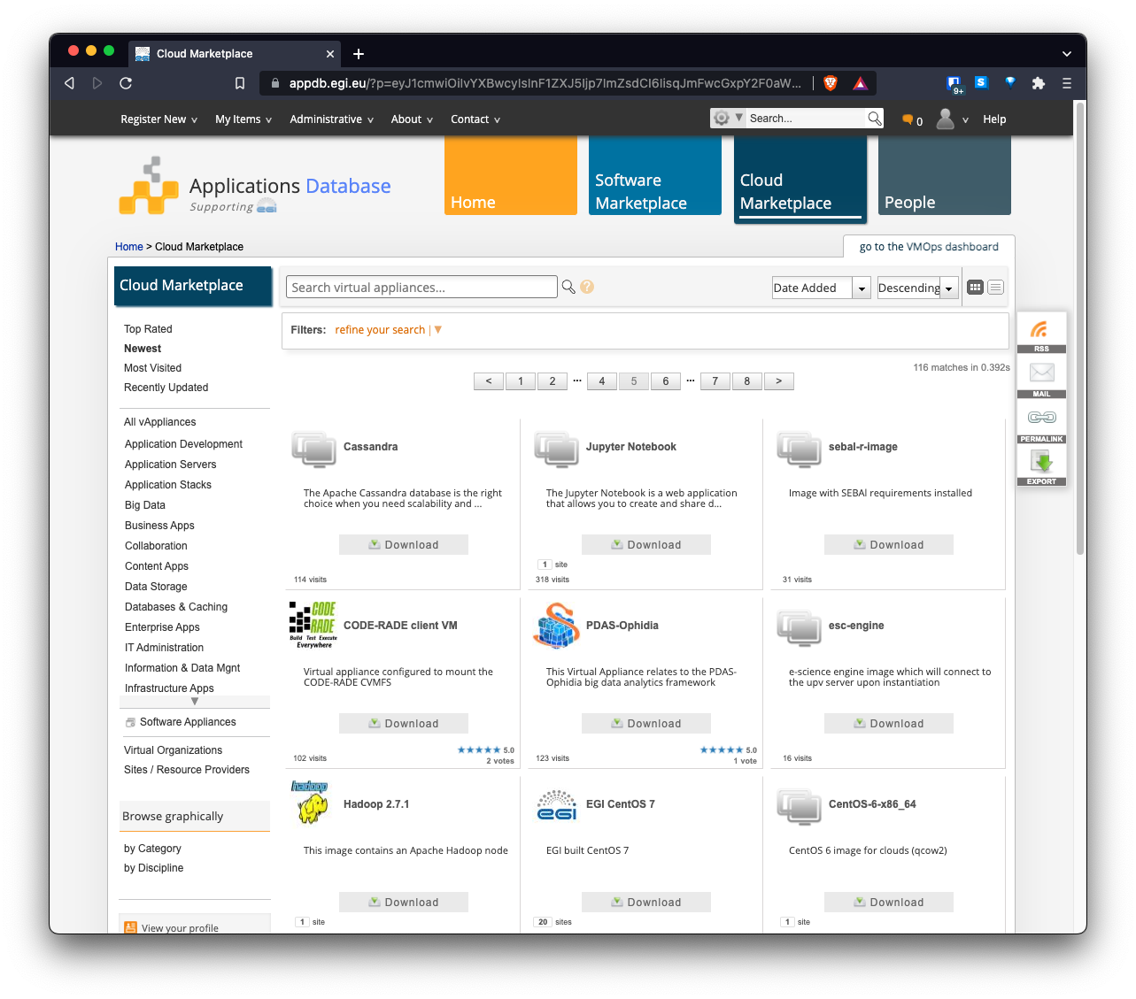
AppDB: an application store for EGI Cloud
Common registry for Virtual Appliances (VA)
VM image + metadata
Available for running at the EGI cloud or on any hypervisor
Community-level management of VAs
Automatic distribution to providers

Slide 17
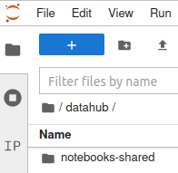

EGI DataHub
Service based on Onedata technology
It allows transparent data access under a common namespace
regardless of the location open access
Access restricted to members of a Virtual Organization (VO)
Data can be accessed via a GUI or APIs
Allows replication of data from data providers for resiliency and
availability purposes. Replication may take place either on­ demand or automatically.
Easy integration with other EGI components thanks to integration with EGI Check-in service, the EGI Authentication and Authorization Infrastructure (AAI)
TUTORIAL: Onedata hands-on workshop: Workflow Processing, Dataset Management and Archiving - Fri 23, 09:00 CEST

Slide 18
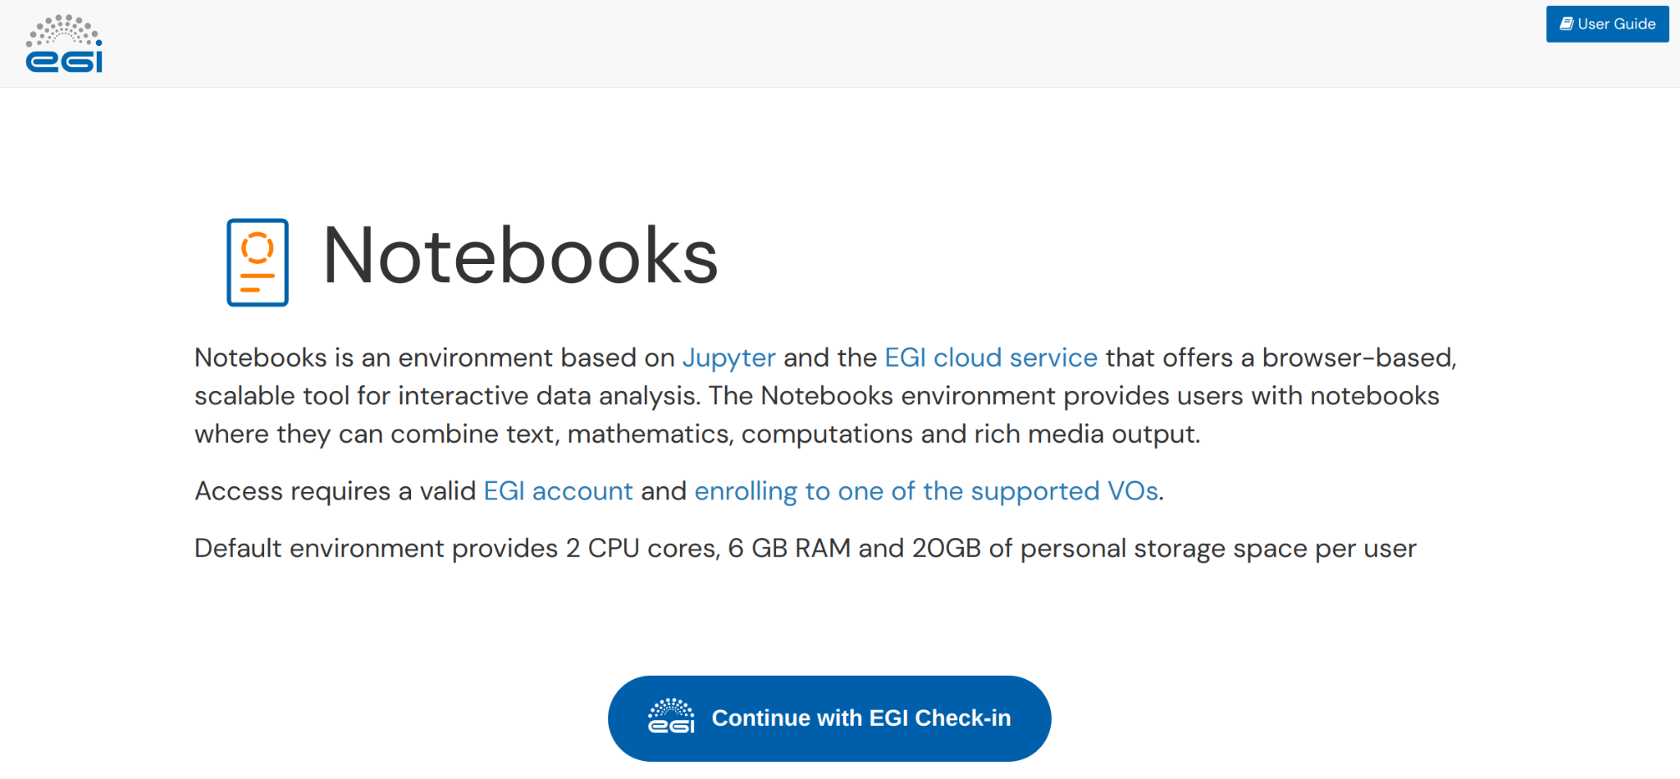
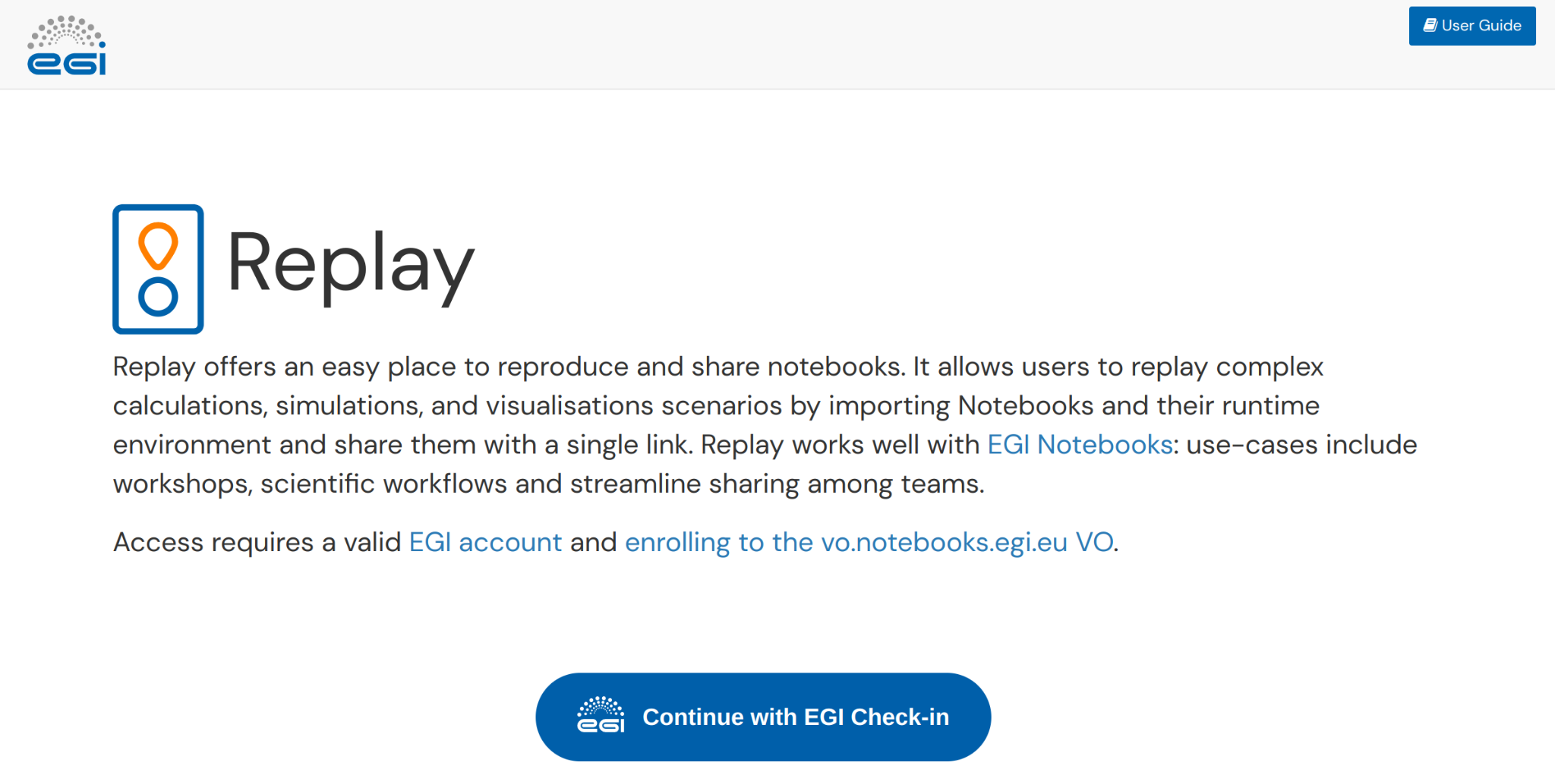
Services open to everyone: EGI Notebooks and Replay
https://notebooks.egi.eu, https://replay.notebooks.egi.eu/
Interactive environment to write, run and share applications, instructions, results.
Access after lightweight ID assessment
  Login with EduGAIN, Google, Facebook, LinkedIn…
  2 vCPUs, 6GB RAM and 20GB of storage
  Persistence (don’t lose work after logout)
  Support for multiple kernels (Python, Julia, R, MATLAB)
  Access remote files (DataHub integration)
  Catch-all deployment and Community specific deployments
User guide
Login
User guide
SESSION: We did it! The innovation impact of EGI-ACE - Tue 20, 13:30 CEST
TUTORIAL: Processing Data from EOSC on EGI Compute resources training - Fri 23, 11:00 CEST
Login

Slide 19



EGI Value Propositions
Services for Research
Services for Federation
Services for Business
Our large-scale computing and data analytics services are helping scientists to accelerate their research.
Our internal services provide tools for coordination of the EGI Federation, improving how we work together.
We help companies to exploit and provide services and resources for compute- and data-intensive research and innovation.
Notes:
3 target user groups supported by EGI

Slide 20
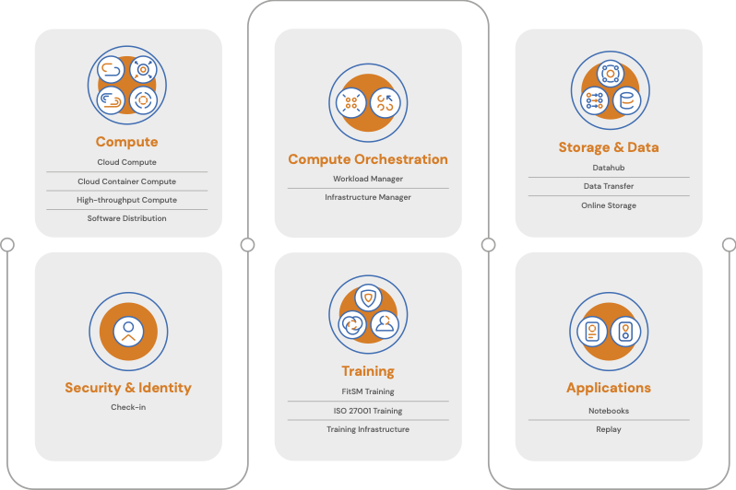


EGI Services for Research
Service catalogue:
https://www.egi.eu/services/
User documentation:
https://docs.egi.eu
Notes:
Infographics

Slide 21
Access policies
Wide access
Users can freely access scientific data and digital services provided by EGI resource providers
Policy-based
Users are granted access based on policies defined by the EGI resource providers or by the EGI Foundation
Market-driven
Users can negotiate a fee to access services either directly with EGI resource providers or indirectly with the EGI Foundation
Example:
EGI Notebooks open instance
EGI Cloud pool for application piloting
Example:
Biomed HTC pool for life sciences
INFN-Bari (IT), IN2P3-IRES (FR), ULAKBIM (TR) provide Clouds for the National Bioinformatics Infrastructure of Sweden
Example:
FitSM training by EGI Foundation
4 EGI Cloud providers deliver to Exprivia

Slide 22




Allocating services and resources
Type, number, size, cost, availability, etc.
Negotiator
Applic.
provider
Instance requirements
Conditions
Storage
provider
Cloud
provider
HTC
provider
Foundation
Users’ representative
Service Level Agreement
Operation Level Agreement
Training
Support
Federation members
Ensure satisfaction, capture achievements,
record feedback
Ensuring that agreed targets are met
Regular satisfaction interviews
Regular service
delivery reports

Slide 23
Who do we support
EGI 2023 Conference - Poznań, Poland

Slide 24
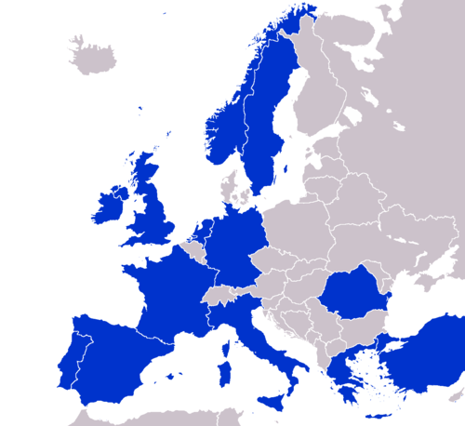
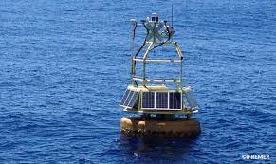
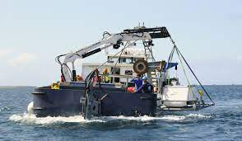
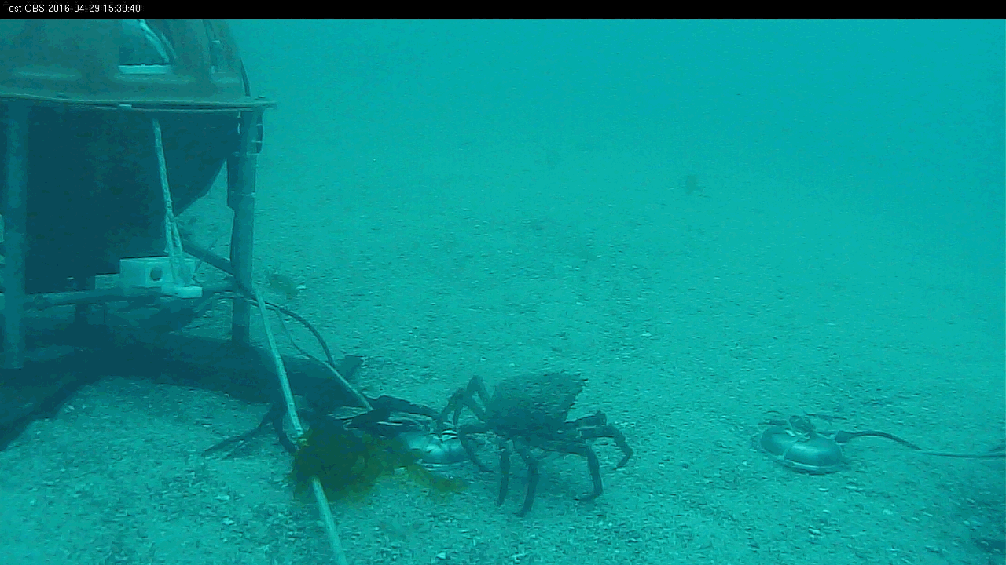
The EMSO-ERIC Data Space
https://emso.eu/
European Multidisciplinary Seafloor and water-column Observatory (EMSO) is a large-scale European distributed Research Infrastructure for ocean observation, enabling real-time interactive long term monitoring of ocean processes.
Observatories are platforms equipped with multiple sensors, placed along the water column and on the seafloor.
  EGI full story: here

Slide 25
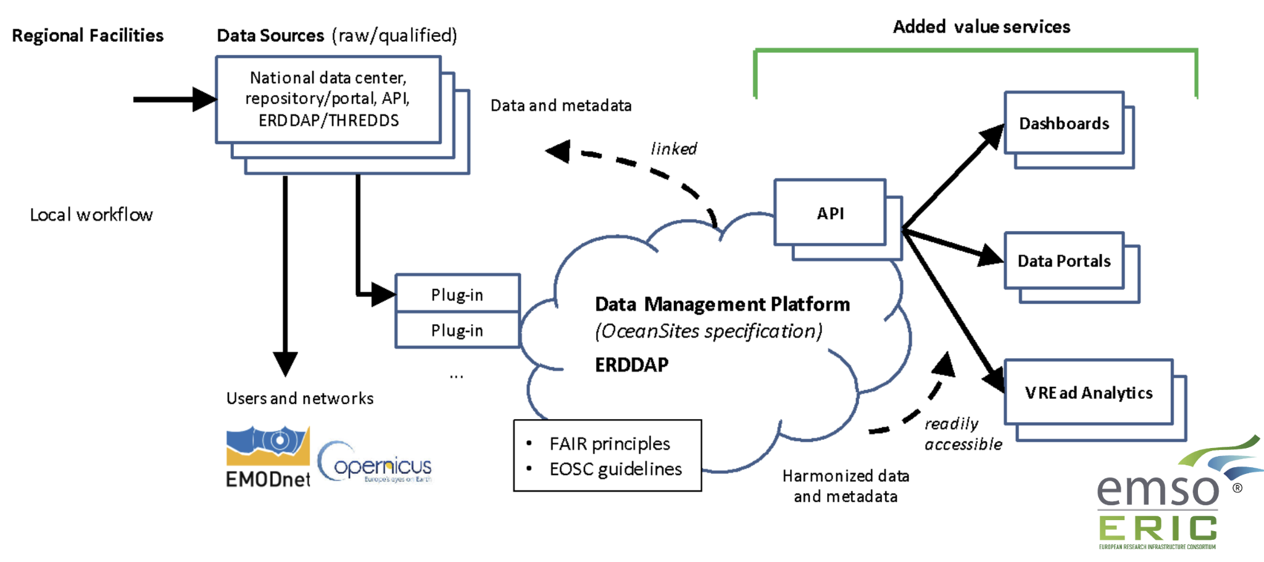


The EMSO-ERIC Data Portal
https://emso.eu/
492 vCPU cores, 1.7 TB of RAM, 20 TB of block storage

Slide 26

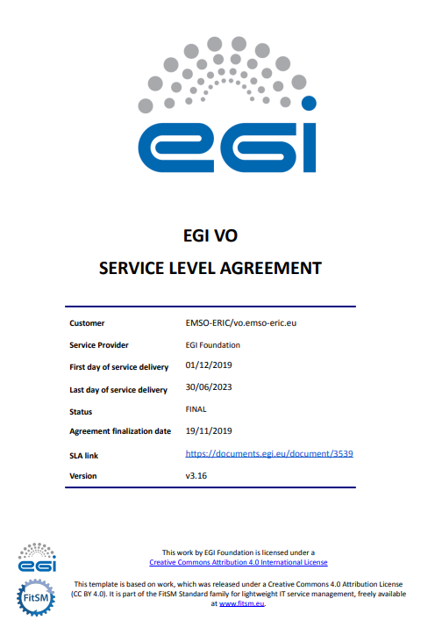
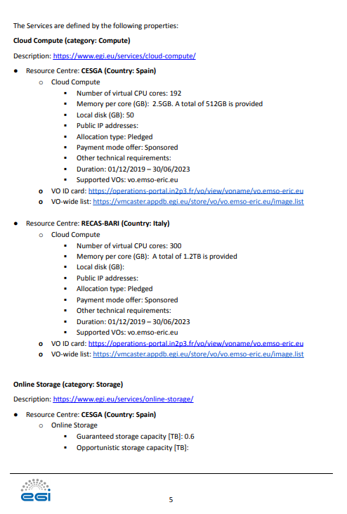
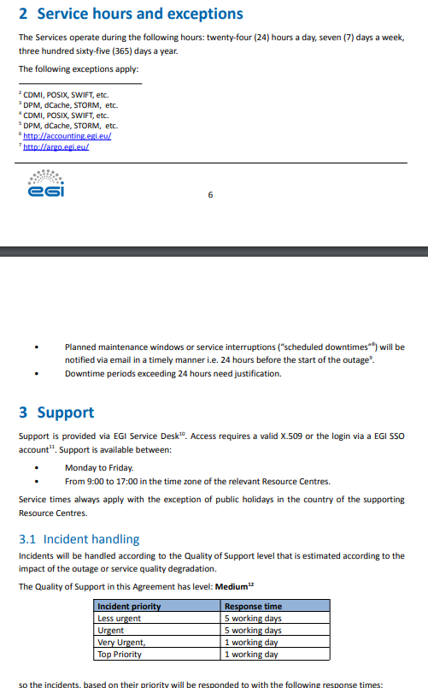
The SLA with EMSO-ERIC
https://emso.eu/

Slide 27
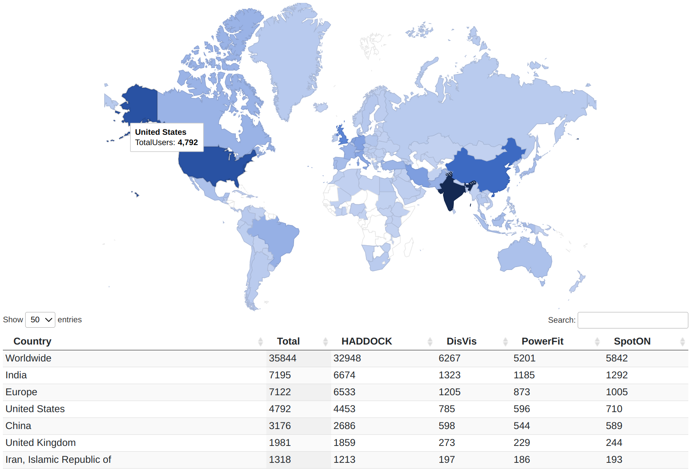
WeNMR
wenmr.science.uu.nl
WeNMR is a worldwide e-infrastructure for Nuclear Magnetic Resonance (NMR)
and Structural Biology
Mission:
  Understand life at molecular level
  Engineer better molecules for material, health of food applications
  Obtain starting point for drug design to combat diseases
The HADDOCK web portal is being used by 32,948 users
across 137 countries!

Slide 28
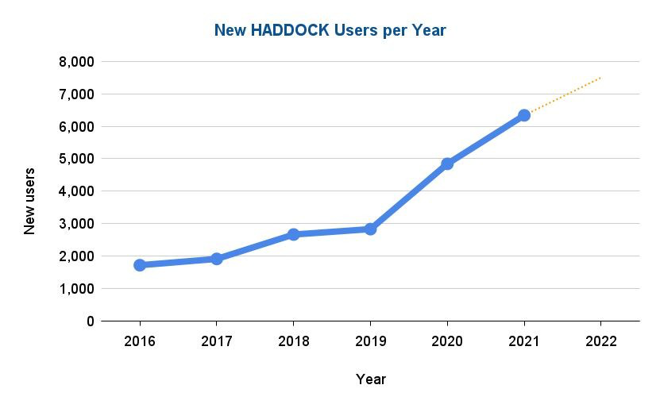
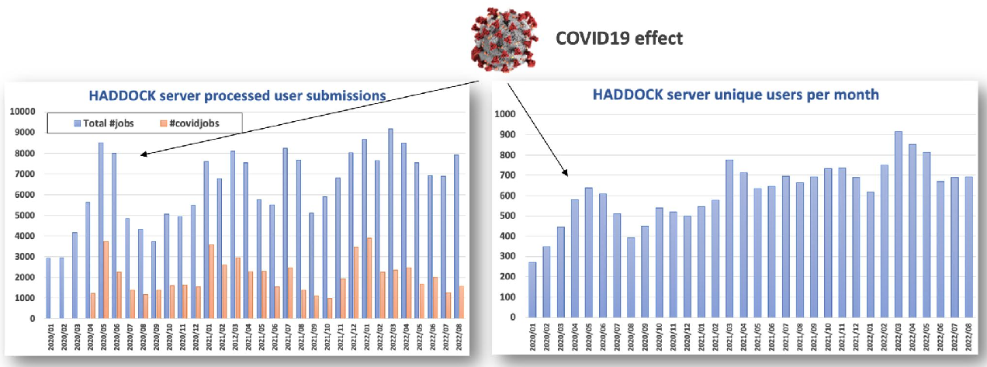
WeNMR
Worldwide Impact and Usage
35,000+ users,
507,900+ jobs
EGI-ACE support
Additional EOSC HTC dedicated resources to support COVID-19 research (EGI and OSG)
CNIC cloud infrastructure
  EGI full story: here
wenmr.science.uu.nl
~30% of all simulations since April 2020 are COVID-19-related
  EGI provides:
Check-in
Cloud Compute
Online Storage
Workload Manager
HTC Compute
CVMFS
EGI BOOTH B: I-VRESSE: A VRE for Integrative Modelling of Biomolecular Interactions with HADDOCK - Tue 20, 19.40 CEST
TALK: Data analytics platforms, tools and VREs for EOSC - Wed 21, 11:00 CEST

Slide 29
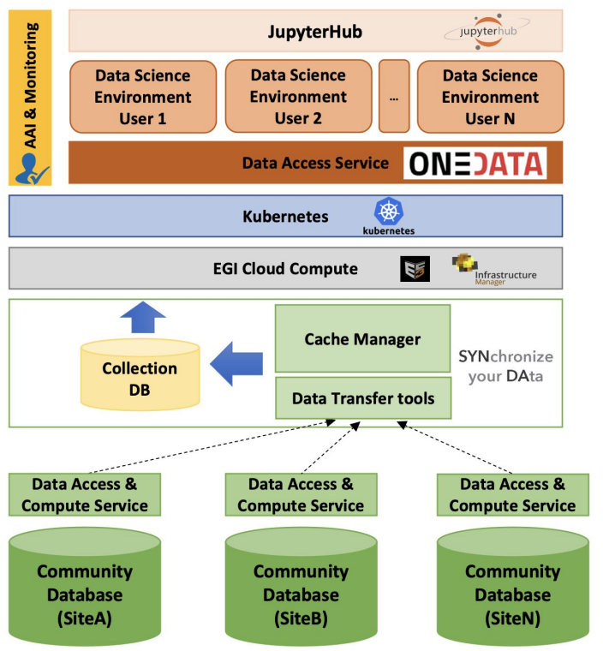






European Network for Earth System Modelling
https://enesdataspace.vm.fedcloud.eu/
Open, scalable and cloud-enabled data space for climate data analysis
Applications
  EGI provides:
Check-in
Notebook
DataHub
Cloud Compute
Online Storage
HPC (pilot)
Application scaling
Data serving
Data
  Read the full story here
EGI BOOTH B: ENES Data Space: an EOSC-enabled and cloud-based environment for climate data analytics - Tue 20, 20:05 CEST
TUTORIAL: The ENES Data Space: an EOSC-enabled and cloud-based environment for climate data analytics - Fri 23, 09:00 CEST
Notes:
The European Network for Earth System modelling (ENES), was launched in 2001 comprising a network of about 50 groups including public, academic and industrial partners who agreed to work together and cooperate to discuss strategies to accelerate progress in climate, Earth system modelling and understanding. The main challenge of this community is the provisioning of comprehensive Earth system data models capable of simulating natural climate variability and human-induced climate changes. The development and use of realistic climate models leads to very large climate simulations output that pose significant scientific data management challenges in terms of data processing, archiving, sharing, and in particular analysis. In such a context, large-scale global experiments for Coupled Model Intercomparison (CMIP) are of paramount importance for the community and are served by the Earth System Grid Federation (ESGF). ESGF is a network of internationally distributed sites that work together providing access to the largest archive of climate data world-wide to facilitate advancements in Geophysical Science. Currently, the total ESGF archive manages over 7 PB of Earth system science datasets from about 31 projects; furthermore, it supports almost 12,000,000 datasets from worldwide laboratories and universities.
EGI-ACE supported the community providing access to the resources and services to deliver an open, scalable and cloud-enabled data science environment for climate data analysis on top of the EOSC Compute Platform. The Data Space will provide access to large scale climate datasets produced in the context of international experiments, giving a wider set of researchers (i.e. outside national climate facilities) the opportunity to perform scientific data analyses at such data scale.
By leveraging on the support offered by EOSC:
The community can operate the ENES Data Space for large-scale climate data analysis, provide technical users support and training activities, and support a wider user base.
The ESGF federated infrastructure can scale-up the nodes, datasets volumes and high performance data analytics capabilities required by researchers to exploit the data which no longer fulfils the traditional workflows where researchers download datasets for local processing.

Slide 30

EGI in numbers
Last 12 months (Updated in June 2022)
36
70M
EU funded projects
415M
Cloud CPU hours consumed
Computational jobs
+84.000
+7.1B
Users
HTC CPU hours consumed
+1790
Enabled articles
29
EGI Council members

Slide 31
EGI Value Propositions
Services for Research
Services for Federation
Services for Business
Our large-scale computing and data analytics services are helping scientists to accelerate their research.
Our internal services provide tools for coordination of the EGI Federation, improving how we work together.
We help companies to exploit and provide services and resources for compute- and data-intensive research and innovation.
Notes:
There are plethora of services offered by the EGI Foundation to the members represented in the EGI Council. We can broadly classify the services in three categories -
Let us look at them in a bit more detail. For that I am going to give examples of some services

Slide 32
Tools and Services for the Federation
Offered by the EGI Foundation to the members of the EGI Council
COORDINATION SERVICES
TECHNICAL TOOLS
SECURITY AND IDENTITY
Operations Coordination and Support
Accounting
Check-in
Community Coordination
Collaboration Tools
Attribute Management
ITSM Coordination
Configuration Database
Technical Coordination
Operational Tools
Project Management and Planning
Helpdesk
Security Coordination
Service Monitoring
Strategy and Policy Development
Validated Software and Repository
Communications
Marketplace
Industry Engagement
https://www.egi.eu/services/federation/

Slide 33
Project Management and Planning
What a year 2022!
14
Projects applied
Projects help us to:
Evolve the EGI Internal/External services → Dev. projects
Engage and support specific scientific communities/Research Infrastructures → Co-design and delivery projects
36
Projects Running
11*
Projects approved
2
Projects rejected
*1 project in reserve

Slide 34
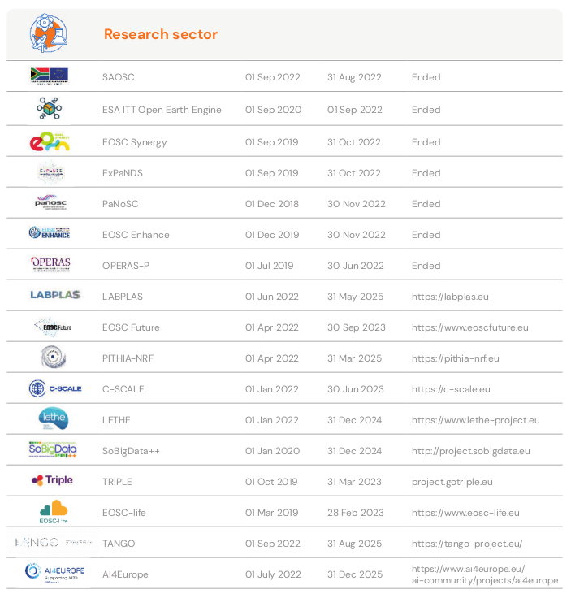
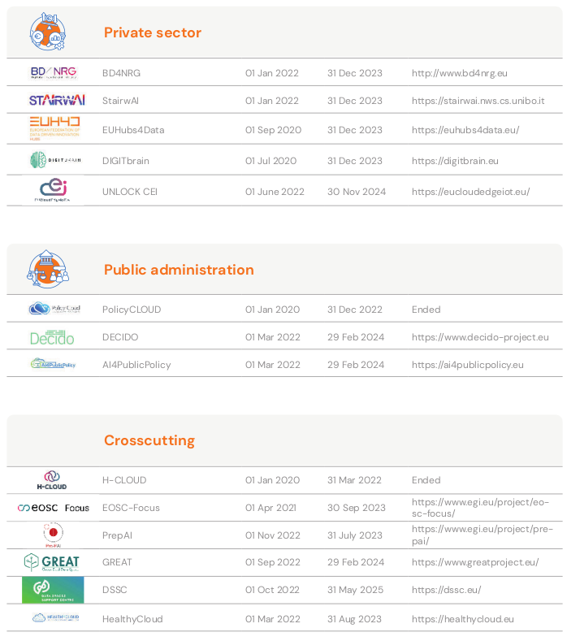
Project management and planning

Slide 35
EGI Value Propositions
Services for Research
Services for Federation
Services for Business
Our large-scale computing and data analytics services are helping scientists to accelerate their research.
Our internal services provide tools for coordination of the EGI Federation, improving how we work together.
We help companies to exploit and provide services and resources for compute- and data-intensive research and innovation.

Slide 36





Services for business
https://www.egi.eu/egi-dih/
Test before you invest
Skills and training
Technical facilities to support companies and SMEs test before investing or to validate services or solutions.
Provide knowledge on the technical offer through webinars or consultancy services.
Networking and community
Find funding
Bring SMEs and communities together with the EGI community and facilitate the interaction and open new market opportunities.
Facilitate the access to funding opportunities and investment mechanisms to sustainable support the innovation.
SESSION: EGI Digital Innovation Hub - Delivering value to the private sector - Thu 22, 11:00 CEST

Slide 37
EGI and the European Open Science Cloud
EGI 2023 Conference - Poznań, Poland

Slide 38
European Open Science Cloud
“
… a virtual environment with free at the point of use, open and seamless services for storage, management, analysis and re-use of research data, across borders and scientific disciplines.
2016 Communication on the “European Cloud Initiative”

Slide 39



EGI and the European Open Science Cloud
A long and rich history
EOSC phase 1: Until end of 2020
  EGI coordinated the EOSC-hub project
    Laid down the operational infrastructure (Helpdesk, Accounting, Monitoring, EOSC Portal).
    Design and operate a service Mgm system
    Contribute to the Service Portfolio (compute, storage, thematic services)
EOSC phase 2: From 2021 – Tripartite partnership (EC, Member states, EOSC Association)
  EGI continues to provide core services (EOSC Future project)
  EGI provides the EOSC Compute platform (EGI-ACE project)
  EGI supports various thematic services (DECIDO, EOSC-Synergy, …)
  EGI members are/will be part of national OSC nodes
EOSC phase 3: From 2023 – Tripartite partnership
  The EOSC Procurement (on-going)
              EC funding for delivery of Core and Horizontal services for ‘European EOSC Node’
EGI-ACE Final event - Tue (11 onwards)
National infrastructures for Open Science in EGI and beyond - Wed 21, 11:00 CEST
Shaping services for the EOSC: the experience of EOSC Future and the infraEOSC 07 projects - Wed 21, 14:00 CEST
Emerging Architectural Directions for Federated Digital Infrastructures - Wed 21, 14:00 CEST
EOSC Platform - Highlighting EGI contribution to EOSC Future - Thu 22, 12:05 CEST
Distributed computing technologies and EOSC Services: Engagement of Public Authorities (DECIDO, AI4PP and EOSC Future) - Thu 22, 15:15 CEST
Polish Data repositories for EOSC - Thu 22, 16:30 CEST

Slide 40


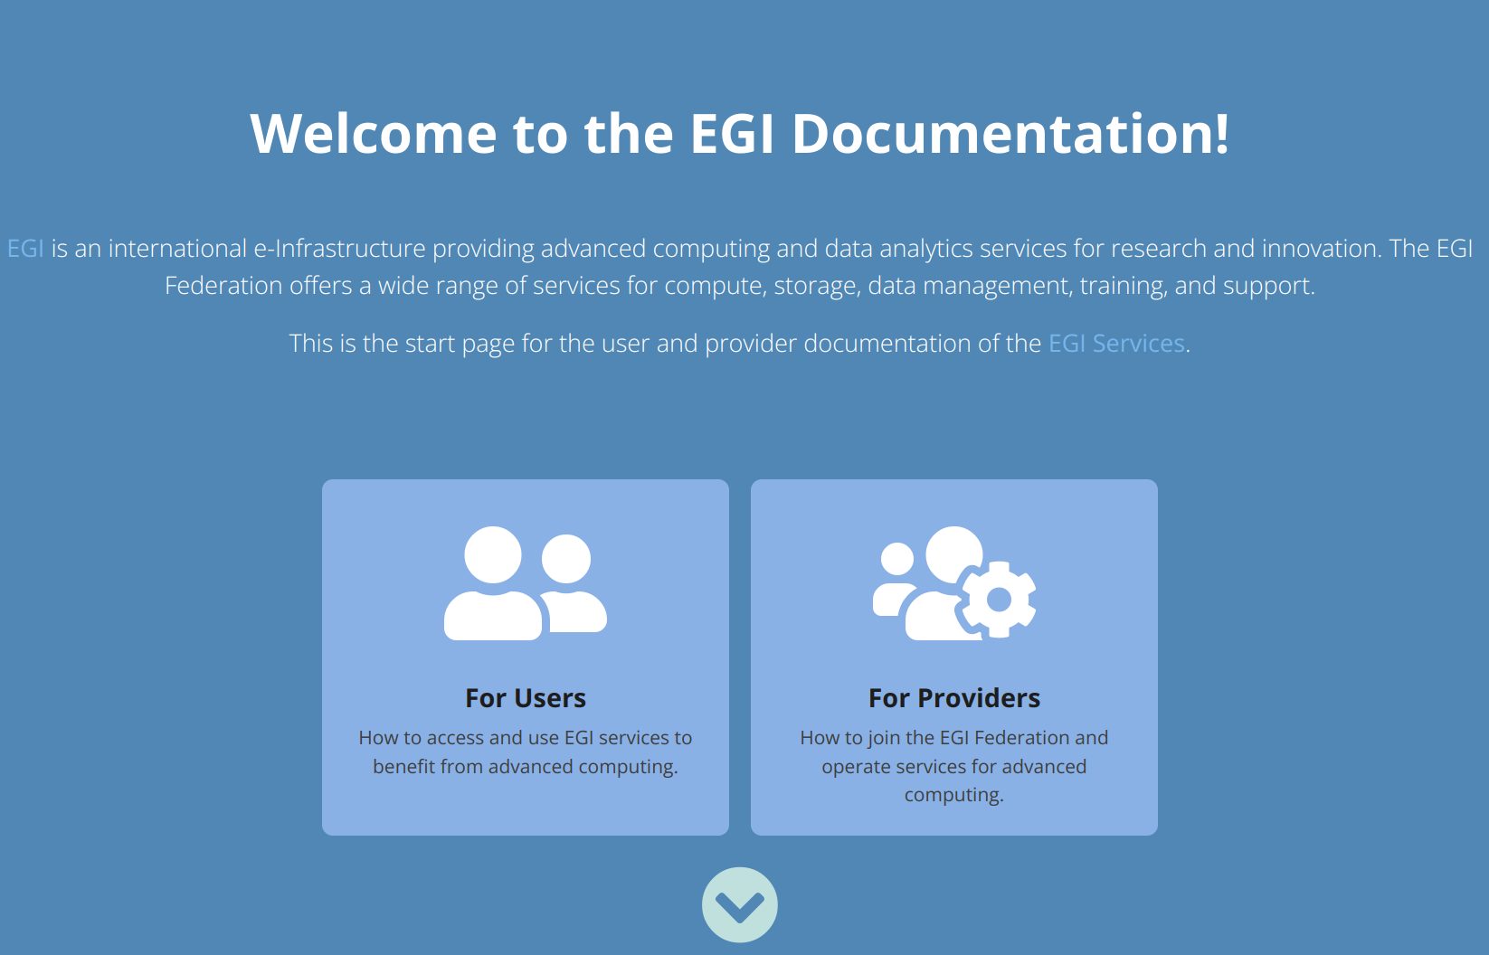
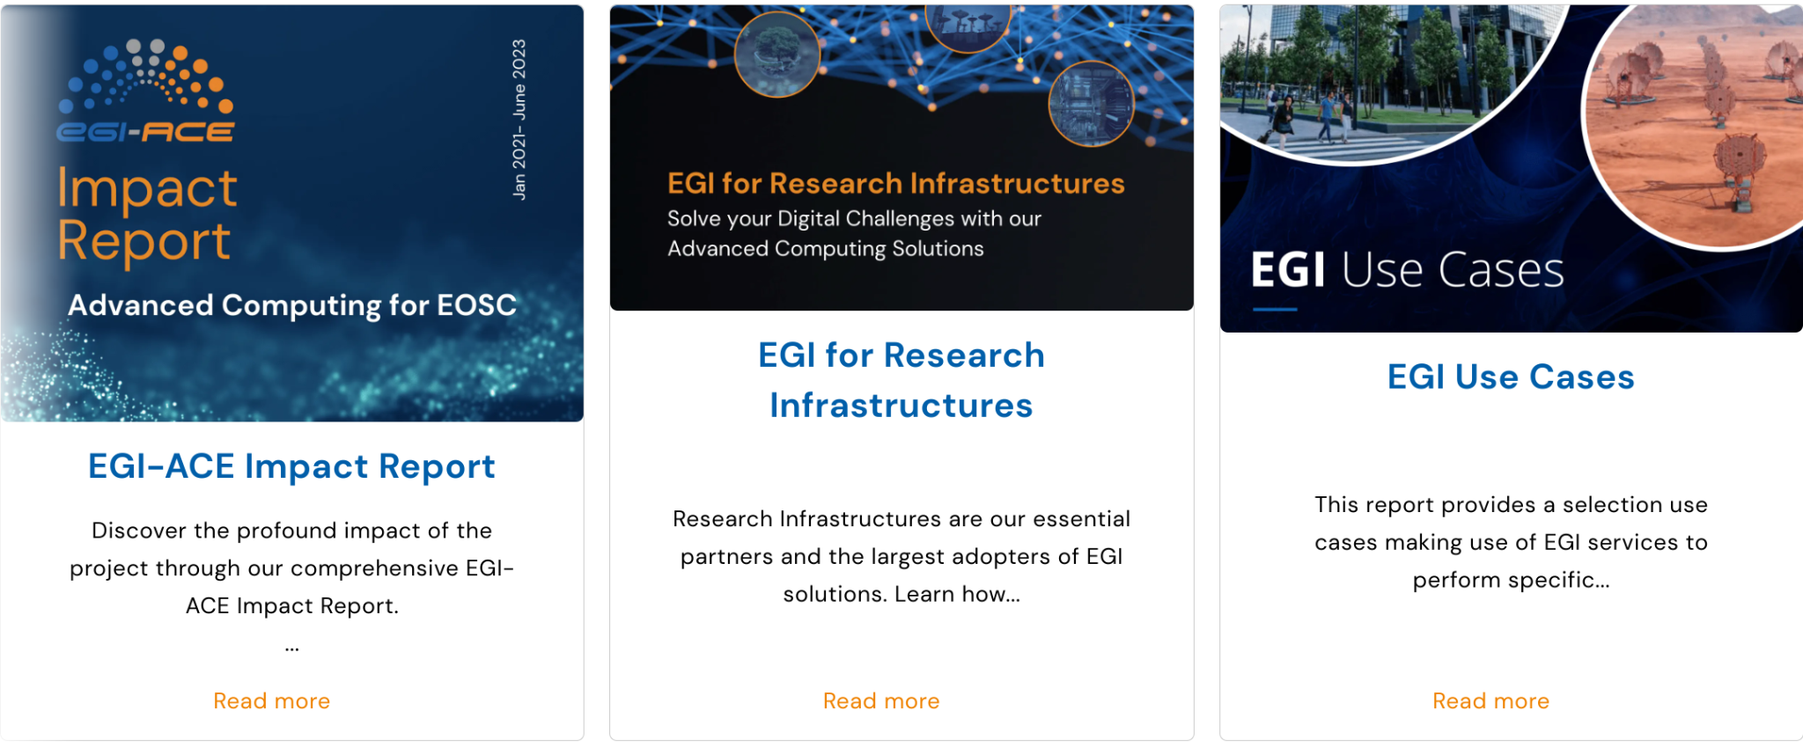
Learn more about EGI
https://www.egi.eu/services/
https://www.egi.eu/publications/
https://docs.egi.eu/

Slide 41
Thank you!
support@egi.eu

