Slide 1
Data Spaces 101
“Everything you wanted to know about data spaces*
*but were afraid to ask”
EGI Conference
19 June 2023
Mark Dietrich, Senior Advisor, EGI.eu

Slide 2
EGI Support for Data Spaces
Technological Services
EGI provides several services and technology solutions for the development and implementation of Data Spaces. These solutions, for example, enable the sharing and collaboration of data in a secure and trusted environment.
Policy Development Support
EGI’s policy development support activities help to ensure that data spaces are established and managed in a way that promotes trust, transparency, and accountability.
Data Space Landscape Harmonisation
EGI helps to create synergies between different projects and initiatives, identifying common goals, aligning activities and standards, avoiding duplication of effort and maximizing the impact of funding and resources, thus harmonising the landscape of different Data Space related initiatives.
Contributions to Projects
EGI leads or contributes to several projects aimed at developing thematic data spaces or contributing to the development of overarching, multidisciplinary data spaces.

Slide 3
Technological Services
Check-In
Cloud Compute
Data Hub
EGI Check-in is a proxy service that operates as a central hub to connect federated Identity Providers (IdPs) with EGI service providers.
Cloud Compute gives you the ability to deploy and scale virtual machines on-demand. It offers guaranteed computational resources in a secure and isolated environment with standard API access, without the overhead of managing physical servers.
DataHub allows you to enable simple and scalable access to distributed data for computation, and to publish a dataset and make it available to a specific community, or worldwide, across federated sites.

Slide 4
Policy and Strategic Analysis
Policy Development Support
EGI shapes the policy framework on Data Spaces through projects such as GREAT and DSSC.
In GREAT, EGI leads the work on appropriate governance for the Green Deal Data Space.
In DSSC, EGI is part of the Strategic Stakeholder Group (SSG), a think-tank and action group that aids in achieving policy goals.
EGI oversees progress, evaluates results, identifies deficiencies, and provides annual recommendations to assist in the evolution of the Support Centre and other Data Spaces initiatives.
DS Landscape Harmonisation
Through our involvement in different projects, EGI brings added value by leveraging the EGI Federation’s expertise and knowledge to align and integrate efforts across initiatives. We help harmonise the landscape and ensure that different initiatives and projects work towards a Data Space development without duplicating the efforts. This results in greater efficiency and impact across projects.

Slide 5
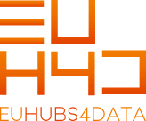
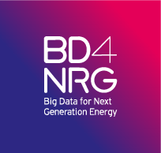
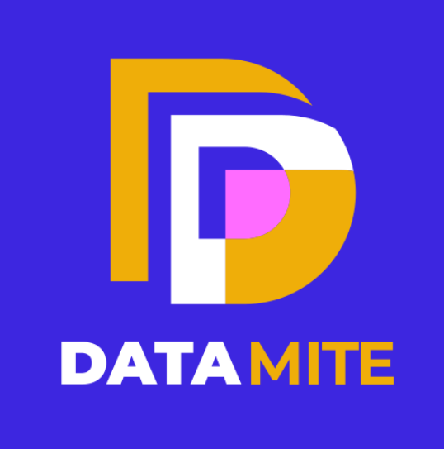
Contributions to Data Space Projects
IMPLEMENTATION
COMMERCIAL SECTOR
IMPLEMENTATION
RESEARCH SECTOR
Data space among Digital Innovation Hubs, serving industry
Big Data for Next Generation eneRGy
Support for climate (ENES), marine (SeaDataNet), biodiversity (GBIF), marine (EMSO), radioastronomy (LOFAR)
E-science centre with datasets and applications for ionosphere, thermosphere and plasmasphere
Technologies for data monetising and data economy
Improve privacy and IP protection for citizens
SECTORAL DATA SPACES
Agriculture
Manufacturing
EUCAIM
EUropean Federation for CAncer IMages
Health
Energy
Financial
Preparatory action for Green Deal Data Space
EUreka3D
Skills
Media
Mobility
Cultural Heritage Data Space
Tourism
Language
Public Administration
Notes:
DSSC : Coordination of Data Sharing initiatives across the whole EU program, mediation between projects and the Data Innovation Board (body to be established in the Commission to provide guidelines and expert advise on data sharing, as stated in the Data Governance Act) . To deliver a community agreed and tested set of building blocks (technical and non technical) to build Data Spaces.
BD4NRG (Big Data for Next Generation eneRGy) is working to deliver a reference architecture for Smart Energy based on Energy standards to enable B2B multi-party data exchange
TANGO: user-friendly, secure, trustworthy, compliant, fair, transparent, accountable and environmentally sustainable data management (data handling, processing, communicating and storage), leverage the power of emerging and digital technologies such as self-sovereign identity SSI
GREAT: will deliver a roadmap for the implementation of the Green Deal Data Space, Roadmap will contain elements of , reference architecture, governance and business models, inventory of High Value data sets. Project will co-design and validate with the Community to ensure early adoption.

Slide 6
Topics
Why do we need Data Spaces?
Different kinds of data, different problems
A definition of Data Spaces – exploring what it means
How do Data Spaces interact?
Purpose, Objectives, Value Creation
Designing a Data Space, Building the Governance Framework
Compliance
Digital Platforms
Data Space Governance
Data Governance
Legal, Operational, Technical Requirements
Building Blocks
EGI Support for Data Spaces

Slide 7
Data Spaces 101
Why do we need Data Spaces?
EGI.eu 2023

Slide 8
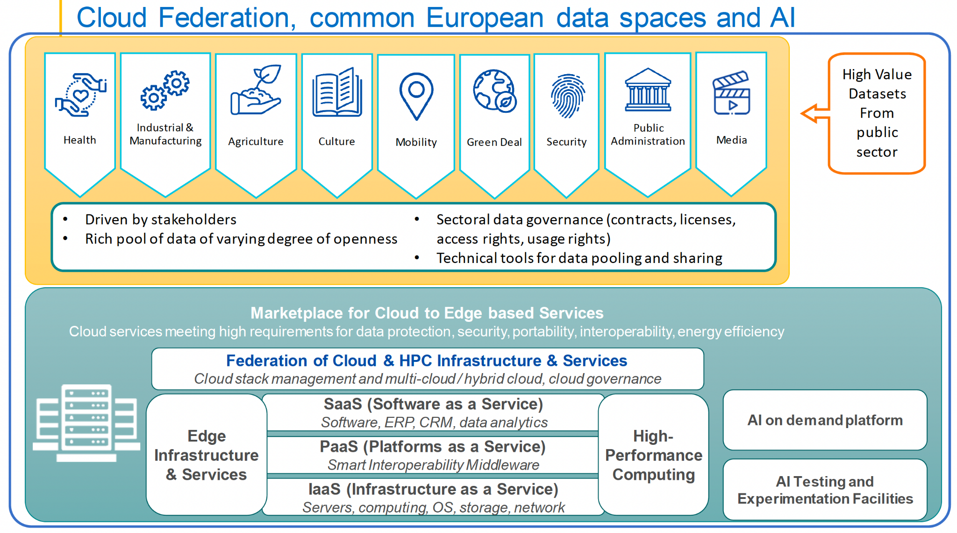
The European Data Strategy
COM/2020/66
Notes:
Single Market for Data
Launch Common European Data Spaces
Legislative Framework

Slide 9
What Data-Related Challenges Need to be Addressed?
TBD

Slide 10
What Data-Related Challenges Need to be Addressed?
Research, Public Sector
Open/Public:
Advancement of Knowledge
Scientific Method
Reproducibility
Required by law, grants
Increasingly FAIR
Catalogues
Repositories
Standard metadata
Attribution
Open license

Slide 11
What Data-Related Challenges Need to be Addressed?
Research, Public Sector
Business, Industry
Open/Public:
Advancement of Knowledge
Scientific Method
Reproducibility
Required by law, grants
Increasingly FAIR
Catalogues
Repositories
Standard metadata
Attribution
Open license
Confidential
Sometimes Trade Secrets
Starting with EDI
Data Sovereignty
Even Metadata visible only to known parties
Controlled access
Limited use, even after access
FAIR not a key objective

Slide 12
What Data-Related Challenges Need to be Addressed?
Research, Public Sector
Health, Statistics
Business, Industry
Open/Public:
Advancement of Knowledge
Scientific Method
Reproducibility
Required by law, grants
Increasingly FAIR
Catalogues
Repositories
Standard metadata
Attribution
Open license
Personal Data: GDPR
Data Sovereignty
Sometimes not even visible, controlled access to catalogues
Metadata critical
Strict Controls (e.g. 5 Safes)
Project Model
Data Access
Known, vetted parties
Data Processing
Use and publication
Confidential
Sometimes Trade Secrets
Starting with EDI
Data Sovereignty
Even Metadata visible only to known parties
Controlled access
Limited use, even after access
FAIR not a key objective

Slide 13
What Data-Related Challenges Need to be Addressed?
Plus
National Security, Critical Infrastructures
Risk of Re-identification
Endangered Species & Populations…
Cultural Artifacts
Research, Public Sector
Health, Statistics
Business, Industry
Open/Public:
Advancement of Knowledge
Scientific Method
Reproducibility
Required by law, grants
Increasingly FAIR
Catalogues
Repositories
Standard metadata
Attribution
Open license
Personal Data: GDPR
Data Sovereignty
Sometimes not even visible, controlled access to catalogues
Metadata critical
Strict Controls (e.g. 5 Safes)
Project Model
Data Access
Known, vetted parties
Data Processing
Use and publication
Confidential
Sometimes Trade Secrets
Starting with EDI
Data Sovereignty
Even Metadata visible only to known parties
Controlled access
Limited use, even after access
FAIR not a key objective

Slide 14
What Data-Related Challenges Need to be Addressed?
Research, Public Sector
Sensitive Data
Business, Industry
Open/Public:
Advancement of Knowledge
Scientific Method
Reproducibility
Required by law, grants
Increasingly FAIR
Catalogues
Repositories
Standard metadata
Attribution
Open license
Personal Data: GDPR
Data Sovereignty
Sometimes not even visible, controlled access to catalogues
Metadata critical
Strict Controls (e.g. 5 Safes)
Project Model
Data Access
Known, vetted parties
Data Processing
Use and publication
Confidential
Sometimes Trade Secrets
Starting with EDI
Data Sovereignty
Even Metadata visible only to known parties
Controlled access
Limited use, even after access
FAIR not a key objective
Data Act → Increase Access to this Data

Slide 15
Quality & Fit for Purpose Are Critical
Research, Public Sector
Sensitive Data
Business, Industry
Purpose:
Advancement of Knowledge
Scientific Method
Reproducibility
Quality required depends on specific study
Mismatches caught in peer review
Purpose: must be declared every time you want to access sensitive data.
Fit for Purpose
Ethics Review
Original reason for data collection must be compatible with proposed use
Even if compatible, quality may not be sufficient
Purpose motivates the first use case
Data sovereignty enables later use cases
Fit for Purpose?:
No review: ends justify the means
Competitive advantage
Bias, Opacity
Disinformation, collusion?

Slide 16
Quality & Fit for Purpose Are Critical
Research, Public Sector
Sensitive Data
Business, Industry
“Fit for Purpose” Problems Amplified with AI
Purpose:
Advancement of Knowledge
Scientific Method
Reproducibility
Quality required depends on specific study
Mismatches caught in peer review
Purpose must be declared every time you want to access sensitive data.
Fit for Purpose
Ethics Review
Original reason for data collection must be compatible with proposed use
Even if compatible, quality may not be sufficient
Purpose motivates the first use case
Data sovereignty enables later use cases
Fit for Purpose?:
No review: ends justify the means
Competitive advantage
Bias, Opacity
Disinformation, collusion?

Slide 17
Quality & Fit for Purpose Are Critical
Research, Public Sector
Sensitive Data
Business, Industry
“Fit for Purpose” Problem Amplified with AI
Purpose:
Advancement of Knowledge
Scientific Method
Reproducibility
Quality required depends on specific study
Mismatches caught in peer review
Purpose must be declared every time you want to access sensitive data.
Fit for Purpose
Ethics Review
Original reason for data collection must be compatible with proposed use
Even if compatible, quality may not be sufficient
Purpose motivates the first use case
Data sovereignty enables later use cases
Fit for Purpose?:
No review: ends justify the means
Competitive advantage
Bias, Opacity
Disinformation, collusion?
AI Act

Slide 18
Data-Related Challenges Differ Across Sectors
Learning from other sectors
 | Research, Public Sector | Sensitive Data | Industry Confidential
Security | ? | ✓ | ✓
Known Parties | Anonymous OK | Strong assurance | Strong assurance
Visibility | Open; 1:Many or 1:Any | Sovereignty, GDPR; 1:1 or 1:Few | Sovereignty; 1:1 or 1:Few Data Act → 1:Few or 1:Many
Findability | ✓ | Five Safes (e.g.) | Sovereignty, to be tempered by Data Act
Accessibility | ✓
Interoperability | increasing
(Re)usability | ✓
Quality, Fit for Purpose | Peer Review | Ethics Review, GDPR | Opportunistic, tempered by AI Act?
Purpose, Objectives | Advancement of Knowledge | MUST be defined up front | Solve my problem, Competitive advantage

Slide 19
Data-Related Challenges Differ Across Sectors
 | Research, Public Sector | Sensitive Data | Industry Confidential
Security | ? | ✓ | ✓
Known Parties | Anonymous OK | Strong assurance | Strong assurance
Visibility | Open; 1:Many | Sovereignty, GDPR; 1:1 or 1:Few | Sovereignty; 1:1 or 1:Few Data Act - 1:Few or 1:Many
Findability | ✓ | Five Safes (e.g.) | Sovereignty, to be tempered by Data Act
Accessibility | ✓
Interoperability | increasing
(Re)usability | ✓
Quality, Fit for Purpose | Peer Review | Ethics Review, GDPR | Opportunistic, AI Act?
Purpose, Objectives | Advancement of Knowledge | MUST be defined up front | Solve my problem, Competitive advantage
Aspects of Governance Frameworks Required to Address the Challenges

Slide 20
Data Spaces 101
A Definition of Data Spaces
Exploring what it means…
EGI.eu 2023

Slide 21
What is a Data Space?
Lots of definitions*
A useful definition from Data Spaces Support Centre (DSSC):
“an infrastructure that enables data transactions between different data ecosystem parties based on the governance framework of that data space”
Infrastructure: Not necessarily digital (old fashioned library), but probably
Data transactions: More than just data transfer, terms and conditions, etc.
Governance framework: Key characteristics of the DS, purpose, objectives, rules (e.g. membership), standard Ts & Cs for data transactions
See References slide at end for links to other definitions…

Slide 22
Roles and Relationships
Data Space – illustrating the scope of this entity
A guide to illustrations – not formal definitions
Governance Framework
Data Space
Governance Artefacts
Data Space Participants
Data Space Component
Metadata Catalogue
Data Space Participants
Data Space Participants
Data Space Participants
Specific Conditions or Contracts
A
C
D
F
Data Transaction(s)
Actual Data Exchange May Occur Outside the Data Space

Slide 23
Closed, Public, Open Data Spaces
Participants = Known parties (legal or natural persons) that have agreed to governance framework
Type | Data Space Visibility | Metadata Catalogue | Data Access/Use
Closed | Public on the Web | Visible only to Participants | Visible only to Participants
Public | Public on the Web | Public on the Web | Visible only to Participants Requires Participation
Open | Public on the Web | Public on the Web | Public on the Web

Slide 24
Simplest Data Space: Bilateral Transaction with a Data Contract
Data Transaction between Parties C and D; Contract for each Transaction
Closed Data Space
Governance Framework = Contract,
including specific conditions
C
D
Data Transaction

Slide 25
A Data Space With More Participants
Among Data Space Parties A through F
Closed Data Space
Agree Once to Governance Framework
Metadata Catalogue
(Private)
Transaction- Specific Use Conditions
A
C
D
F
Data Transaction(s)

Slide 26
Across 2 Different Data Spaces
Transactions not covered between 2 Data Spaces – Until important questions are answered
Closed
Data
Space #1
Closed
Data
Space #2
Agree Once to Governance Framework #1
Agree Once to Governance Framework #2
Harmonize 2 Frameworks
Catalogue #1
(Private)
Agree to expose metadata?
Catalogue #2
(Private)
A
C
D
F
Data Transaction?

Slide 27
Public Data Space
Metadata is visible to anonymous visitors. But visitors must identify themselves, agree to governance, before access is possible.
Public Data Space
Agree Once to Governance Framework
Agree to Governance Framework
Public Metadata Catalogue
Transaction- Specific Use Conditions
Transaction- Specific Use Conditions
?
C
?/D
?
Data Transaction

Slide 28
Public Open Data – Trivial “Data Space”, no Governance Framework
Data is accessible by anonymous “parties”.
Open Data Space
Public Metadata Catalogue
Public Data Repository
?
C
?
?
?/D
Data Access – No Conditions

Slide 29
Lots of Infrastructures with Governance Frameworks → Lots of DSs
Community 1
Users
Com. n
SP1
SP2
SPn
Com. 3
EOSC Platform
Data/Service Providers, Contributors
Community 2
EU EOSC Node
Thematic EOSC Nodes
Regional EOSC Nodes
Catalogue A
Repository B
Aggregator C
Cluster
D
Catalogue E
Cluster
Z
SMPL Agent X
SMPL Agent Y
SMPL Agent Z
Data Space 1
Data Space 2
Data Space 3
Data Space n

Slide 30
A Party can join multiple data spaces…
… but that doesn’t mean the data spaces have merged – they are still separate, with different governance frameworks.
“Known Parties” from the real world – legal, natural

Slide 31
Data, Services can be listed in multiple data spaces…
… but that doesn’t mean the data spaces have merged – they are still separate, with different governance frameworks.

Slide 32
Vertical, Horizontal, Transverse
Data Spaces can have overlapping parties and data, but they are still separate, with separate governance frameworks…

Slide 33
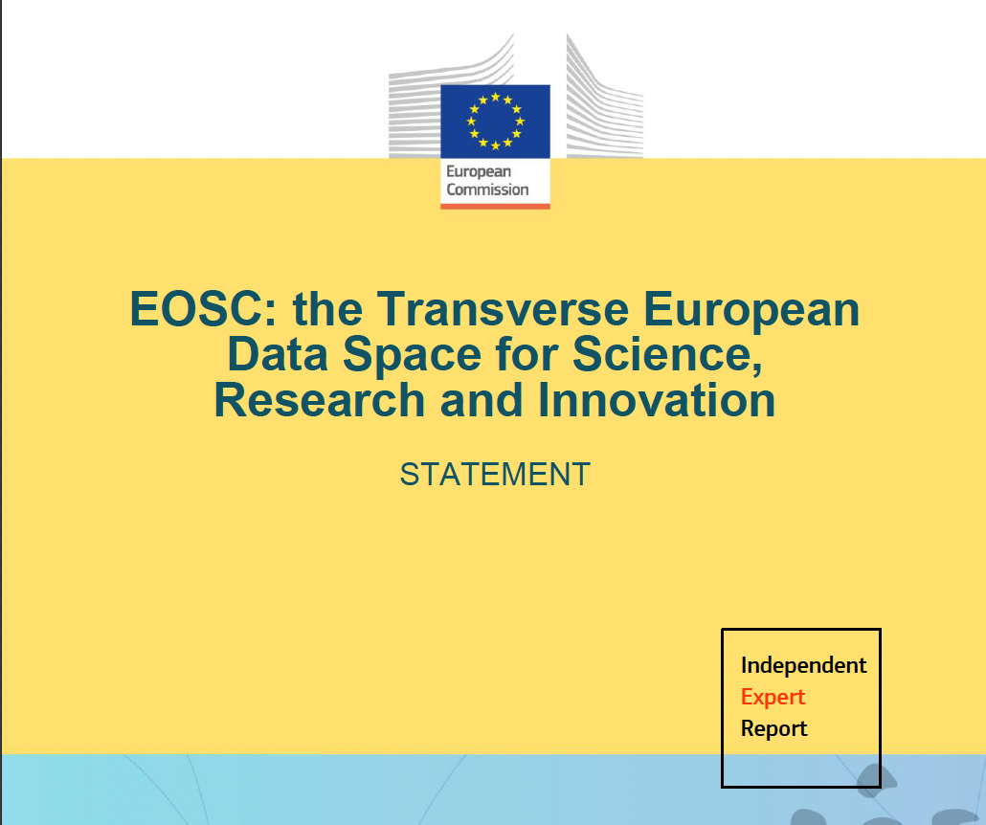
Transverse Data Spaces
EOSC
Green Deal
Language
…others
“Transverse”: Many items of Data, Services and Participants in common with other data spaces…
November 2022

Slide 34
Data Spaces 101
Purpose, Objectives,
Value Creation
EGI.eu 2023

Slide 35
Most Data Spaces Support Multiple Use Cases
Data Space Purpose
Combination of Planned Use Cases
Each Use Case → Objectives for its Participants
Objectives → Value Creation Requirements to be fulfilled by the Data Space
Some Use Case Objectives may require more advanced capabilities than others
Phased Implementation?
There is also value creating Data Spaces around One or a Small Number of Use Cases:
Human health research project data space
Collaborative Condition Monitoring for 1 kind of machine
A personal data space (financial, health)
Digital twins?

Slide 36
Use Case → Objectives → Value Creation Requirements
Use Case: Expressed as Specific Objectives for Specific Participants
Level | Objective | Value Creation Requirements
L0 | Presence of Many Parties, Relevant Parties | Attract and retain multiple participants*
L1 | L0 + Broad range of data, services | Incent parties to provide data and services; data preparation (anonymisation); data “staging”; data inclusion; search and discovery
L2 | L1 + Quality (fit for intended purpose) | Incent parties to provide quality data and services and disclose reliable details about their quality and utility; evaluation/transformation tools
L3 | L2 + Data Fusion/Integration, Analytics | Services for data fusion and service composition, standards that enable integration of data and consumption by analytics; provenance and traceability; make it easy to expose new results to the data space; value sharing tools (complementarity, collective action, generativity)
L4 | L3 + Produce Actionable Insights | Framework to categorize analysis results
L5 | L4 + Analysis of Impact, Aggregation | Taxonomy for characterising nature, scope and extent of impacts
L6 | L5 + Performance Monitoring | Monitoring mechanisms (reporting, exceptions, dashboards, status levels, alerts)
L7 | L6 + Target Setting and Monitoring | Link monitored values with targets and thresholds, and logic for triggering monitoring actions.
Notes:
This is an “objective ladder” developed for Green Deal – other domains may have other levels, other aspects of value creation

Slide 37
Data Spaces 101
Designing a Data Space,
Building the Governance Framework
EGI.eu 2023

Slide 38
Getting Started:
Governance is the process for making decisions about an entity
Who Makes What Decisions and When?
Formation
Agreeing on the "scope" and "boundaries" of the entity, initially and over time.
Deciding who should be involved in decision-making, including both the actual decision process (including activities like voting, etc.), as well as consultation about each decision.
Decisions include decisions about the creation of the entity, such as its form and the relationships between and among outside parties with the entity, as well as who should participate in both decision making and governance and in the operation of the entity.
Operation
Managing the decision-making process, recording both results and details about how these results were decided, including details such as who was consulted.
Communicating about the governance process -- identifying who is involved, what decisions are being considered, what decisions have been made.
Monitoring
Tracking the decisions made, monitoring compliance with these decisions, enforcing those decisions consistent with processes (which have also been decided through the governance process).
Persistence/Dissolution

Slide 39
Design Decisions
4 Layers
What is needed for Compliance? – these will constrain choices in the other layers
EU Laws and Regulations
MS laws, local regulation
Sector-specific laws and regulation
Design Choices for Digital Platforms – a useful layer, heavily studied already
Mission, Principles, Values
Value Creation Requirements, Services
Platform Architecture, Control
Governance Operations, Monitoring
Data Space Choices – about data transactions, with specific data and specific parties
Data Governance Choices – about the governance of each piece of data

Slide 40
Design/Governance in 4 Layers x 4 Stages
Layer | Formation | Operation | Monitoring | Persistence
Compliance
Design Choices for Digital Platforms
Data Space Choices
Data Governance Choices

Slide 41
Design For Compliance
These will drive/constrain choices in other layers
Layer | Formation | Operation | Monitoring | Persistence
Compliance
Design Choices for Digital Platforms
Data Space Choices
Data Governance Choices
Key Horizontal Legal Frameworks
GDPR
Open Data Directive
NIS Directive
Competition law
Data Governance Act
Data Act (proposed)
AI Act
Digital Services Act
Digital Markets Act
Member State/Sector Specific Instruments
Lifecycle of Data
Cybersecurity for storage and processing
Visibility
Sharing/Intermediation
Accessibility
Interoperability
Processing, Analytics, Re-use
Types of Data
Public Sector Data
Publicly funded Research Data
Personal Data
Critical Infrastructures
Trade Secrets
Intellectual Property
Databases

Slide 42
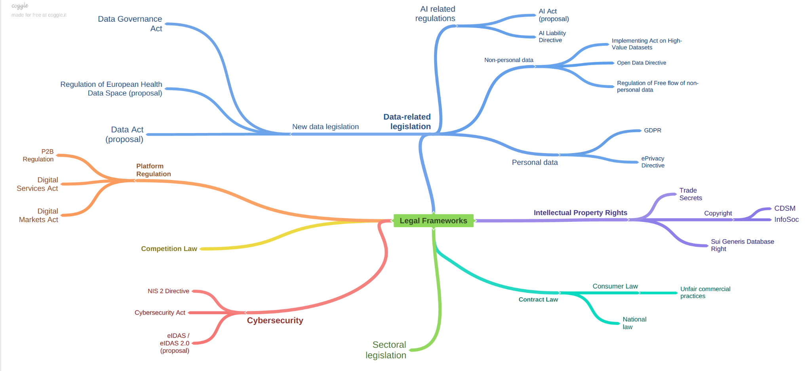
Many Relevant Horizontal Legal Frameworks

Slide 43
Data Intermediaries (DIs) Touch Every Stage of Lifecycle
A complicated, and not fully clear, concept introduced by the Data Governance Act (DGA)
Layer | Formation | Operation | Monitoring | Persistence
Compliance | DI/DIS | DI/DIS | DI/DIS | DI/DIS
Design Choices for Digital Platforms
Data Space Choices
Data Governance Choices

Slide 44
Impact of DGA: Data Intermediaries (DIs)
‘Data intermediation service’ (DIS): links data subjects and data holders with data users, through commercial relationships that might involve technical, legal or other means. Examples include:
Data marketplaces through which providers could make data available to others
Orchestrators of data sharing ecosystems that are open to all interested parties, e.g. common European data spaces.
Data pools that license the use of contributed data and then reward contributors for their contributions. This example seems to match Data Cooperatives defined in the DGA.
Excluded: closed data sharing ecosystems, intermediation of public sector and research data, data altruism organisations.
Requirements:
DISs must be provided by separate legal entities that must register with competent national authorities.
DISs must be provided separately from other services (e.g. data preparation, value added analytics), giving users full autonomy in the use of these other services, particularly without bundling.
DISs must be provided in a FRAND manner, logged and monitored by the competent authority, must ensure cybersecurity, interoperability and continuity of service, prevent fraud and abuse, and act in data subjects’ best interests.
Data related to DISs can only be used to improve the DIS and must not be sold separately.

Slide 45
Entities to be Governed, Operations to be Managed
DGA requires that Data Intermediaries should be legal entities
What is the scope of those legal entities?
Most flexible structure (but maybe most complicated):
Data Intermediary (DI) is legal entity (“DI Company”), with Members that participate in the governance of the legal entity
Operates a Digital Platform that delivers “core services” for the ecosystem of the Data Space
Other services are provided by other Participants that comply with the Governance Framework for the Data Space.
Digital Platform that underpins Data Space operated separately from “DI Company”
Digital Platform requires separate governance structure, likely including representation from Participants

Slide 46
The Picture…
Data Space Platform
Data Ecosystem – Services & Data
Data Space – Onboarded Services & Data
Data Space Core
Data Space Catalogue
Data Intermediary
Onboarding Process
Metadata added to Catalogue
Notes:
Who is paying for storage of data?

Slide 47
…Looks like EOSC
EOSC Platform
Research Ecosystem – Services & Data
EOSC Exchange
EOSC Core (& core services)
EOSC Catalogue
Data Intermediary?
Onboarding Process
Metadata added to Catalogue
Notes:
Who is paying for storage of data?

Slide 48
MS, Sector-Specific Laws & Regulation → Possible Approach
No automatic nesting or overlaps; Relationships must be explicitly governed
Pathways represent data provided from one DS to another (same item of data in both, or service output from 1st DS provided as data to 2nd DS)
Global
European Union
National
National
National
Regional
Regional
City
City
City
City

Slide 49
Achieving Quality, Consistency
Transformation Services, Feedback services deliver Information on Quality of provided data (e.g. deltas)
Global
European Union
National
National
National
Regional
Regional
City
City
City
City

Slide 50
Digital Platform Design
Italicized entries align with OpenDEI Technical Building Blocks
Layer | Formation | Operation | Monitoring | Persistence
Compliance
Design Choices for Digital Platforms
Data Space Choices
Data Governance Choices
Value Creation, Services
Providers & Consumers
Targeting, Awareness, Inclusion & Retention
User Experience
Service Requirements
Service “stacking”
Value sharing, exploitation
Collective action, generativity
Architecture, Control
Openness, Modularity
Centralized, Federated, Distributed
Identification/Registration
Cybersecurity
Trust Framework
Domain Data Models, Interoperability
Boundary Resources
Development Plan
Mission
Objectives
Principles, Values
Actors Needed, Desired
Roles Needed, Desired
Roles & Responsibilities

Slide 51
ID Binding
Legal compliance requires digital identities to map to legal/natural persons!
Requires identities with higher level of assurance in AARC
“Known Parties” from the real world – legal, natural

Slide 52
Digital Platform Design
Italicized entries align with OpenDEI Technical Building Blocks
Layer | Formation | Operation | Monitoring | Persistence
Compliance
Design Choices for Digital Platforms
Data Space Choices
Data Governance Choices
Platform Launch
Incorporate?
Registration
Member Onboarding
…
Processes
Membership
Decision-making
Communications
Onboarding
Participants
Services & Data
Security
Innovation & Growth
Training
Monitoring
Compliance
@ All levels
Performance
Risks

Slide 53
Data Space Design Choices
Italicized entries align with OpenDEI Technical Building Blocks
Layer | Formation | Operation | Monitoring | Persistence
Compliance
Design Choices for Digital Platforms
Data Space Choices
Data Governance Choices
Service Design
Intermediation/Marketplace
Catalogue Functions
Decentralized?
Data Preparation, Encryption, Anonymisation, Transformation
Enrichment, Aggregation, Analysis
Dashboarding, Monitoring Services, Alerts
Monitoring
Log Processing
Compliance, reporting
Risk management (re-identification)
Quality/Ethics of Analytics/AI
Operations
Contract Negotiation
Provenance & Traceability
Composition
Infrastructure Supports

Slide 54
Data Governance Choices
Italicized entries align with OpenDEI Technical Building Blocks
Layer | Formation | Operation | Monitoring | Persistence
Compliance
Design Choices for Digital Platforms
Data Space Choices
Data Governance Choices
Data Governance Model
Data Types (e.g. W3C: DPV+)
Metadata/Self-Description
Defining Access, Usage Policies
Licensing
Standards, Vocabularies
Quality Measures
Fit for Purpose
Data/Service Lifecycle
Security
Privacy
Visibility
Findability
Enforcing Access, Usage Policies
Negotiation
Consent Management
Orders and Instantiation
Usage Accounting
Data Transfers
Transaction Logging
Monitoring
Compliance, Risks
Performance
…

Slide 55
Data Spaces 101
Legal, Operational, Technical Requirements: Building Blocks
EGI.eu 2023

Slide 56
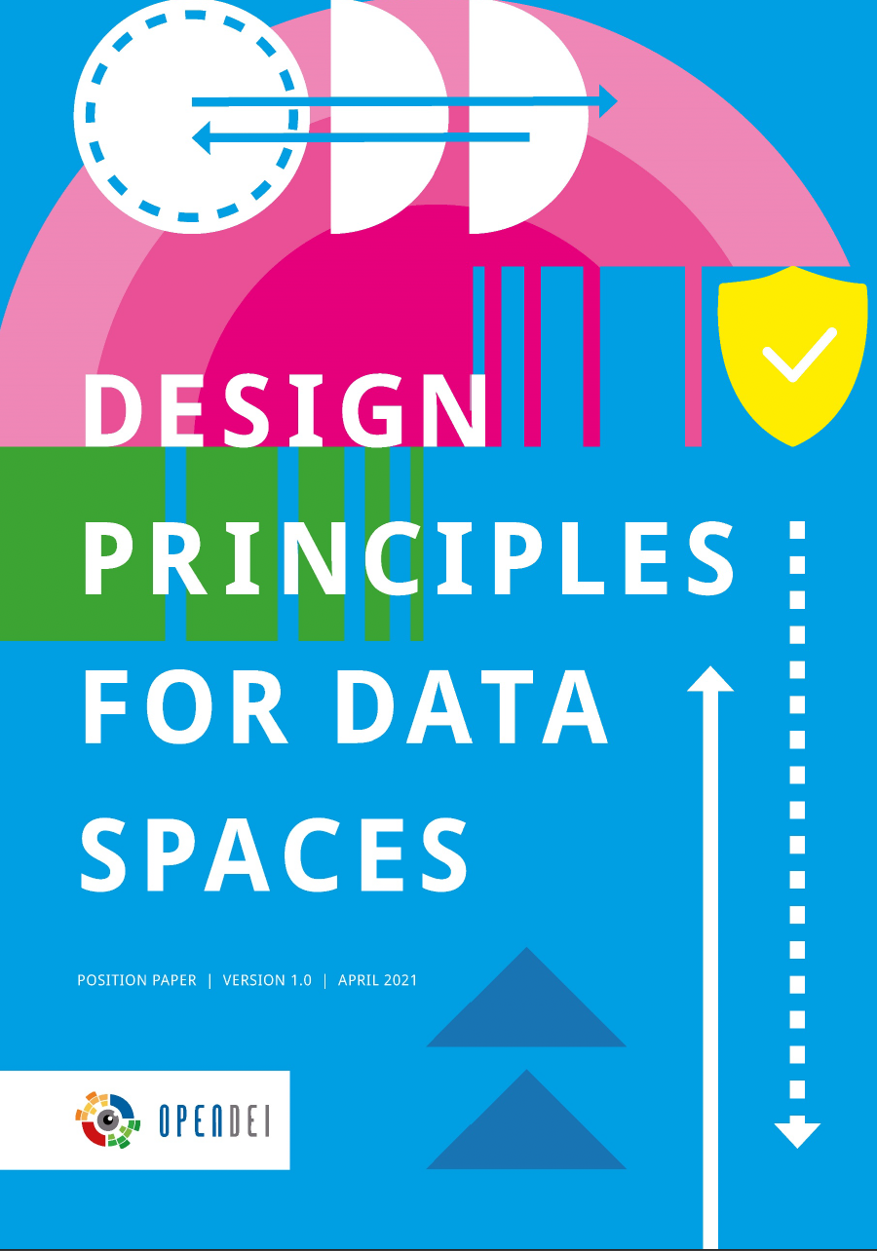
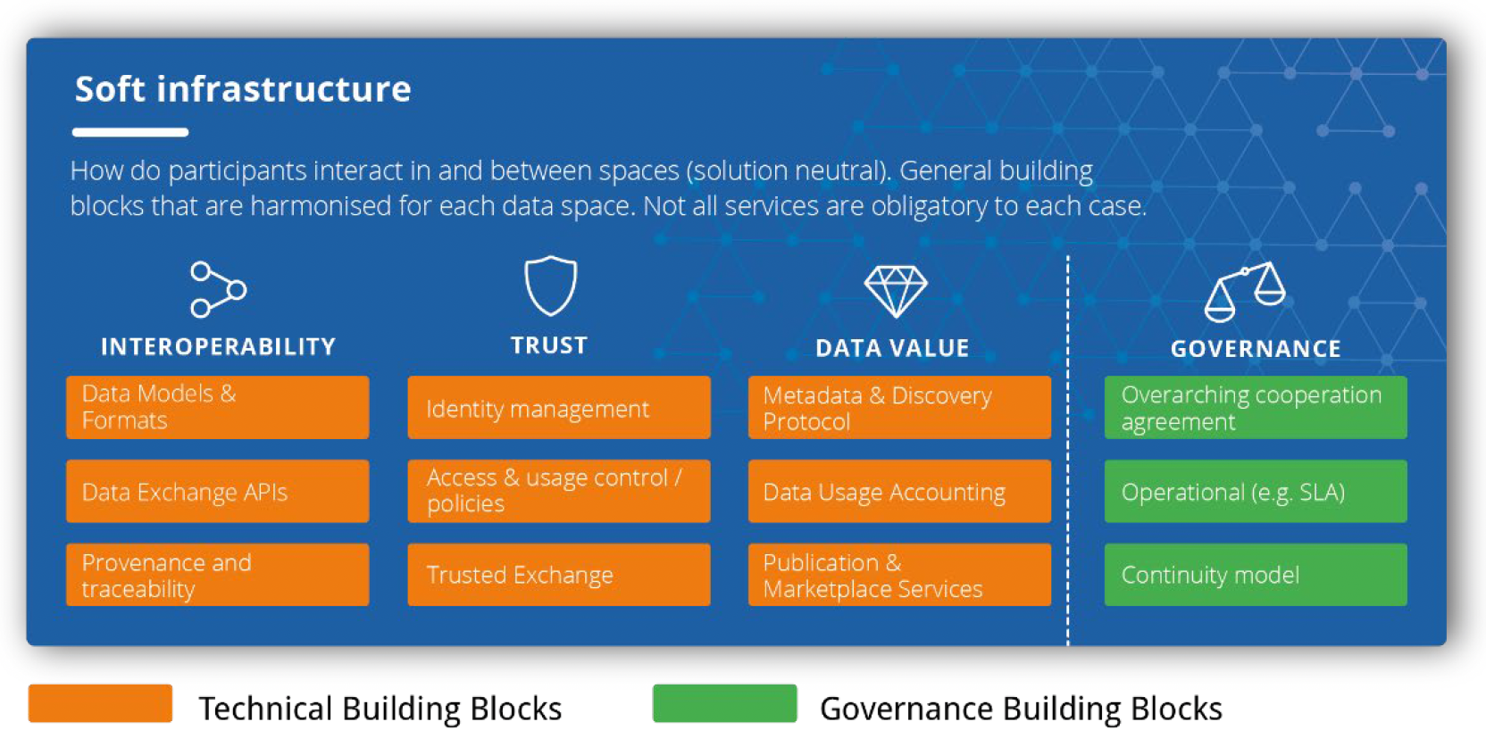
From Design to Implementation: The Building Blocks
April 2021

Slide 57
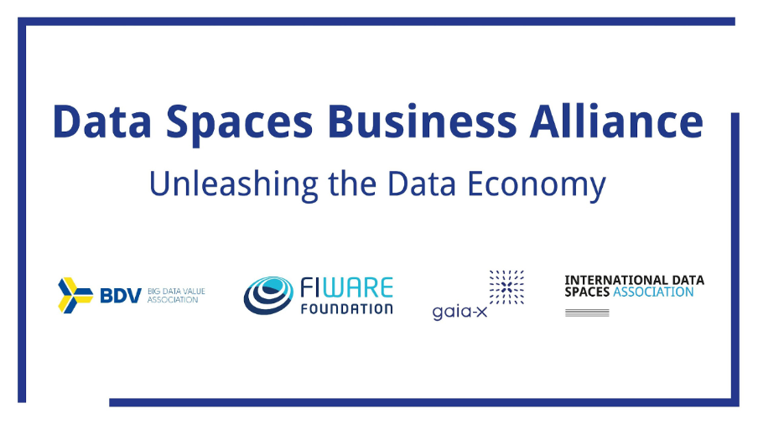
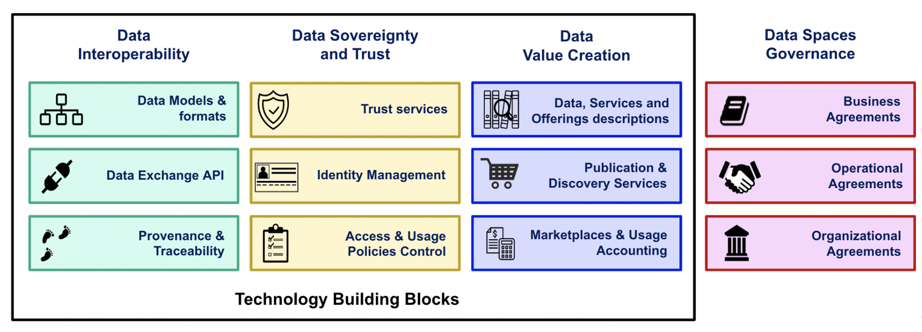
Converging Parallel Technical Efforts
Technical Implementation – creating a complete “data space” you can install and run – requires work

Slide 58
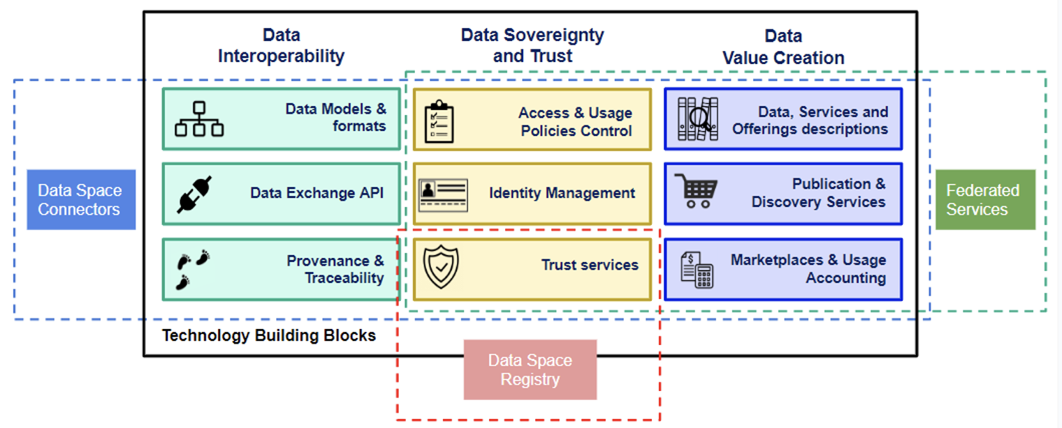
Open Architectural Questions
Connectors
One for each Participant AND Data Space? Or just one per Participant?
Federated Services
But a Centralized Marketplace proposed?
Trust Framework and Trust Anchors
Separate for each Data Space?
Common Trust Anchors?
Relationships between Data Spaces
Create a Registry of all Data Spaces?

Slide 59
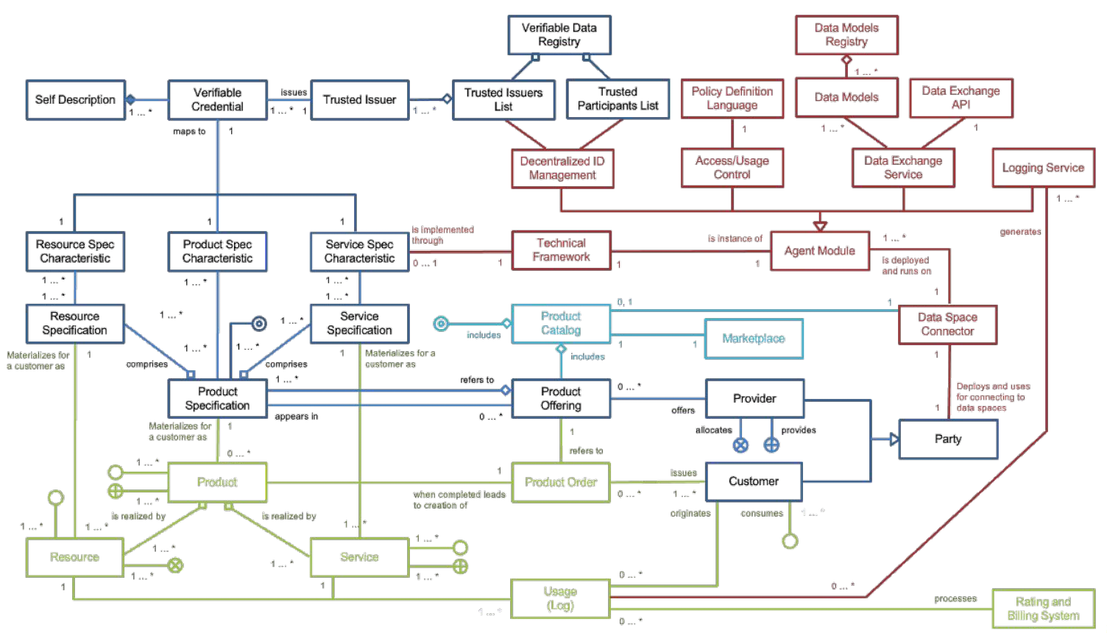
Conceptual Model – still a work in progress
What is inside a data space, what is outside?

Slide 60
Data Spaces 101
Conclusions
EGI.eu 2023

Slide 61
Conclusions
Data Spaces designed to address different kinds of data, different problems
We will probably end up with many Data Spaces that address specific data, specific problems, comply with different rules
Let’s figure out how will they will interact!
Clarifying Purpose, Objectives and Value Creation Mechanisms is Key
Creating a bigger pile of data is not enough
Many Design and Governance Questions need to be answered, at multiple levels
We are now building a shared understanding of what needs to be defined
Community Work has focussed on Technical Building Blocks
Design context, business models surrounding those building blocks will be critical to delivering useful technology

Slide 62
Thank you!
About Mark
Data Spaces Support Centre (DSSC)
EOSC-Future, EOSC-Focus
GREAT (preparatory action for the Green Deal Data Space)
HealthyCloud.eu (Five Safes)
EGI-ACE
HCloud.eu (Horizon Cloud)
First analysed The European Data Strategy, June 2020
EUCloudEdgeIoT.eu
Gaia-X
Supercomputing, HPC (green computing, economic models)
Contact: mark.dietrich@egi.eu

Slide 63
Acknowledgements & References
Acknowledgements
Funding provided by
Icons created by Dinosoftlabs, Eucalyp, Freepik, Icon Mania, Inkubators, Parzival’ 1997: https://www.flaticon.com/free-icons/code
References
Other definitions of data spaces
D
D
D
ddd

