Slide 1
EGI 2023
From Millions to Billions: 20 years of excellence in scientific computing in Europe
T. Ferrari
20-06-2023
Director / EGI Foundation
EGI 2023

Slide 2
Our Services
Services for Research
Services for Federation
Services for Business
Large-scale computing and data analytics services are helping scientists to accelerate their research.
Our internal services provide tools for coordination of the EGI Federation, improving how we work together.
We help companies to exploit services and resources for compute- and data-intensive research and innovation.

Slide 3
EGI Federation - 2004/2023

Slide 4
Our Growth in numbers
2021
2022

Slide 5
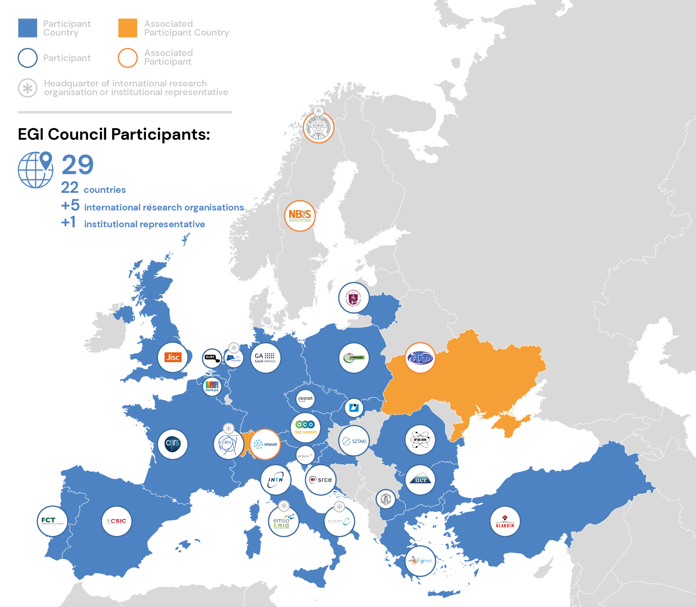
EGI Council Participants
Highlights
2022 - new participants joining the EGI Council
ACONET Verein
Vilnius University
National Bioinformatics Infrastructure Sweden

Slide 6
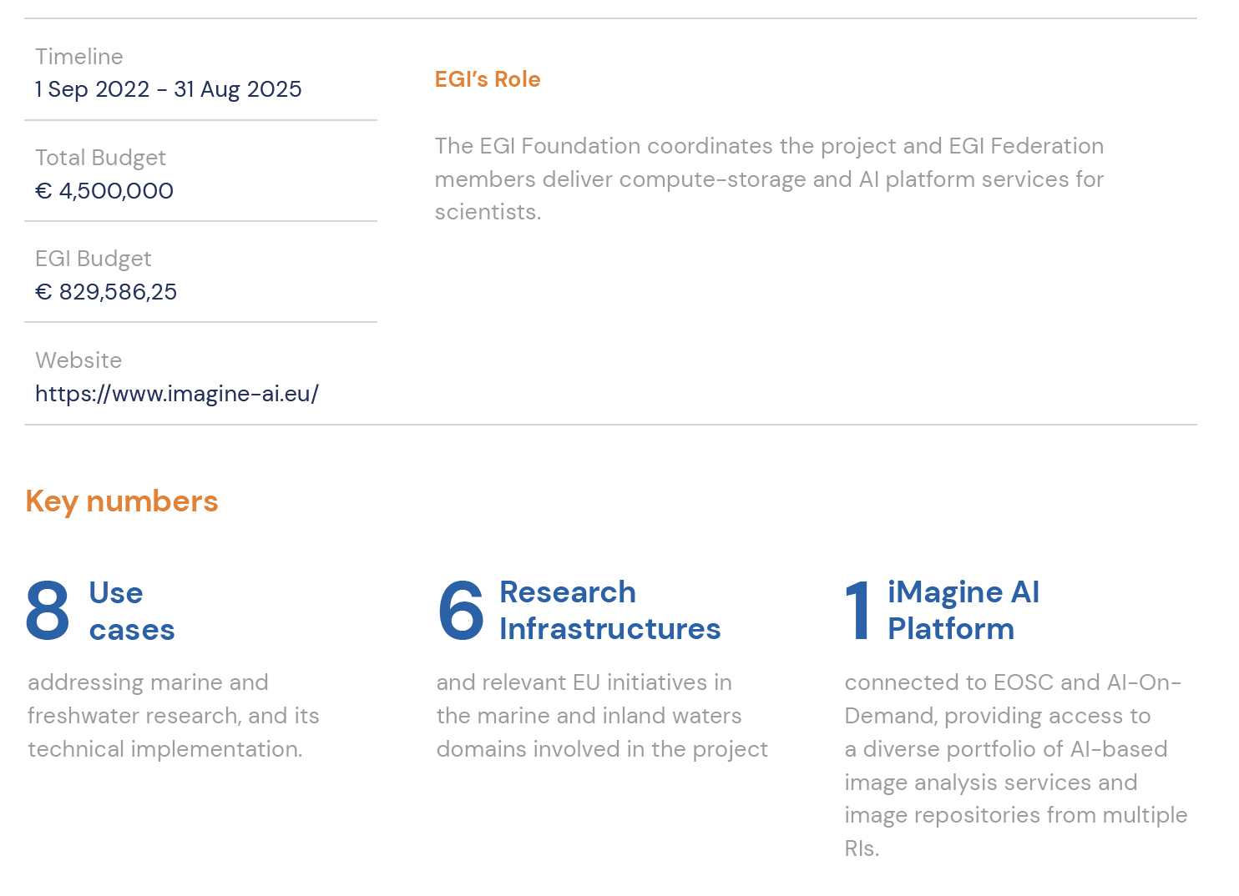

Slide 7
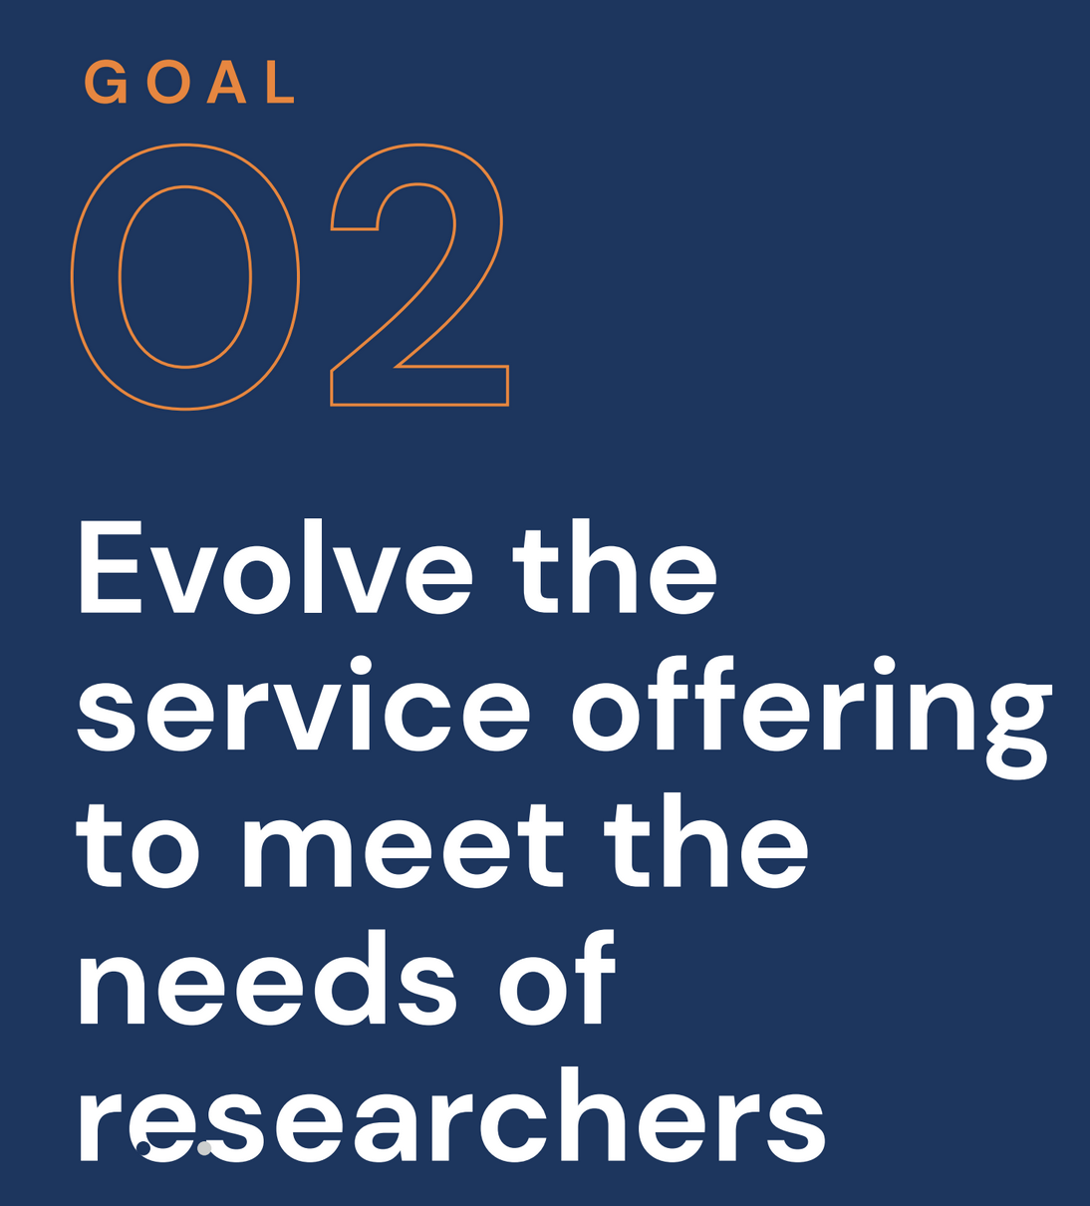
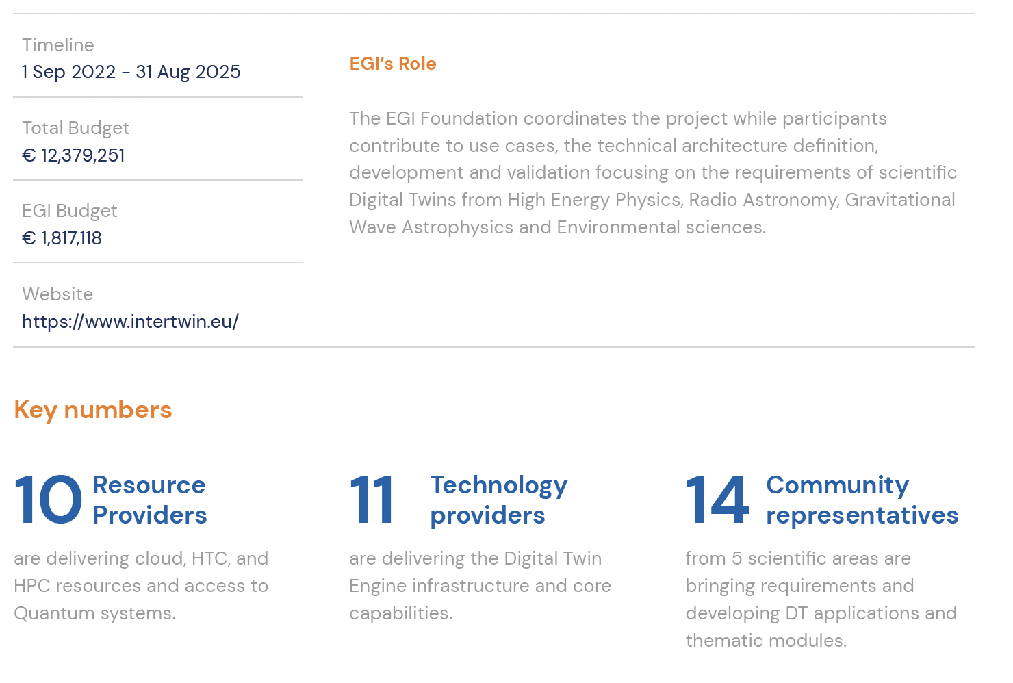

Slide 8
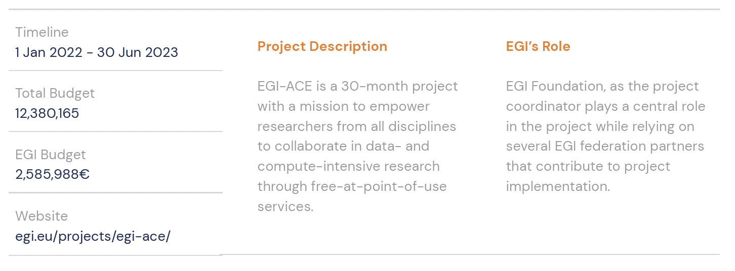

Slide 10
EGI User Community

Slide 12
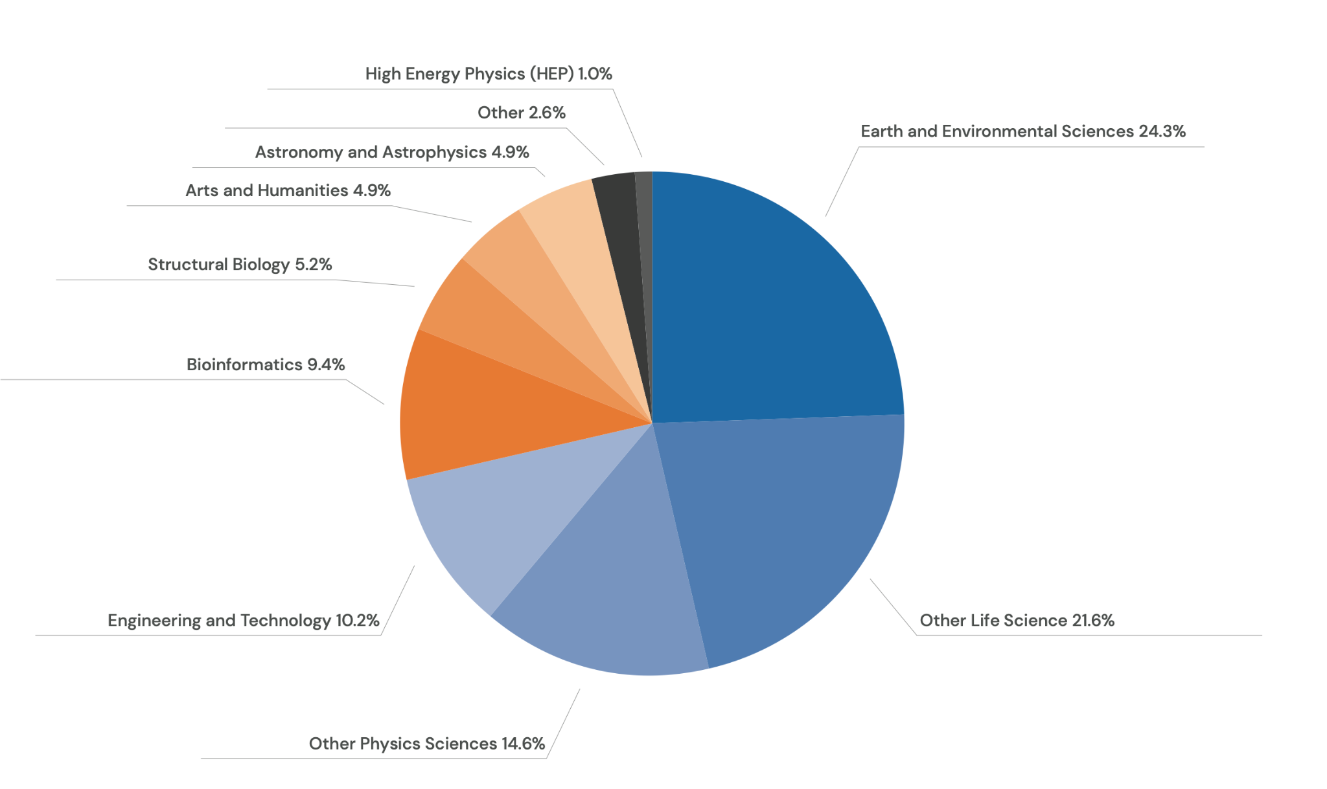
Spread of EGI Cloud CPU-hour use across disciplinary areas

Slide 13
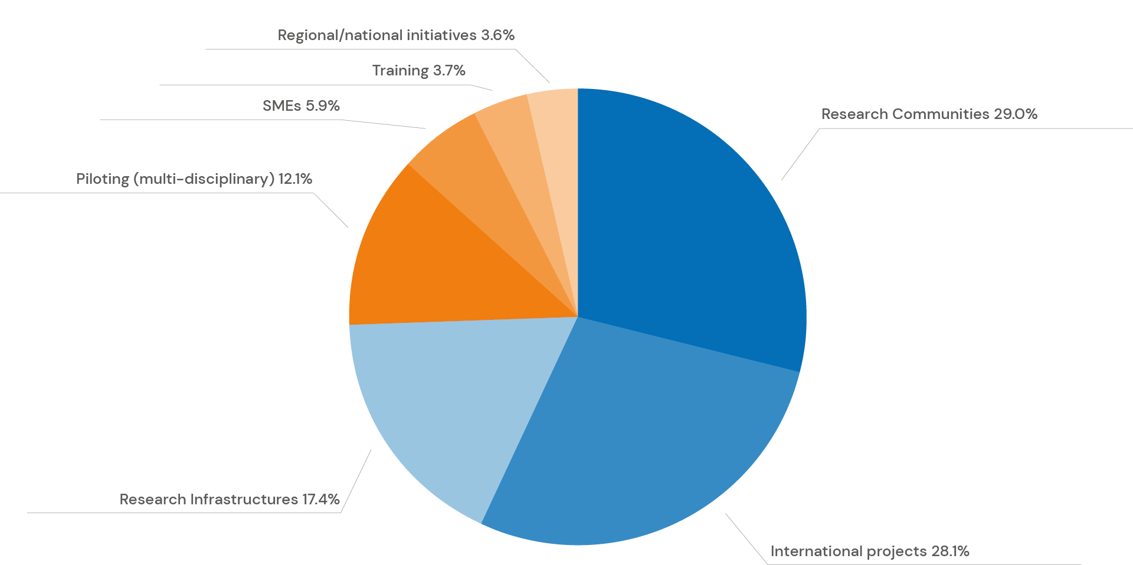
Spread of EGI Cloud CPU-hour use across type of activity

Slide 14
ESFRI RI engagement
Blue: members; orange: newly engaged in 2022

Slide 15
Back to 2004

Slide 16
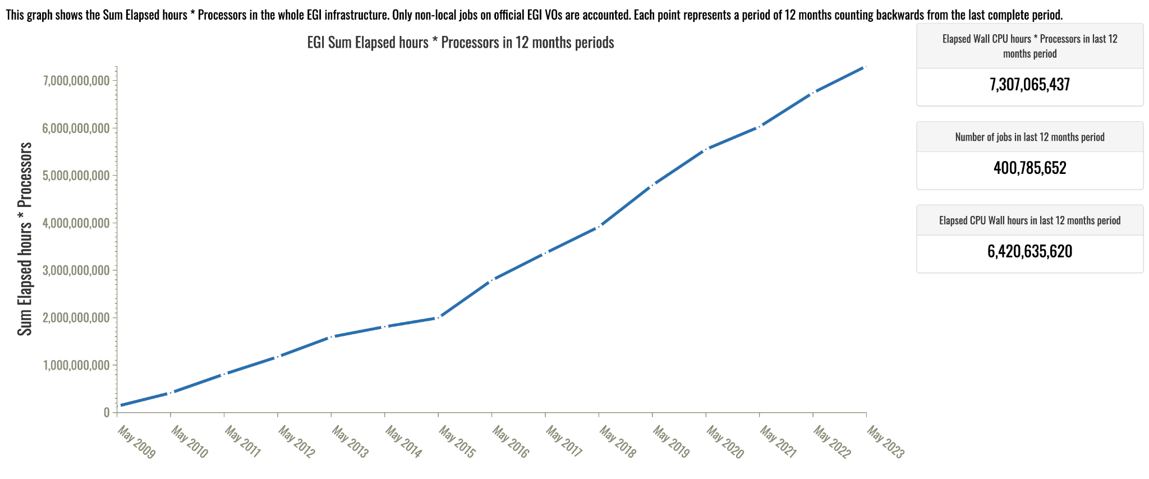
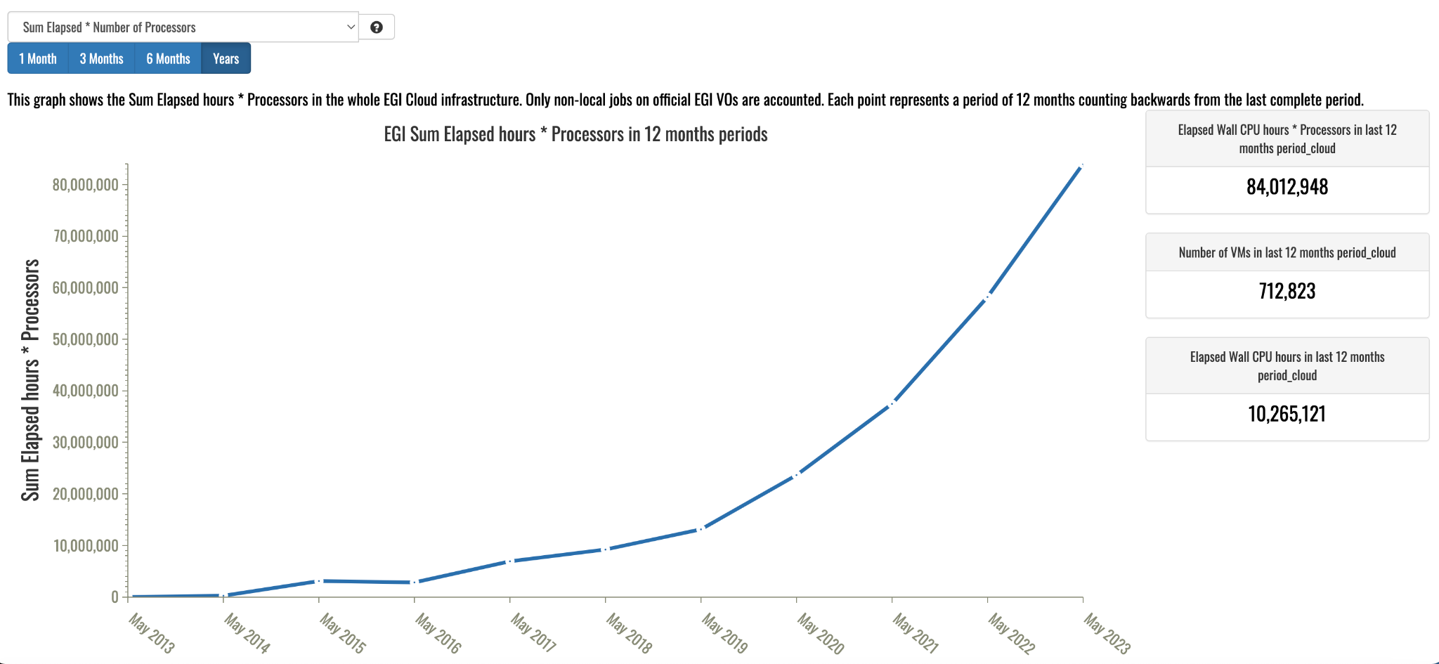

Slide 17
From concept to implementation

Slide 18
https://www.egi.eu/publications/

Slide 19
Thanks EGI Community!

Slide 20
Requirements and state of the art for data, HTC, HPC and Cloud federation in Europe
Alexandre Bonvin, Scientific Director, Bijvoet Centre for Biomolecular Research
Marek Magryś, Deputy Director for HPC, Cyfronet
Dick Schaap, Managing Director, MARIS
Oxana Smirnova, Associate Professor at Lund University
Magdalena Szwochertowska, Policy and Programme Officer, CNECT Unit C.1 Open Science and Digital Modelling at European Commission
Moderator: Tiziana Ferrari (EGI)

