Slide 1

Destination Earth
Interoperability
Towards a shared architecture understanding
thomas.geenen@ecmwf.int

Slide 2
Interoperability
Understanding that there are many, many digital twin engines under development
Understanding that the DT landscape is expanding rapidly
We want to create a common understanding of the basic DTE architecture + glossary
In order to be able to have a constructive dialogue on where to interface and with what
We also want to understand if we can converge on certain component with a proven track record (high TRL)
Define a shared set of requirements for Earth System DT towards the commision

Slide 3
Different types of Integration
Full Integration mode
Directly integrated in the DestinE simulation and data handling system
Coupling mode
Integrated in a workflow where Digital Twins have their own simulation and data fusion tasks interfacing with DestinE
Post-processing mode
Integrated as data post-processing application without own Earth-system simulation
Integration continuum
Use DTE Workflow management, HPC and data handling software infrastructures
Compatible with DTE Workflow management, HPC and data handling software infrastructures
Weak DTE coupling independent Workflow management, data management support
DTE in the background implicit data handling software infrastructure use By the end user from the DESP

Slide 4
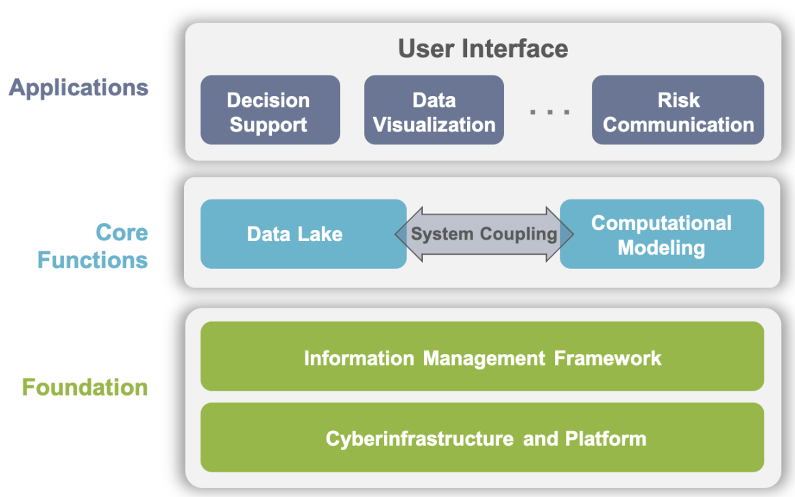
conceptual diagram of a digital twin engine
https://arxiv.org/abs/2306.11175

Slide 5
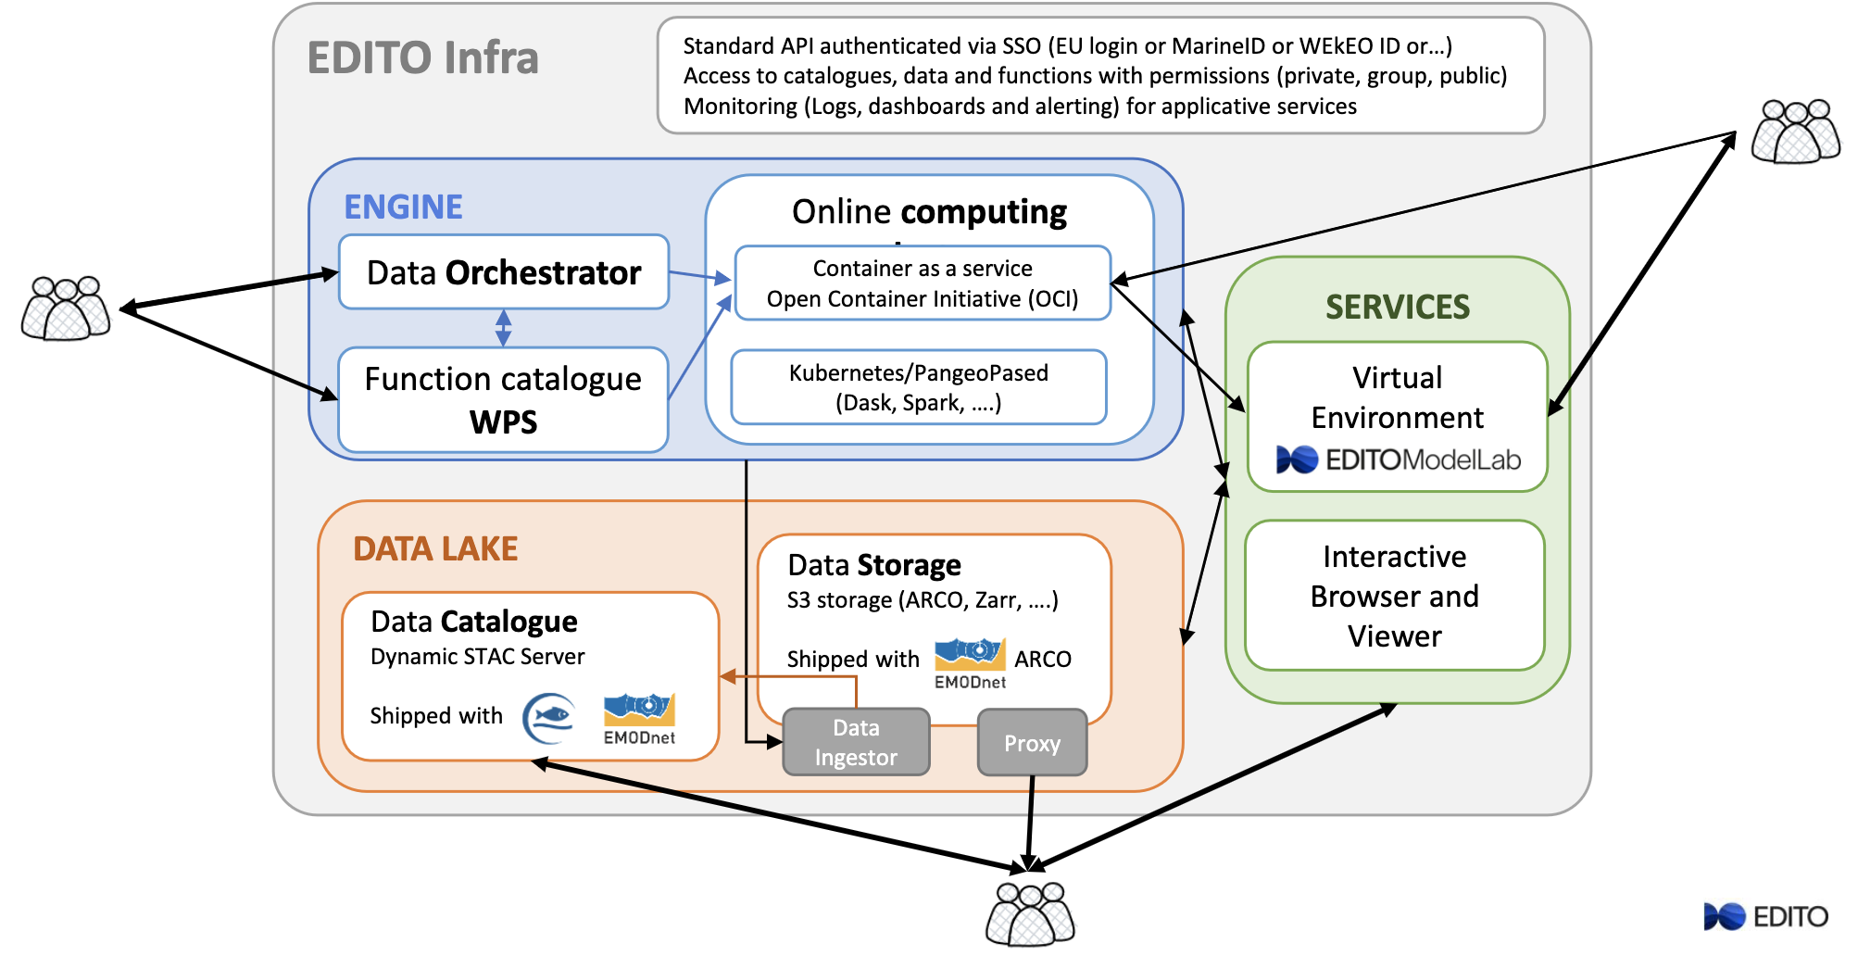
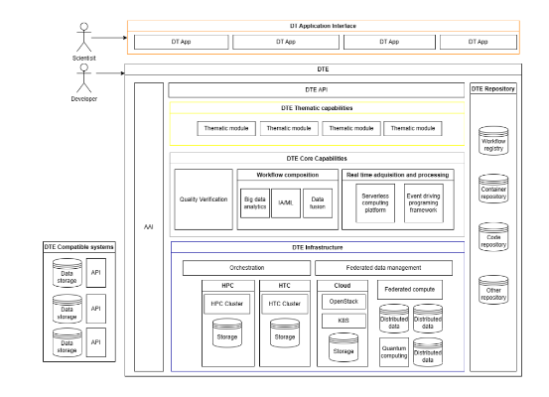
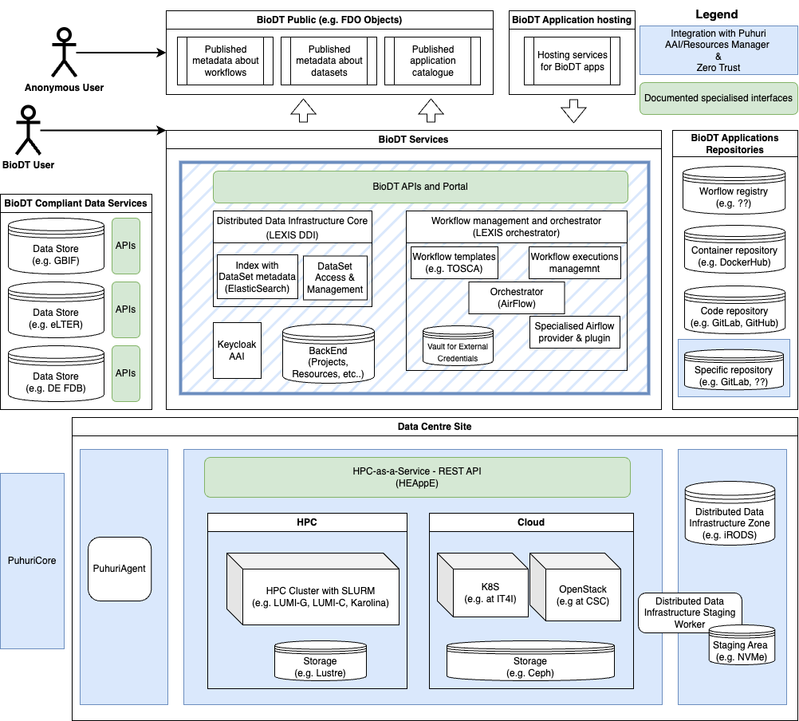
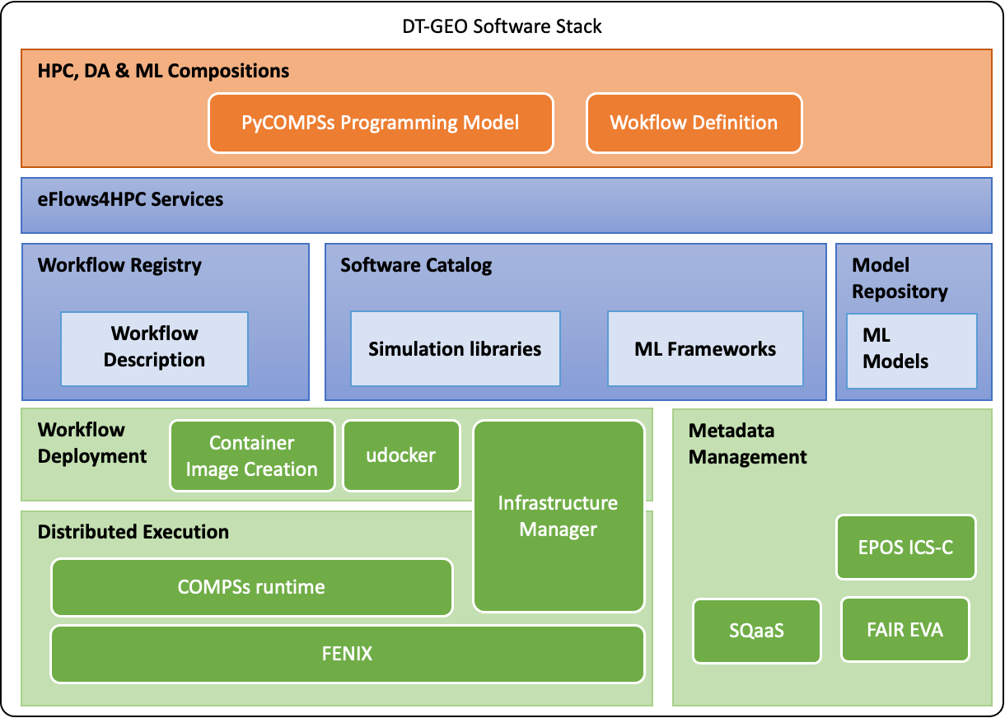

Define Interoperability landscape for Earth system DTs

Slide 6
Integration via data and workflow interfaces
An example from DT-geo on component level
Maps on the same concepts but tool choice differs

Slide 7
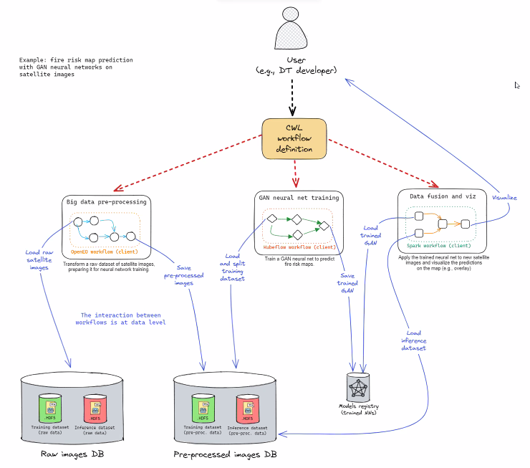
Interfaces, at what abstraction level

Slide 8
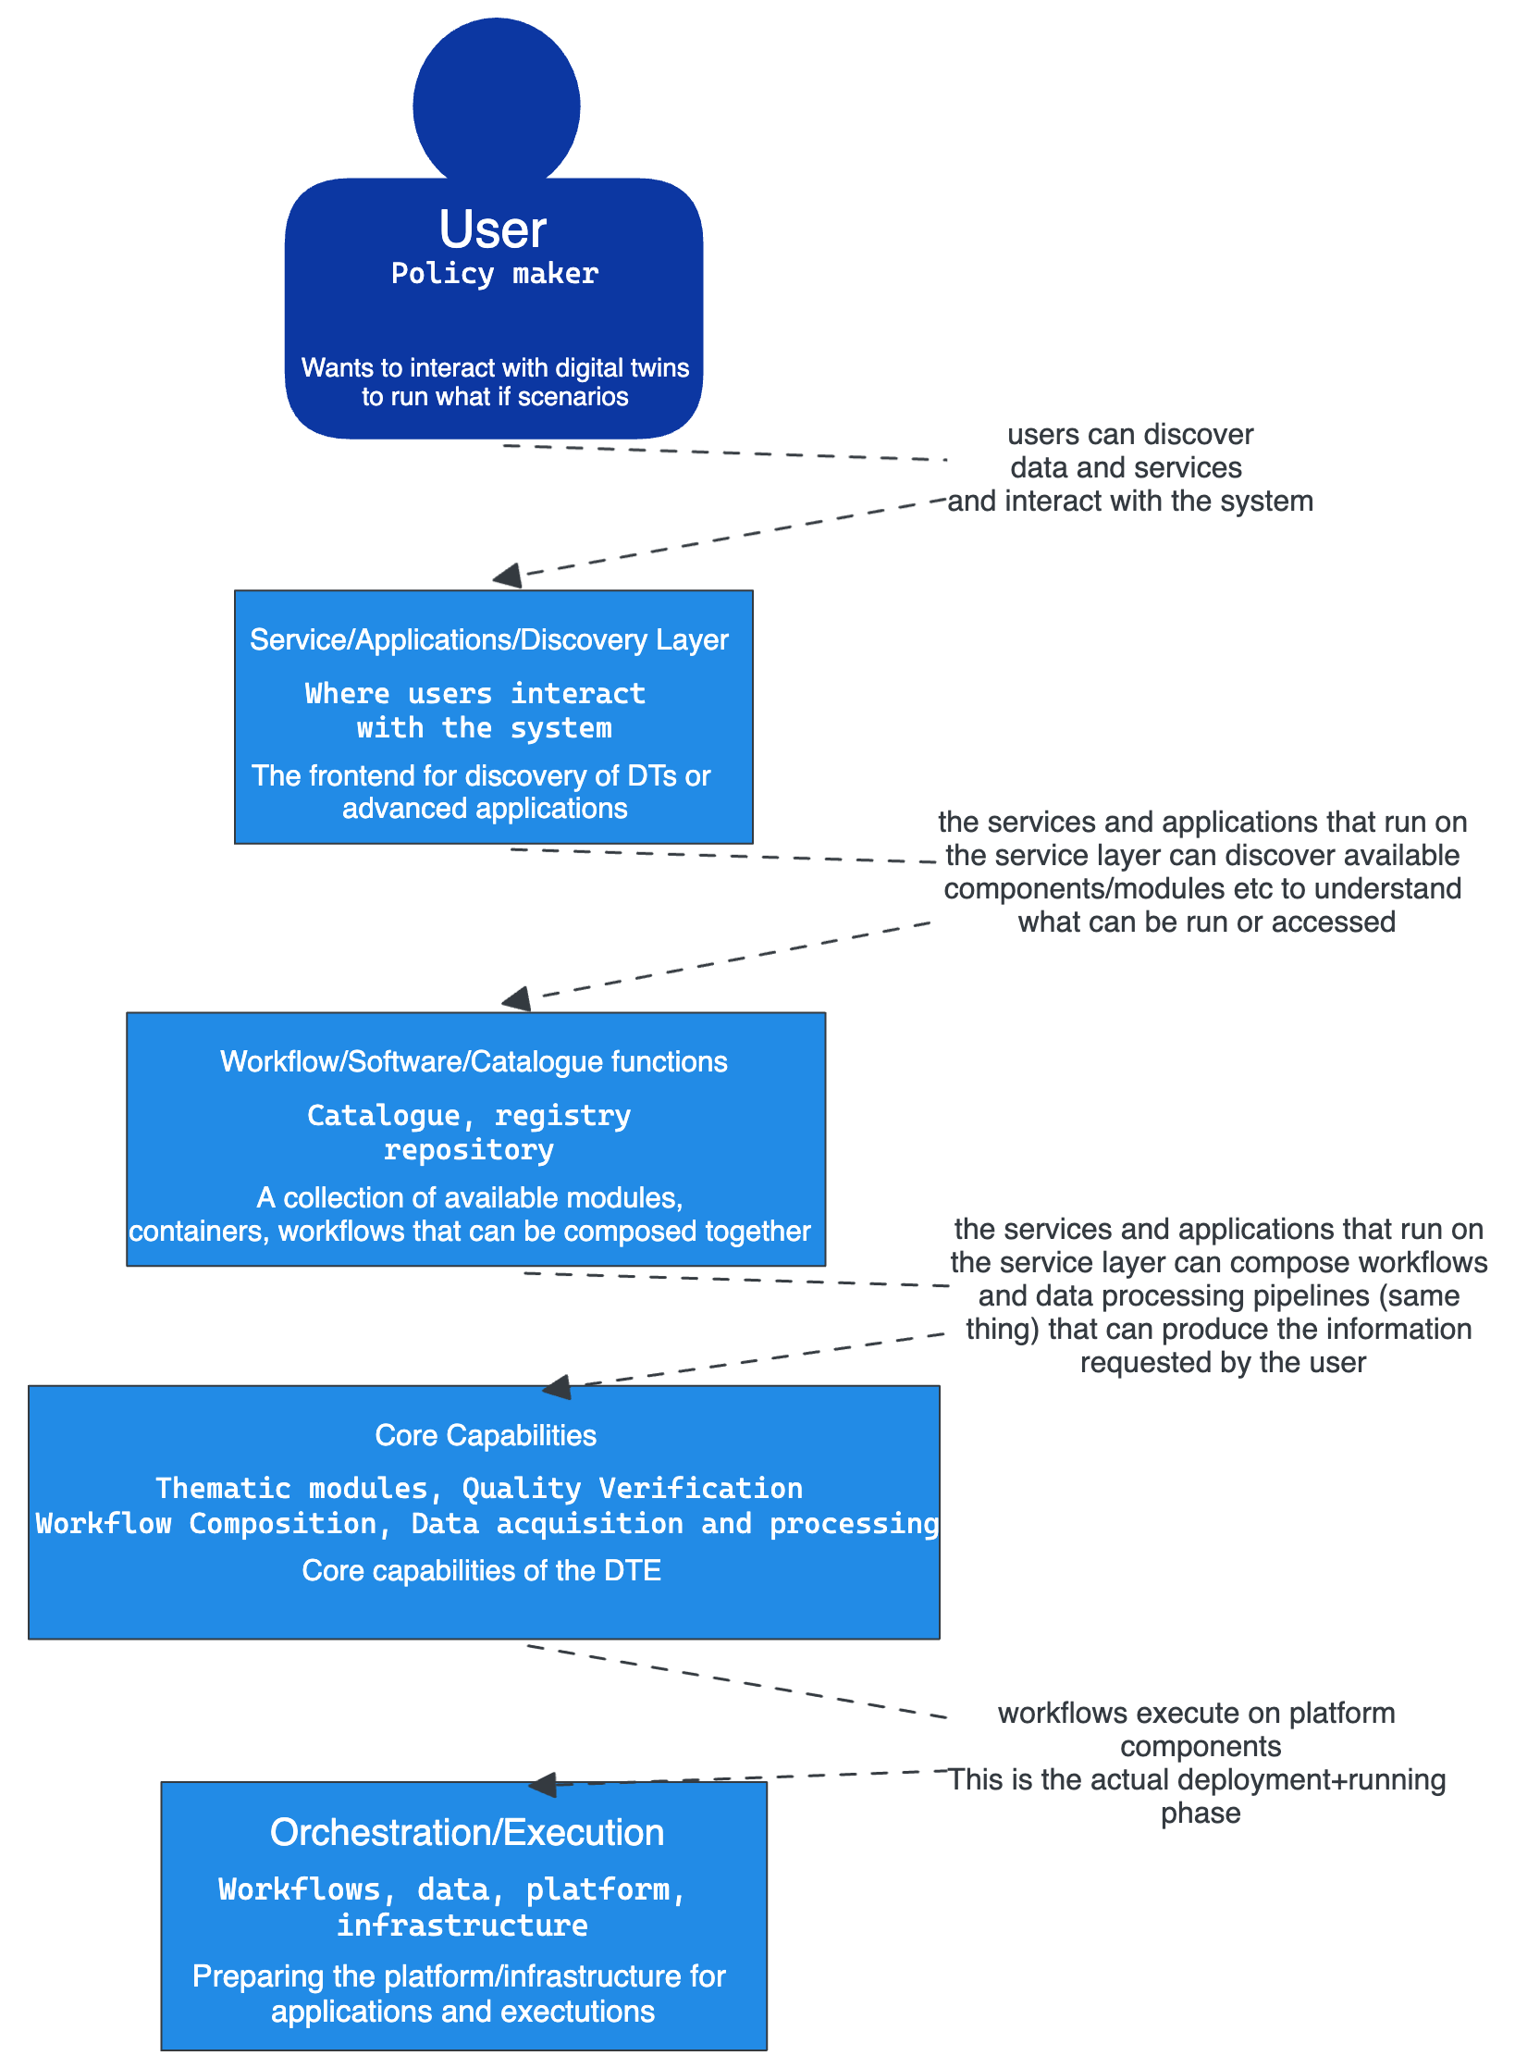
High Level Architecture
Adopting the C4 architecture diagrams/modelling
System view would look something like this
Create C4 for container/component views for each DTE
Define touch points for interfaces
Understand what/why certain tools are adopted
Rank TRL etc and define how to close the gap/distance
Between different implementations

Slide 9
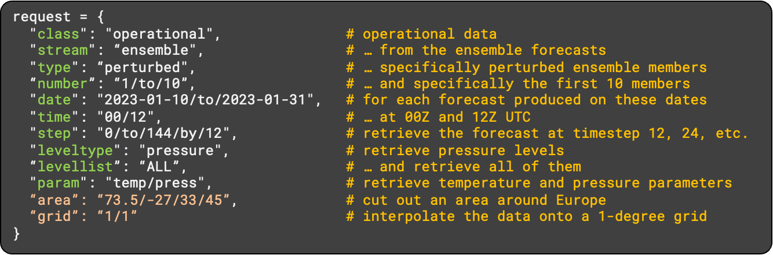
Polytope: Supporting Different Interfaces
Polytope is a data access and retrieval tool for ECMWF data cubes
Uses ECMWF MARS language to access datacubes
MARS is specific to ECMWF data and can be difficult to use for new users
Need to know parameter codes, experiment number, levels, etc...
Want new users to be able to access ECMWF datacubes in way they are used to

Slide 10
OGC EDR (Environmental Data Retrieval)
Already existing standard such as OGC environmental data retrieval API
https://ogcapi.ogc.org/edr/
Use OGC EDR requests using existing REST API
http://polytope.ecmwf.int/edr/collections/ERA5/position?coords=POINT(101.896366 45.209662)&parameter-name=Pressure&z=850&crs=CRS84&f=CoverageJSON
We automatically convert to MARS request and use polytope to retrieve data
No need to learn MARS or polytope high level API but take advantage of polytope and its quick data access
Currently involved in OGC GeoDataCubes standard which we hope to support in the future

Slide 11
Adding EDR to Polytope
Easier than you would think (so far)
Requirements:
  Knowledge of MARS or polytope high level API
  Existing Interface that supports shapes like WKT
For EDR relatively easy:
  EDR uses WKT shapes e.g. POINT, LINESTRING, POLYGON
  Polytope uses own shapes e.g. SELECT, PATH, POLYGON
Translation of these shapes main work
Also need to translate any other variables e.g. height, params, grid, resolution
All work in progress. Hope to release soon but main translations done
https://en.wikipedia.org/wiki/Well-known_text_representation_of_geometry

Slide 12
Summary
We got a mandate from the commission, DG-CNECT, to work on technology transfer between HE funded earth system DT’s
Its not just Interwin but also
DT-geo
BioDT
EDITO
And the future HE calls (HORIZON_HORIZON-INFRA-2024-TECH-01-04 etc)
Define a pilot per initiative to work on specific interfaces
Intertwin:
https://stories.ecmwf.int/destine-digital-twins-to-anticipate-the-devastating-effects-of-flooding-in-coastal-areas/index.html

Slide 13
BACKUP

Slide 14
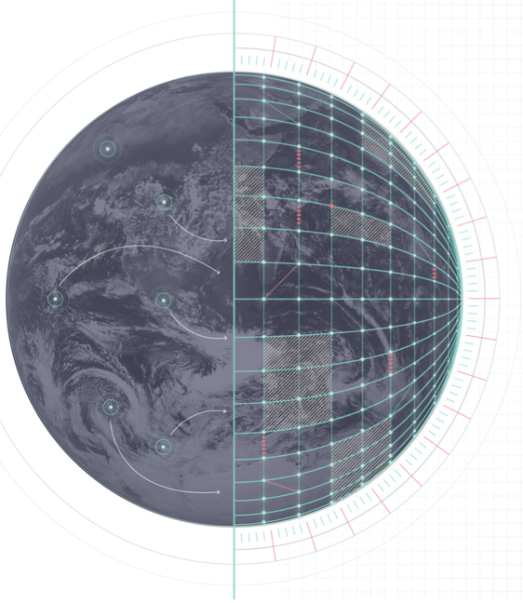

1st DestinE User eXchange 2023
15th February 2023 | ESA-ESRIN | Frascati (Rm), Italy
DTE components and objectives
Digital Twins
EuroHPC
Data Bridge
DESP
notifications
Notification services
Data stream
Applications
& pipelines
Data handling services
DESP services
Fields
Users on DESP
FDB
Machine Learning
Post-Processing
Data Analytics
Impact Models
Decision Making
FDB
control
Model interaction
Workflow management
Interactive services
https://digital-twin-engine.readthedocs.io

