Slide 1
EGI Accounting Portal
Carlos Fernández (CESGA) & Iván Rodero (Quanta Labs)
New architecture
Updates
Implementation of new features
New benchmark
Storage Accounting
GPU Accounting

Slide 2
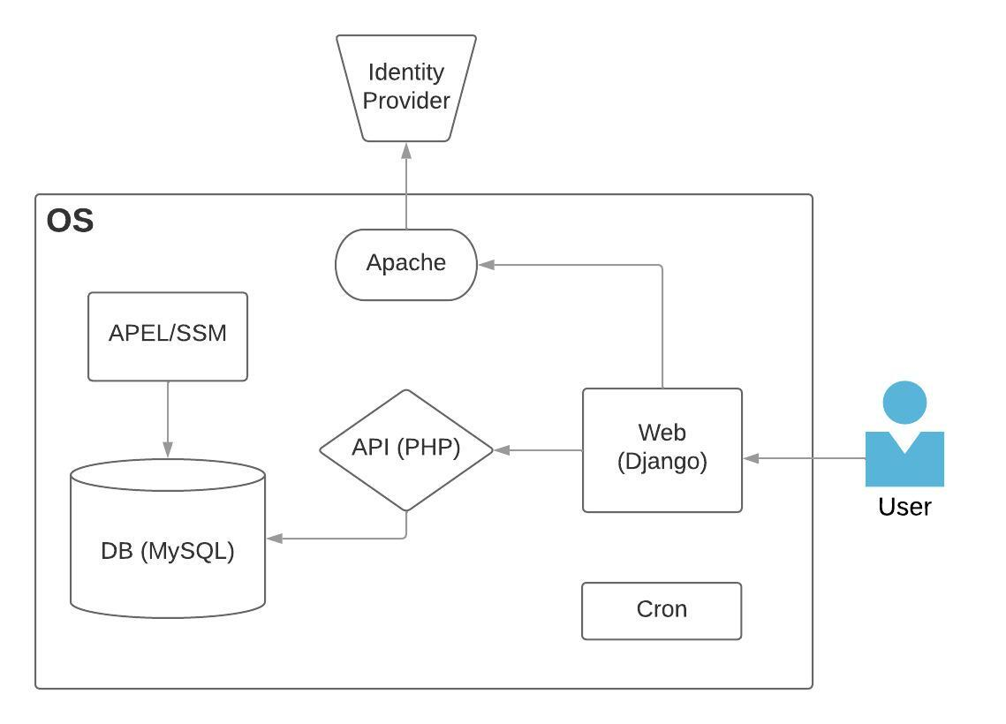
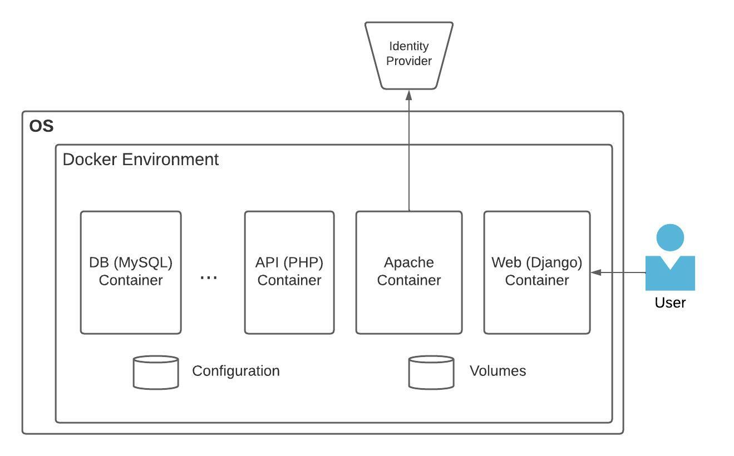
EGI Accounting Portal – New Architecture
Monolithic architecture - single point of failure
Outdated OS, libraries, etc.
Not scalable and difficult to maintain
Operating system independent
Easy to maintain (development and operation)
Decoupled and scalable (e.g., K8S if need be)

Slide 3
EGI Accounting Portal – Updates
Ticket EGITCB-133: port code to python3
Python has been updated from version 2 to version 3.1.
Ticket EGITCB-454: update Django
Django has been updated from version 1.9 to the latest one (version 4.1).
Ticket EGITCB-134: Improve performance and responsiveness of the Portal
Should be solved in the new version. However monitoring and KPIs will be collected before closing the ticket
Ticket EGITCB-135: Stress and security testing
To be done once new version in production
Other issues
Fixed issues while transitioning like the broken footer on the reports views, some stylesheets and css files that didn’t work, outdated libraries in the services, some php and other updates that where needed for changing the architecture into independent components with containers.

Slide 4
EGI Accounting Portal – New bechmark
Ticket EGITCB-449: replacing HepSpec06 with the new benchmark
We replaced in the web interface all of the references to the current benchmark Hepspec06 with the new one, HEPscore23: in the metrics, in the menus, in the explanation text of metrics, tables, and plots. At the moment the changes are essentially cosmetic.

Slide 5
EGI Accounting Portal – Storage
Ticket EGIREQ-62: Storage Accounting view in production
Storage accounting records need to be summarised first (EGITCB-145)
Once this is implemented, the view will be available in the accounting portal in production

Slide 6
EGI Accounting Portal – GPU
Ticket EGITCB-183: GPU accounting in Cloud Compute
Ticket EGITCB-237: GPU accounting view in the Accounting Portal
Dependent on having GPU accounting records in the repository
With sample records a template the view might be implemented by end of April

