Slide 1
EGI e-infrastructure:
Advanced computing services
for science
Giuseppe La Rocca
Community Support Team Lead.
giuseppe.larocca@egi.eu
Agenda:
https://indico.egi.eu/event/6087/
TLP: GREEN Limited disclosure
EGI - ACONET Austrian community workshop

Slide 2
About me
Community Support Team Lead. @ EGI Foundation
Member of the EGI Foundation team since Dec. 2015
MSc in Computer Science Engineering from the University of Catania (Italy).
EGI-ACE Community Manager
Based on Catania, Italy
giuseppe.larocca@egi.eu
https://www.egi.eu/people/giuseppe-la-rocca/

Slide 3
Outline
Who we are
What we do
Who do we support
Our services (value propositions)
  For Research
  For Federations
  For Business
EGI and EOSC

Slide 4
Introduction about
the EGI and the EGI Infrastructure
EGI - ACONET Austrian community workshop

Slide 5

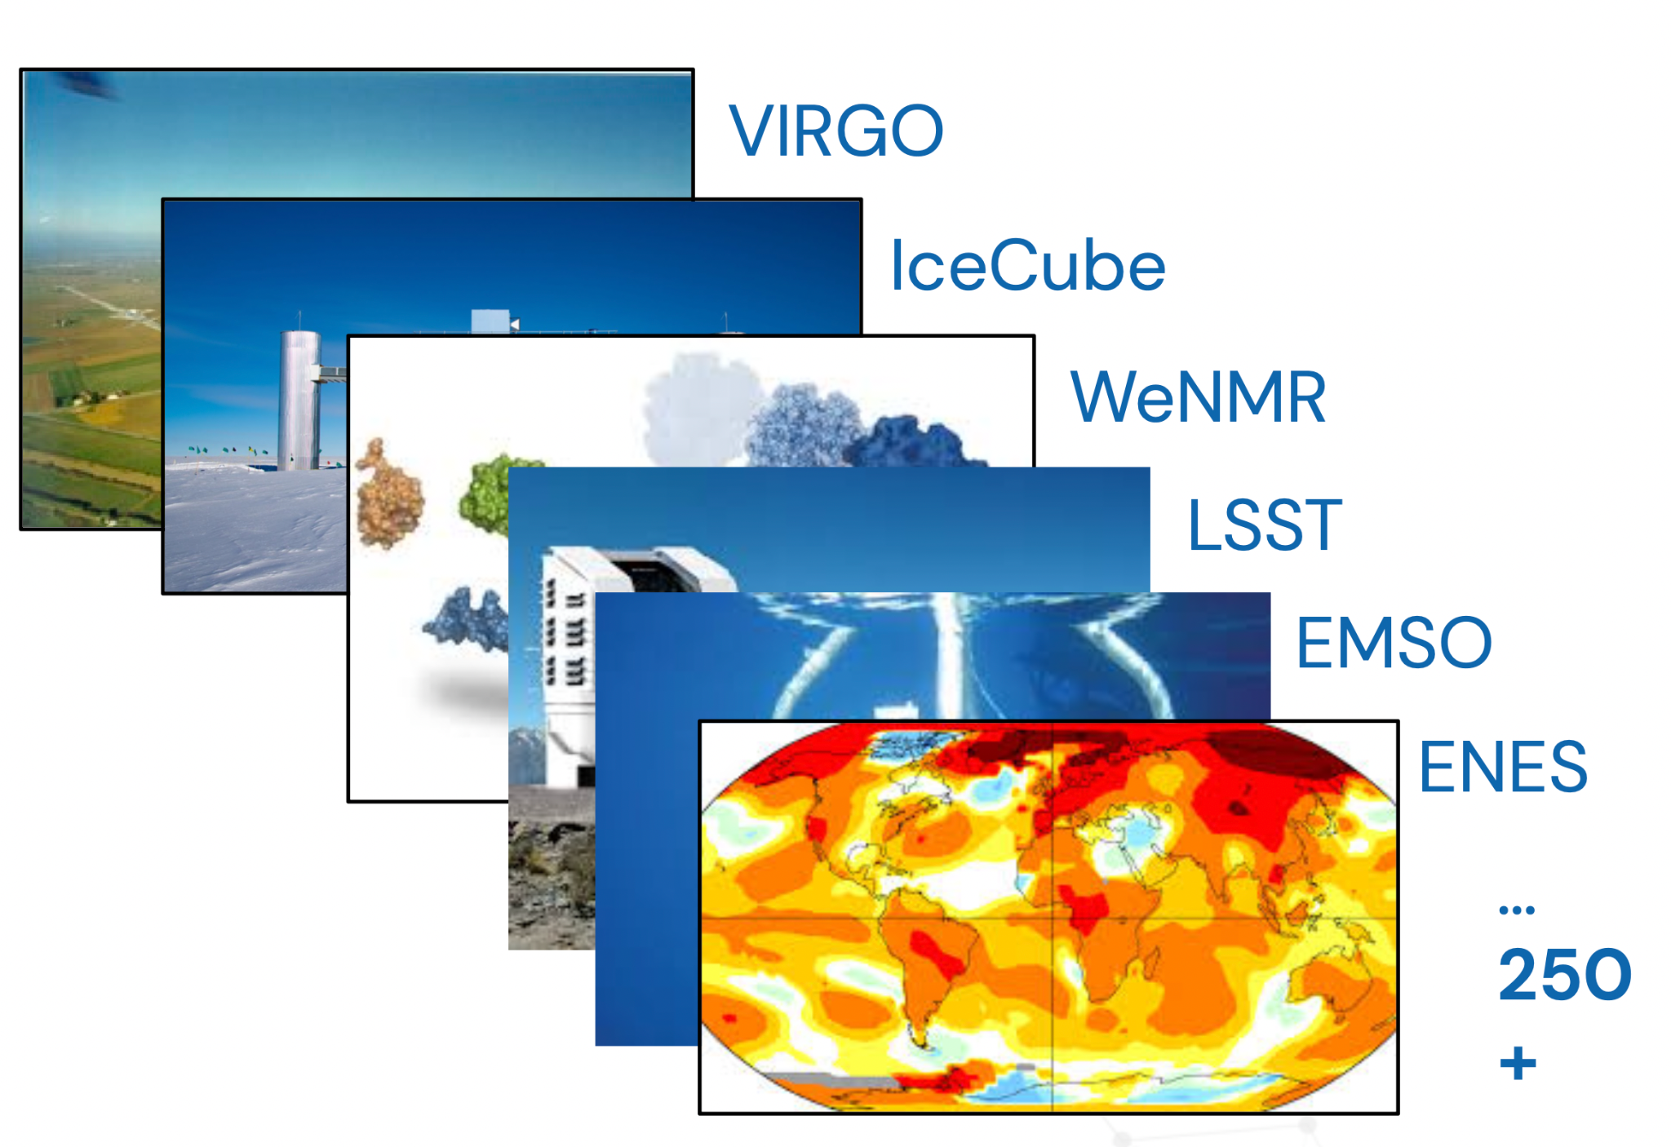
The EGI Federation is an international e-infrastructure
We provide advanced computing and data analytics for research and innovation
2010
From the high-energy physics compute grid
(WLCG)
2023
To a multi-disciplinary, multi-technology infrastructure

Slide 6
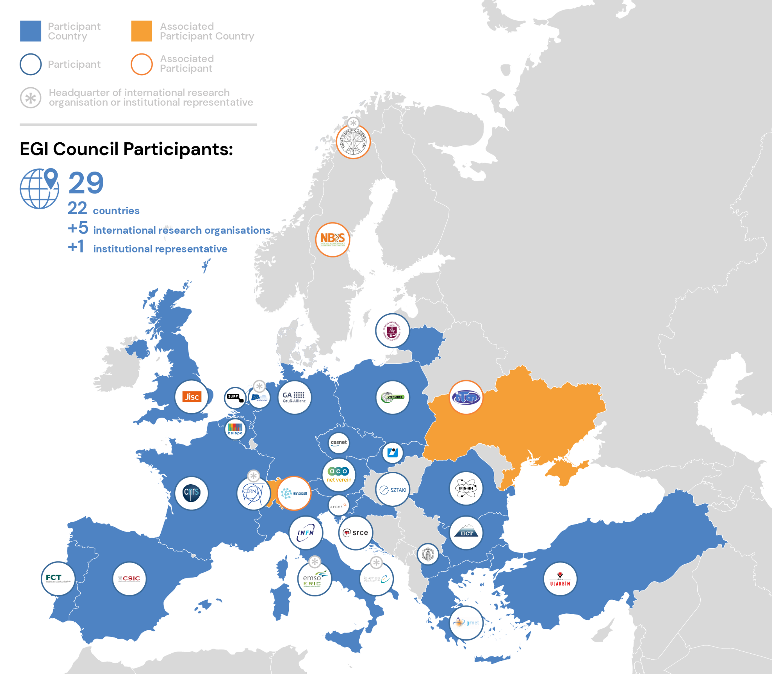
Vision
All researchers have seamless access to services, resources and expertise to collaborate and conduct world-class research and innovation
Mission of the EGI Federation
Deliver open solutions
for advanced computing and data analytics in research and innovation
Mission of the EGI Foundation
Enable the EGI Federation
to serve international research and innovation together

Slide 7
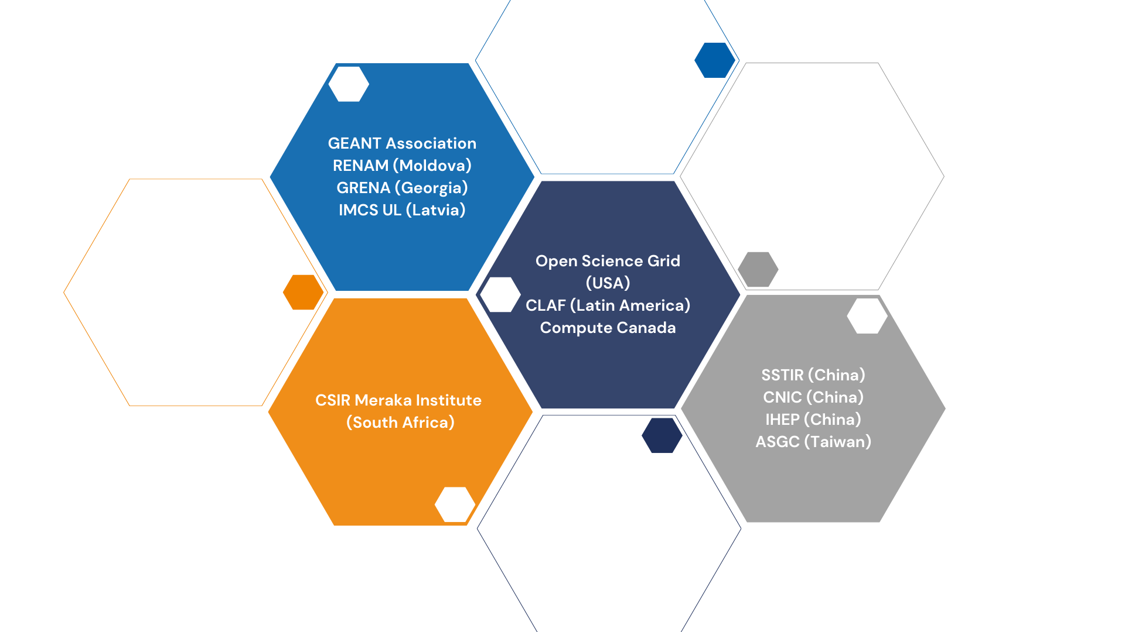
International Partnerships

Slide 8
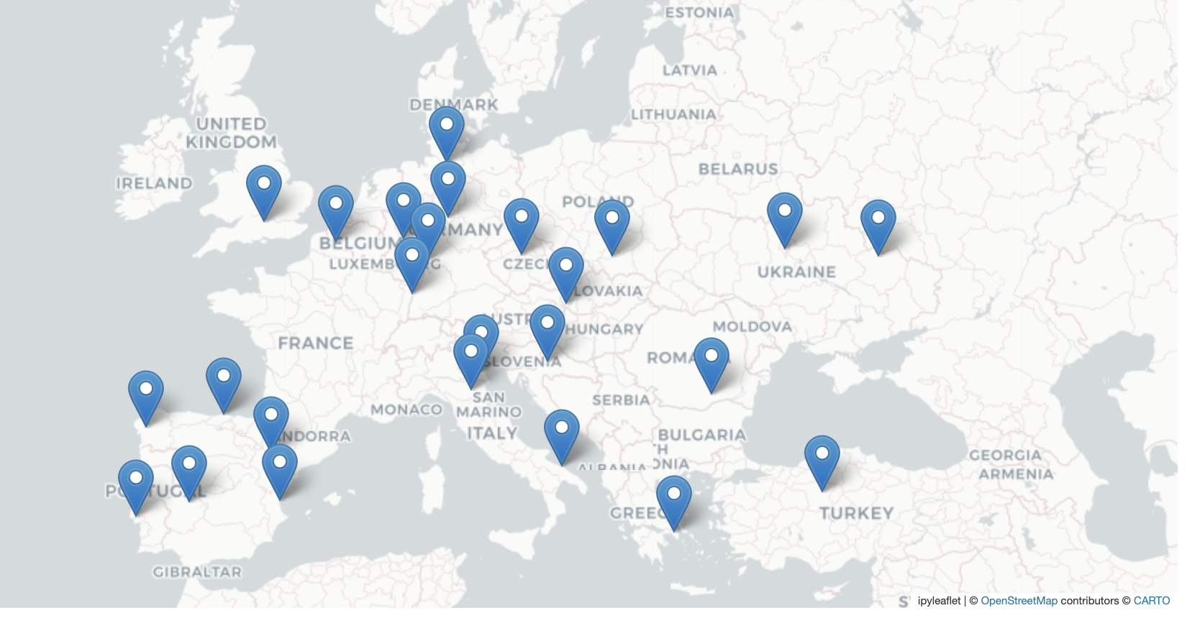
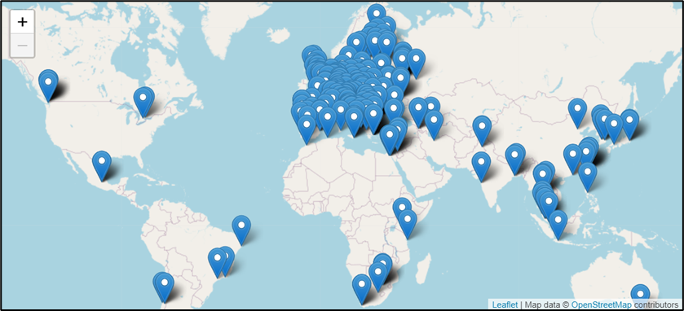
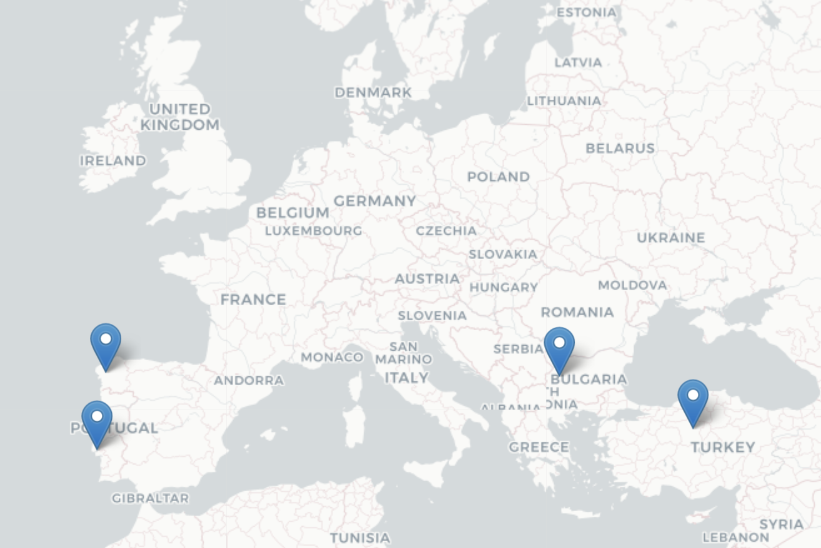
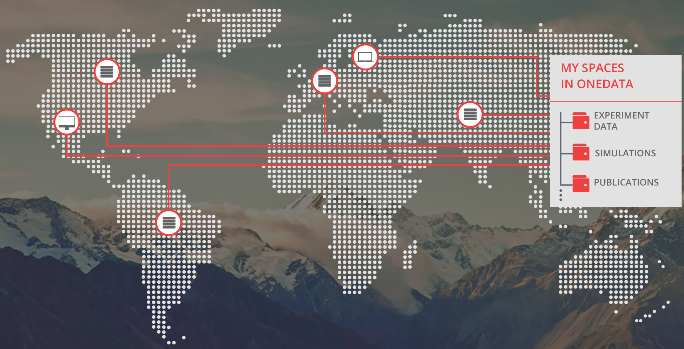
The EGI Infrastructure
Platform and community specific services built on top:
Scientific gateways, Virtual Research Environments, Application portals, etc.
High-Throughput Compute
(ARC-CE, HTCondorCE, SRM, webdav, XrootD)
Cloud Compute
(based on OpenStack. Since 2013)
EGI Internal services
Service registry
Monitoring
Accounting
Helpdesk
Single sign-in
Security oversight
Capacity management
etc.
High Performance Compute
(since 2022)
…
Data
(based on OneData)

Slide 9
The EGI HTC Federation
>1.2 Million computing cores
> 1 EB disk & tape
816 service end-points
200+ High Throughput Compute sites
(ARC-CE, HTCondorCE, SRM, webdav, XrootD)

Slide 10




Federating HPC resources
Pilot service offer that brings EuroCC HPC providers into the federation
Access to cloud IaaS infrastructures and HPC
  Hosting long-running services as cloud VM, data transfer using cloud storage, spawning jobs to HPC as needed
  Access HPC with Check-in identities
4 initial providers:
  LIP/INCD (PT), CESGA (ES), TUBITAK (TR), IICT-BAS (BG)

Slide 11
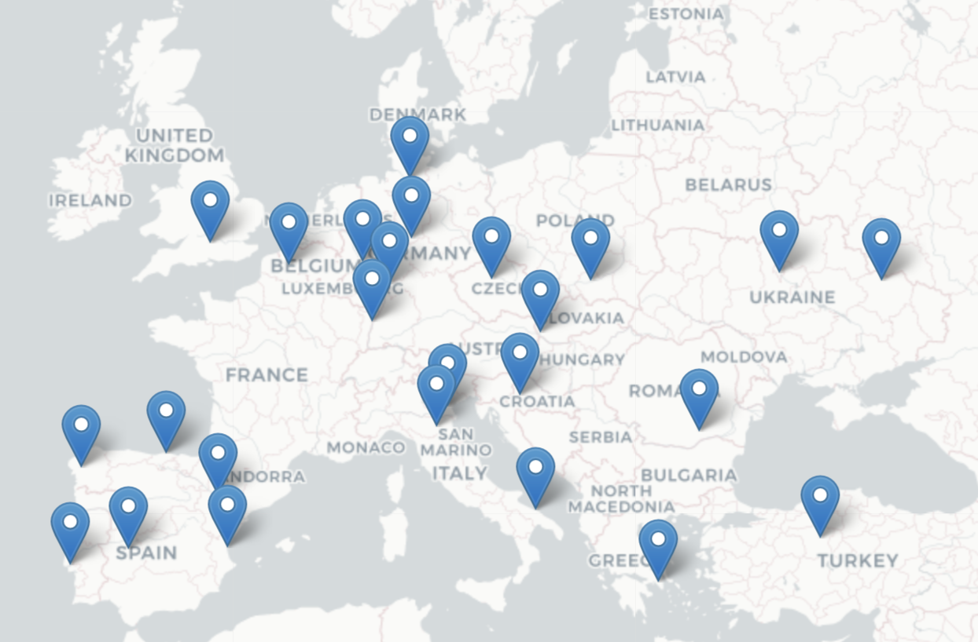
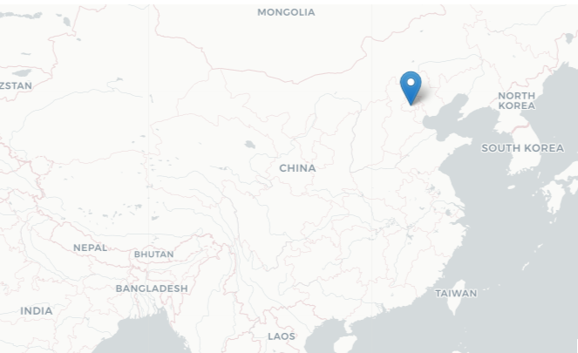
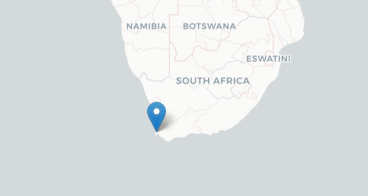
The EGI Cloud Federation
Operational since 2013
28 Cloud Providers (OpenStack)
Providing different functionalities and more dynamic platforms for scientists
70,140,605 Cloud CPU/h consumed in 2022
105 Virtual Organisations supported (Virtual Organisation = Resource pool)
Access via GUI, CLI, OpenStack native and libcloud APIs, Terraform

Slide 12
Kubernetes (Containers) in the EGI Cloud
Self-deployed by users
Spin up some VMs and deploy Kubernetes (works with existing tooling targeting OpenStack)
Automated deployment with Infrastructure Manager (IM)
Select site, size of VMs and go
Rancher-based access to managed clusters (under development)
Rancher integrated with EGI Check-in
Access to pre-configured clusters managed by expert operators

Slide 13

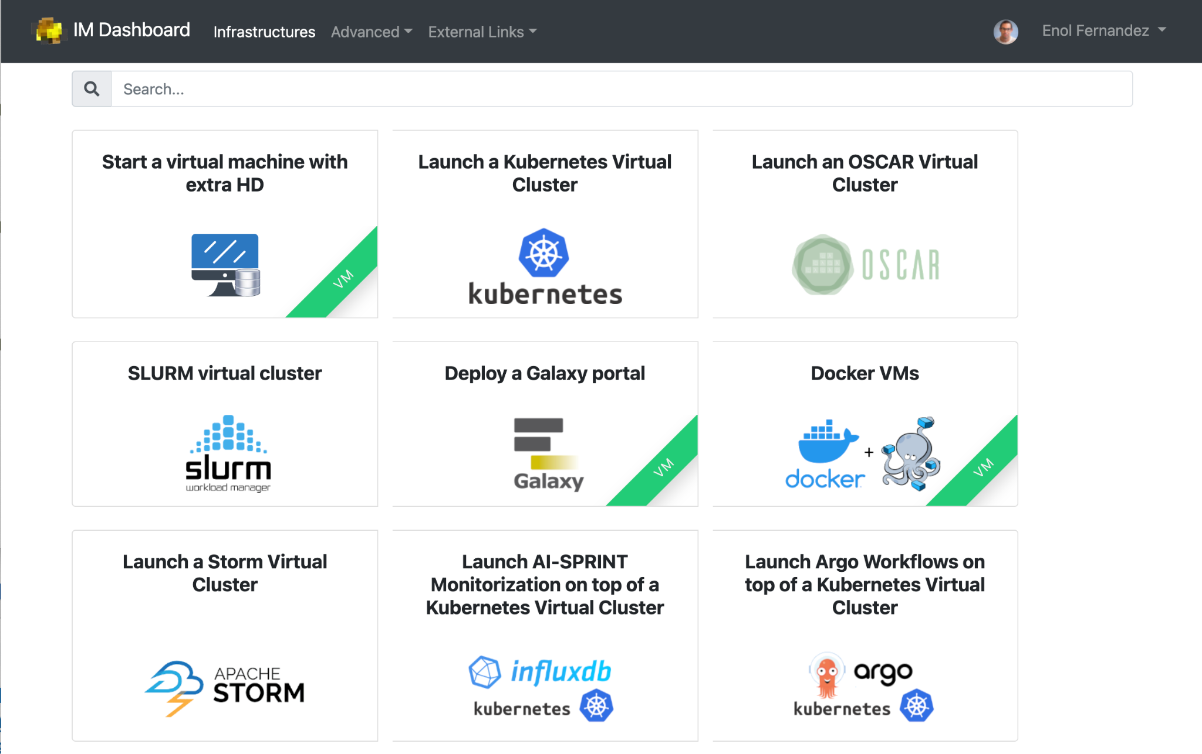
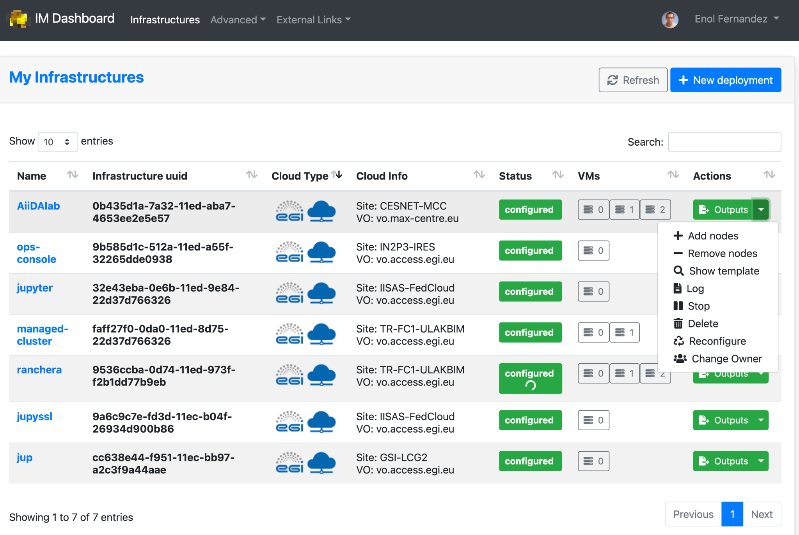
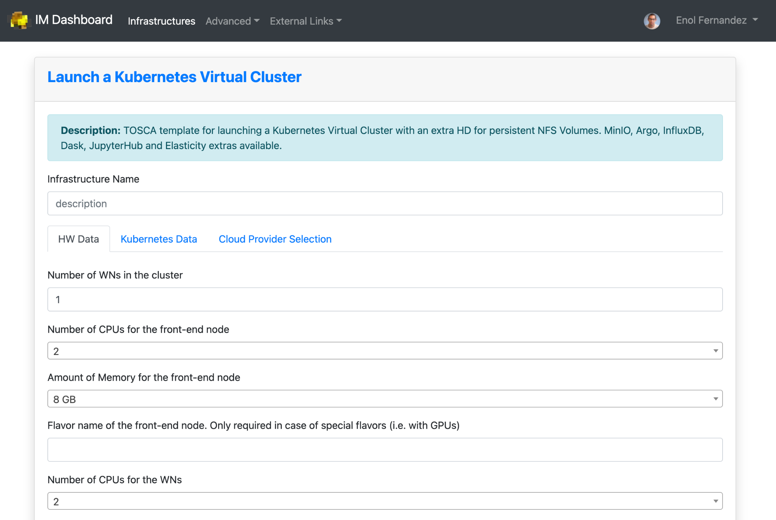
Federation services for Cloud
Infrastructure Manager orchestrates deployment of Virtual Infrastructures
Multi-cloud following Infrastructure as a Code (IaC) paradigm
Rely on Ansible and Helm to manage definition of complex infrastructure
Manages whole life-cycle: deployment, monitoring, reconfiguration (such as scaling-up or down) and removal.
Support for TOSCA

Slide 14
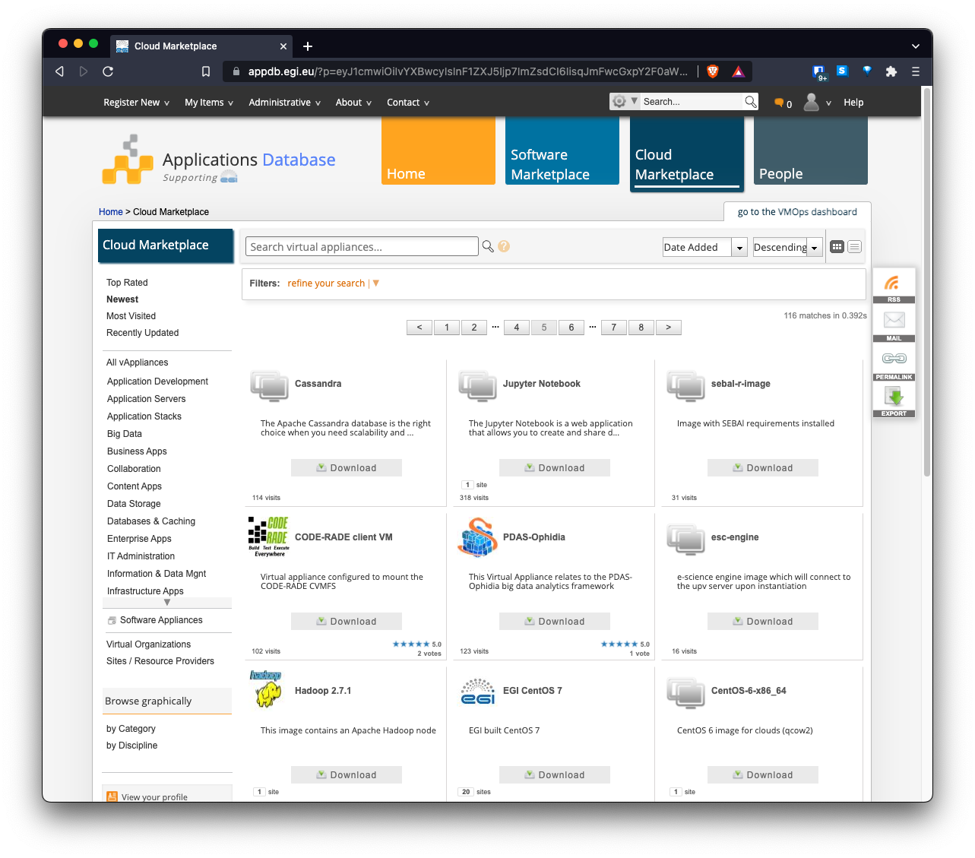
AppDB: an application store for EGI Cloud
Common registry for Virtual Appliances (VA)
VM image + metadata
Available for running at the EGI cloud or on any hypervisor
Community-level management of VAs
Automatic distribution to providers

Slide 15
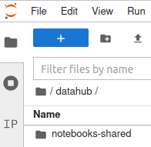

EGI DataHub
Service based on Onedata technology
It allows transparent data access under a common namespace
regardless of the location open access
Access restricted to members of a Virtual Organization (VO)
Data can be accessed via a GUI or APIs
Allows replication of data from data providers for resiliency and
availability purposes. Replication may take place either on­ demand or automatically.
Easy integration with other EGI components thanks to integration with EGI Check-in service, the EGI Authentication and Authorization Infrastructure (AAI)

Slide 16
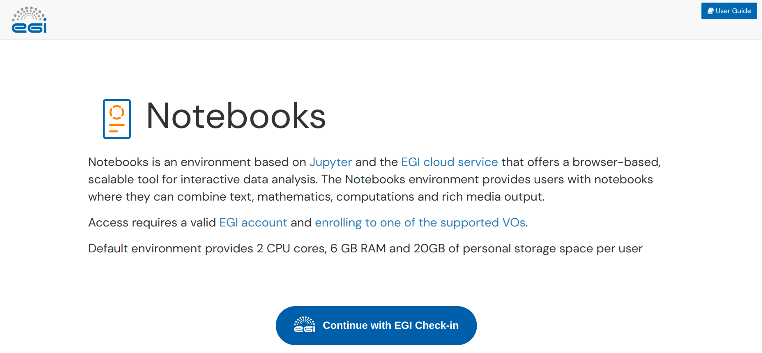
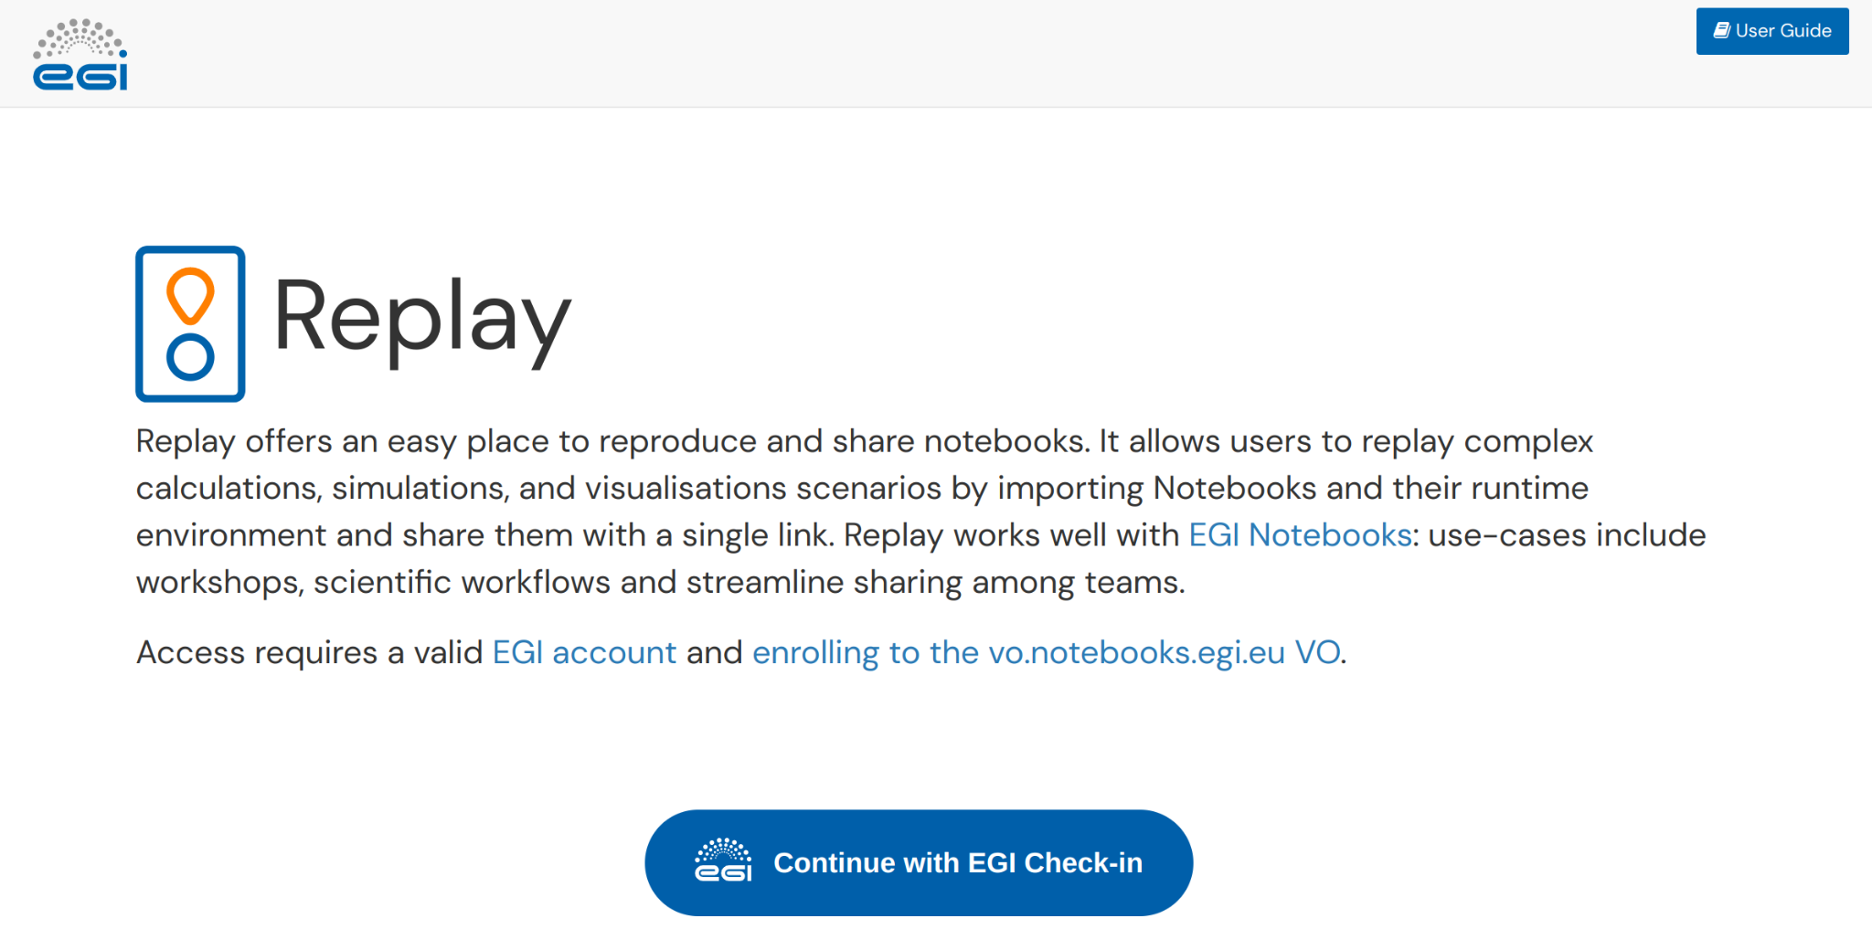
Services open to everyone: EGI Notebooks and Replay
https://notebooks.egi.eu, https://replay.notebooks.egi.eu/
Interactive environment to write, run and share applications, instructions, results.
Access after lightweight ID assessment
  Login with EduGAIN, Google, Facebook, LinkedIn…
  2 vCPUs, 6GB RAM and 20GB of storage
  Persistence (don’t lose work after logout)
  Support for multiple kernels (Python, Julia, R, MATLAB)
  Access remote files (DataHub integration)
  Catch-all deployment and Community specific deployments
User guide
Login
User guide
Login

Slide 17
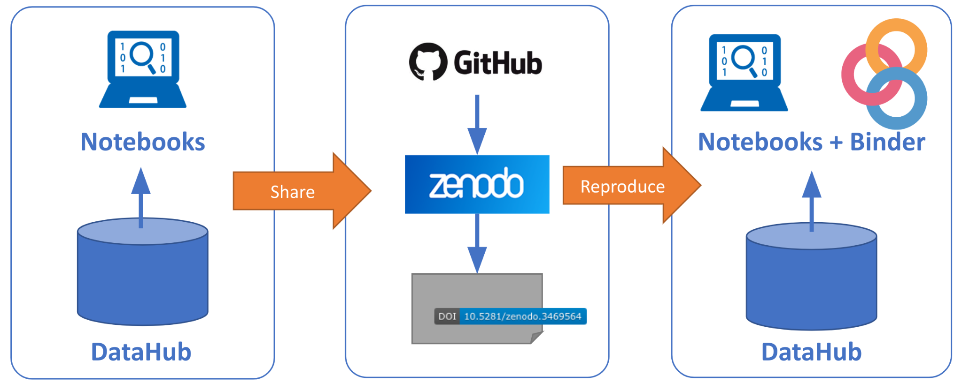
Reproducible Open Science in EGI/EOSC

Slide 18



EGI Value Propositions
Services for Research
Services for Federation
Services for Business
Our large-scale computing and data analytics services are helping scientists to accelerate their research.
Our internal services provide tools for coordination of the EGI Federation, improving how we work together.
We help companies to exploit and provide services and resources for compute- and data-intensive research and innovation.

Slide 19
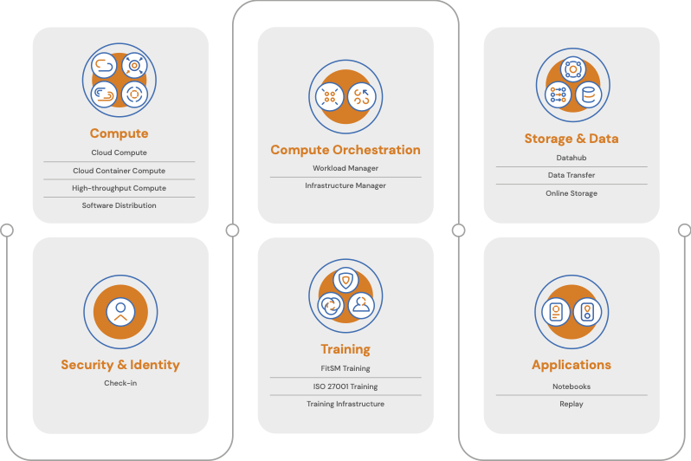


EGI Services for Research
Service catalogue:
https://www.egi.eu/services/
User documentation:
https://docs.egi.eu
Notes:
Infographics

Slide 20
Access policies
Wide access
Users can freely access scientific data and digital services provided by EGI resource providers
Policy-based
Users are granted access based on policies defined by the EGI resource providers or by the EGI Foundation
Market-driven
Users can negotiate a fee to access services either directly with EGI resource providers or indirectly with the EGI Foundation
Example:
EGI Notebooks open instance
EGI Cloud pool for application piloting
Example:
Biomed HTC pool for life sciences
INFN-Bari (IT), IN2P3-IRES (FR), ULAKBIM (TR) provide Clouds for the National Bioinformatics Infrastructure of Sweden
Example:
FitSM training by EGI Foundation
4 EGI Cloud providers deliver to Exprivia

Slide 21




Allocating services and resources
Type, number, size, cost, availability, etc.
Negotiator
Applic.
provider
Instance requirements
Conditions
Storage
provider
Cloud
provider
Foundation
HTC
provider
Scientific community’ representative
Service Level Agreement
Operation Level Agreement
Training
Support
Federation members
Ensure satisfaction, capture achievements,
record feedback
Ensuring that agreed targets are met
Regular service delivery reports
Regular satisfaction interviews

Slide 22
Who do we support
EGI - ACONET Austrian community workshop

Slide 23
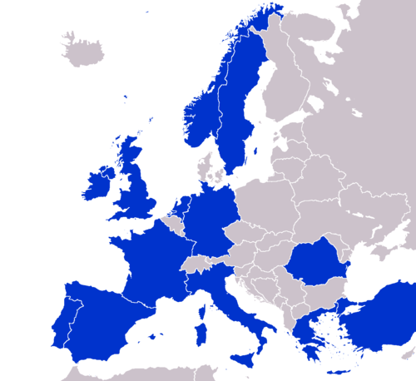
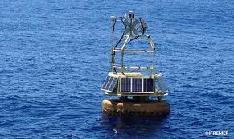
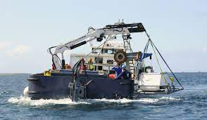
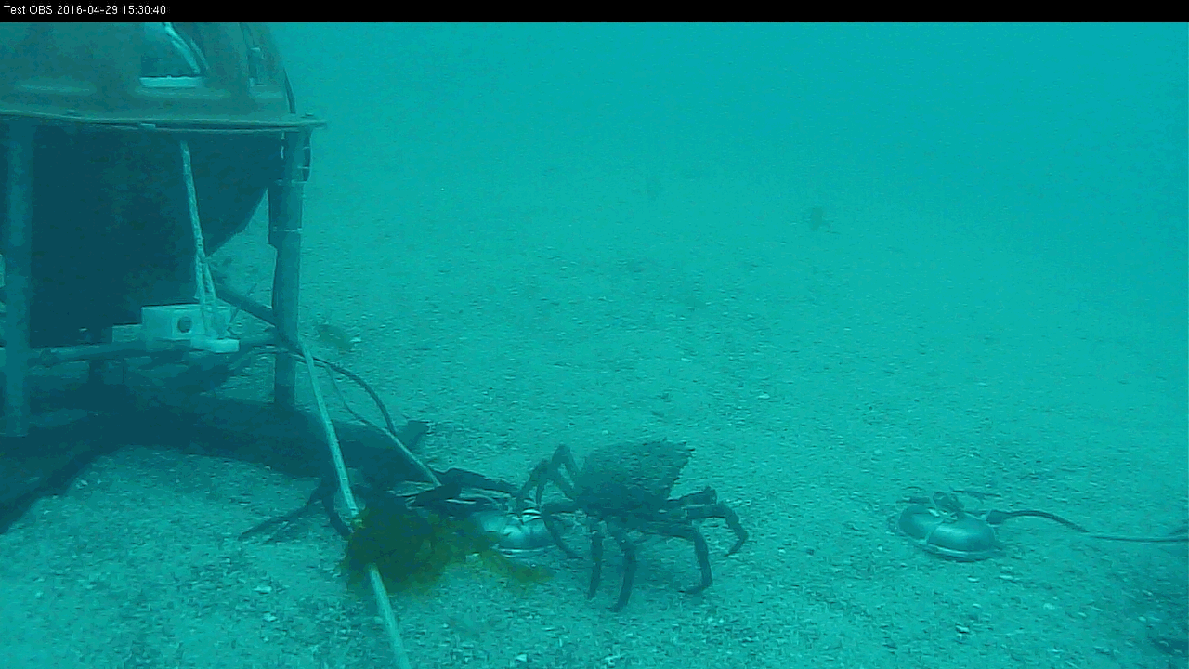
The EMSO-ERIC Data Space
https://emso.eu/
European Multidisciplinary Seafloor and water-column Observatory (EMSO) is a large-scale European distributed Research Infrastructure for ocean observation, enabling real-time interactive long term monitoring of ocean processes.
Observatories are platforms equipped with multiple sensors, placed along the water column and on the seafloor.
  EGI full story: here

Slide 24
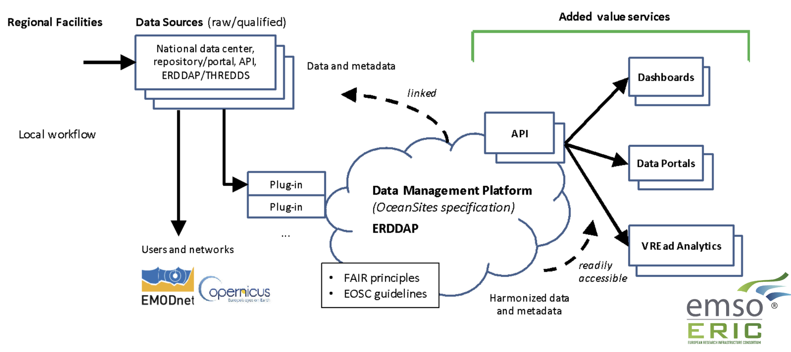


The EMSO-ERIC Data Portal
https://emso.eu/
492 vCPU cores, 1.7 TB of RAM, 20 TB of block storage

Slide 25

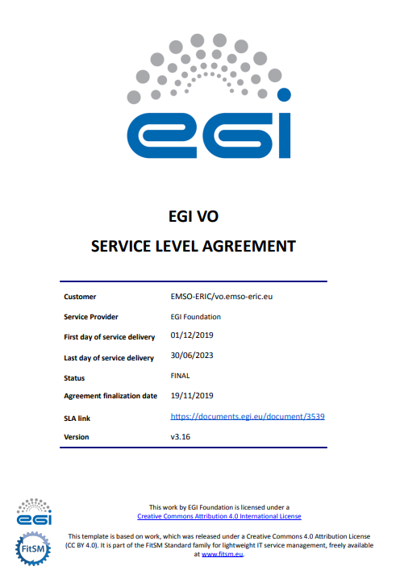
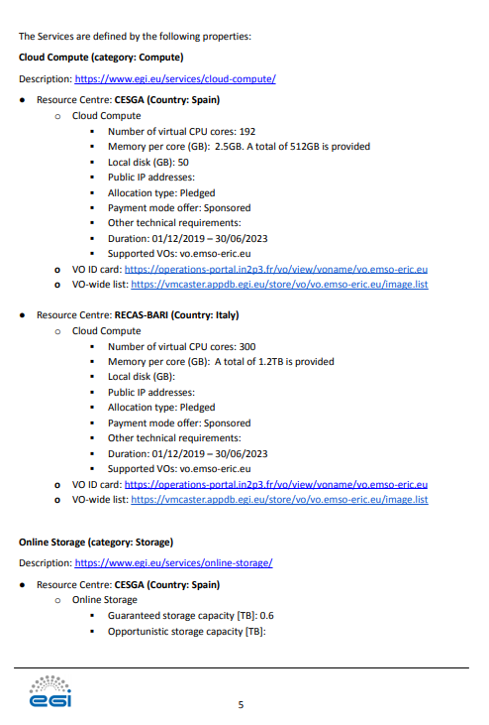
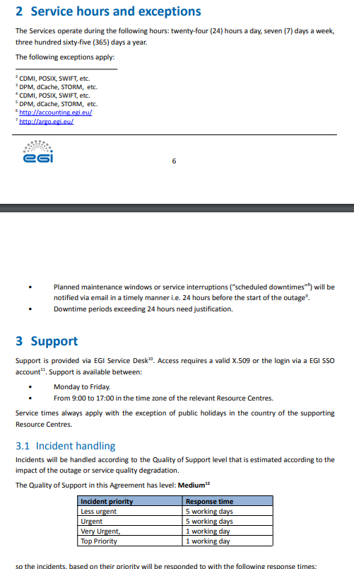
The SLA with EMSO-ERIC
https://emso.eu/

Slide 26
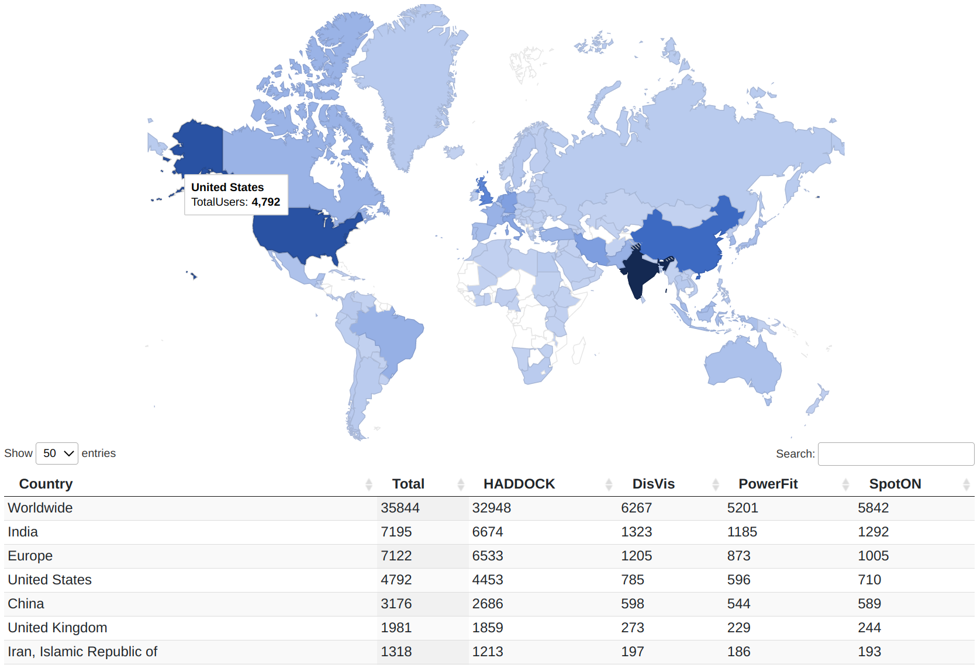
WeNMR
wenmr.science.uu.nl
WeNMR is a worldwide e-infrastructure for Nuclear Magnetic Resonance (NMR)
and Structural Biology
Mission:
  Understand life at molecular level
  Engineer better molecules for material, health of food applications
  Obtain starting point for drug design to combat diseases
The HADDOCK web portal is being used by 32,948 users
across 137 countries!

Slide 27
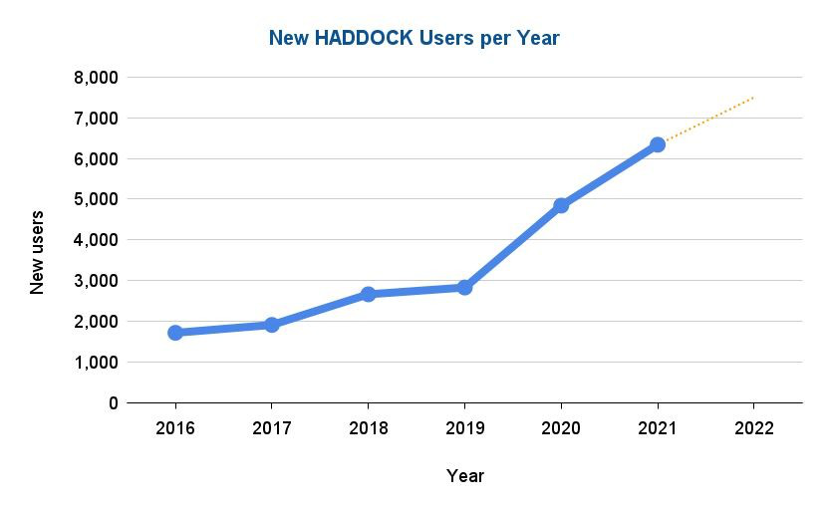
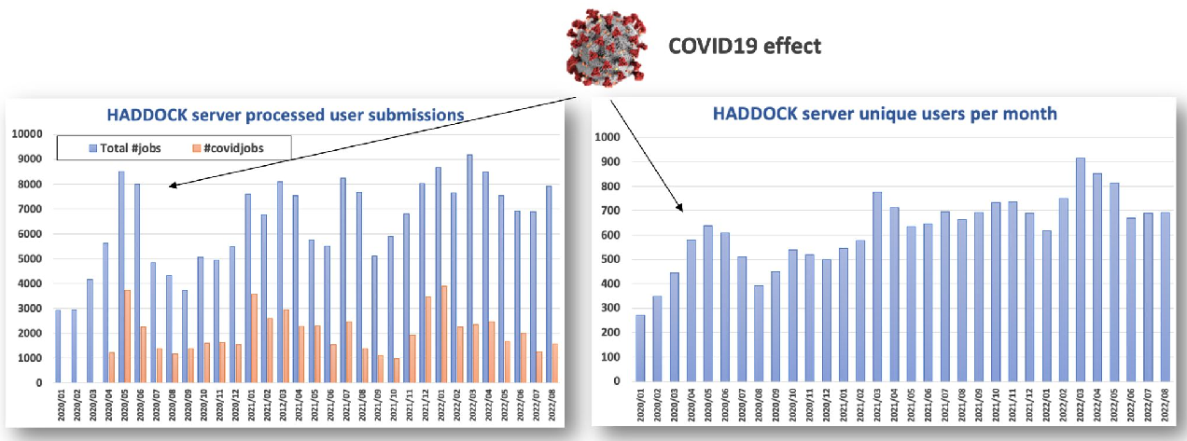
WeNMR
wenmr.science.uu.nl
Worldwide Impact and Usage
35,000+ users,
507,900+ jobs
COVID-19 Support
Additional EOSC HTC dedicated resources to support COVID-19 research (EGI and OSG)
~30% of all simulations since April 2020 are COVID-19-related
  EGI provides:
Check-in
Cloud Compute
Online Storage
Workload Manager
HTC Compute
CVMFS
  EGI full story: here

Slide 28

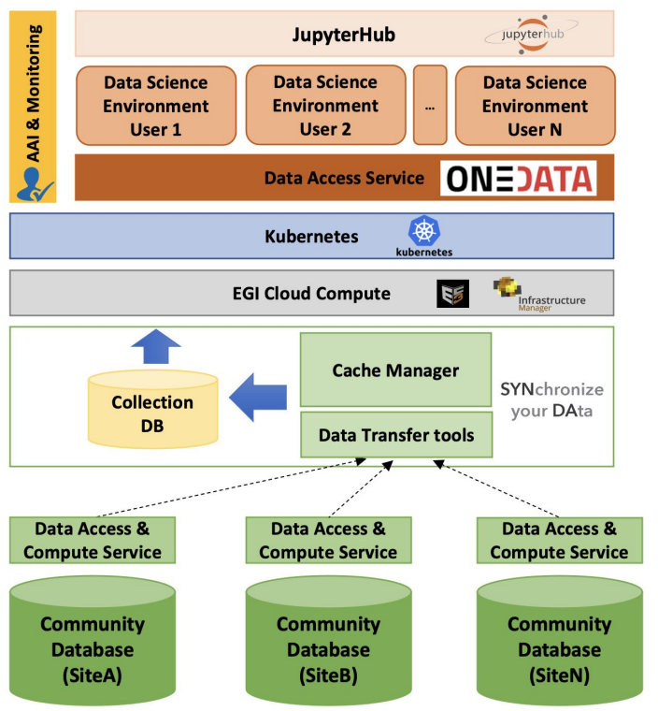





European Network for Earth System Modelling
Mission:
  Deliver an open, scalable and cloud-enabled data science environment for climate data analysis on top of the EOSC Compute Platform
Jupyter-based Data Science environment
  EGI provides:
Check-in
Cloud Compute
Notebook
Online Storage
DataHub
EOSC compute services and interface
EOSC data access services and interface
Infrastructure as a Service (IaaS)
  EGI resources:
160 vCPU cores
160 GB of RAM
300 TB of block storage
Data Collector and cache service
  EGI full story: here

Slide 29
EGI Value Propositions
Services for Research
Services for Federation
Services for Business
Our large-scale computing and data analytics services are helping scientists to accelerate their research.
Our internal services provide tools for coordination of the EGI Federation, improving how we work together.
We help companies to exploit and provide services and resources for compute- and data-intensive research and innovation.
Notes:
There are plethora of services offered by the EGI Foundation to the members represented in the EGI Council. We can broadly classify the services in three categories -
Let us look at them in a bit more detail. For that I am going to give examples of some services

Slide 30











Technical Tools for the Federation
Configuration Database
Information about sites and hosted services
Validated Software and Repository
Unified Middleware Distribution
Usage Accounting
Compute usage records (accounting.egi.eu)
Monitoring
Healthiness of our services
Operations Tools
Essential toolkit to run a core infrastructure platform in a federated ecosystem
Helpdesk
Point of contact to ask for support at EGI
Collaboration Tools
IT tools for better coordination
Marketplace
Expose your services to a broader audience
Check-In
Login with your own credentials

Slide 31
How C-SCALE relies on the EGI Internal services
EGI Check-in: Control who has access to:
  Deploy infrastructure with FedEarthData
  Download Copernicus data with Earth Observation - Metadata Query Service
  Use openEO Platform
GOCDB: Discoverability of providers
  Copernicus data providers register their STAC endpoints in GOCDB
  Earth Observation - Metadata Query Service will discover them and search with user’s queries
How EGI brings Austrian solutions to the European landscape in C-SCALE
Vienna Scientific Cluster (https://vsc.ac.at/) part of the HTC/HPC federation in C-SCALE; integrated with https://sram.surf.nl/ as AAI (ongoing synergies with Check-in)
EODC Cloud (https://eodc.eu/) is being integrated as part of the EGI Cloud federation

Slide 32
EGI Value Propositions
Services for Research
Services for Federation
Services for Business
Our large-scale computing and data analytics services are helping scientists to accelerate their research.
Our internal services provide tools for coordination of the EGI Federation, improving how we work together.
We help companies to exploit and provide services and resources for compute- and data-intensive research and innovation.

Slide 33





Services for business
https://www.egi.eu/egi-dih/
Test before you invest
Skills and training
Technical facilities to support companies and SMEs test before investing or to validate services or solutions.
Provide knowledge on the technical offer through webinars or consultancy services.
Networking and community
Find funding
Bring SMEs and communities together with the EGI community and facilitate the interaction and open new market opportunities.
Facilitate the access to funding opportunities and investment mechanisms to sustainable support the innovation.

Slide 34
The European Open Science Cloud
initiative
EGI - ACONET Austrian community workshop

Slide 35
European Open Science Cloud
“
… a virtual environment with free at the point of use, open and seamless services for storage, management, analysis and re-use of research data, across borders and scientific disciplines.
2016 Communication on the “European Cloud Initiative”

Slide 36



EGI and the European Open Science Cloud
A long and rich history
EOSC phase 1: Until end of 2020
  EGI coordinated the EOSC-hub project
    Laid down the operational infrastructure (Helpdesk, Accounting, Monitoring, EOSC Portal).
    Design and operate a service Mgm system
    Contribute to the Service Portfolio (compute, storage, thematic services)
EOSC phase 2: From 2021 – Tripartite partnership (EC, Member states, EOSC Association)
  EGI continues to provide core services (EOSC Future project)
  EGI provides the EOSC Compute platform (EGI-ACE project)
  EGI supports various thematic services (DECIDO, EOSC-Synergy, …)
  EGI members are/will be part of national OSC nodes
EOSC phase 3: From 2023 – Tripartite partnership
  The EOSC Procurement (on-going)
              EC funding for delivery of Core and Horizontal services for ‘European EOSC Node’

Slide 37

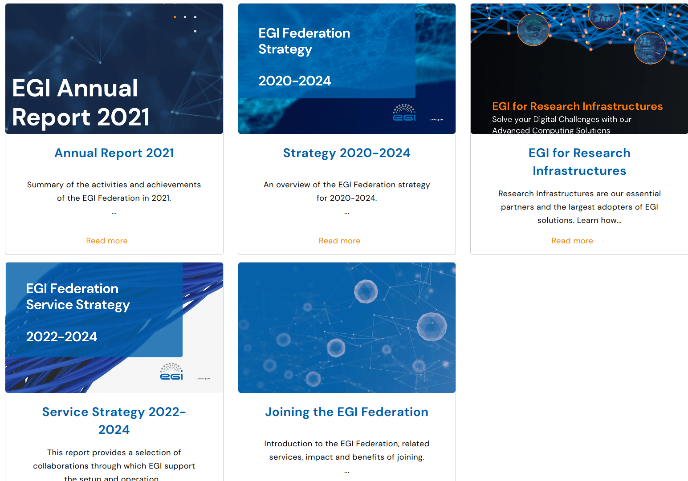
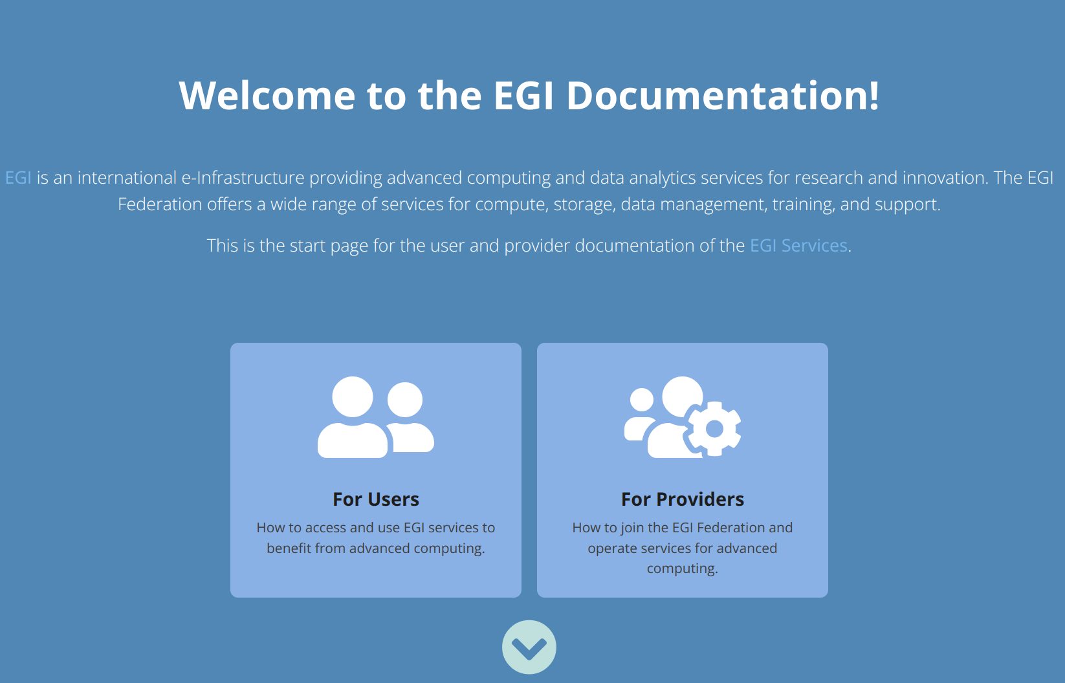
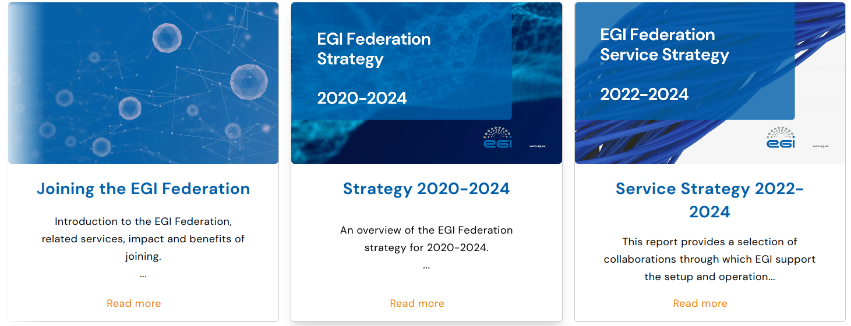
Learn more about EGI
https://www.egi.eu/services/
https://www.egi.eu/publication/
https://docs.egi.eu/

Slide 38

Upcoming EGI Conference
https://www.egi.eu/event/egi2023/
Registration is open!

Slide 39
Thank you!
support@egi.eu

