Slide 1
Distributed cloud computing with EGI services - Hands-on
Giuseppe La Rocca
Community Support Team Lead.
giuseppe.larocca@egi.eu
Agenda: https://indico.egi.eu/event/6087/
TLP: GREEN Limited disclosure
EGI - ACONET Austrian community workshop

Slide 2
Learning objectives
Use the EOSC services to search for datasets of interested and trigger the transfer in the EGI Infrastructure.
Use the EGI Cloud Compute service to run scientific applications

Slide 3
Outline of the hands-on
Move datasets in EGI: the EOSC Data Transfer Portal
Login the EGI Federated Cloud infrastructure
Start your first VM in EGI
Perform data transformation in EGI (with Josef Tata)
Run scientific workflows in EGI with Snakemake

Slide 4
The EOSC Data Transfer Portal
EGI - ACONET Austrian community workshop

Slide 5
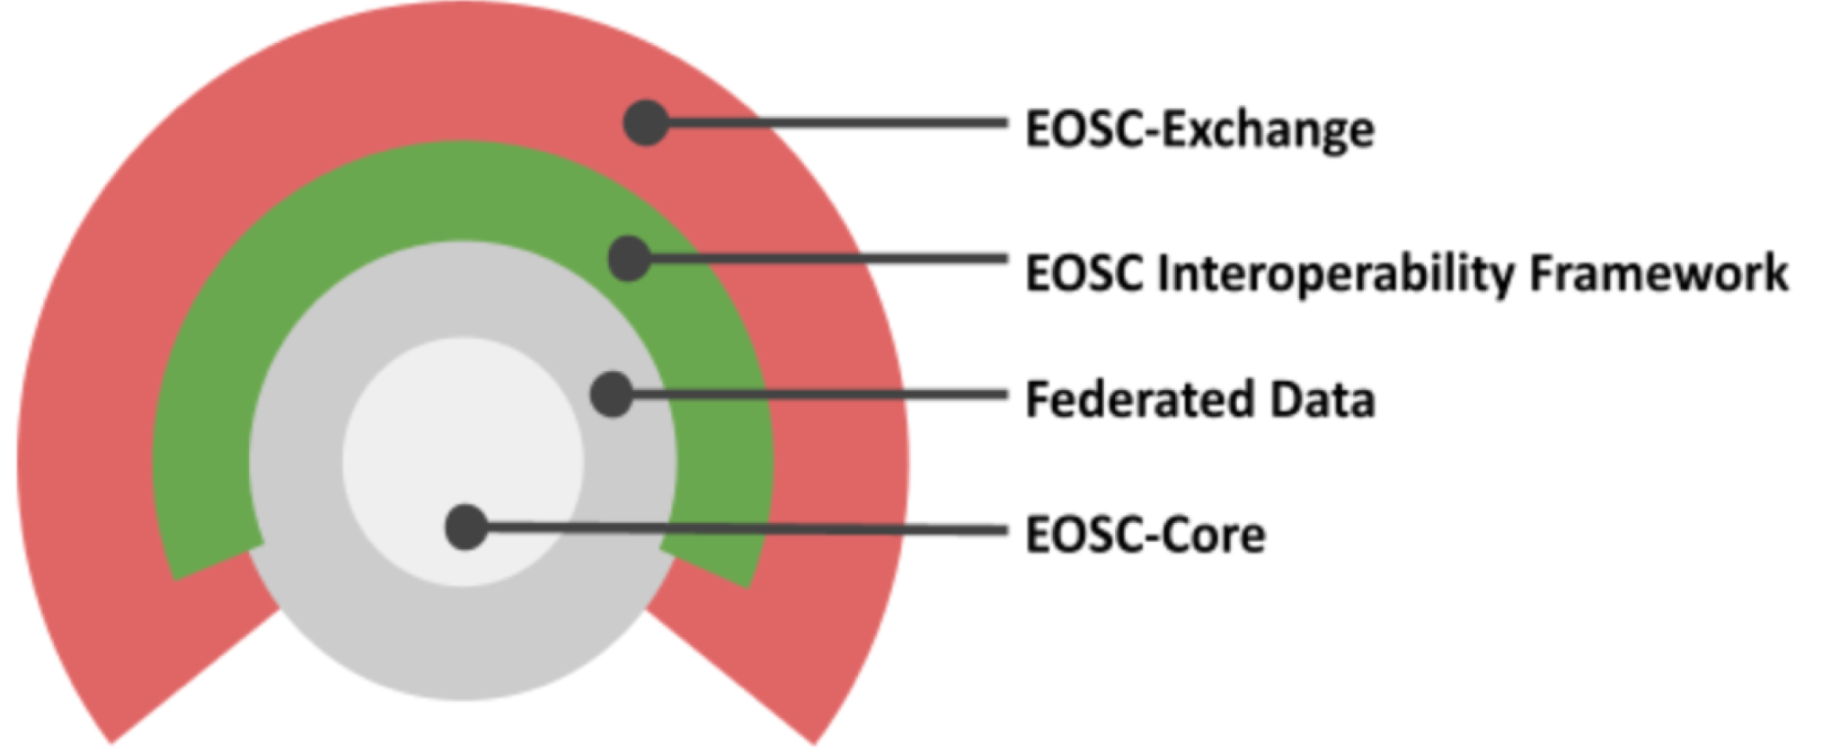
The EOSC Architecture
Processing services (incl. OpenStack, Notebooks)
EOSC Data Transfer service (currently prototype level)
Portal, Marketplace, Rules of Participation, Order Management, Helpdesk, Monitoring, etc.
EOSC Multi-Annual Roadmap 2023-2024 (May 2022)
Tutorial during the #EGI2023 conference
Notes:
Architecture of EOSC (Core + Data + Services that can understand the data) 1st Core Data management service in EOSC: Data Transfer Aim: Be able to stage ‘onboarded’ data (files) to ‘onboarded) services (processors)

Slide 6
EOSC Data Transfer
What we will see in this demo:
1.) Use the EOSC Marketplace to find a dataset
2.) Get the DOI of the dataset to be transferred
3.) Click on the dataset and open the EOSC Explore interface
4.) Select the settings for the data transfer
5.) Initiate the data transfer
6.) Use the AWS CLI to check the files transferred to the destination

Slide 7
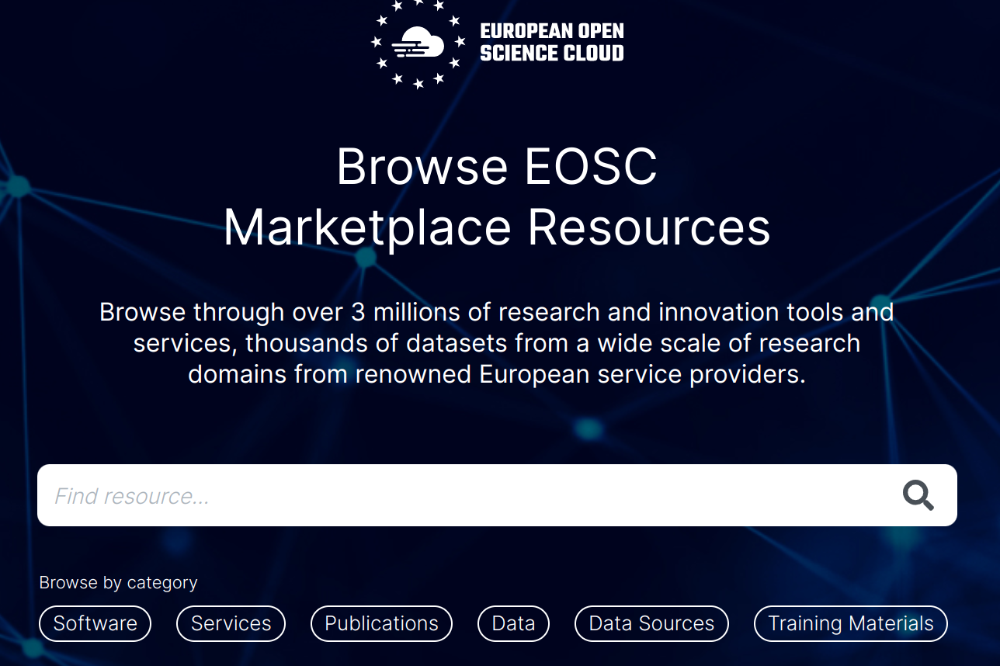
EOSC Data Transfer
1.) Find the dataset in the EOSC Marketplace
Access the EOSC Marketplace: https://marketplace.eosc-portal.eu/
Select Data as “Category”

Slide 8
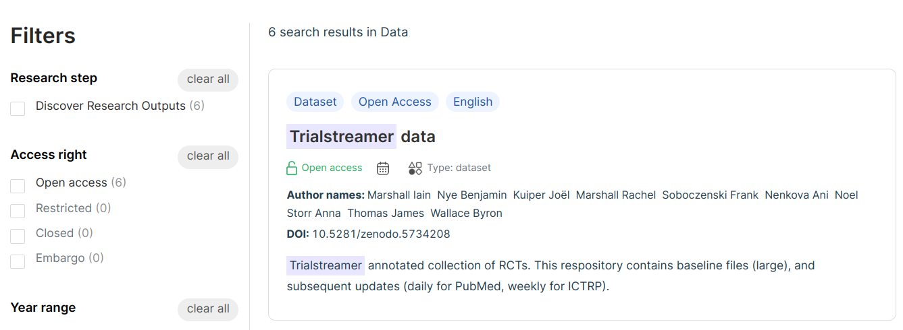
EOSC Data Transfer
2.) Get the dataset to be transferred (e.g.: Trialstreamer)
DOI: 10.5281/zenodo.5734208

Slide 9
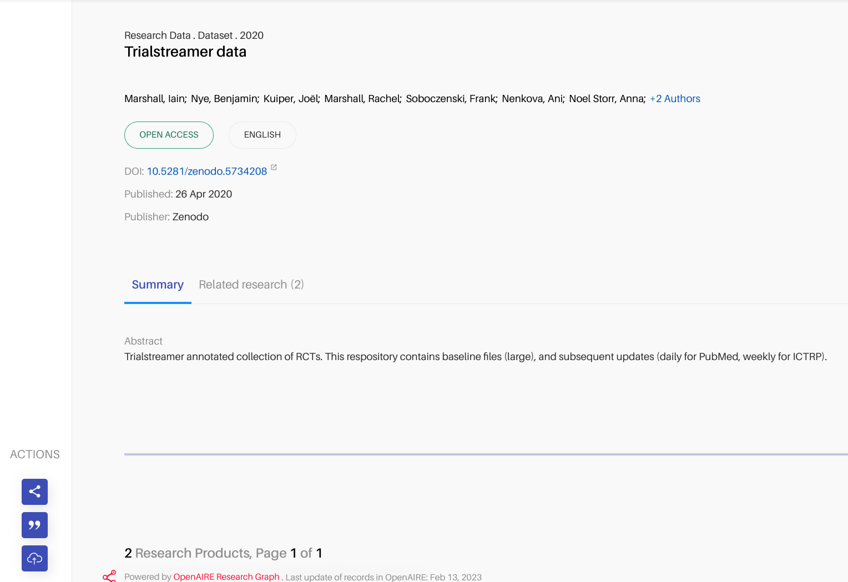
EOSC Data Transfer
3.) Click on the dataset to access the file in the EOSC Explorer
WARNING - Datasets must be stored in Zenodo! - S3 support in EOSC Data Transfer portal is not fully working. It will be available in production in May 2023.

Slide 10
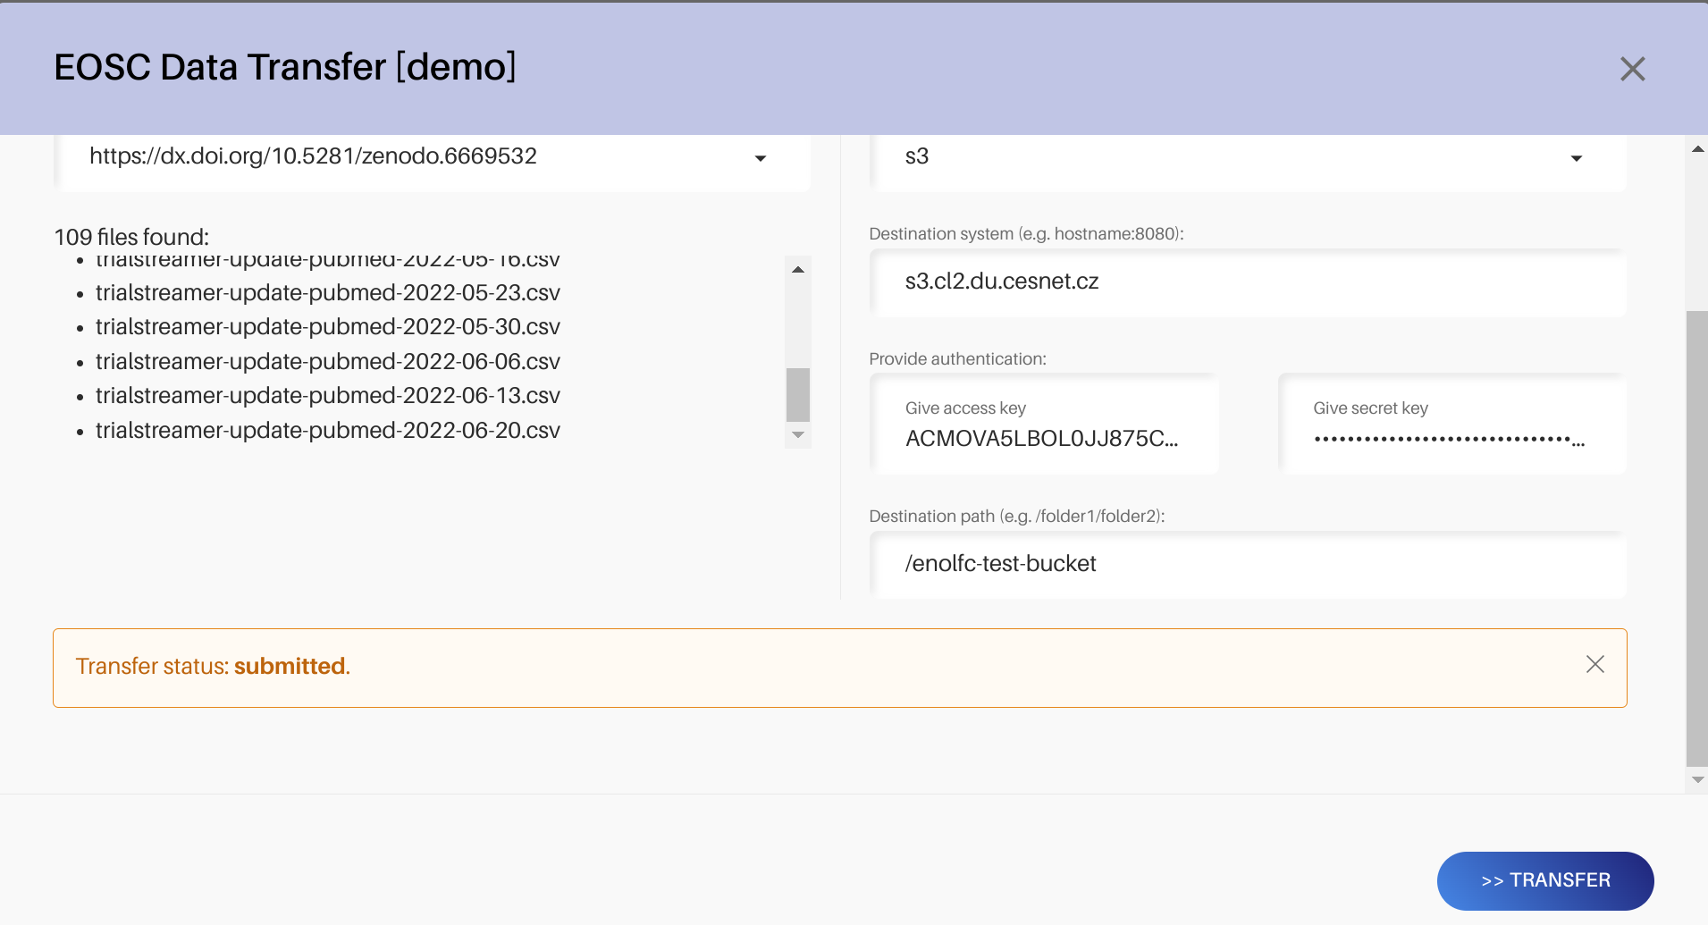
EOSC Data Transfer
4.) Start the data transfer using the dev instance
5.) Click on “Transfer” to initiate the data transfer

Slide 11
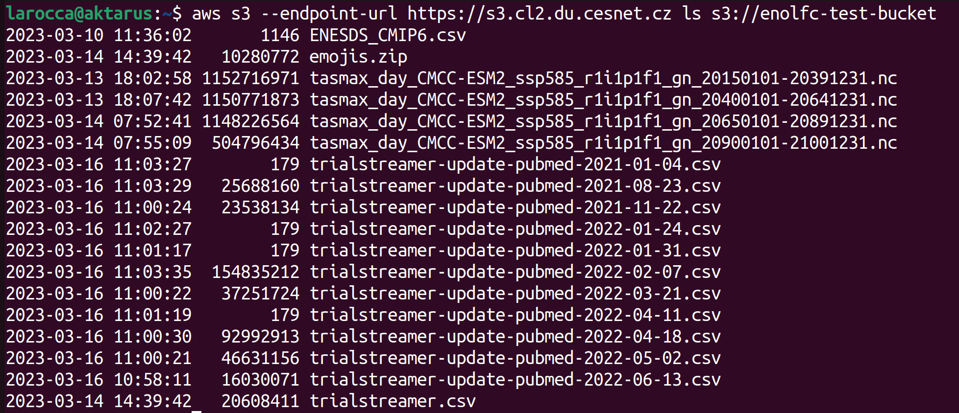
EOSC Data Transfer
6.) Use the AWS client to check the files transferred in the S3 bucket

Slide 12
Access the EGI Fedcloud Infrastructure
EGI - ACONET Austrian community workshop

Slide 13
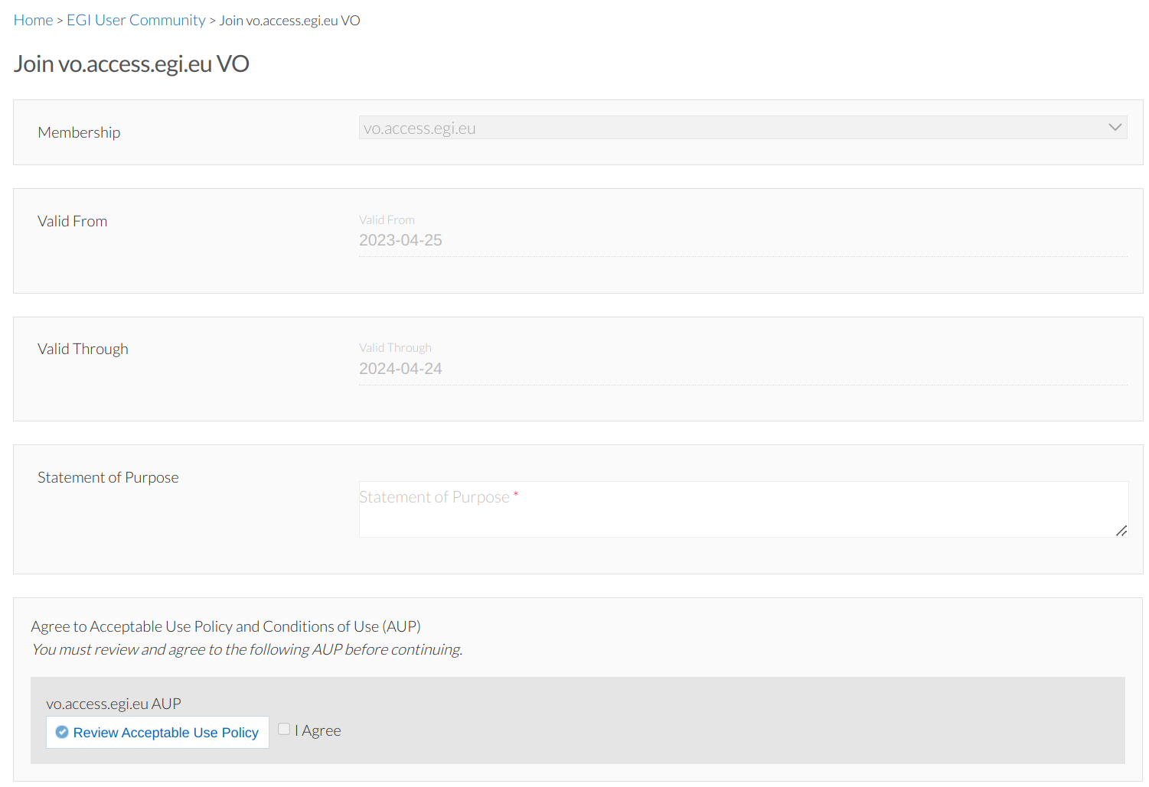
Sign-up and join the resource pool for the workshop
Sign-up (https://aai.egi.eu/signup) for an EGI Check-In account
Subscribe the vo.access.egi.eu Virtual Organisation (VO) by visiting the enrollment URL (https://go.egi.eu/4pnU7) with your EGI Check-In account.
The subscription requires approval from the VO Manager.

Slide 14
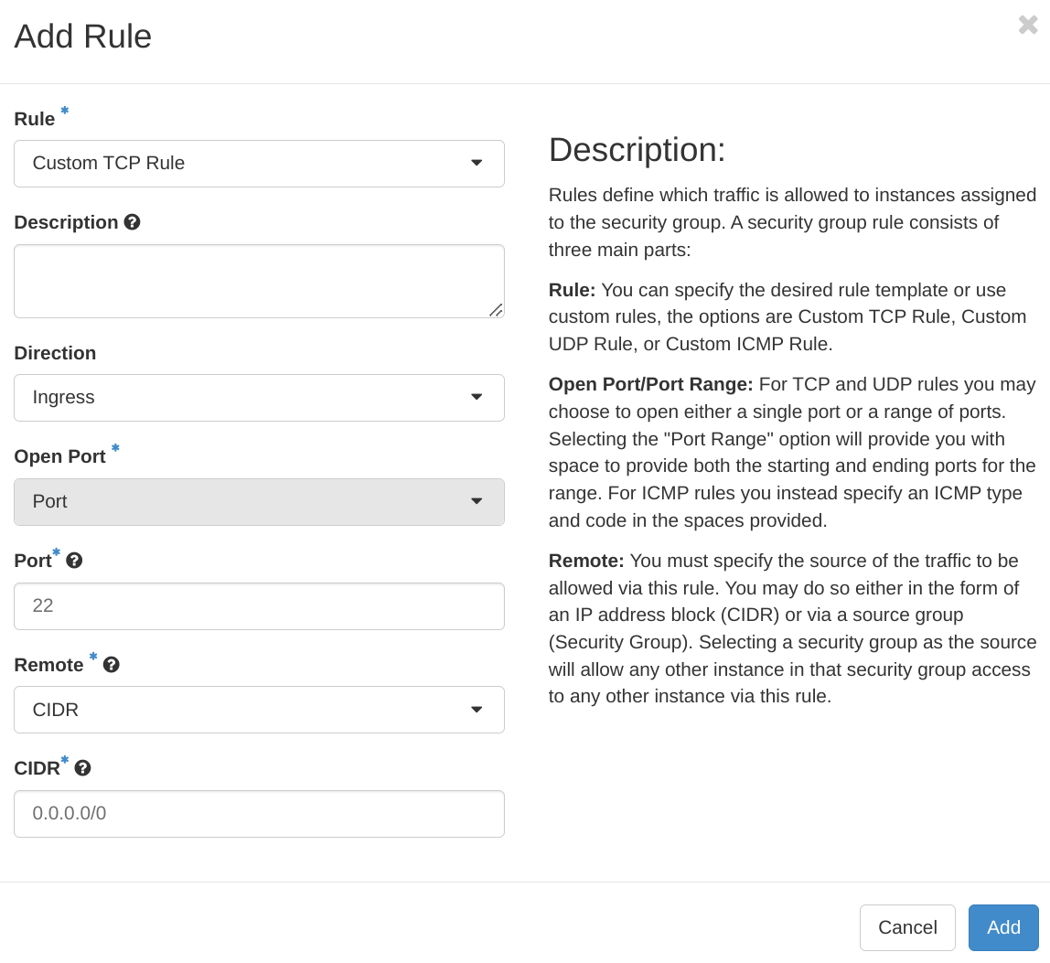
Configure the Security Group
Click on Network > Security Group
Click on Manage Rules and add a new Port to enable connection on port 22

Slide 15
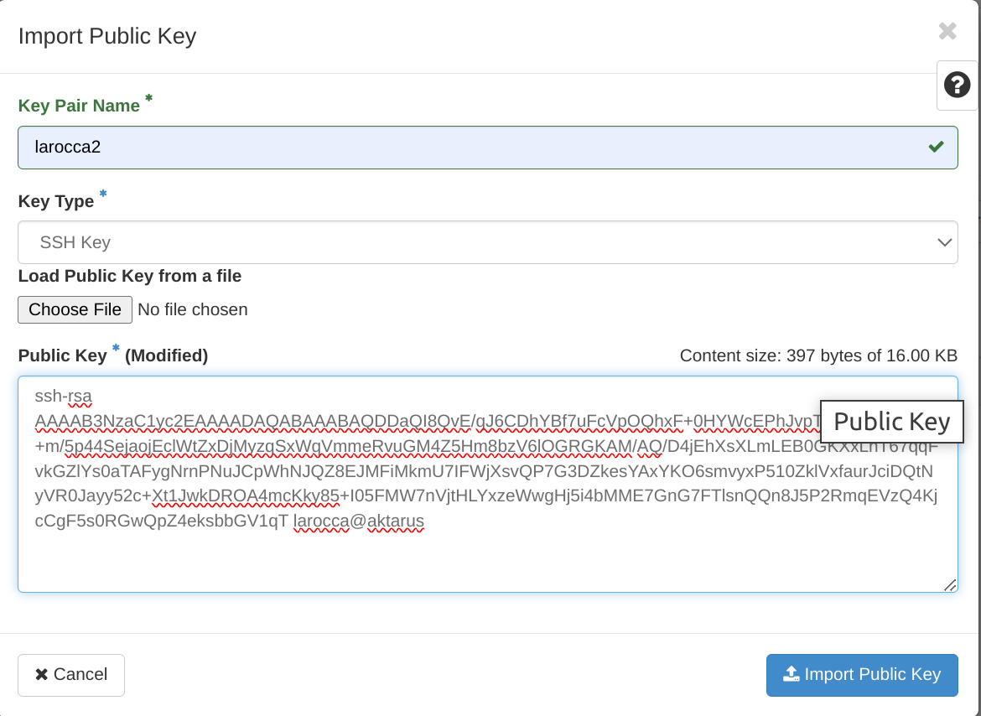
Configure your Key Pair
Click on Key Pair to import your SSH Public key

Slide 16
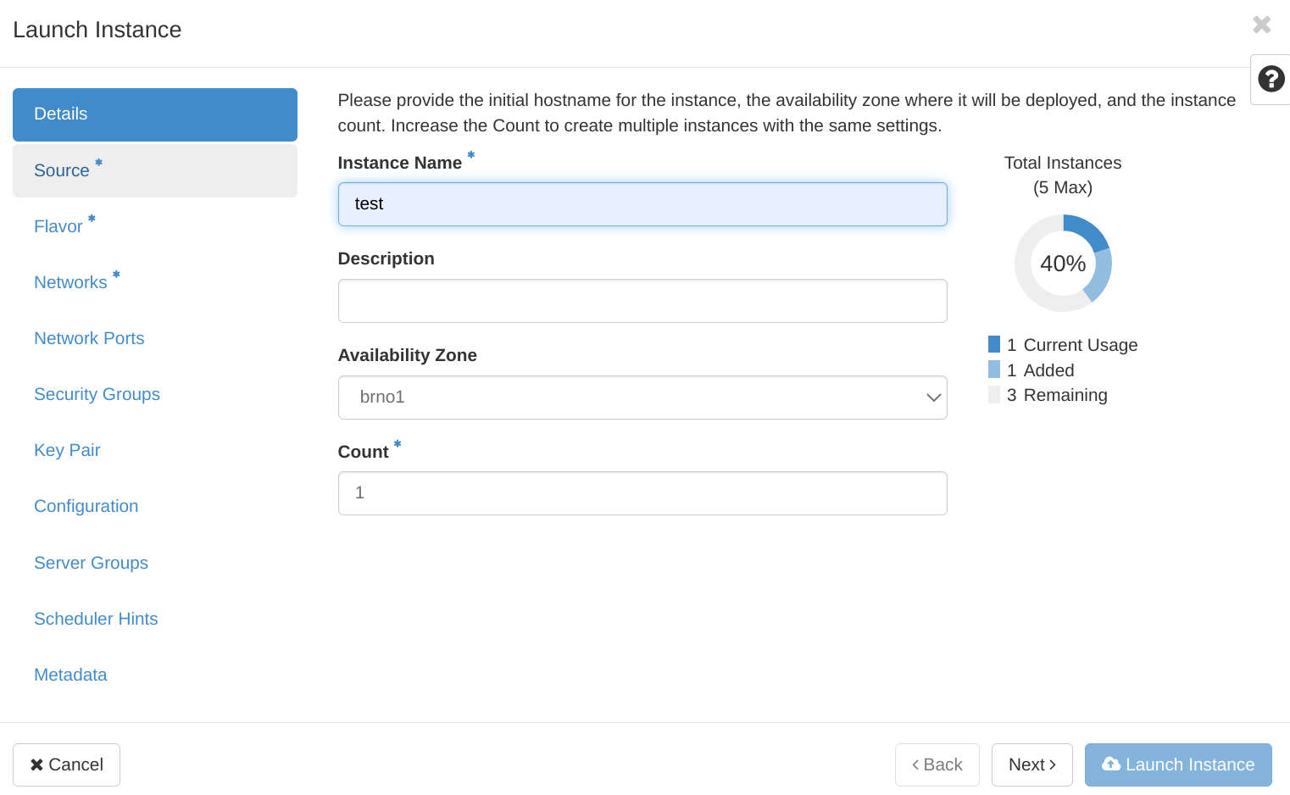
Launch your first VM
Click on Compute > Instances > Launch Instance

Slide 17
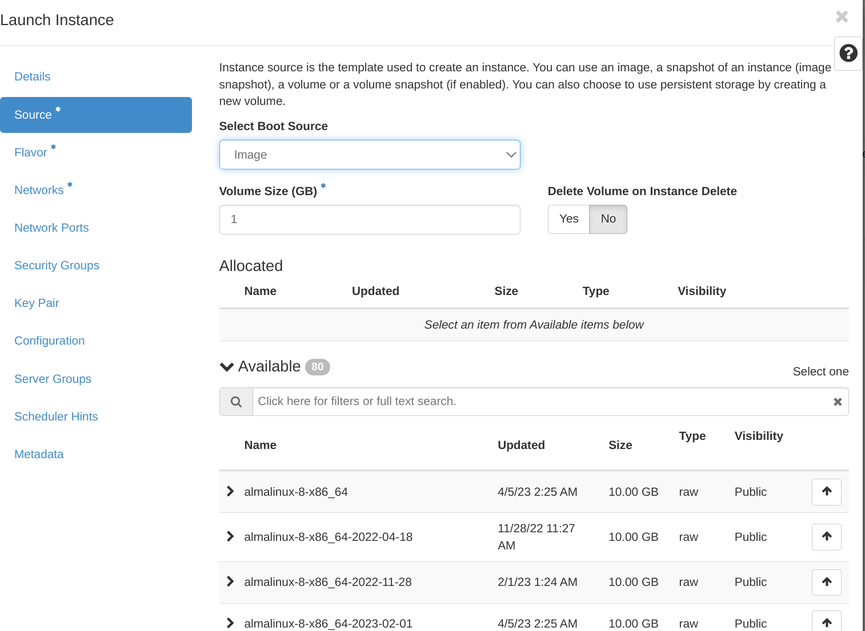
Launch your first VM (cont.)
Select as Source: Image and select one of the available image

Slide 18
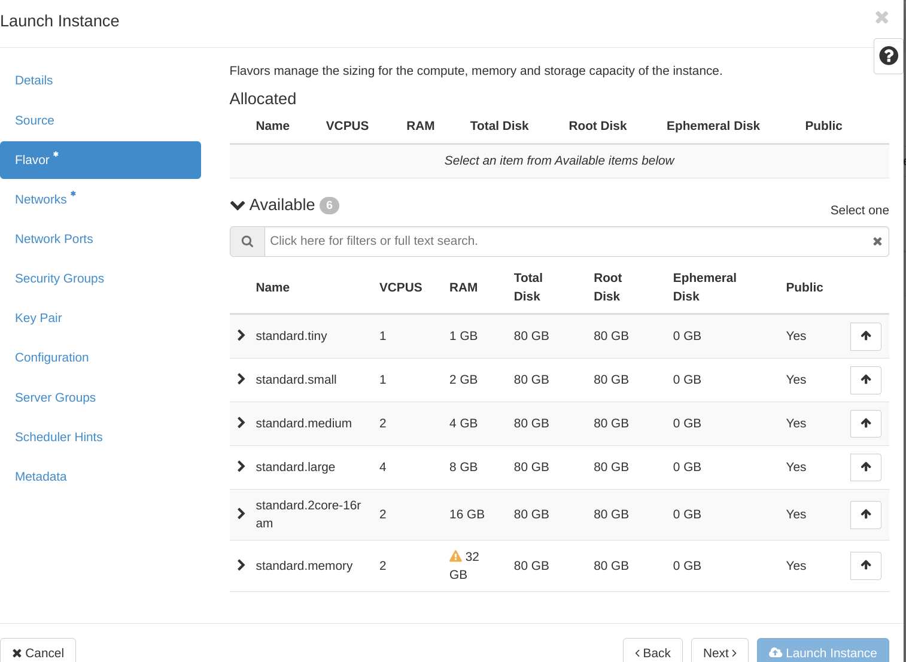
Launch your first VM (cont.)
Select as Flavor: standard.small

Slide 19
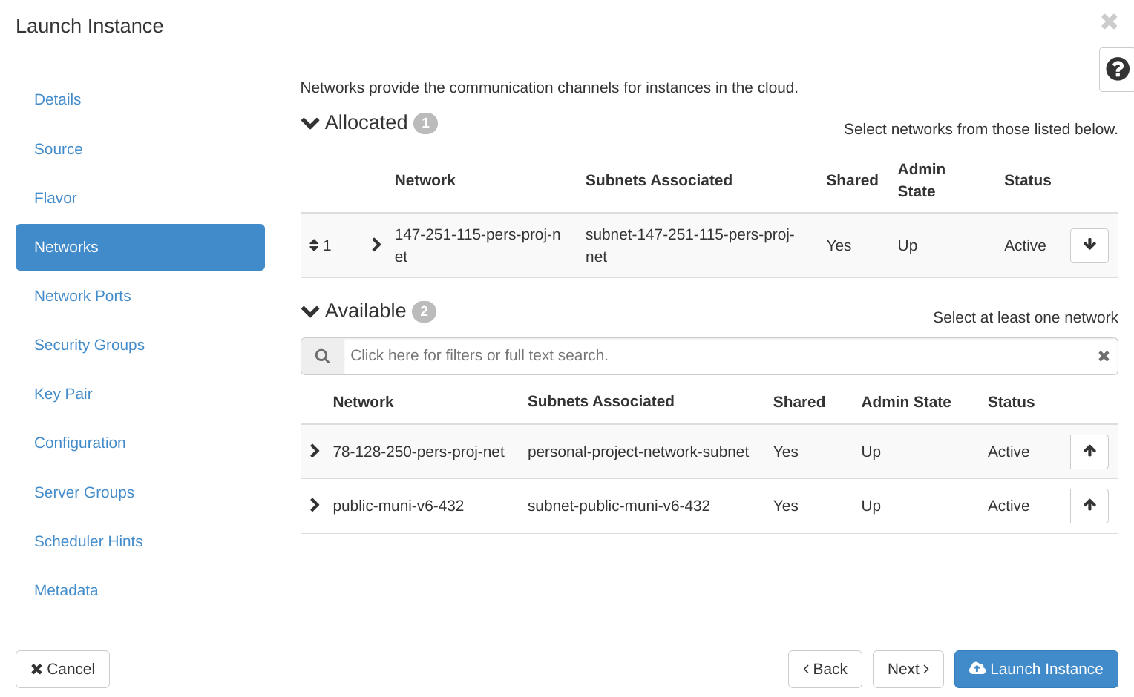
Launch your first VM (cont.)
Select as Networks: 147-251-115-pers-proj-net

Slide 20
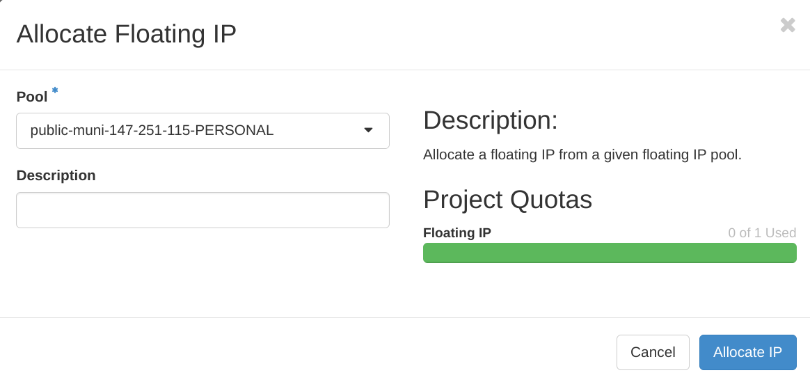
Launch your first VM (cont.)
Assign a Floating IP selecting as Pool: public-muni-147-251-115-PERSONAL
Connecting to the running VM:
]$ ssh -o ServerAliveInterval=15 -o ServerAliveCountMax=3 ubuntu@<PUBLIC_IP>

Slide 21
Running workflows with Snakemake
Mature workflow management system.
Great community around it.
Easy to learn? :)
Snakemake integrates with the package manager Conda and the container engine Singularity such that defining the software stack becomes part of the workflow itself.
https://snakemake.readthedocs.io

Slide 22
Login EGI FedCloud Infrastructure: Summary
Access the cloud-based resources at CESNET-MCC via the OpenStack Horizon dashboard:
URL: https://dashboard.cloud.muni.cz/
Authenticate with: EGI Check-in
Project name: <YOUR_USERID>
Security Group:
Default: Add ingress traffic to port 22 (SSH)
Click on Compute > Instances to launch your first instance
Key Pair:
Configure your Key Pair before to launch your VM
Use the following Network ID:
Use: 147-251-115-pers-proj-net
Select: public-muni-147-251-115-PERSONAL (to assign a floating IP)
]$ ssh -o ServerAliveInterval=15 -o ServerAliveCountMax=3 ubuntu@<PUBLIC_IP>

Slide 23
Install Snakemake with conda (and mamba)
# Create a working directory
]$ mkdir working-dir
]$ cd working-dir/
# Install conda
]$ wget https://repo.anaconda.com/miniconda/Miniconda3-latest-Linux-x86_64.sh
]$ bash Miniconda3-latest-Linux-x86_64.sh -b -p conda-install
]$ source conda-install/etc/profile.d/conda.sh
]$ conda install mamba -c conda-forge --yes
# Install snakemake
]$ mamba create -c bioconda -c conda-forge -n snakemake snakemake-minimal --yes
]$ conda activate snakemake

Slide 24
Install examples
# Clone repo and install examples
]$ git clone
https://github.com/c-scale-community/c-scale-tutorial-snakemake.git
]$ ls examples/
Snakefile-1 Snakefile-3 Snakefile-6 Snakefile-8b Snakefile-10 Snakefile-4 Snakefile-7 Snakefile-9 Snakefile-2 Snakefile-5 Snakefile-8a count_countries.yaml other-countries.txt European-countries.txt number-of-countries.txt

Slide 25
Running workflows with Snakemake
Snakemake follows the GNU Make paradigm: workflows are defined in terms of rules that define how to create output files from input files.
Snakefile-1
rule count_countries:
input:
"european-countries.txt"
output:
"number-of-countries.txt"
shell:
"wc --lines european-countries.txt > number-of-countries.txt"
$ cat european-countries.txt
Netherlands
Greece
Spain
Portugal
Italy
Poland
Austria
count_countries.yaml
name: count_countries
channels:
- conda-forge
- defaults
dependencies:
- coreutils
The application of a rule to generate a set of output files is called job
]$ cd c-scale-tutorial-snakemake/examples/
]$ snakemake --snakefile Snakefile-1 --cores 1 count_countries

Slide 26
Running workflows with Snakemake
Snakefile-1
rule count_countries:
input:
"european-countries.txt"
output:
"number-of-countries.txt"
shell:
"wc --lines european-countries.txt > number-of-countries.txt"
$ cat european-countries.txt
Netherlands
Greece
Spain
Portugal
Italy
Poland
Austria
Belgium
Snakemake only re-runs jobs if one of the input files is newer than one of the output files or one of the input files will be updated by another job.
If nothing has changed:
Building DAG of jobs…
Nothing to be done (all requested files are present and up to date).
Complete log: .snakemake/log/2023-04-21T161630.730444.snakemake.log

Slide 27
Running workflows with Snakemake
Generalize the rule
Snakefile-2
rule count_countries:
input:
"european-countries.txt"
output:
"number-of-countries.txt"
shell:
"wc --lines {input} > {output}"
$ cat european-countries.txt
Netherlands
Greece
Spain
Portugal
Italy
Poland
Austria
]$ cd c-scale-tutorial-snakemake/examples/
]$ snakemake --snakefile Snakefile-2 --cores 1 count_countries

Slide 28
Running workflows with Snakemake
Adding more rules
Snakefile-4
rule pre_processing:
input:
"number-of-countries.txt"
output:
"pre-processing.done"
shell:
"touch pre-processing.done"
rule count_countries:
input:
"european-countries.txt",
"other-countries.txt"
output:
"stats/number-of-countries.txt"
shell:
"mkdir -p ./stats; wc --lines {input} > {output}"
$ cat european-countries.txt
Netherlands
Greece
Spain
Portugal
Italy
Poland
Austria
$ cat other-countries.txt
US
Canada
]$ cd c-scale-tutorial-snakemake/examples/
]$ snakemake --snakefile Snakefile-4 --cores 1 <targets>

Slide 29
Running workflows with Snakemake
Configuration
Snakefile-5
$ cat config.yaml
european: './european-countries.txt'
other: './other-countries.txt'
configfile: "config.yaml"
rule count_countries:
input:
expand("{input}", input=config['european']),
expand("{input}", input=config['other'])
output:
"stats/number-of-countries.txt"
shell:
"mkdir -p ./stats; wc --lines {input} > {output}"
$ cat european-countries.txt
Netherlands
Greece
Spain
Portugal
Italy
Poland
Austria
$ cat other-countries.txt
US
Canada
]$ cd c-scale-tutorial-snakemake/examples/
]$ snakemake --snakefile Snakefile-5 --cores 1 count_countries

Slide 30
Running workflows with Snakemake
Logging
Snakefile-6
$ cat european-countries.txt
Netherlands
Greece
Spain
Portugal
Italy
Poland
Austria
configfile: "config.yaml"
rule count_countries:
input:
expand("{input}", input=config['european']),
expand("{input}", input=config['other'])
output:
"stats/number-of-countries.txt"
log:
"logs/count_countries.log"
shell:
"mkdir -p ./stats; mkdir -p ./logs; wc --lines {input} > {output}"
$ cat other-countries.txt
US
Canada
]$ cd c-scale-tutorial-snakemake/examples/
]$ snakemake --snakefile Snakefile-6 --cores 1 count_countries

Slide 31
Running Copernicus workflow with Snakemake
Snakefile
rule download_data:
input:
output:
"data/input.zip"
conda:
"envs/download_data.yml"
log:
"logs/download_data.log"
shell:
"""
wget --output-document data/input.zip \ https://github.com/c-scale-community/c-scale-tutorial-snakemake/raw/main/data/f610d7aa9b4c715ad9ddacf0b057b95e6f4a1cdc.zip
"""

Slide 32
Running Copernicus workflow with Snakemake
Snakefile
rule unzip_data:
input:
"data/input.zip"
output:
"data/u2000_clc1990_v2020_20u1_raster100m/DATA/U2000_CLC1990_V2020_20u1.tif"
conda:
"envs/unzip_data.yml"
log:
"logs/unzip_data.log"
shell:
"""
cd data
unzip input.zip
unzip u2000_clc1990_v2020_20u1_raster100m.zip
"""

Slide 33
Running Copernicus workflow with Snakemake
Snakefile
rule plot_data:
input:
"data/u2000_clc1990_v2020_20u1_raster100m/DATA/U2000_CLC1990_V2020_20u1.tif"
output:
"plot/output.png"
conda:
"envs/plot_data.yml"
log:
"logs/plot_data.log"
shell:
"""
cd plot
python clc_plot.py
"""
]$ cd c-scale-tutorial-snakemake
]$ snakemake -c1 download_data --use-conda --conda-frontend mamba
]$ snakemake -c1 unzip_data --use-conda --conda-frontend mamba
]$ snakemake -c1 plot_data --use-conda --conda-frontend mamba

Slide 34
Thank you!
Q & A

