Slide 1
OMB Oct 2023
Matthew Viljoen,
Operations Manager
EGI Foundation

Slide 2
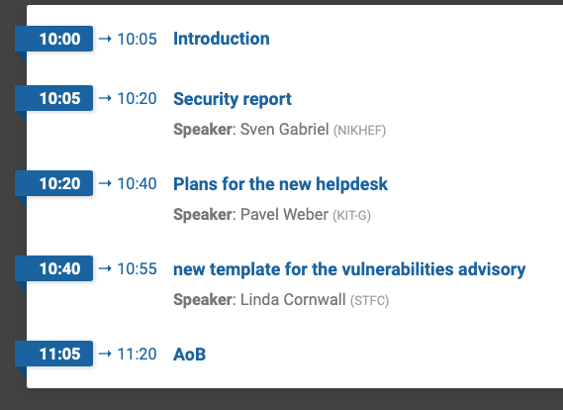
Agenda

Slide 3
Deployment of new benchmark HEPscore23
The benchmark HEPscore23 is replacing HEPSPEC06
New version of APEL client compliant with HEPScore23 to be released in UMD
Testing on the central repository the aggregation of the accounting records and by benchmarks
To monitor the move of resources to the new benchmark over the time
The Accounting Portal will implement the change afterwards
Investigating an issues preventing the staging Accounting Portal instance to retrieve the accountin records via the Message Service
Created Instructions for the sites for updating the apel client and use the new benchmark

Slide 4
Transition from X509 to federated identities
Focussing on the computing elements
The Check-in team released a plugin for the CEs allowing the Check-in/AARC token profile to work
The HTCondor team set-up an upgrade procedure to help sites and VOs with the migration from X509 personal certificates to tokens.
Created an intermediate step where the plain SSL authentication (X509) can be used to authenticate a client' proxy, in addition to the VOMS-based or to the token-based one
Agreed with WLCG to start with the upgrade/migration campaign when the LHC Heavy-Ion has finished (by the end of October
Waiting also for the new HTCondorCE version (9.0.19) included in UMD
ARC-CE can still work with both VOMS and token authz

Slide 5
DPM decommissioning campaign
Started in Sept 2022
DPM support ended in June 2023
CERN takes care of security fix until June 2024
57 sites involved
Most of the sites migrated to dCache, EOS, xrootd.
The rest will complete it either by the end 2023 or beginning of 2024

Slide 6
Next Linux distribution to use
See also September GDB agenda: https://indico.cern.ch/event/1225116/
All EL9 variants are deemed compatible with each other
Alma 9 (AL9) aims to remain ABI compatible with RHEL9
Rocky 9 (RL9) continues being exact rebuilds for now
CentOS 9 is discouraged because of questionable support
CERN and possibly FNAL will look into Debian as a future alternative.
Some discussions at the Hepix workshop last week

Slide 7
Next OMB
21 Dec (provisional)
To be confirmed on ML

