Slide 1
EOSC Beyond Consortium Agreement
Consultation meeting
Tiziana Ferrari
13-12-2023
EGI Foundation
Consortium Meeting
TLP: AMBER Internal Use
EOSC Beyond Project Consortium Parties

Slide 2
Objectives of the meeting
Subtitle
About Lump Sum Projects and related risks
Recommendations from the DESCA group
Discussion

Slide 3
Lump Sum Projects and related risks
Definition of accepted budget in an incomplete WPs

Slide 4
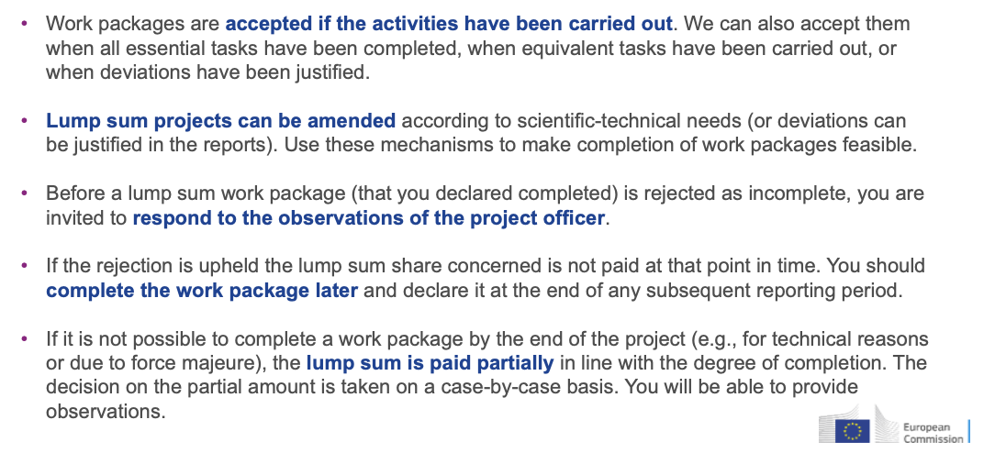
Acceptance of work packages

Slide 5
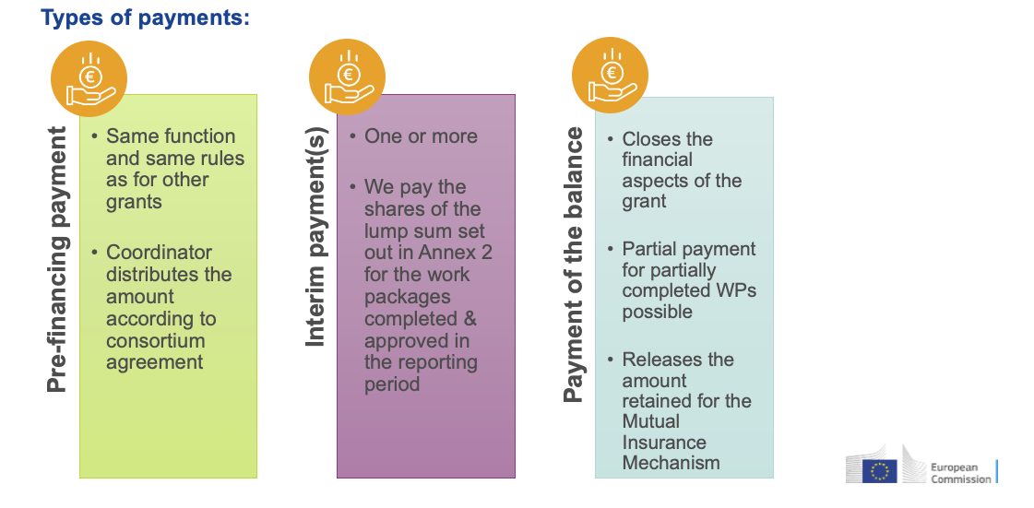
Payment schedule

Slide 6
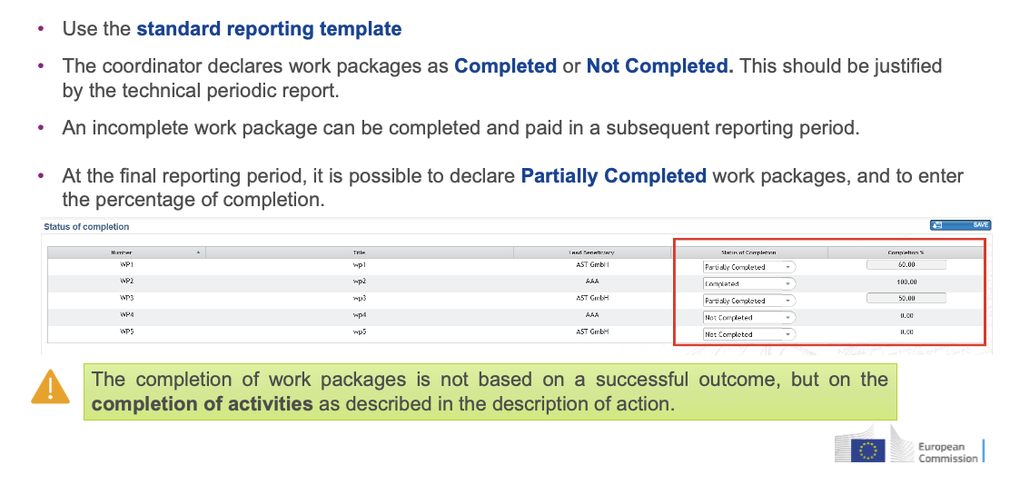
Reporting and payment

Slide 7
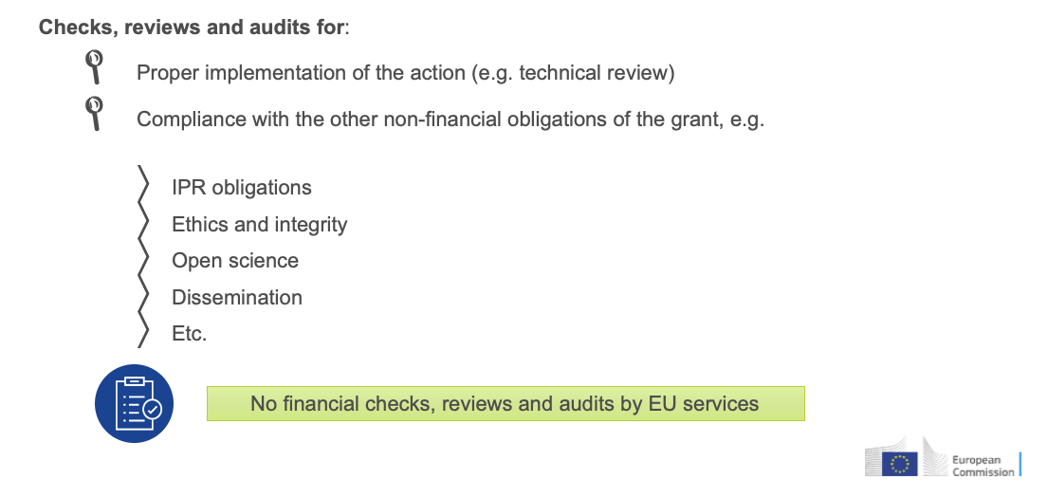
Ec-post controls

Slide 8
Definition of budget – Annex 2
How to define the ‘partial amount’ of accepted budget in case of incomplete WP?

Slide 9
Definition of budget – Annex 2 (cont)

Slide 10
Dependencies of between deliverables
In LS projects the ability to receive in full the LS contribution of a partner in one WP depends on
the successful completion of all results of the WP
The successful completion of results from other WPs a given WP depends on
An under/no performing party or leaving party in one WP can affect
The timeline of the payment of the other parties of the WP - Incomplete WPs are paid at the end of the project
The ability to receive the full amount due - The lump sum contribution may be paid partially depending on the degree of completion of a WP

Slide 11
Conclusions - budget
Annex 2 does not provide sufficient information in case the cost of a WP is partly accepted
In order to determine the amount of budget which can be accepted within an incomplete WP, is important that the consortium tracks
For each WP, the budget allocated to each WP deliverable
For each deliverable, the participating partners and their respective budget share

Slide 12
Conclusions - Monitoring
It is a vested interest of all parties that costs sustained are paid in full and payments are on time
The degree of completion of a WP needs needs to be monitored
Distribution of payment should take into account progress achieved by parties in contributing to deliverables
It is in the interest of all performing parties that costs sustained are paid in full and payments are on time

Slide 13
DESCA recommendations

Slide 14
Recommendations from DESCA team
DESCA template for LS projects is in draft status and will not be completed in time for the start of EOSC Beyond
DESCA team recommendations
Determine dependencies among partners of the same work package and different work packages to easily determine the distribution of liability for improper implementation
Monitor implementation at WP and project level and determine % of partial completion of a WP, the responsible parties and their % of responsibility
Monitor implementation at WP and project level
Protect the consortium from risks related to recollection of undue payments
Define mechanisms to determine liability in case of termination of a partner within a WP
Manage timeline of payment of leaving members

Slide 15
DESCA Recommendations
Reporting

Slide 16
Recommendations from DESCA team
It is of increased importance to continuously monitor the progress of the implementation of the Project at the level of a Work Package Leader Group (or other equivalent Governance Structure body)
Introduction of ‘Internal Progress Reports’ and ‘Termination Reports’
A Party leaving the consortium shall provide guidance to the other Parties on the tasks originally attributed to them to support the development of alternative solutions for the completion of work packages and a reallocation of tasks via the termination amendment.

Slide 17
Recommendations from DESCA team - Cont

Slide 18
DESCA Recommendations
Governance and monitoring

Slide 19
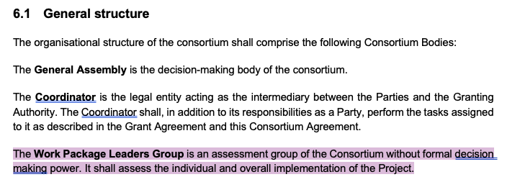
Recommendations from DESCA team - Governance

Slide 20
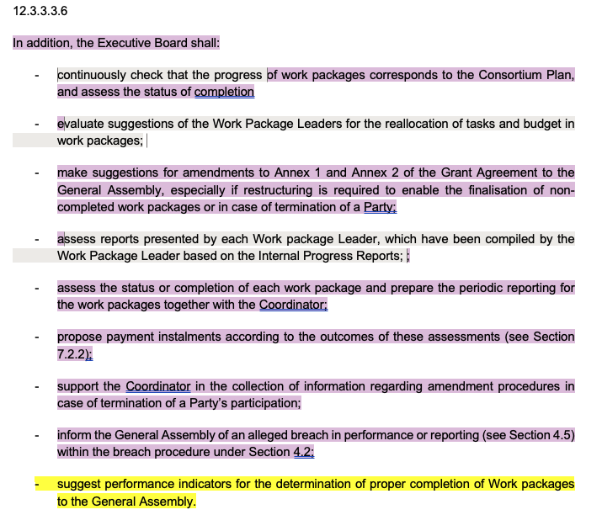
Recommendations from DESCA team - Governance
Executive board
The EB (or equivalent group in the project governance) shall have extraordinary meetings scheduled in order to be able to decide on the individual performance of single beneficiaries in case of termination and non-completion of WPs at final reporting and amendments.
Checking justification of deviations, if any; comparing essential planned tasks with equivalent and alternative tasks, if any; comparing the work package status with performance indicators such as deliverables and milestones;
Reallocation suggestions for reshaping of / shifts between WPs come from the WP leaders (amendment Annex 1 of the Grant Agreement) as well as suggestions for the reallocation of budget shares (amendment of Annex 2 of the Grant Agreement) may become necessary if it appears that a WP cannot be completed as initially planned.

Slide 21
Proposal - Extension to Section 4.2 Breach and Conflict of Interest
In case of partially funded WP or not funded WP, General Assembly identifies a breach and decides on share of responsibility of Parties and distribution of financial penalties upon proposal of the Executive Board (or equivalent body in the project governance)
EB members may have a conflict of interest
According to current DESCA Article 12.2.4 Veto rights, ‘A Party may neither veto decisions relating to its identification to be in breach of its obligations nor to its identification as a Defaulting Party. The Defaulting Party may not veto decisions relating to its participation and termination in the consortium or the consequences of them’
Partners involved in an incomplete WP should not be allowed to participate in decisions that concern Breach

Slide 22
Decision making process
The Parties shall use amicable, good-faith negotiations to agree on the party or parties responsible of no/partial performance and their % of responsibility
Failing an amicable resolution within 14 days of receipt of the relevant quarterly payment by the Lead Entity, the dispute will be referred to a Dispute Review Expert (DRE) - an expert familiar with the Project and contract interpretation, remaining impartial to all Parties.
The DRE's decision on attributions concerning damages, liquidated damages, or price reductions will be non-binding.
Should the Parties fail to agree on a DRE or are unsatisfied with the DRE's decision, or if the DRE doesn't decide within 40 days of the request, any Party may initiate a standard procedure for settlement of disputes

Slide 23
DESCA Recommendations
Funding

Slide 24
DESCA Recommendations - Funding

Slide 25
DESCA Recommendations - Transfer of pre-financing according to installments

Slide 26
DESCA Recommendations - Funding
Transfer of pre-financing according to installments
The General Assembly should agree on the calculation of the excess payment amount. The excess payment amount could be set as the difference between the funding received and the interim amount approved by the Granting Authority minus a fixed percentage of the pre-financing.
The fixed percentage should be agreed by the Parties upfront and allow for a certain but restricted float of money for work package implementation.

Slide 27
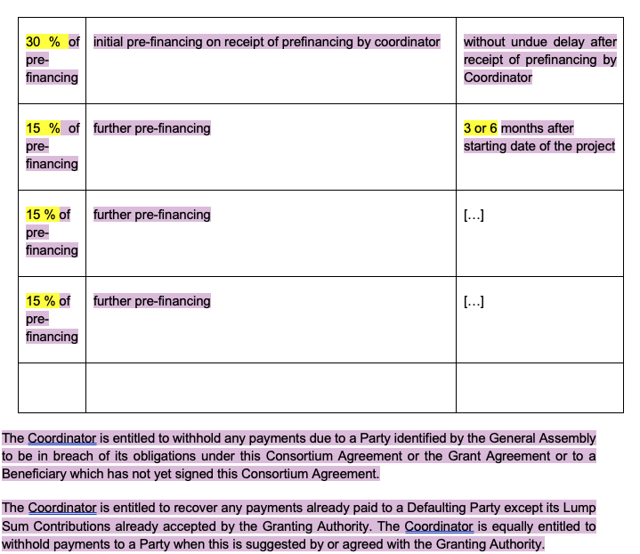
DESCA Recommendations - Transfer of pre-financing according to installments (cont)

Slide 28
Example of internal reporting plan and project financing plan
Reporting period 1: M1-M15
M5: 1st internal progress report
M10: 2nd internal progress report
M15: 3rd internal progress report
Reporting period 2: M16-M30
M20: 4th internal progress report
M25: 5th internal progress report
M30: 6th internal progress report
Mutual Insurance Mechanism: 5%
 | Internal reporting periods | 30% of pre financing | Aggregate funding received | Precondition
First reporting period M1-M15 | 1st internal period M1-M5 | 30% of total pre financing (4 M€) |  | Receipt of pre financing by EC
 | 2nd internal period M6-M10 | 15% | 45% | Upon positive performance assessment
 | 3rd internal period M11-M15 | 15% | 60% | Upon positive performance assessment
Second reporting period M16-M30 | 4th internal period M16-M20 | 15% | 75% | Upon positive performance assessment
 | 5th internal period M21-M25 | 15% | 90% | Upon receipt of 1st interim payment and positive performance assessment
 | 6th internal period M26-M30 | 5% | 95% | Upon positive performance assessment
 | Final payment | 5% | 100% | Upon acceptance of all participated WPs

Slide 29
DESCA Recommendations
Monitoring

Slide 30
Monitoring progress of a WP
DESCA recommends monitoring of status of completion at WP level through checking progress of deliverables and milestones and performance indicators
The Consortium Plan and budget defined in Annex 2 currently do not provide indication of share of funding by milestone and deliverable
The current DESCA template draft does not provide indications on how to manage this information
Proposal
An annex to the CA is created defining for each WP
The cost share of each deliverable/milestone - what is the cost associated to a deliverable/milestone and how much funding should be released in an intermediate payment installment?
The list of partners involved in the production of a deliverable/milestone and their respective share - who is involved in a delayed deliverable?
The dependency of the deliverable/milestone on other deliverables/milestones - who is affected by a delayed deliverable?
For each deliverable/milestone verifiable progress indicators are defined - how do I monitor progress of a WP?

Slide 31
Example 1
WP1 has 1.7 M€ funding, 3 deliverables and 4 parties
 | WP1 D1.1: 800 K€ Depends on: - Means of verification: # of software release | D1.2: 600 K€ Depends on: D1.1 Means of verification: # of workshops organized | D1.3: 300 K€ Depends on: WP2 D2.1 Means of verification:
Beneficiary 1 | 25% | 50% | 0%
Beneficiary 2 | 50% | 25% | 50%
Beneficiary 3 | 25% | 25% | 0%
Beneficiary 4 | 0% | 0% | 50%

Slide 32
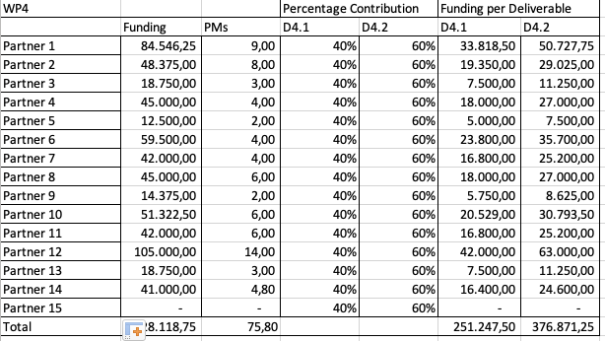
Example 2 applied to a real project WP

Slide 33
Financial monitoring
Not requested by the EC anymore, the consortium can decide to adopt internal financial reporting if useful to the action implementation
+ Simplification of reporting procedures
- Issues
No easy way to fund project extensions with budget
No unspent budget to be reallocated to fund deviations in the work plan, for example, a party contributing to a deliverable ‘over budget’ has no way of getting compensation unless another party voluntarily gives up budget
Does the consortium support/not support keeping internal financial reporting?

Slide 34
Discussion

Slide 35
Proposed approach for discussion
Governance
Align with DESCA governance, monitoring and funding distribution approach ⇒ Adoption of periodic internal reports (e.g. every 5 months) and terminating reports. Is the 5 month reporting period acceptable?
Use of a Dispute Review Expert (DRE). Do you consider the DRE an advantageous dispute resolution approach compared to mediation and arbitration in case of disagreement with a GA resolutions on responsibility in case of no/partial performance?
Monitoring
Introduce interim report and terminating reports. Is the approach accepted?
Develop a detailed activity and budget plan expanding Annex 1 and Annex 2:
Dependencies among deliverables (within and across WPs), WP funding share per deliverable, partner’s share per deliverable, progress verification means per deliverable/milestone. Is the proposed methodology accepted?
Finance
Funding distribution: 30% of pre-financing followed by further periodic installments. Is proposal acceptable?
Financial monitoring: do you support/not support internal financial monitoring?

