Slide 1
SOCIB's DTO prototypes in the Balearic Sea:
DTO for coastal flooding and erosion
SOCIB Team
Angels Fernandez-Mora
20 March 2024
Palma, Spain

Slide 2
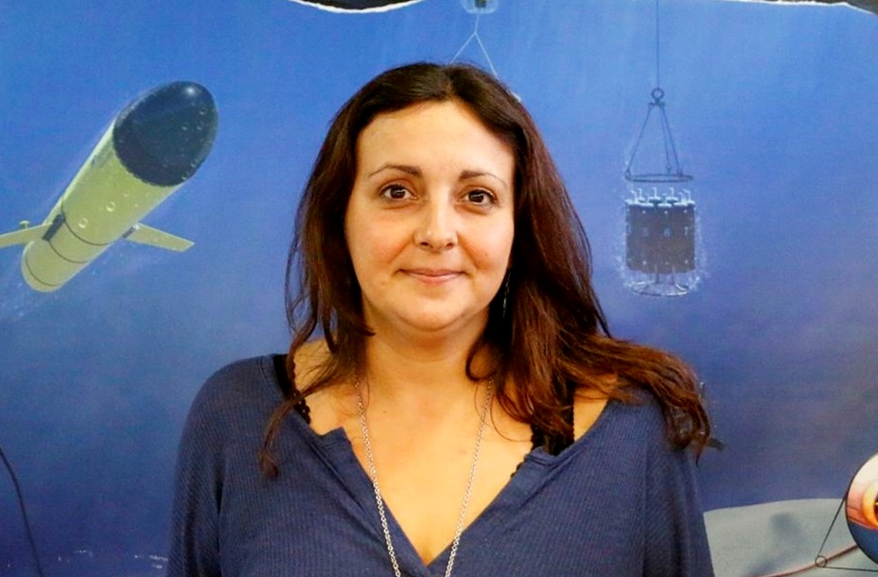
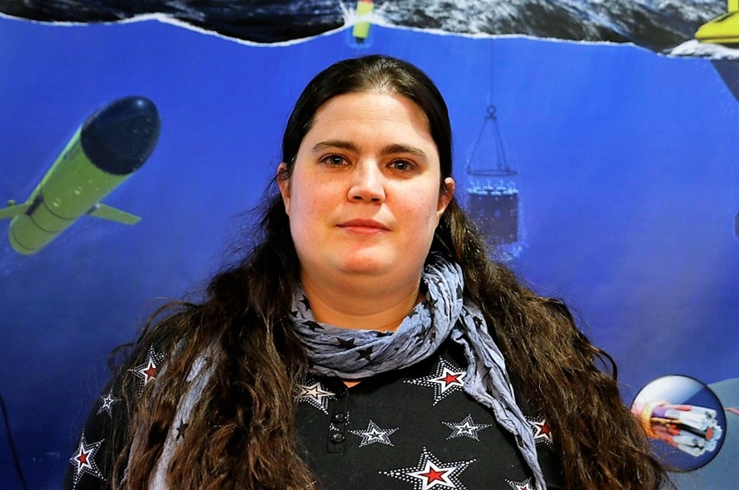
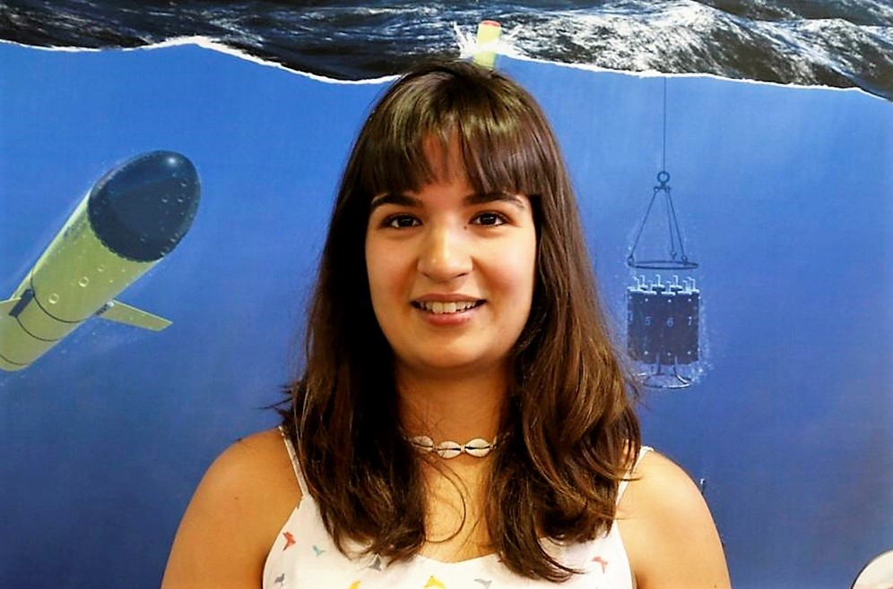
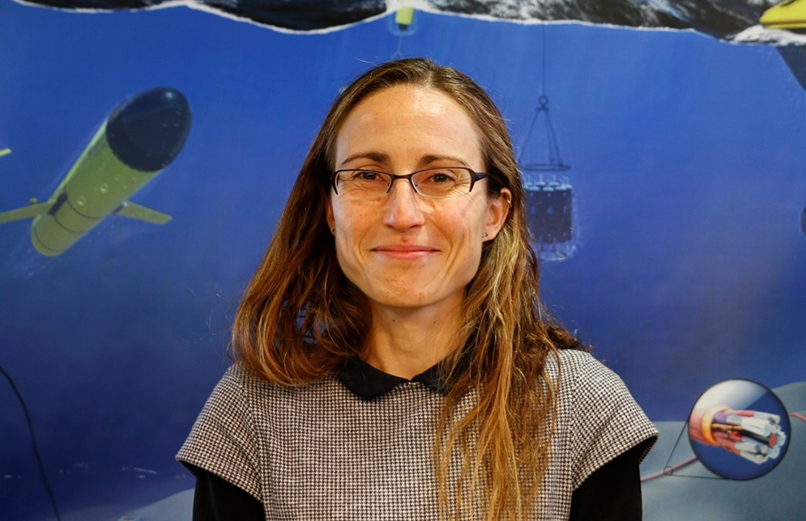
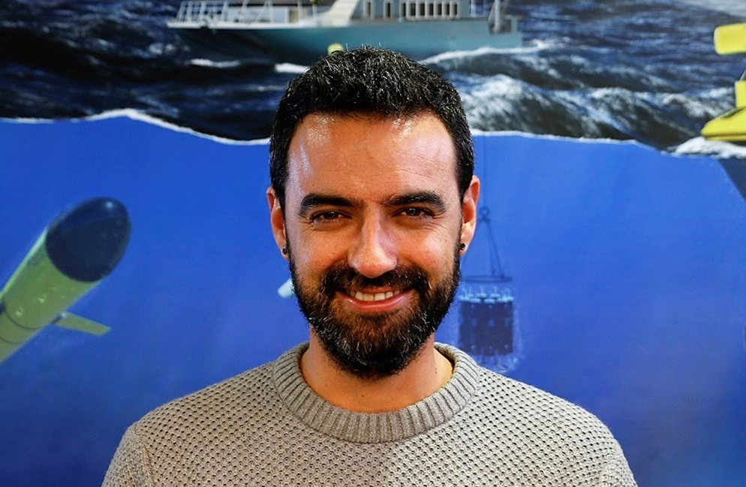
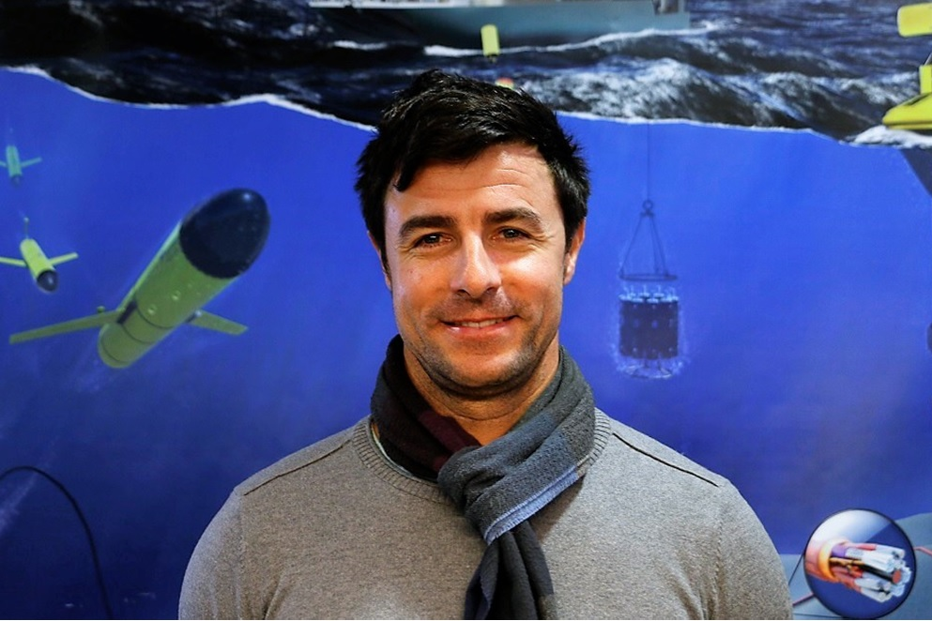
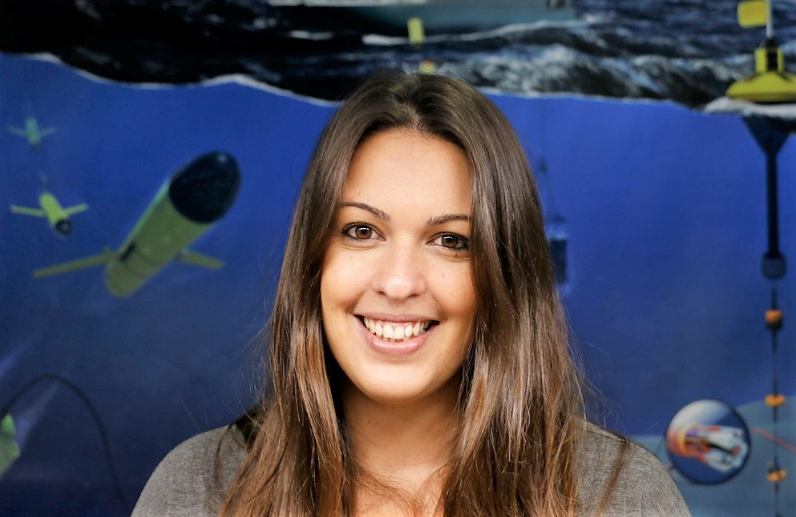
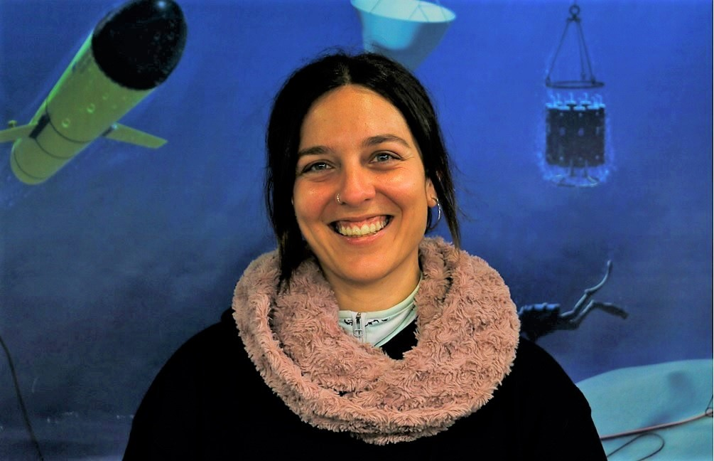
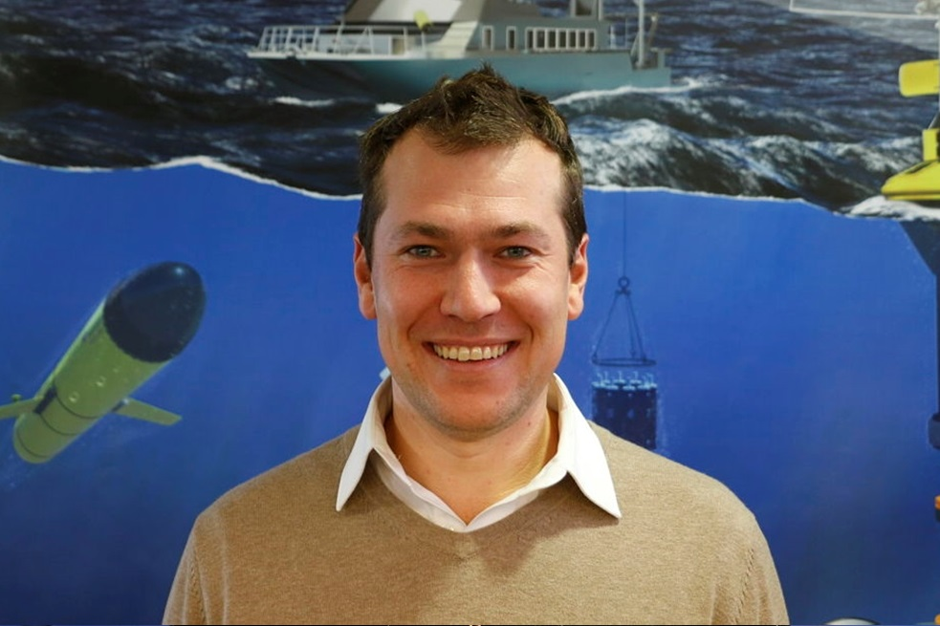
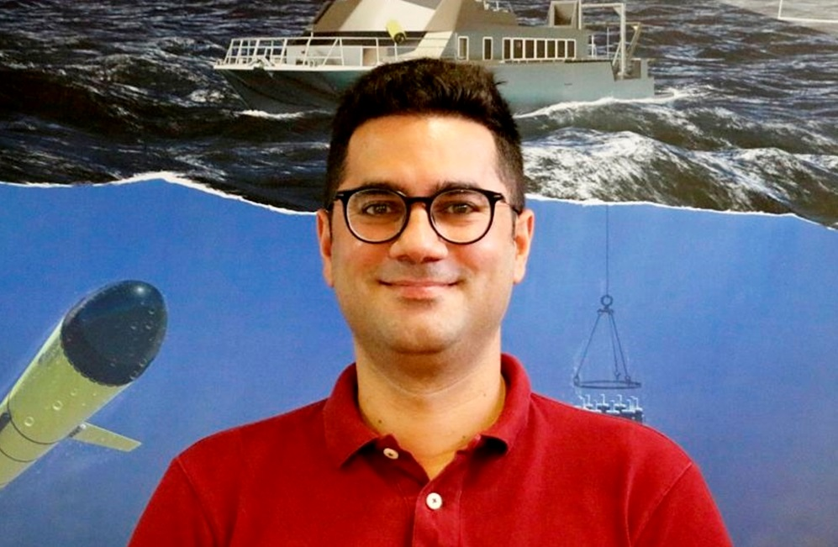
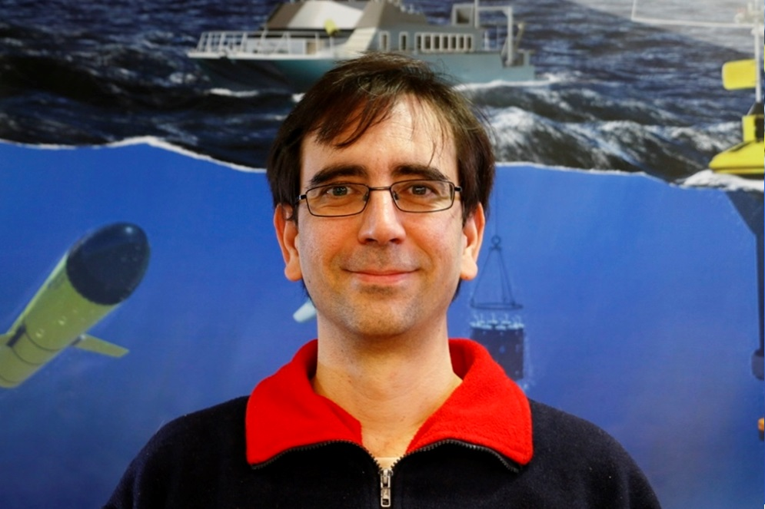
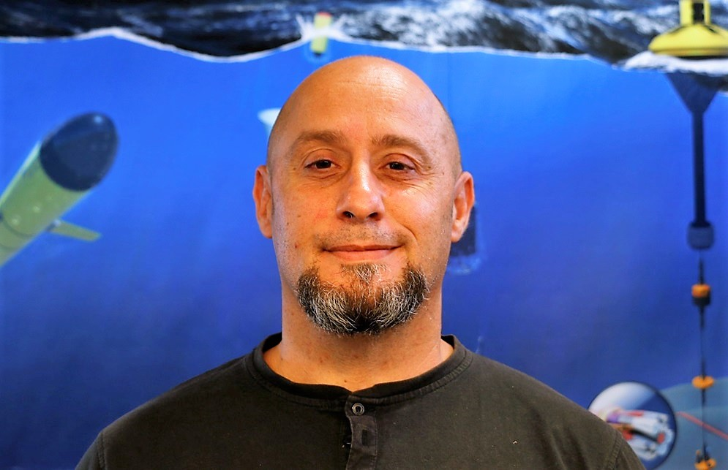
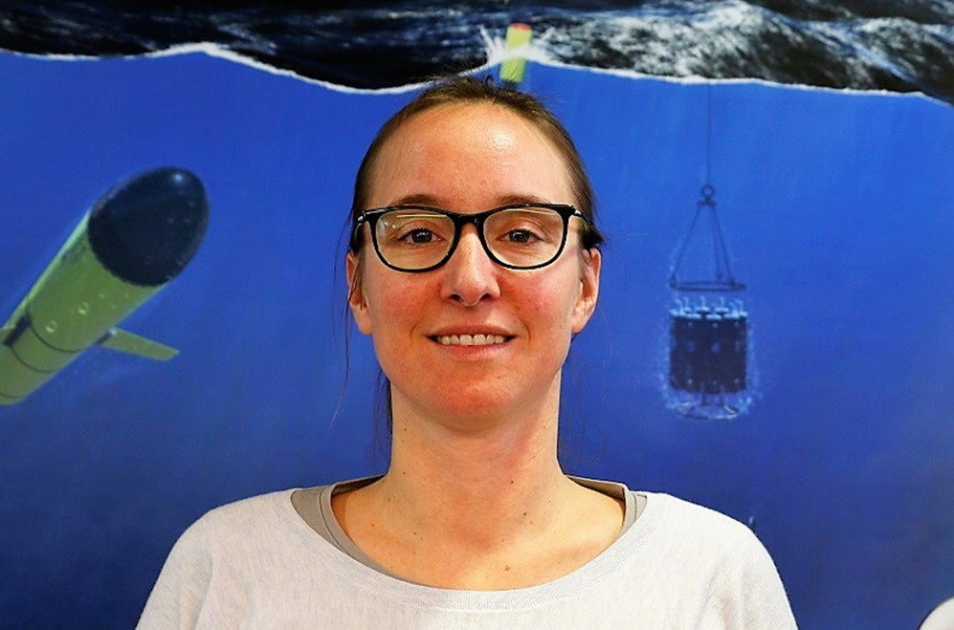
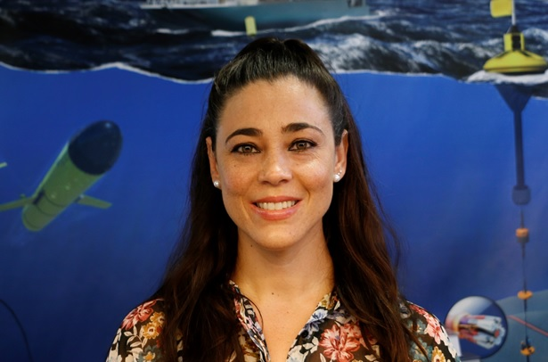
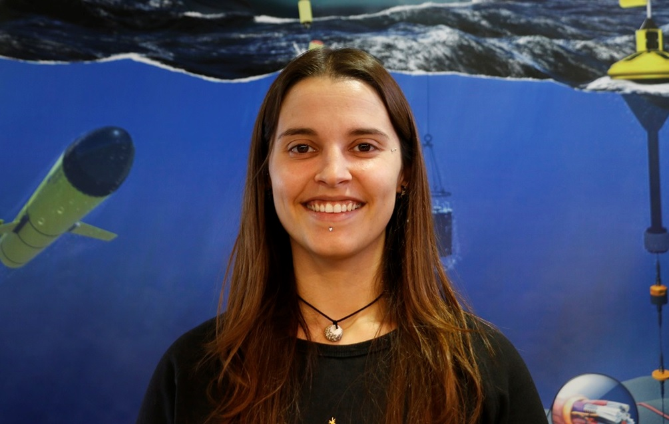
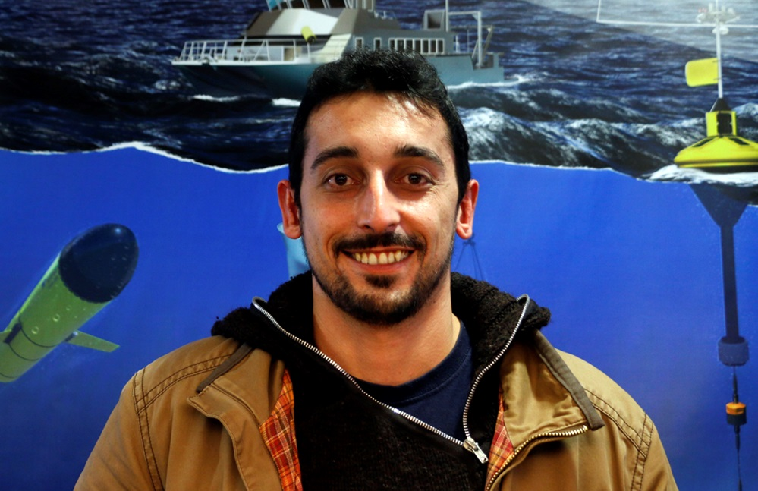
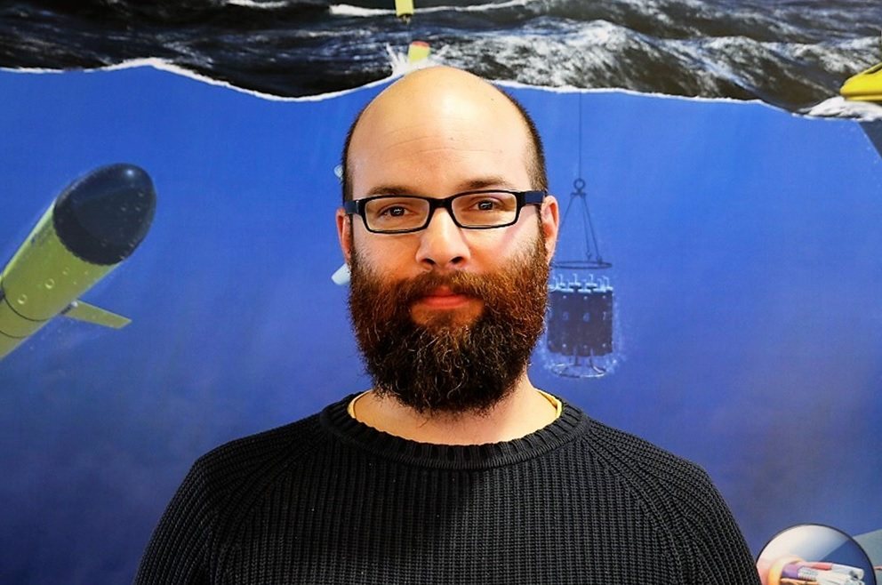
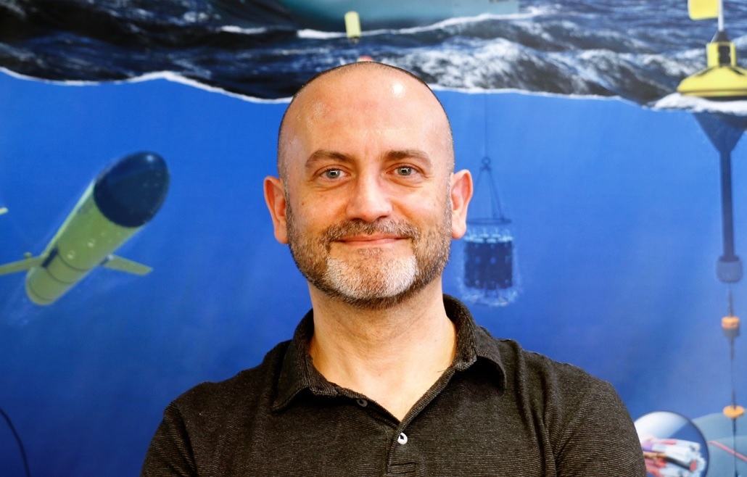
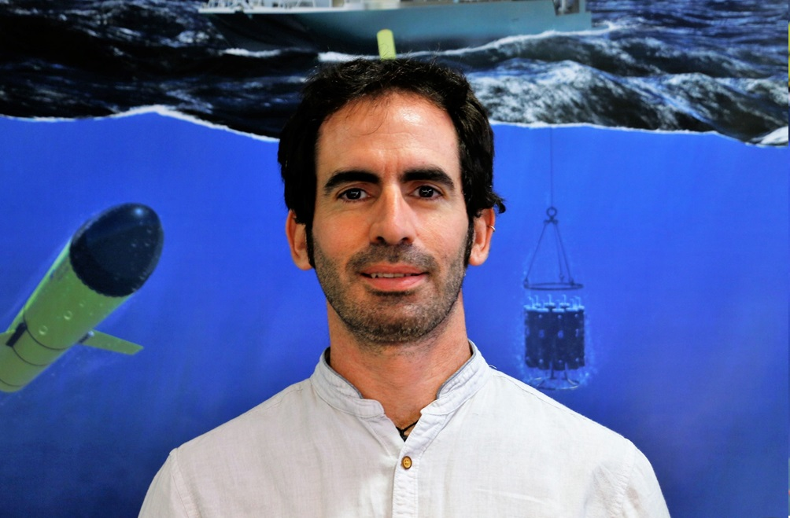
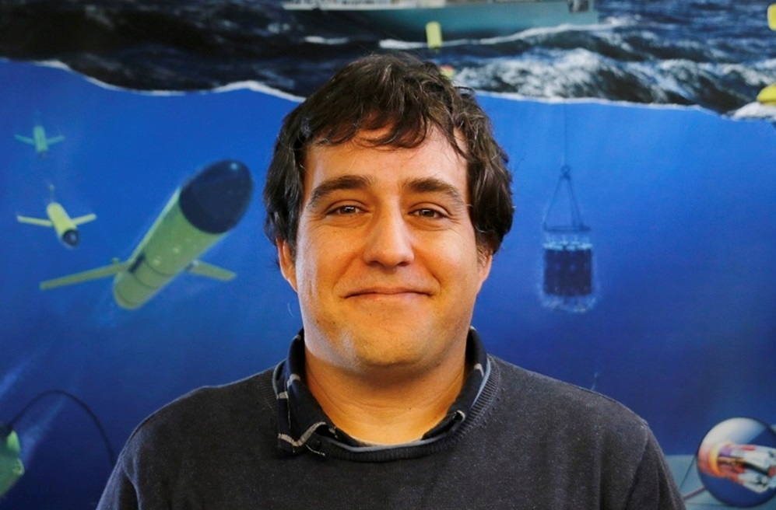
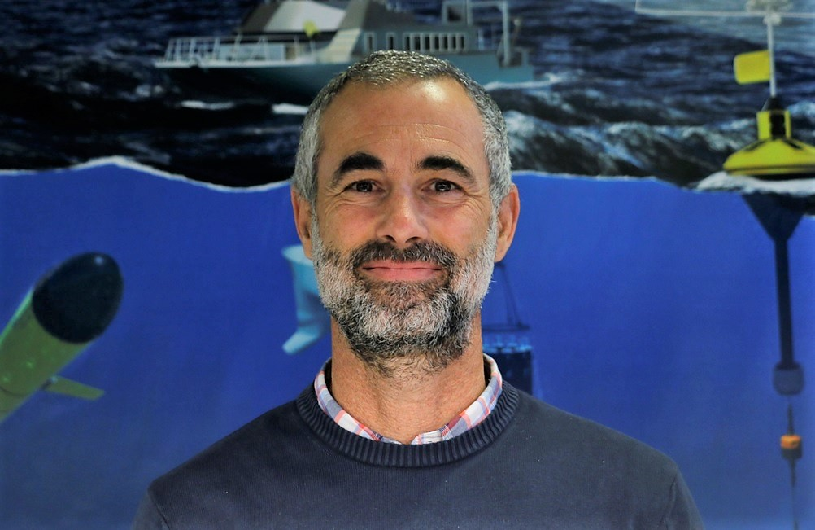
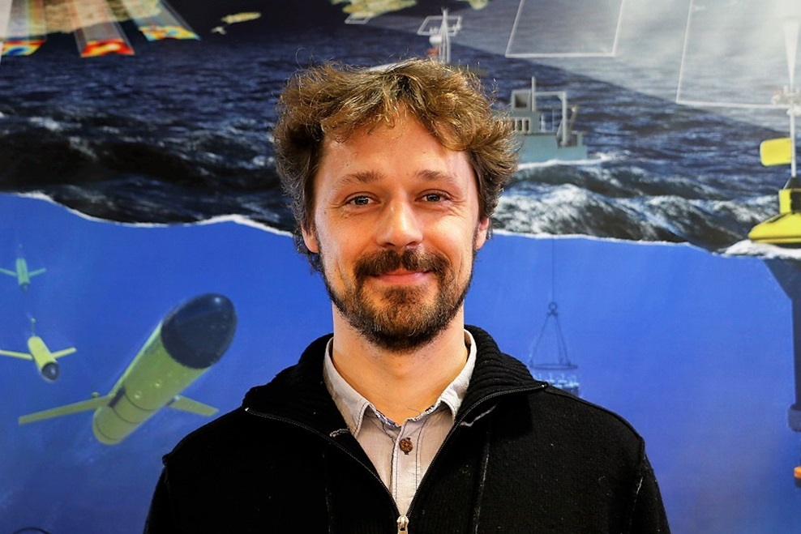
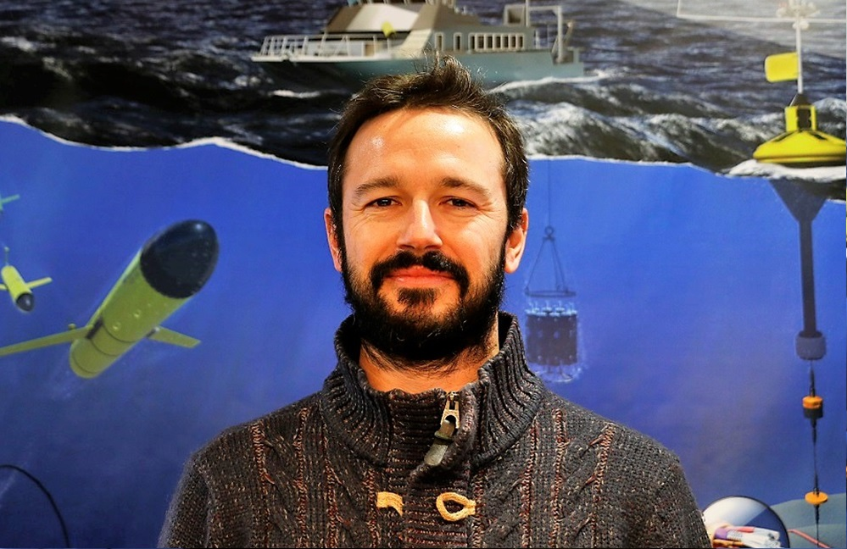
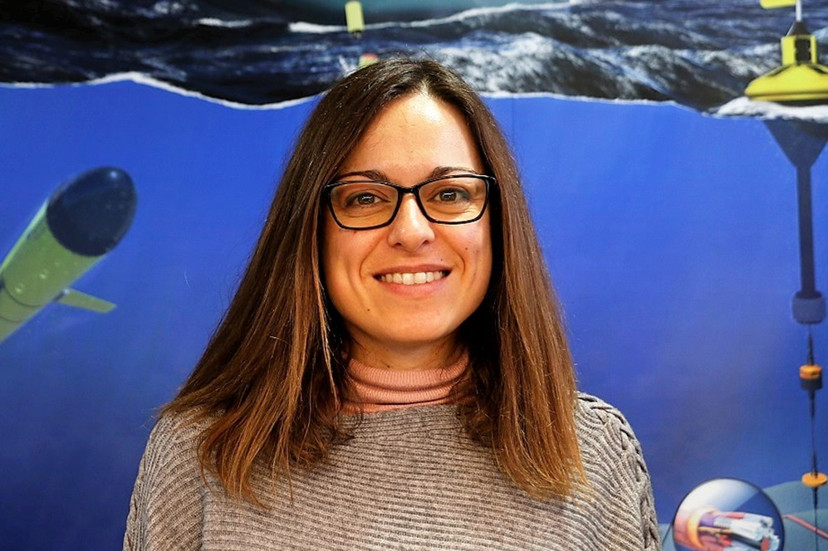
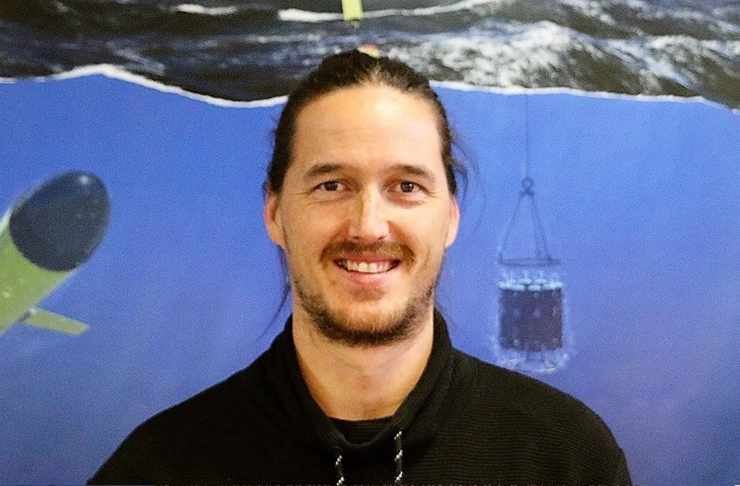
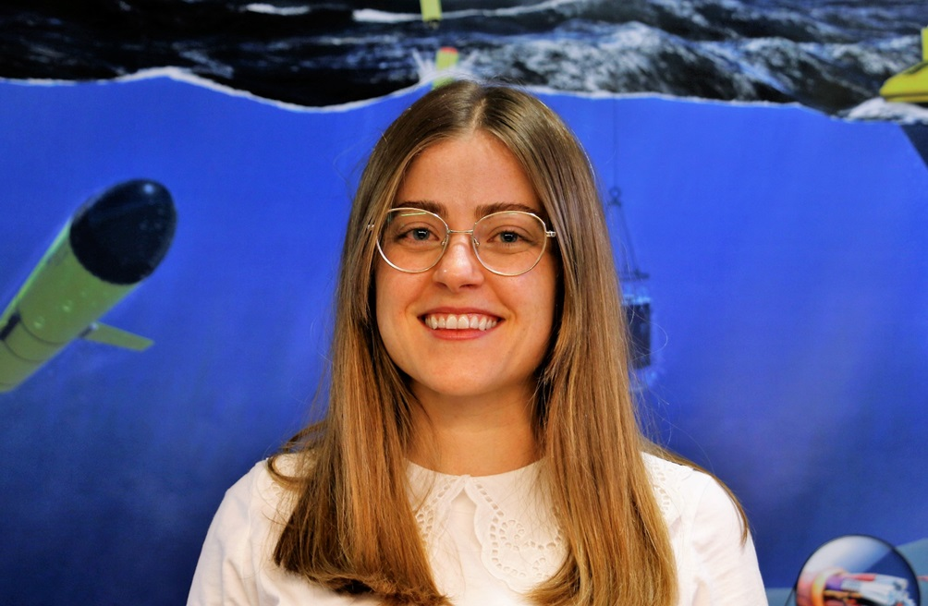
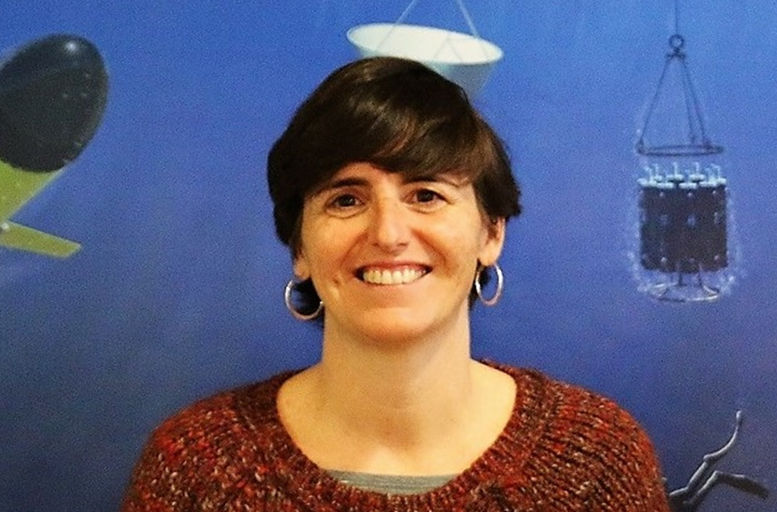
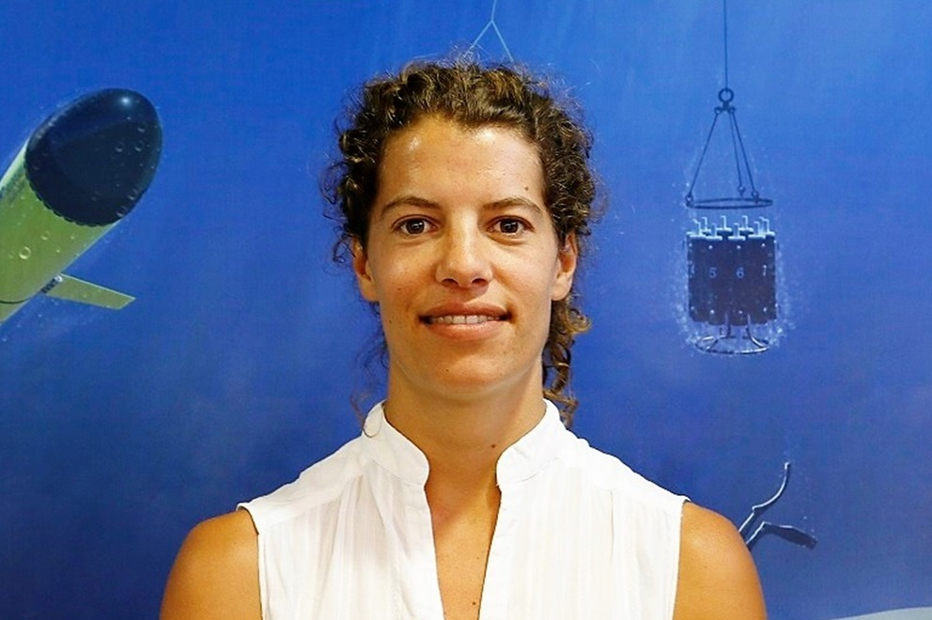
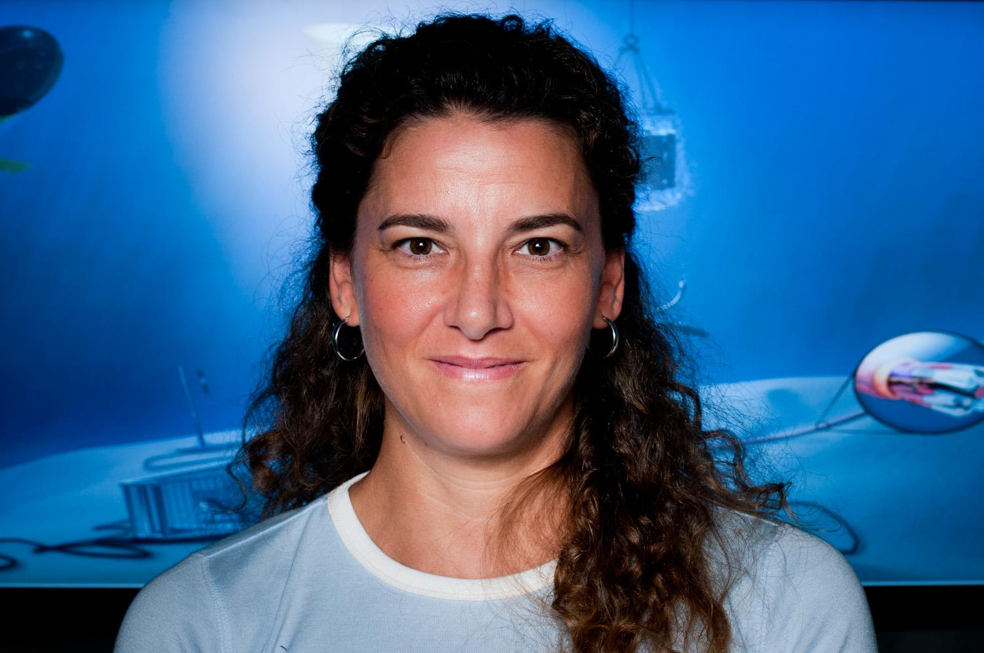
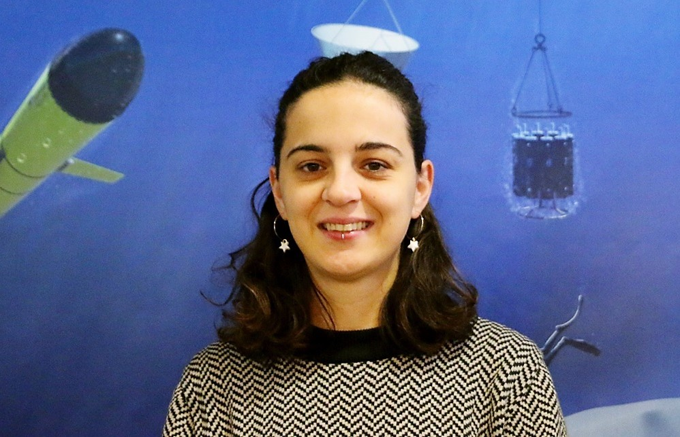
SOCIB: A multi-disciplinary & committed team
42
people

Slide 3
Outline
1
SOCIB - Multi-platform and coastal observation system
2
Digital Twins & Digital Twins of the Ocean
3
SOCIB towards the Balearic Sea DT
4
DTOs architecture & SOCIB DTO Architecture
5
SOCIB DTO prototypes
6
AI within DTOs
7
iMagine within DTOs

Slide 4
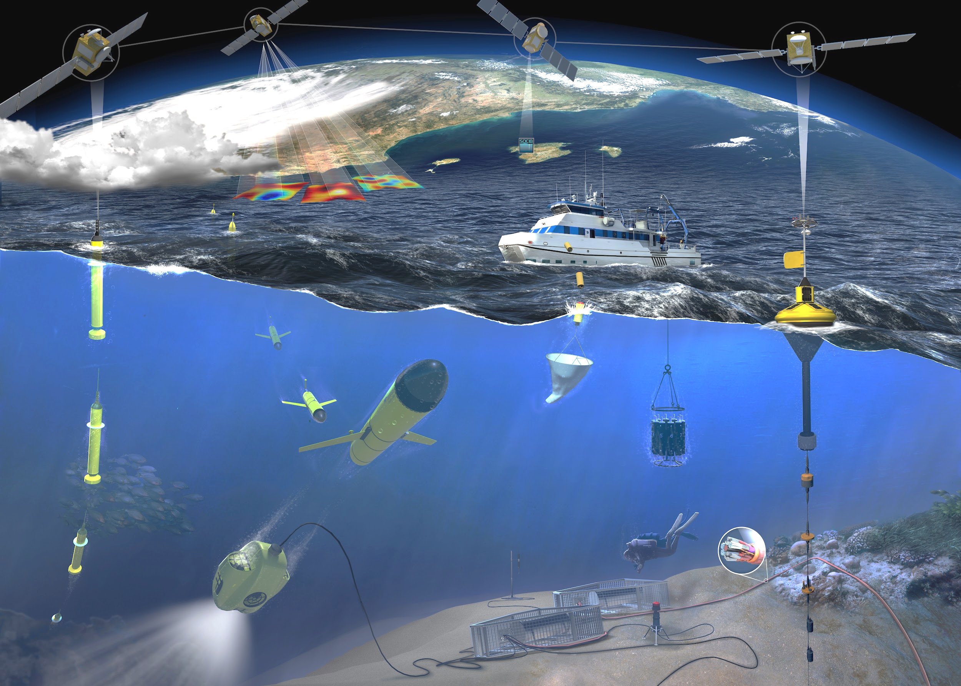
SOCIB
Integrated multi-platform ocean observing system: bridging near-shore to open ocean, providing near-real time observations and predictions

Slide 5
SOCIB: activity axes
Observing System
Forecasting
System
Scientific Research
Raw/Processed RT data
Curated data
Archive, Open Access, FAIR
SOCIB
Data Repository
Data Management System
Corporate Strategy, Communication & Knowledge Transfer
Integrated multi-platform ocean observing system: bridging near-shore to open ocean, providing near-real time observations and predictions

Slide 6
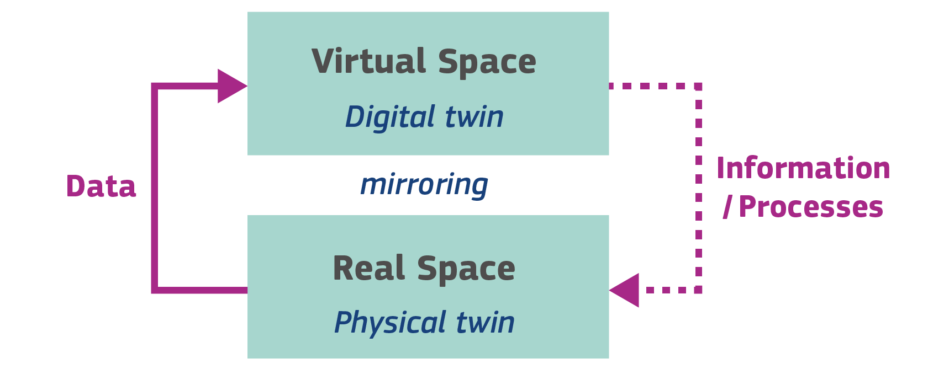
Digital Twins
ISO SC41 IoT and Digital Twin - ISO 30173 DIS
Digital representation of a target entity with data connections that enable convergence between the physical and digital states at an appropriate rate of synchronization
DTs simulate real-world scenarios based on data
DTs are expanding from industry to diverse sectors, including the ocean
AI Generated (Nightcafe studio)
Source: DestinationEarth (DestinE)
https://digital-strategy.ec.europa.eu/en/library/destination-earth

Slide 7
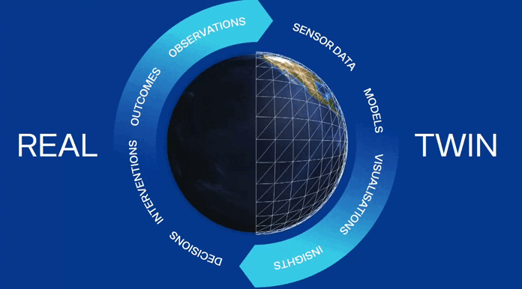
Digital Twins of Ocean
The Digital Twin Ocean (DTO) is a detailed virtual representation of the ocean, integrating real-time data, AI, and advanced modeling for widespread accessibility
Observations change and refine the twin
Twin manipulation highlights real regions in need of better observations
Source: digitaltwinocean.mercator-ocean.eu

Slide 8
Digital Twins of Ocean
1
Improve disaster-risk management
Restore marine habitats and biodiversity
2
3
Strengthen ocean governance
Source: digitaltwinocean.mercator-ocean.eu

Slide 9
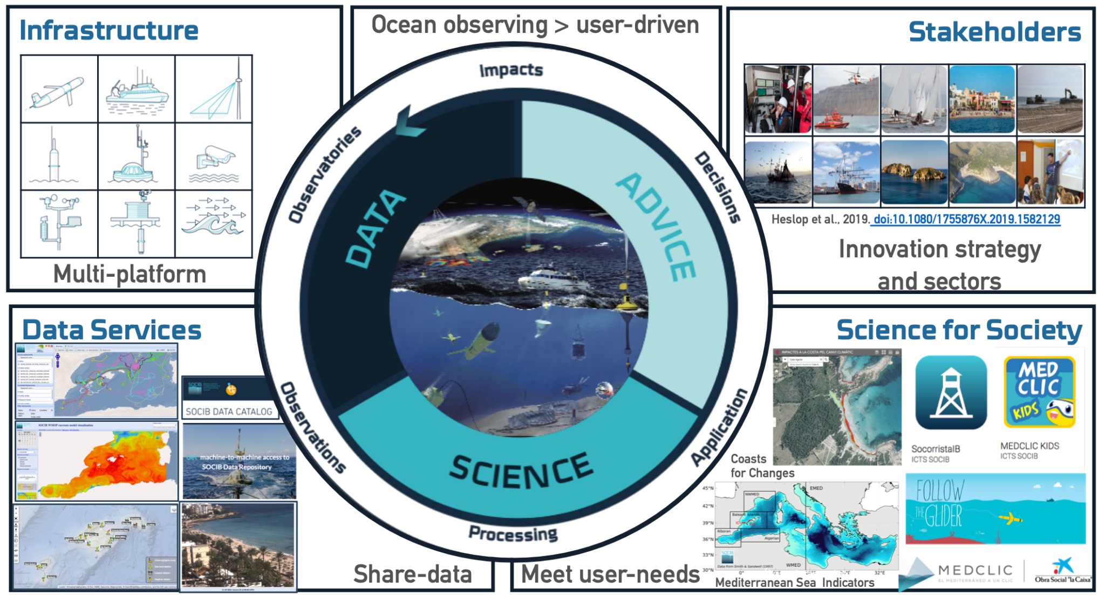
SOCIB towards DTO prototypes in the Balearic Sea
The ICTS SOCIB has:
the facilities
the knowledge
the data
10 yrs ahead
(2024-2033)
The ICTS SOCIB needs:
extra integration effort
user needs
interoperability (decentralized)
scalability & resilience
federated system approach
Integrated multi-platform ocean observing system aligned with DITTO WGs

Slide 10
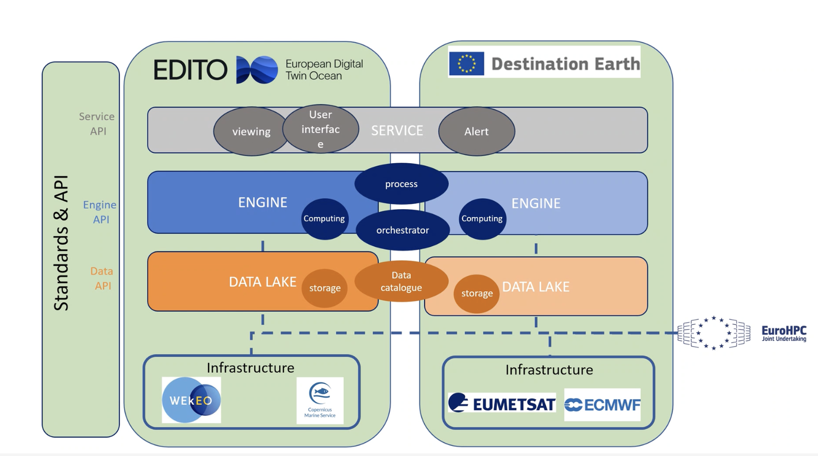
DTOs Architectures at-a-glance
Source: modified fromEDITO-Infra and DestinE projects

Slide 11
SOCIB structure within DTOs architecture
Observing System
Forecasting
System
Scientific Research
Raw/Processed RT data
Curated data
Archive, Open Access, FAIR
SOCIB
Data Repository
Data Management System
Corporate Strategy, Communication & Knowledge Transfer
How should we evolve our structure towards a DTO?

Slide 12
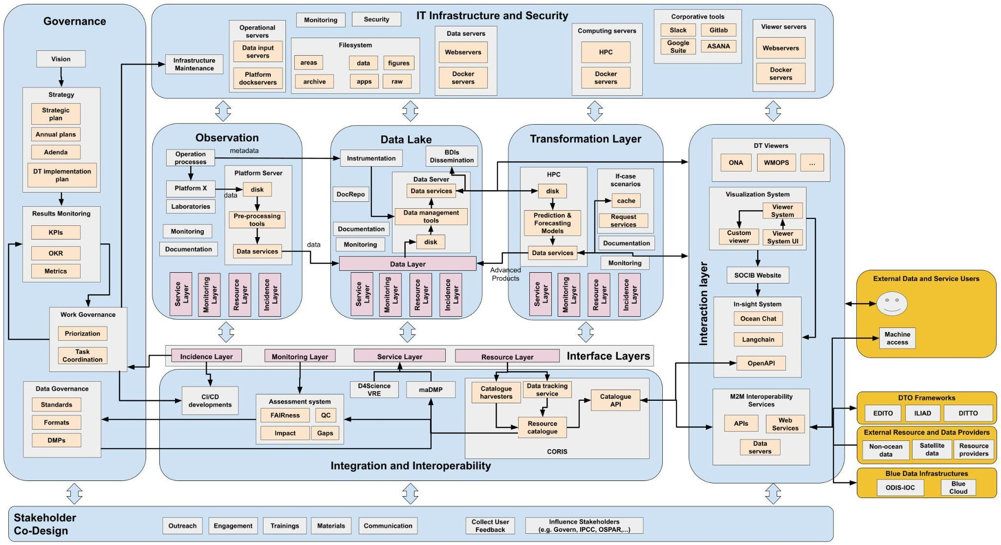
SOCIB DTOs Architecture

Slide 13
SOCIB DTOs Architecture (simplified)
Designed by Freepik
IT Infraestructure & Security
Integration
User’s Interfaces
Data Sources & Providers
Data Lake
Engine
Governance
Interoperatibility
Stakeholder
Co-Design
SOCIB added-value: from data acquisition to user-information

Slide 14
SOCIB DTOs Architecture (simplified)
Operational servers &
Filesystem
IT Infraestructure & Security
Vision
Computing servers
Viewer servers
Data servers
Strategy
Viewers
Observations & Forecasts
Data Repository
Forecasting Models
GUI
Systems
Work Governance
Data Providers
Integration
?
Open
insights
Data Governance
User’s Interfaces
Data Sources & Providers
Data Lake
Engine
Data
catalog
M2M
Services
Governance
Interoperatibility
Stakeholder
Co-Design
Outreach
Training
Communication
SOCIB added-value: from data acquisition to user-information

Slide 15
SOCIB DTOs Architecture (simplified)
Operational servers &
Filesystem
IT Infraestructure & Security
Vision
Computing servers
Viewer servers
Data servers
Strategy
Viewers
Observations & Forecasts
Data Repository
Forecasting Models
GUI
Systems
Work Governance
Data Providers
Integration
?
Open
insights
Data Governance
User’s Interfaces
Data Sources & Providers
Data Lake
Engine
Data
catalog
M2M
Services
Governance
Interoperatibility
Stakeholder
Co-Design
Outreach
Training
Communication
SOCIB added-value: from data acquisition to user-information

Slide 16
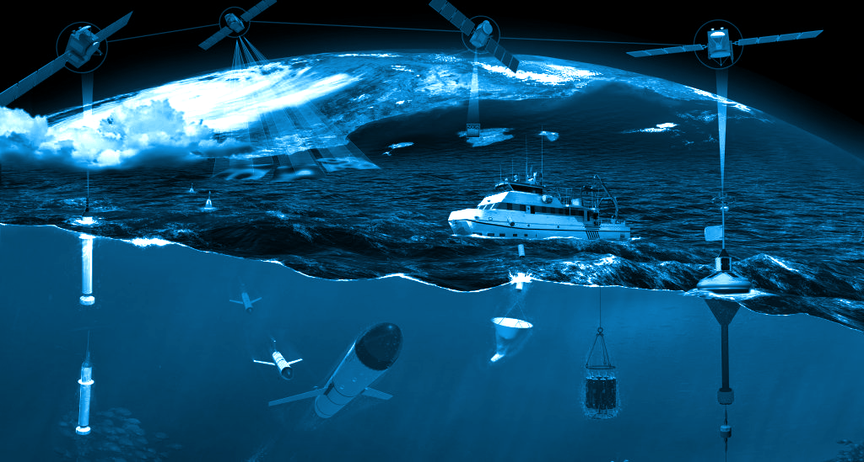
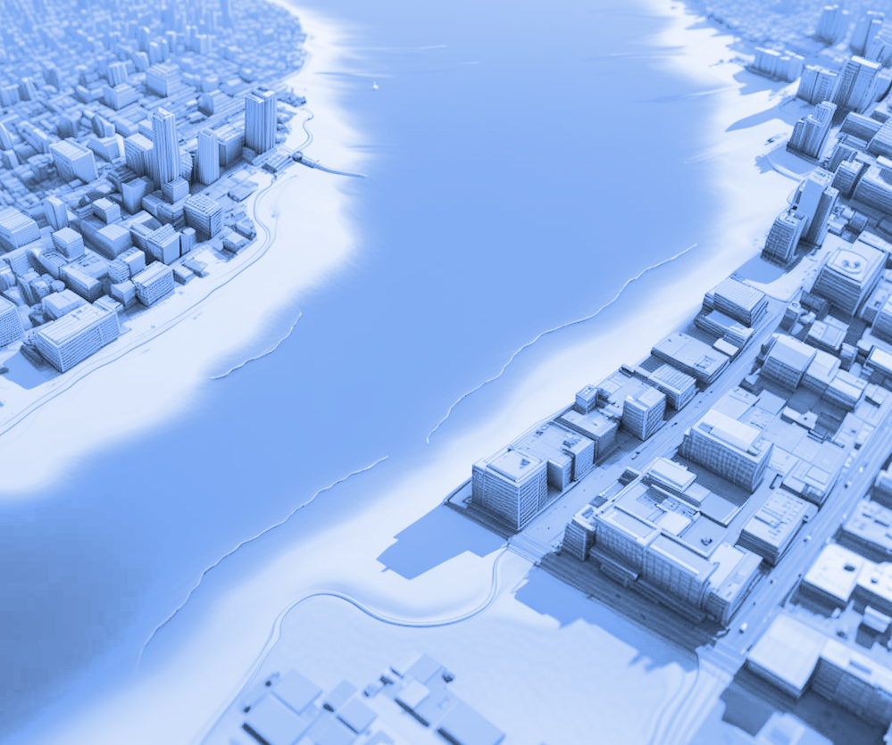
SOCIB 2030: Implementation phases
2023
Launching of the SOCIB 2030 initiative
2024
Finalization of the Co-design, Implementation, and Management Plan of different DTs prototypes in the Balearic Sea
2026
Launching of the first two prototypes in the Balearic Sea: climate change adaptation and marine protected areas
2030
Development of SOCIB 2030: Completion of the first two DTs, validation, test and training and launching of the third prototype
2033
Connection of Digital Twins with the European DTO
PAST
PRESENT
FUTURE
2023-2026
2027-2030
2031-2033
INITIATING
PLANNING
EXECUTING
CLOSING

Slide 17
SOCIB DTOs prototypes
1
Early Warning Systems
2
Marine Protected Areas
3
Climate Change Adaptation Planning
Balearic Rissaga Forecasting System (BRIFS)
Marine Observatory of climate change at National Parks
ONA-Operational toolbox for climate change effects at local scales
Meteo-Tsunamies: Significant high-frequency sea level oscillations (10.5 min period), generated by atmospheric pressure disturbances
Objective: Analize climate change impacts at marine National Parks and monitor extreme ocean events with satellite data.
Upgrades needed towards DTO:
interactive graphics, extreme events detection, integrate HR satellite images, 10-day forecast for all indicators, expand to coastal Spanish waters, add bio and environmental indicators
Objective: Simulate impacts of extreme storms for climate change scenarios (coastal flooding)
Upgrades needed towards DTO:
continuous coupling with data, ML methods on extreme events definition, HR topobathymetries database, visualization engines
Objective: Predict extreme sea level oscillations at Ciutadella Harbour (Menorca)
Upgrades needed towards DTO:
data accessibility at SOCIB Data Repository.
Integration to Alert System in PortsIB viewers

Slide 18
Coastal Digital Twins for climate adaptation planning
Coastal Digital Twins:
By integrating real-time data, predictive models, data-base models, digital technologies and advanced analytics to create accurate virtual replicas of environmental systems
DTOs offer a comprehensive and integrated approach to understanding and responding to the effects of climate change on the environment
Key elements for strategic climate change adaptation plans
Respond to coastal ‘what if’ scenarios
AI Generated (Nightcafe studio)

Slide 19
SOCIB DTO Prototype 3: ONA-Toolbox
ONA Toolbox
6
ONA-Toolbox
Operational climate
chaNge locAl impacts tool
To provide local government of a tool to estimate flooding and erosion areas at local scales due to sea-level rise and extreme wave events, as support for the management and decision-making in Climate Change Adaptation Plans, City Planning Reorganization, Emergency and Risk Plans,...
ONA Toolbox is the recommended software by the Balearic Islands Government to develop such strategic plans.
Public officers and employees are being trained on the use of ONA Toolbox.

Slide 20
ONA Toolbox: Conceptual model
ONA Toolbox
6
η (x,y,t) = 𝑓 (MSL_{RCP}(t_{h}), S_{s}(t) , W_{s} (x,y,t))
Total sea-surface level at the shoreline
Mean sea-level
of RCP projection
Meteorological tides - Storm surges
Wave propagation processes

Slide 21
ONA-Toolbox: arquitecture
ONA Toolbox
6

Slide 22
ONA-Toolbox: the elements
ONA Toolbox
6
Marginal analysis and Multivariate copulas
Spatially distributed sea-level and extreme storm database
Wave propagation → SWAN model (Navier Stokes)
Flooding → LISFLOOD model (Sain Venant)
Beach erosion → Q2D approach
Process-based models coupling
ONA Toolbox is a local build software
with USER FRIENDLY INTERFACE (GUI) to guide the user through each step of simulations
User’s Interface and results viewer and exporting

Slide 23
ONA-Toolbox as a DTO prototype
Operational servers &
Filesystem
IT Infraestructure & Security
Vision
Computing servers
Viewer servers
Data servers
Strategy
Viewers
Observations & Forecasts
Data Repository
Forecasting Models
GUI
Systems
Work Governance
Data Providers
Integration
?
Open
insights
Data Governance
User’s Interfaces
Data Sources & Providers
Data Lake
Engine
Data
catalog
M2M
Services
Governance
Interoperatibility
Stakeholder
Co-Design
Outreach
Training
Communication

Slide 24
ONA-Toolbox as a DTO prototype
Operational servers &
Filesystem
IT Infraestructure & Security
Vision
Computing servers
Viewer servers
Data servers
z
Viewers
Strategy
Observations & Forecasts
Data Repository
Forecasting Models
GUI
Systems
Work Governance
Data Providers
Integration
?
Open
insights
Data Governance
User’s Interfaces
Data Sources & Providers
Data Lake
Engine
Data
catalog
M2M
Services
Governance
Interoperatibility
Stakeholder
Co-Design
Outreach
Training
Communication
We have the pieces…

Slide 25
Future perspectives of AI within DTOs
Operational servers &
Filesystem
IT Infraestructure & Security
Vision
Computing servers
Viewer servers
Data servers
z
Viewers
Strategy
Observations & Forecasts
Data Repository
Forecasting Models
GUI
Systems
Work Governance
Data Providers
Integration
?
Open
insights
Data Governance
User’s Interfaces
Data Sources & Providers
Data Lake
Engine
Data
catalog
M2M
Services
Governance
Interoperatibility
Stakeholder
Co-Design
Outreach
Training
Communication

Slide 26
Future perspectives of AI within DTOs
Big data processing methods and rich data pipelines
Enhanced Predictive Capabilities: Process-based models and physics-guided machine learning and causal reasoning
Autonomous Optimization
Personalized Solutions: insights and recommendations for diverse industries and applications
Integration with IoT: comprehensive monitoring, analysis, and control of physical systems in real time.
Source: DestinationEarth (DestinE)
https://digital-strategy.ec.europa.eu/en/library/destination-earth
Improved process understanding

Slide 27
iMagine into DTOs: an example from UC7
Coastal features detection
Coastal Research
Shoreline Evolution
Hybrid model
Posidonia Oceanica:
berms formation processes and beach litter management
?
Short Term
Morphodynamic patterns:
shoreline evolution
response to extreme events
erosion and accretion
Mid Term
Physics-guided ML applications

Slide 28
iMagine within DTOs: an example from UC7
Coastal features detection
Coastal Research
Shoreline Evolution
Hybrid model
Posidonia Oceanica:
berms formation processes and beach litter management
?
Short Term
Morphodynamic patterns:
shoreline evolution
response to extreme events
erosion and accretion
Mid Term
Physics-guided ML applications
Rip-currents detection
Real-time warning system
Rip-currents likelihood forecasting system
+
+
Short Term
Mid Term
Logistic Regression Models

Slide 29
iMagine within DTOs
Ecosystem Monitoring
Phytoplank. detection
Underwater noise
Aquatic litter
Beach monitoring
Oil Spills Detection
Satellite
Bathym.
ExoTaxa
Diatoms
Early-Warning Systems
Marine Protected Areas
Ocean Governance

Slide 30
Concluding remarks
Outstanding questions
SOCIB is aligned with european DTO initiatives and accounts for the DTO key elements for ensure a sustainable marine systems management
DTOs offer a comprehensive and integrated approach to respond to the effects of climate change on the environment and to coastal ‘what if’ scenarios
AI applications: leading big data and hybrid models to enable simulations and predictive analytics for marine systems
iMagine project outcomes to be integrated to the future SOCIB DTO prototypes
Architecture elements and processes are under discussion…
Observing and Forecasting facilities: are they part of the architecture?
Your feedback on DTOs architectures is valuable!

Slide 31
Thanks for your attention!

