Slide 1
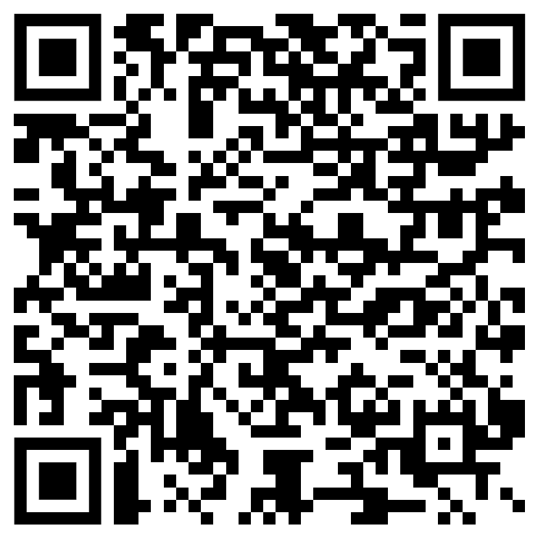
The complete SSH workflow for sharing sensitive data
1 October 2024 Lucas van der Meer & Ahmad Hesam (ODISSEI & SURF, NL)

Slide 2
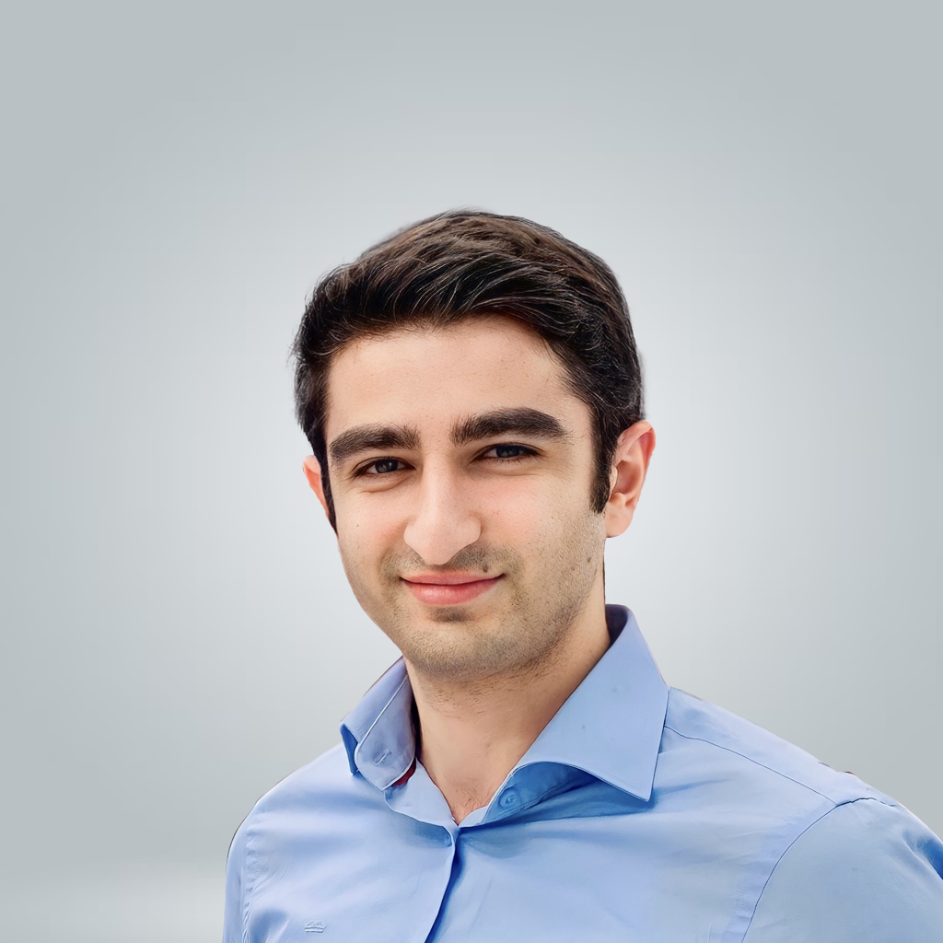
Ahmad Hesam
Project Manager
SURF, NL
Lucas van der Meer
CTO
ODISSEI, NL

Slide 3
0. Introduction
[02:00] Lucas

Slide 4
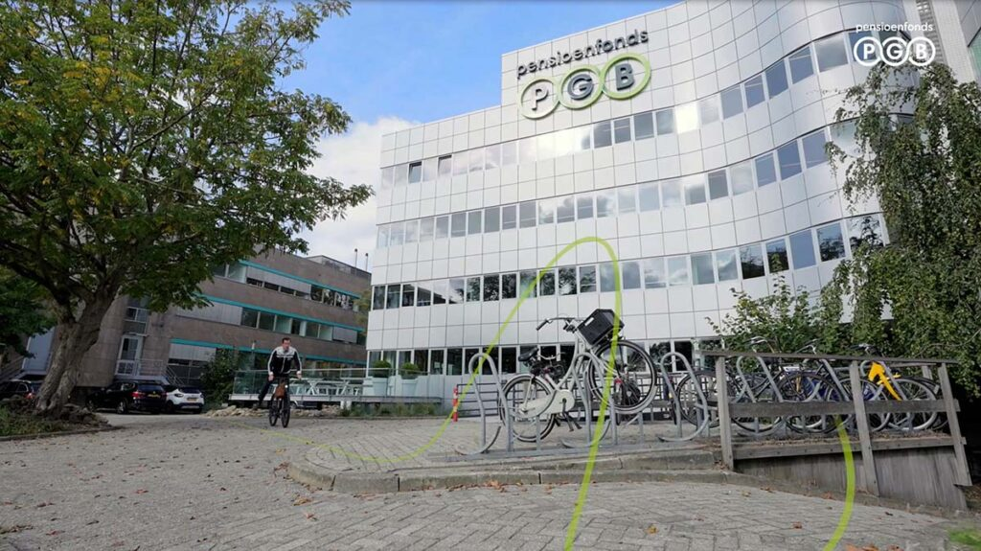
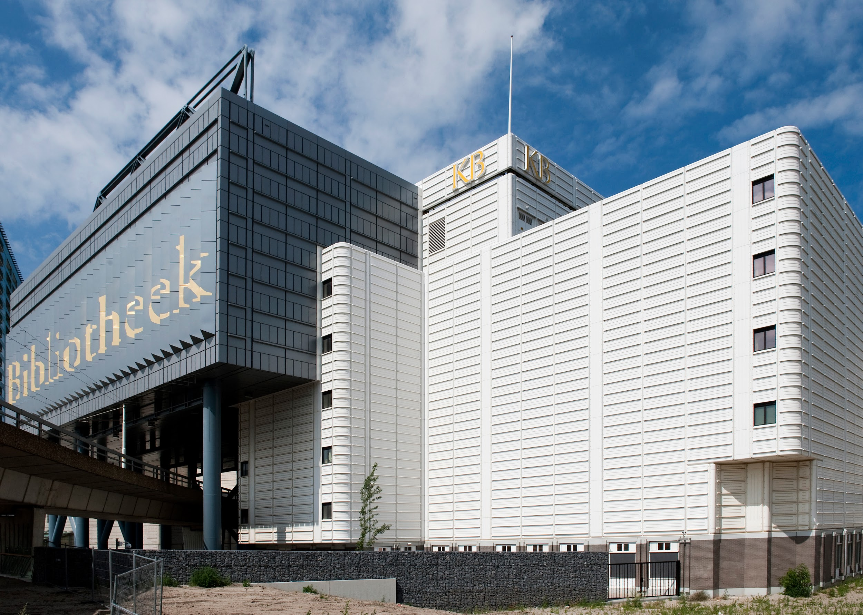
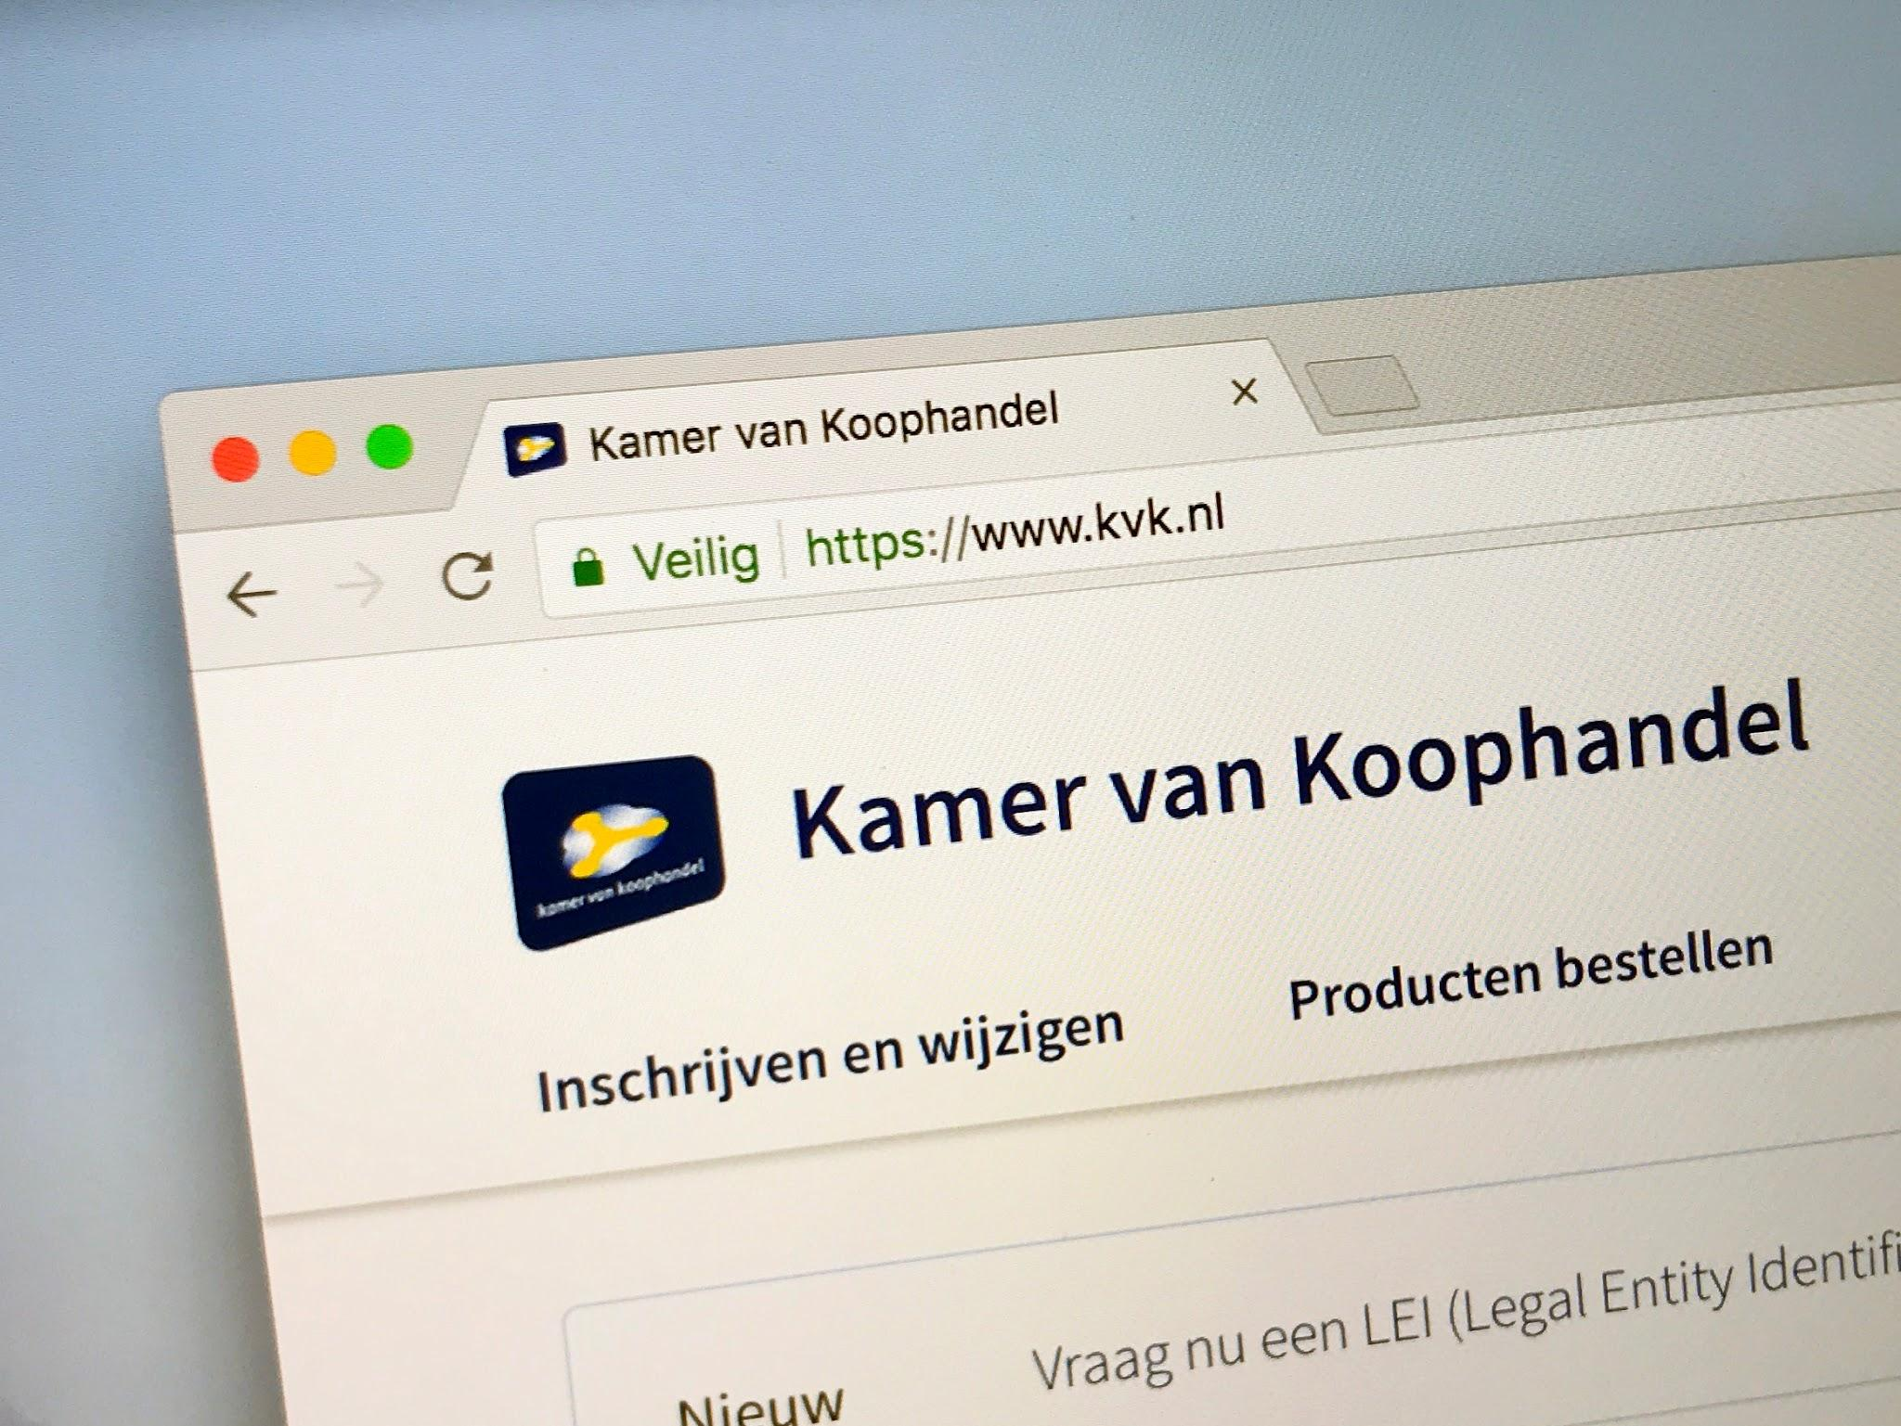
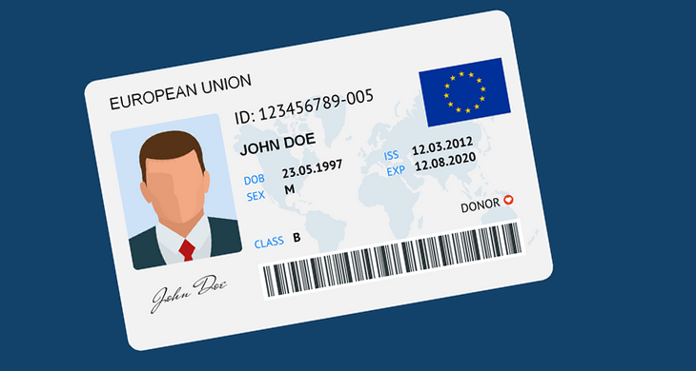
Sharing research data
Increasing willingness to share data with researchers
Foto: Business Film School ©
Foto: Wikimedia ©
Foto: BG Legal

Slide 5
4. Use cases

Slide 6
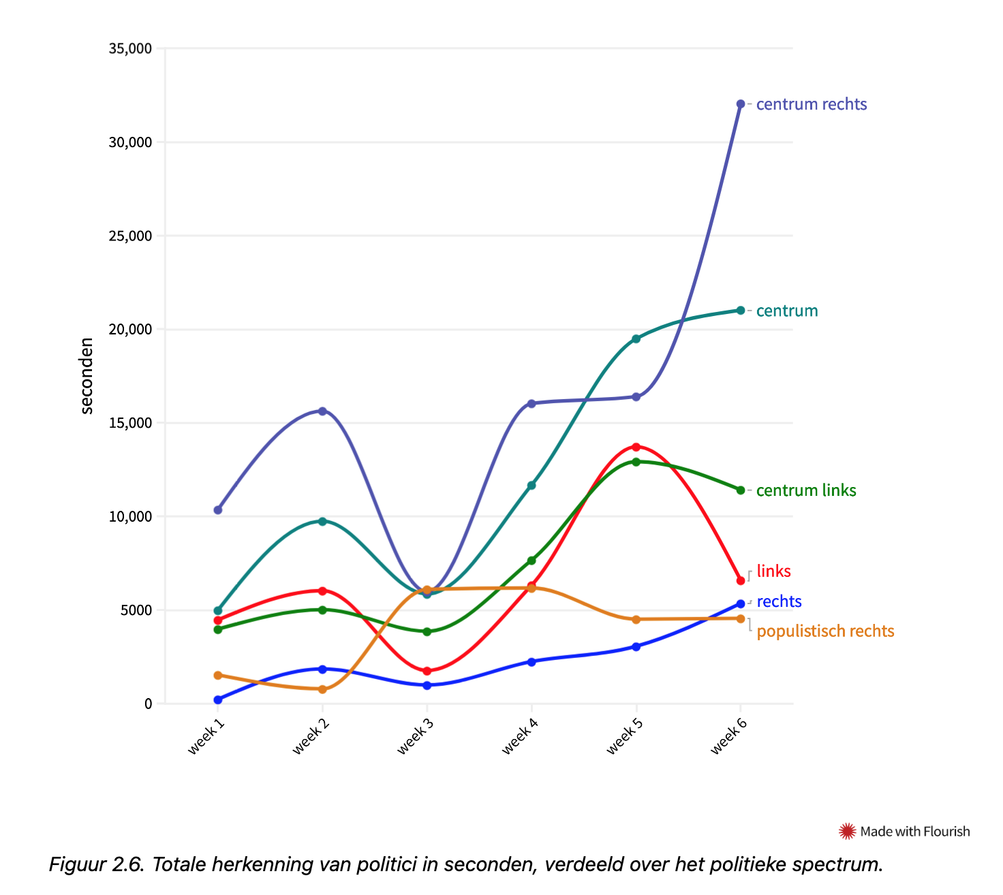
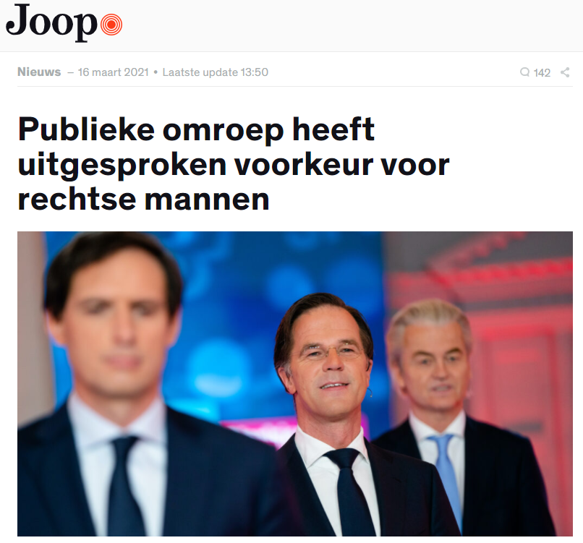
Example “Who is Speaking” with face/voice models
Analysis of presence of Dutch politicians on television during the elections
https://mediasuitedatastories.clariah.nl/elections-dec-2021/

Slide 7
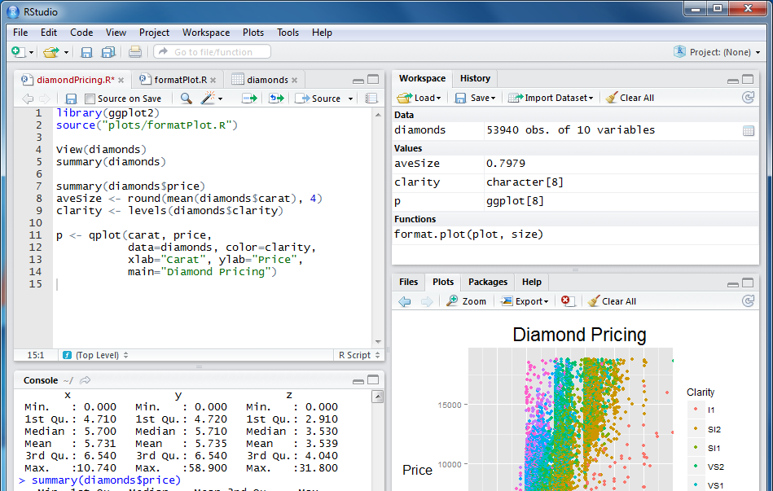
Researcher on KvK
“To what extent does the proportion of part-time employees affect firm closure?”
Firm closure data from KvK
Access provided by the Firmbackbone project
Own data set on age of employees
Foto: BG Legal
Part-time employees

Slide 8
Recipe for non-scientific data providers
Delivering trust through use cases
Banks
Pension funds
Governments
Companies
Figure: UKDS ©

Slide 9
FAIR data ~= Open Science <> Open data
Data findable based on metadata (description, variables…)
Access requirements clearly defined
Interoperable metadata across a wide diversity of data
Reusable after a granted access request

Slide 10
Complete workflow
Researcher
3 Analysing data
Data Access
OSSC
SANE
CBS RA
1 Finding data
2 Requesting access
Data Request
Data Transfer
Data Request
Metadata Providers

Slide 11
Finding data [04:00] Lucas

Slide 12
Finding data

Slide 13
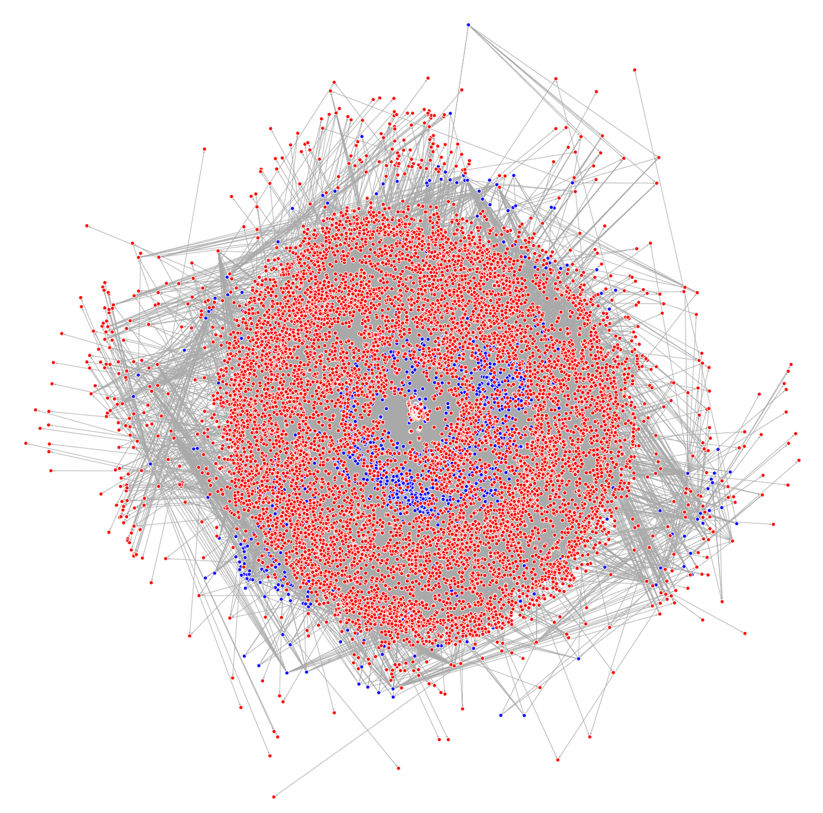
/ Firmbackbone
…
PORTAL
Ineo
MCAL
Data scouts

Slide 14
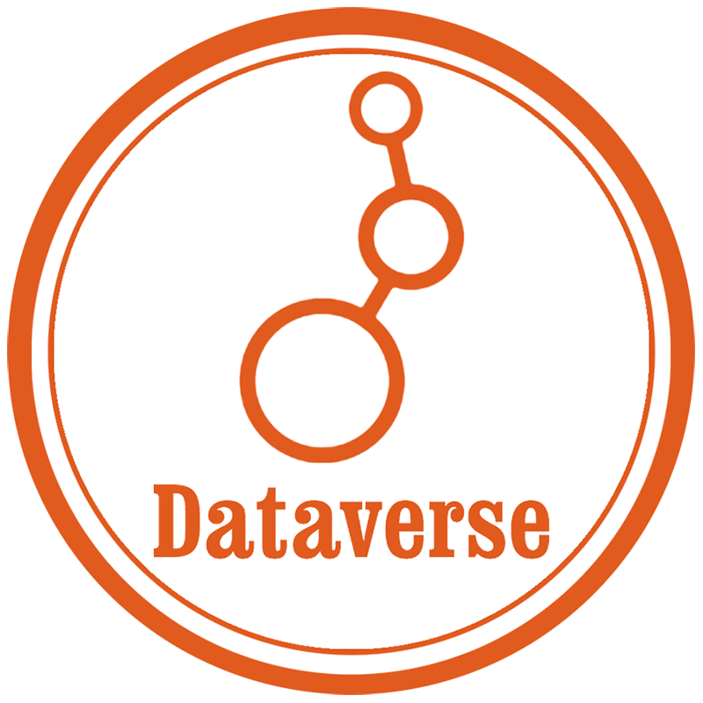
Aggregate &
Enrich
Notes:
Multiple Dataverses, aggregator and enricher
Loads of functionality off-the-shelf

Slide 15
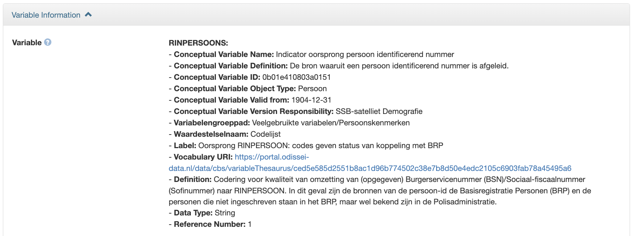
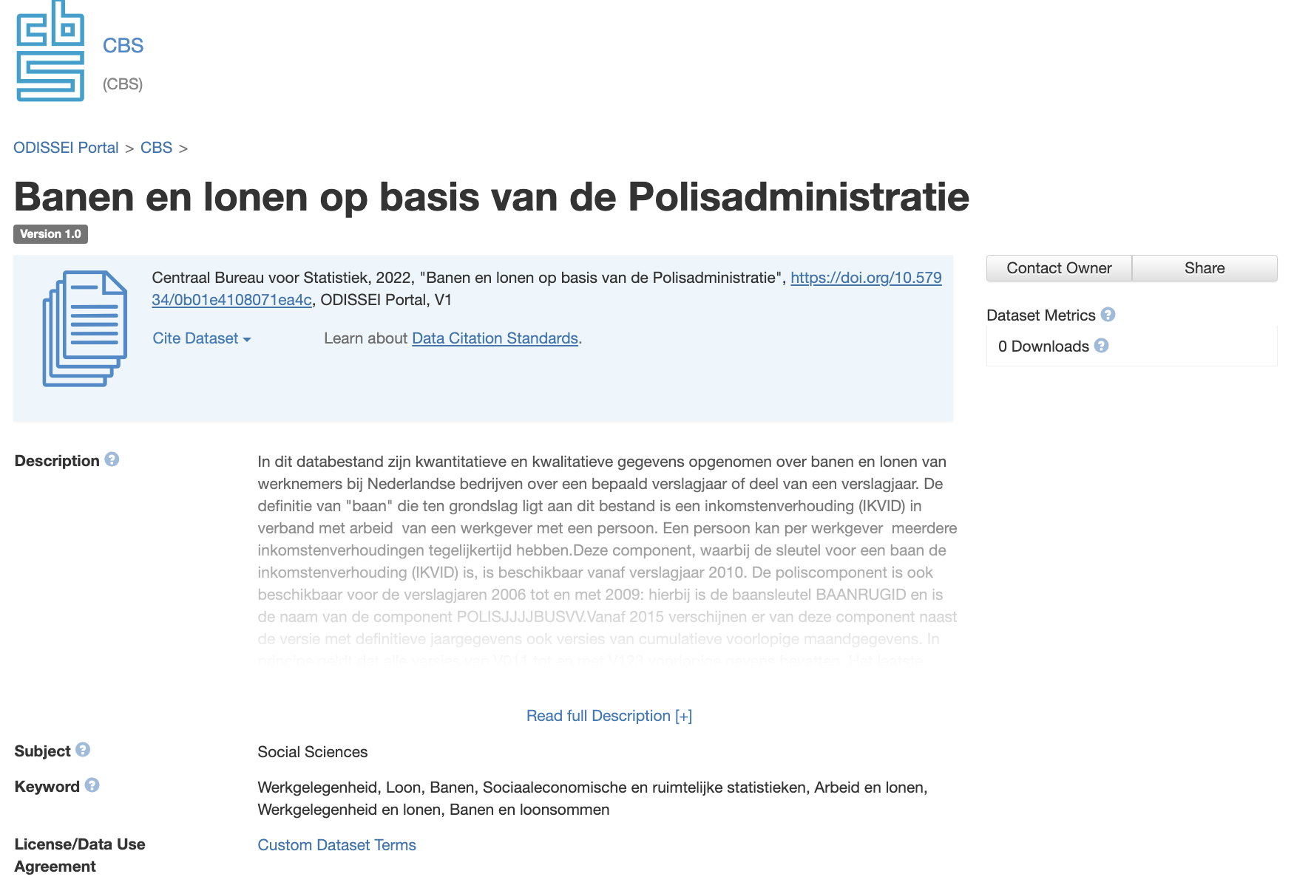
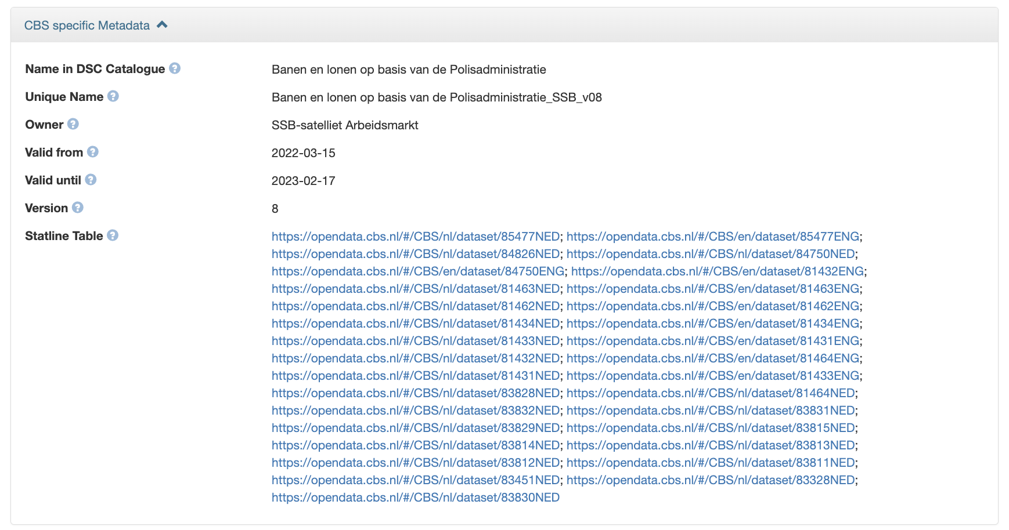
Notes:
Voorbeeld dataset
Variable-level information!

Slide 16
Notes:
Dutch data set
ELSST, Taxonomy, Classifications

Slide 17
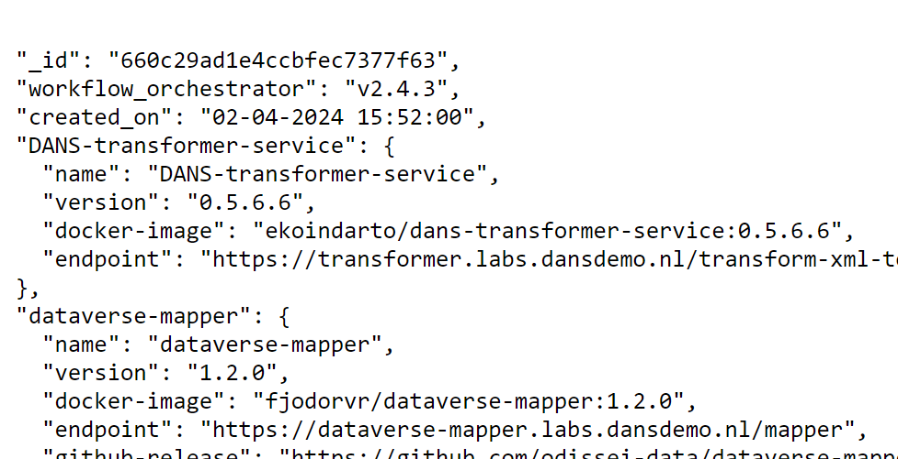
a Aggregate
Periodic ingest from providers through OAI-PMH endpoint
Provenance as nano publication
Mapping of providers’ high-level metadata to CESSDA Metadata Model (CMM)
Extension of DDI Codebook
Adding rich variable-level metadata for key providers

Slide 18
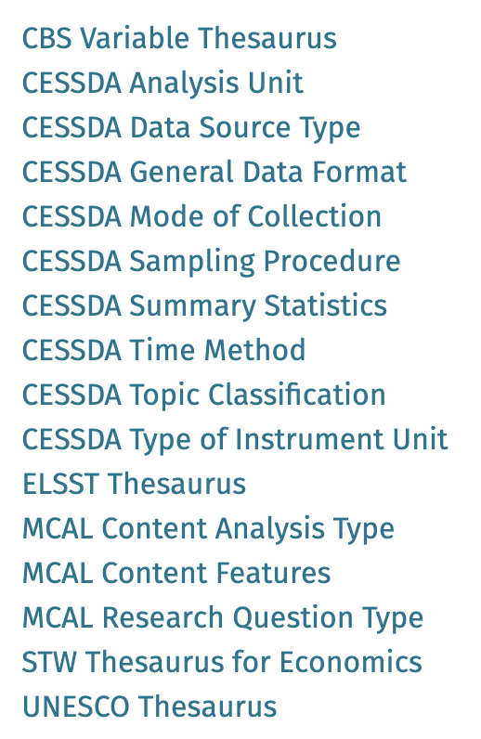
b Enrich
skosmos.odissei.nl/en/
Keywords in current metadata
Ad hoc and not systematic
→ Which keywords is used by which data provider?
For CBS: Dutch only
Not linked to broader/narrower/related terms
We used controlled vocabularies to solve some of these issues
Use PIDs to concepts defined in a vocabulary
Link to translated terms
Link to broader/narrower/related terms
ELSST terms
CBS classificaties en begrippen

Slide 19
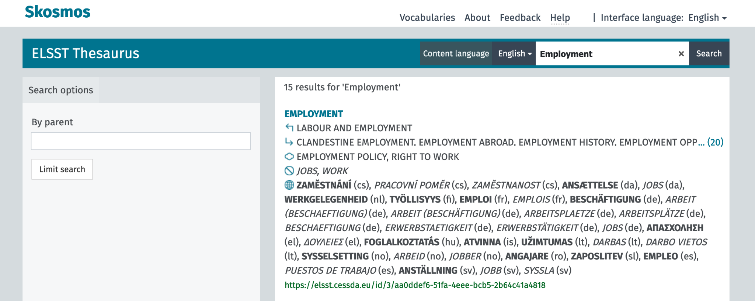
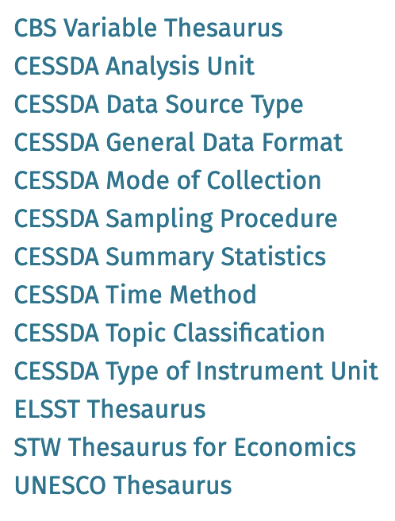
The power of CVs - ELSST
https://skosmos.odissei.nl/en/

Slide 20
2. Requesting data
[07:00] Ahmad
Data Access Broker (Ahmad)

Slide 21
3. Analysing data
[12:00] Lucas

Slide 22
3. Analysing data

Slide 23
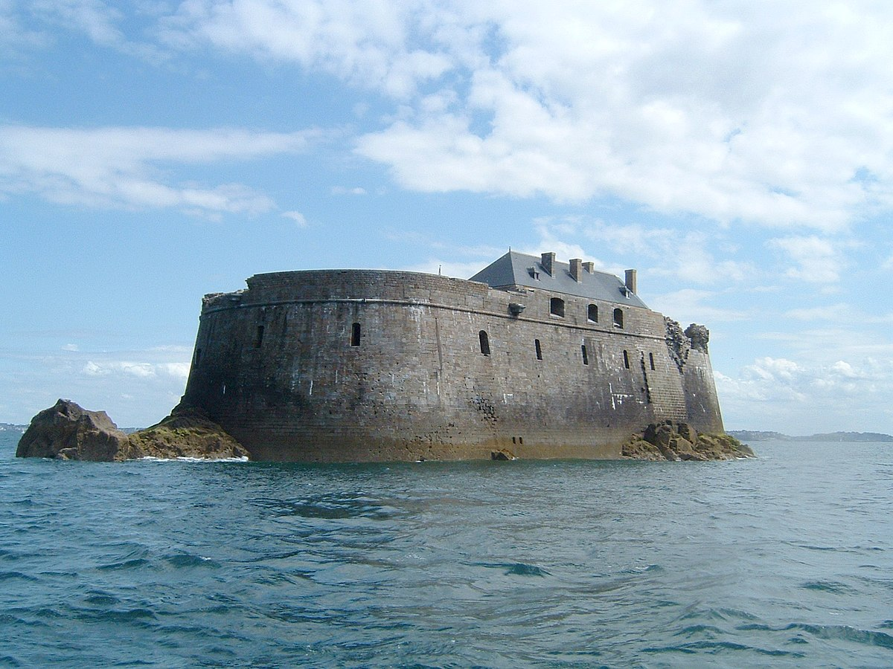
SANE:
Secure ANalysis Environment
Figure: Wiktionary ©

Slide 24
Trusted Research Environments (TREs)
What is it? Ask 10 people, get 11 answers
Standard Architecture Trusted Research Environments (SATRE):
“Any kind of computing environment set up for research with sensitive data that has built-in security controls and user access management feature”
DARE UK (2021)
List of 160+ requirements (mandatory, recommended, optional)
SANE evaluation done → 96% score (considering mandatory only)
EOSC-ENTRUST: Blueprint architecture for federating TREs
Keeping track of developments on EU level
TRE Working Groups at EGI and RDA

Slide 25
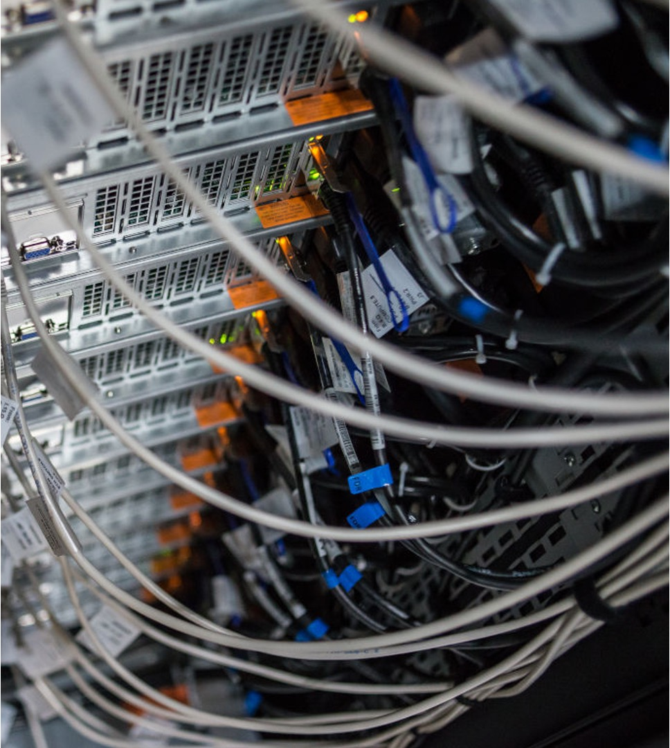
Secure Analysis Environment (SANE)
SANE is a virtual, fully shielded computing environment containing pre-approved analysis software and access to the sensitive data. It allows the data provider to maintain complete control while still allowing the researcher to study the data in a convenient manner.
Tinker SANE: allows the researcher to see, manipulate and play with the data
Blind SANE: the researcher submits an algorithm without being able to see the data and the data provider approves the algorithm and output

Slide 26
SANE: an off-the-shelve, data holder-agnostic TRE

Slide 27
SANE: an off-the-shelve, data holder-agnostic TRE
Sensitive data
Researcher
Enter
Private cloud
Output checks
Analysis
tools
Own data

Slide 28
SURF Research Cloud & HPC cloud
Sensitive data
Researcher
Enter
Private cloud
SURF Research Access Management
(SRAM)
Output checks
Analysis
tools
Own data
SURF Research Drive

Slide 29
SURF Research Cloud
Easily create predefined cloud workspaces
Infinite scalability
On-premise deployment
Researcher environment
Data server
Data provider portal
https://aws.amazon.com/ec2/pricing/on-demand/

Slide 30
Compliant
GDPR compliant
Full control over the sensitive data by the original data controller
Appropriate safeguards via the Five Safes principle, ISO 27k1 certification, independent penetration test, on-premise deployment…
DGA / DA compliant
Data altruistic organisations can impose conditions for data sharing

Slide 31
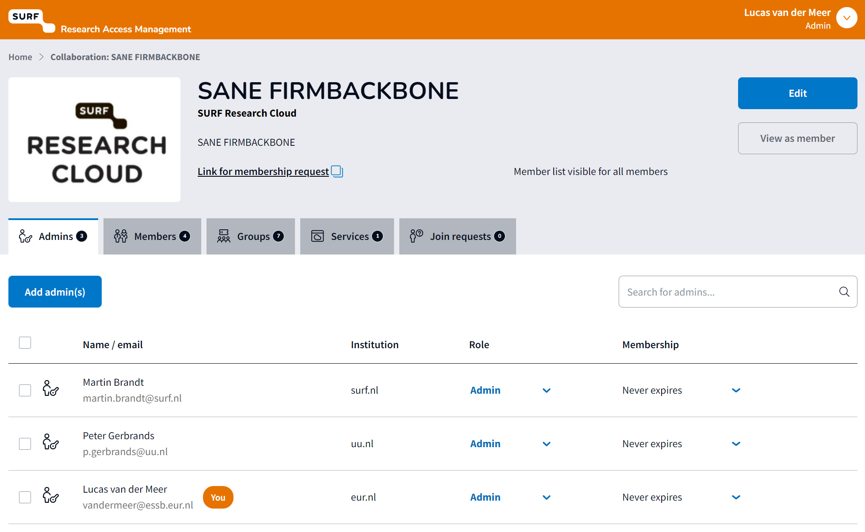
Notes:
EduGain

Slide 32
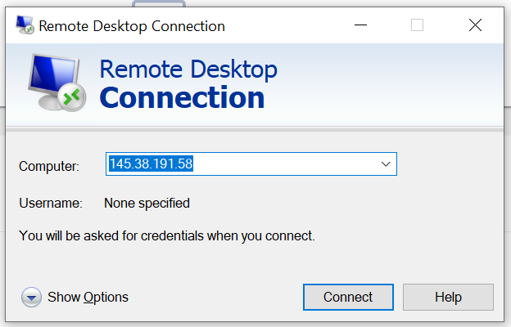
Logging in

Slide 33
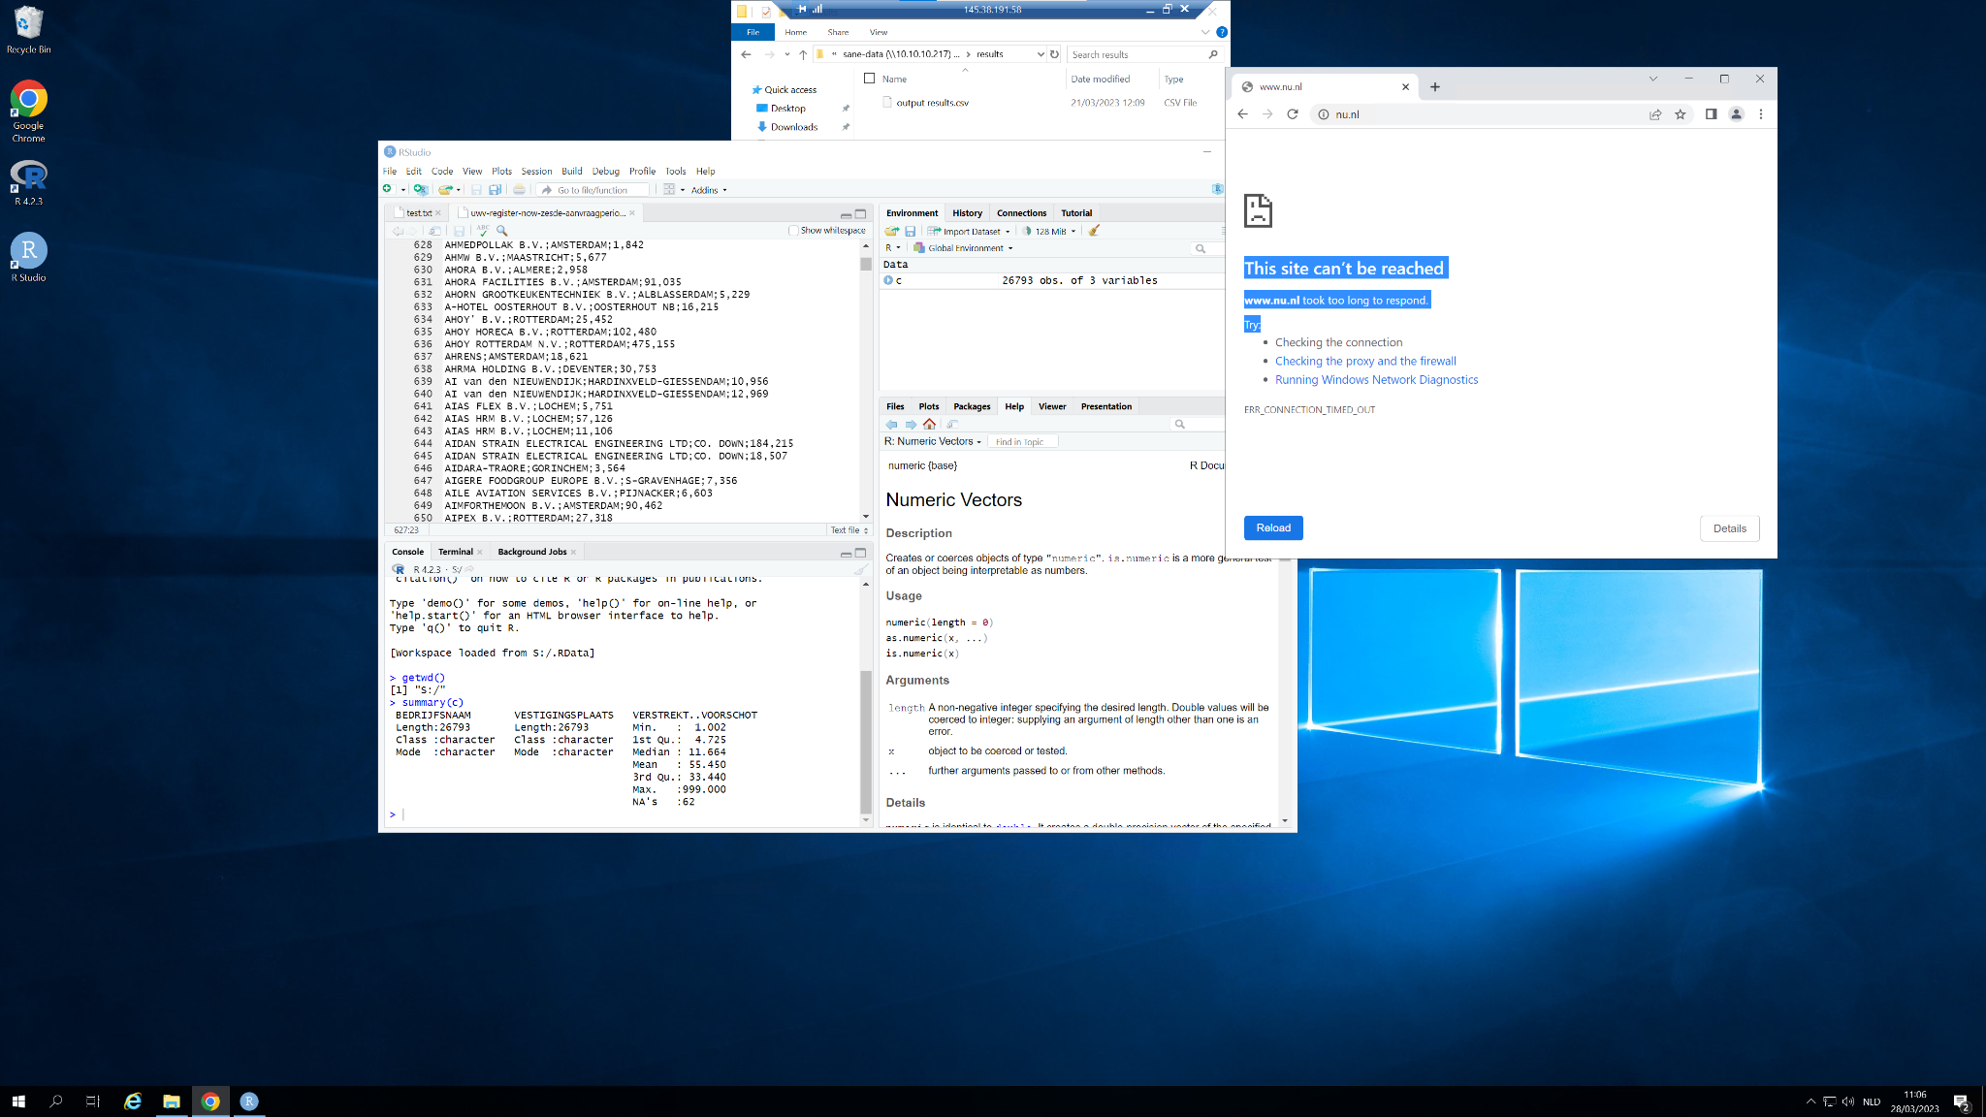
4. Analyse

Slide 34
2. Requesting data

Slide 35
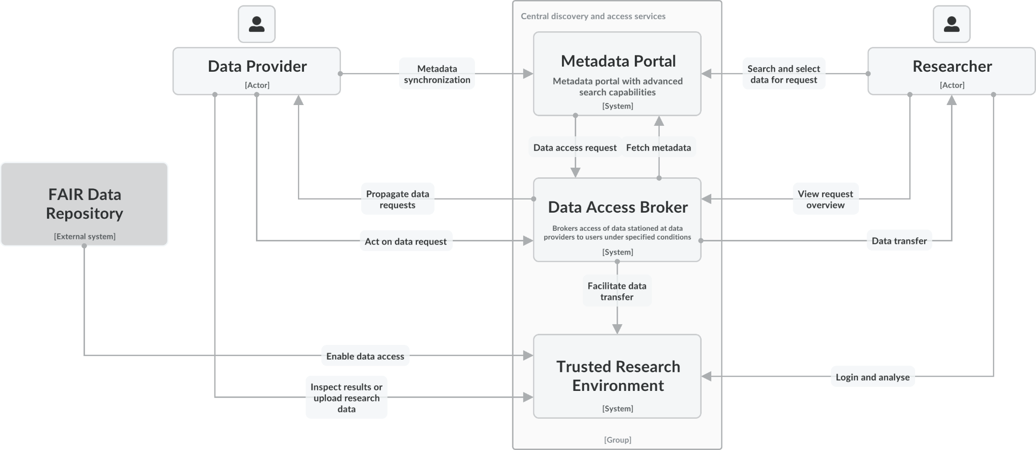
Notes:
Mention visual workflow on the demo session

Slide 36
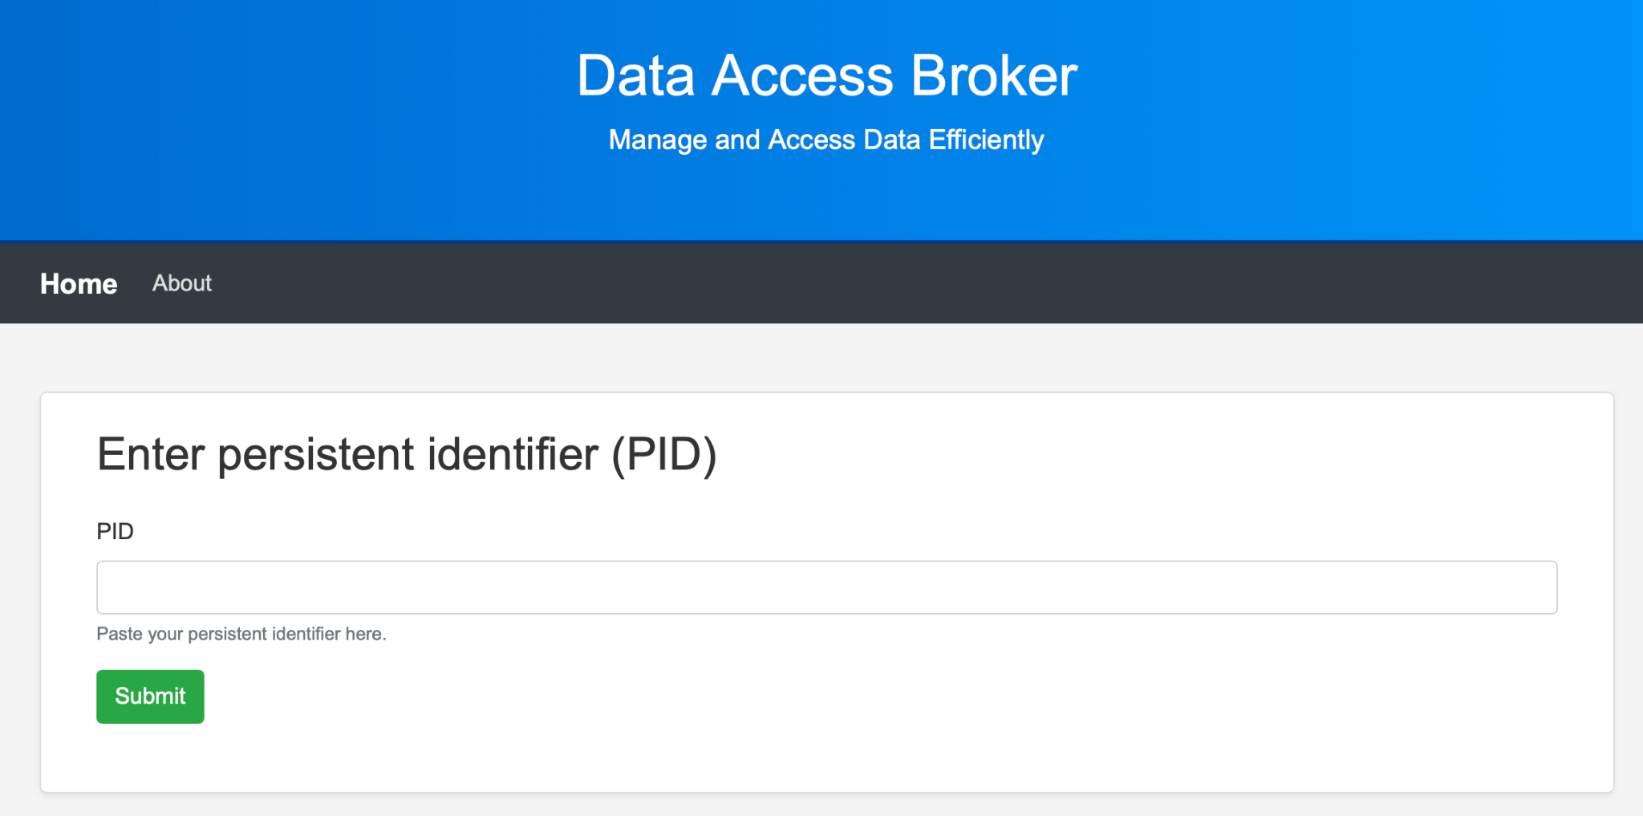
Data Access Broker
Notes:
This is simply a web client; real DAB is the API behind it

Slide 37
The data access request process
The user selects DOIs in the Portal
The user authenticates him/herself
The user requests access
The DAB parses the licences and other relevant metadata (e.g. access conditions) associated with the DOIs
The DAB automatically performs checks when possible and displays the parsed result
The DAB sends the parsed result (i.e. advice) to the data provider
The data provider acts, for instances places the data in a TRE

Slide 38
Data Access Broker parses the licenses
Statistics NL
Condition | Check
Researcher Dutch Uni | Yes ✅
Signed NDA | Yes ✅
Data in archive | Yes ✅
Research purpose | N/A ✅
SANE allowed | Yes ✅
⇒ Check passed ✅
DAB tells the data provider to transfer the data of the DOIs to SANE
Institute Sound & Vision
Condition | Check
Researcher Dutch Uni | Yes ✅
Signed NDA | Yes ✅
Data in archive | Yes ✅
Research purpose | No ❌
SANE allowed | Yes ✅
⇒ Manual action needed 🟡
Data provider informs the DAB of the status of the access request for the DOIs
Notes:
Data providers specify their conditions

Slide 39
Standardizing data access conditions
Make an inventory of existing data access conditions (however way they are defined)
Active survey by DANS, the Dutch national centre of expertise and repository for research data
Workshop to create a ‘profile’ for (SSH) data providers
Various Dutch research communities, under guidance of UK Data Services
Making access conditions from the data providers machine-readable & -actionable using Open Digital Rights Language (ODRL)

Slide 40
Why a DAB?
For non-institutional data providers, sharing data with researchers only costs time and effort.
Every second less it takes, increases the probability of sharing.

Slide 41
4. Use cases
[16:00]

Slide 42
4. Demo & wireframes

Slide 43
5. Q&A

Slide 44
The complete SSH workflow for sharing sensitive data
1 October 2024 Lucas van der Meer & Ahmad Hesam (ODISSEI & SURF, NL)

