Slide 1
iMagine: an AI platform supporting aquatic science use cases
Gergely Sipos
Head of services, Solutions, Support (EGI Foundation)
iMagine Project Coordinator
EGI 2024, Lecce, Italy

Slide 2
Outline
Project facts
Technical architecture
Imaging thematic services
Opportunity to work with iMagine

Slide 3
50% of the global oxygen production is produced by photosynthesis of marine algae.
Oceans are home to the world’s largest diversity of species and habitats.
Annually 100 Mio tons of marine organisms are exploited as food source.

Slide 4
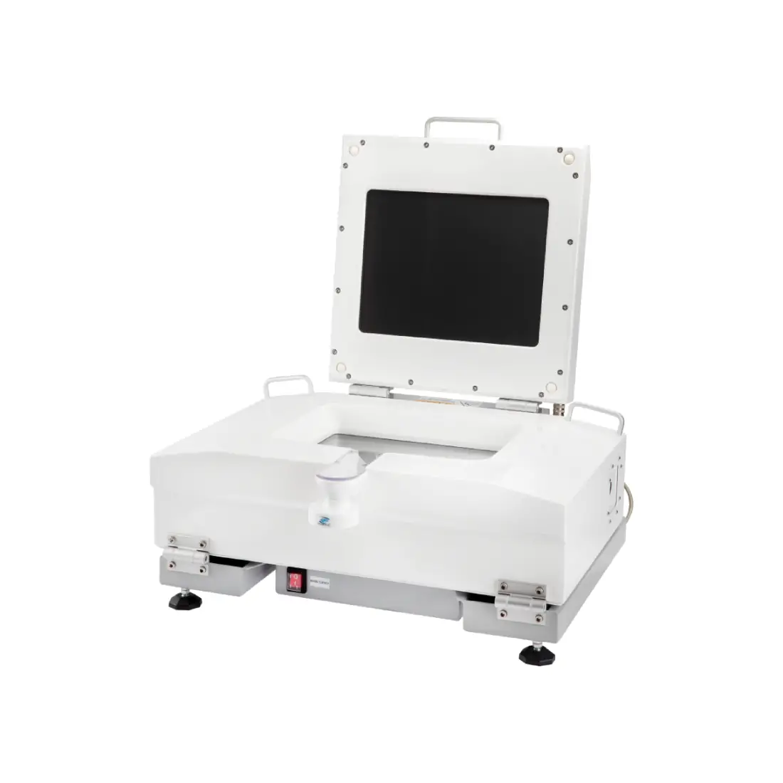
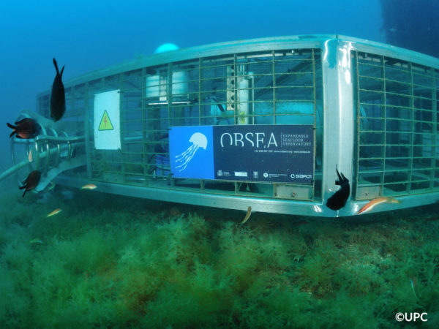
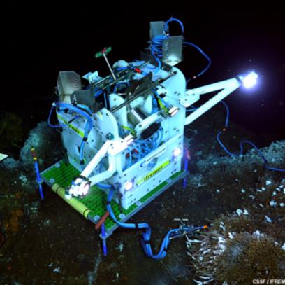
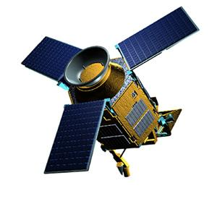
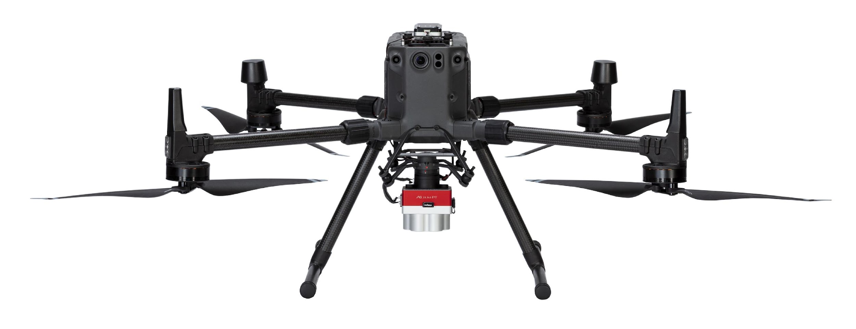
Image data tsunami in aquatic sciences
In Europe, we spent circa 1.4 Billion Euro a year in marine data acquisition (1.0 BE in-situ; 0.4 BE remote sensing)
Artificial intelligence
Machine learning
From DATA to KNOWLEDGE
Underwater cameras
Microscopes
CCTV cameras
Seafloor observatories
Satellites
Drones
. . .
ACQUISITION
MANAGEMENT
VALORISATION
Notes:
Marine environmental management and implementing ocean restoration initiatives require more knowledge and understanding. The implementation requires an increase of our overall knowledge, demanding more science and improved access to observation data and analytical processing. This builds upon national environmental observation and monitoring networks and programs, complemented with EU initiatives such as the Copernicus programme (CMEMS) and EMODnet, and European Research Infrastructures (RIs). Great additional potential in collecting and processing image data using high-performance image analysis tools, including Artificial Intelligence (AI) techniques, and in more sharing of image repositories.

Slide 5
Project Factsheet
OBJECTIVE:
To deploy, operate, validate, and promote a dedicated iMagine AI framework and platform, connected to EOSC and AI4EU, giving researchers in aquatic sciences open access to a diverse portfolio of AI based image analysis services and image repositories from multiple RIs, working on and of relevance to the overarching theme of ‘Healthy oceans, seas, coastal and inland waters.
36 months
From Sept. 2022 until Aug. 2025
€4.5 million EC funding
24 participants (19 beneficiaries + 5 affiliated partners)
18 service installations (Virtual Access)

Slide 6
Enabling scalable AI/ML services
4 national cloud compute centres and 5 AI/ML technology development institutes supports
14 research institutes for 12 RIs
Notes:
Research institutes with Logo
AI/ML technical experts: LIP, CSIC, IISAS, KIT, UPV
Infrastructure providers: TUBITAK, CSIC, INCD, Walton, GRNET
EGI.eu
—--------------
Add consortium member logos, classify into these groups - Section 3.2 gives you the list
From DoA:
“The three groups will compose a single, integrated value-chain for marine and freshwater research:
● 4 Compute/data centres deliver generic compute-storage capabilities and related expertise for image analysis.
● 5 Technology development institutes provide AI/ML application development and deployment services, related user support and training. They use the generic compute-storage capabilities for scalable model training and delivery.
● 14 RI institutes benefit from these services, deploy and deliver thematic research datasets and applications on top for end users in research, policy-making and other related sectors.
”

Slide 7
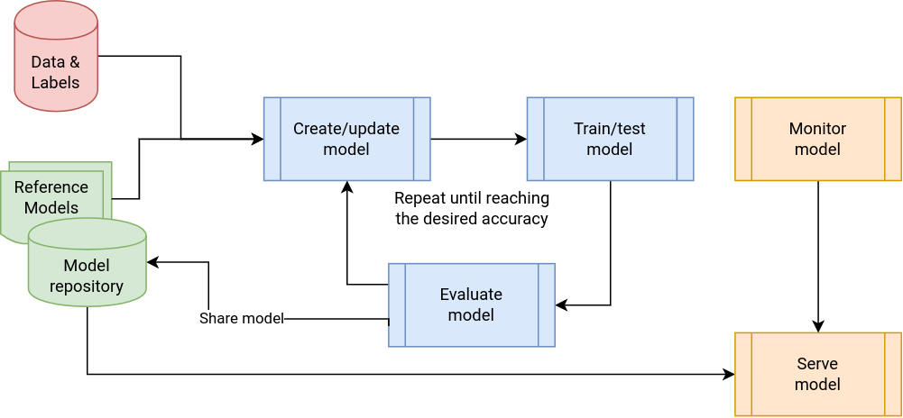
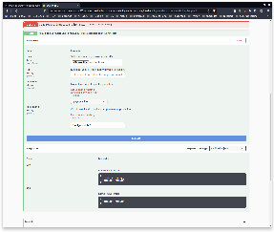
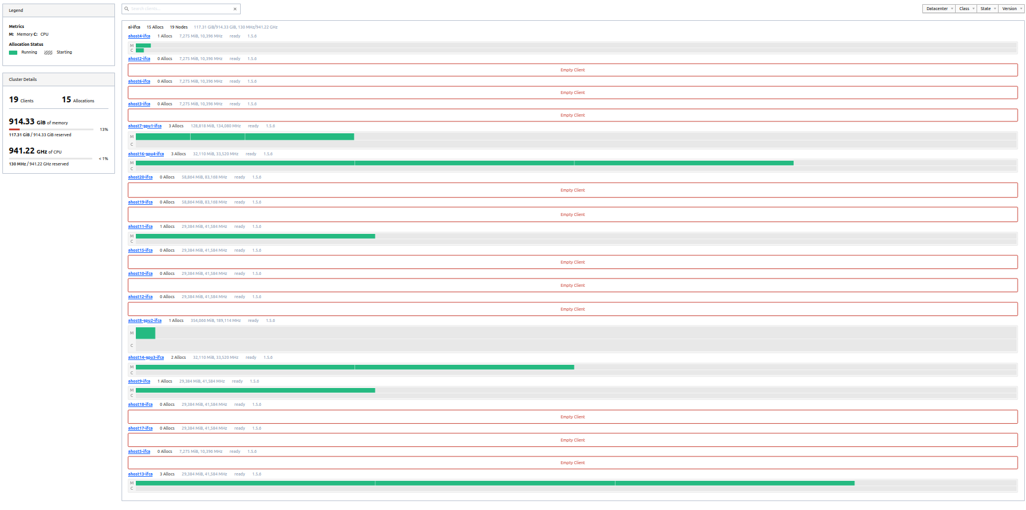
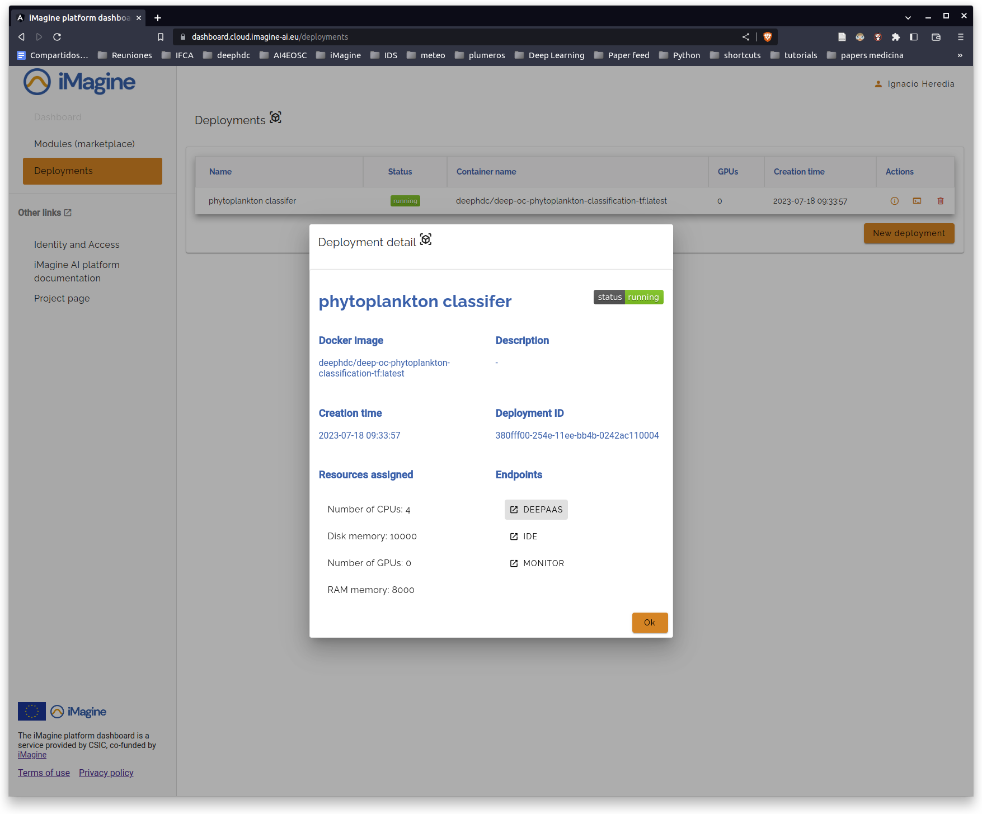
The iMagine Approach
5 Thematic Services
6 Thematic service candidates
Competence Centre
AI/ML Model development, training and delivery
CPU intensive
GPU intensive
8 internal use cases &
3 external use cases
Benefitting 10+ Research Infrastructures and linking to
Thematic Services
iMagine AI Platform
Generic, scalable platform for developing and sharing AI/ML applications.
Platform Service
EGI Federated Cloud
Infrastructure
1500 TB-months
132,000 GPU-hours
6,000,000 CPU-hours
OpenStack clouds with GPUs, CPUs, Storage in Spain, Portugal, Turkey & Ireland.

Slide 8
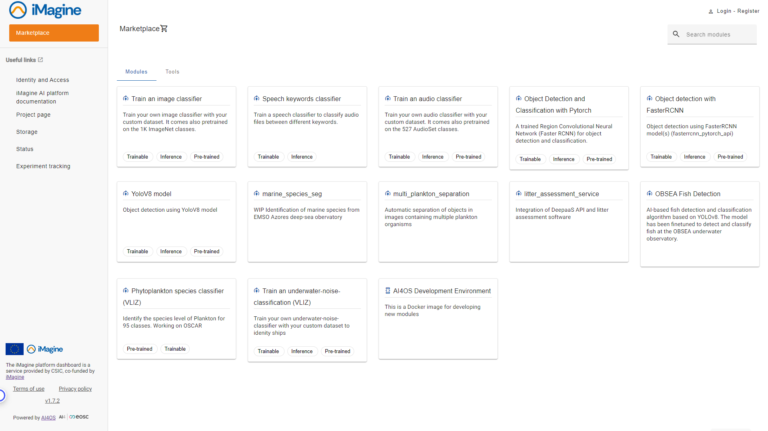
iMagine AI Platform

Slide 9
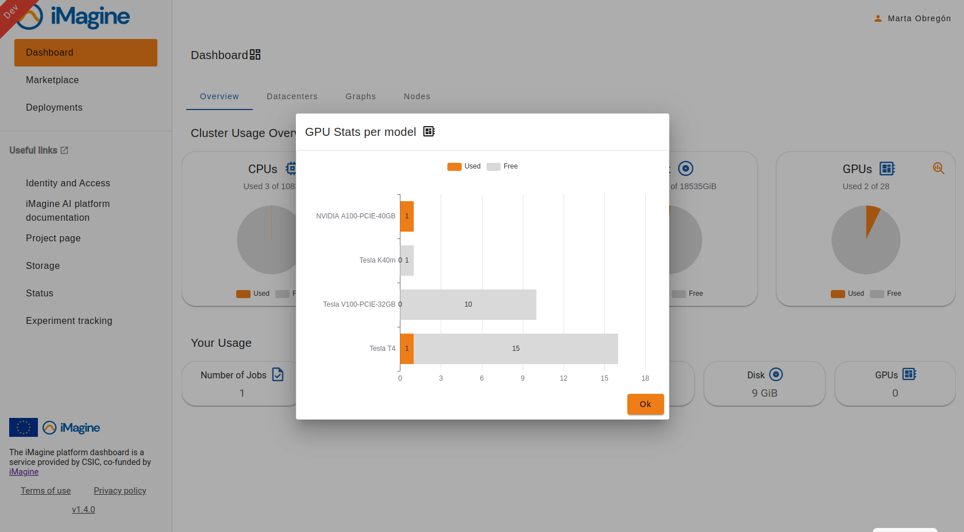
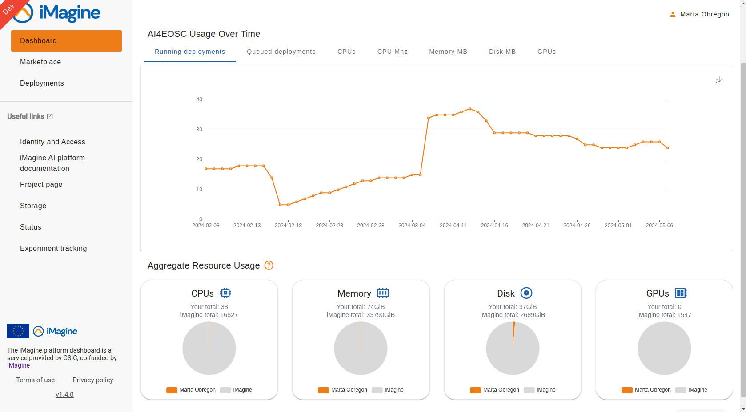
iMagine AI Platform
Delivering platform and compute services with Virtual Access funding

Slide 10
Common implementation approach across the Thematic Service use cases
NOW
Continuous interaction with users, feedback & knowledge sharing
Agile development in epics
Building up operation plans
Data delivery
Application service delivery
Good practices on AI for RIs
Results published in iMagine community in Zenodo: https://zenodo.org/communities/imagine-project/

Slide 11
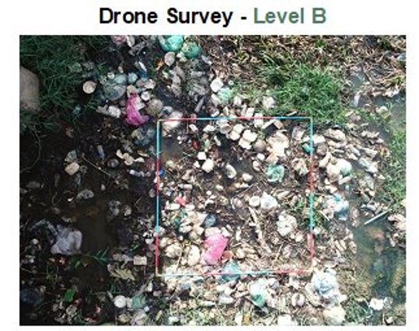
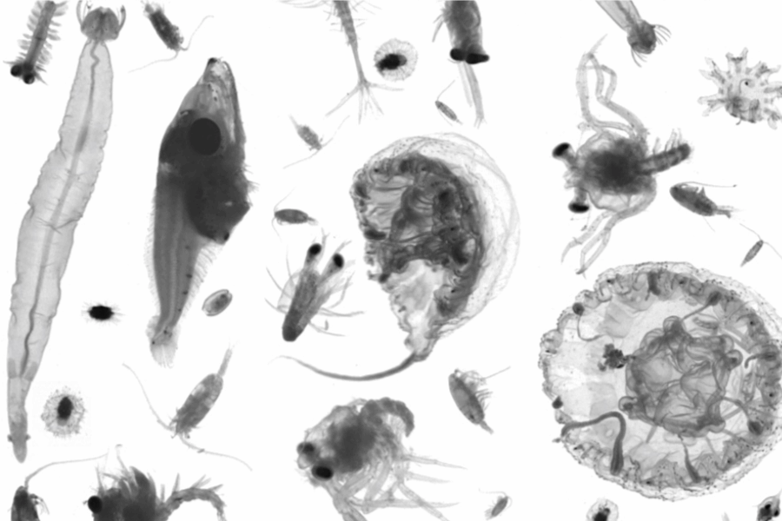
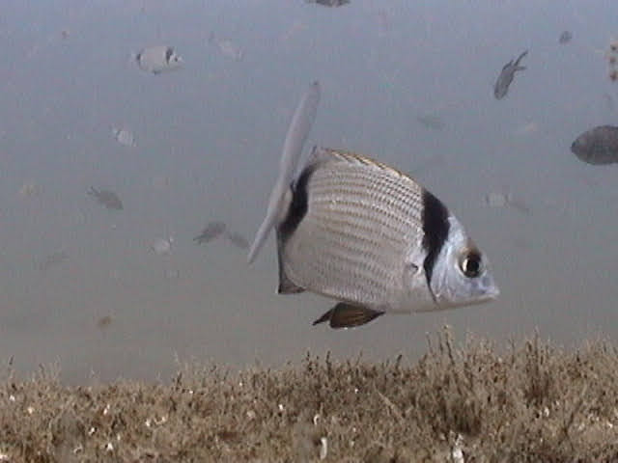
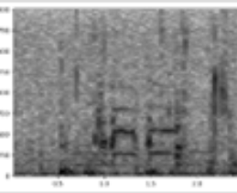
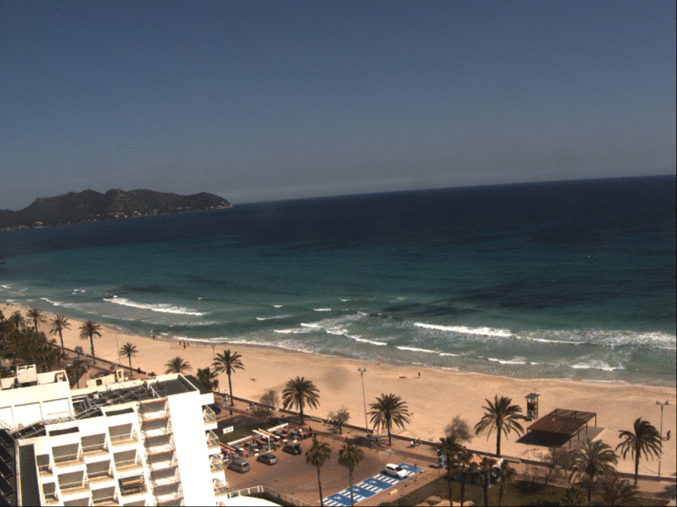
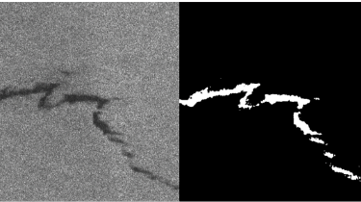
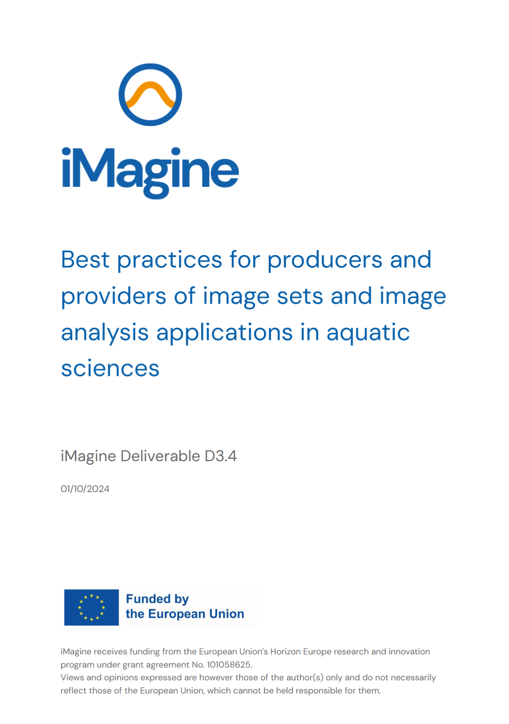
From models to services
Training Data sets
Image analysis services (powered by trained models)
Training datasets
AI application lifecycle
Good practices

Slide 12
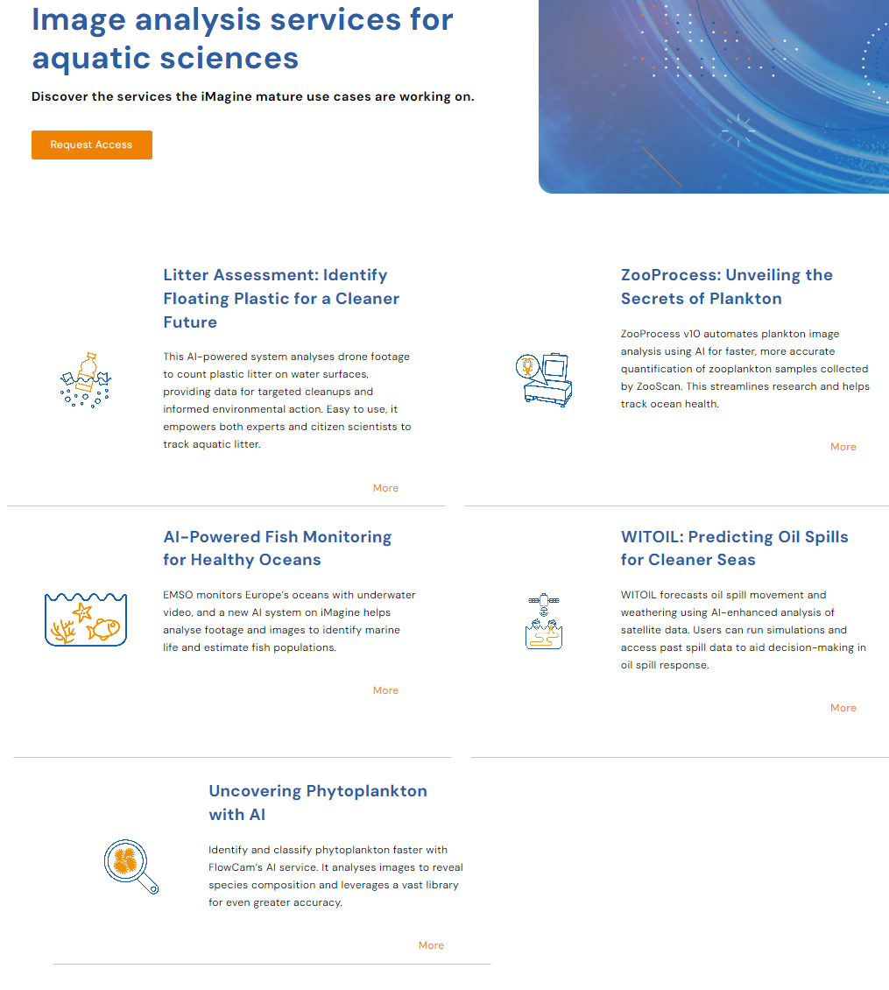
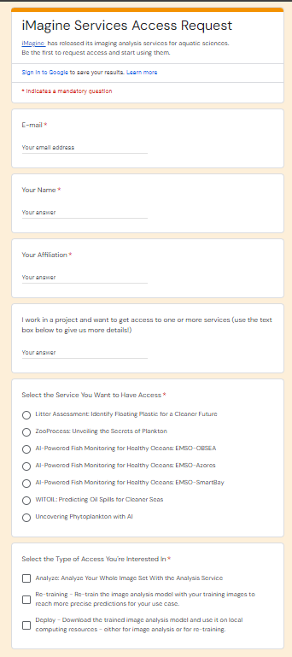
Thematic Services for image analysis - Access at https://www.imagine-ai.eu/services/image-analysis-services-for-aquatic-sciences

Slide 13
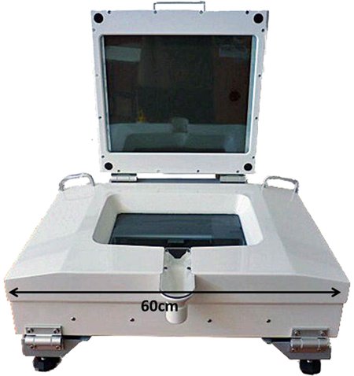
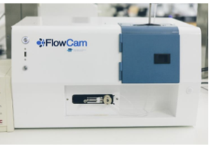
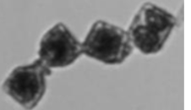
5 Thematic services
Aquatic Litter Drones: Aquatic Litter monitoring system using drones | DFKI (DE) + MARIS (NL) + OGS (IT)
EcoTaxa pipeline: Taxonomic identification of zooplankton using Zooscan | Sorbonne Université (LOV+IMEV) (FR)
Ecosystem monitoring at EMSO sites by video imagery | EMSO ERIC (IT) + UPC (ES) + Ifremer (FR) + MI (IE)
Oil Spill Detection: Oil spill detection from satellite images | CMCC (IT) + OrbitalEOS (ES) + Uni. of Trento (IT)
Taxonomic identification of phytoplankton using Flowcam images | VLIZ (BE)
60% oxygen on Earth!

Slide 14
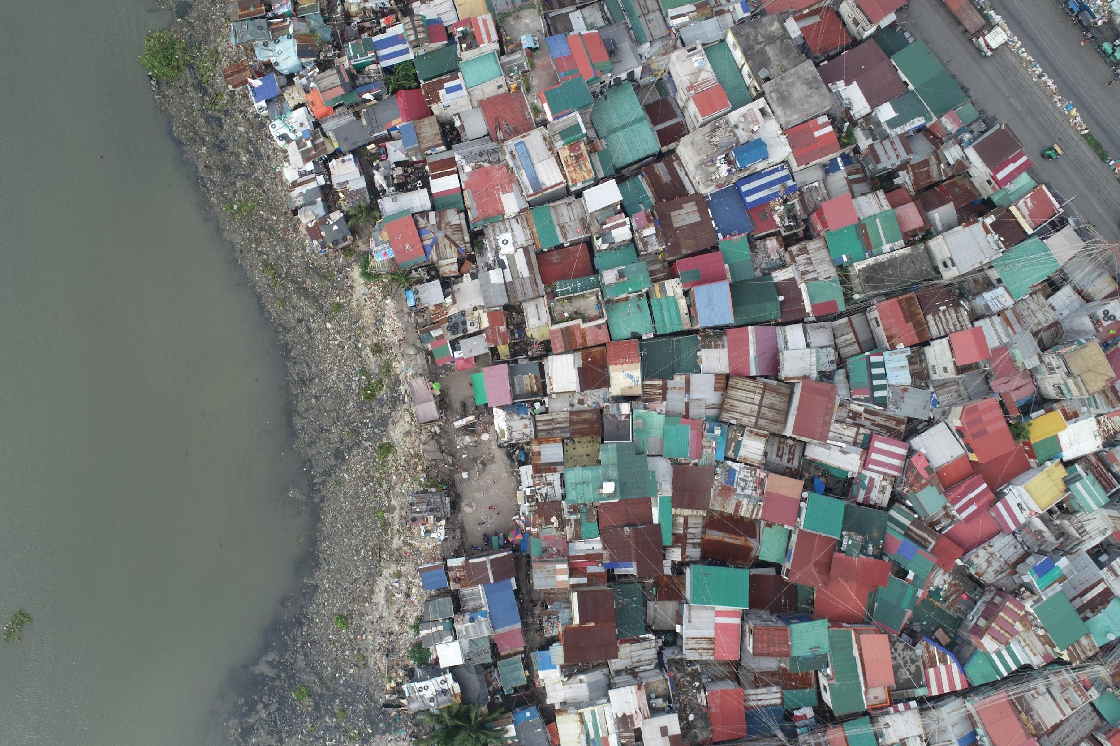
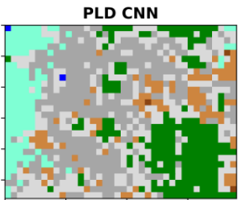
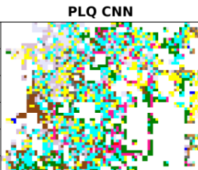
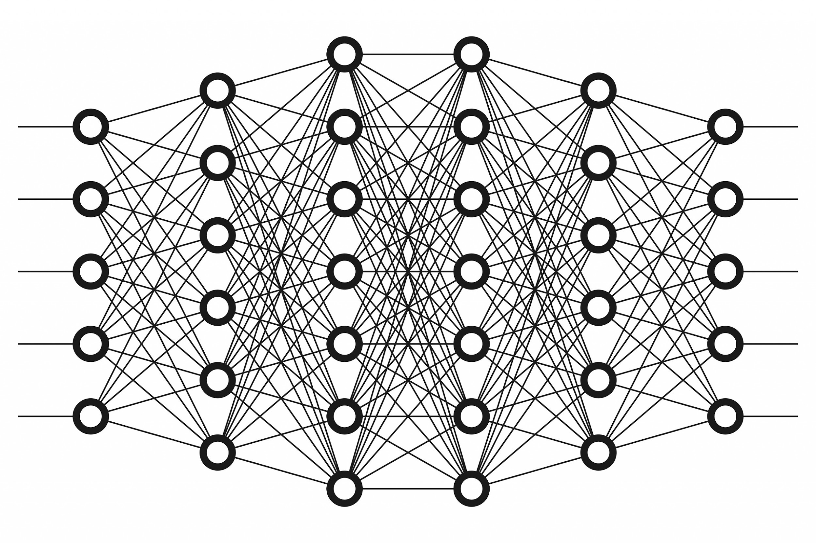
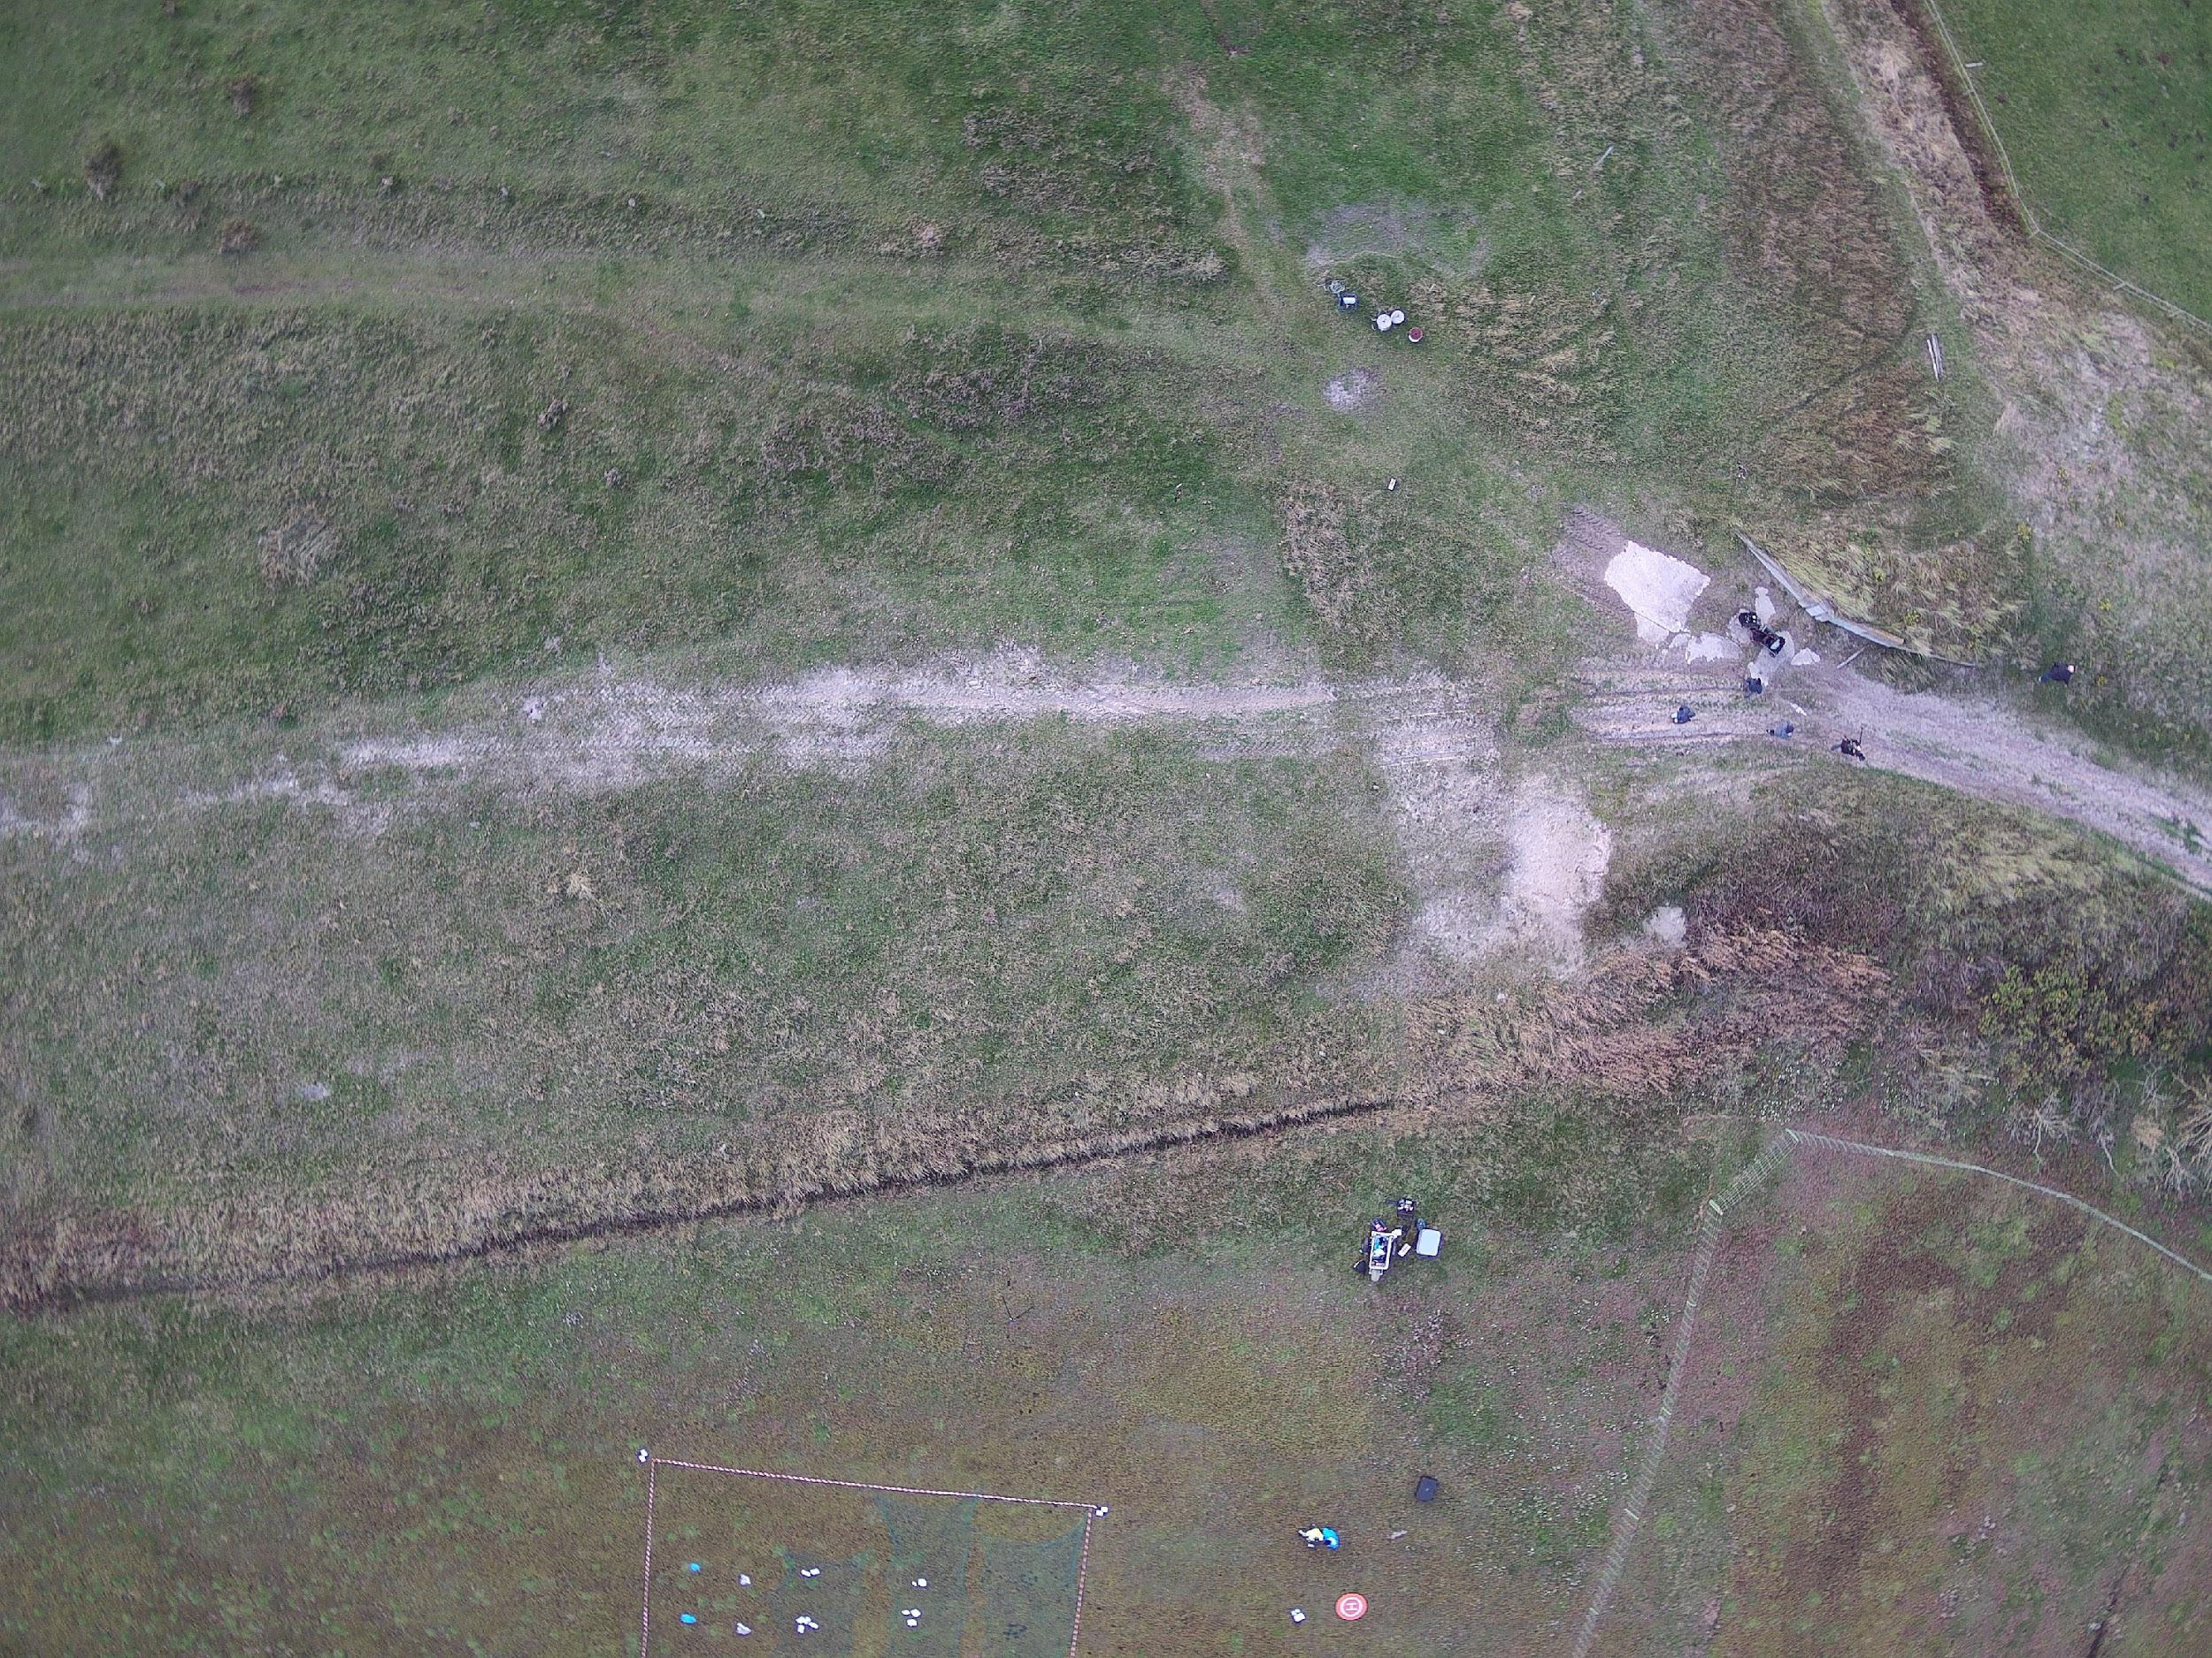
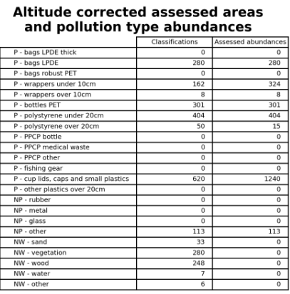
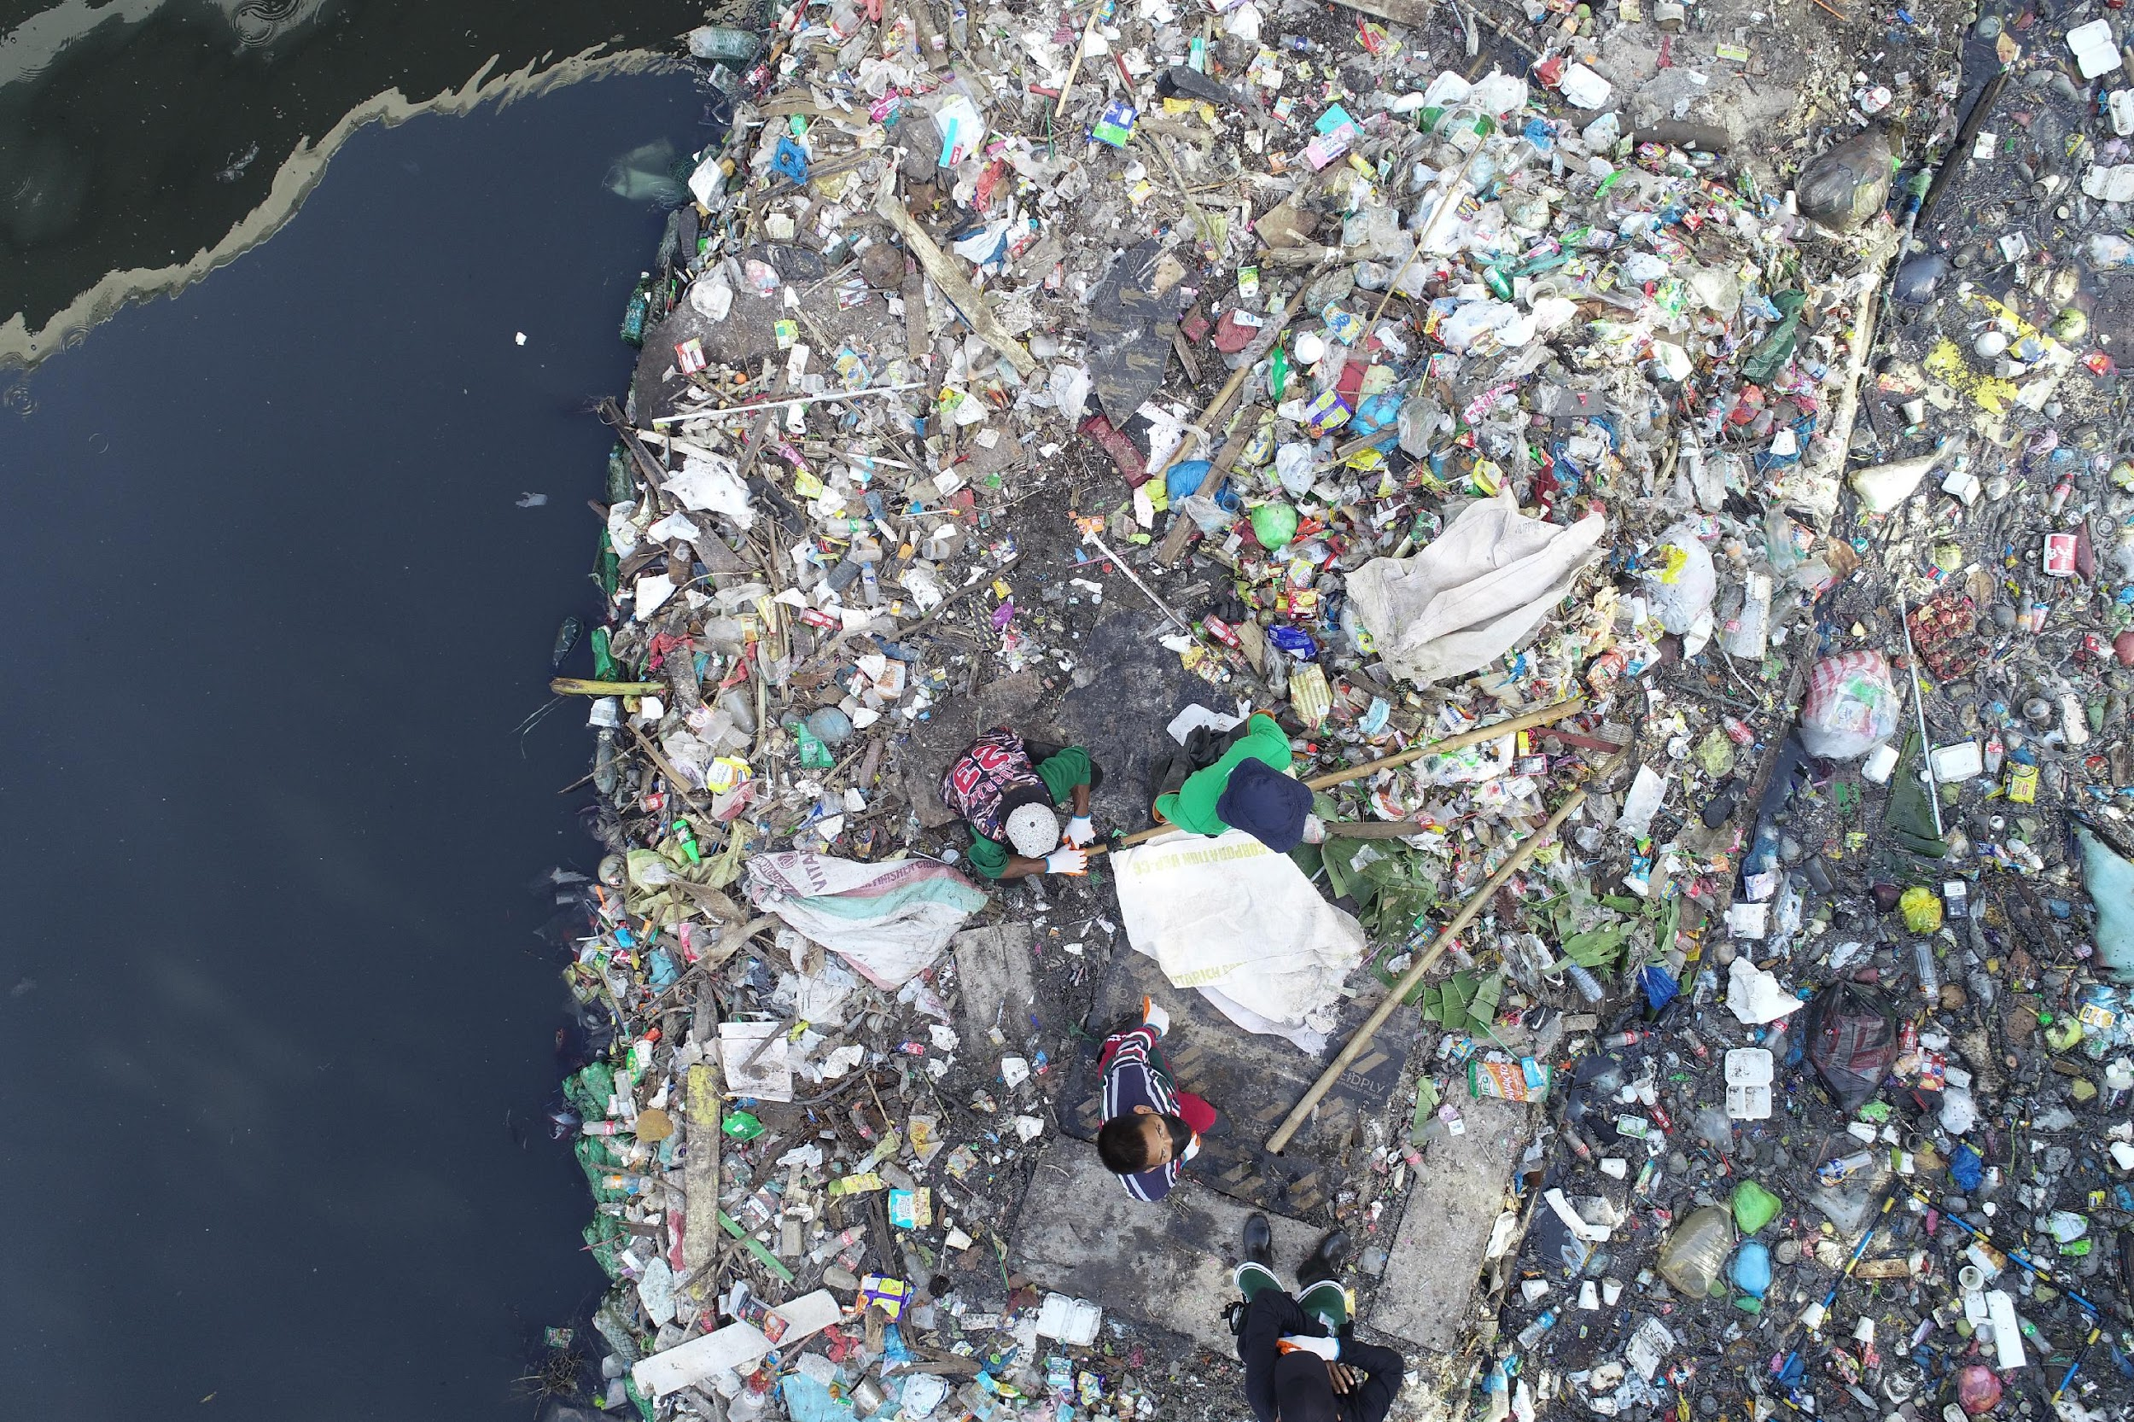
Aquatic Litter monitoring system using drones
Geographical distribution map
Standard classification of litter objects
Supporting clean-up operations; Environment monitoring agencies; Policy making

Slide 15
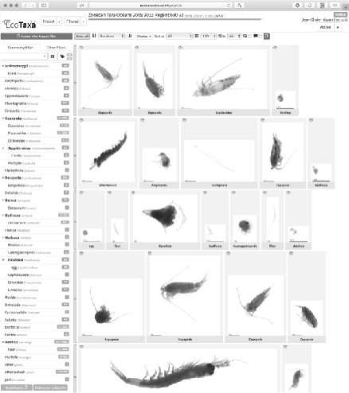
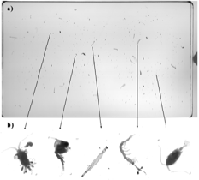
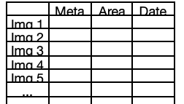
Zooprocess: Unveiling the secrets of planktons
API
Image processing
Web Front
Acquisition and metadata
Deep classifier of multiples
Deep segmenter
DB

Slide 16
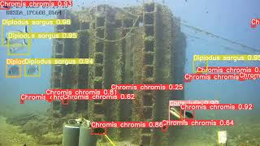
Fish classification at the EMSO OBSEA underwater observatory (Spain)

Slide 17
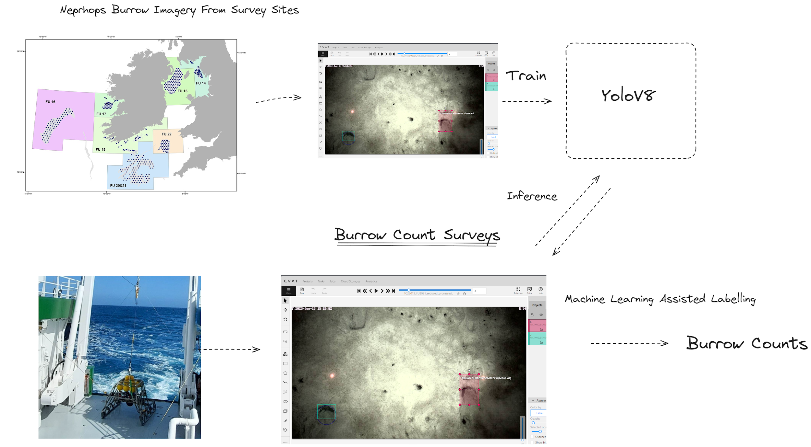
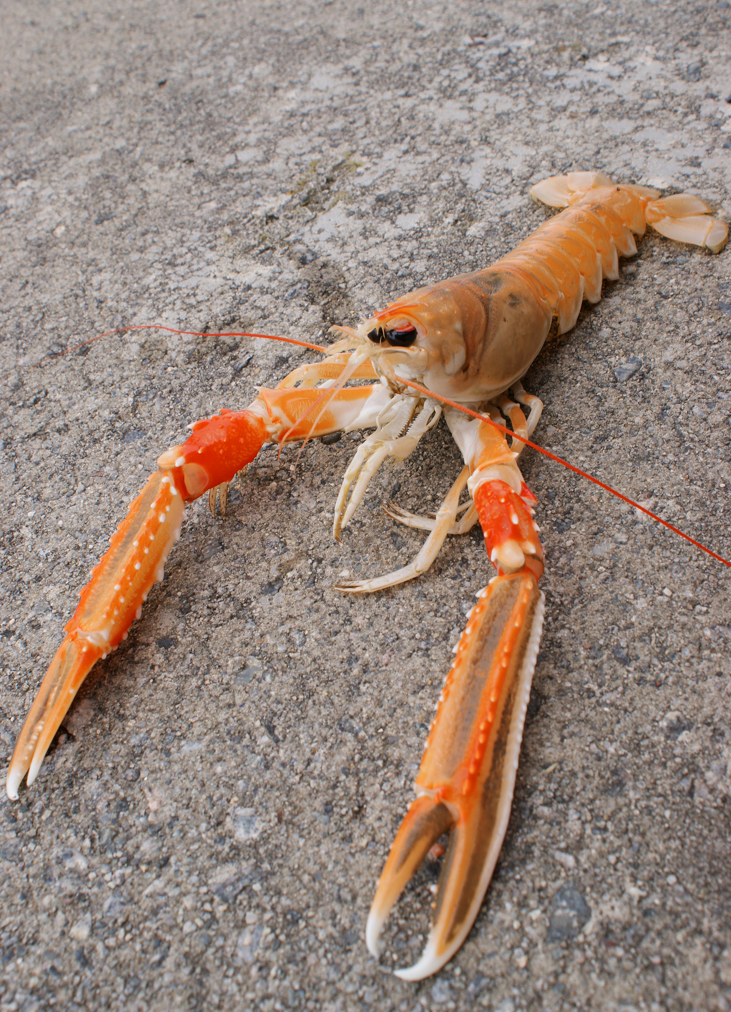
Nephrops Survey via burrow counts at EMSO Smartbay (Ireland)

Slide 18
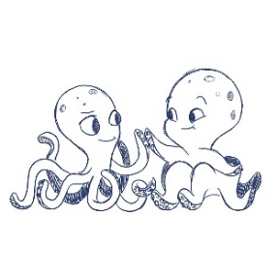
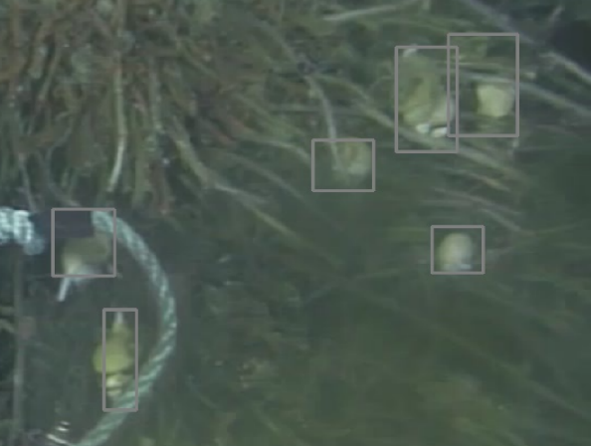
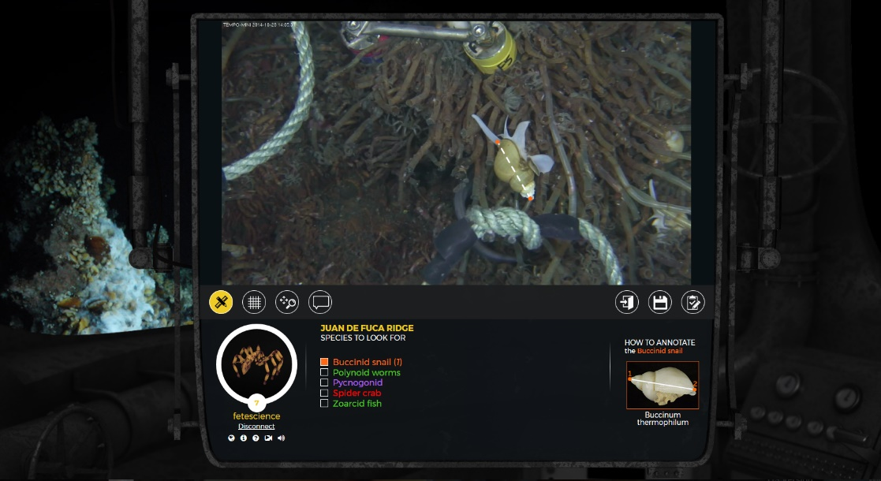
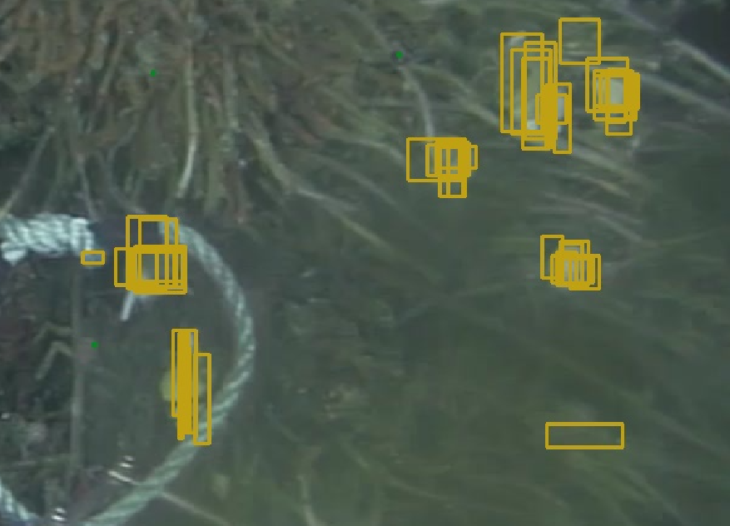
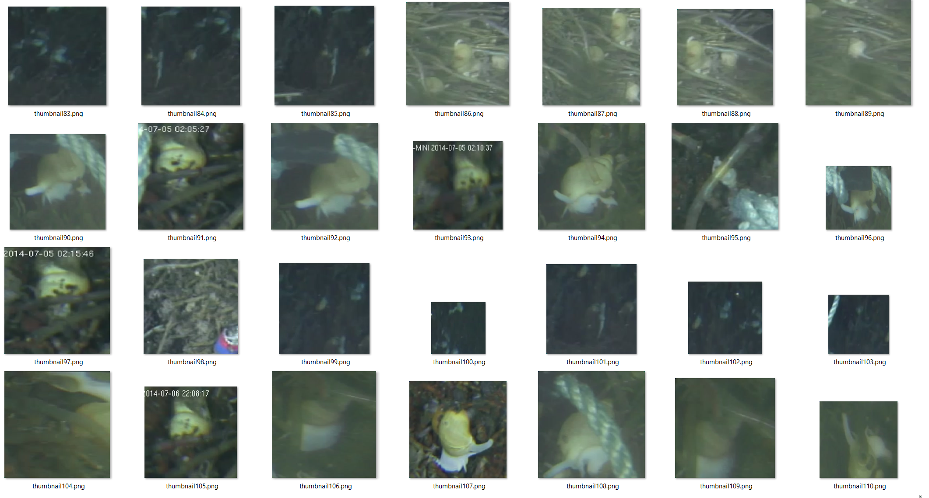
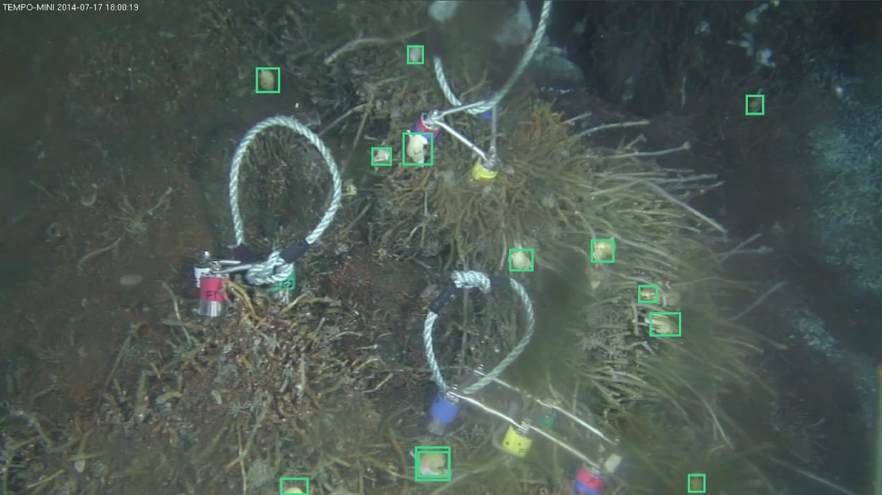
Ecosystem monitoring at EMSO-Azores (France)
Workflow
Imagery acquisition
Citizen contribution
Unique annotations
Seafloor Observatories
Deep Sea Spy
Data cleaning
& validation
Database, catalogues
Training
Inference
Data cleaning
& validation
Deep learning
Workflow of iMagine “Ecosystem monitoring at EMSO Azores sites by video imagery” use case
Notes:
Citizen annotations from Deep Sea Spy, a participative science platform launched in 2017 giving access to EMSO-Azores and Ocean Networks Canada observatories images to be annotated by citizens.
3156 images, 15 classes, 235323 annotations
Development of an user-friendly pipeline including:
Conversion of various annotation types to bounding boxes
Unification of overlapping bounding boxes
Visualisation of bounding boxes
Thumbnail generation and deletion of unreliable annotations
Automatic dataset reformatting and preparation for Yolov8 training
Training of Yolov8 model
Training on citizen annotations and on expert annotations when available
Validation on expert annotations when available
Focus first on Buccinid class on Ocean Networks Canada and Bythograeid crab on EMSO Azores
Expand to other species (Pycnogonid, Alvinocarid shrimp, Cataetyx fish)
Deployment of the pipeline and pre-trained model on the iMagine platform

Slide 19
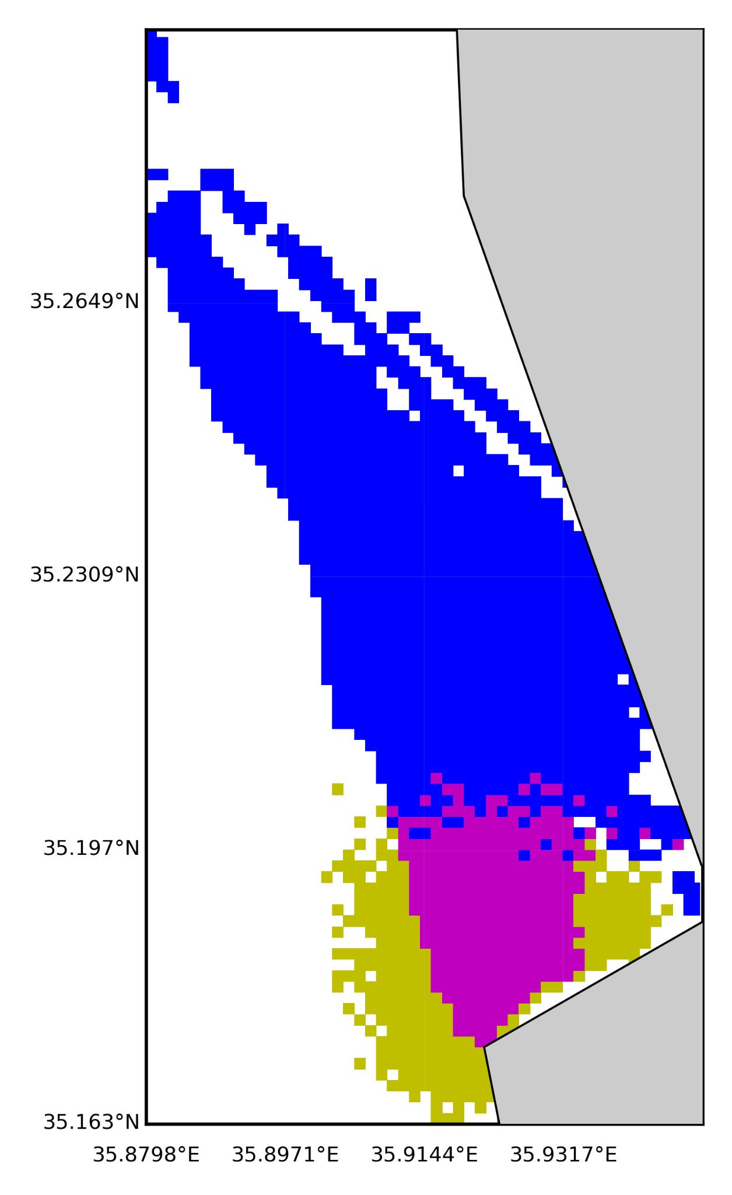
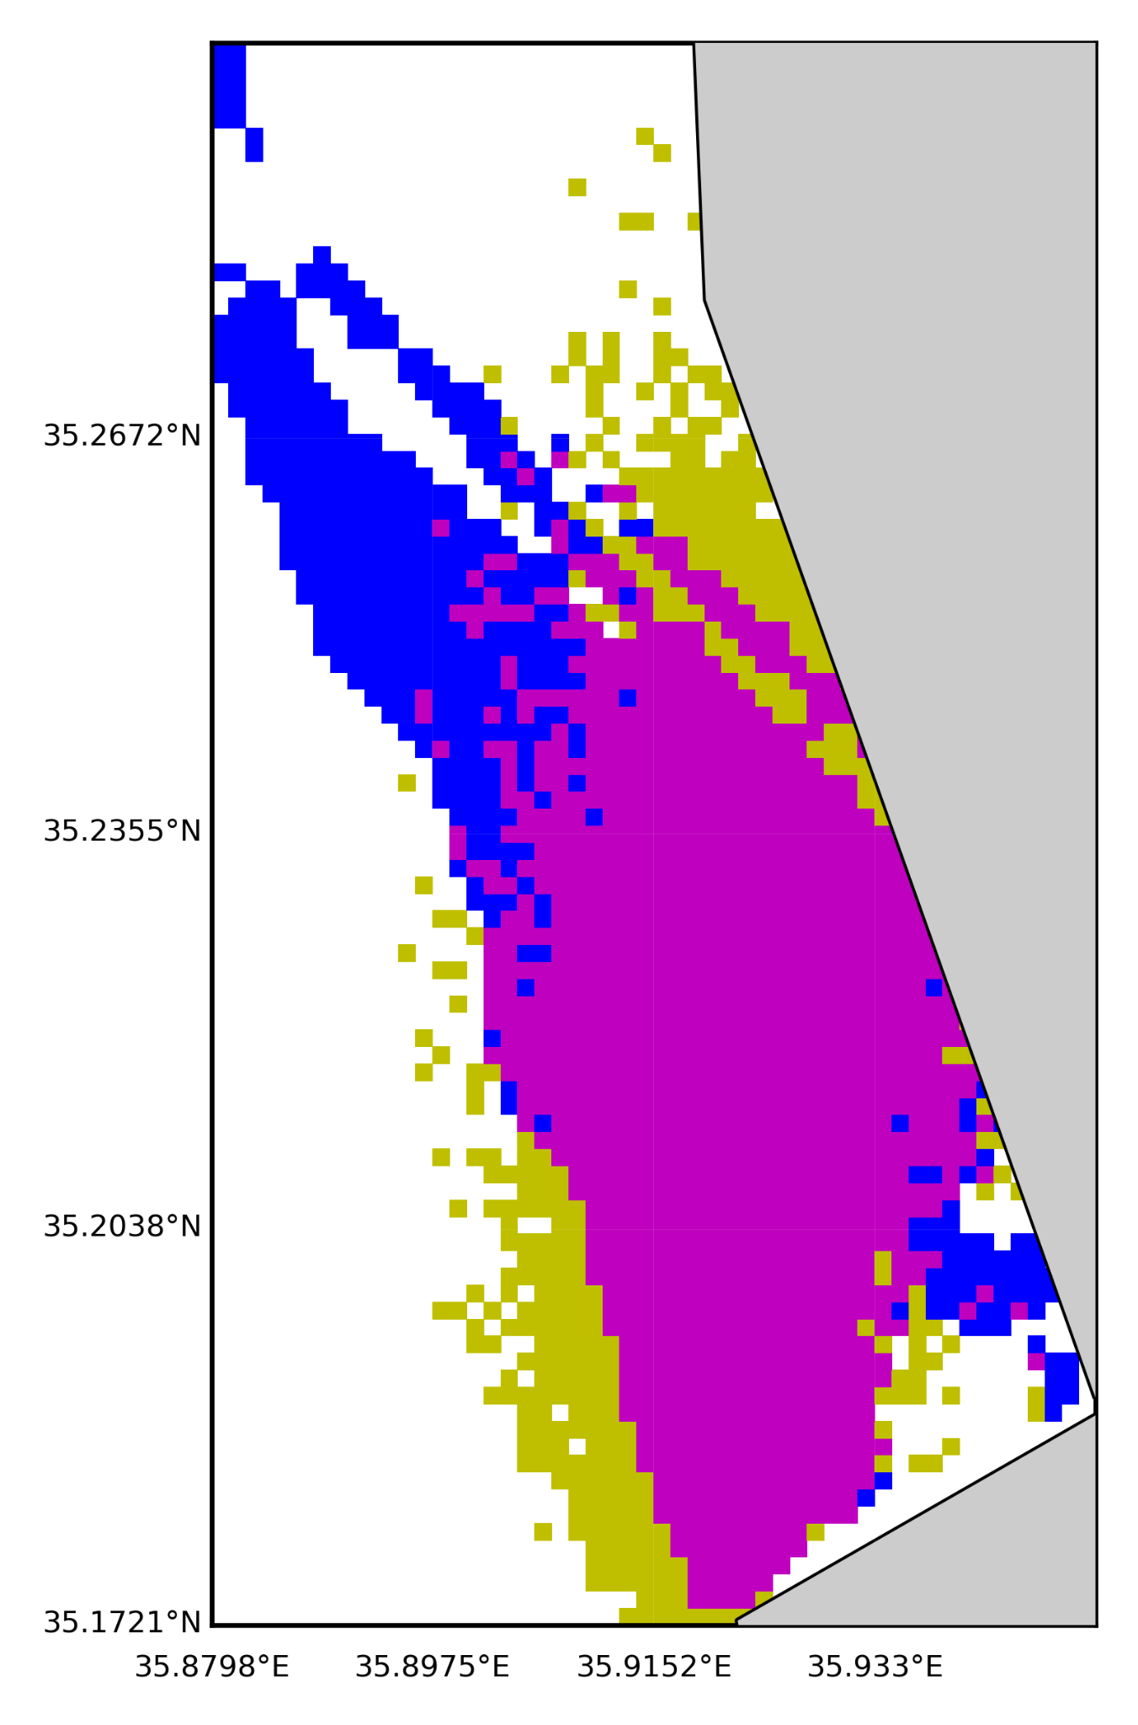
Oil Spill Detection
Standard simulation
BayesOpt simulation
 | Horizontal Diffusivity | Wind correction (Drift Angle at zero wind speed) | Wind correction (Drift Factor) | Metric
Standard | 2.00 | 0.00 | 0.78 | 0.35
BayesOpt | 17.08 | 1.73 | 0.04 | 0.85

Slide 20
Uncovering Phytoplankton with FlowCam and AI
2,2 M images
Notes:
in iMagine:
Image augmentation and transformation
Model performance analysis

Slide 21
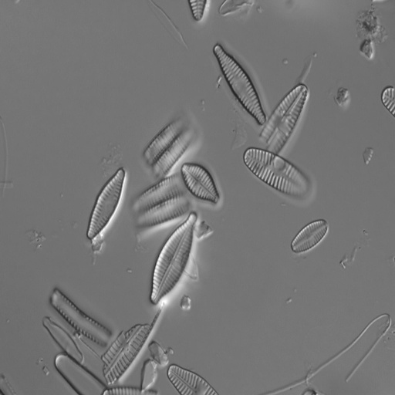
3 Thematic service candidates
Underwater Noise Identification: Underwater noise identification from acoustic recordings using spectrograms | VLIZ (BE)
Beach Monitoring: Posidonia oceanica berms and rip-currents detection from beach monitoring systems | SOCIB (ES)
Identification of diatoms in freshwater (unicellular microorganism) | UL-LIEC (FR) + CNRS-IRL2958 (FR) + SU-LOCEAN (FR)
Spectrograms
Palma

Slide 22
Data Repositories https://www.imagine-ai.eu/services/imagine-datasets
Aquatic Litter Drones
Underwater Noise Identification
Labelled Image Database: 26.147 for Plastic Litter Detection and 38.417 for Plastic Litter Quantification.
1.5 years of underwater sound data. Spectrograms of short time duration.
Zooscan-EcoTaxa Pipeline
Beach Monitoring
ZooScan segmentation benchmark: ~100 scans from Tara Oceans
ZooScan classification data: ~1.4M images + metadata
EcoTaxa: ~200M images
SIRENA image products and database: 3+ Million images.
Freshwater diatom identification
1000 key diatom species.
Hundreds of individual images /species gathered from real images and taxonomic guides.
Ecosystem monitoring at EMSO sites
EMSO-Obsea: 10-year dataset of images annotated with number and type of species that appear on each photo.
EMSO-Smartbay: Archive footage archives dating back to 2017. Data from the measurement of temperature, salinity, dissolved oxygen, turbidity, current flow and sound.
Flowcam phytoplankton identification
5 years of biomonitoring data. 1.2+ Million validated images along with 800K unvalidated images. 90 microplankton classes.

Slide 23
Best practices
Lessons learned during the whole AI model lifecycle
Experiences from 8 aquatic image analysis use cases
Available since 1st of October 2024:
https://zenodo.org/records/13866394

Slide 24
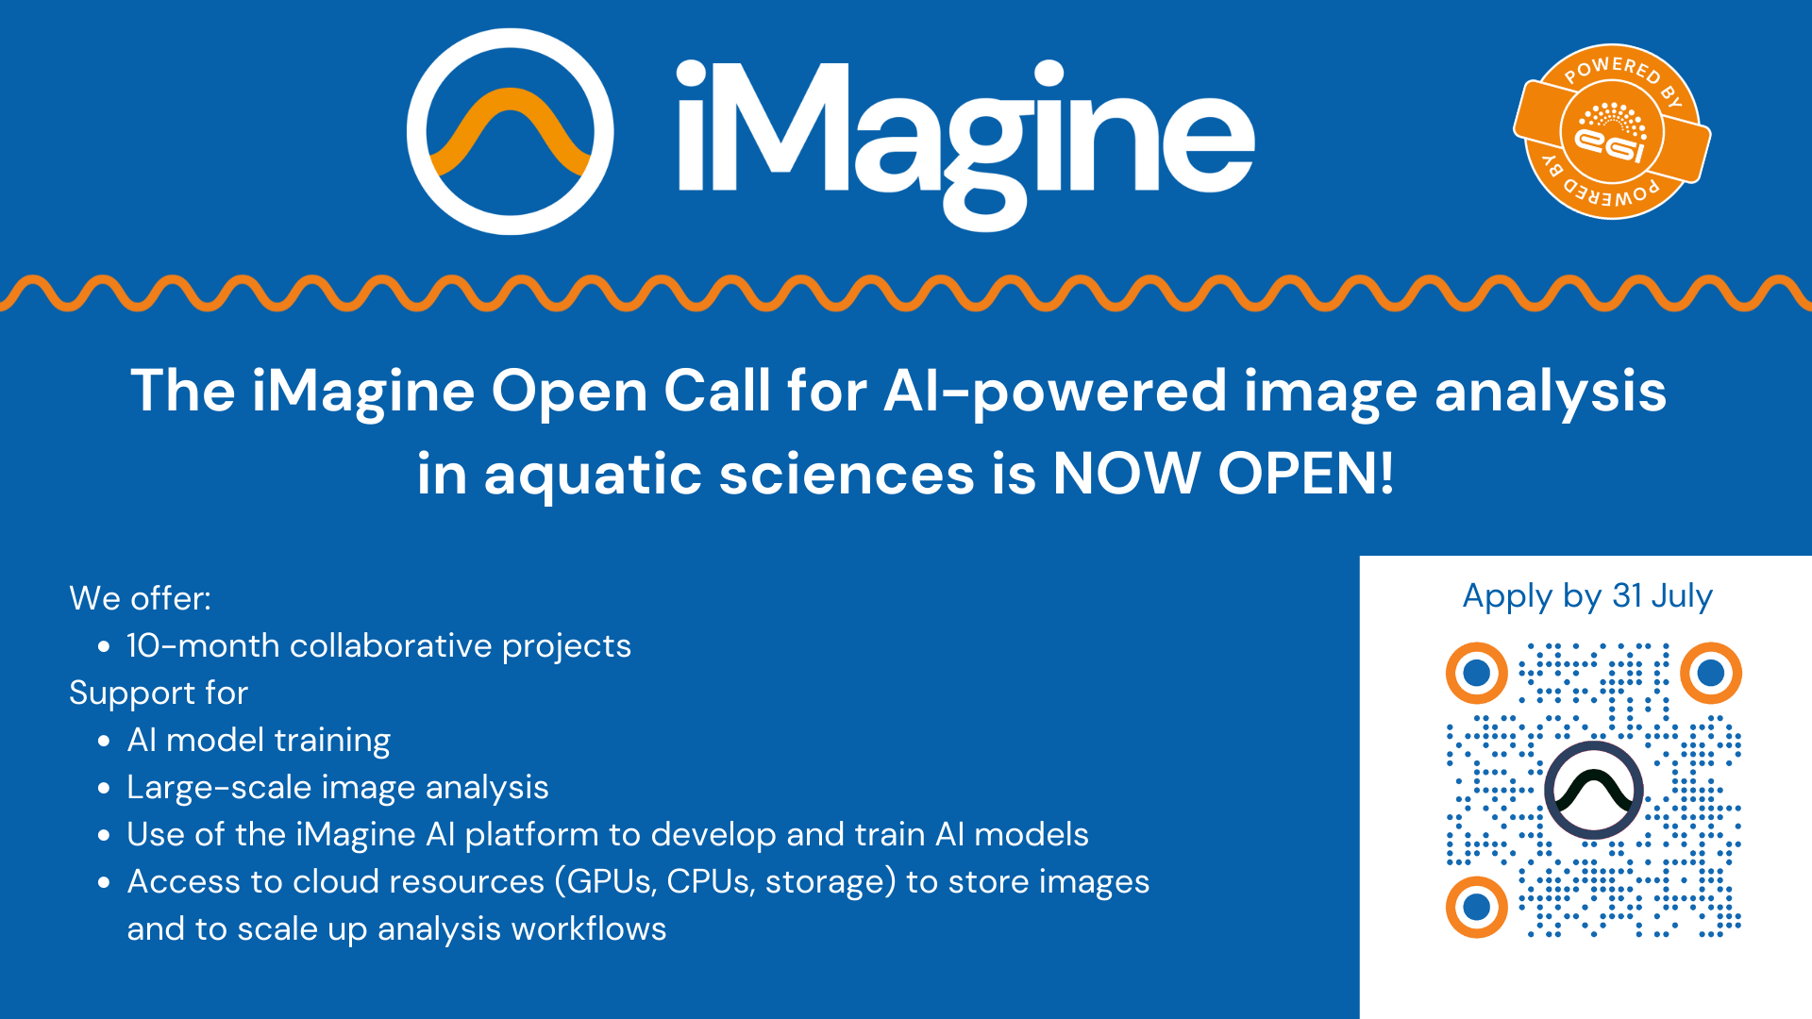
Call for additional use cases

Slide 25
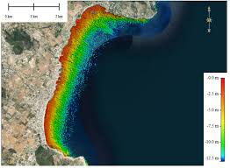
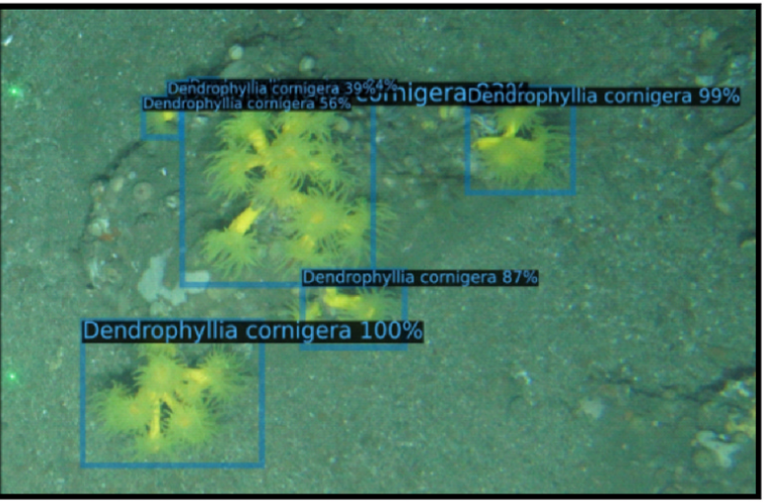
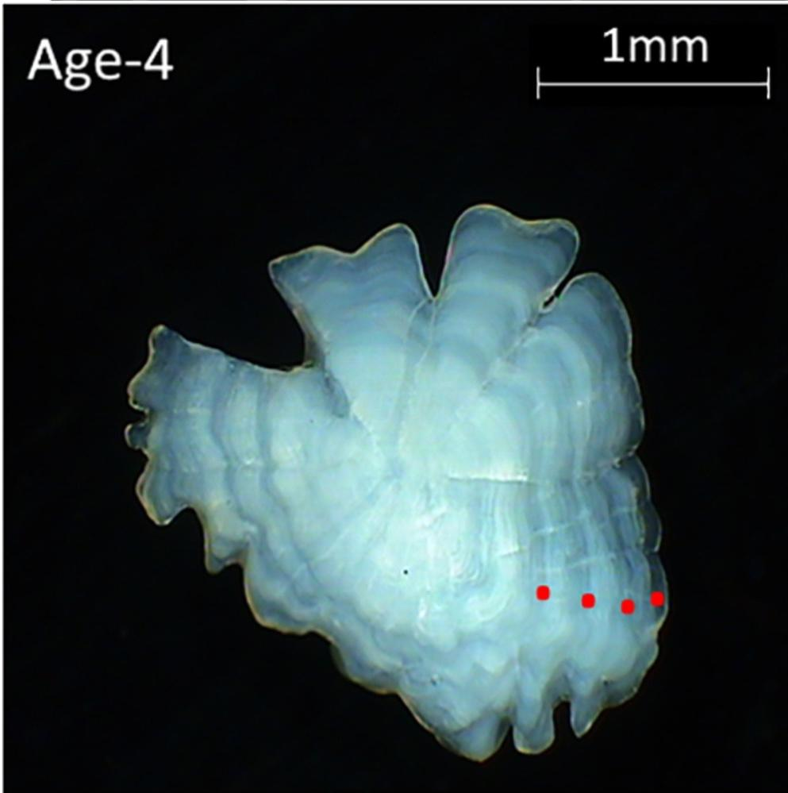
3 External Use Cases onboarded so far through the Open Call
Satellite-Derived Bathymetry
Institute of Marine Sciences of Andalusia
Nearshore bathymetry for coastal studies
Improving knowledge about Cold Water Coral Reef
Spanish Oceanographic Institute
Use AI to precisely delineate areas of living coral and dead coral
AI for image based age reading from fish otoliths Danish National Institute of Aquatic Resources
To develop an AI algorithm to identify the age of a fish from an otolith image

Slide 26
Thank you!

