Slide 1
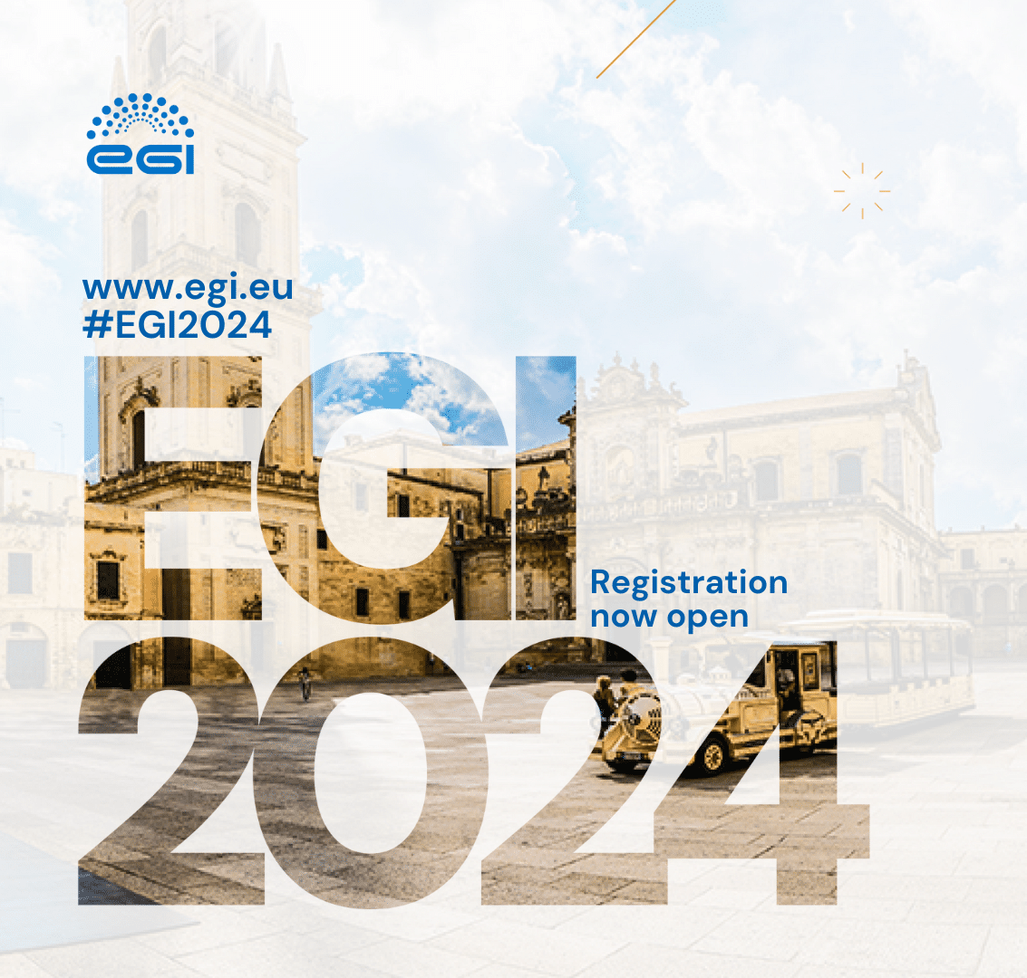
Exploring Climate Data Analysis with MATLAB in the ENES Data Space
Kostas Leptokaropoulos^{1,2},Shubo Chakrabarti¹ and Fabricio Antonio³
1
2
3
Contact: kleptoka@mathworks.com or via LinkedIn and Research Gate
Notes:
Hello everyone! I am Kostas Leptokaropoulos, and I am Geoscience Manager at MathWorks, and also a visiting research fellow at the University of Southampton.
Today, I will show you a case study on how to access, analyze and visualize open climate data, using MATLAB within the ENES Data Space, prepared with my colleagues, Colleague Shubo Chakrabarti from MathWorks and Fabrizio Antonio from CMCC, who offered his valuable support and assistance in integrating Data, Codes, documentation and workflows into the ENES data space.
We will have some time for Discussion after the presentation. FYI The slide deck will be distributed, and you can always contact me and EGI members for any queries and requests.
So, without further ado, let’s start with the agenda

Slide 2
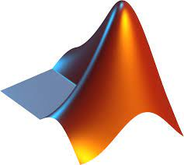
Agenda
Introduction
Introduction to MATLAB
Introduction to European Network for Earth System Modelling (ENES) Data Space
Case Study: Use MATLAB within the ENES Data Space to Import, Analyze and Visualize Global precipitation data from the CMCC
Summary and Resources
Notes:
I will start with an Introduction to MATLAB and a very brief overview of some existing and new features relevant to the EGI users …
Followed by an introduction to The European Network for Earth System Modelling Data Space, which is a comprehensive platform for accessing, sharing, and managing geodata and climate data.
The second part of the presentation is a Case Study in which we will see how to Use MATLAB within the ENES Data Space to Import, Analyze and Visualize Global precipitation data coming from the Euro- mediterranean Centre on Climate Change.

Slide 3
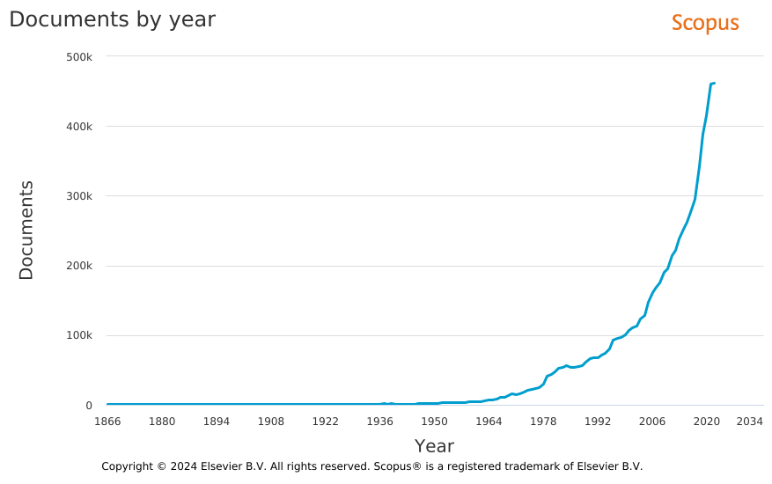
Introduction: Publications in Earth, Planetary & Environmental Sciences
More Papers
More Data
More Tools
More Collaborations
2017
~2000

Slide 4
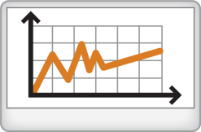
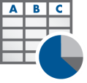
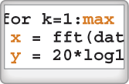
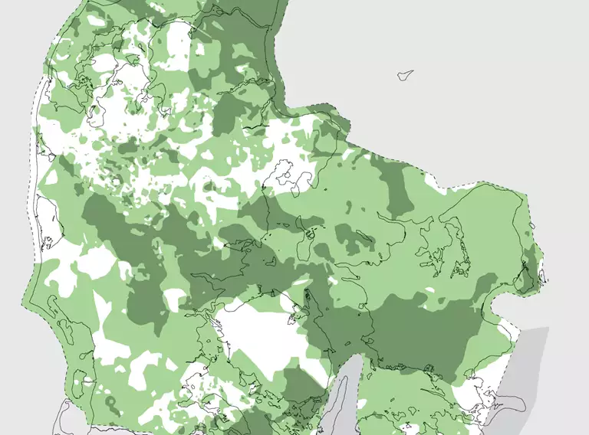
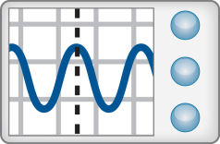
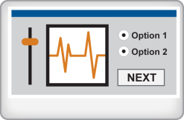
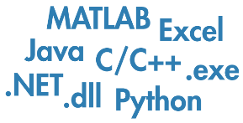
MATLAB maps to the Science Workflows
Access
Explore & Analyze
Output & Share
Data
Reporting and Documentation
Data Analysis & Modeling
Software
Algorithm Development
Data, methods, guidelines and software tools
Code & Applications
Application Development
Hardware
Automate
Notes:
Well, let’s see how MATLAB supports different stages of research by (click)
Offering access to data, software, hardware and web services;
Exploring and Analyzing data; and developing models and algorithms
Producing and Sharing research outcomes, such as data, methods, documentation, apps and tools

Slide 5
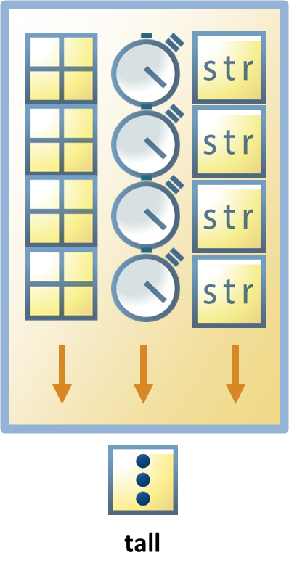
Geodata Access
Data Sources
NOAA
ECMWF/CDS
NASA (e.g., Earthdata, Images of Change)
NCAR TDS
ENES Data Space
Gebco Bathymetry
NGDC (BGS)
OPeNDAP
EarthScope
And more…
Data Formats
Raster file formats: GeoTIFF, USGS DEM, DEM, DTED, Arc ASCII Grid, GTOPO30, ETOPO, and worldfile
Vector file formats: ESRI shapefiles, KML, GPX, VMAP0, and GSHHS
Image file formats: TIFF, JPEG, PNG, JPEG2000, LandSat, NITF and HDR
Scientific data: NetCDF, HDF5, GRIB, CDF, FITS, and multiband files (BIP, BIL, BSQ)
And more…
timetable
Data Format Functions >>
Data Formats >>
Notes:
Climate data is usually available via data agencies and web portals such as the ones shown here.
These Data Portals provide centralized access to vast repositories of diverse climate datasets in a variety of types and formats such as click...
In addition, these portals, oftentimes offer sophisticated tools for data management, visualization, analysis and scientific collaboration
(Click) Today we will discover such features by exploring a case study carried out exclusively on the ENES Data Space

Slide 6
ENES Data Space
Notes:
ENES DS is an open, cloud-enabled data science environment for climate data analysis built on top of the (click) EOSC (or European Open Science Cloud) , providing both storage and computational capabilities.
The service hosts data from the (click) ESGF archive (or Earth System Grid Federation), to support researchers in climate model analysis.
ENES Data Space, is made available through a user-friendly JupyterLab GUI (click), which integrates into a single environment: climate datasets from well-known initiatives (e.g., CMIP6 – or Phase 6 of the Coupled Model Intercomparison Project ), as well as various computing tools, including (click) the MATLAB integration, aiming among others, at big data processing, interactive analytics and visualization.

Slide 7
Case Study - Precipitation Variability Analysis
https://enesdataspace.vm.fedcloud.eu/notebooks.html
Notes:
Having said that, let’s move to the Case Study:
This case study is presented as a Live Script as well as a Jupyter Notebook. A Live Script, is a MATLAB computational notebook incorporating text, code, equations, hyperlinks and custom-built low-code Live Tasks all in one document.
The workflow to be demonstrated includes importing, filtering, and manipulation of the data, creating maps and graphs, comparing results with each other and performing hypothesis testing to evaluate the statistical significance of different outcomes.
So let’s now move into the ENES data space.

Slide 8
Access ENES Data Space - https://enesdataspace.vm.fedcloud.eu/home.html

Slide 9
Workspace - JupyterLab

Slide 10
Data and Workspace
notebooks/Visualize_Climate_Data_with_MATLAB.ipynb at main · ENES-Data-Space/notebooks (github.com)

Slide 11
Code – MATLAB Online, MATLAB Kernel for Jupyter

Slide 12
Results, export and share

Slide 13
Wrap up
ENES Data Space is a Cloud-enabled environment for climate data storage and analysis.
Example of Climate data import, processing and visualization.
Analysis performed with MATLAB within the ENES Data Space environment.
Notes:
- ENES Data Space is a Cloud-enabled environment for climate data storage and analysis, providing both storage and computational capabilities
- We demonstrated an example of Open Precipitation data import, processing and visualization.
- The entire process was performed in MATLAB within the ENES Data Space environment with no need to install software or download data on the users’ local (non-cloud) devices.

Slide 14
Resources: Precipitation Analysis Using MATLAB in the ENES Data Space
ENES Data Space
Sign up
Home
Notebook
Link to the EGI Webinar (22 May):
Slide Deck (Zenodo)
Recording (YouTube ~ 50’)
Code and access to data available at:
GitHub
File Exchange
Reproducible Capsule in Code Ocean with DOI
Visit us at MathWorks Booth #2 for discussion and live demos

Slide 15
Thank you for your Attention!
Contact author via LinkedIn:
Contact: kleptoka@mathworks.com or via LinkedIn and Research Gate

Slide 16
Supplements

Slide 17
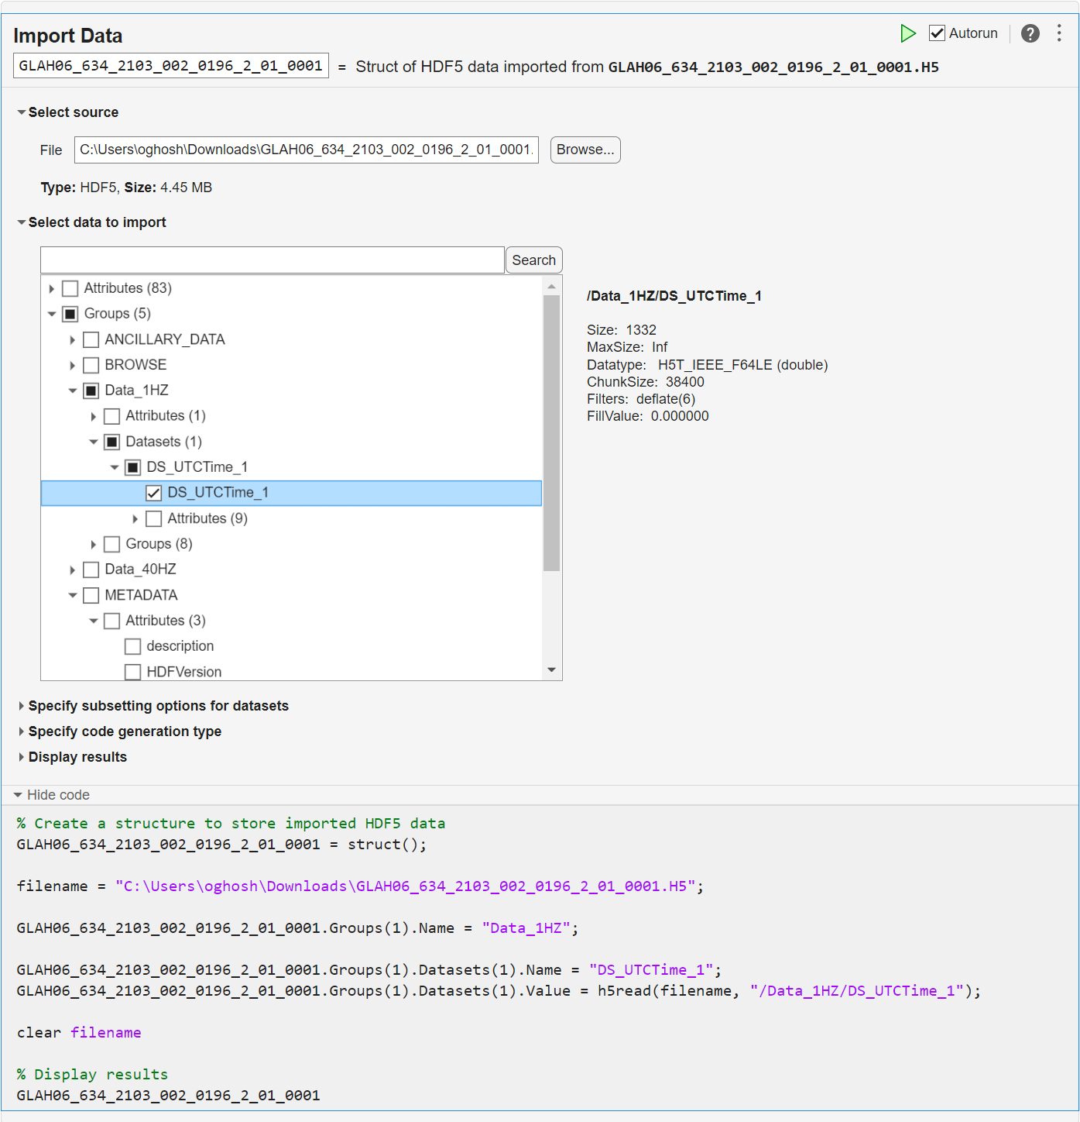
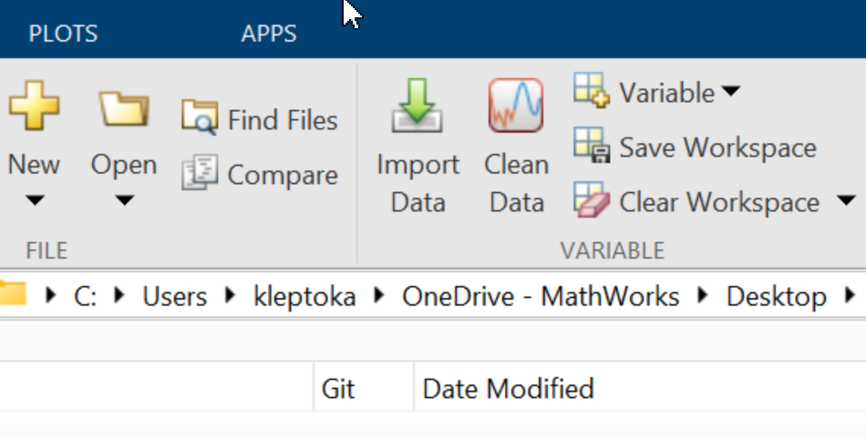
MATLAB Live Editor: Import Data Live Task now supports both
NetCDF (R2023b)
HDF5 (R2024a)
GRIB (R2024b)
Code Generated

Slide 18
Resources
What Is Open Science? - MATLAB & Simulink
Reading in data formats in MATLAB
Scientific data formats in MATLAB
Reading GRIB data in MATLAB
Pandas dataframes in MATLAB
Community tools on File Exchange
Data types in MATLAB
Writing your code
Live Editor
MATLAB Integration for Jupyter
Source Control with MATLAB
Use git with MATLAB
Contact: kleptoka@mathworks.com or via LinkedIn and Research Gate

