Slide 1

Enlivening the Heritage Digital Twin
Franco Niccolucci (ARIADNE RI & PIN)
Achille Felicetti (ARIADNE RI & PIN)

Slide 2
Digital documentation of cultural heritage
The EU Commission pushes the digitisation of monuments and sites, heritage objects and artefacts to boost their reuse in domains such as education, sustainable tourism and cultural creative sectors: creation of the Data Space for Cultural Heritage (Commission Recommendation of 10.11.2021 on a common European data space for CH) and increase the number of 3D models
Europeana manages 58 million digitised cultural heritage records from over 3600 European cultural heritage institutions, using the EDM metadata ontology, and is creating the Data Space for CH
ARIADNE RI manages 4.000.000 archaeological research datasets from 35 research centres of 20 countries, using a specialization of the CIDOC CRM ISO standard
The 4CH project has developed tools to avail of digital tools (notably 3D models) to support the conservation of monuments and sites. It started the development of the HDT
The ECCCH project ECHOES (start May 2024) will create tools to manage heritage data
The 3D-4CH project (start 2025) will create a virtual research centre about 3D for CH
The ARTEMIS project (start 2025) will support the use of AR and VR for the conservation and restoration of heritage assets
There is an urgent need of organizing the heritage (meta)data in an efficient way, compliant with existing standards and suitable for collaborative heritage research, study and conservation

Slide 3
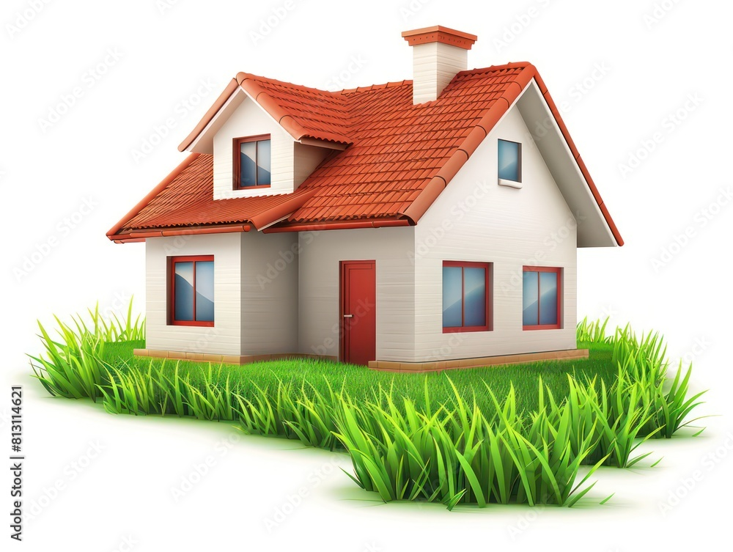

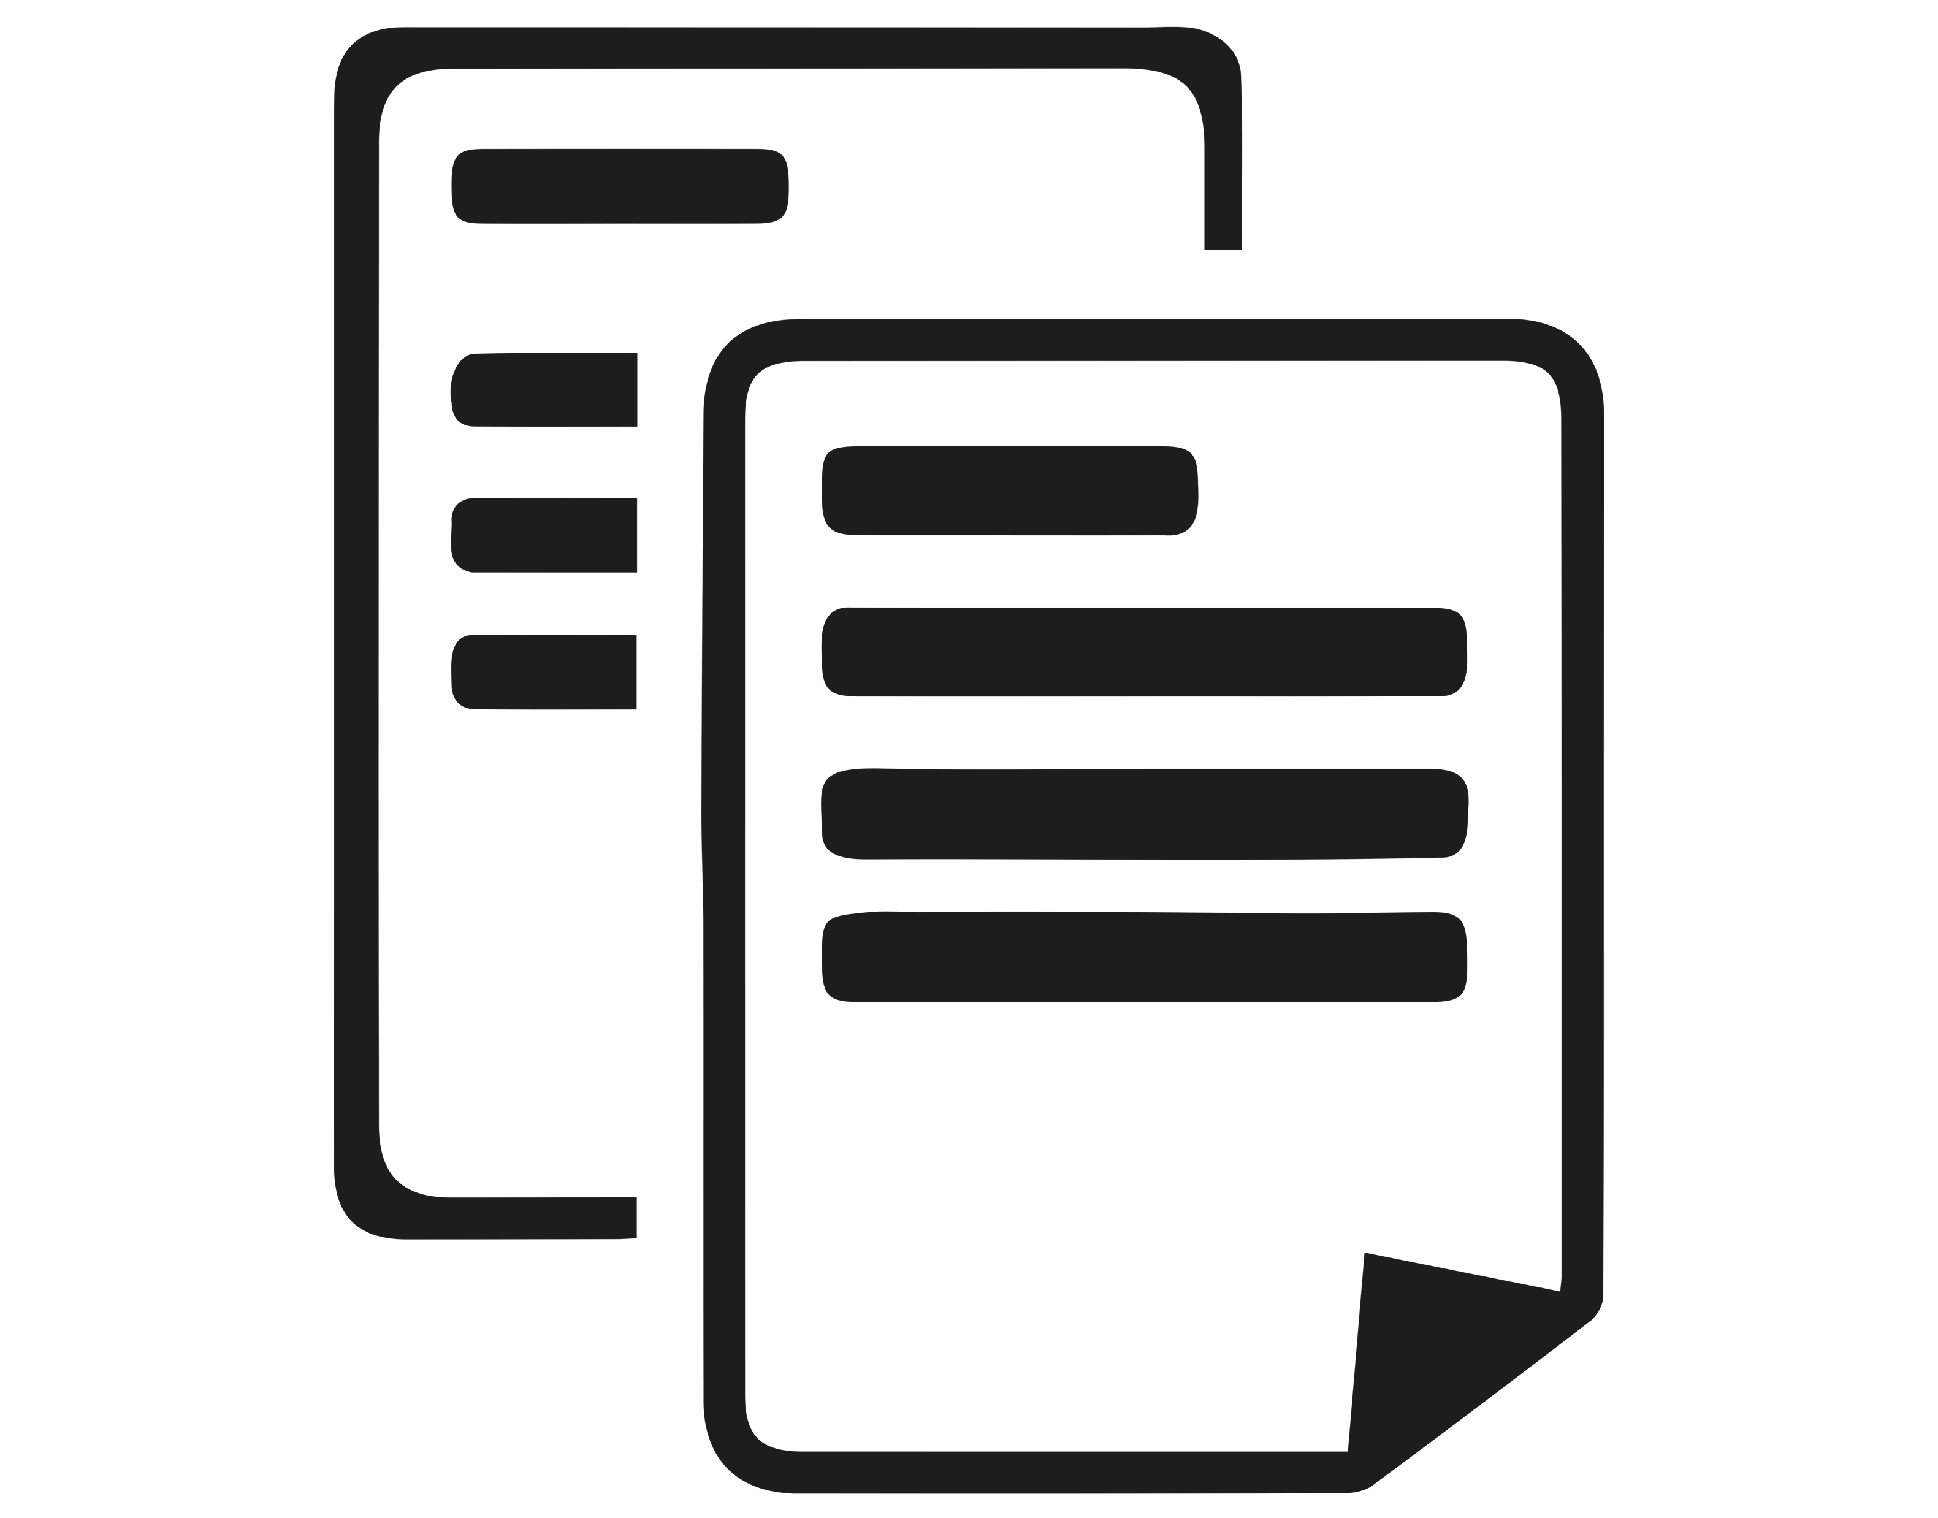
Misconceptions about CH digital twins
“A digital twin is the 3D model of a heritage asset”
Information is “attached” to the model
  Using 3D scan point clouds and attaching “sticky” information
    Does not allow cross-model searches
  Using BIM models (= CAD-based) and extending BIM to include heritage information (➜ HBIM)
    Uses non-standard (meta)data formats
Neither works for intangible assets
Roof
Point cloud with “notes”
Window
Door
Grass
Wireframe (CAD) with extra info

Slide 4
Introducing the Heritage Digital Twin (HDT)
The HDT is defined as the holistic complex of all the information related to a heritage asset (movable, immovable, tangible or intangible)
It may incorporate references to graphic representations (including 3D, but also 2D, videos, 4D, etc.) as well as references to texts, results of scientific analyses and so on
The first version (2022) was static: data may have a timestamp but there is no direct interaction with the reality

Slide 5
A (simplified) semantic diagram of the HDT

Slide 6
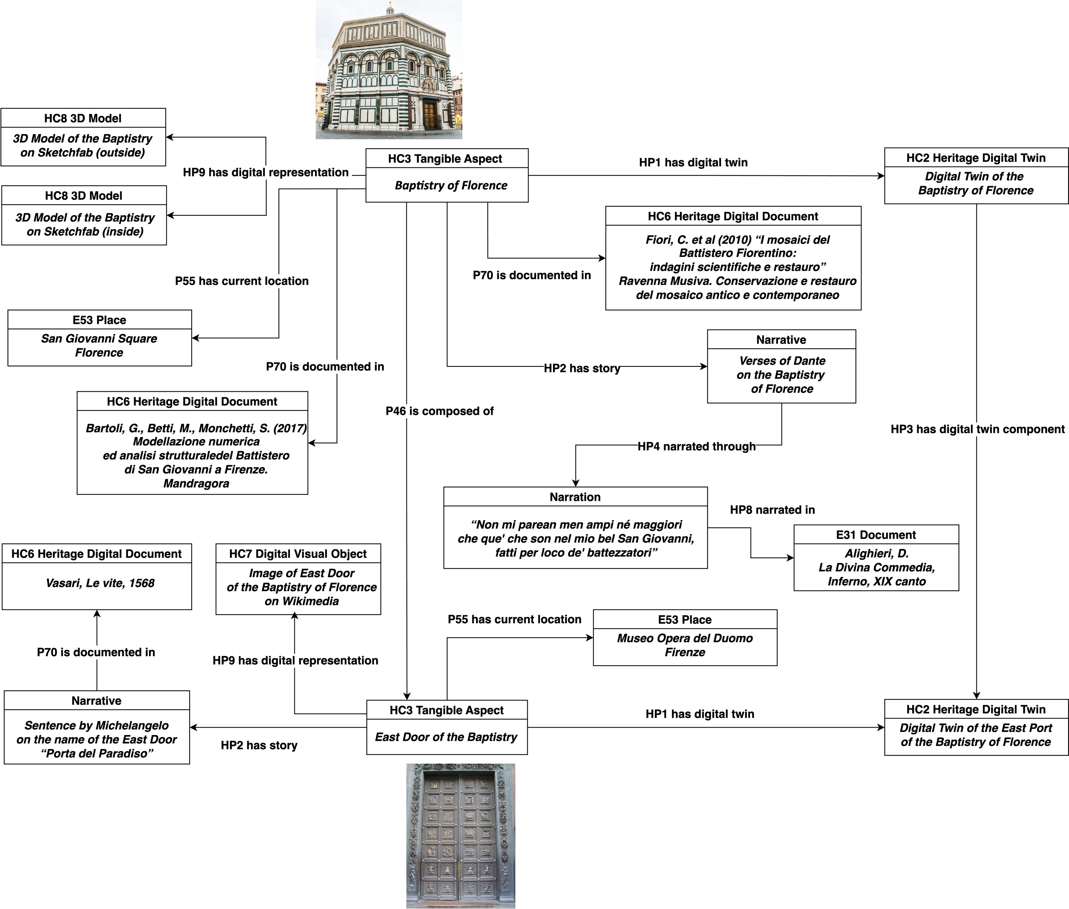
An example: the Baptistry of St. John (Florence)
XI century (building) XIV-XV century (doors)
This is only a part of the knowledge graph, evidencing the management of the intangible component data

Slide 7
The Reactive HDT
The Reactive Heritage Digital Twin ontology introduces direct connections with the reality called sensors. These are elements (IoCT devices) which capture information from the real world with actual sensors; or receive information in real time from other digital systems. They send the data to a decider which evaluates the information and according to predetermined rules launch an interaction with the real world via activators
Examples
  Fire sensors: a device measures the temperature (and possibly other values, e.g. smoke) and sends the information to the RHDT sensor. The data proceed to the decider which analyses them according to predetermined rules and, according to the result, alerts an activator, which executes actions such as opening a sprinkle, filling the site with azote, calling the fire brigade, etc. In practice the sensor is a door receiving data, the decider is software evaluating the input, possibly checking other internal information, and the activator sends orders to external devices.
  Environmental alarm: The sensor is software regularly interrogating an external data centre (e.g. a meteo forecast centre); the decider compares the input with the location data of the asset and decides if there is an alarm situation; the activator sends alarm messages and/or activates protection mechanisms (e.g. watertight doors, elevation machines, etc.)

Slide 8
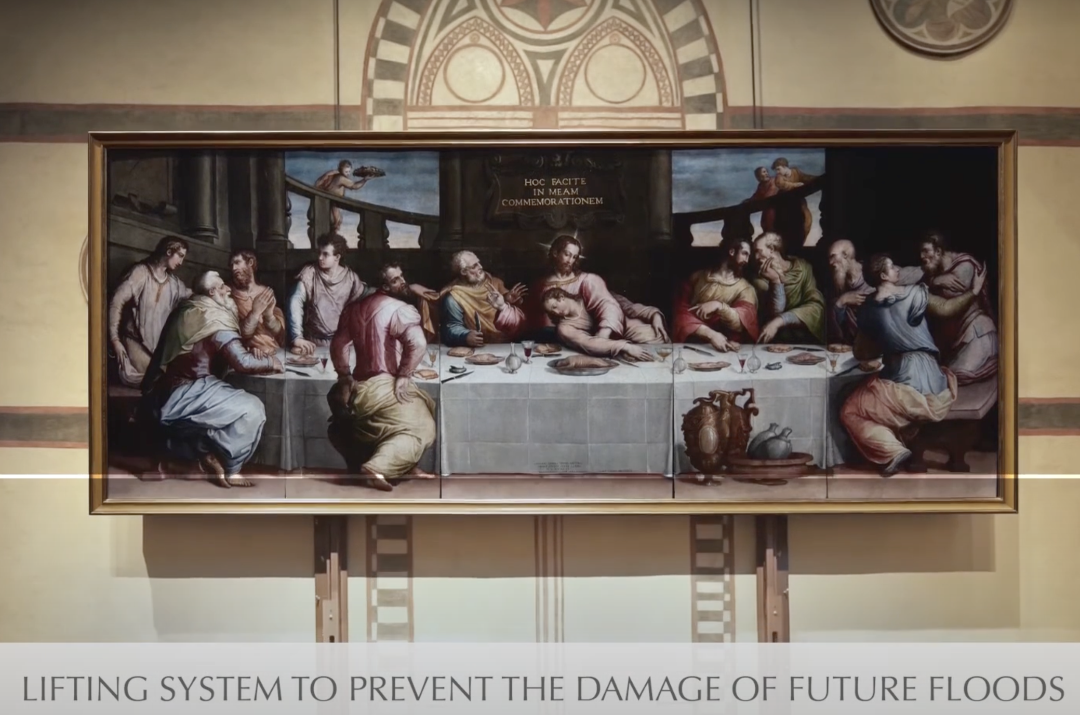
An example of possible application
Lifting system to protect the Last Supper by Giorgio Vasari - placed in the church of Santa Croce, Florence – from the risk of a flood. The painting was badly damaged by the 1966 flood.
At present, the lifting system is manually activated but it might be connected to the activator of an RHDT, automatically lifting the painting when there is a flood risk, evaluated basing on weather forecasts and a terrain model

Slide 9
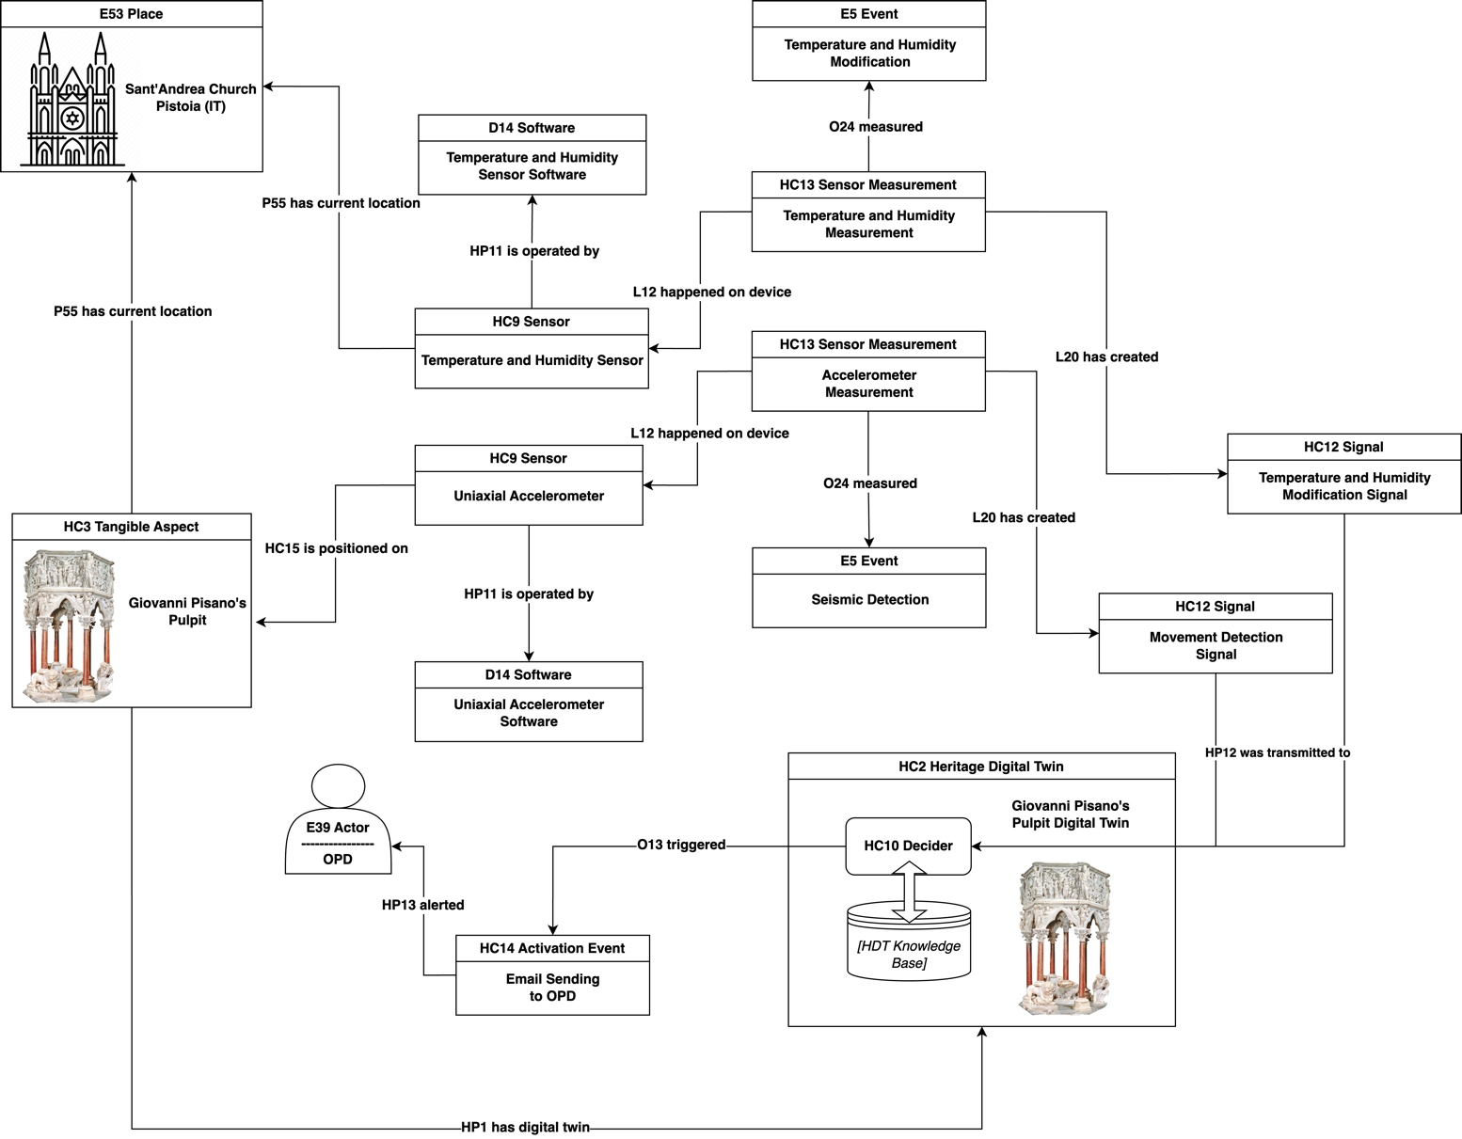
RHDT application to a monitoring system
Pulpit in the church of Sant’Andrea in Pistoia (Italy), a medieval masterwork by the Italian sculptor Giovanni Pisano
Sensors gather environmental dynamic data and humidity, and include uniaxial accelerometers
Data are sent to the decider/activator, which alerts the operators when necessary

Slide 10
Conclusions
The RHDT ontology (RHDTO) can be used to organize data in many application domains
Datasets encoded according to the CRM standard can be straightforwardly mapped to the RHDTO
The RHDTO allows the aggregation and integration of distributed data, organizing their metadata in a knowledge base which can be explored navigating the corresponding semantic graph
It is flexible and adapts to heritage assets of various nature, including the intangible ones as well as the intangible component of tangible assets (see the Baptistry example)
It is conceived as interoperable with the Digital Twin of the Earth

Slide 11
References
Niccolucci, F.; Felicetti, A.; Hermon, S. “Populating the Digital Space for Cultural Heritage with Heritage Digital Twins”. Data 2022, 7, 105 . https://doi.org/10.3390/data7080105
Niccolucci, F.; Markhoff, B.; Theodoridou, M.; Felicetti, A.; Hermon, S. “The Heritage Digital Twin: A bicycle made for two. The integration of digital methodologies into cultural heritage research”. arXiv 2023, arXiv:2302.07138. https://doi.org/10.48550/arXiv.2302.07138
Niccolucci, F.; Felicetti, A. “Digital Twin Sensors in Cultural Heritage Ontology Applications”. Sensors 2024, 24, 3978. https://doi.org/10.3390/s24123978

