Slide 1
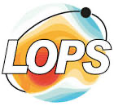
From HPC to EOSC to DestinE: Leveraging Pangeo in the Global Fish Tracking System for Impactful Marine Conservation
Tina Odaka¹, Anne Fouilloux², Daniel Wiesmann³, Emmanuelle Autret¹, Mathieu Woillez⁴, and Benjamin Ragan-Kelley²
1 LOPS (Laboratory for Ocean Physics and Satellite remote sensing), UMR 6523, Univ Brest-Ifremer-CNRS-IRD, Plouzané, France
2 Simula Research Laboratory, Oslo, Norway
3 Development Seed, Lisbon, Portugal
4 DECOD (Ecosystem Dynamics and Sustainability), IFREMER-Institut Agro-INRAE, Plouzané, France
Notes:
Today, I’m excited to share how we are laveraging(HPC), the (EOSC), and the Pangeo ecosystem to enhance marine conservation efforts through the Global Fish Tracking System, or GFTS.
●Let me first introduce what why in GFTS, we want to track the movement of fish.

Slide 2
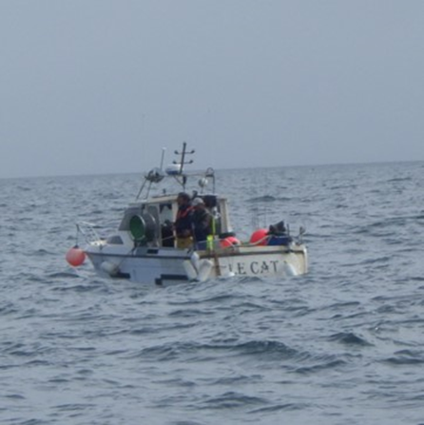
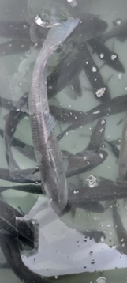
Why studying fish movement?
Motivation:
Food security and sustainable exploitation of natural resource
Study how fish movements and migrations influence population dynamics
Provide knowledge crucial for improving fishery management and defining conservation areas
Address the lack of information on fish spatial structure and essential habitats, as highlighted by the International Council for the Exploration of the Sea (ICES)
Notes:
●Marine ecosystems face pressures from overfishing, climate change, and habitat loss. To manage and conserve these ecosystems effectively, we need detailed knowledge of fish behaviors, including their movements and migrations.
•But Fish are a major source of protein for millions of humanbeengs globally,
•By understanding fish migration patterns, we can help ensure fishery management so that it is sustainable.
•Conservation areas: Fish movements give us clues to define critical areas, such as spawning and feedinggrounds, which need protection.
●The International Council for the Exploration of the Sea (ICES), gives advises for such protection areas. But theyaddress is the lack of data on fish spatial structures and essential habitats on certain speciss, such as seabuss.
This is the gap GFTS aims to fill. But how do we get this data?

Slide 3
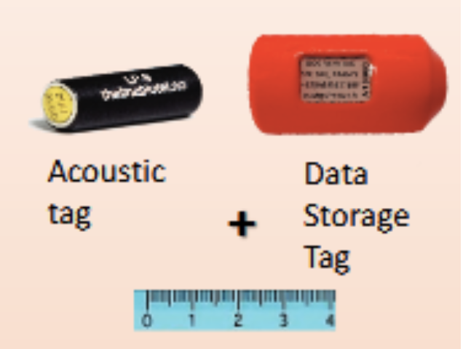
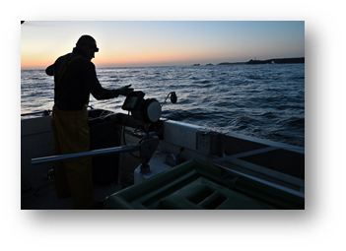
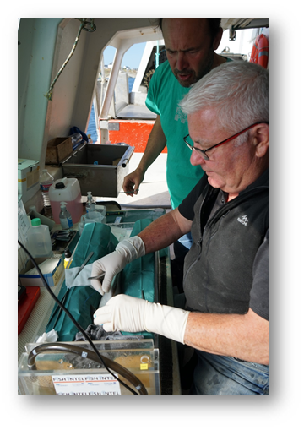
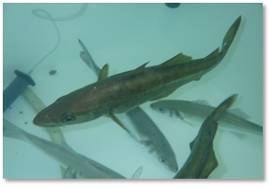
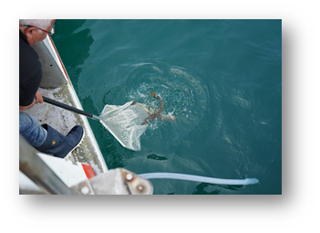
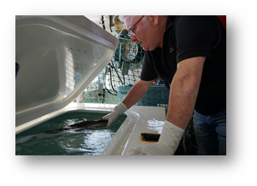
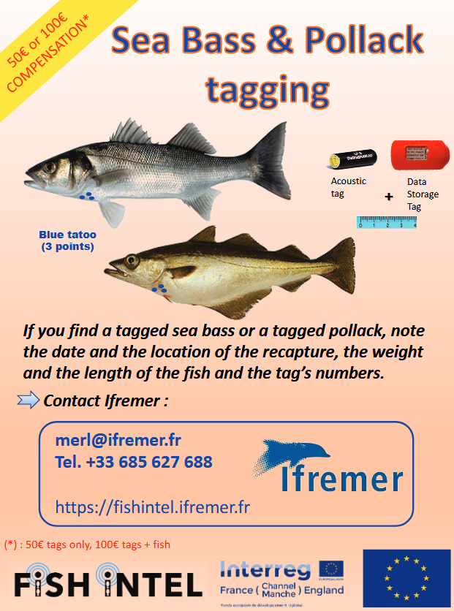
Bio-logging
Attaching small devices to animals to track their behavior and gather environmental data
Stabulation, then anesthetize the fish
Implant the acoustic tag + Data Storage Tag (DST)
Fish capture
Fish release
Waking and housing fish
Data Storage Tag: Store time series of observed temperature, depth in a tag.
Acoustic Tag: tag emits signal, detect tagged fish using acoustic telemetry network
Combine both approaches together with earth science data: Infer fish trajectory from individual environmental data histories using geolocation models
Notes:
●At the core of GFTS is the use of bio-logging data.
●biologgin—attaching small devices to fish to track their behaviors and environmental conditions.
●
●How do we attache the biologging device? . (photos)
●
●
●There are two main types of tags:
as you can see in the poster on the right;
1.Data Storage Tags (DST): These tags record time series of temperature and depth as fish move through differentocean zones.
2.Acoustic Tags: These tags emit signals detected by an acoustic telemetry network. This network allows us to track the location of tagged fish within a region, but very limitted area.
data storage tags, we caon only exploire the data if the tag is back to the lab. incentive 100euros

Slide 4
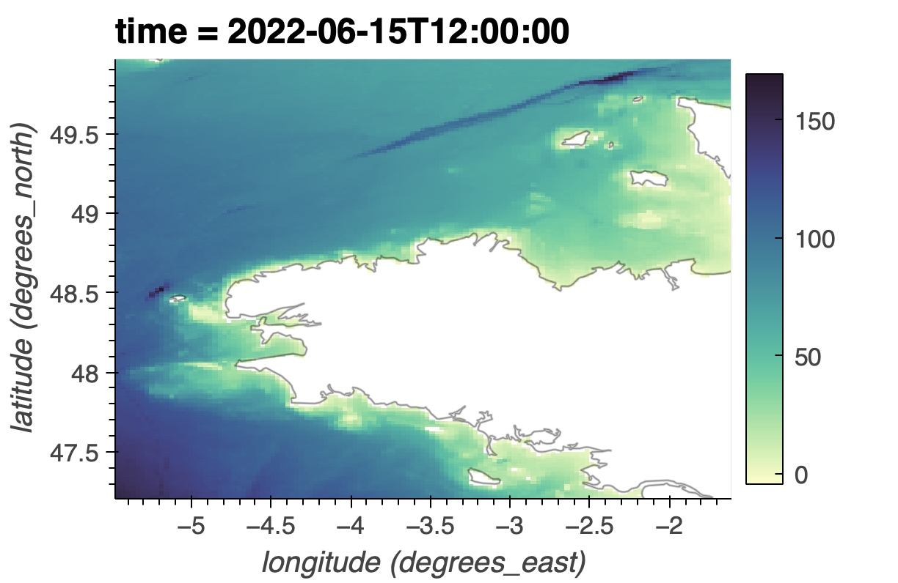
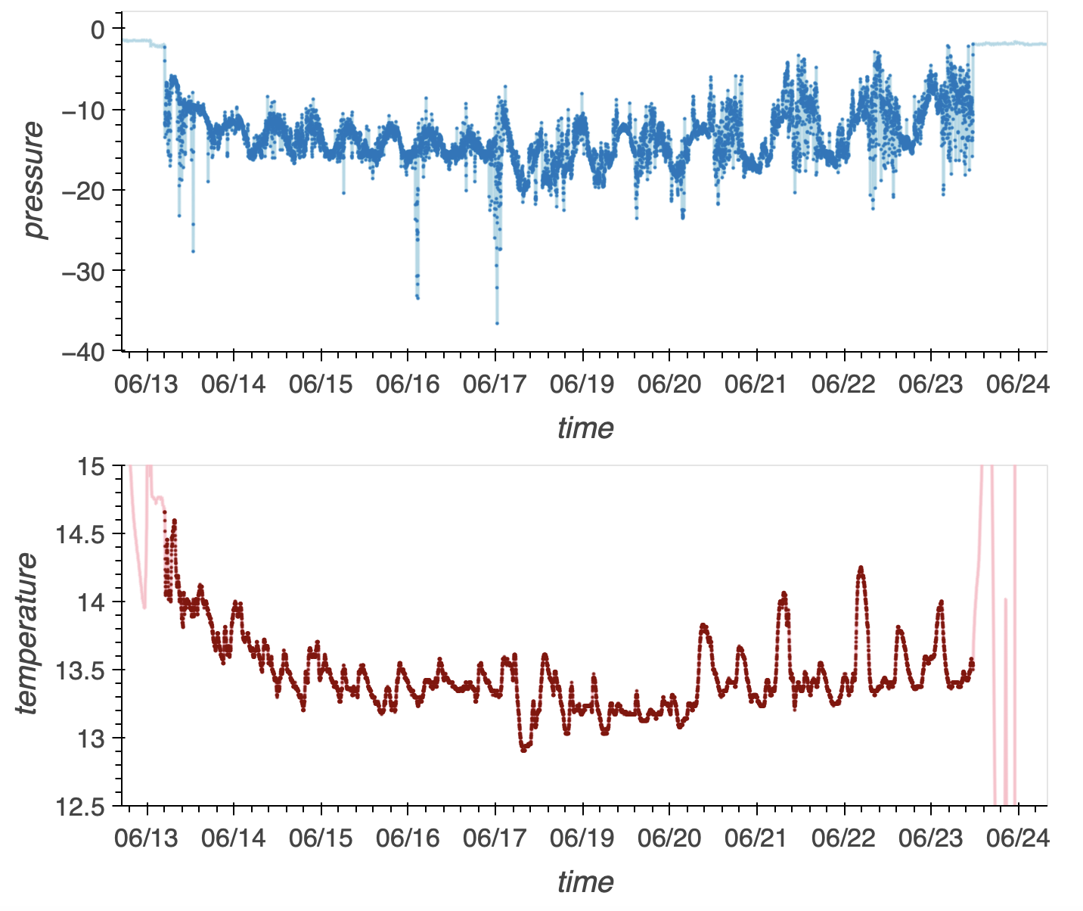
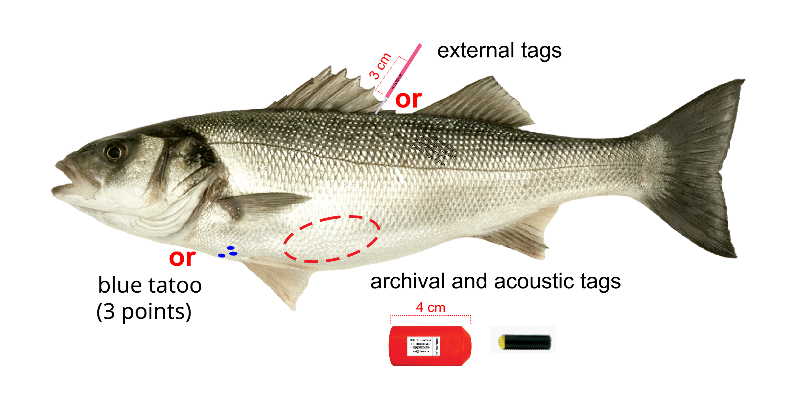
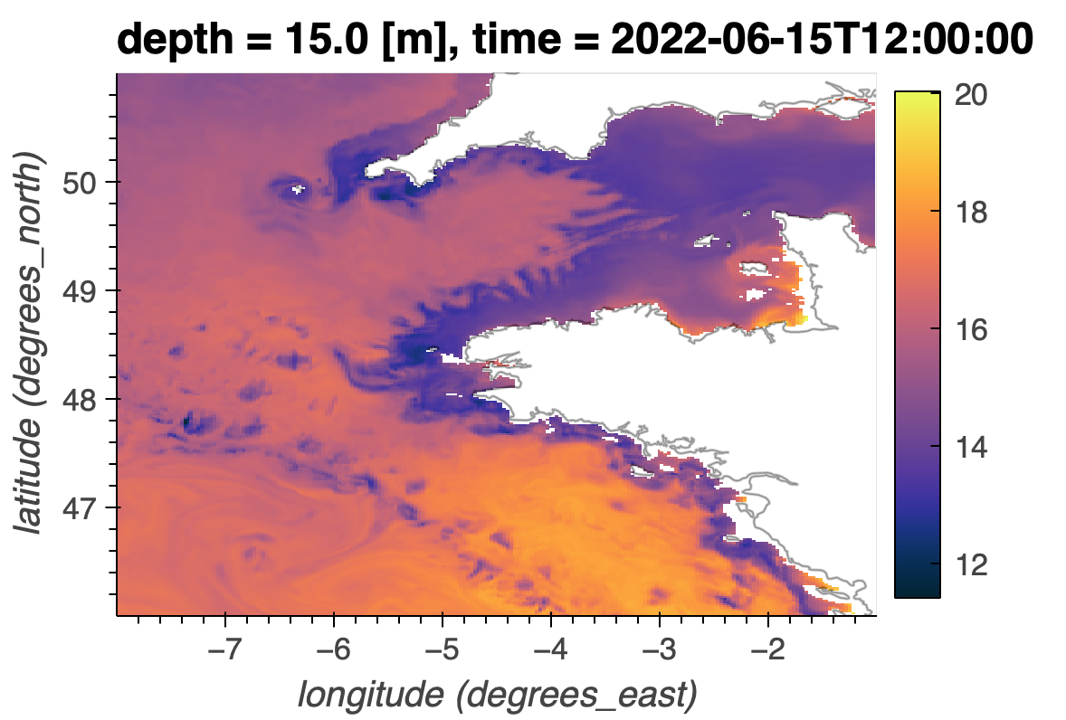
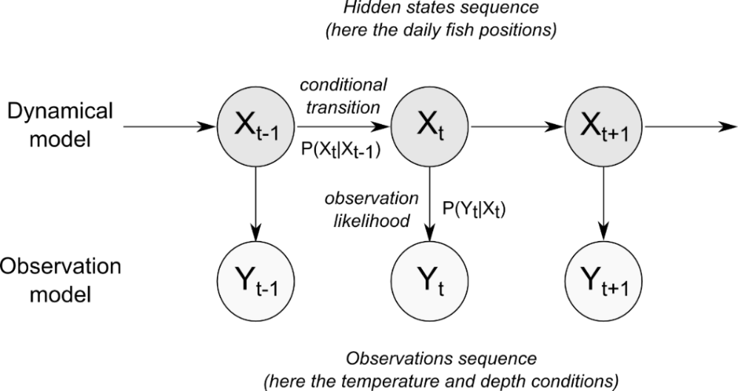
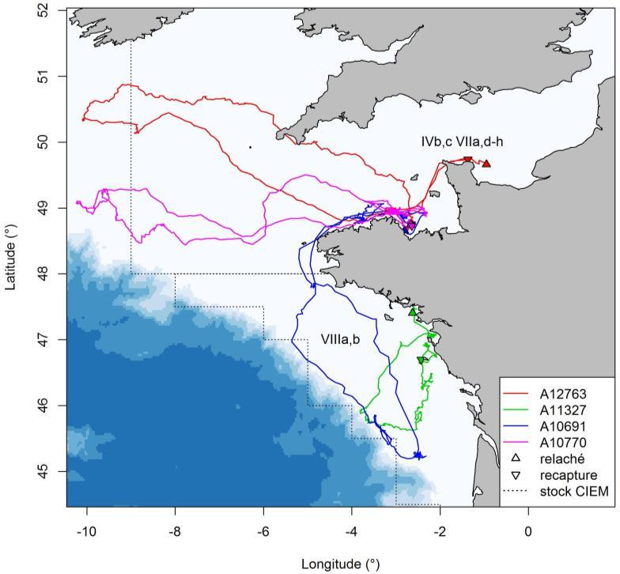
Fish Tracking Modeling
Bio-logging data
Earth science data
Model: Hidden Markov Method
Geolocation model developed by Woillez et al. (2016), temperature and bathymetry as reference fields, adapted from Pedersen et al. (2008)
Constrains:
- acoustic detection,
- bathymetry
- release location
- recapture location
Likelihood of Observed Temperature at depth by fish from earth science data
Bathymetry
Depth
Temperature at depth
Temperature
Hidden Markov Method
X_{t+1} = X_{t} + ε_{D}
Y_{t} = f(X_{t}) + ε_{σ}
Notes:
●The model we use to track these movements is called the Hidden Markov Model (HMM).
●This model takes several constraints into account:
•Bathymetry (the topography of the ocean floor)
•Acoustic detection (from the telemetry network)
•Known release and recapture locations
•The main part of the computation of this model relays on liklyhood of sea temperatreu data and fish observedtemperatreu data at it’s depth.
•This gives enormous data to treat to have the optimal solution.
=> could be good one day we add some 4D cube image here to show the ‘diff’ / convolve part

Slide 5
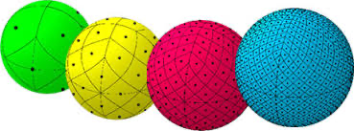
Software for track reconstruction
Quality and resolution (spatial and temporal) of earth science data (sea temperature) is crucial for track reconstruction.
Original HMM software developed in 2016 was not scalable.
Software workflow
Accessing in-situ observe environment data (biologging data)
Accessing big earth science data (IO intensive Computation)
Computation in python
Visualisation
⇒ Make our data, software and workflows FAIR (or as FAIR as possible)
⇒ Leverage the Pangeo ecosystem and Pangeo@EOSC to make our solution scale from laptop, cloud, HPC
Notes:
●A key challenge in the past was the scalability of the software we used for track reconstruction.
●The original version, developed in 2016, was not built to handle massive datasets—an issue we have sinceaddressed.

Slide 6
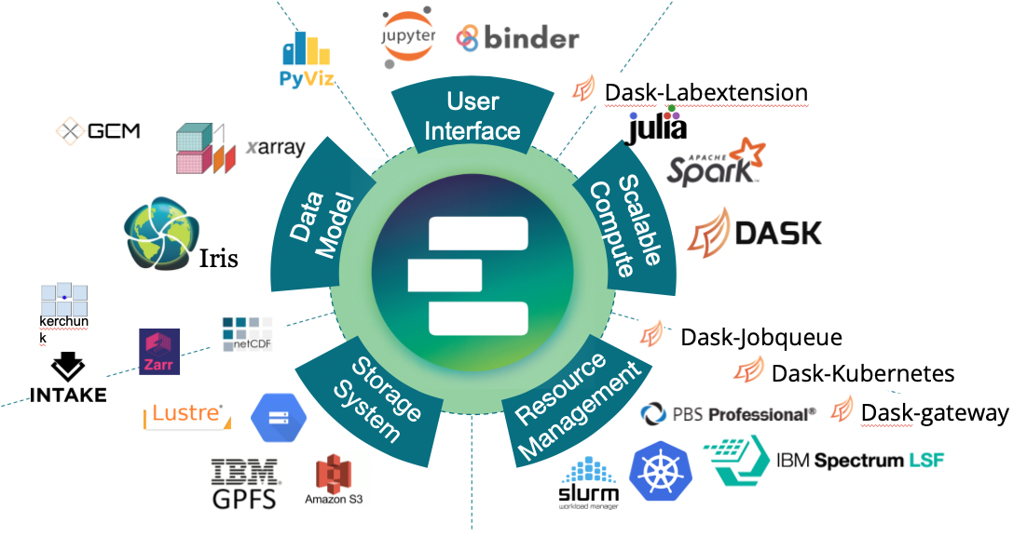
Pangeo-fish and Pangeo@EOSC
The Pangeo ecosystem was created by a community of engineers and geoscientists specifically to address big geoscience dat challenges.
It improves data access and usage efficiency
Pangeo-fish development started at HPC.
Ported to EOSC thanks to collaboration with EGI:
Pangeo@EOSC in collaboration with EGI-ACE and C-SCALE projects
Pangeo Notebooks with Dask Gateway for large-scale data analysis;
Be prepared for future implementation on DestinE Platform using a similar implementation e.g. JupyterHub + dask gateway.
Notes:
●With advancements in the Pangeo ecosystem, we’ve improved access to big data and developed tools that allowus to process vast amounts of Earth science data, such as sea temperature, with much higher efficiency. Our workflow now spans everything from accessing in-situ environmental data to processing that data in Python and visualizing the results.
●Our guiding principle has been to make the software FAIR—Findable, Accessible, Interoperable, and Reusable. This makes our work valuable not just to our team but to the broader scientific community.
●Pangeo-Fish started as an HPC-based project, but we’ve since expanded it to the European Open Science Cloud (EOSC), thanks to collaborations with EGI-ACE and C-SCALE. By moving to the cloud, we’ve made oursolutions scalable and ready for operational use on the upcoming DestinE platform.

Slide 7
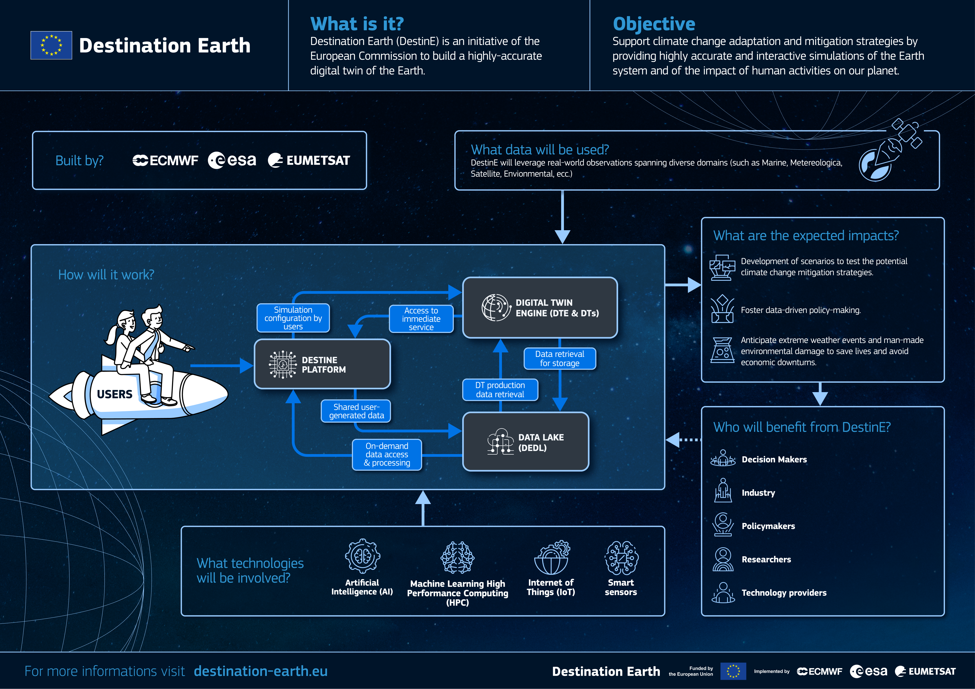
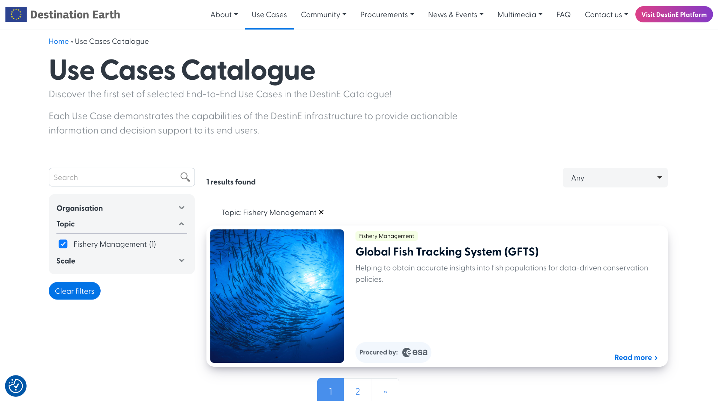
Destination Earth in a nutshell
We got selected for the DestinE platform!

Slide 8
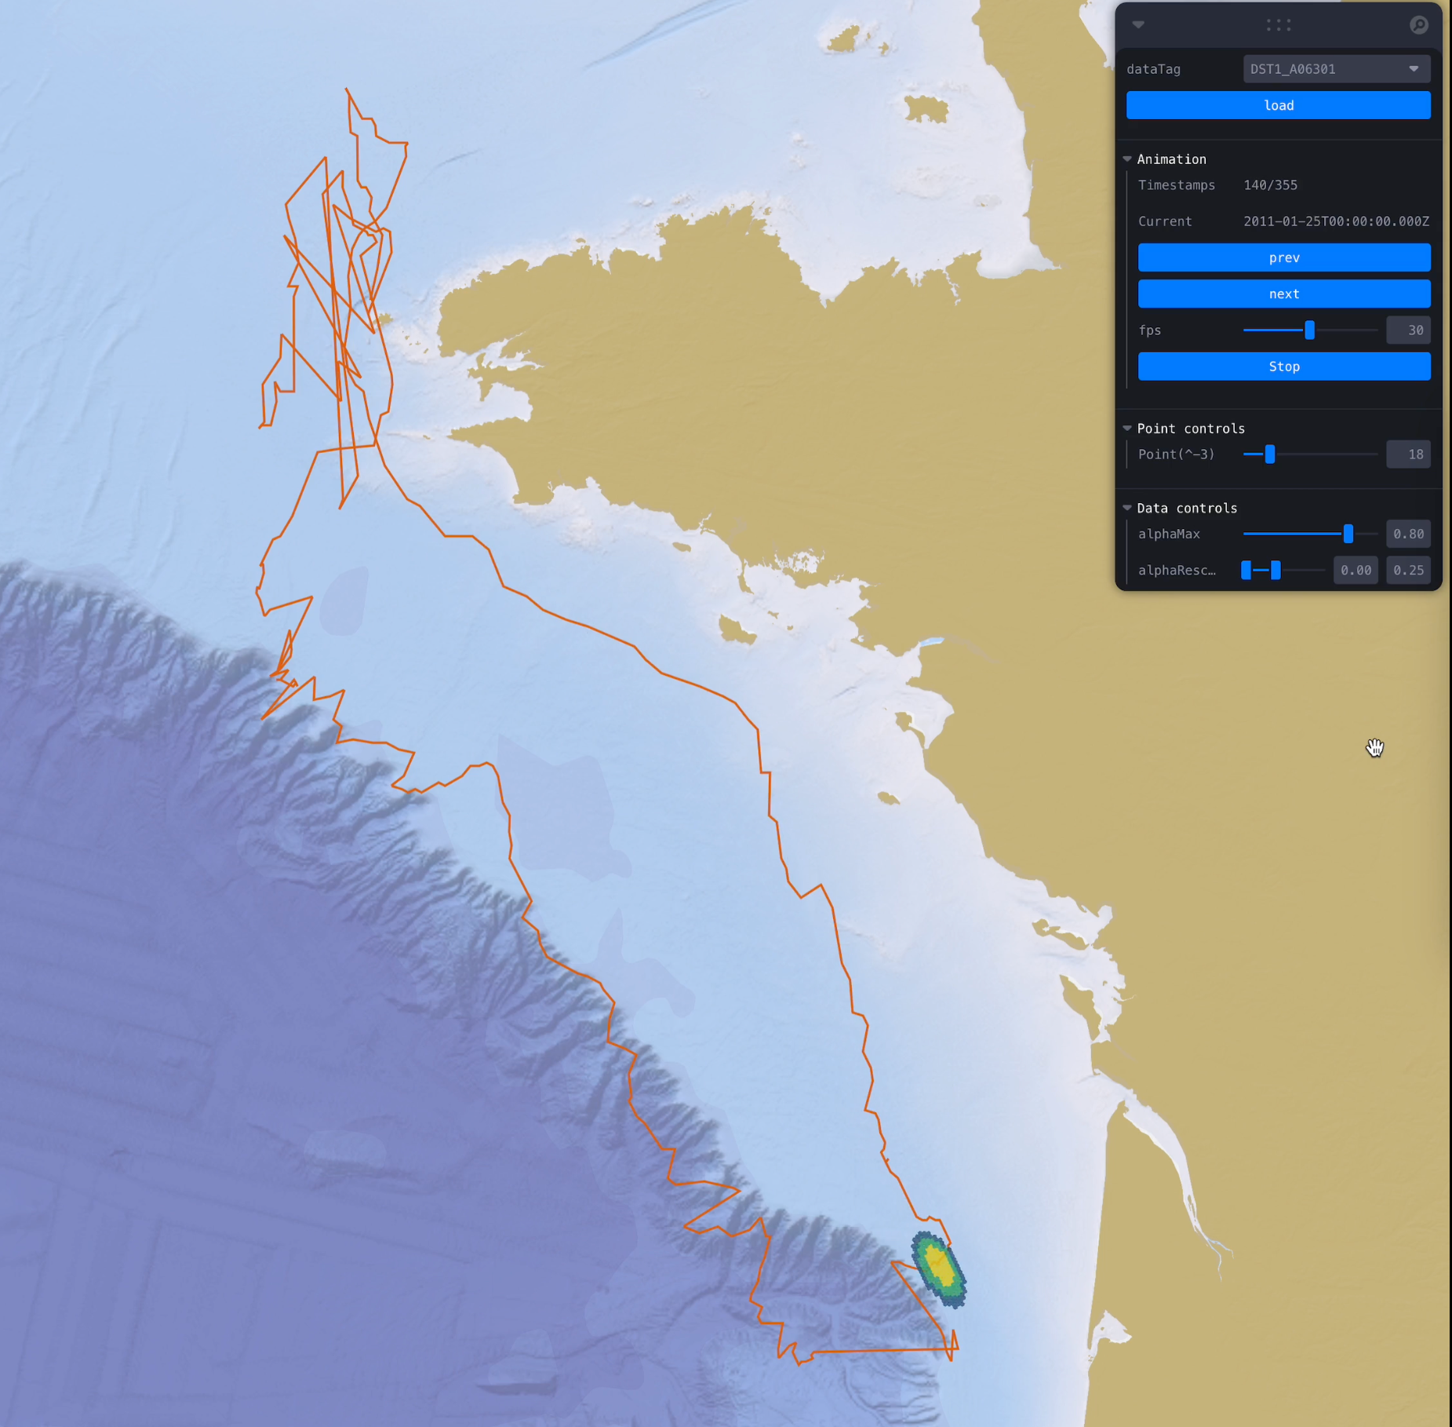
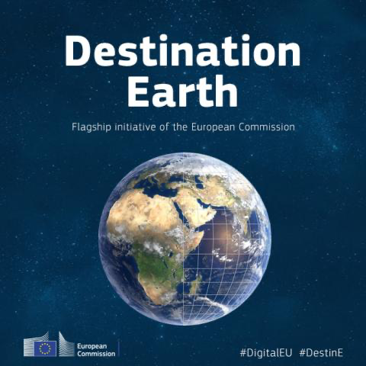
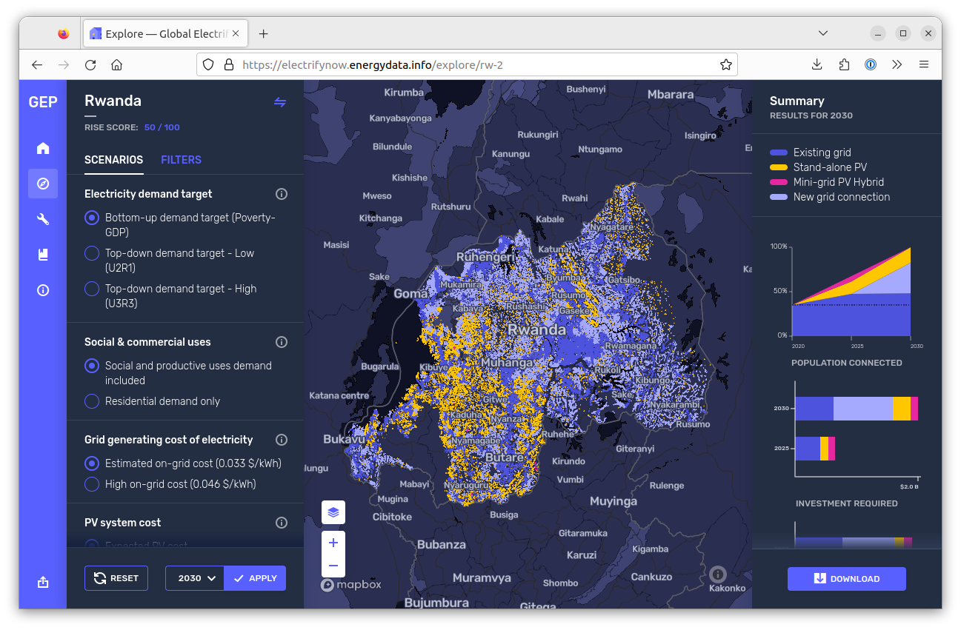
GFTS: Pangeo-Fish in Destination Earth
Web Interface
Making the vast amount of data generated by the model useful to decision makers.
Fish Track Modeling
Based on biologging data of individual tagged fish and the ocean around them
Pangeo Infrastructure
Cutting edge models will be combined with the cloud based simulations from the DestinE ocean data based on pangeo.

Slide 9
Decision support tools
Tools for analyzing reconstructed fish track together with Digital Twin data.
Answer questions and help decision-making:
Where do fish spawn ?
Where are the fish swimways ?
Are these essential fish habitats stable over years ?
How robust is the positioning of these habitats to errors and biases from reference geophysical fields ?
Which ocean conditions fish encounter during their journey ?
Notes:
●To translate into real-world impact,
●We are developping decision support tools to help answer key questions for policymakers

Slide 10
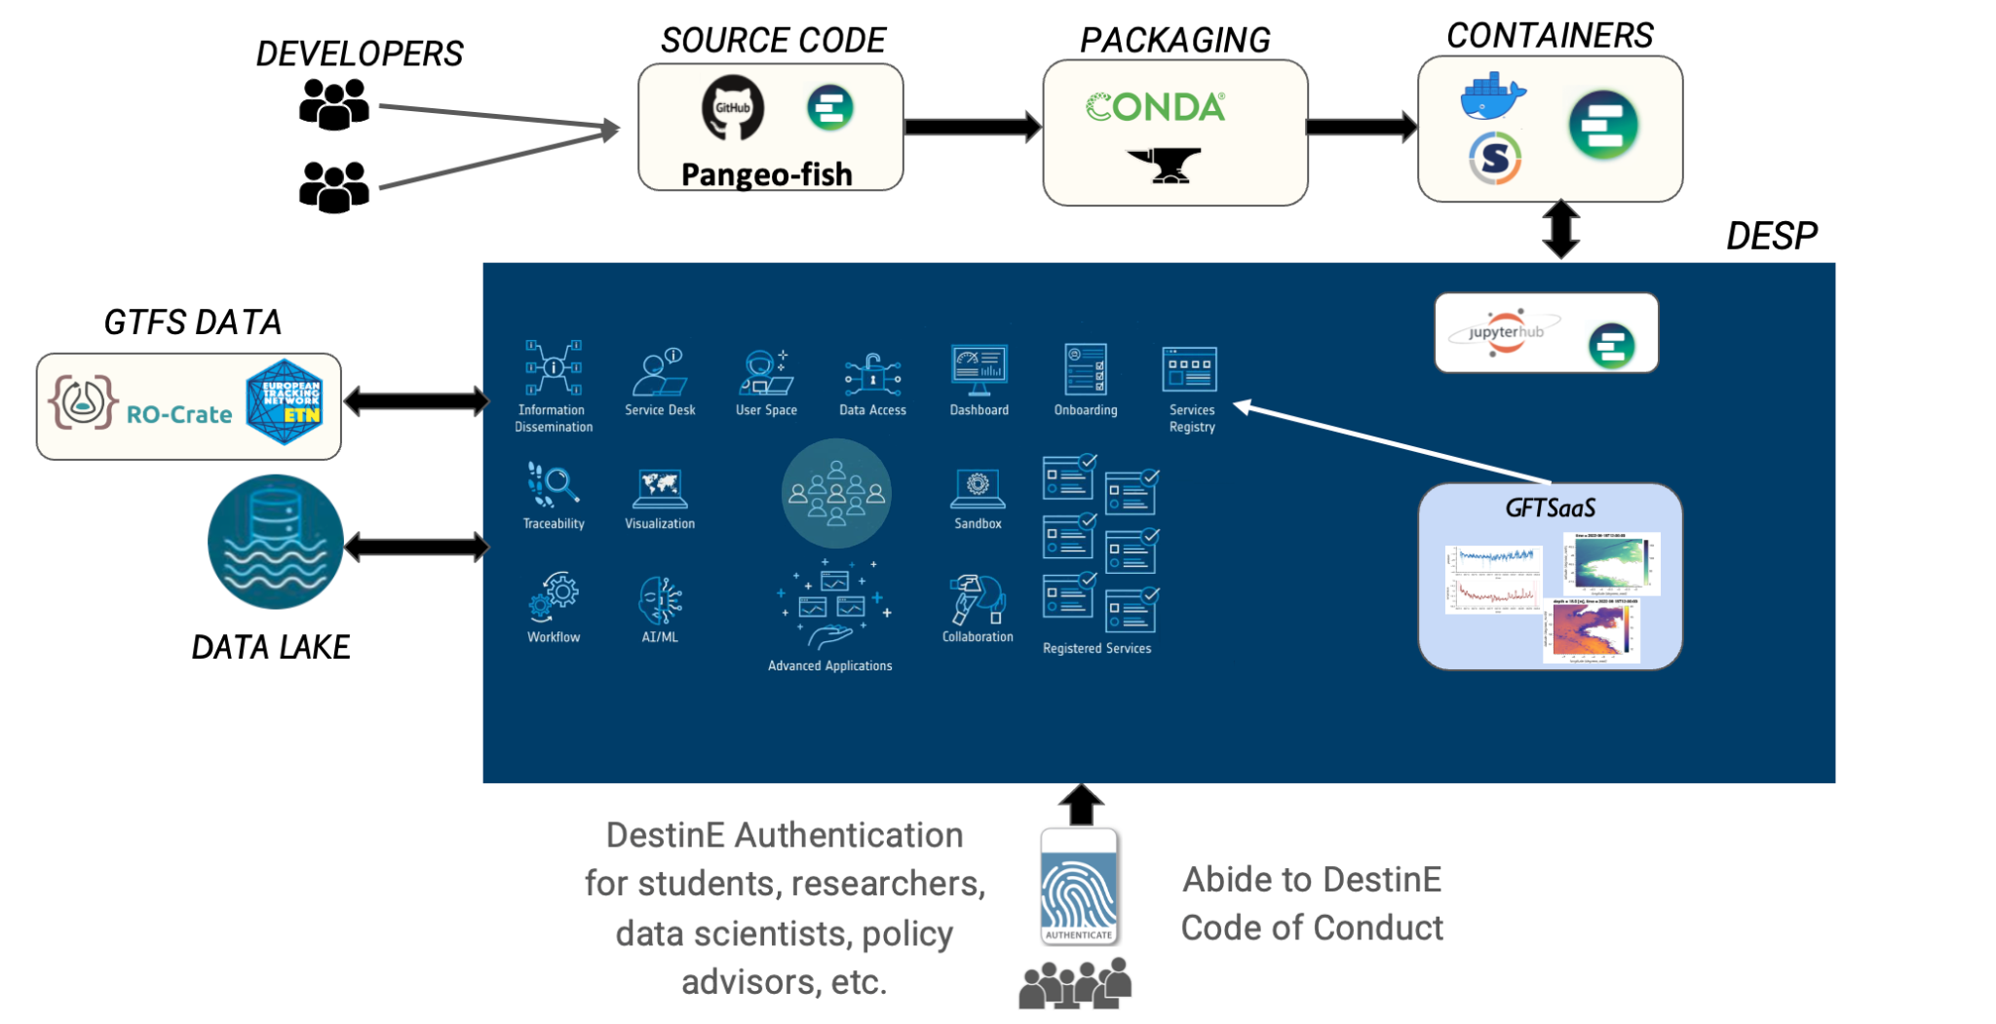
Open Science & FAIR Principles
GFTS adheres to Open Science guidelines.
Decision Support Tool (DST) aids in result interpretation.
Accessibility, usability, and data sharing are compliant with FAIR principles.
Operationalizing GFTS is simplified by following Open Science and FAIR principles.

Slide 11
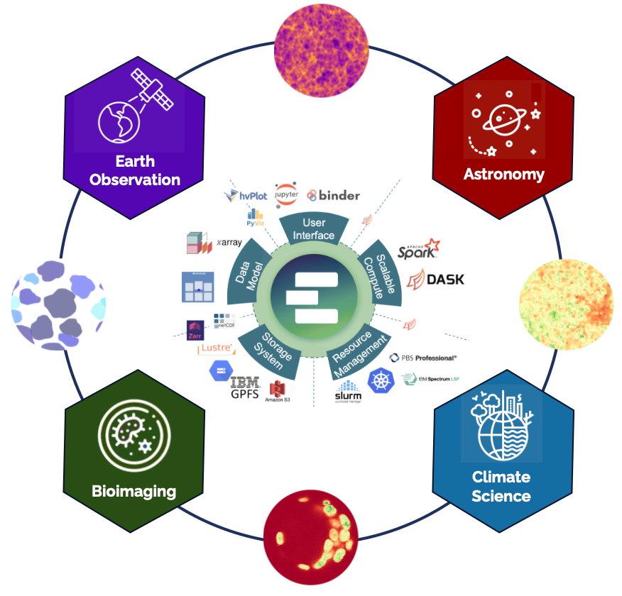
Conclusion
GFTS: Efficient use of data and technology for ocean conservation
Commitment to open science and advanced technology
Insights into practical benefits for marine ecosystem preservation
Don’t miss the Pangeo@EOSC demo on Thursday 12:30 - 13:00 (Barocco)
Pangeo@EOSC: A EOSC service to enable big data scientific discoveries and collaborations

Slide 12
THANK YOU
Contact us
Tina Odaka¹, tina.odaka@ifremer.fr
Anne Fouilloux², annef@simula.no
Daniel Wiesmann³, danielwiesmann@developmentseed.org
Benjamin Ragan-Kelley², minrk@simula.no
Mathieu Woillez⁴ , mathieu.woillez@ifremer.fr
¹ LOPS (Laboratory for Ocean Physics and Satellite remote sensing), UMR 6523, Univ Brest-Ifremer-CNRS-IRD, Plouzané, France
² Simula Research Laboratory, Oslo, Norway
³ Development Seed, Lisbon, Portugal
⁴ DECOD (Ecosystem Dynamics and Sustainability), IFREMER-Institut Agro-INRAE, Plouzané, France

Slide 13
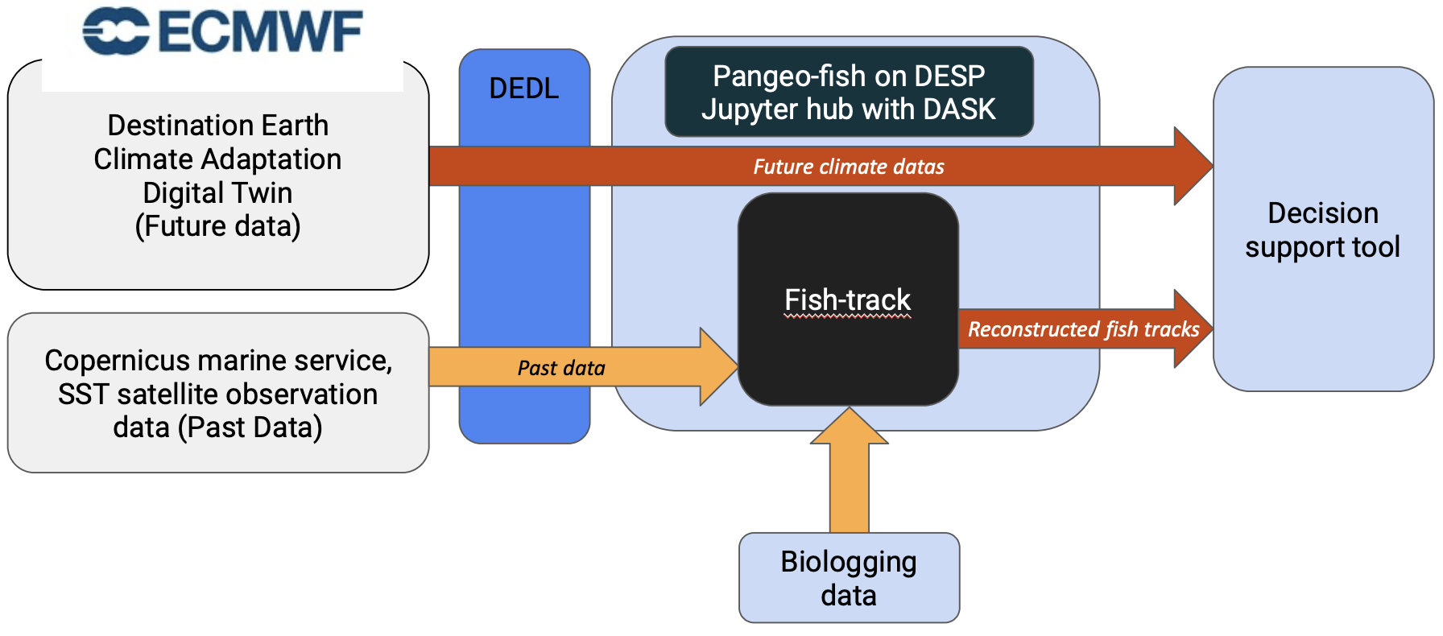
Destination Earth and Pangeo-Fish

Slide 14
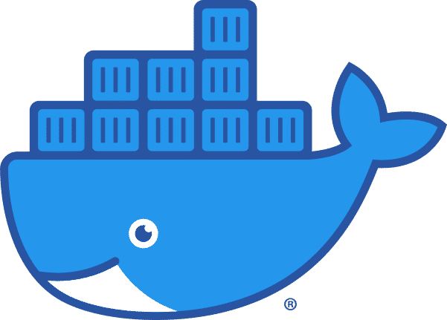
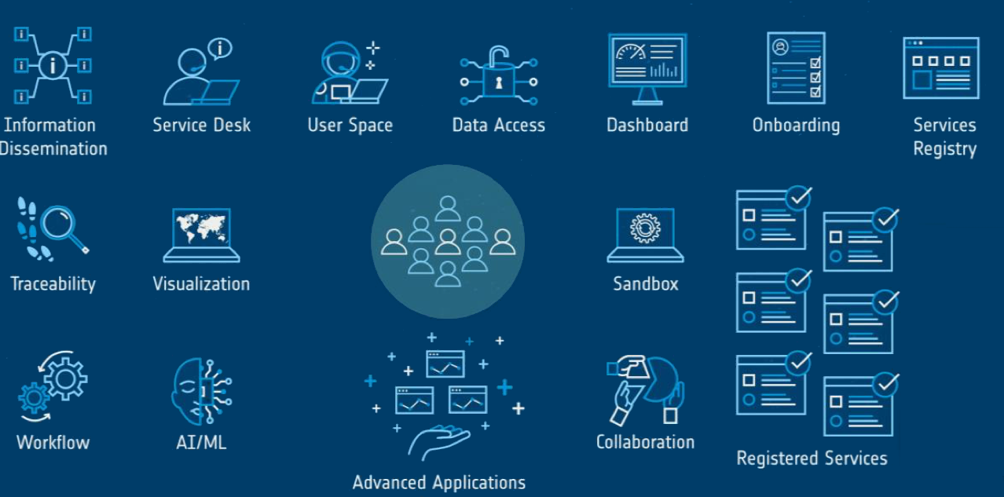
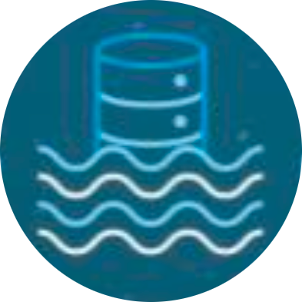
Operationalization of GFTS
DEVELOPERS
SOURCE CODE
PACKAGING
CONTAINERS
Pangeo-fish
DESP
GTFS DATA
GFTSaaS
DATA LAKE
DestinE Authentication for students, researchers, data scientists, policy advisors, etc.
Abide to DestinE Code of Conduct
Notes:
https://meetingorganizer.copernicus.org/EGU24/EGU24-15500.html

Slide 15
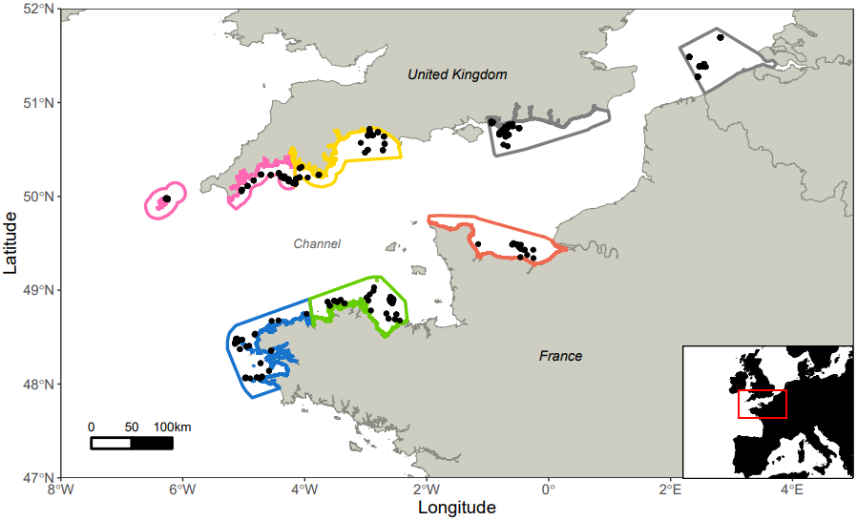
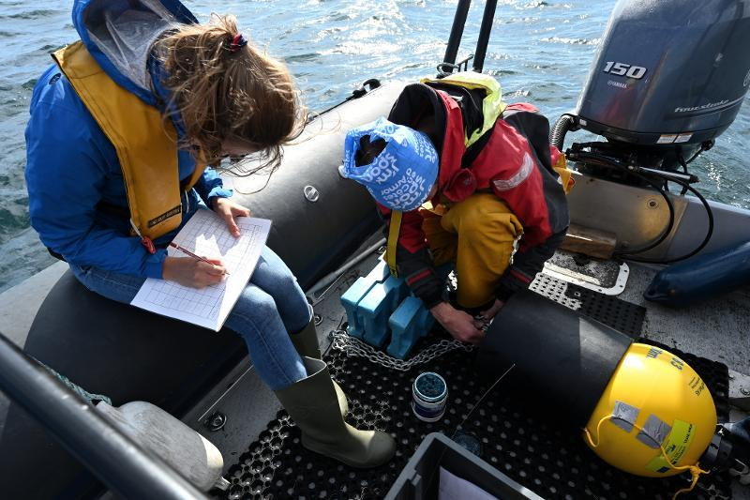
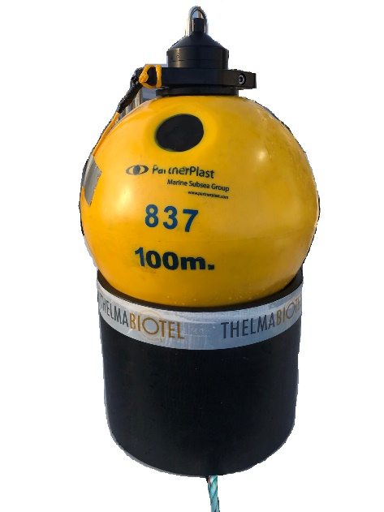
Acoustic tag detection: Acoustic telemetry network
Stations' locations were based on fishers’ knowledge
198 stations have been deployed (October 2021 – October 2023)
Thelma Biotel (TBR 800 RELEASE) in France, VEMCO in the UK and Belgium
South Devon
Sussex
LifeWatch
Cornwall
Seine
Iroise
Armor
Receiver
Buoy
The acoustic tag regularly emits a unique identifier over an extended period (1-5 years)
The receiver can detect acoustic tags (in the tagged fish) that are in the nearby area
Data shared in ETN (European Tracking Network)
Rope canister
(dyneema)
50-75 kg
Notes:
Acoustic tag are detected through acoustic telemetry network
Here is the map of acoustic telemetry network implemented in Fish intel project.
We have about 200 stations deployed, based on knowledge on fisheries.
-The acoustic tag regulary emits xx
- The receiver
-All data

