Slide 1
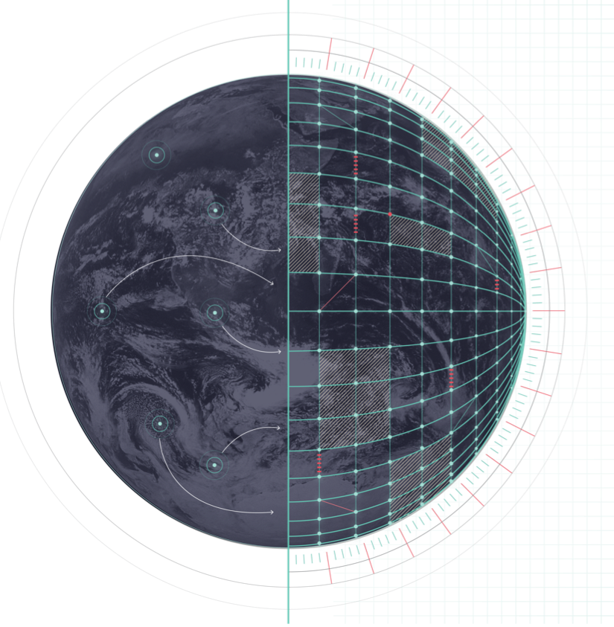
DESTINATION EARTH
Interoperability between digital twinS
Thomas Geenen, ECMWF
EGI2024
Lecce, October 1st 2024
Notes:
Welcome slide

Slide 2
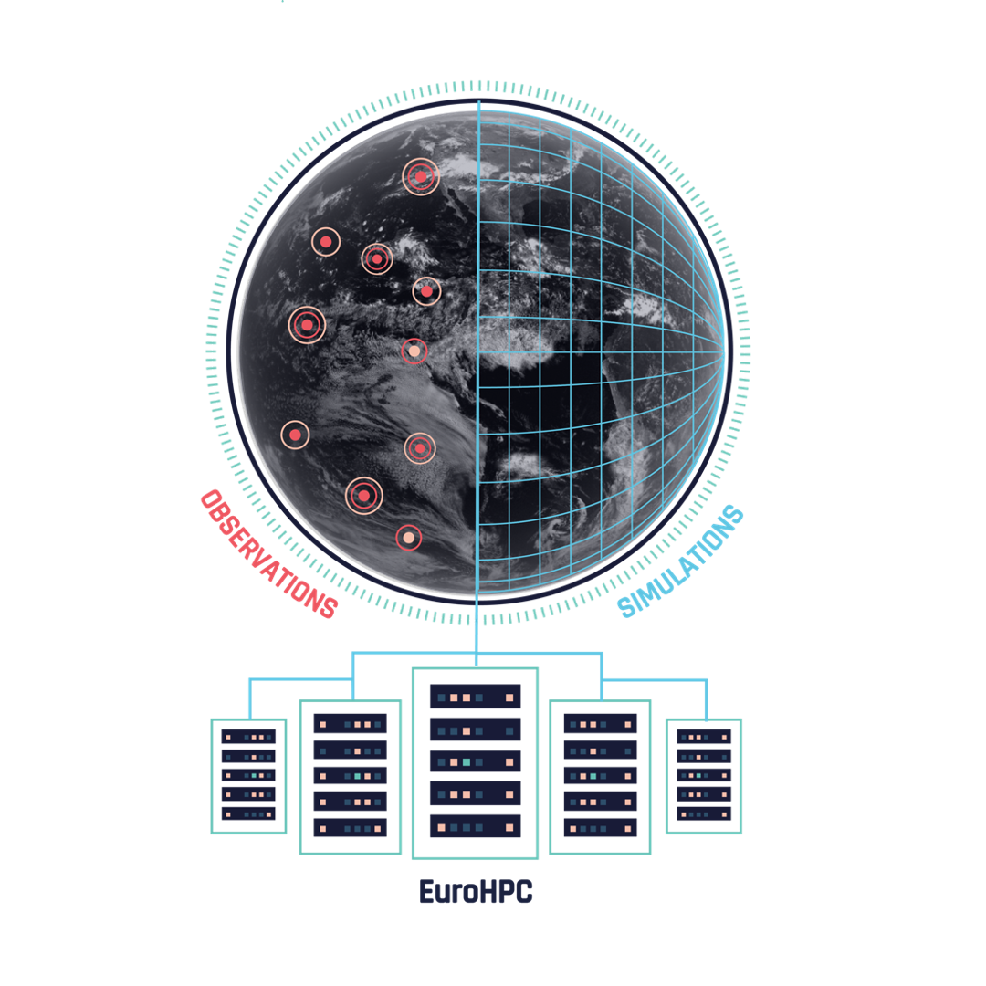
DEstine: a digital twin of our planet to respond and adapt to climate change and extreme events
DestinE, in strategic partnership with EuroHPC Joint Undertaking:
Establishes bespoke cutting-edge simulation capabilities
Provides Earth-system information at scales where the impacts of extreme events and climate change are felt
Fosters an innovative and thriving AI-enabled digital ecosystem
LUMI
MN5
Leonardo
MeluXina
Notes:
Destine is responding to this need by creating a digital replica of our planet = this can represent a gamechanger in this context. By using cutting-edge simulations, observations, AI, supercomputing and cloud technologies it creates a novel information system in support of the implementation of the Green Deal and the Digital transition.

Slide 3

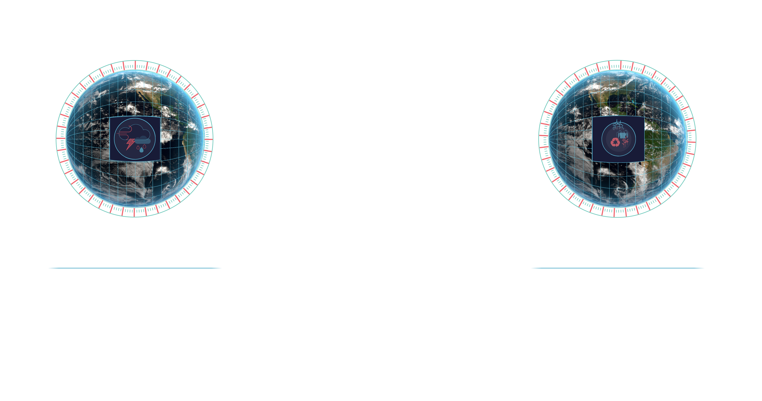

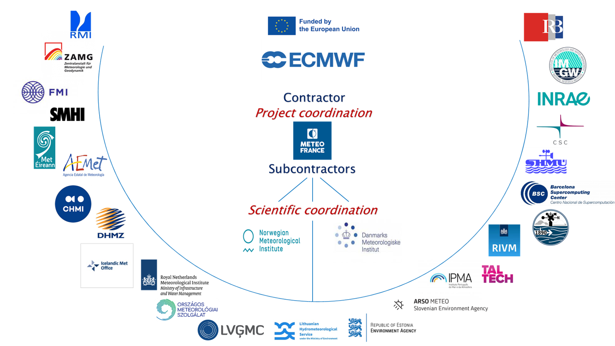
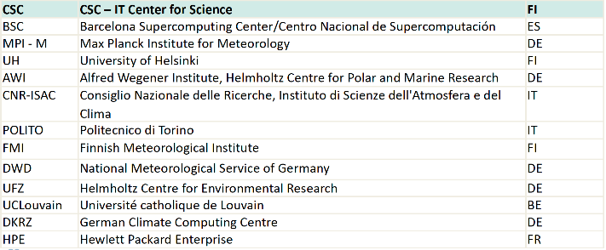
First high priority digital twins support the Green DeaL
Climate change adaptation
Weather-induced extremes
Climate change adaption
Weather-induced extremes
To support policymaking for adaption
For rapid response to extreme events
Multi-decadal timescales
For a few days ahead
Notes:
A

Slide 4
Phase 1 – DestinE‘s initial development phase
2022
2024
June 2024
June 2026
2030
Procuring and building the key components and interfaces demonstration
at scale
System integration and testing with selected users
Opening to users the core service platform, the data lake, digital twin engine and digital twins
Evolutions and ramp-up operations, consolidation, maintenance and evolution of the DestinE system
Transition to long-term operations
2023
Launch event
EuroHPC access
Data access for users

Slide 5
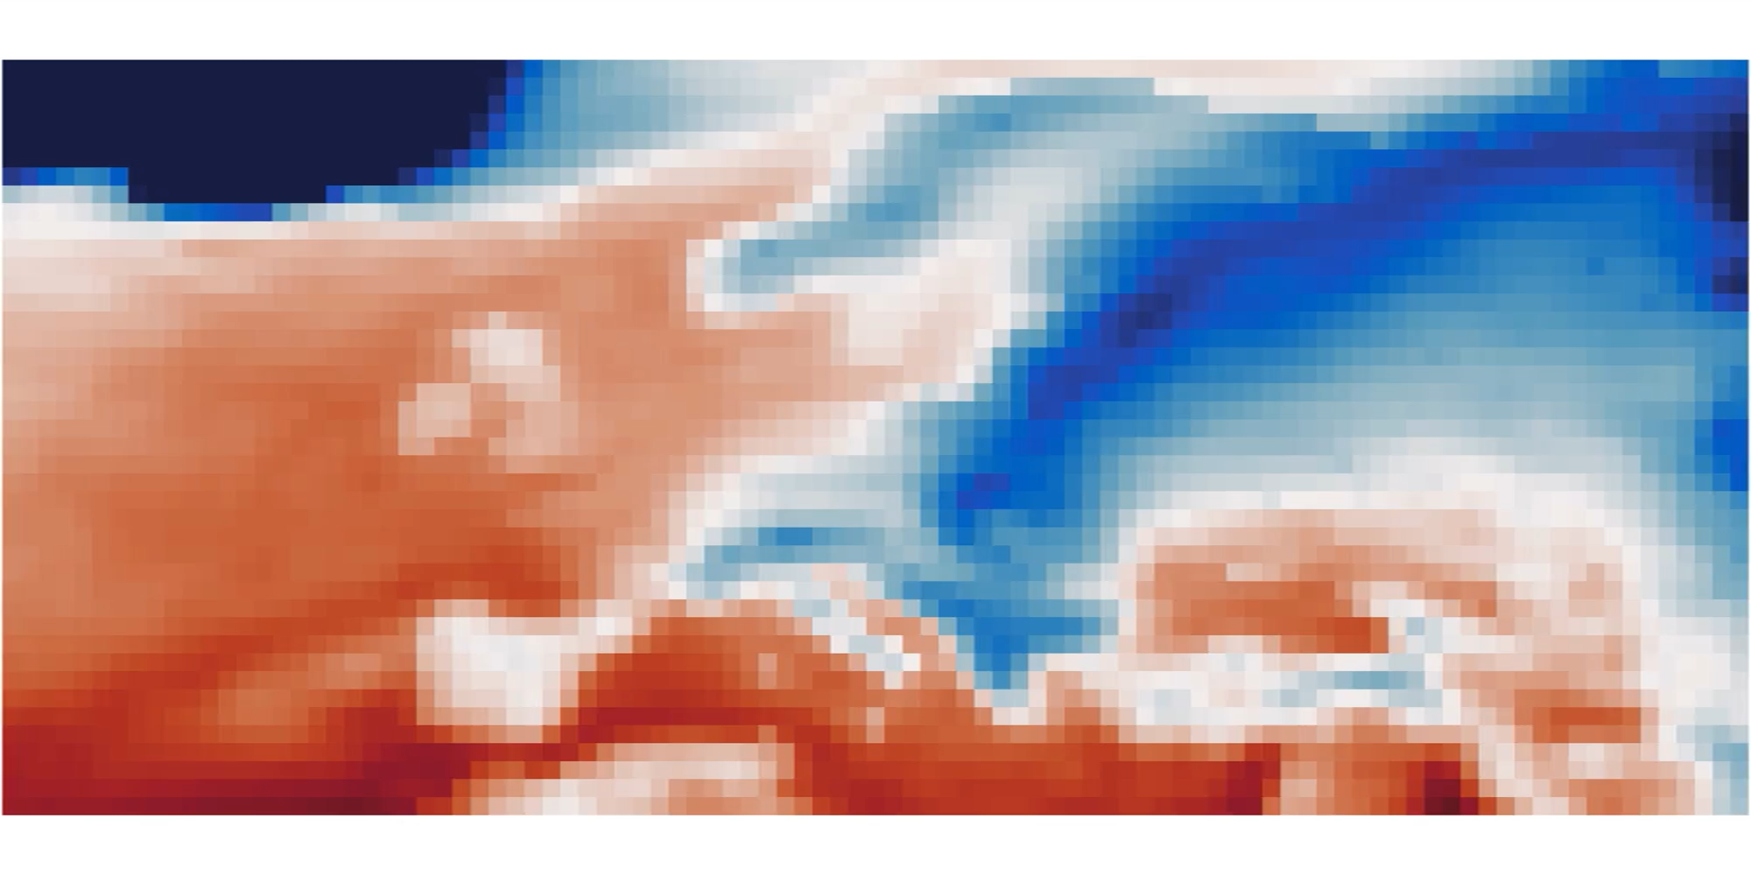
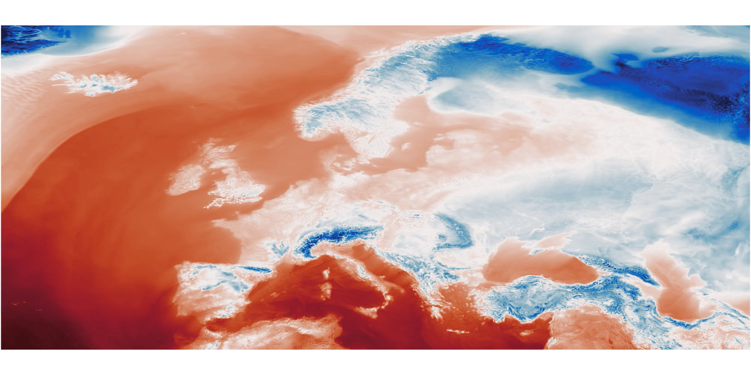
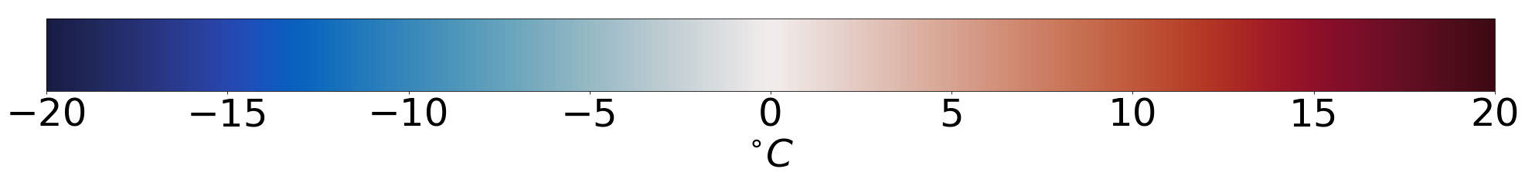
CLIMATE DT: Globally consistent climate information at KM-scale
To enable policy actions in support of climate change adaptation
IPCC AR6 (2021), 100km
Digital Twin, 5km
End-to-end climate DT workflow, including selected applications, deployed on LUMI
First ever projections (2020-2040) at ~ 5km across earth-system components running now on LUMI with 2 models, streaming information to selected applications

Slide 6
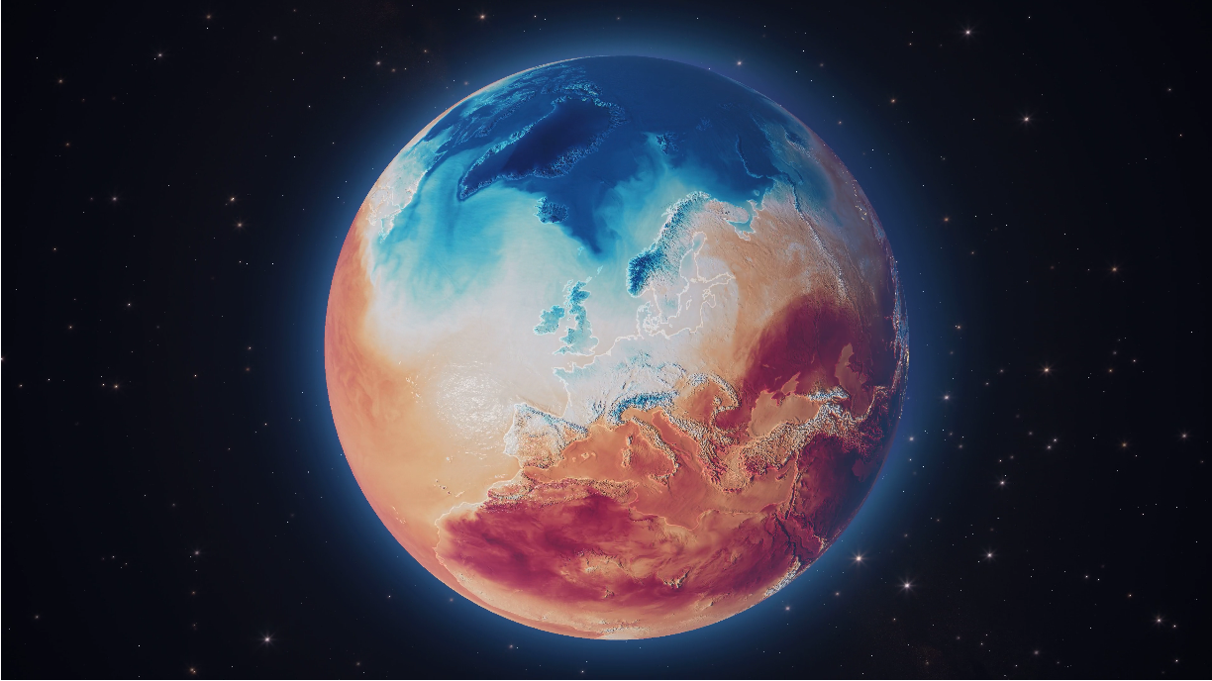


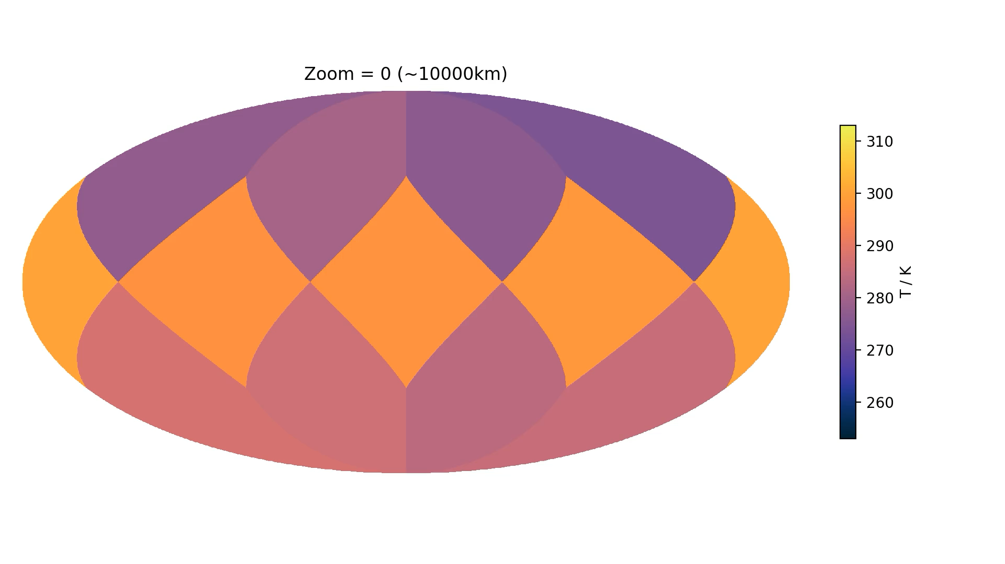


Climate DT: Capabilities at the end of Phase 1
Monitoring & evaluation framework
AQUA
Common format & data governance
Computing statistics
GSV
One-pass algorithm
3 global climate models at ~5km
IFS-NEMO
IFS-FESOM
ICON
Impact-sector models
Healpix a common grid for climate DT outputs
Notes:
There are three global coupled models with a resolution of about 5 km. The Climate DT has its own challenges where we cannot store high frequency global fields. So we need to stream the data that cannot be stored!
A novel feature is the GSVs which will unify the model output format, in terms of parameters, units, and grid, facilitating consistency and interoperability across models and datasets. Then the impact sector models integrated into the workflow can be streamed directly. The one-pass algorithm makes it possible to compute statistics of high-frequency fields without archiving them. They are then visualised on a platform called AQUA, developed in DestinE.

Slide 7
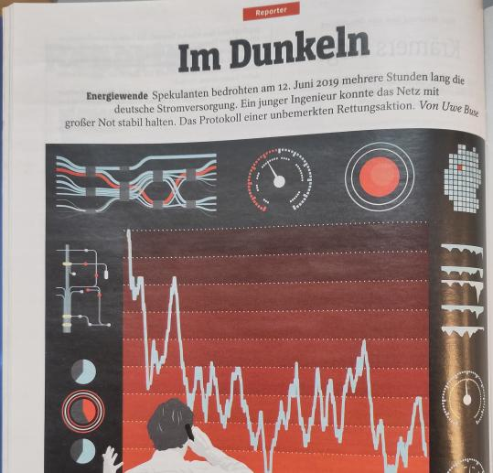
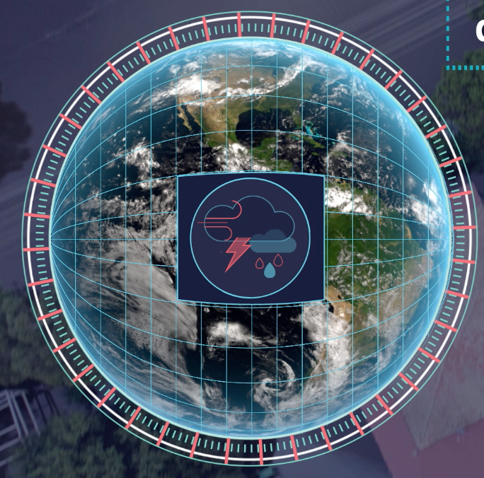
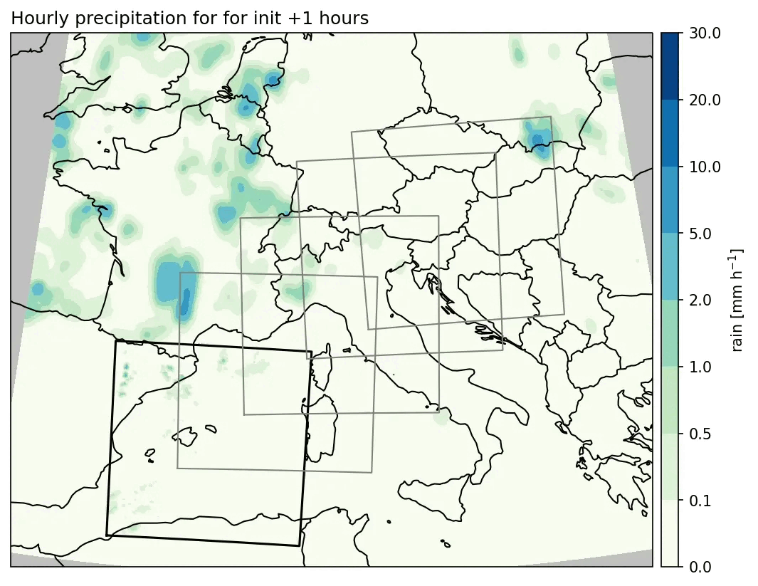
Extremes DT: a magnifying glass on extreme events
Globally, 4 days ahead, 2-4km
over Europe, 2 days ahead, 500-750m
1
How will the approaching storm affect solar energy production?

Slide 8
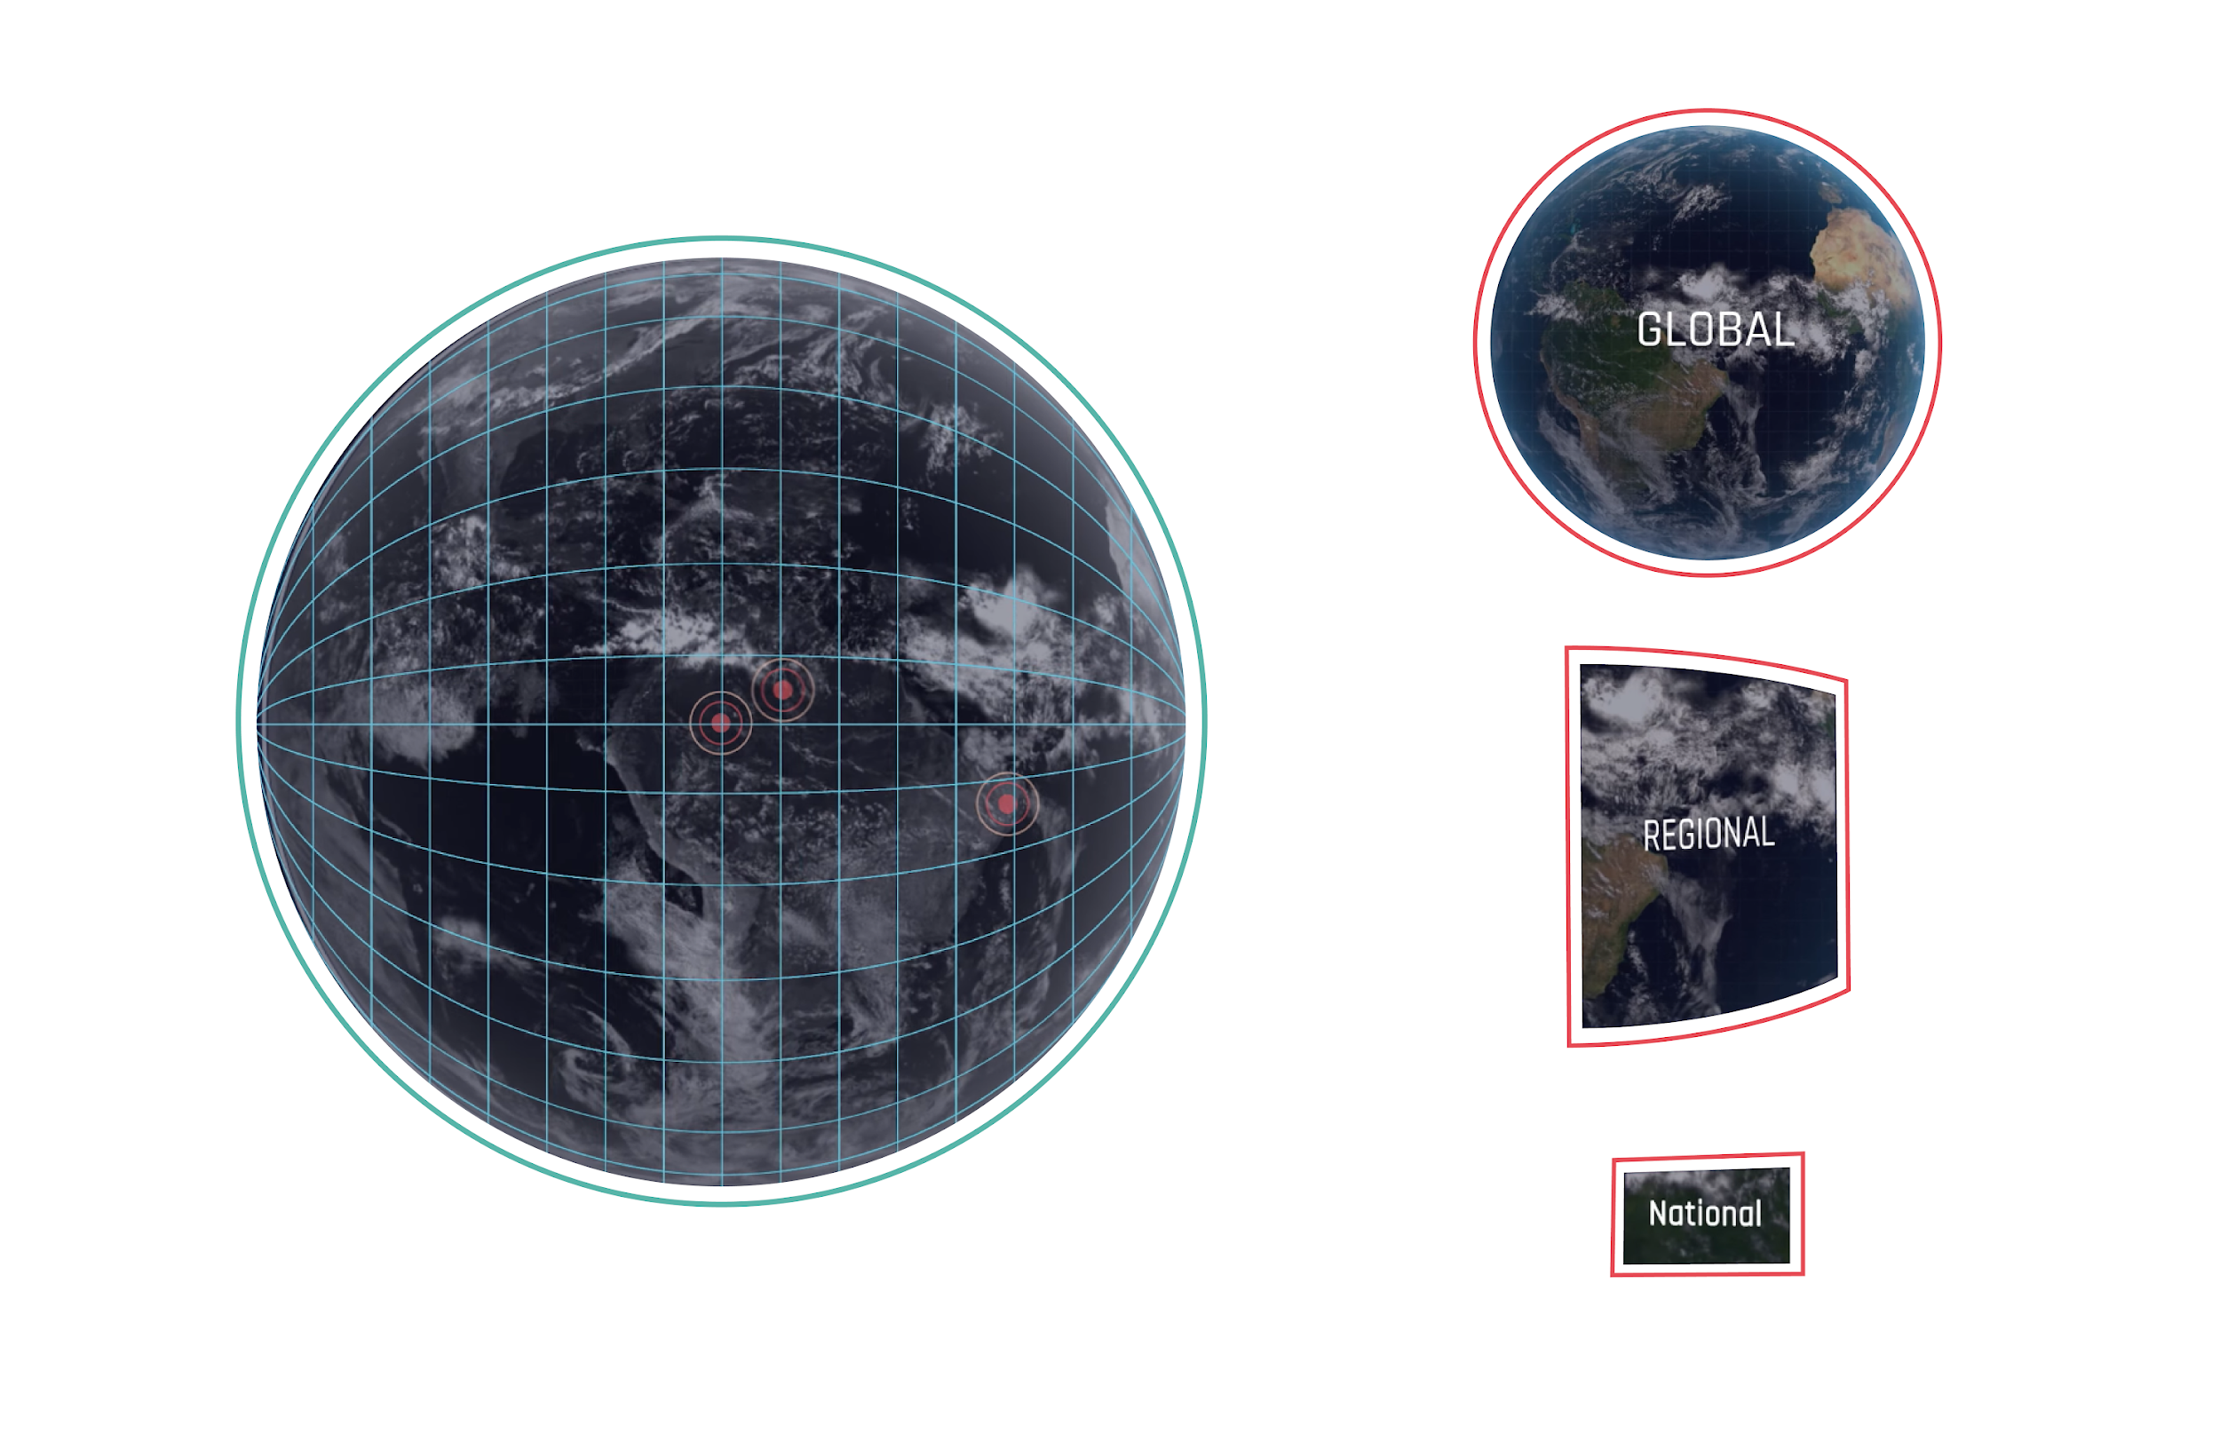
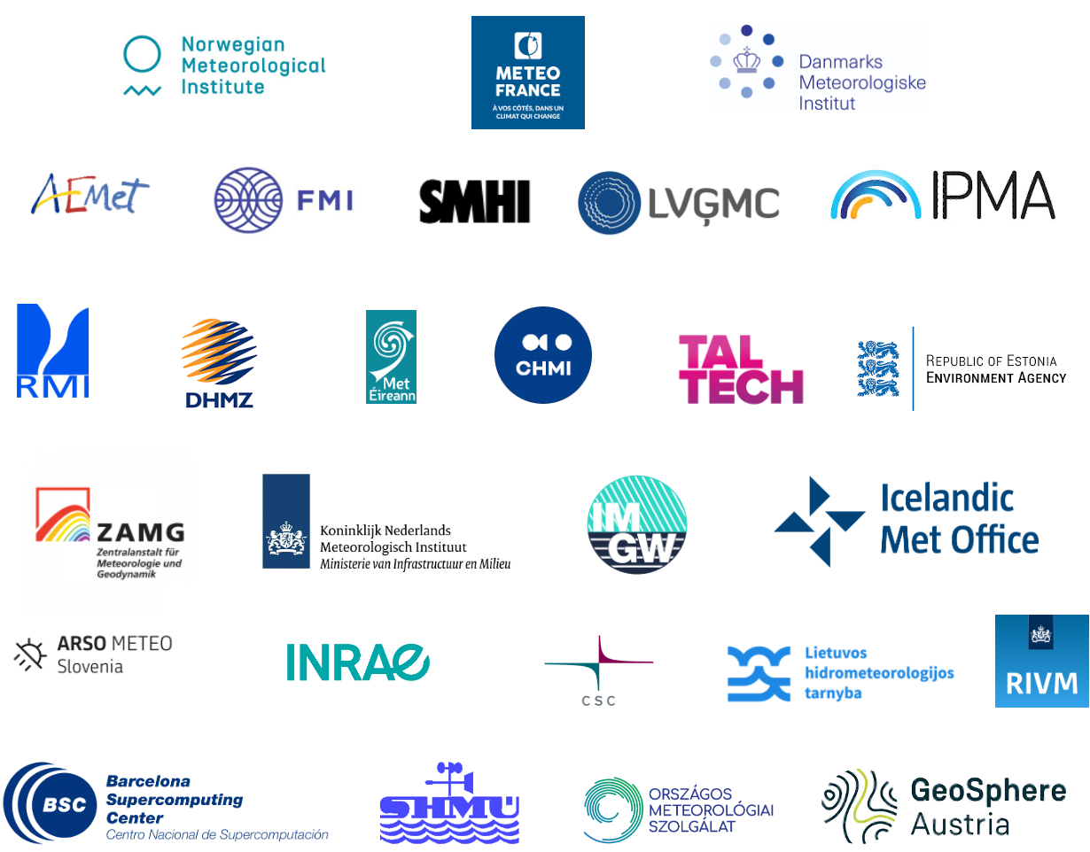


EXTREMES DT: status
DETECTION/
TRIGGERING
Global and daily simulations of extreme weather
4 days ahead at 4.4km
On-Demand regional simulations
2 days ahead at 750m to 500m
Impact-sector models:
user-relevant information for societal impacts
Arome
Harmonie-Arome
Alaro
IFS-NEMO
Notes:
The Extremes DT is the tool that will help us respond to rapidly developing extreme weather events.

Slide 9
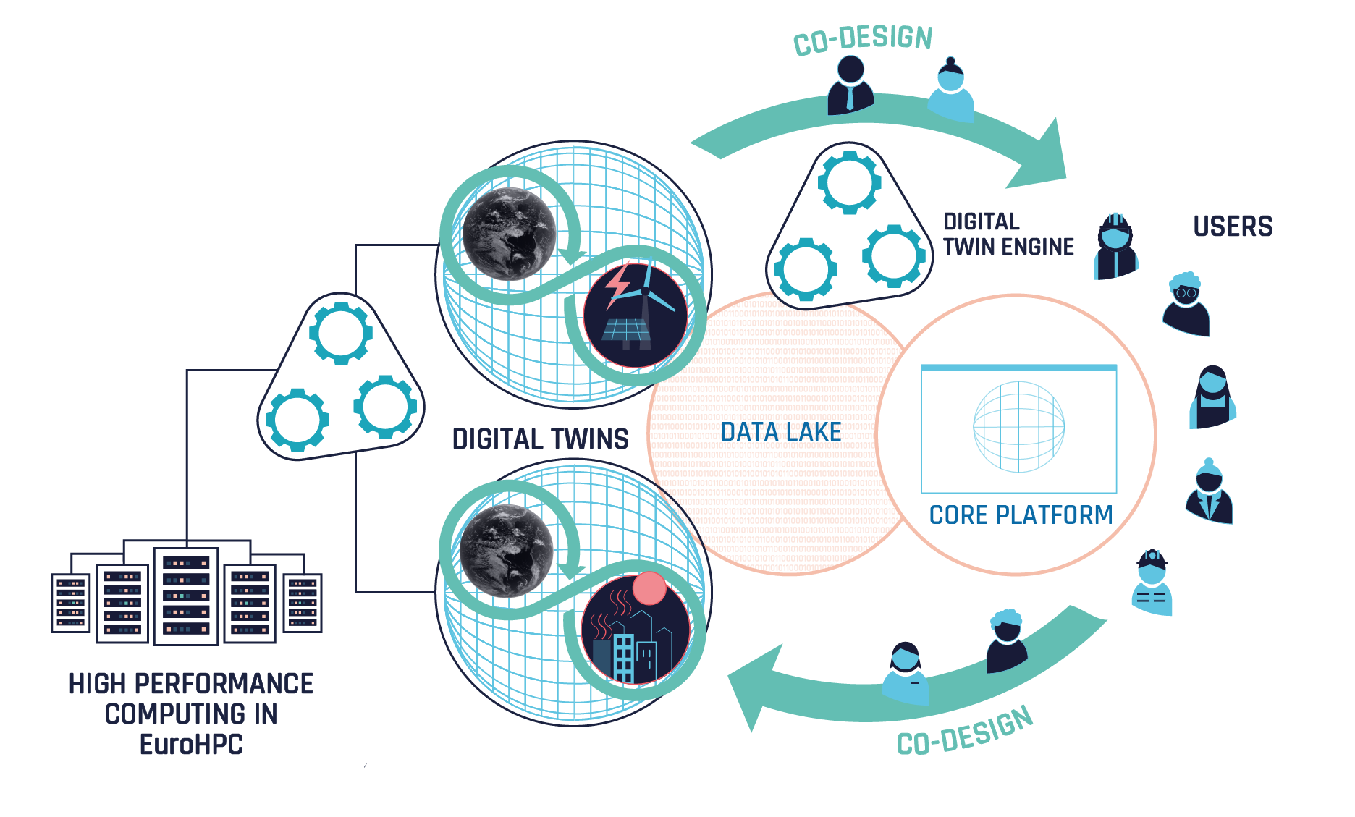


DestinE: A novel information system
DIGITAL
TWIN ENGINE
Notes:
Creating the digital twin our planet also crucially relies on developing the key elements of the destine system. The digital twins built in a close co-design approach with the users are of course at the heart of this system – and constitute the main innovation element. The other main innovation element is the digital twin engine which represents the software infrastructure which provide the flexible environment to exploit the euroHPC capabilities and operate the digital twins. It also allow users to interact with the digital twins and their data by interfacing with the two are components of the system - the data lake and the core platform.

Slide 10
Digital twin engine (DTE) components and objectives

Slide 11
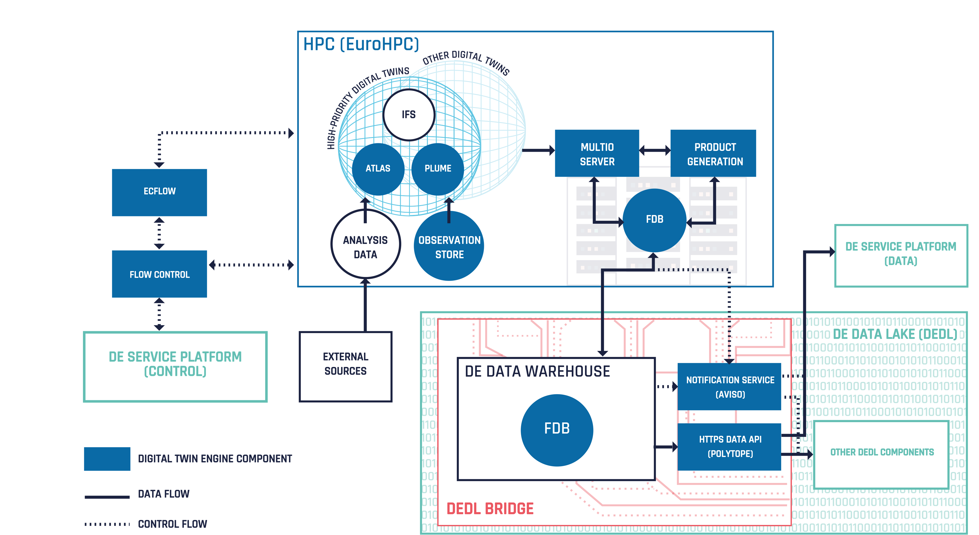



How the Data flows through the DestinE system

Slide 12
Different types of Integration

Slide 13
Technology transfer
What has been done so far:
  In Bilateral meetings we have:
  Drafted a first version of a common DT architecture description (using C4 modeling )
  Started working on the glossary (forked from Digital twin consortium, like BioDT and Intertwin)
  Define pilots to test for interoperability
    With DT-Geo a tsunami DT (also looking into urgent computing aspects)
    With BioDT a DT on consequences of climate change to agricultural crops over Europe (together with Eumetsat)
    With Intertwin a DT on flood adaptation and mitigation (a shared usecase between Intertwin and DestinE)
  We are sketching solution paths for these pilots in the architecture landscape

Slide 14
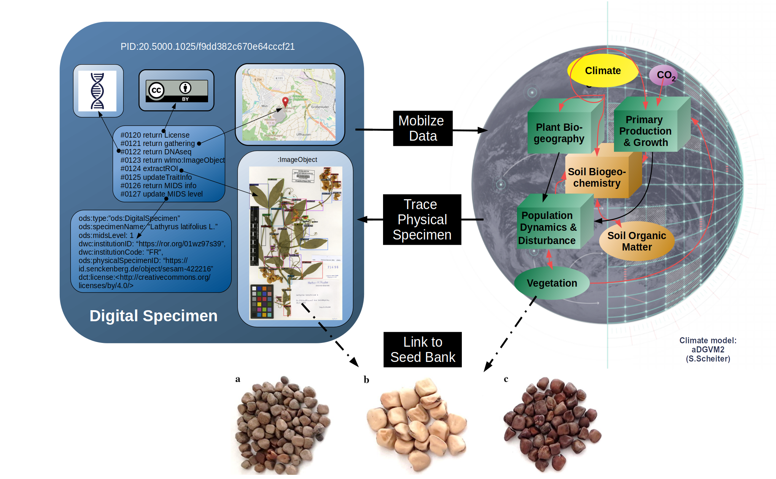
pDT Crop Wild Relatives
Online coupling with Weather-induced and Geophysical Extremes DT, and/or the Climate adaption DT
Suggested at PhenoHarmonIS 2024 WS: Provide links to seed banks based on habitat suitability

Slide 16
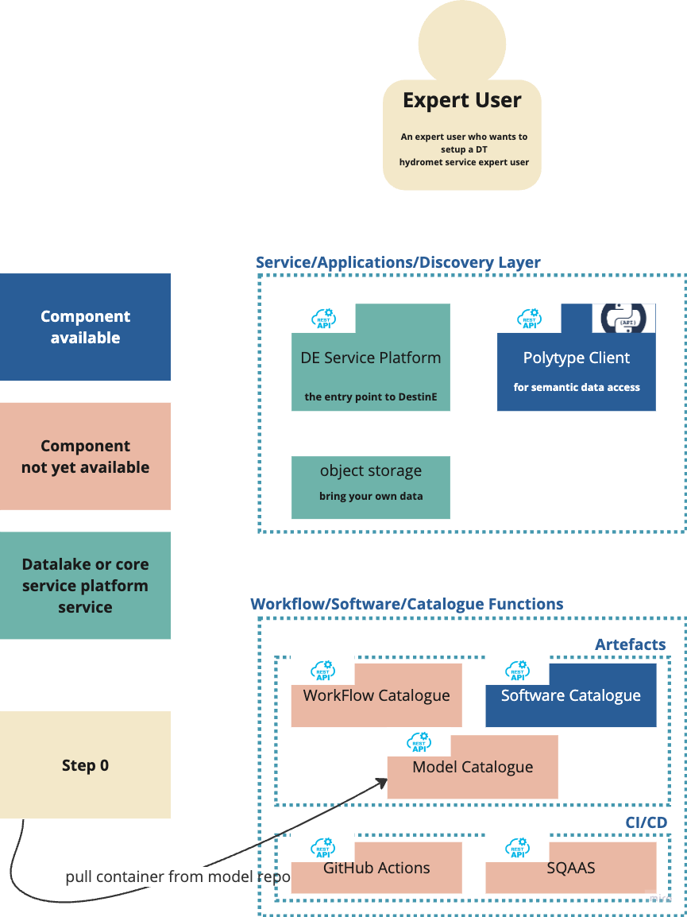
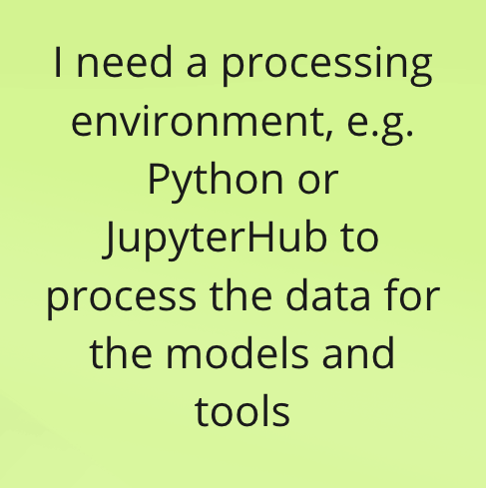
OK that should not be a problem since python and jupyter are available on the Destination earth service platform and python across all DE platforms

Slide 17
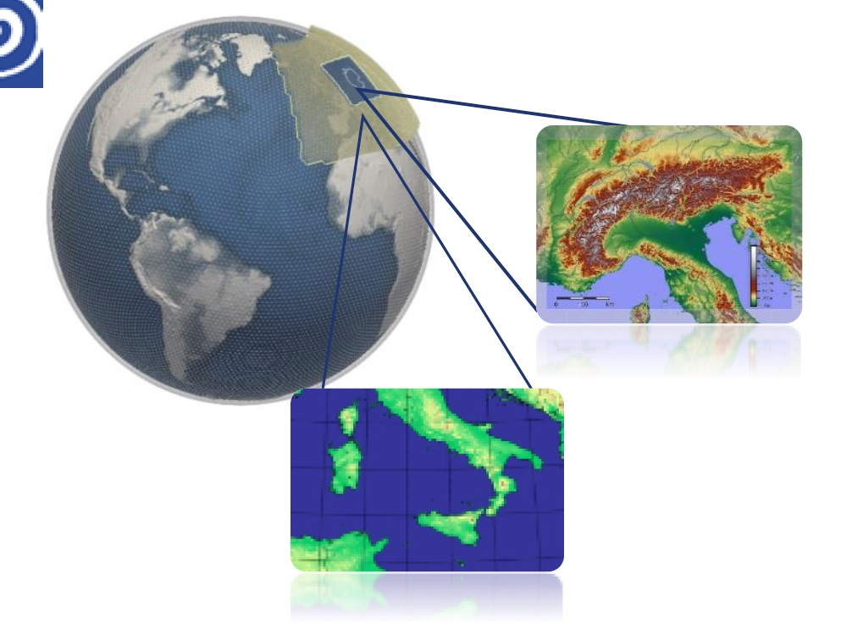

GLORI4DestinE
Global-to-Regional-ICON
Digital Twin
ECMWF
Cineca, ItaliaMeteo, Arpae, CMCC
+
GLORI consortium

Slide 18
The GLORI Digital Twin

Slide 19
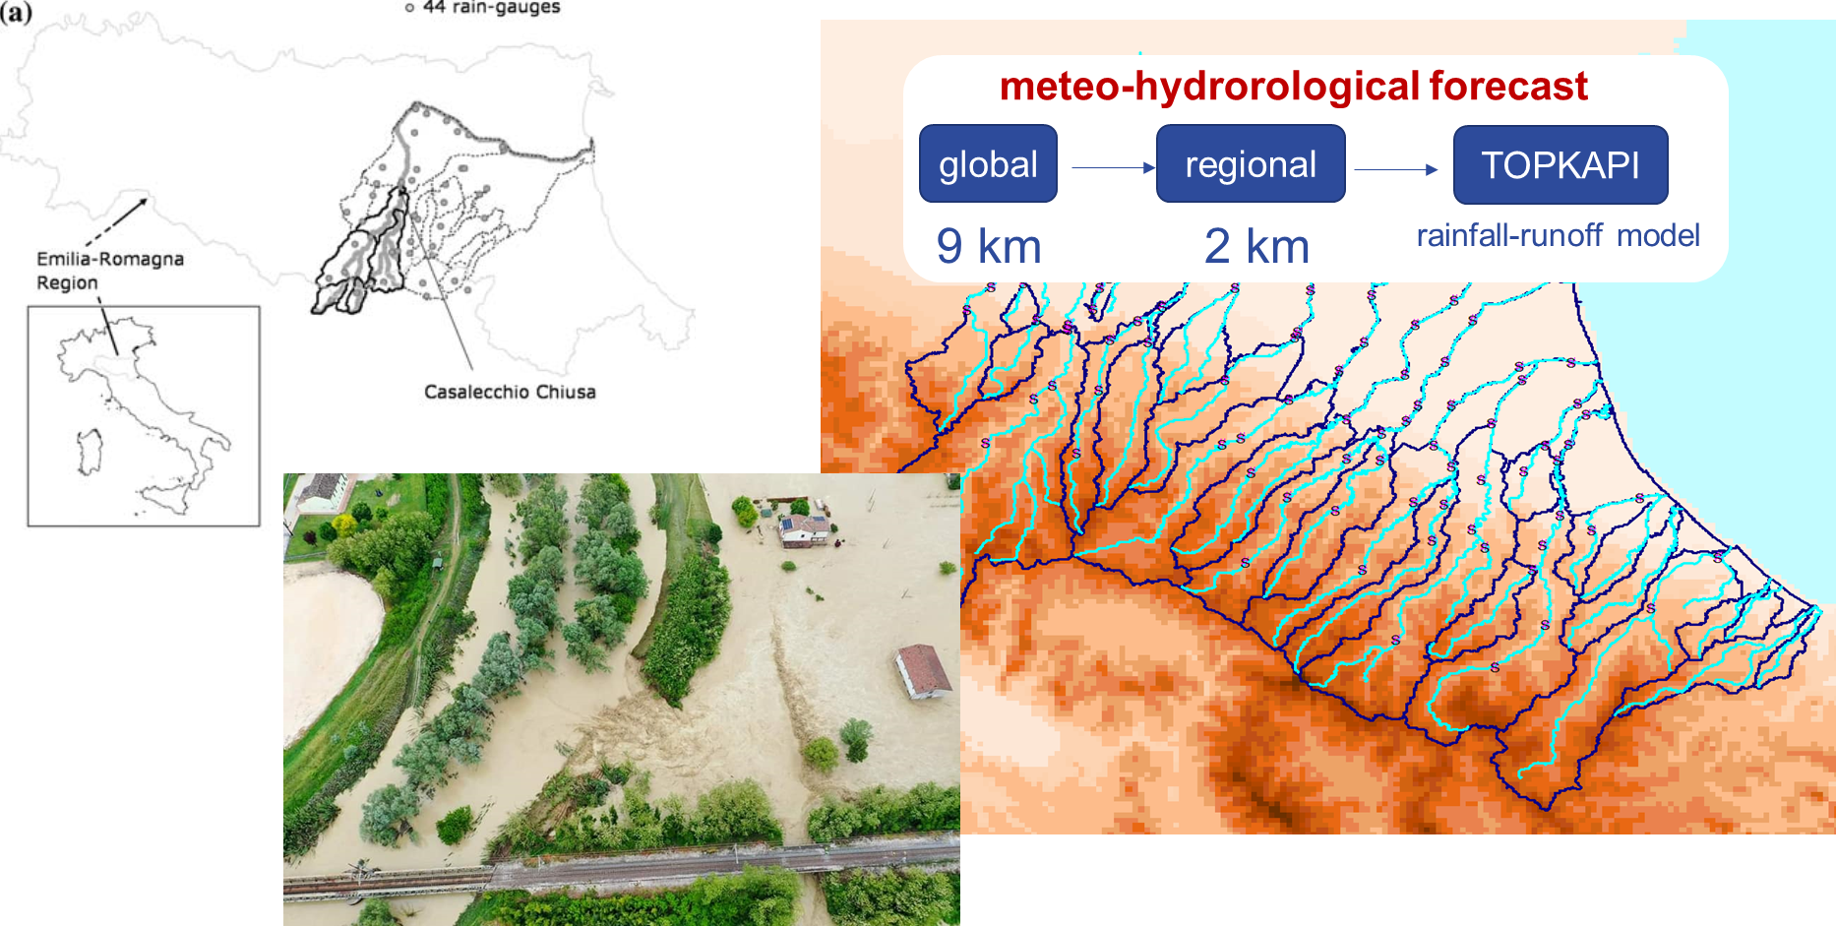
Example of application

Slide 20
Coupling of the digital twins via the DTE
Scenario 1: ICON global -> drive ICON regional -> output in the FDB
Scenario 3: DestinE extremes DT global -> drive ICON regional -> output in the FDB
Scenario 4: ICON global -> output in FDB, also as BCs available for DestinE Extremes on demand

Slide 21
