Slide 1


The PITHIA e-Science Centre
Prof Tamas Kiss
University of Westminster
EGI 2024 Conference – 02/10/2024
Lecce, Italy

Slide 2

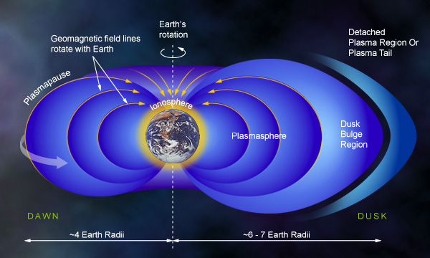
PITHIA-NRF project overview
PITHIA-NRF: Plasmasphere Ionosphere Thermosphere Integrated Research Environment and Access services: a Network of Research Facilities
  Build a network of research facilities that specifically supports the research community related to the study of the Earth’s ionosphere, thermosphere and plasmasphere
  Integrate observing facilities, data collections, data processing tools and prediction models
  Duration: 4 years (April 2021 – March 2025) – EU H2020
  Funding: EUR 5.4 Million
  22 project partners – 20 scientific and 2 technical partners (UoW, EGI)

Slide 3
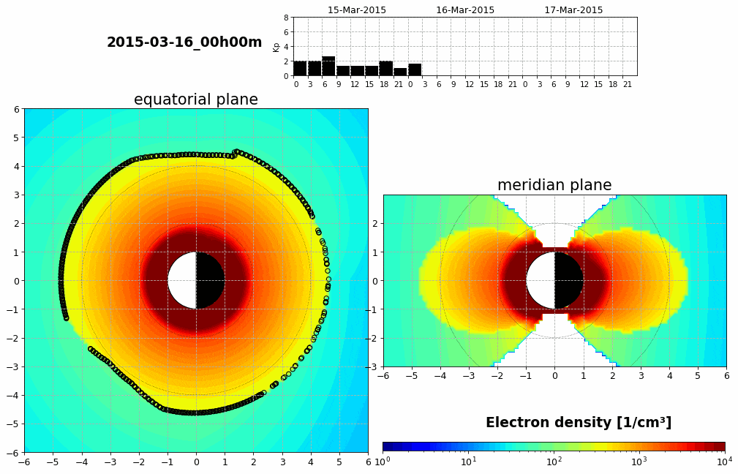
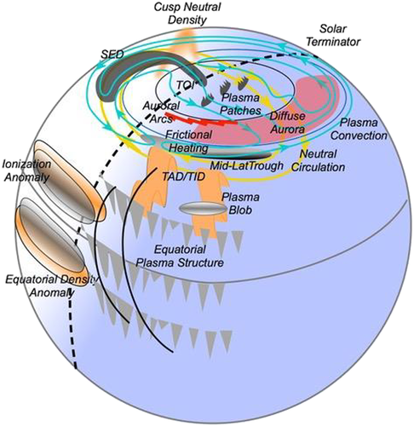
Scientific challenges
The Earth’s Ionosphere, Thermosphere, and Plasmasphere is governed by the complex electrodynamic and photochemical system of the upper atmosphere coupled with variable electromagnetic fields and thermospheric winds.
These physical processes are the source of many scientific, operational, societal, and environmental challenges that affect the smooth and uninterrupted operation of critical technological systems and of research infrastructures.
While we understand the broad features of the coupled ionosphere thermosphere plasmasphere system response, we lack the depth of understanding of its variability in long- and short-time scales that would allow us to build models with real predictive power.
Courtesy: BIRA-IASB

Slide 4
What is the PITHIA e-Science Centre?
A central web portal to provide a single point of entry to heterogenous and distributed resources (Data Collections)
  Datasets
  Models
  Catalogues
  Workflows
Standardised metadata and ontology-based search
Seamless interaction with all registered resources
Usage is free and available for everyone – https://esc.pithia.eu

Slide 5
PITHIA Ontology and Metadata Structure
Registration to be completed in defined order considering dependencies
Acceptable values are defined by the PITHIA Space Physics Ontology

Slide 6
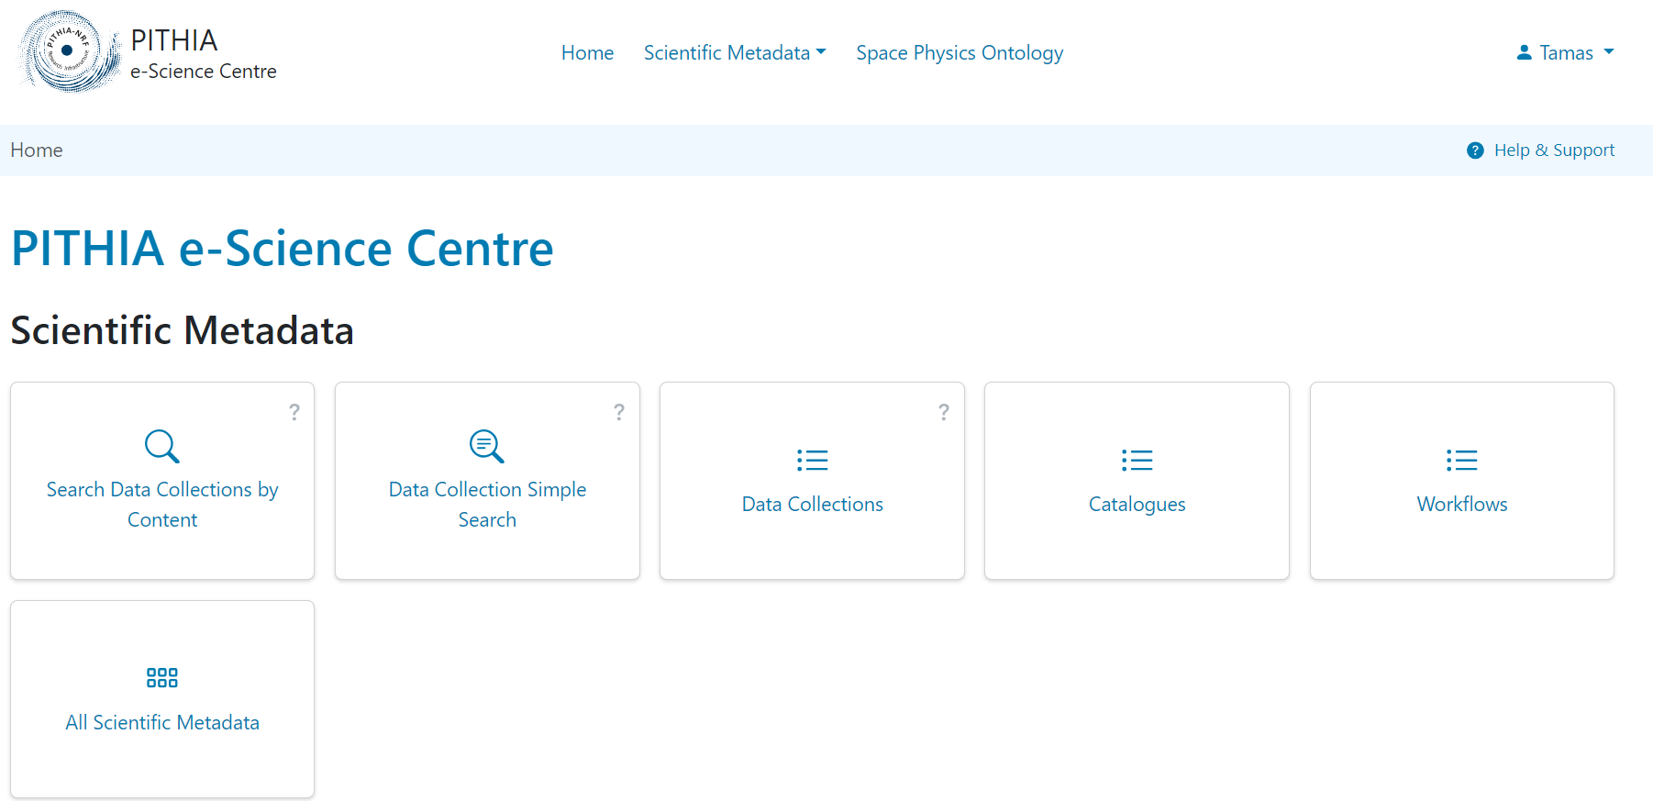
eSC Generic Structure
Open for everyone

Slide 7
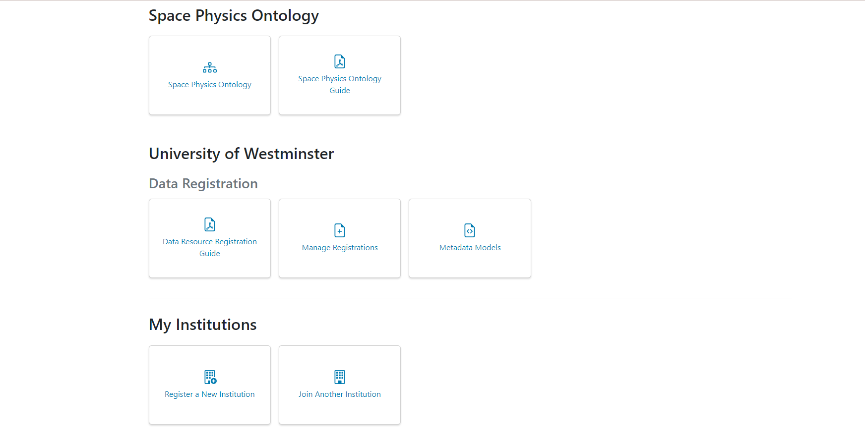
eSC Generic Structure
Open for everyone
Only after logging in

Slide 8
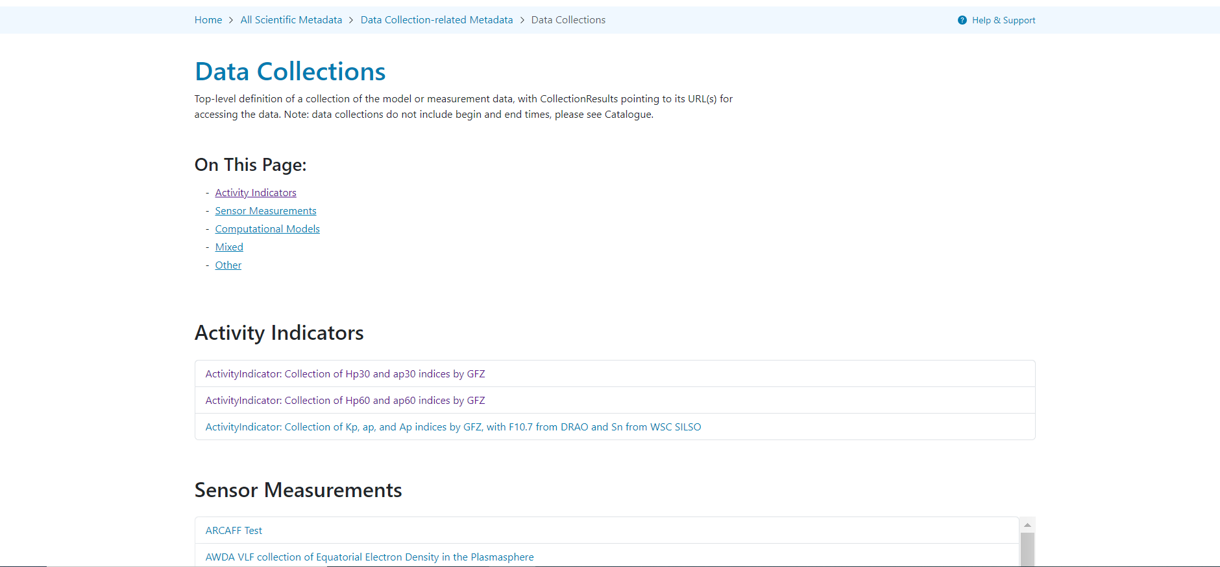
eSC Highlights – Search for Data Collections
Browse Data Collections
Main categories of Data Collections
Relevant Data Collections per category

Slide 9
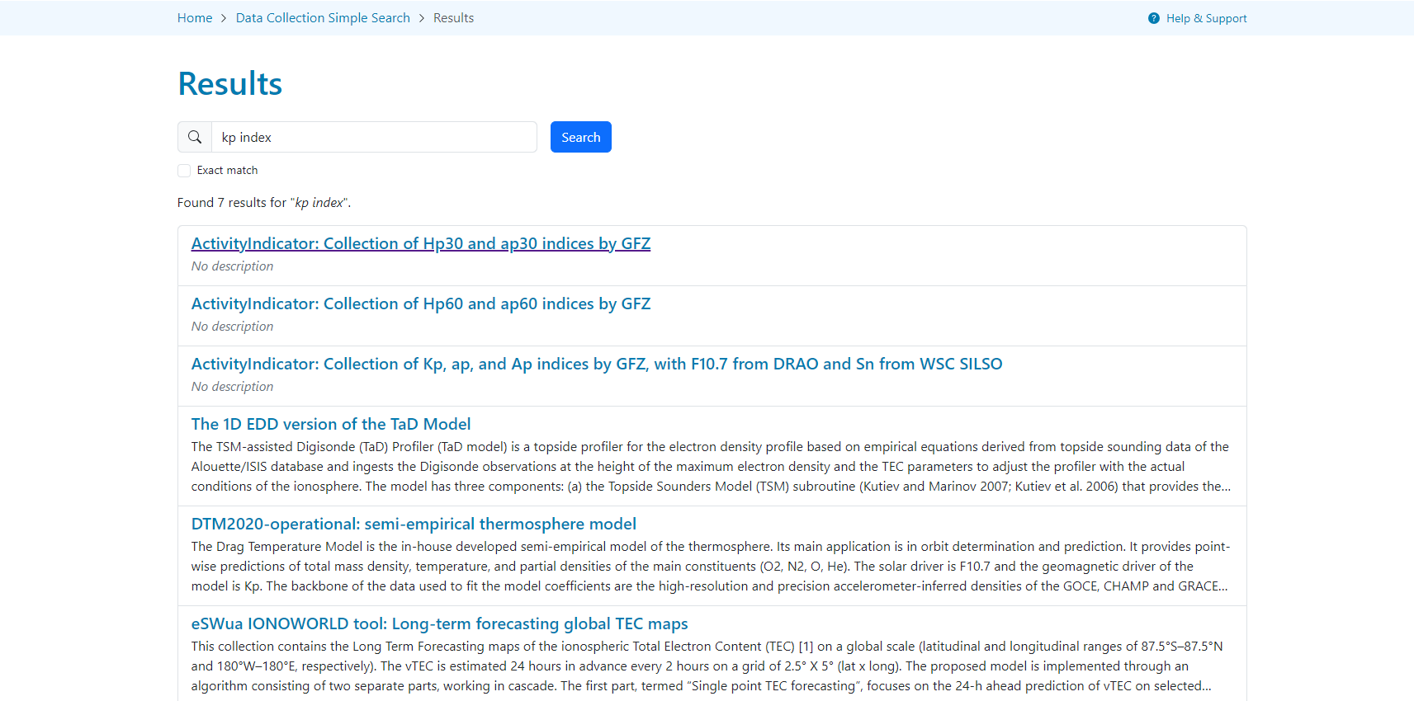
eSC Highlights – Search for Data Collections
Simple keyword-based search
Search text / keyword
All data collections relevant to that keyword

Slide 10
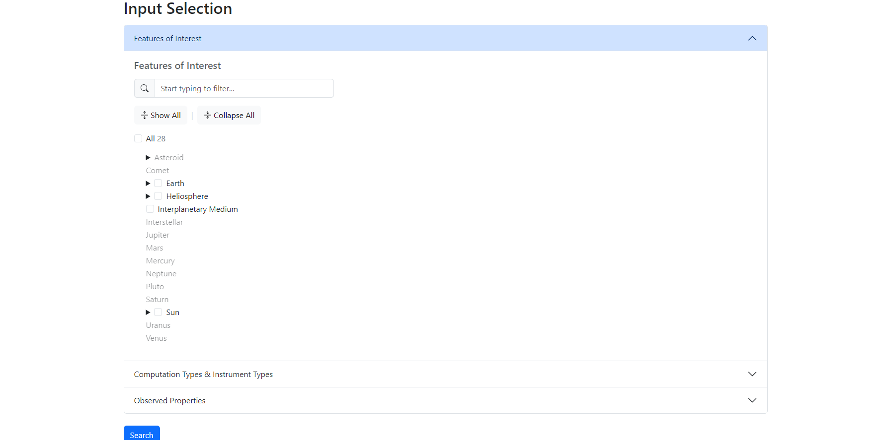
eSC Highlights – Search for Data Collections
Content-based search using Space Physics Ontology
Define Features of Interest, Computation or Instrument Type, and Observed Property based on the PITHIA Space Physics Ontology
Search for Data Collections relevant to the defined content

Slide 11
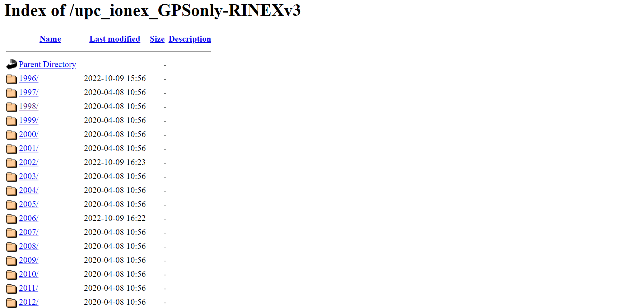
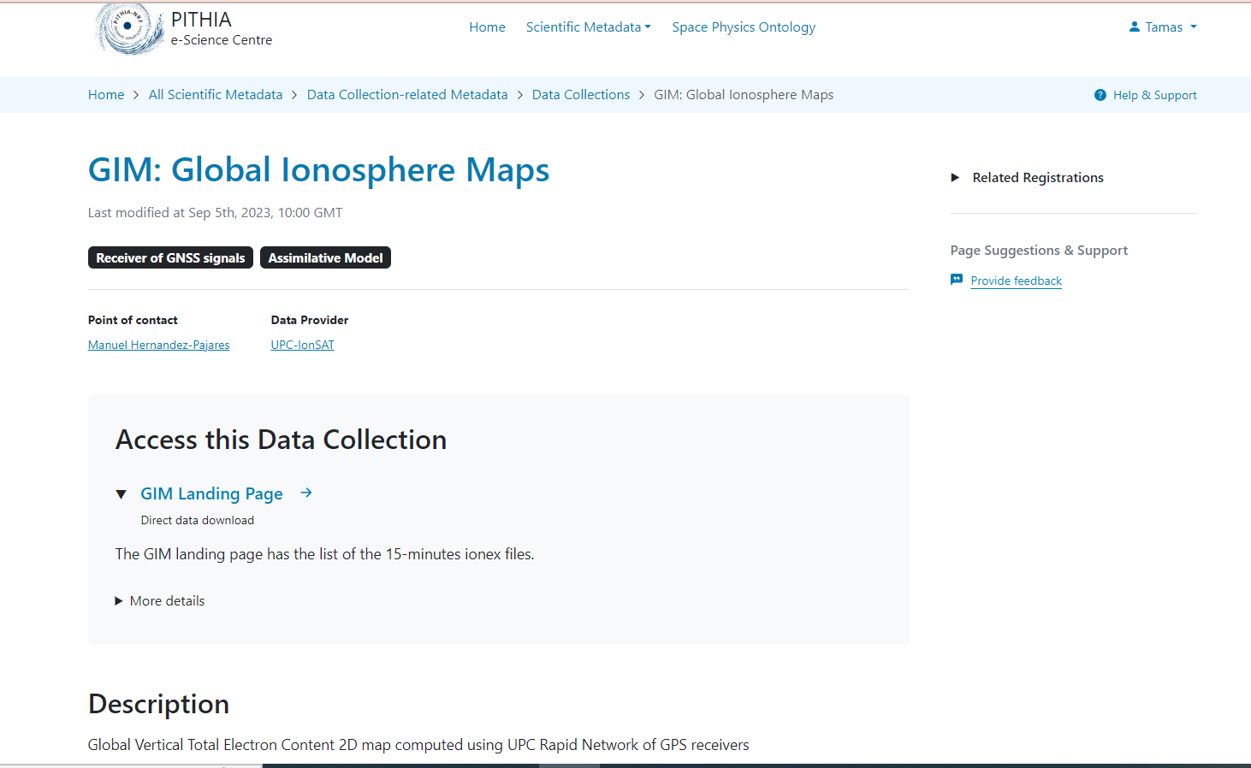
eSC Highlights – Interact with Data Collections
Get direct access to a Data Collection hosted externally
Click on link to access data directly.
Access Data Collection on remote site
Learn more about the Data Collection based on the XML metadata published by the owner

Slide 12
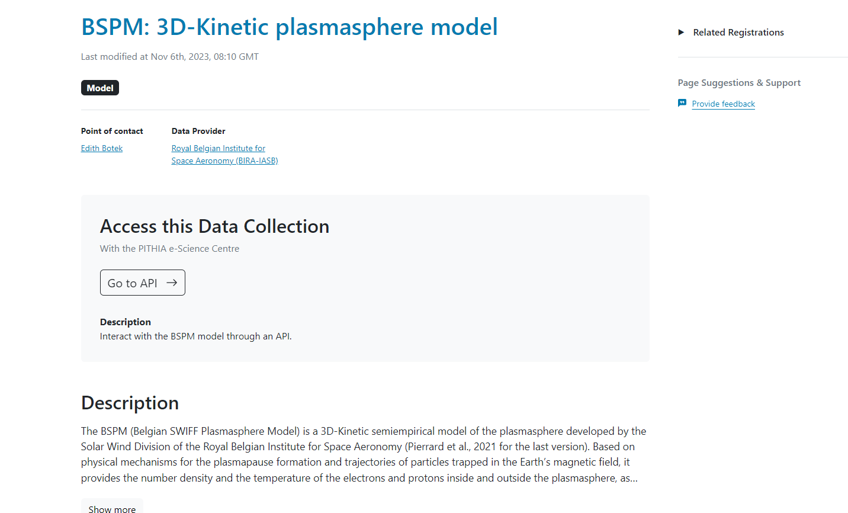
eSC Highlights – Interact with Data Collections
Run model or access data directly from the eSC (using API)
Find link to execute model
Find Data Collection (computational model)

Slide 13
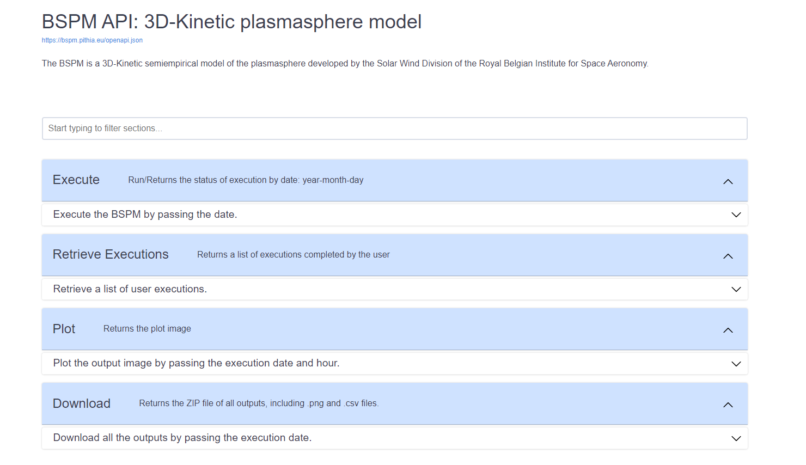
eSC Highlights – Interact with Data Collections
Run model or access data directly from the eSC (using API)
Select desired functionality/operation

Slide 14
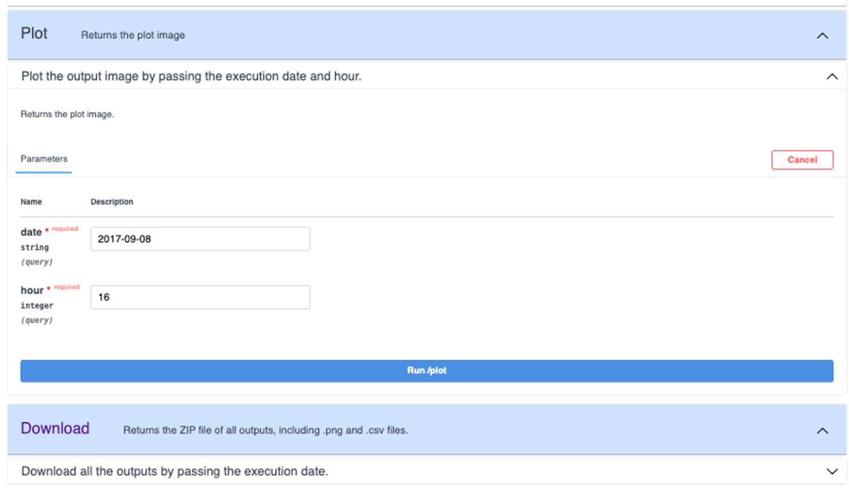
eSC Highlights – Interact with Data Collections
Run model or access data directly from the eSC (using API)
Provide input parameters

Slide 15
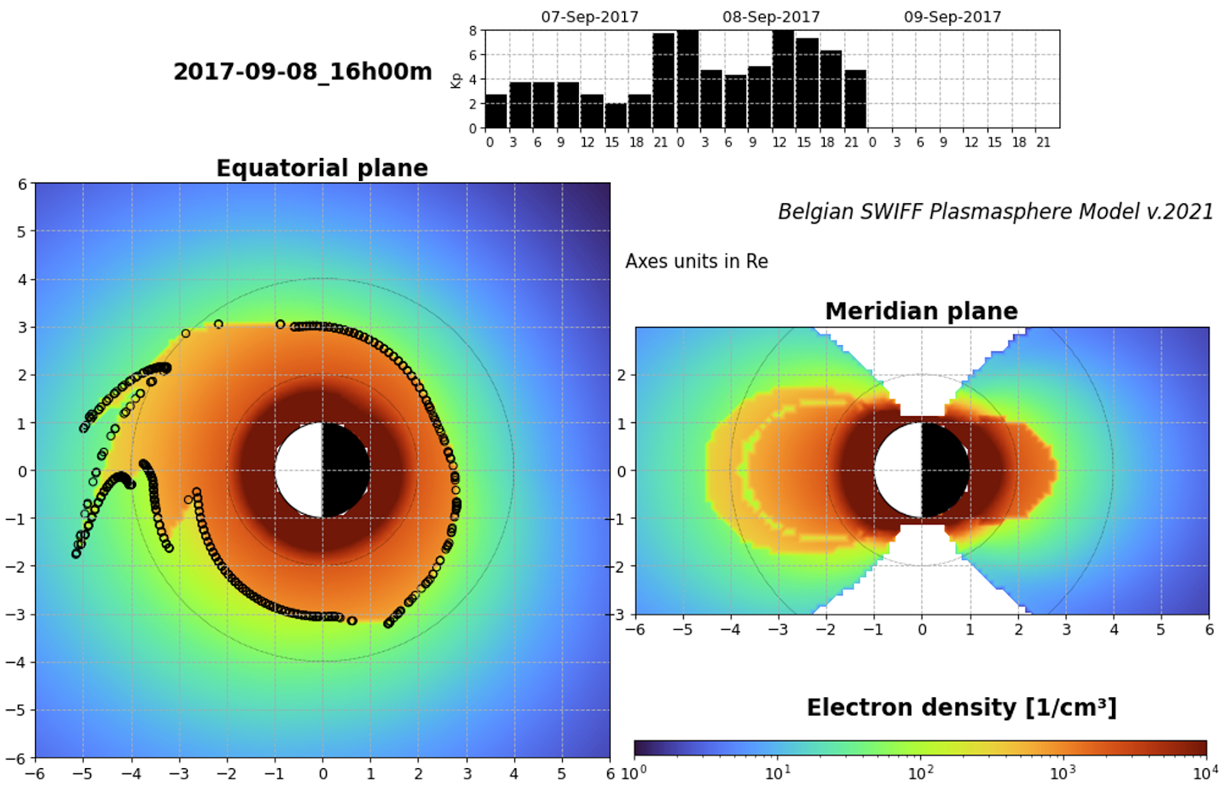
eSC Highlights – Interact with Data Collections
Run model or access data directly from the eSC (using API)
Observe results

Slide 16
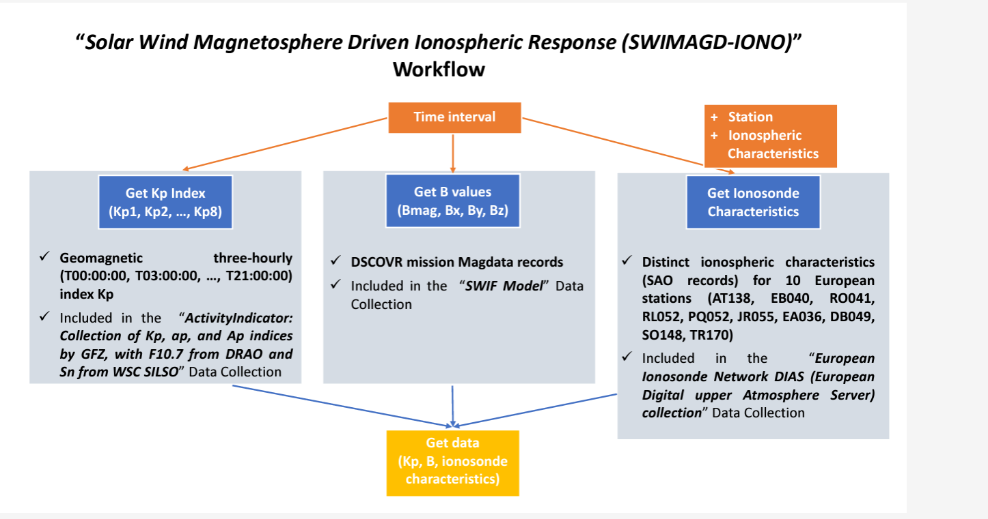
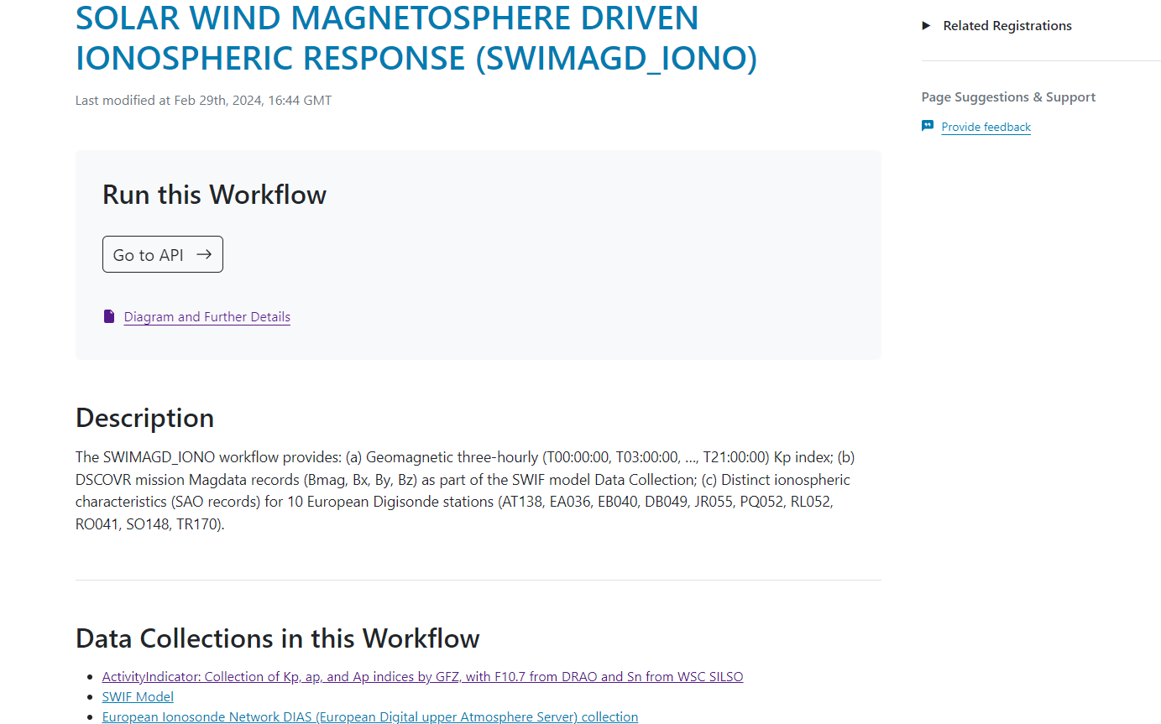
eSC Highlights – Execute Workflows
Combine multiple Data Collections into one automated execution
Find the workflow and learn about it

Slide 17
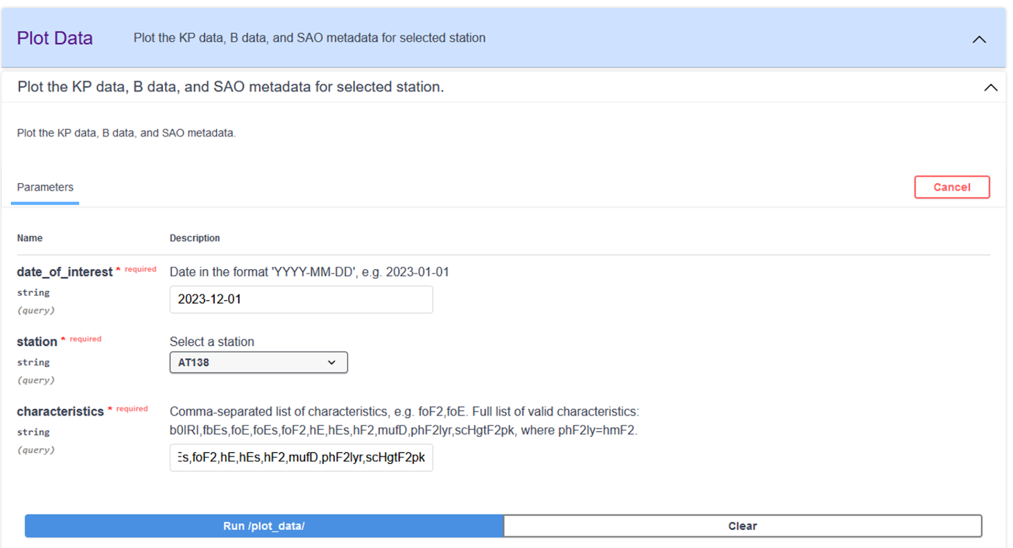
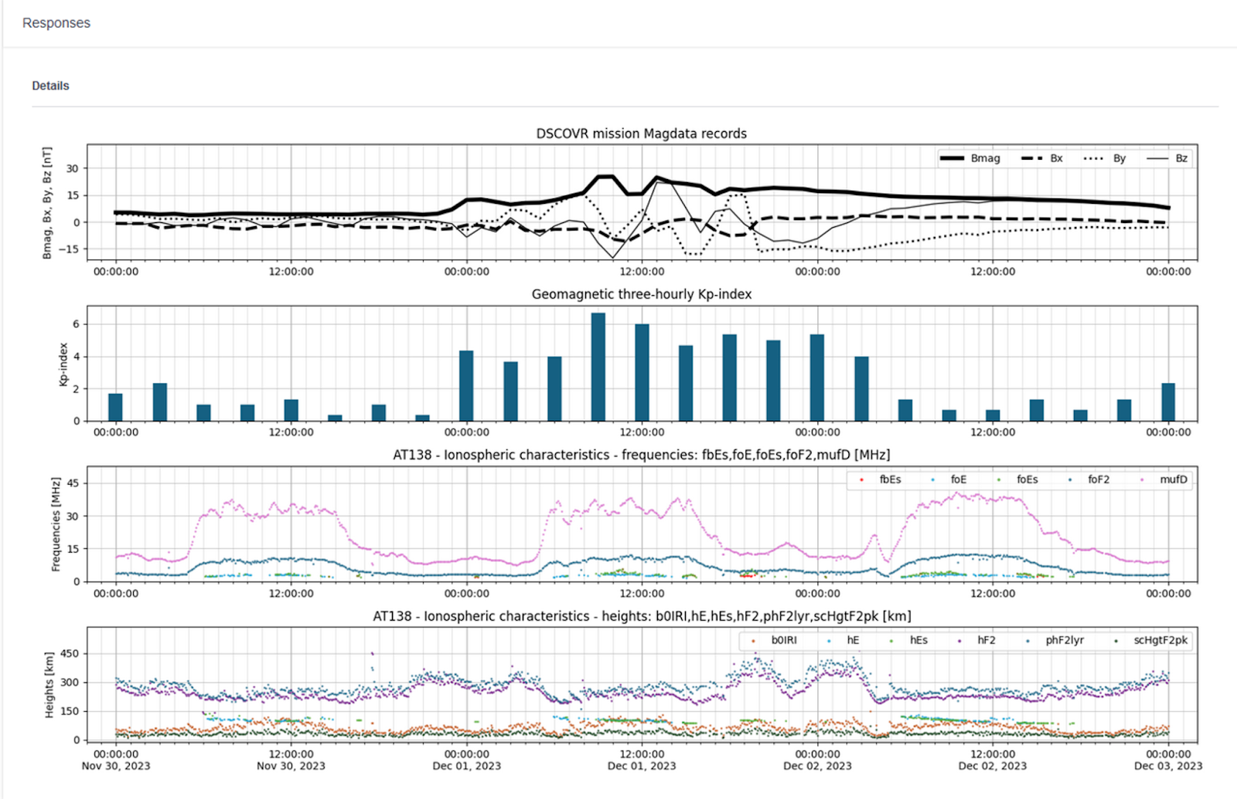
eSC Highlights – Execute Workflows
Combine multiple Data Collections into one automated execution
Execute workflow and visualise results

Slide 18
eSC Highlights – Resource management
Registered users can create, delete or modify resources under their institution
  A resource can be a Data Collection, a Workflow or a Catalogue
  Registering a Data Collection requires up to 12 steps
Resource registrations are in XML format
Two options for managing/creating XML files
  Edit XML files off-line and upload them
  Use registration wizard to generate XML automatically
User management is based on EGI CheckIn for authentication and Perun for authorisation

Slide 19
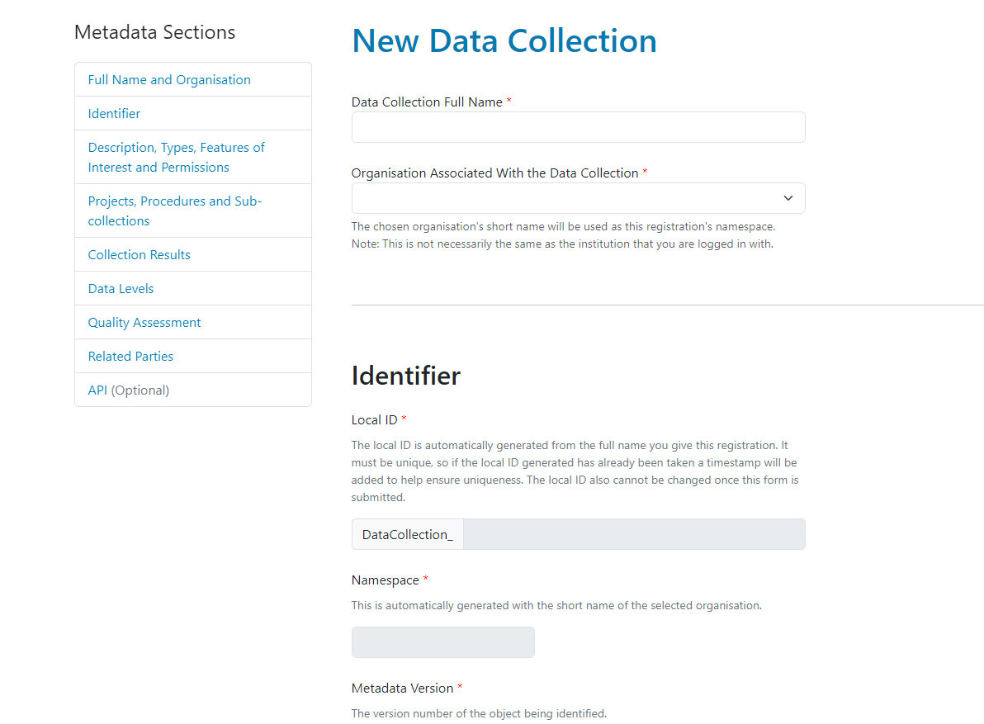
eSC Highlights – Resource management
Registration Wizard
Complete fields by typing in information directly
Select information from drop down box
Some information in generated automatically so that user does not have to worry

Slide 20
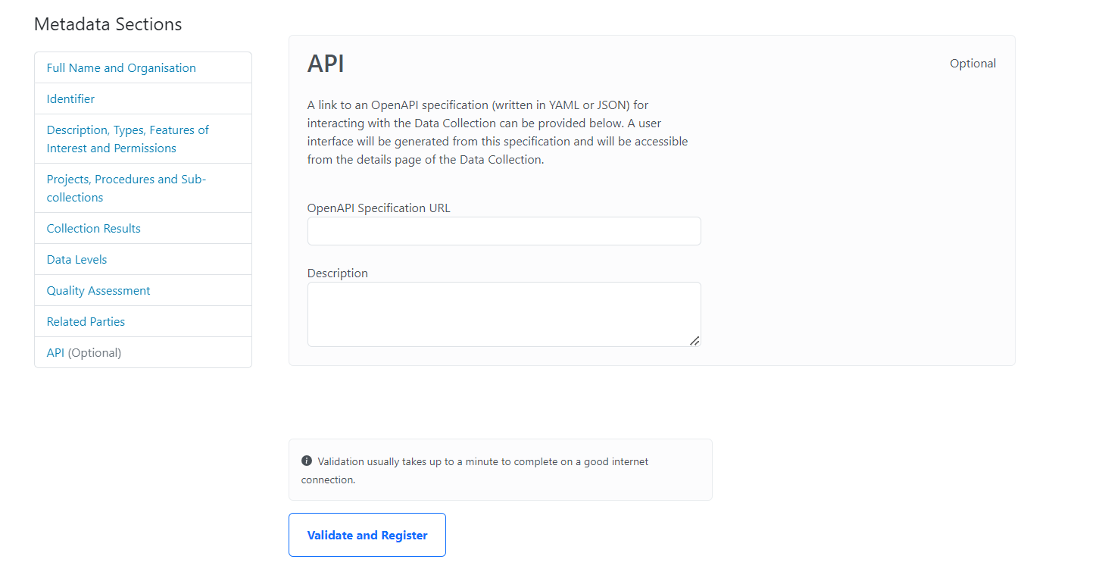
eSC Highlights – Resource management
Registration Wizard
Once form completed, user can validate it and generate XML automatically

Slide 21
eSC Deployment

Slide 22
eSC in Numbers
  Number of registered Data Collections: 61
  Number of Workflows: 2
  Number of Catalogues: 2
  Total number of XML files: 834
  Number of registered Users:
  Number of registered Institutions:

Slide 23

Thank you for your attention!
WEB:
  https://www.pithia-nrf.eu
  https://esc.pithia.eu/
The PITHIA-NRF project has received funding from the European Union’s Horizon 2020 research and innovation programme under grant agreement No 101007599

