Slide 1
EOSC Beyond
Enhancing EOSC Core capabilities and piloting EOSC Nodes
Diego Scardaci
EGI Foundation

Slide 2
Project Overall Objective
Advance Open Science and innovation in research by providing new EOSC Core capabilities that allow scientific applications to integrate and compose multiple EOSC Resources from national, regional and thematic EOSC Nodes

Slide 3
Project Factsheet
Budget: 10.000.000€
Start: 01/04/2024
Duration: 36 months
Consortium: 33
E-Infrastructures: EGI, OpenAIRE, EUDAT, GEANT
Technology providers: ATHENA, CERN, CESNET, CYFRONET, DANS, FZJ, GRNET, GWDG, IISAS, INFN, IPB, KIT, LIP, UPV, SRCE, UKIM, UPV
Research communities: CNB-CSIC, CESSDA (EKKE, TARKI), CMCC, DESY, ENEA, INSTRUCT-ERIC, LifeWatch. NFDI. Premotec, UNITN
Call topic: HORIZON-INFRA-2023-EOSC-01-04
Next generation services for operational and sustainable EOSC Core Infrastructure
16
Coordinator: EGI Foundation
Work packages
39
Deliverables
Project Officer:
Flavius Alexandru PANA
European Research Executive Agency
Unit REA.C.4
33
Milestones

Slide 4
Specific Objectives
1
Enable a European Network of pilot EOSC Nodes
2
Accelerate the time to produce scientific applications with ready-to-use adapters
3
Enable Open Science with machine-composability and dynamic deployment of shared Resources in the context of the EOSC Execution Framework
4
Increase innovation in EOSC with an environment for the development, testing, integration and deployment of services, data and other research objects
5
Enable federated discovery and access of FAIR data across EOSC and European Data Spaces

Slide 5
Next Generation Core services to support the setup and the Federation of EOSC Nodes
AAI, Resource Catalogues, Monitoring
Accounting, Helpdesk, etc.
Advanced IF registry
Machine composability
AWM
SW Libraries implementing interface described in the EOSC IF Guidelines
Improved existing EOSC Core services and framework
The EOSC Execution Framework
The EOSC Integration Suite
Enhanced EOSC Platform Reference Architecture
EOSC Core Innovation Sandbox
National/Regional:
Germany (NFDI)
Czech Republic (e-Infra CZ),
NI4OS Southeast Europe (GRNET, IPB, UKIM)
e-Infrastructures:
EGI Federation
Thematic:
Environmental (LifeWatch)
Health and Food (METROFood-RI)
Structural Biology (Instruct-ERIC)
Climate Science (ENES)
Network of EOSC Pilot Nodes

Slide 6
Contribution to the establishment of EOSC
EOSC EU Node
Improved and extended set of EOSC Core services to shape EOSC EU Node v2.0
The current EU Node might adopt minor improvements in agreement with the EC and its implementing entities
EOSC Federation
Modelling the Technical Architecture
Piloting the node concepts and provide feedback
Beyond Pilot Nodes as test users for the EOSC EU Node
Identify connections of interest between Nodes for research communities (federated capabilities)
Next generation of EOSC Core Services
EOSC EU Node v1 (2024)
EOSC EU Node v2 (2027)
EU Node v2 Technical Specs

Slide 7
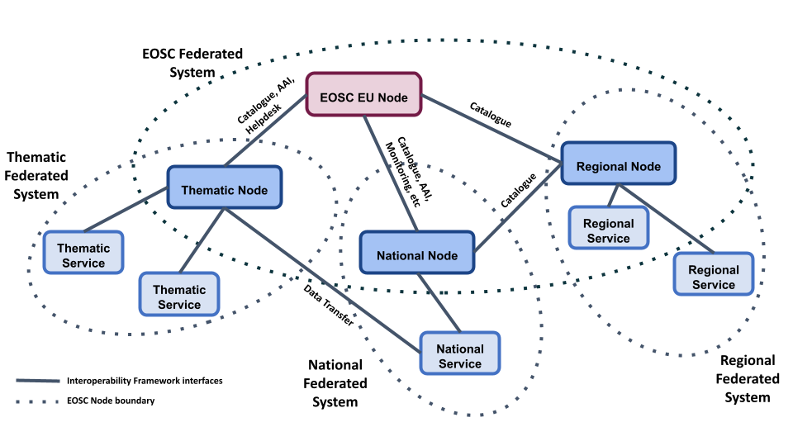
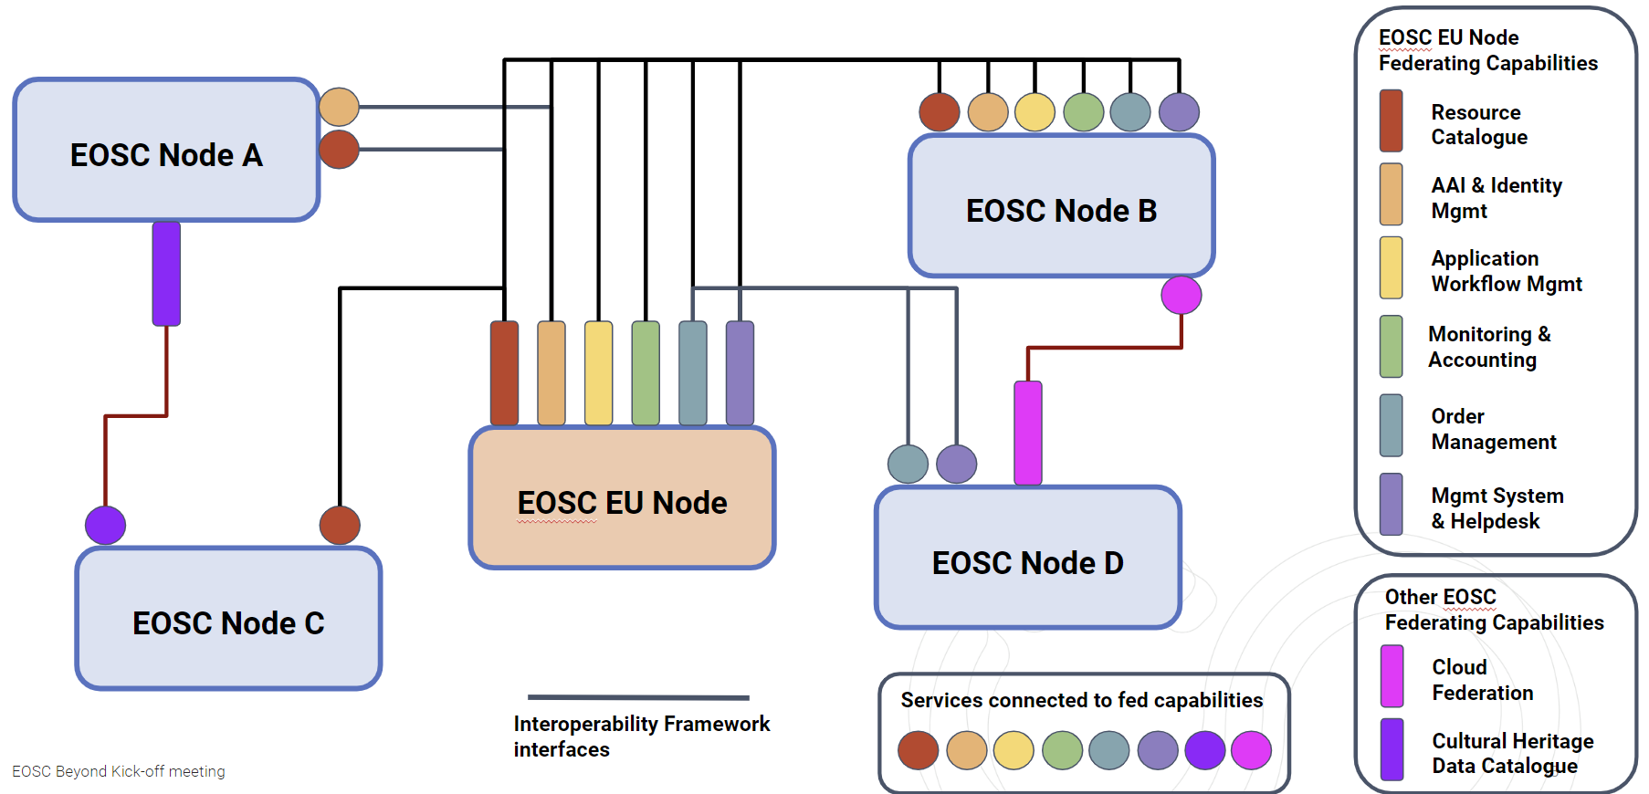
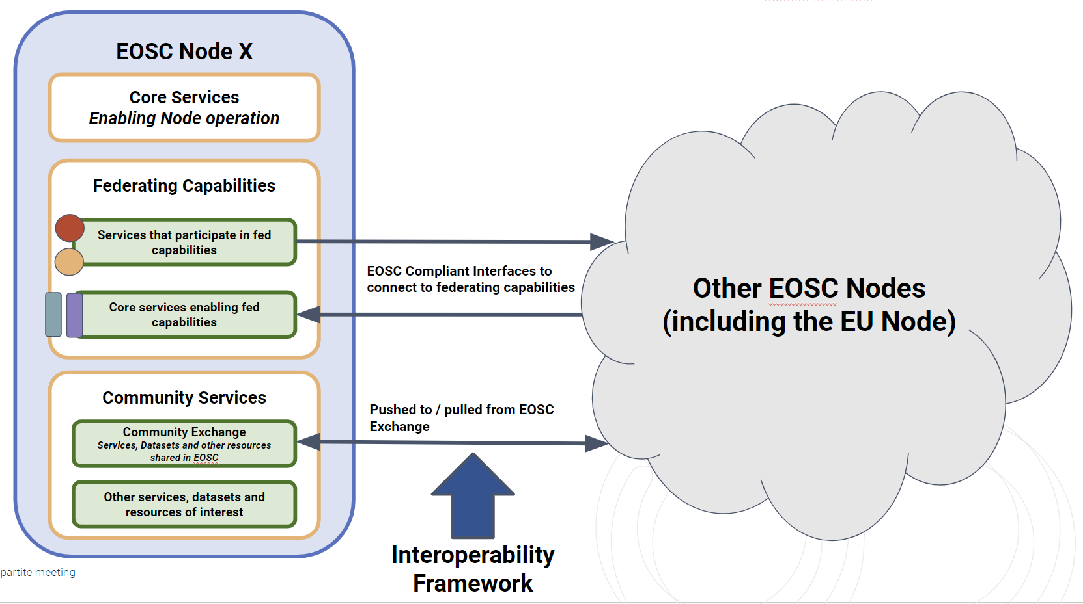
EOSC Federation Technical Architecture
EOSC as a Federation of Nodes
Federating Capabilities
Ongoing Activities
Modelling the Technical Architecture according to the requirements of the pilot nodes & other users
Identifying Federating Capabilities and piloting related use cases
Participation in the EOSC Federation Handbook writing (EOSC Tripartite initiative)
Live paper on the EOSC Federation Technical Architecture (first version Oct 24) → D5.3 (Sept 2025)
EOSC Node Service Structure

Slide 8
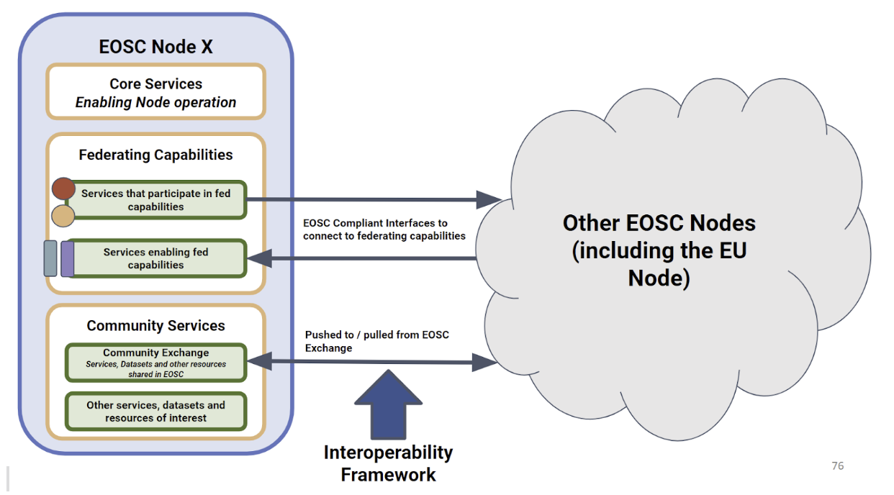
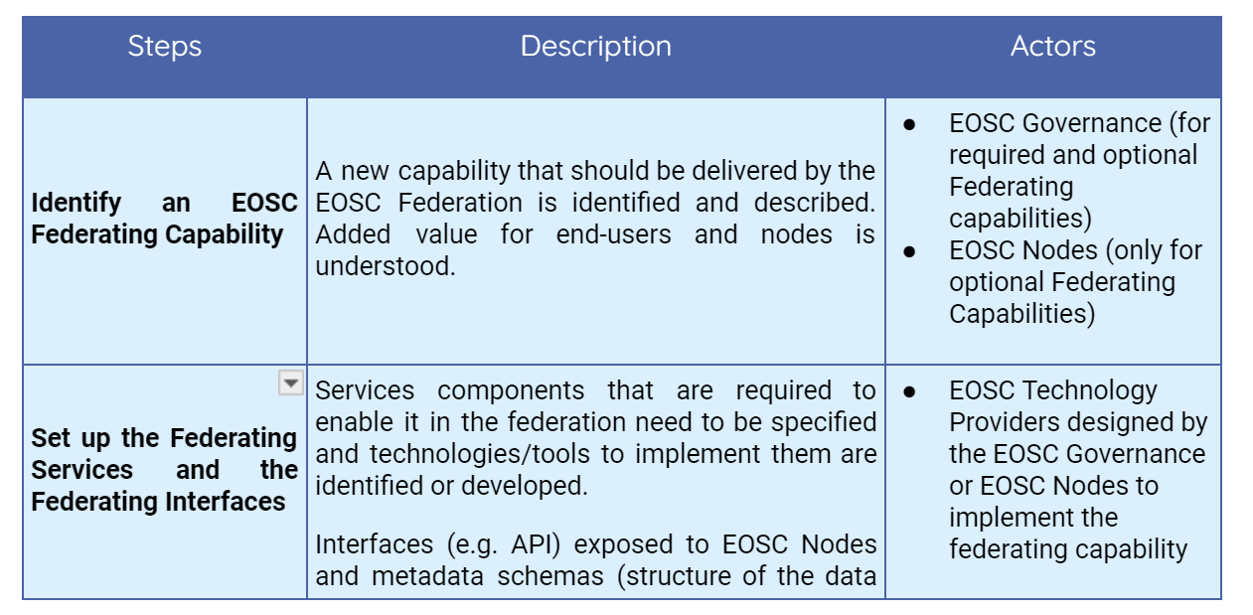
Paper: EOSC as a Federation of Nodes
Coming soon: October 2024
EOSC Node Service Structure
Definitions
Process to setup Federating Capabilities
Live document for community feedback!

Slide 9
EOSC Beyond Pilot Nodes
8 Pilot Nodes in the project
3 Regional Nodes: Germany (NFDI), Czech Republic (e-Infra CZ), NI4OS Southeast Europe (GRNET, IPB, UKIM)
4 Thematic Nodes: Environmental (LifeWatch), Health and Food (METROFood-RI), Structural Biology (Instruct-ERIC), Climate Science (ENES)
1 e-Infrastructure: EGI
Actively working to identify more pilots
OSCARs, RIs, other e-Infras
4 additional pilots already involved: SSHOC, ENVRI, DARIAH , CLARIN
Pilot Nodes are being defined via interviews and dedicated workshops
10 Pilot Nodes attended the event:
NFDI
e-Infra CZ
LifeWatch
MetroFood-RI
INSTRUCT ERIC
ENES
EGI
SSHOC
DARIAH
CLARIN

Slide 10
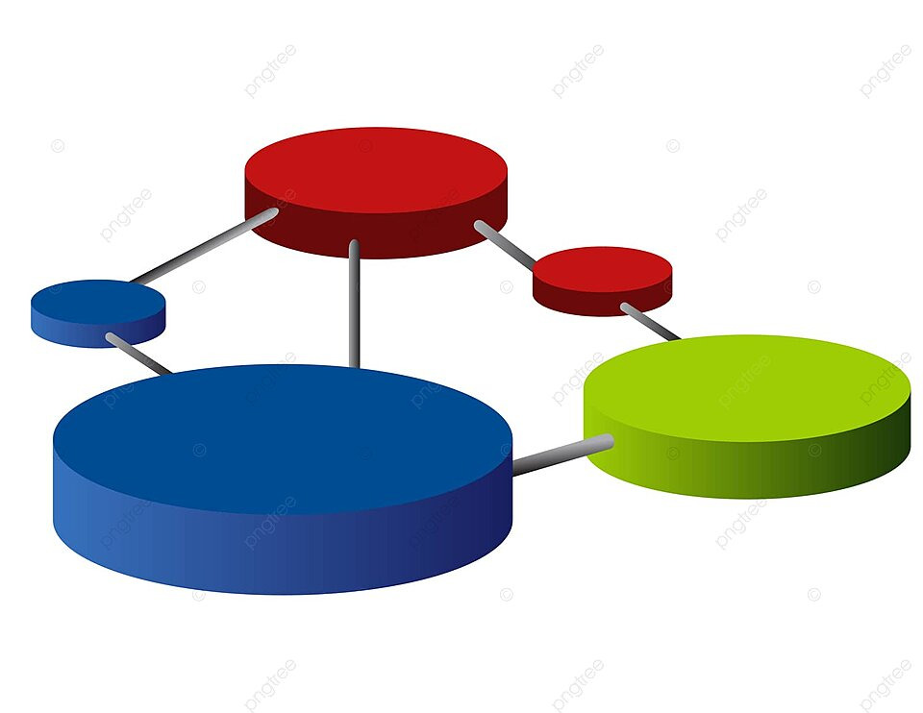
Use cases involving multiple EOSC Nodes
Bottom-up approach to identify connections between Nodes (including the EU Node)
User stories translated into service requirements
Pilot nodes define
What the Node needs from the Federation (from other Nodes)
What the Node can offer to the EOSC Federation
User stories
Use cases
Real life usage scenarios driven by existing data life cycles in RIs/e-Infras
Highlight the interactions between Node services to implement the user stories

Slide 11
Use cases involving multiple EOSC Nodes
Identified 46 User Stories requiring services to work together across multiple nodes
ENES Pilot Node User Stories

Slide 12
Beyond Pilots: Potential connections to the EOSC EU Node Core Capabilities
Initial analysis
Core services VS Pilot Nodes | NFDI | e-Infra CZ | EGI | INSTRUCT | LifeWatch | METROFOOD | ENES | ENVRI | CLARIN
AAI | X | X | X | X | X | X | X | X | X
Service Accounting | X | X | X |  |  |  | X | X
Service Monitoring | X | X | X | X | X | X | X | X
Research Product Accounting |  |  | X |  |  |  |  | X
Resource Catalogue | X | X | X | X | X | X | X | X | X
Order Management |  |  | X
Helpdesk | X | X | X | X | X | X | X | X
PID Service |  |  | X | X |  |  |  | X | X
Tool Market | X |  |  |  | X |  |  | X

Slide 13
Example: Scaling up EOSC EU Node resources by federating with EGI Pilot Node
Submit a recipe
EOSC Users
EGI Cloud Federation
EOSC EU Node
Cloud Provider 1
Federating Capability
Additional Resources when needed
Application Workflow Management (orchestration)
Cloud Provider 2
EOSC IF Interfaces
EGI Node
Federating Capability
Lot 2 resources
EOSC EU Node Cloud
Cloud Provider n
Agreements between the EOSC EU Node and the EGI Node to enable resource federation

