Slide 1
An EGI Research Commons?
Rory Macneil, Research Space
EGI2024 , Lecce
October 2, 2024

Slide 2
Overview
Problem
Context
Concept
Global Open Research Commons (GORC) model
Examples
Research Clouds
Commons and Clouds compared
EGI as a GORC?

Slide 3
Problem
Lack of data-centric tools
Lack of interoperability
between tools
Siloed data
Impeding FAIR
Creating friction for researchers

Slide 4
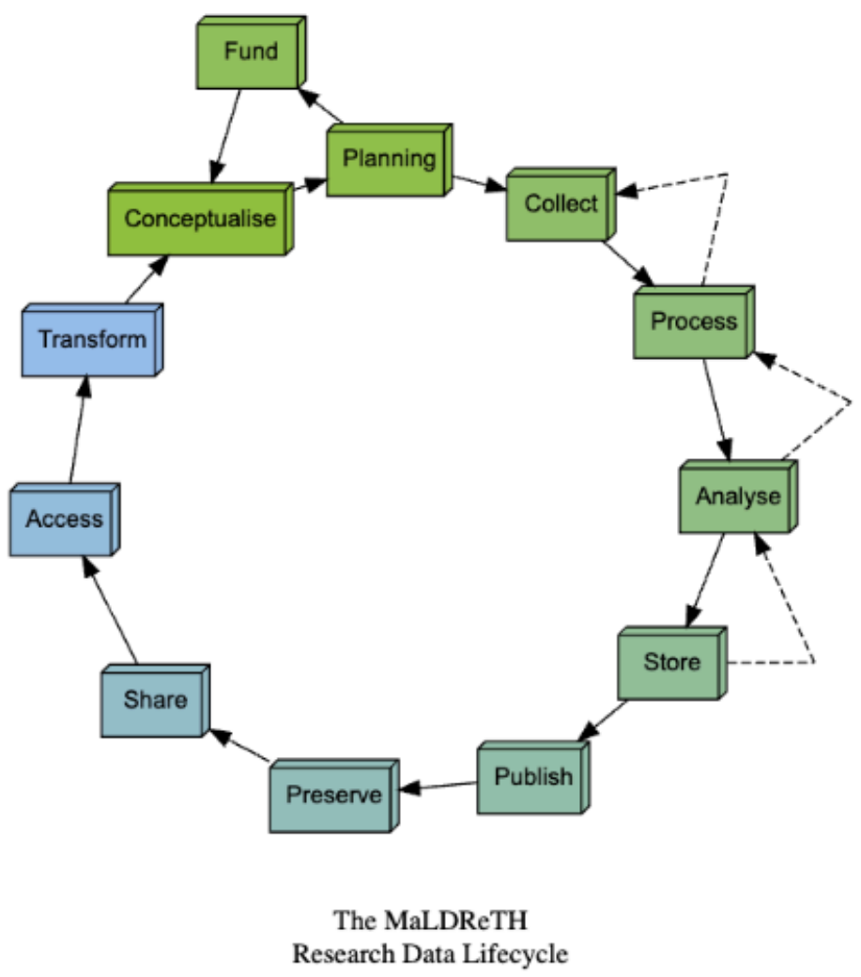
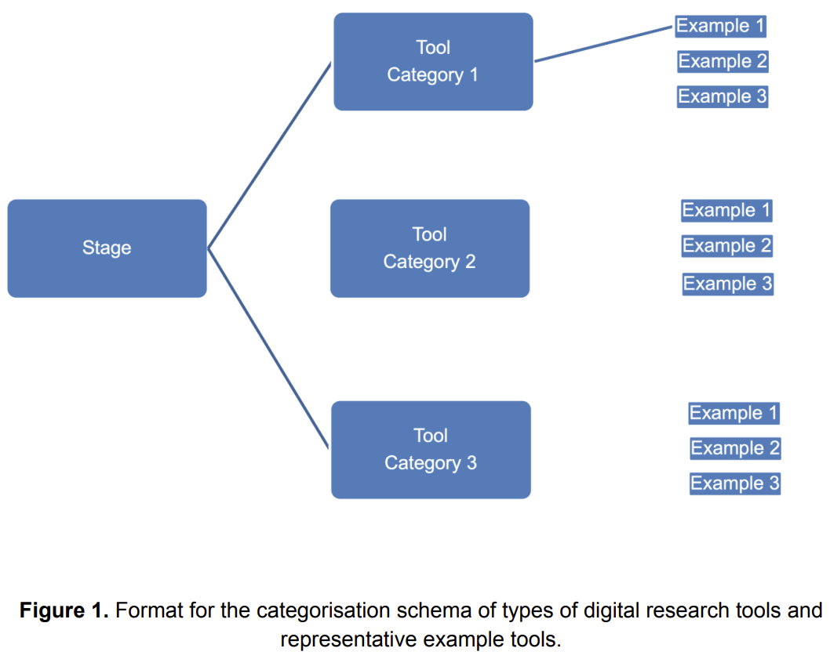
Context: Research Data Lifecycle

Slide 5
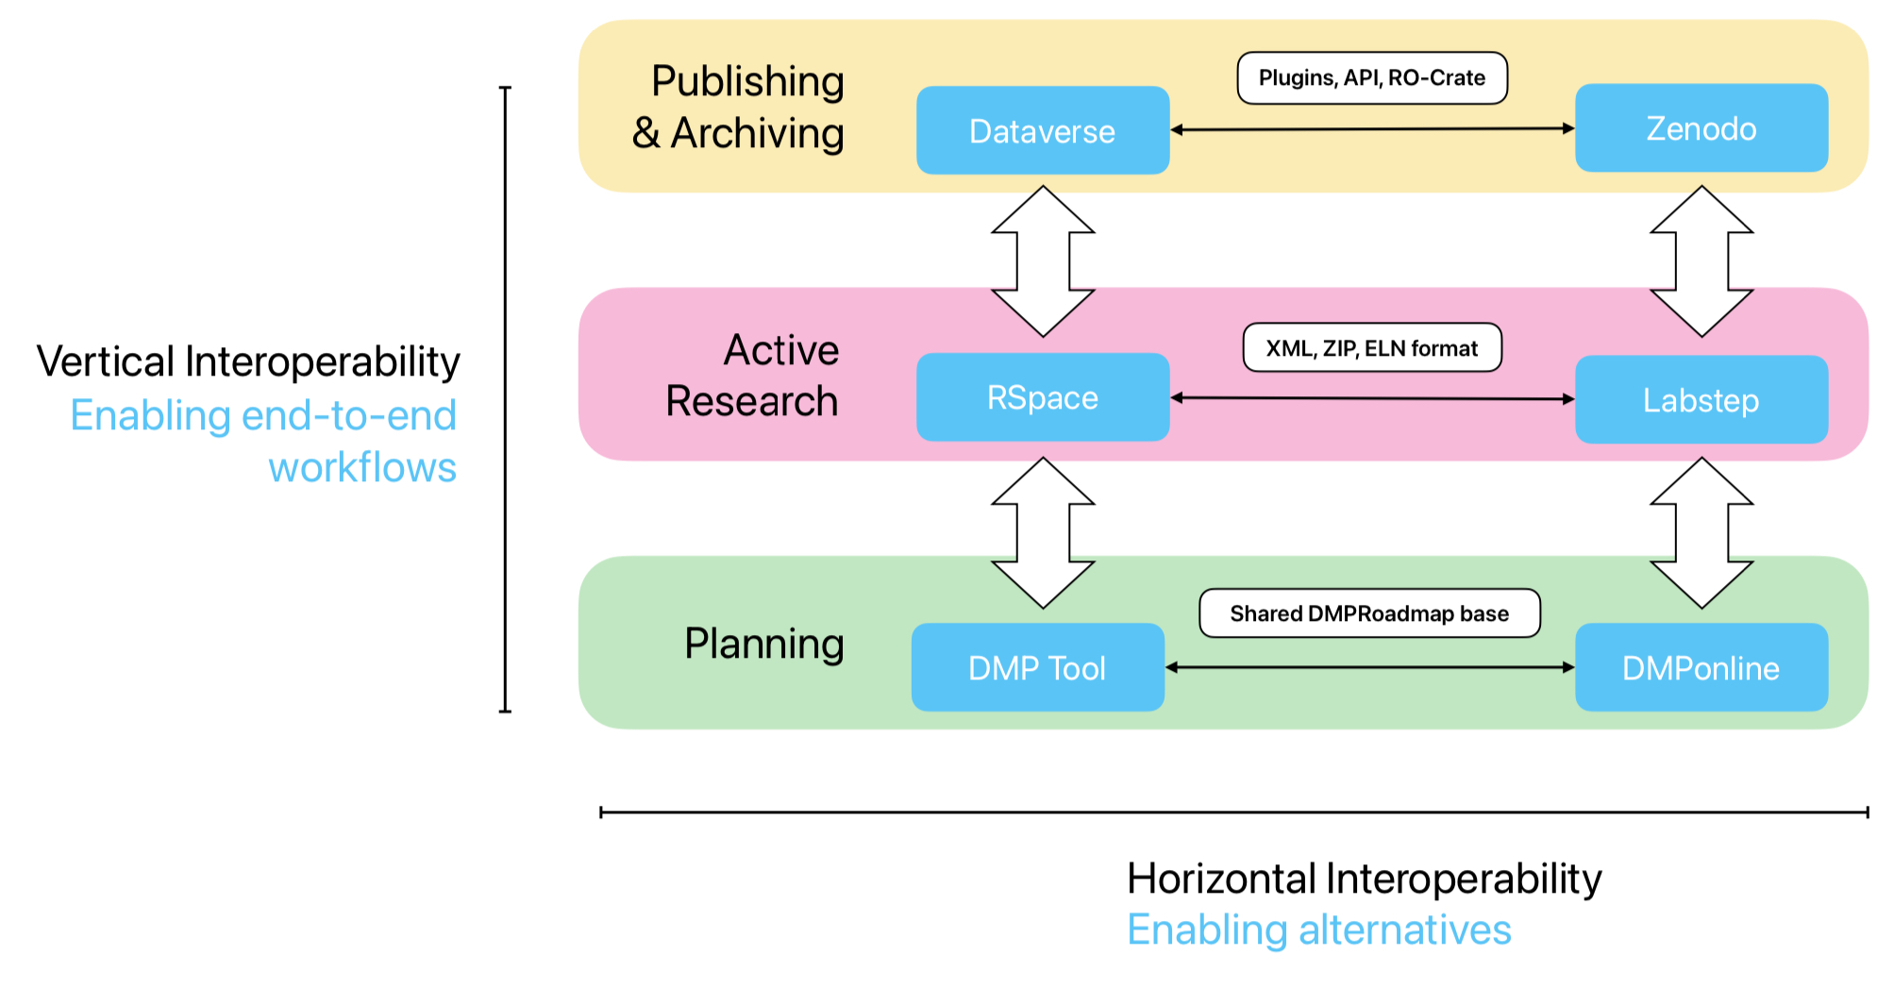
Objective:
Enable streamlined passage of data and metadata throughout the lifecycle via vertical interoperability

Slide 6
Research Commons concept
”Bring together data with cloud computing infrastructure and commonly used software, services and applications for managing, analyzing and sharing data to create an interoperable resource for a research community”
Scott Yockel, Harvard University
Towards a Data Commons at Harvard

Slide 7
Who will provide Research Commons?
Universities
Harvard
National and regional organizations
New England Research Cloud
Canada’s Digital Research Alliance
Supra national organizations: EOSC
EGI?
EUDAT Collaborative Data Infrastructure?

Slide 8
Global Open Research Commons International Model
Developed by Research Data Alliance working group
Released November 2023
Model/guideline for Research Commons
Three core technical elements and surrounding process/governance wrap
Many countries are looking at adopting – Canada, Sweden, Netherlands, Germany, UK, etc.

Slide 9
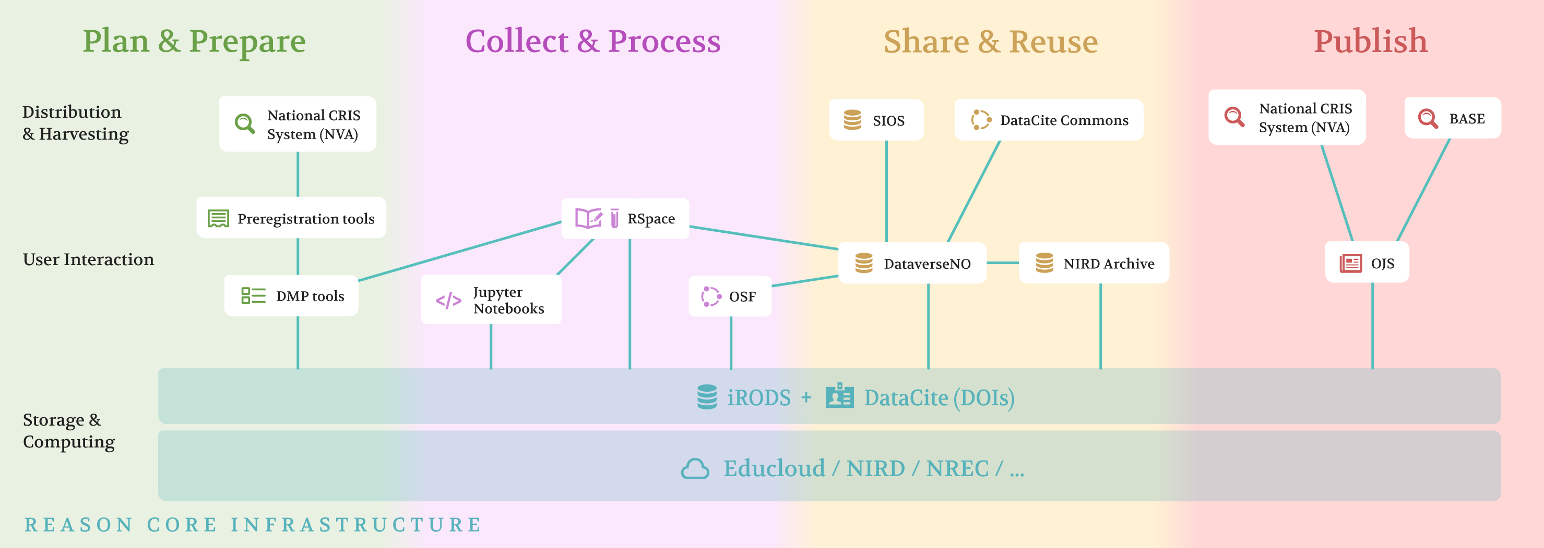
Reason: Research Commons for Norway
Core elements are Dataverse, iRODS and RSpace, which are already integrated
Includes integration of these and other resources with storage and compute infrastructure
Focus of proposed work is on further enhancing existing interoperability between tools
Objective: integrated infrastructure that facilitates data and metadata flow throughout the research data lifecycle

Slide 10
REASON as a model for other Research Commons
Comprehensive use of GORC elements
Detailed instantiation of Services and Tools Element of the GORC model
Built around around a group of complementary generalist tools all designed to enhance FAIRification of data
Focus on interoperability of tools, data and metadata
Encompasses need to interoperate with existing generalist and domain specific research infrastructure

Slide 11
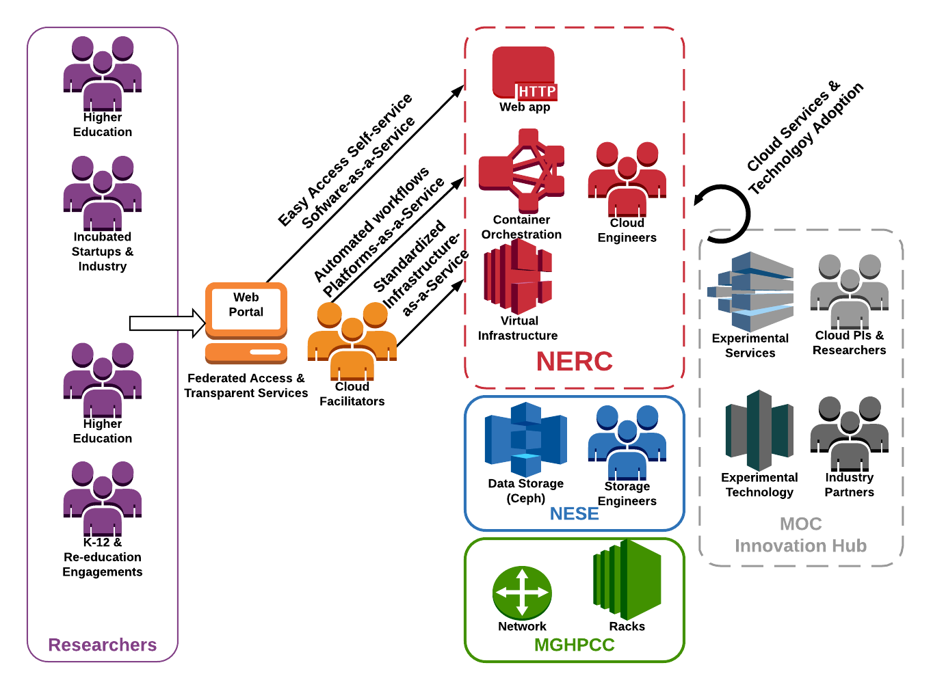
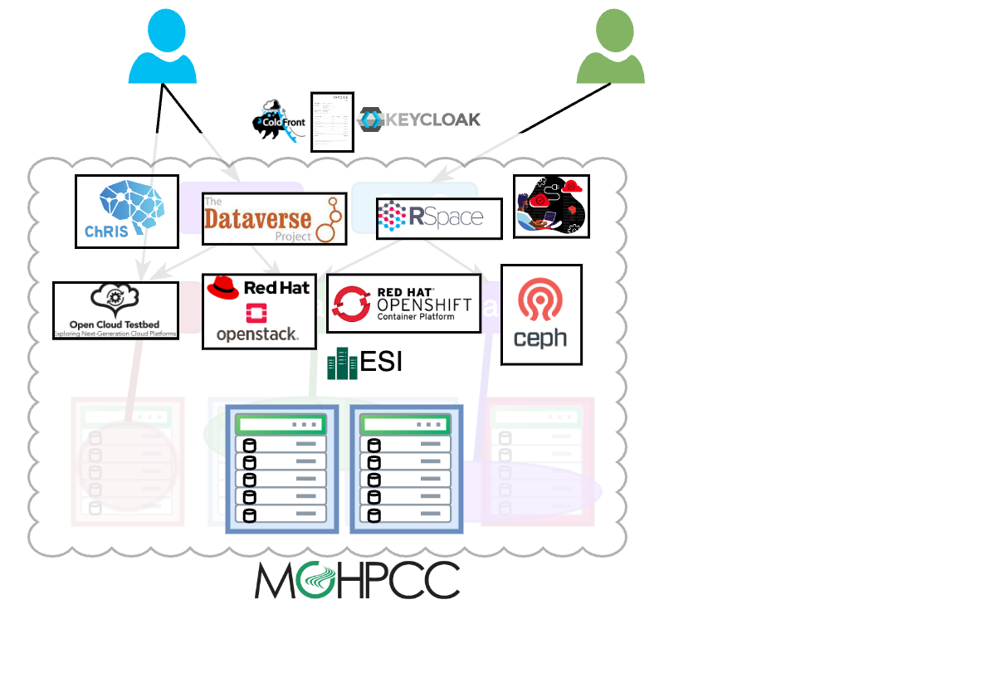
New England Research Cloud

Slide 12
Canada’s Alliance Cloud Connect
A unified platform that streamlines the process of accessing and administering community and commercial cloud services. This platform aims to provide better access to compute, software, storage, and hosting services through a centralized and user-friendly interface, ensuring efficiency, security, and compliance for the Canadian research community.
Research tools (e.g., RSpace)
Computational Services (Jupyter and Galaxy)
Cloud

Slide 13
Commons and Clouds:
REASON compared to NERC and ACCP
 | Commons | Clouds
Who designs and builds | Research Data Managers | HPC/Research Computing
Single integrated infrastructure | ✔️ | ✔️
Generalist approach with support for multiple research domains | ✔️ | ✔️
Adoption of standard, widely available tools and resources | ✔️
Research Data Lifecycle | ✔️
Research tool focus | ✔️
Interoperability between research tools | ✔️
Storage/compute focus |  | ✔️
Interoperability between storage/compute and tools |  | ✔️

Slide 14
EGI as a GORC–inspired Research Commons
Discrete services integrated platform
Enable external services to fill in gaps and connect
Factor in non-technical elements – Governance, Rules of Participation, Human Capacity
Develop documentation and graphics to communicate

Slide 15
Resources and contact
GORC International Model
https://zenodo.org/records/10694490
Research Commons and Clouds
REASON -- https://zenodo.org/records/10410202
Towards a Data Commons at Harvard
New England Research Cloud https://docs.google.com/presentation/d/1FVNNWzRkOOjiQQxaSdg_WqlNTD6jqDBid2W2TTHi0a0/edit - slide=id.g2b2db4dd832_0_0
Alliance Cloud Connect https://alliancecan.ca/en/accp
MaLDReTH Map of the Digital Tools Landscape
https://www.rd-alliance.org/group_output/mapping-the-landscape-of-digital-research-tools/
Vertical Interoperability
https://zenodo.org/records/13829209
rmacneil@researchspace.com

