Slide 1
Sunet Drive An Academic Toolbox FAIR Data Storage, Analysis and Publication
2024-10-02 – EGI Conference 2024

Slide 2
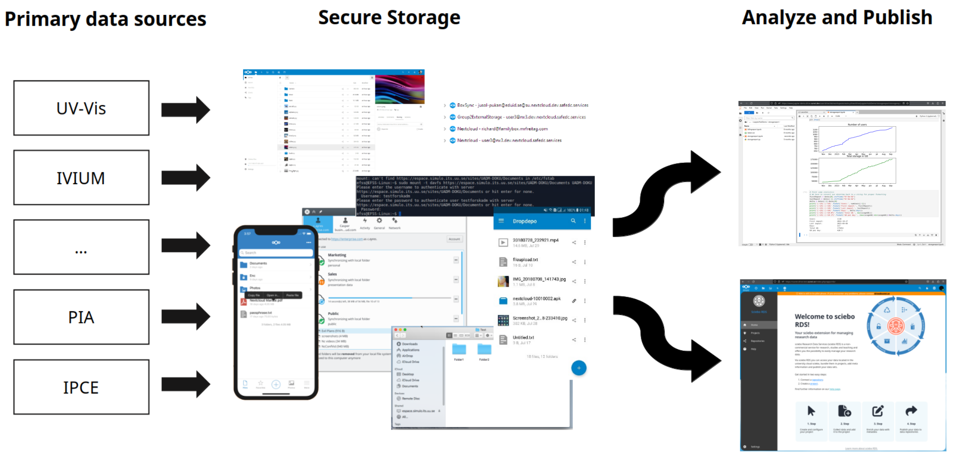
Sunet Drive – Architecture
2024-10-02 – EGI Conference 2024

Slide 3
Sunet Drive – Architecture
An Academic Toolbox
Following FAIR principles
2024-10-02 – EGI Conference 2024

Slide 4
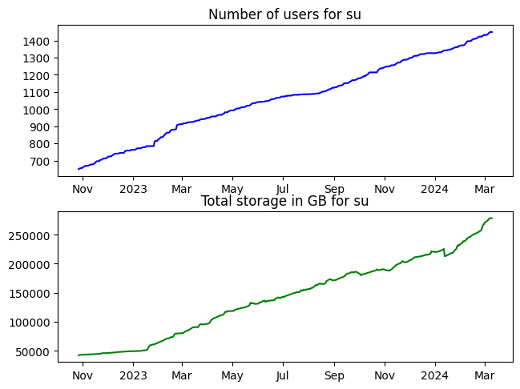
Sunet drive today
Sunet Drive development & projects
Full RDS-setup in production
JupyterHub
Secure Zones/MFA/Step-up Authentication
Security Audit
Devops: Third data centre & Kubernetes
AI Assistant with “Ethical AI”
2x54 nodes on 300 servers in two data centres
100% powered by green energy
20 paying customers
508TB data stored with >0.5TB added daily
3,752 total users, >600 daily users
Core Application
JupyterHub
Core Application
Sciebo Research Data Service
Core Application
ScienceMesh

Slide 5
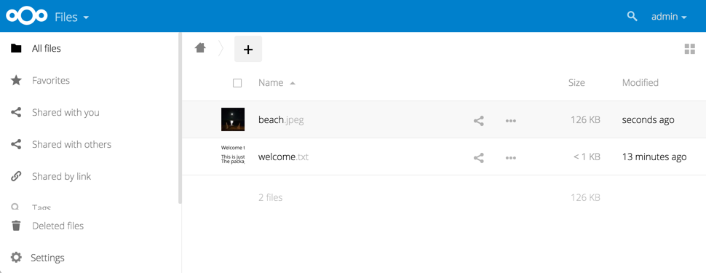
Sunet Drive
Allows people to store, share and collaborate on any type of file
Runs in the browser, on your computer, on your phone and probably more!
Secure datacenters controlled by SUNET. No data leaves our datacenter, unless you want it to!
2024-10-02 – EGI Conference 2024

Slide 6
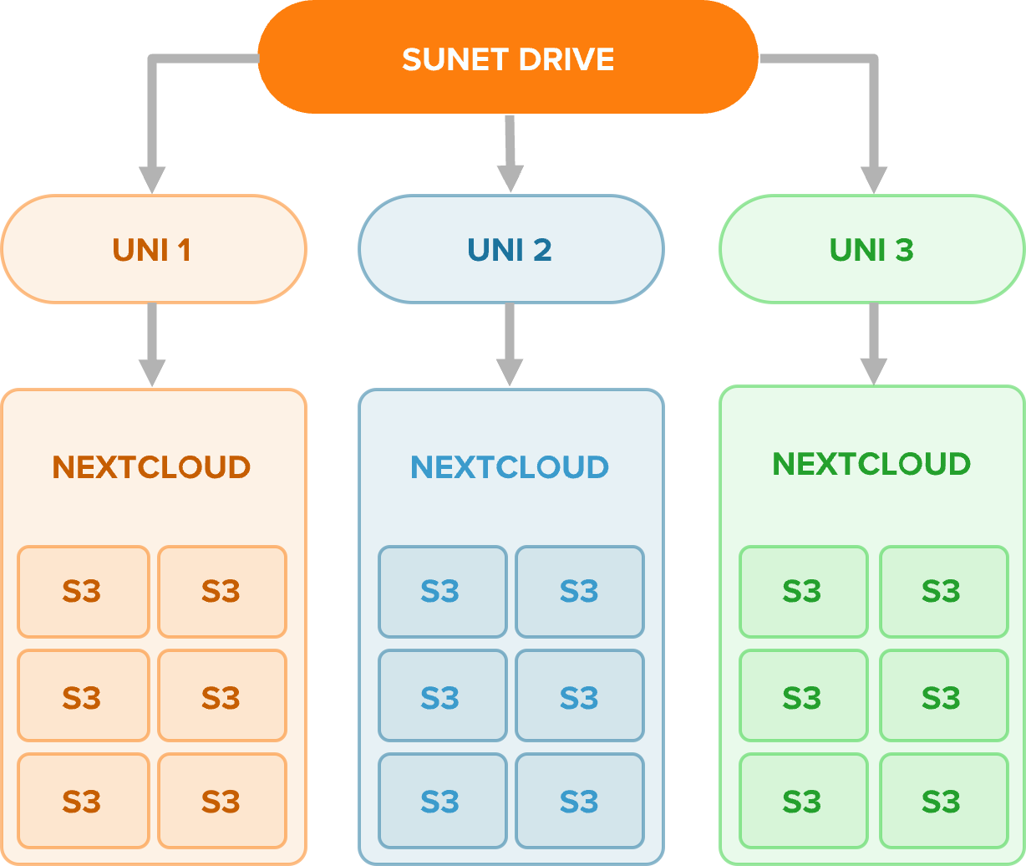
Co-management of nodes
S3-bucket storage
Share data between nodes
Access ownership separation
Lifecycle managed buckets
Co-managed with users for continuous improvement
2024-10-02 – EGI Conference 2024

Slide 7
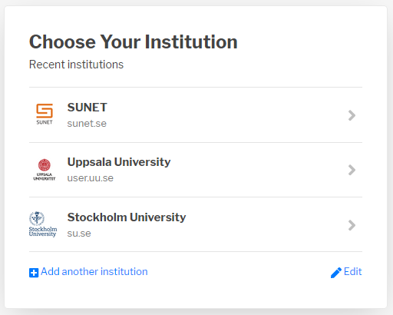
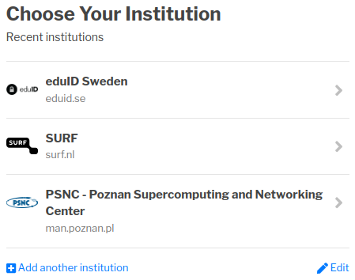
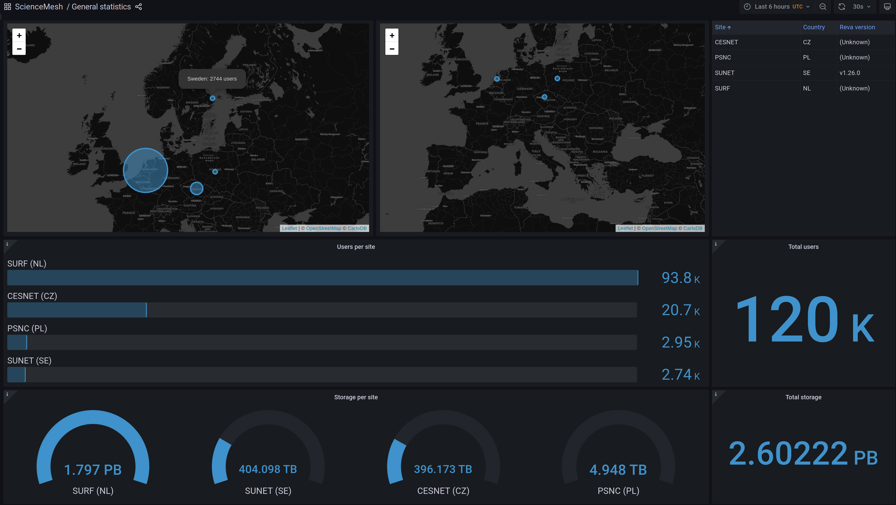
Global Collaboration
Nationally: eduGAIN
~6000 Identity Providers
Eduid.se for external collaborators
Globally: OCM
OpenCloudMesh protocol
Initiated in 2015 by GÉANT
Supported by ownCloud, Nextcloud, Seafile
Global federated shares with local sovereign solutions (e.g. SurfDrive, Sciebo)
“ScienceMesh” by design (i.e., without app)
MFA proposed for v1.2
sunet.drive.sunet.se
uu.drive.sunet.se
su.drive.sunet.se
Swedish Account
Global Account
extern.drive.sunet.se
2024-10-02 – EGI Conference 2024

Slide 8
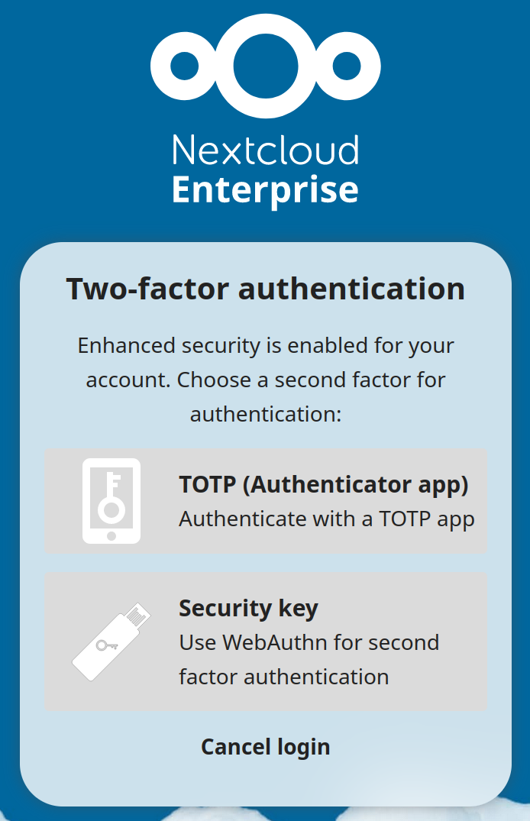
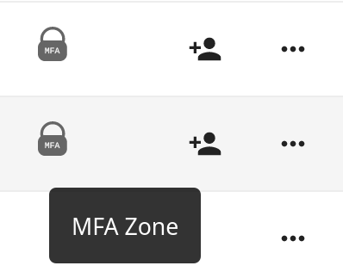
Step-up Authentication & MFA Zones
Step-up Authentication
Adds Nextcloud-native MFA to SSO accounts
TOTP or WebAuthn
Can be enforced via groups (forcemfa)
Might be made mandatory in the future for all users on all nodes
MFA Zone
Enforces MFA on file- and folder-level
Prevents sharing with non-MFA accounts
Works only on a local node
Proposed OCM-extension
”The auditors tried to bypass MFA and Step-up authentication but failed. So, even though the efforts were made, our conclusion is that the quality is outstanding regarding the main target of the audit.”
2024-10-02 – EGI Conference 2024

Slide 9
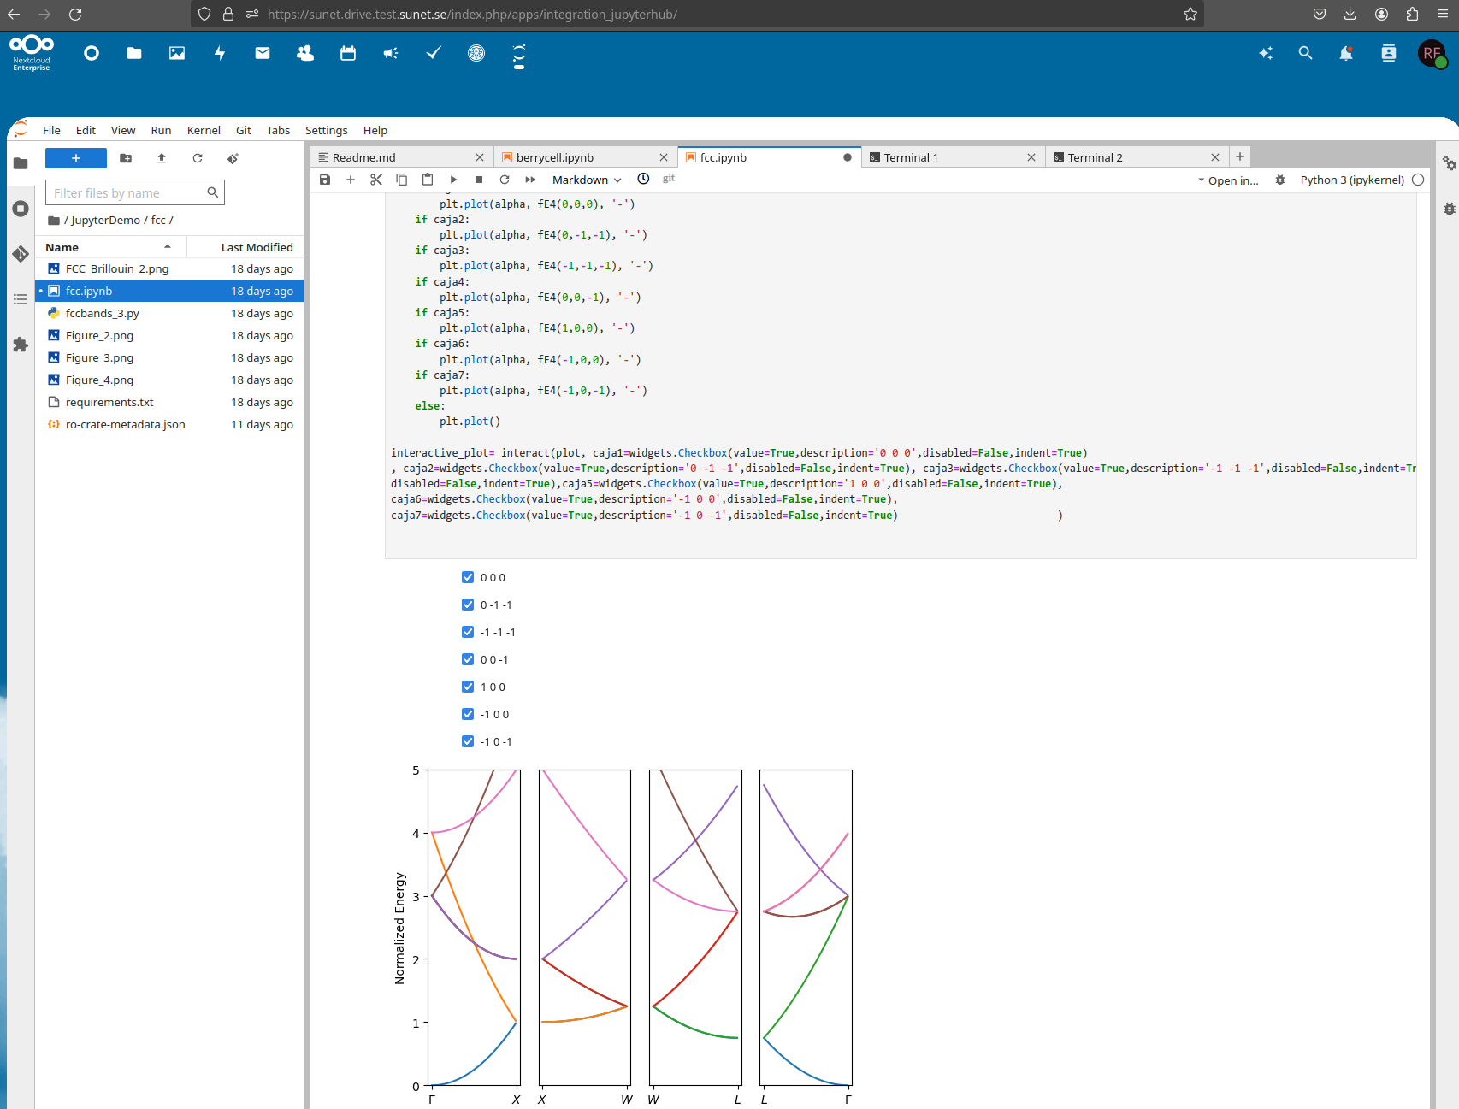
Academic Toolbox – JupyterHub
Integrated in Sunet Drive
Users can individually execute notebooks
Users get 10GB “local” Jupyter Storage
Storage is continuously synchronized between Sunet Drive and JupyterHub
Allows people to share and collaborate on code
Write once, execute however often you like
Supports 40+ programming languages
Funded by GÉANT Above-the-Net Services Incubator
2024-10-02 – EGI Conference 2024

Slide 10
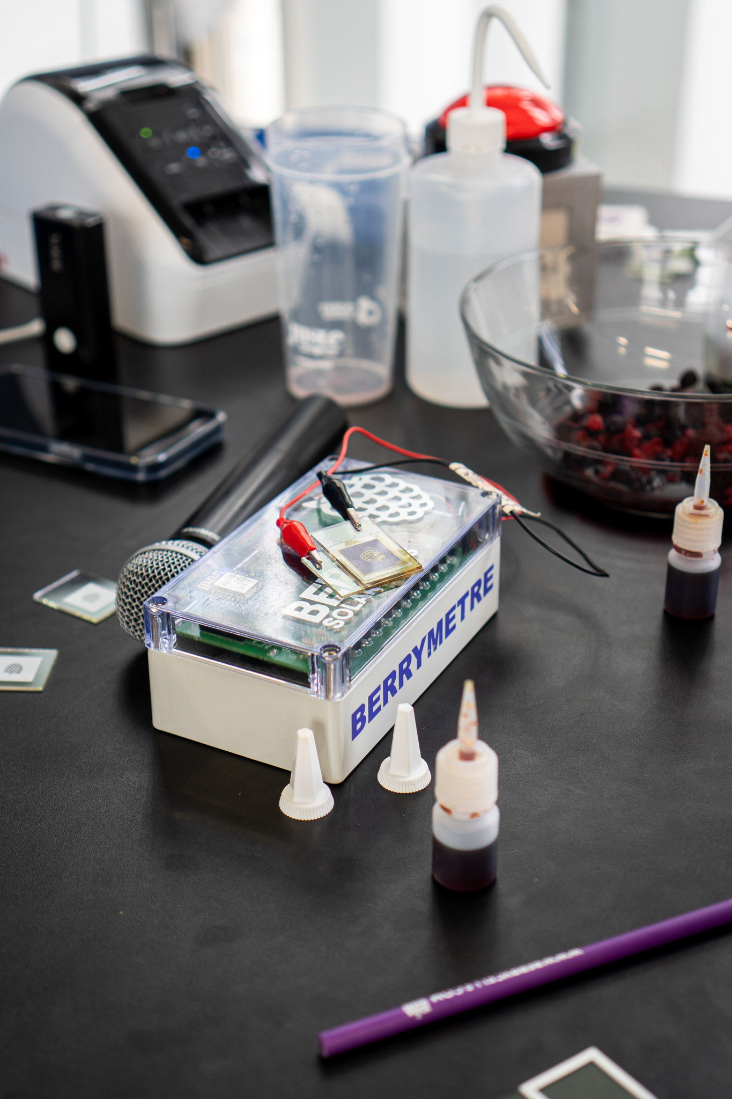
Academic Toolbox – From Data to DOI with a Berry Solar Cell
Execute Experiment
Jupyter notebook with instructions to make a simple organic solar cell
Measure data an upload to Sunet Drive in realtime
Data Analysis
Analyse and visualise data in JupyterHub
Publish Data
Prepare data and metadata
Publish to Zenodo using ScieboRDS app
https://sandbox.zenodo.org/records/70251
Showcased as live demo at TNC24
Berrycells.com
2024-10-02 – EGI Conference 2024

Slide 11
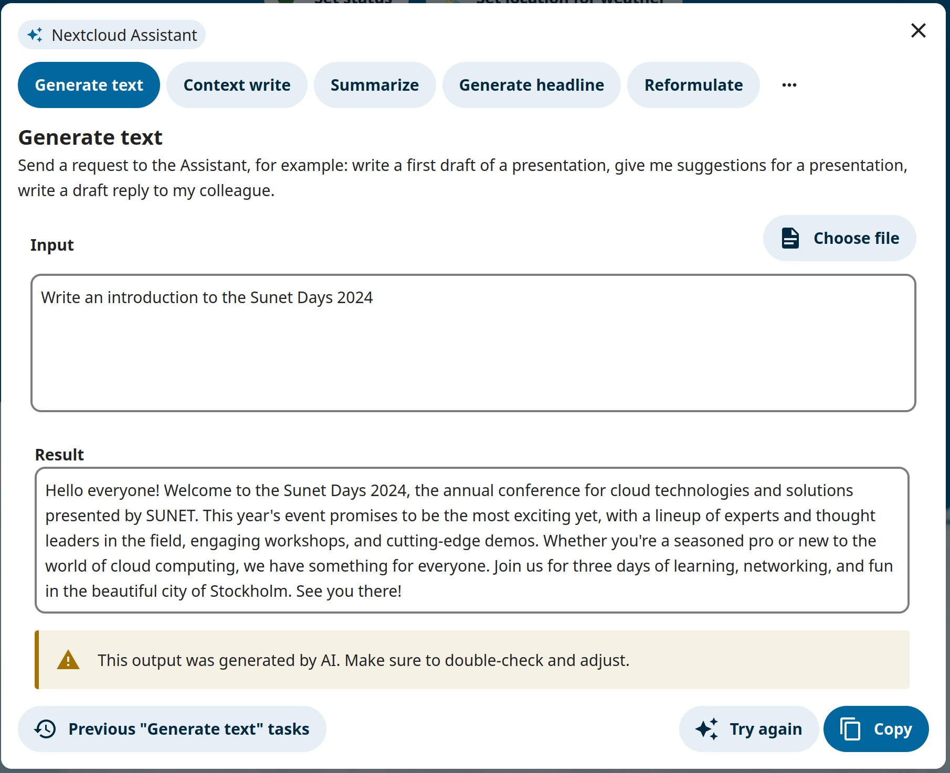
AI Assistants
Introduced in Nextcloud 27.1 and improved in 28 and 29
Has support for OpenAI and Local Large Language Models
On-prem inference using “Ethical AI”
LLM, Speech2Text, Image Generation and other assistants available
Requires many resources (CPU & GPU)
Many open questions (technical and legal)
Under evaluation
2024-10-02 – EGI Conference 2024

Slide 12
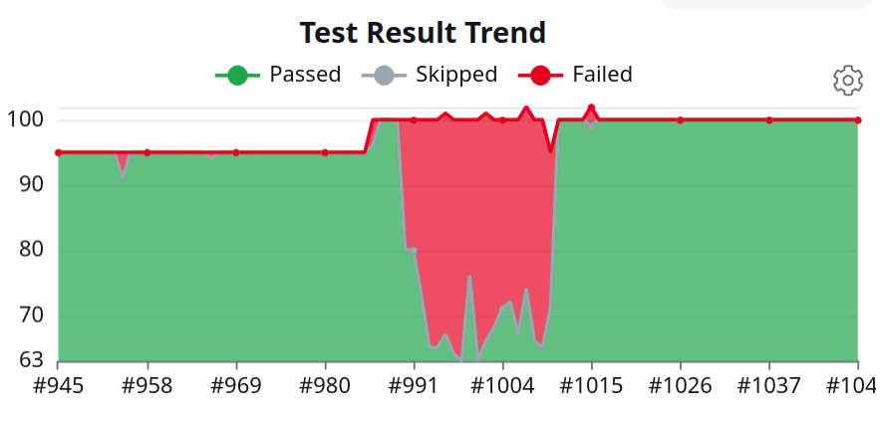
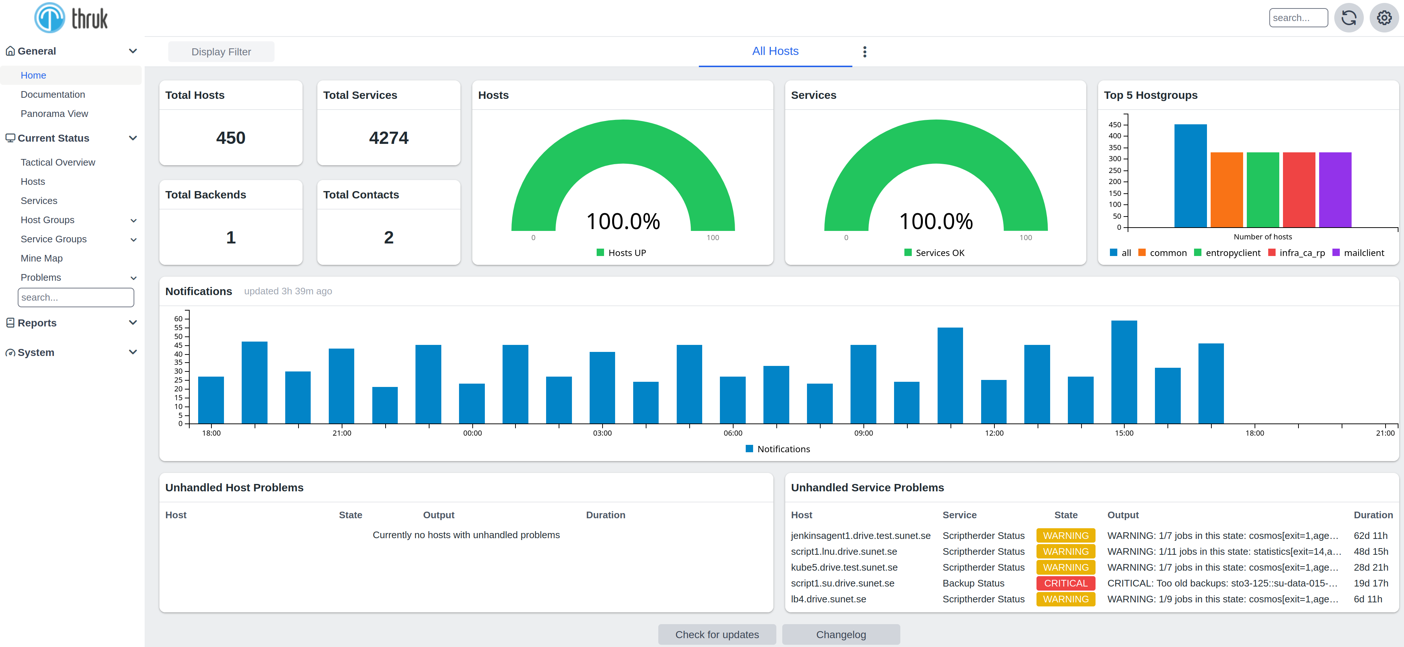
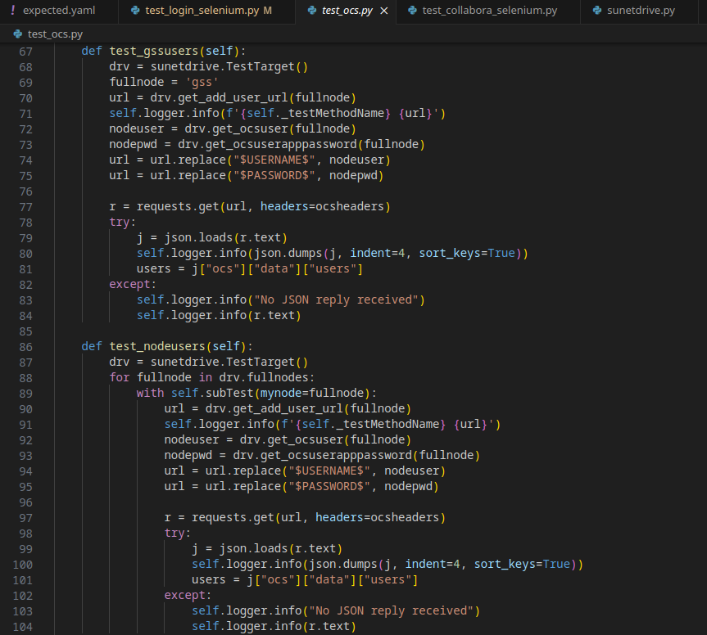
Everything else
Open for everyone via EduGAIN
Monitoring with Thruk: >6000 monitoring points
Automated testing: >30k test points per day
Infrastructure as Code
Open Source
https://github.com/SUNET/nextcloud-custom
https://github.com/SUNET/nextcloud-jupyter
https://github.com/SUNET/nextcloud-mfazones
https://github.com/SUNET/drive-tests
https://github.com/cs3org/OCM-API
And more: eduid.se, ScienceMesh, OCM, RDS-ng, ...
2024-10-02 – EGI Conference 2024

Slide 13
Tack! Frågor?
Anders Nilsson
anders@sunet.se
Richard Freitag
freitag@sunet.se
Micke Nordin
kano@sunet.se
Magnus Andersson
mandersson@sunet.se
Issues and Questions
drive@sunet.se
2024-10-02 – EGI Conference 2024

