Slide 1
Empowering Reproducible Open Science through the Cloud Computing Platform (CCP) by D4Science
M. Assante, A. Dell’Amico, M. Lettere¹, P. Pagano, G. Panichi
CNR - Istituto Scienza e Tecnologia dell’Informazione “A. Faedo”, Pisa, Italy
¹ Nubisware s.r.l., Pisa, Italy

Slide 2
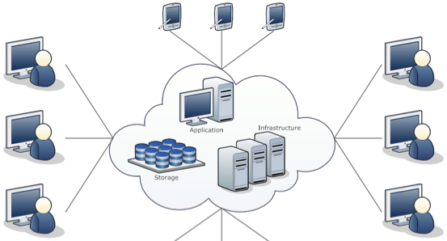
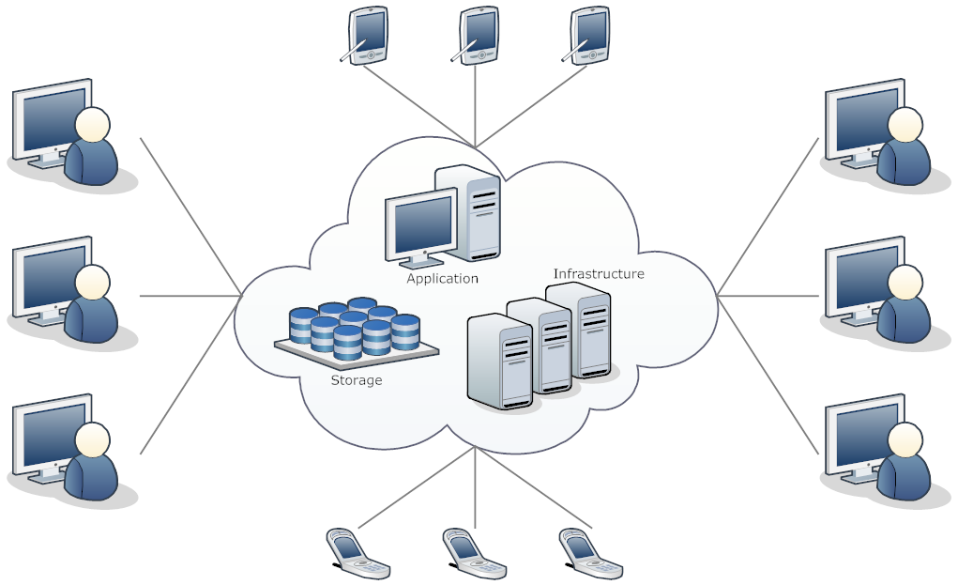
What is D4Science
A digital infrastructure for collaborative scientific research, combining over 500 software components into a coherent and centrally managed system of hardware, software, and data resources

Slide 3
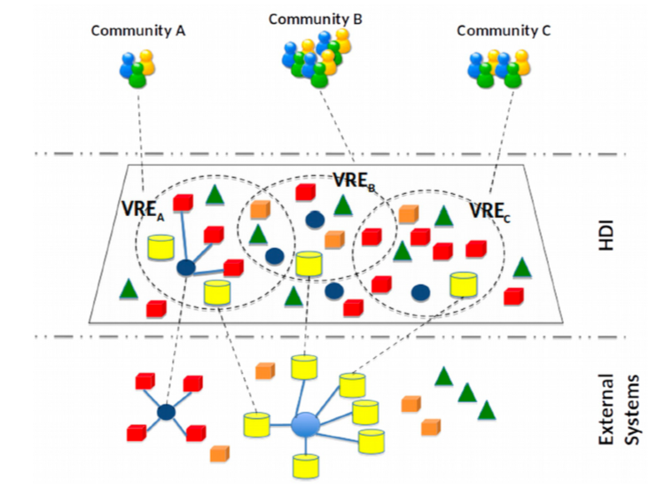
promotes Open Science practices through the operation of a Data Infrastructure service
leverage external systems (e.g. data, storage, cloud-based infrastructures)
by exposing them as a common unified space of resources
to serve diverse community of researchers
via the provision of tailored services and sharing tools
made accessible through a flexible, web-based and on-demand environments called Virtual Research Environments (VRE)
M. Assante et al. (2023) Virtual research environments co-creation: The D4Science experience.
Concurrency Computat Pract Exper. 2023; 35(18):e6925. doi:10.1002/cpe.6925
M. Assante, et al. (2019) Enacting open science by D4Science.
Future Generation Computer Systems (Vol. 101) doi: 10.1016/j.future.2019.05.063

Slide 4
Resources Evolution
Pisa CPUs
1.624
Dec. ‘22
3.248
Today
6.976
June ‘23
11.100
Dec. '24
D4Science is a federated digital infrastructure
4 sites (1 Pisa, 3 @ GARR)
6.900 CPUs core
29 TB RAM
1.400 TB Storage
D4Science is owned and managed by CNR
It supports ESFRI RIs, national and European projects, national and international initiatives

Slide 5
Collaborative Data Analytics tools
Highly Configurable Jupyter Notebook env.
Rstudio Version 4+ env.
Shiny Apps, Dash Apps
Custom Service/Docker
VRE tools
Analytics Engine (CCP)
Galaxy Workflows
VRE Core Services
Workspace
(Cloud Storage)
Scientific
Collab.
Analytics
Publishing
Empowering Reproducible Open Science through the Cloud Computing Platform (CCP) by D4Science - EGI 2024 -Lecce (Italy)
5

Slide 6
Collaborative Data Analysis
Highly Configurable Jupyter Notebook env.
Rstudio Version 4+ env.
Shiny Apps, Dash Apps
Custom Service/Docker
VRE tools
Analytics Engine (CCP)
Galaxy Workflows
VRE Core Services
Workspace
(Cloud Storage)
Scientific
Collab.
Analytics
Publishing
Empowering Reproducible Open Science through the Cloud Computing Platform (CCP) by D4Science - EGI 2024 -Lecce (Italy)
6

Slide 7
Cloud Computing Platform (CCP)
User-friendly data analytics platform offering on-demand, scalable computing resources on the Cloud.
Supports method import and execution, allowing collaboration through the sharing of methods, inputs, executions, and results with colleagues.
Facilitates seamless team collaboration by enabling users to work together, sharing the same data and applications.
Built on modern technologies such as containerization, REST APIs, and JSON, ensuring flexibility, scalability, and integration capabilities.
Empowering Reproducible Open Science through the Cloud Computing Platform (CCP) by D4Science - EGI 2024 -Lecce (Italy)

Slide 8
CCP main features
Per-method Web UI and REST API access via Standard (OGC API – Processes)
Provenance management
Method import support via a dedicated tool supporting any prog. language
“out-of-the-box” methods as-a-Service and automatic code generation for Python, R, Julia, IPy notebooks
Empowering Reproducible Open Science through the Cloud Computing Platform (CCP) by D4Science - EGI 2024 -Lecce (Italy)

Slide 9
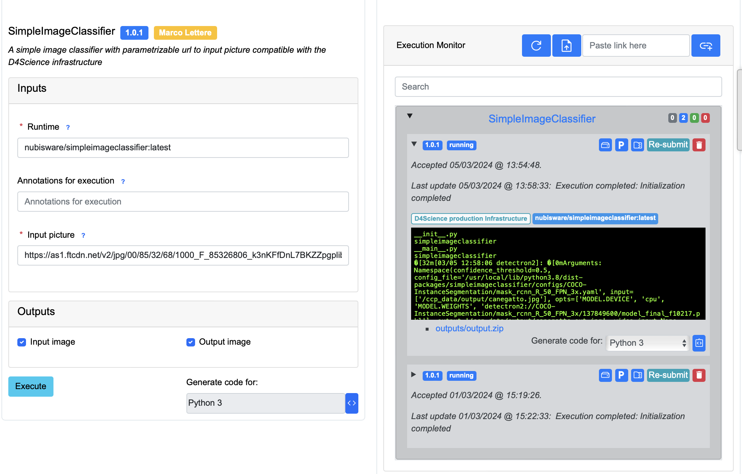
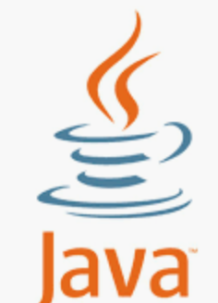
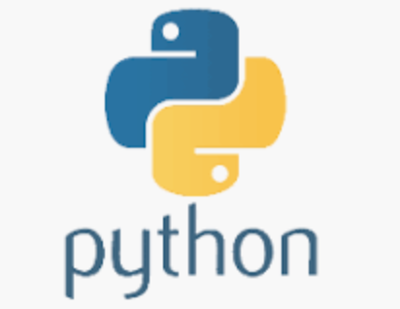
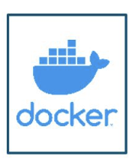
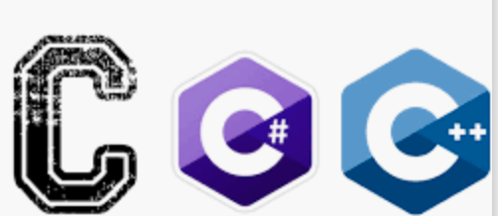
CCP, Methods Editor and Execution
Method:
Script, Algorithm
Software
Resulting Web UI &Web API
Importing phase
METHOD EDITOR
METHOD EXECUTIONS
Empowering Reproducible Open Science through the Cloud Computing Platform (CCP) by D4Science - EGI 2024 -Lecce (Italy)

Slide 10
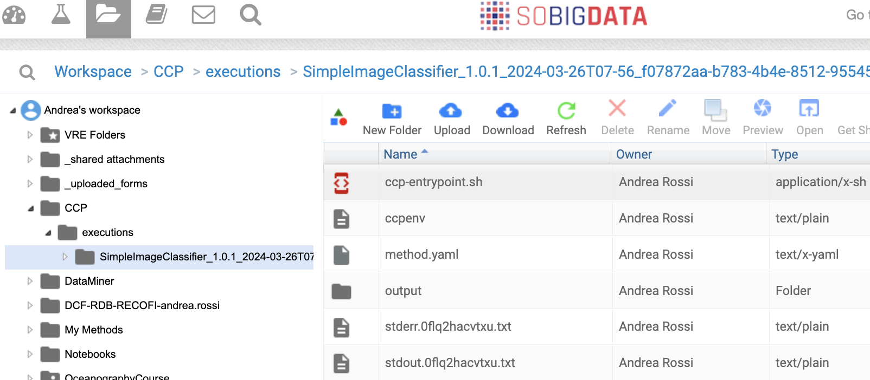
CCP, Methods and Method Executions in the Cloud Storage (Workspace)
Web UI / Web API
METHOD EXECUTIONS
Empowering Reproducible Open Science through the Cloud Computing Platform (CCP) by D4Science - EGI 2024 -Lecce (Italy)

Slide 11
CCP, Methods and Method Executions in your Email Inbox
Web UI / Web API
METHOD EXECUTIONS
Empowering Reproducible Open Science through the Cloud Computing Platform (CCP) by D4Science - EGI 2024 -Lecce (Italy)

Slide 12
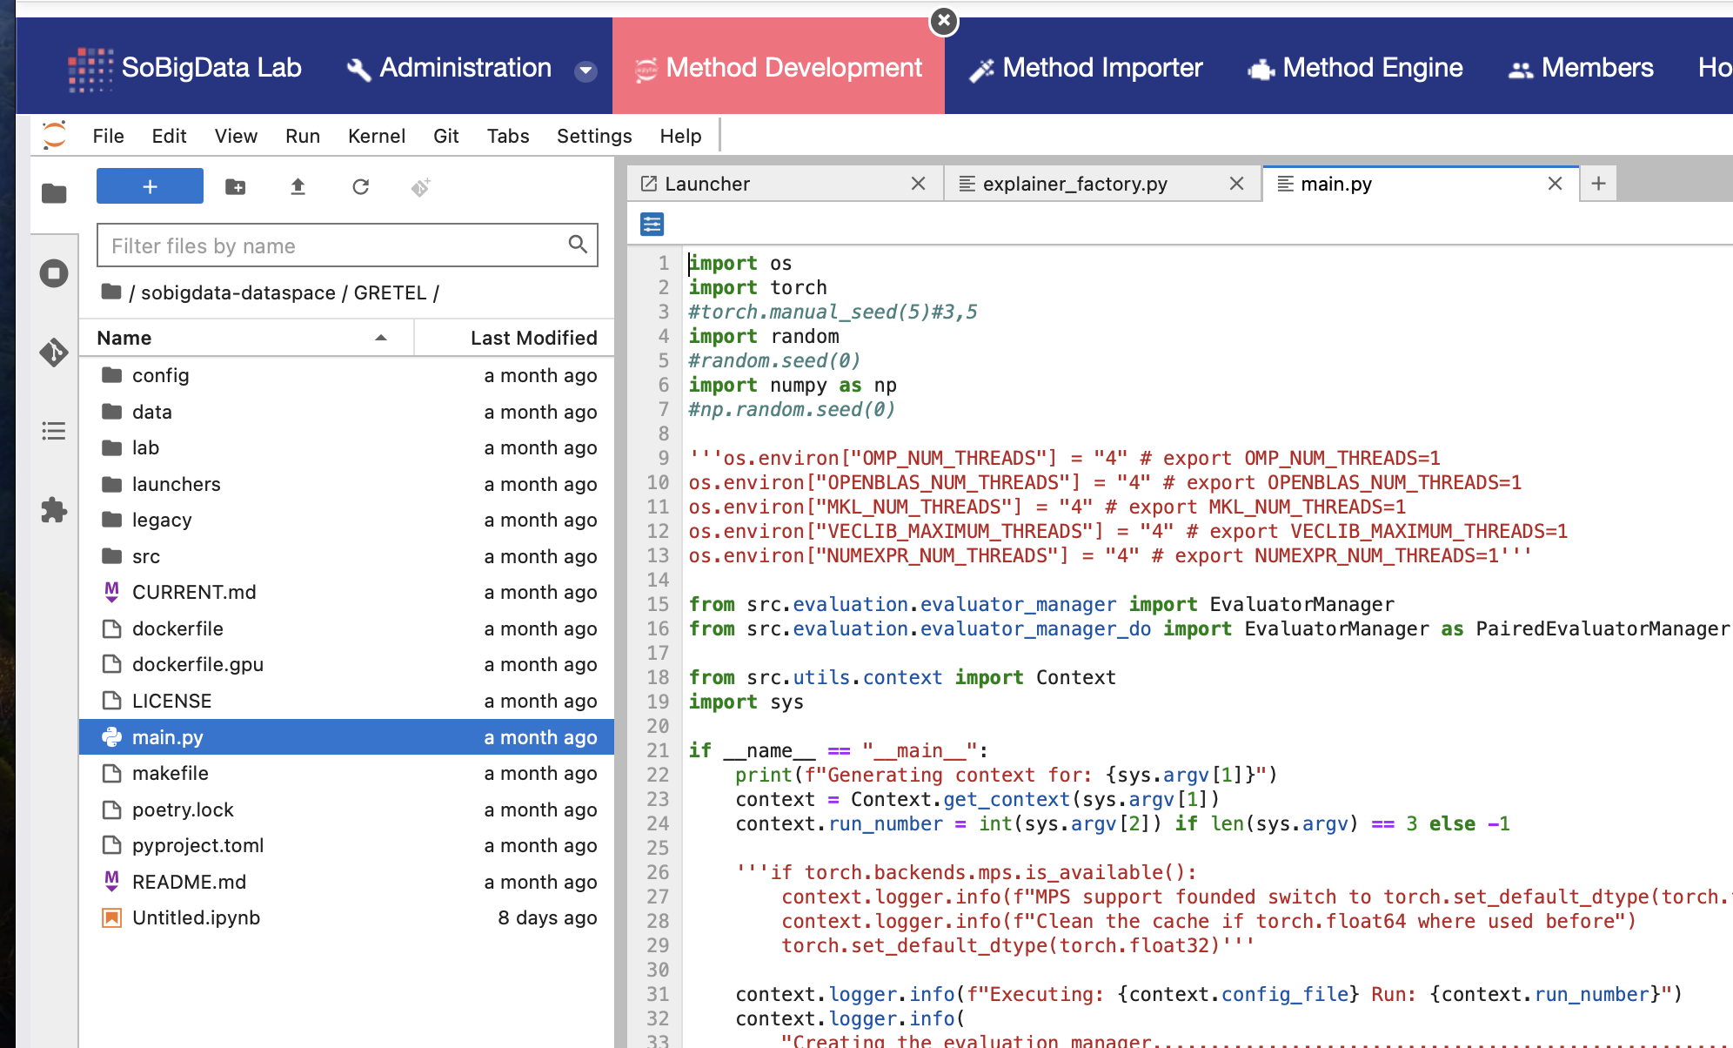
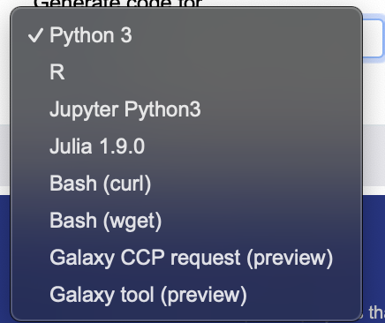
Launch Method Execs programmatically, automatic code generation
METHOD
EXECUTIONS
Automatic
code generation:

Slide 13
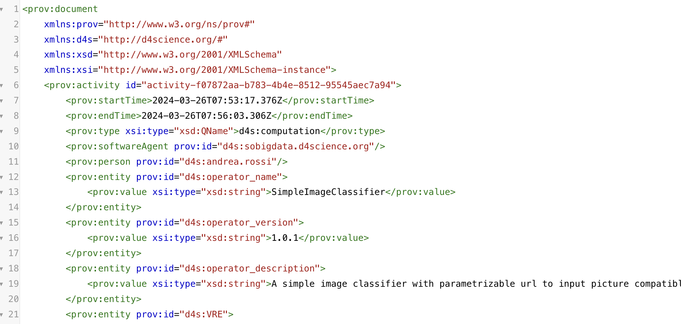
A note on CCP Provenance management
Provenance plays an important role in Data Science;
Experiments are often developed iteratively involving multiple executions with different versions of data sources, accessing multiple applications and infrastructure services;
CCP adopts the the PROV Ontology (PROV-O) expresses the PROV Data Model using the OWL2 Web Ontology Language (OWL2).
“Provenance is information about entities, activities, and people involved in producing a piece of data or thing, which can be used to form assessments about its quality, reliability or trustworthiness.”
W3C Recommendation https://www.w3.org/TR/prov-dm/

Slide 14
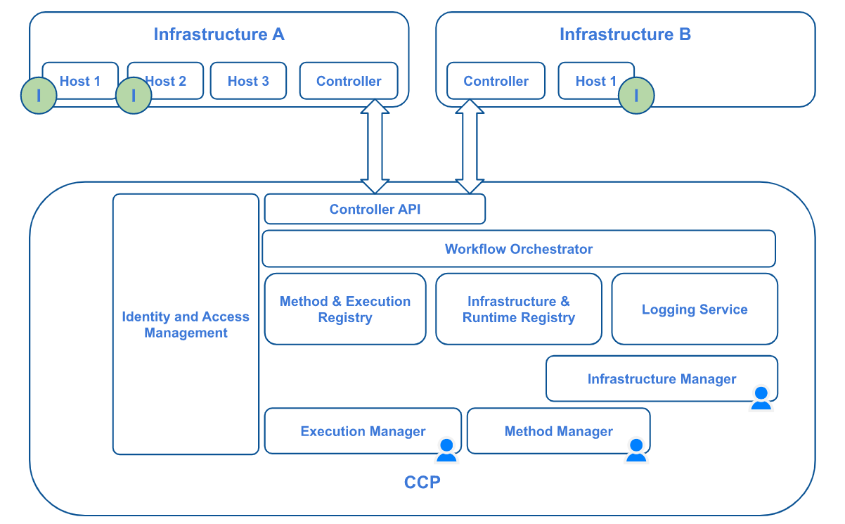
CCP Logical architecture
Empowering Reproducible Open Science through the Cloud Computing Platform (CCP) by D4Science - EGI 2024 -Lecce (Italy)

Slide 15
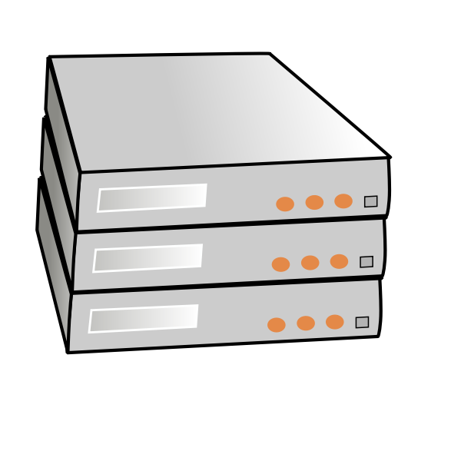
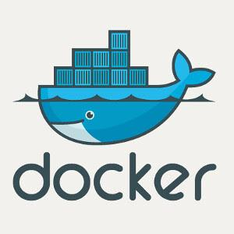
Translates to physical …
PROD
DEV
My laptop
Empowering Reproducible Open Science through the Cloud Computing Platform (CCP) by D4Science - EGI 2024 -Lecce (Italy)

Slide 16
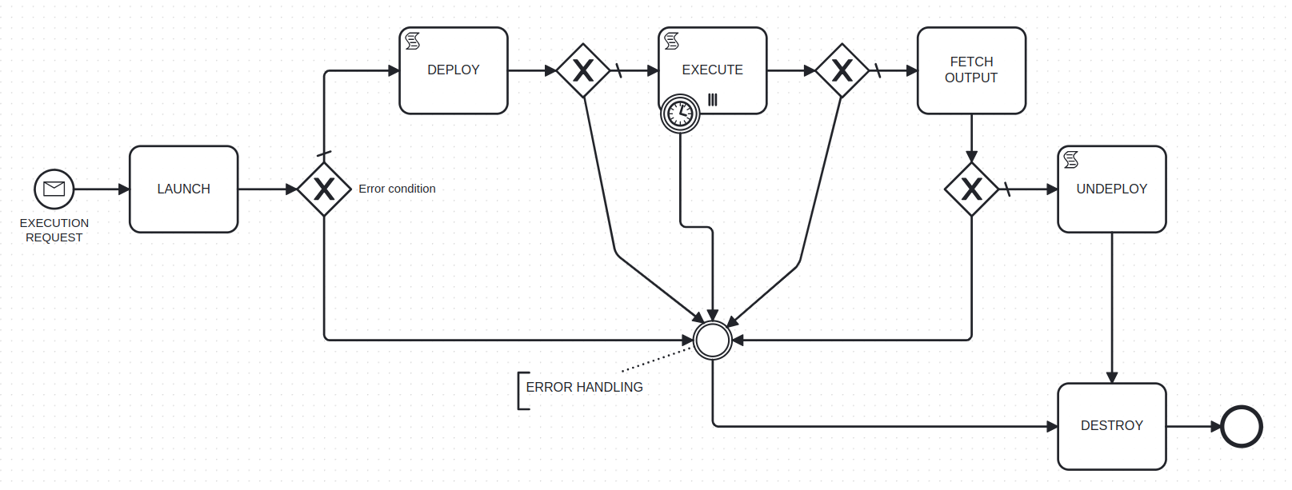
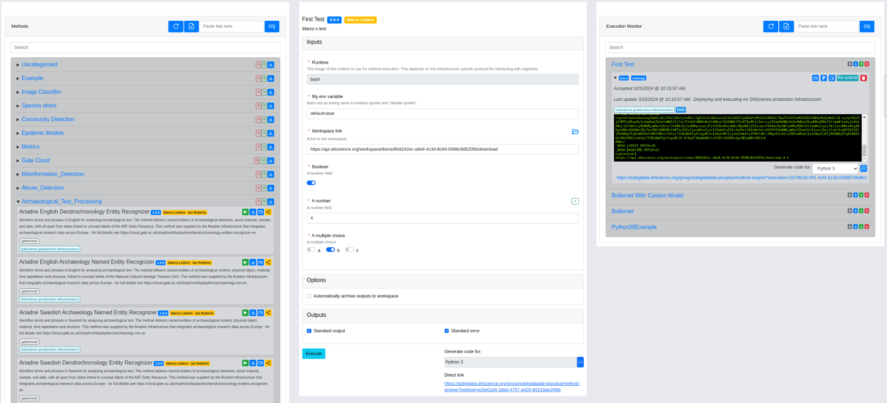
CCP Methods lifecycle explained
Scriptable for fine tuning
Install libraries, pull code, fetch files from workspace
Fed with input parameters and useful variables such as Token and URIs
Scriptable for fine tuning
start scripts or commands with input parameters
Controllable timeout
Multi-instance for coarse grained parallelism
Fed with input parameters and useful variables such as Token and URIs
All files stored in predefined directory /ccpdata
It’s meant for small outputs and logs
Use external storage and link reference for large files
Several input types including Arrays, secrets, local and remote files,...
flexible output specification
Special inputs for governing container images, maximum duration, semantic annotation
From UI, code, Galaxy, …
Could be scriptable but not for container based environments
Empowering Reproducible Open Science through the Cloud Computing Platform (CCP) by D4Science - EGI 2024 -Lecce (Italy)

Slide 17
Methods vs Runtimes
The power and flexibility of containers
Inputs
Method
Application deps.
Application code
Inputs
Inputs
Experimentation
Method
Method
pytorch
pytorch
Runtime
Git repo, configs
Git repo, configs
Prog. Lang. runtime
Runtime
Runtime
OS Libraries
python 3.8
Git, CUDA
Operating System
Ubuntu 22.04
cupv/nvidia-cuda
Hardware
Hardware
Empowering Reproducible Open Science through the Cloud Computing Platform (CCP) by D4Science - EGI 2024 -Lecce (Italy)

Slide 18
Methods vs Runtimes
Consolidate for reproducibility
Inputs
Method
Application deps.
Application code
Inputs
Inputs
Consolidation
Method
Method
Runtime
Prog. Lang. runtime
OS Libraries
Operating System
me/mymethod:v1
me/mymethod:v2
Hardware
Hardware
Empowering Reproducible Open Science through the Cloud Computing Platform (CCP) by D4Science - EGI 2024 -Lecce (Italy)

Slide 19
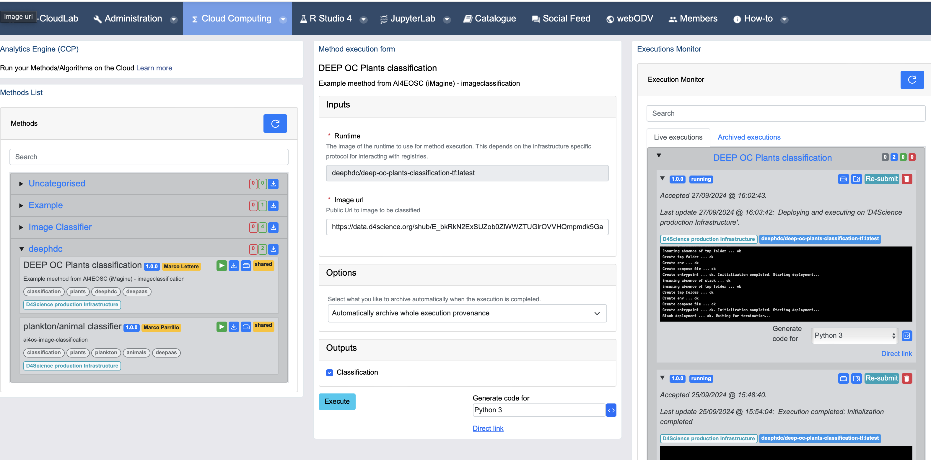
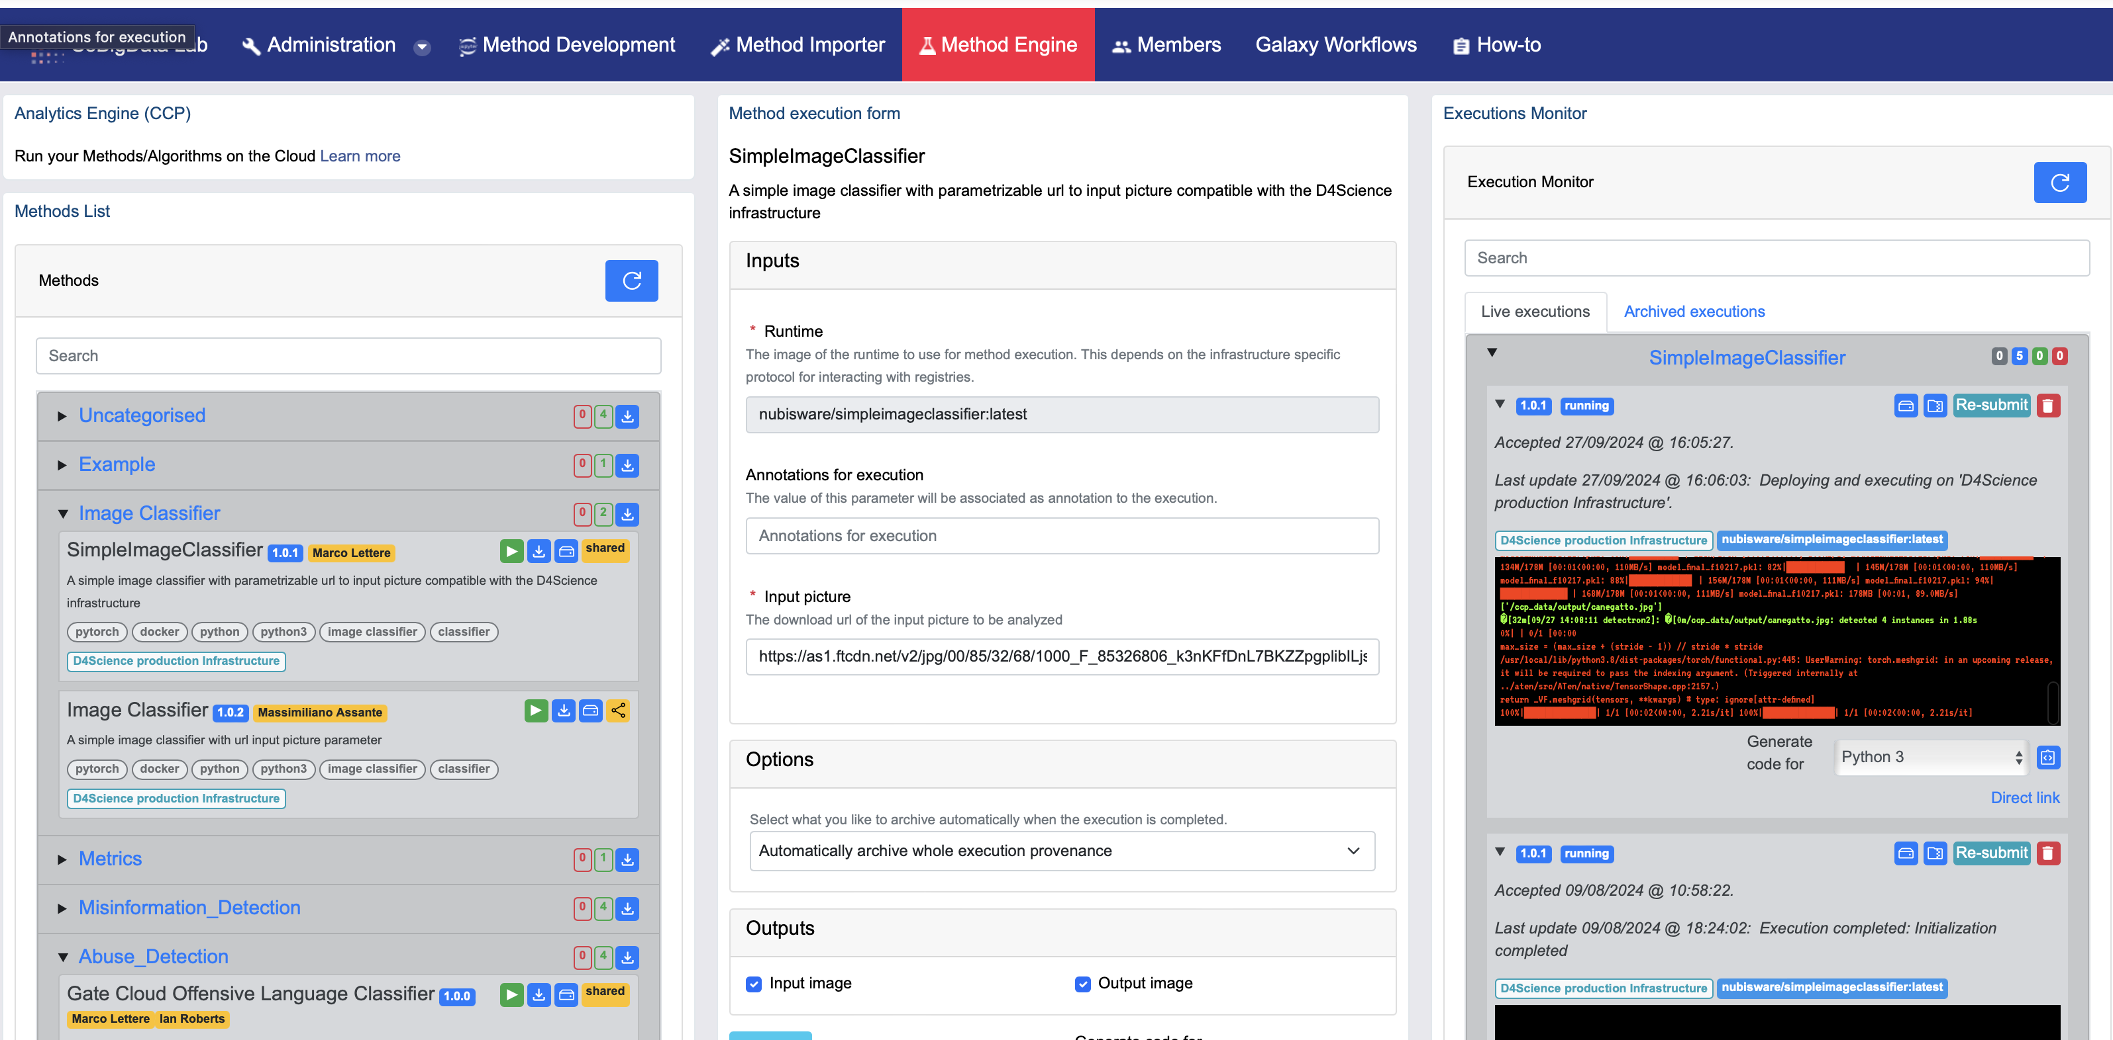
CCP deployments in EU Projects
https://blue-cloud.d4science.org
https://sobigdata.d4science.org
Look for the open VLabs in Blue-Cloud or SoBigData and try CCP!

Slide 20
How does CCP supports Open Science?
Improves transparency and ways of disseminating knowledge
Enables re-usability of methods and their outputs
Uses digital technologies and collaborative tools
Enables the reproducibility of method executions
What is Open Science
An approach to the scientific process based on cooperative work and ways of disseminating knowledge, improving accessibility to and re-usability of research outputs by using digital technologies and collaborative tools.
SOURCE: COMMISSION RECOMMENDATION (EU) 2018-790 of 2018
Thanks for your attention

