Slide 1
Perun AAI
Peter Balčirák
peter.balcirak@cesnet.cz

Slide 2
Motivation

Slide 3
Motivation
AAI

Slide 4
Perun AAI
Complex AAI Solution
Collaboration of CESNET and Masaryk University
National & International Involvement
e-INFRA CZ
Life Science AAI

Slide 5
Perun AAI under the hood
Authentication Capabilities
Single-Sign On - login once, access the whole infrastructure
Authorization Capabilities
Performs authorization (allowed to access, approved all policies)
Packs services with data for making authorization decisions
Identity Management
Manage user identities (link, manage associated data, …)
Access Management
Define rules for authorization (e.g. user must be a member of a group)

Slide 6
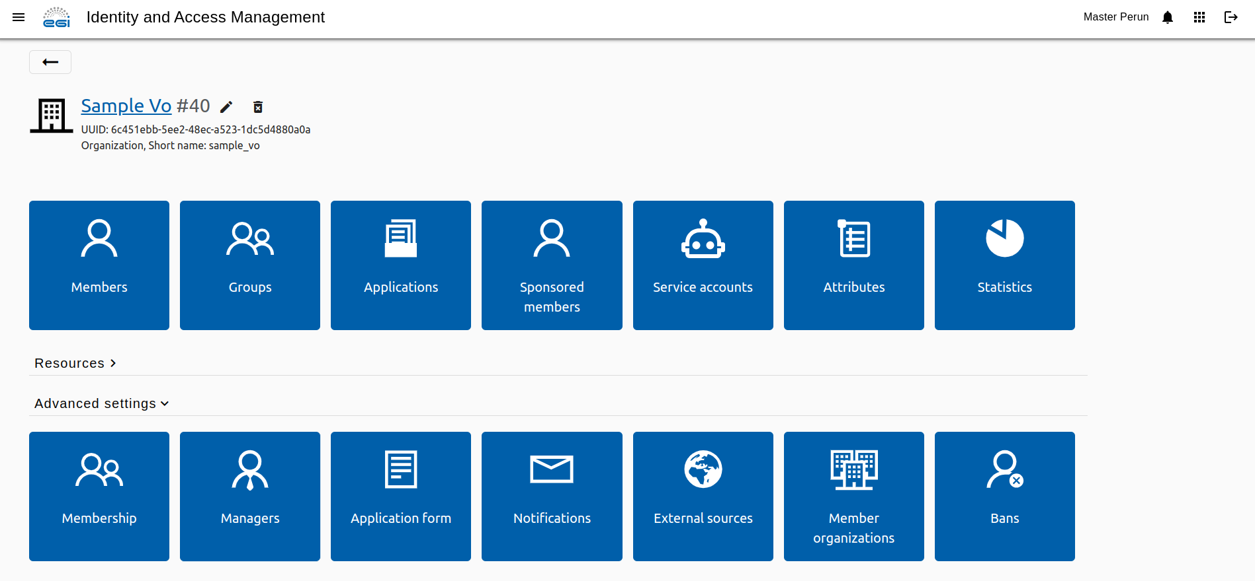
Perun & EGI Federation
Perun offered as a core service to EGI communities
Serves as a complementary solution for VO management
More about the offered service here

Slide 7
Membership Management
User Enrolment
Define registration processes
Invitation capabilities
User Life-Cycle
Control user membership by automatic processes
Group Structure
Hierarchy, inclusions…
VO Structure
Different communities share services
Delegation
Passing rights to others
Notes:
Better explain group and vo hierarchy

Slide 8
Control Access
Just-in-time
User driven
Usually based on entitlements and other attributes
Example: Login to a web portal
Just-in-case
out-of-band provisioning
Example 1: Joining a project mailing list
Example 2: Controlling user access to rooms
GDPR Aspect

Slide 9
Control De-Provisioning
When It is not only about allocating resources
Storages, Mailing lists, Virtual Environments…
Manual interventions not needed
Connected to user life-cycle within the organization
GDPR Aspect
What if user asks us to remove the account?

Slide 10
The end
Thank you

