Slide 1
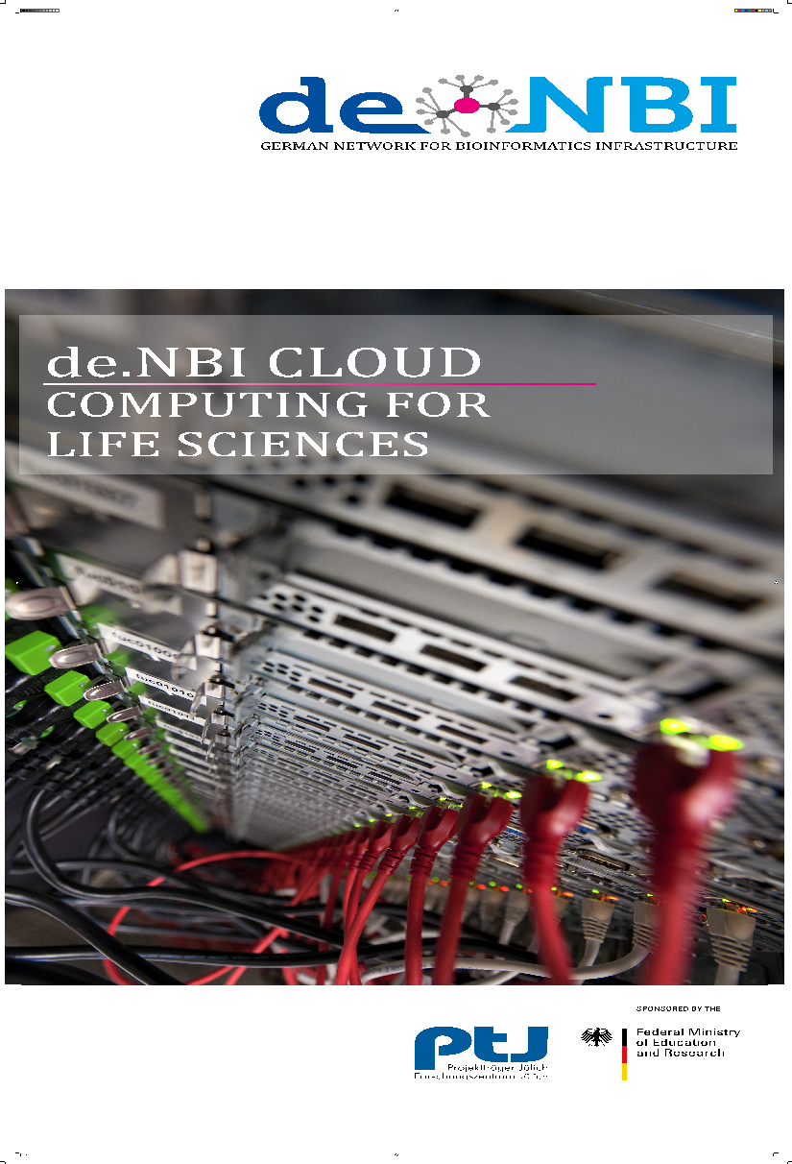
SimpleVM - a Framework for Federated Research Environments in the de.NBI Cloud
Nils Hoffmann, de.NBI Cloud Governance EGI 2024, Lecce Italy

Slide 2
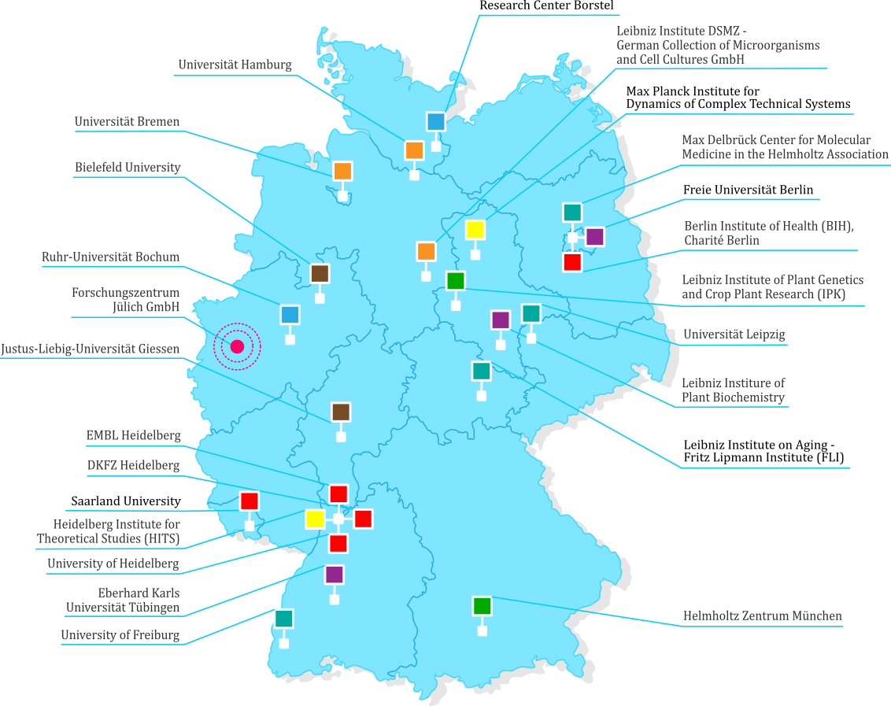
de.NBI – German Network for Bioinformatics Infrastructure
de.NBI consortium
24 partners
8 service centers
national German node in ELIXIR
since 2022 sustained funding via German federal budget to FZJ within Helmholtz Society
de.NBI mission
Provision of comprehensive first-class bioinformatics tools & services to users in basic and applied life sciences research
Bioinformatics training in Germany and Europe through a wide range of workshops and courses
Providing cloud computing resources for academia in Germany
Transfer of expertise between academia and industry in our Industrial Forum
Cooperation of the German bioinformatics community with international bioinformatics networks
The consortium is organised into eight thematic Service Units.

Slide 3
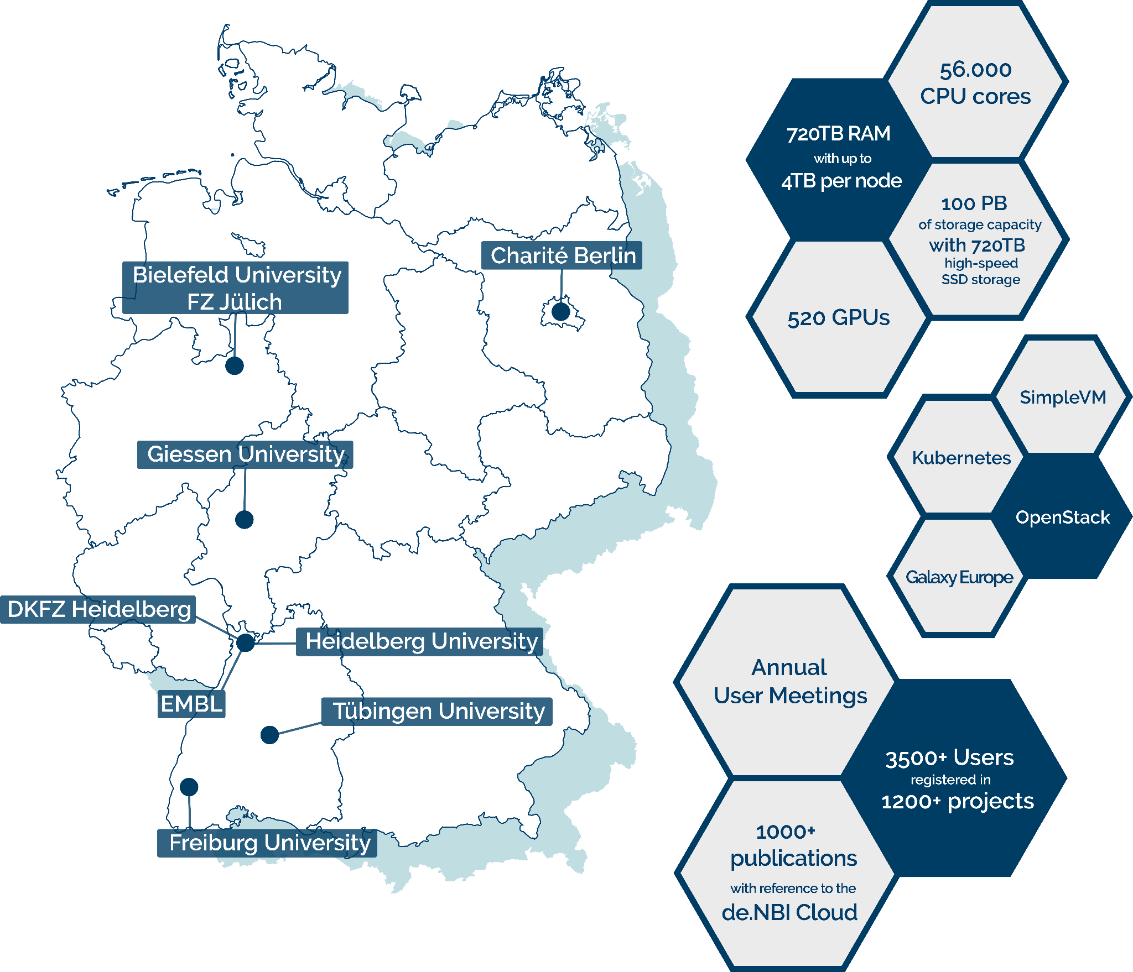
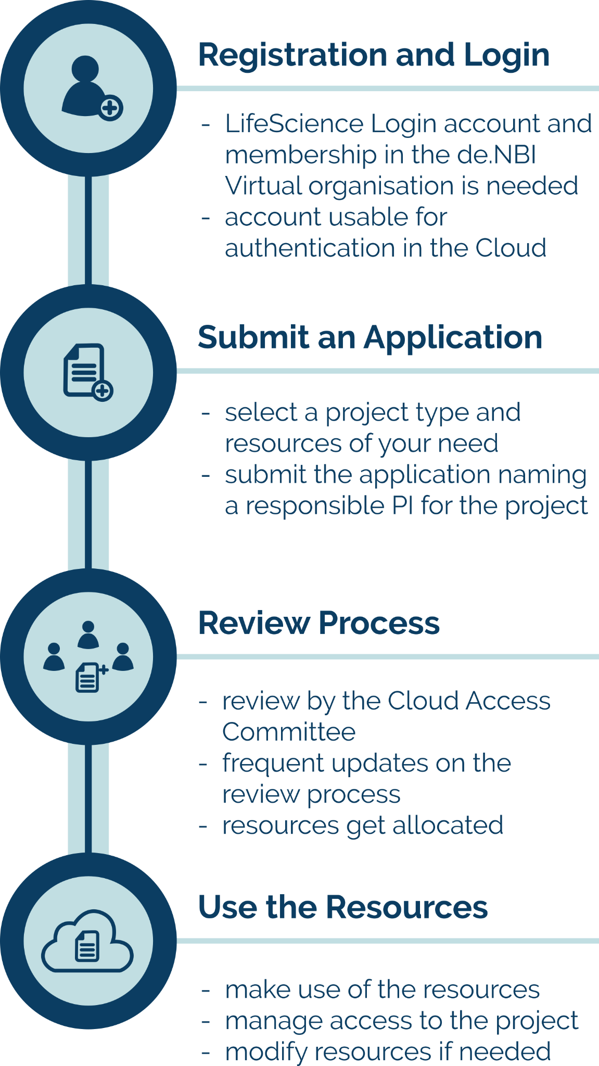
de.NBI Cloud Overview
Perun

Slide 4
SimpleVM - Simplified Access to Virtual Machines
Self Service VMs and Research Environments
Beginner-friendly, preconfigured & custom research environments
Integrated with LifeScience AAI for authentication and authorization
Easy VM, volume and user management
Browser and SSH access
IDEs
Data Science Notebooks
Remote Desktop
Custom VREs
Community Curated
+
based on OpenStack, Ansible and Packer, recipes at https://github.com/deNBI/resenvs

Slide 5
SimpleVM Federation & Deployment
Deployed across four de.NBI Cloud sites with central project and VM management dashboard
Deployed at Bielefeld University for Data Science Infrastructure
Pluggable AAI (e.g. local University IdP or LifeScience AAI) via Keycloak and local DB
Microservice Architecture
SimpleVM Portal
SimpleVM API Gateway & reverse proxy
SimpleVM OpenStack Client (per site)
VM access via GW and single IP (per site)
Intrusion Prevention using SNORT & vulnerability scans with Greenbone
Notes:
We use path based routing via the reverse proxy and additional LS AAI authentication to allow only configured users to access VMs

Slide 6
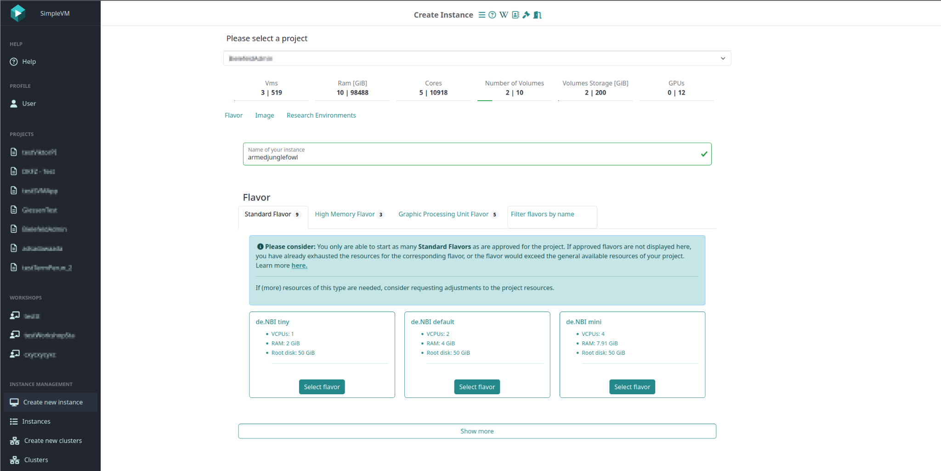
SimpleVM Portal - Create Instance - Flavor Selection

Slide 7
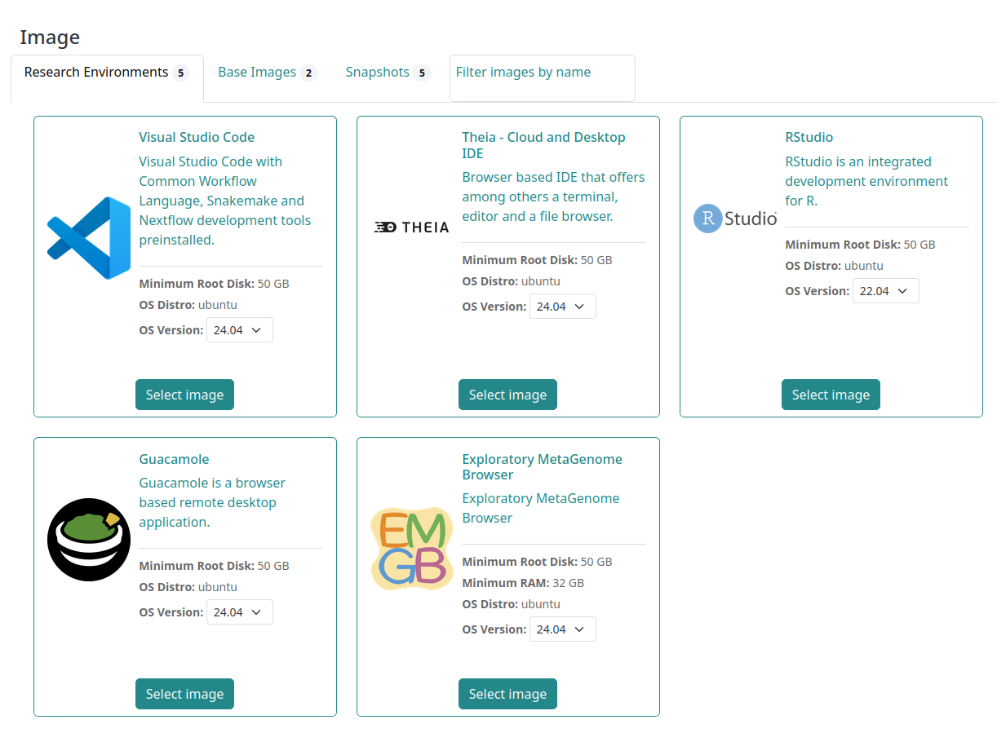
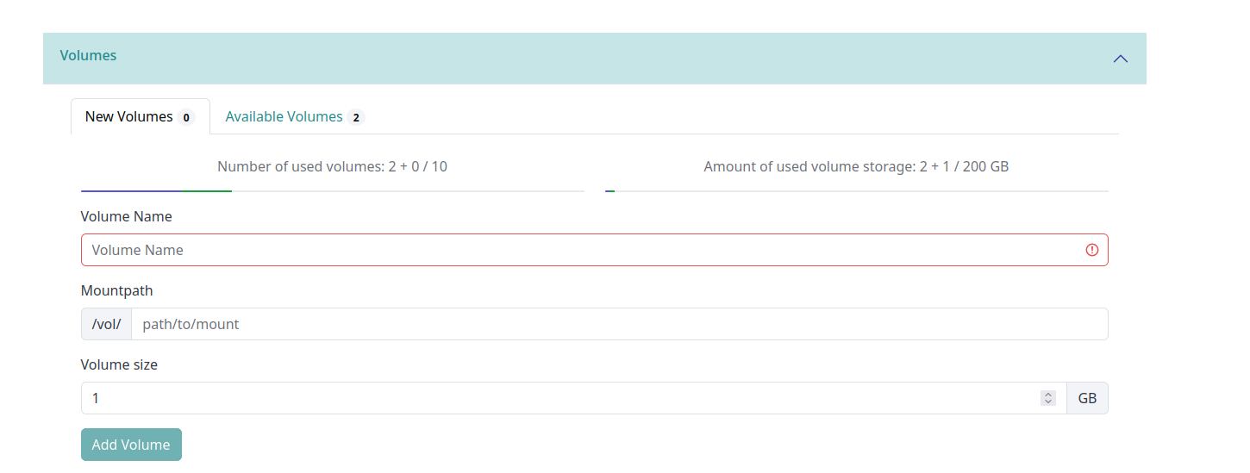
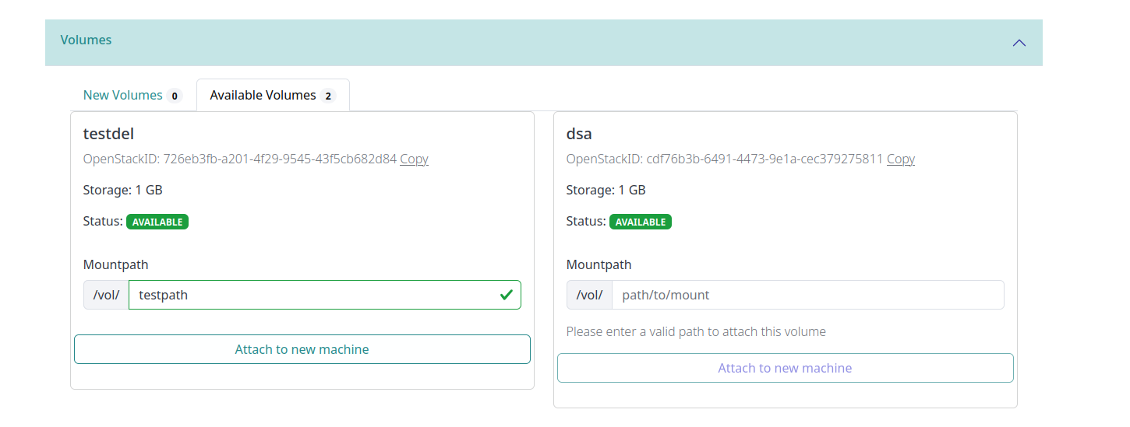
SimpleVM Portal - Resenvs and Volume Management

Slide 8
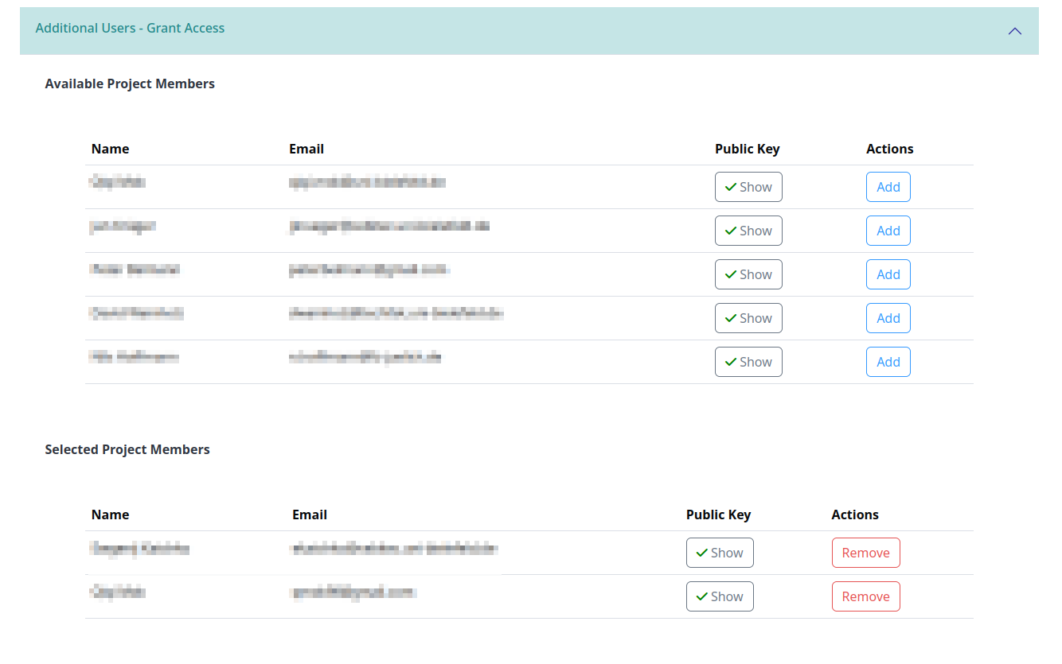
SimpleVM Portal - VM Access Management

Slide 9
SimpleVM Features: Workshop & Cluster Module
Workshop module to define VMs using base images, virtual research environments, or snapshots
Add participants with an existing Life Science AAI account to your project
Send VM access details to each participant individually
Launch VM instances for your participants
“One-click” solution for starting more complex cluster setups, e.g. for Nextflow
Connect multiple machines to one SimpleVM Cluster
Job scheduling mechanism (SLURM)
Easy automatic scale-up and scale-down
Currently in beta development, available on request

Slide 10
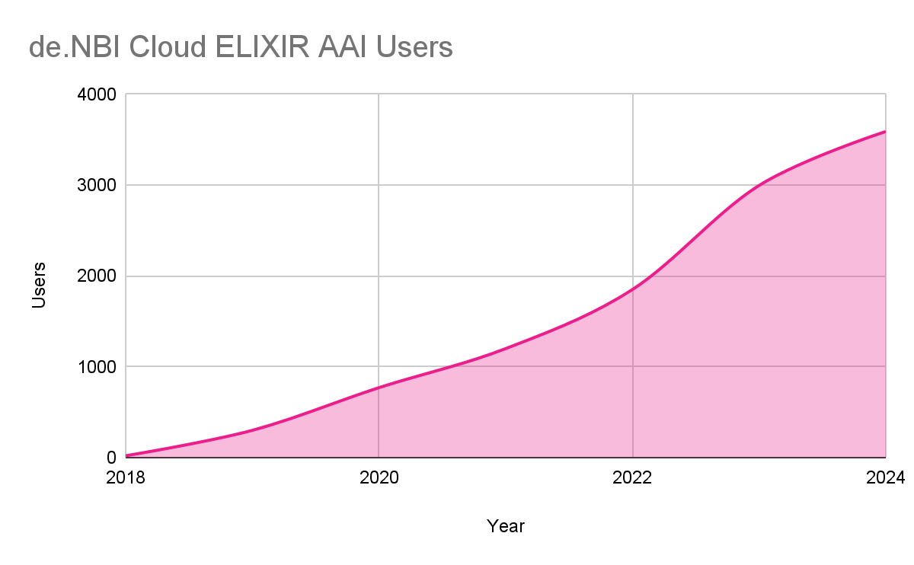
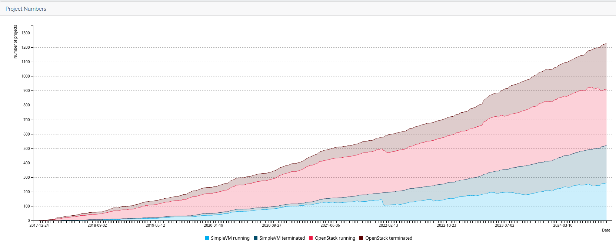
de.NBI Cloud Federation - Projects and Users
> 3,500 registered users
> 1,200 projects registered
OpenStack > 700
Workshop 37
SimpleVM > 500
Workshop 59
Cluster 29
Perun
> 1000’s of users of our services:
numbers as of Sep. 12th 2024

Slide 11
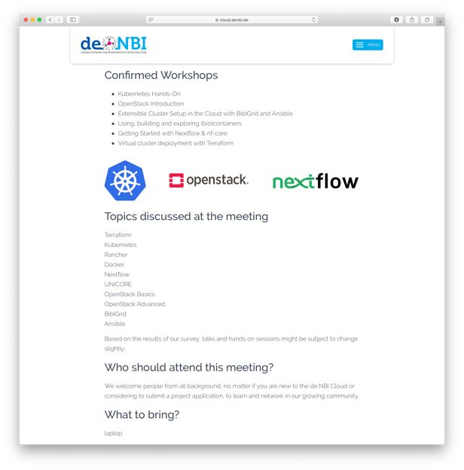
Training and Community Building
47 Participants
75 Participants
20 Participants
Jülich
2019
2021
2023
2018
2020
2022
2024
ONLINE
60 Participants
67 Participants
Courses:
Beginners
Introduction to VM basics: Linux, command line
Using SimpleVM with Research Environments for applied bioinformatics use-cases
Intermediate
Bioinformatics workflows: BioConda, BioContainers, CWL, Nextflow, Snakemake
Advanced
IaaS / PaaS courses for: OpenStack, Kubernetes
Infrastructure automation: Ansible, Terraform
Grid computing in the cloud: BiBiGrid / SLURM
Training Announcements at https://www.denbi.de/de-nbi-events or @denbiOffice, Registration: https://events.denbi.de/

Slide 12
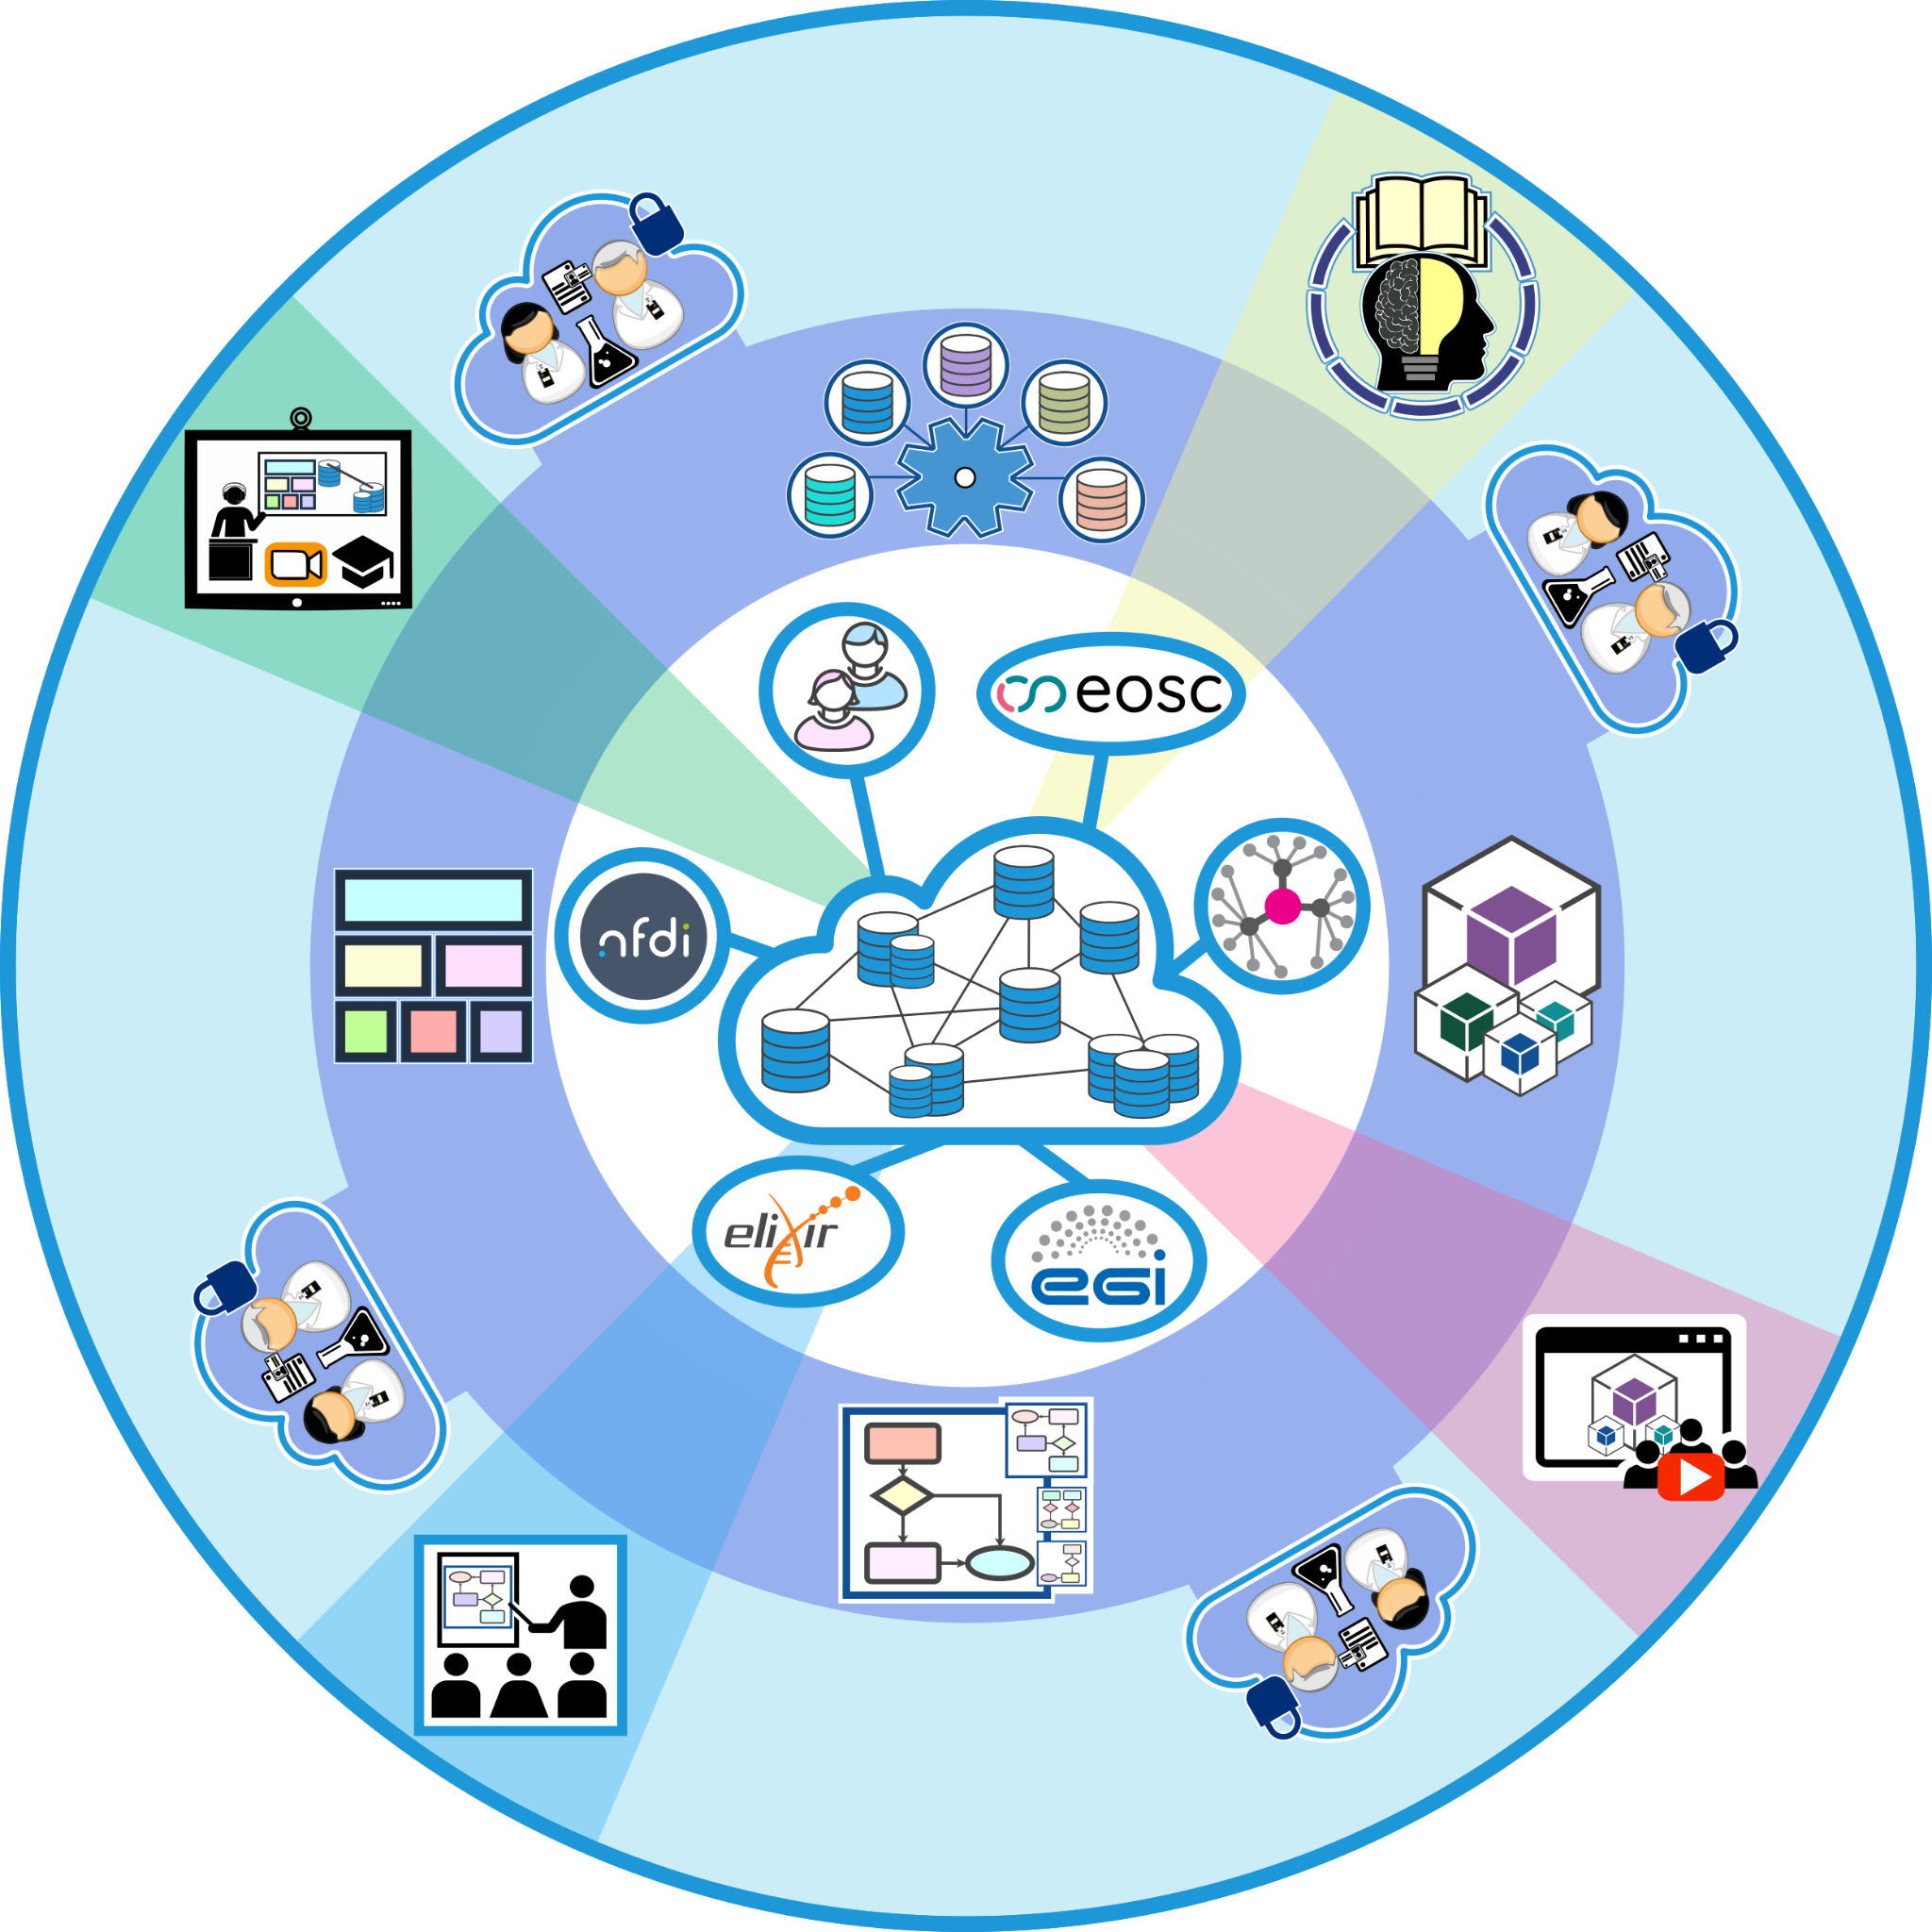
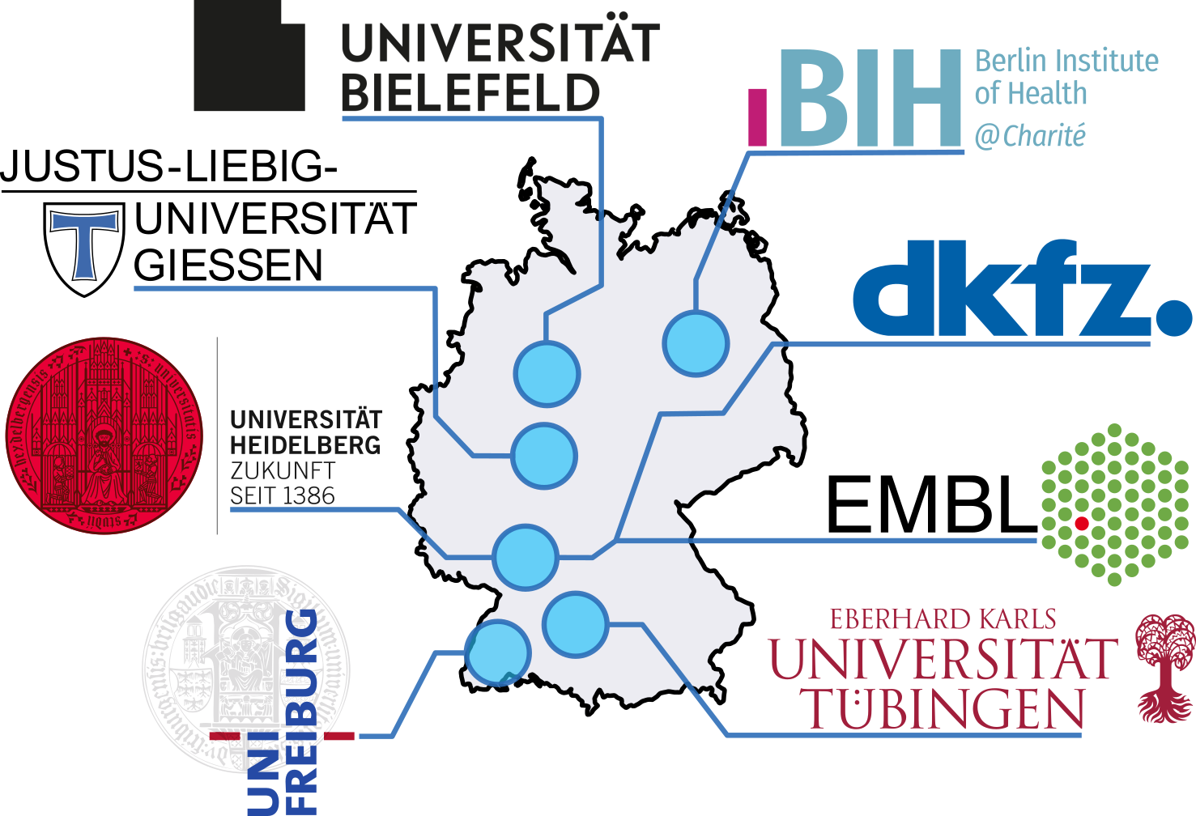
de.KCD - German Competence Center Cloud Technologies for Data Management and Processing
https://datenkompetenz.cloud
Collaboration with multiple RDM initiatives & NFDIs & other DCCs
Part of the Data competence centers for science German Recovery and Resilience Plan (DARP) and BMBF’s Research data action plan
Project Administration: VDI/VDE Innovation und Technik GmbH

Slide 13
Acknowledgements
Meet us at our poster: The de.NBI Cloud Federation
Bielefeld University
Jens Stoye
Volker Tölle Stefan Albaum Björn Fischer
DKFZ
Ivo Buchhalter
Martin Lang
Philip Kensche
Jordi Pujol
Bastian Beyer
Heidelberg University
Rob Russel
Nick Kepper
EMBL
Peer Bork
Jan Korbel
Tobias Rausch
Berlin Institute of Health
Roland Eils
Jürgen Eils
Martin Braun
Stefan Schneider
Valentin Schneider-Lunitz
Sven Twardziok
Harald Wagener
FZ Jülich @ Bielefeld
Peter Belmann Christian Henke Nils Hoffmann Jan Krüger Qiqi Mok Grace Florensia Viktor Rudko Alexander Sczyrba Alex Walender David Weinholz
Contact:
Dr. Nils Hoffmann
IBG-5, Forschungszentrum Jülich
n.hoffmann@fz-juelich.de
Mastodon: @TheLipidHoff@scicomm.xyz
Gießen University
Alexander Goesmann
Burkhard Linke
Marius Dieckmann
Frank Förster
Freiburg University
Rolf Backofen
Björn Grüning
Jan Leendertse
Marc Herbstritt
Tübingen University
Oliver Kohlbacher
Jens Krüger
Johannes Werner
Mohamad Chehab
Fabian Wannenmacher
Amir Baleghi
Fabian Paz
https://cloud.denbi.de

