Slide 1
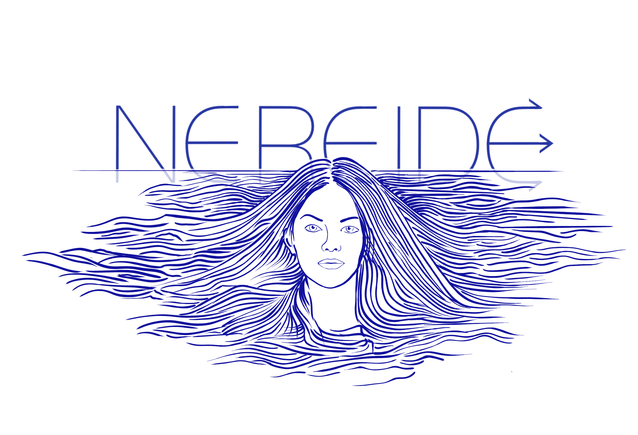
Virtual Data Center:
a platform for enabling data scientists to access integrated and scalable online environments
Stefano Chiappini & Stefano Cacciaguerra

Slide 2
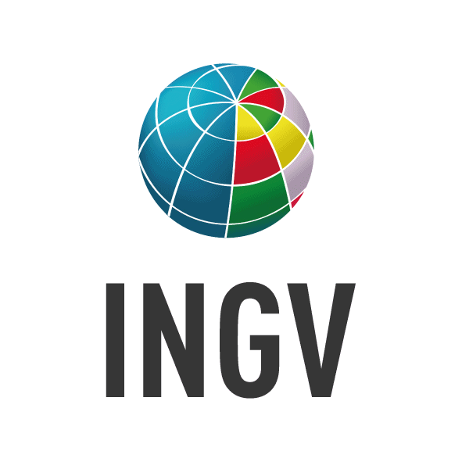
Modern Research Needs
Complexity and Interdisciplinarity Modern research merges multiple disciplines, utilizing different data and methods.
Need for Collaboration Increasingly complex questions require geographical distribution and disciplinary collaborations to harness various expertises.
Technological Advances Improvements in data and computational management facilitate handling large datasets and complex simulations, supporting effective collaboration despite distances
Data Sharing Essential for validating results, enabling new discoveries through open data availability and allow others to build on existing work.
Reproducibility Challenges Critical for scientific trust, yet complicated by the complexity of modern research.

Slide 3
NE.RE.I.D.E.
Real case: EMSO (ERIC focused on marine sciences)
Italy (coordinator country)
INGV (representing entity)
INGV implemented the NEw REsearch Infrastructure Datacenter for EMSO near the Western Ionian Sea site, at Portopalo di Capopassero (SR), Italy.
An ICT infrastructure for:
archiving, processing, and sharing scientific data from marine observatories
developing advanced services
promoting multidisciplinary research in the deep marine environment

Slide 4
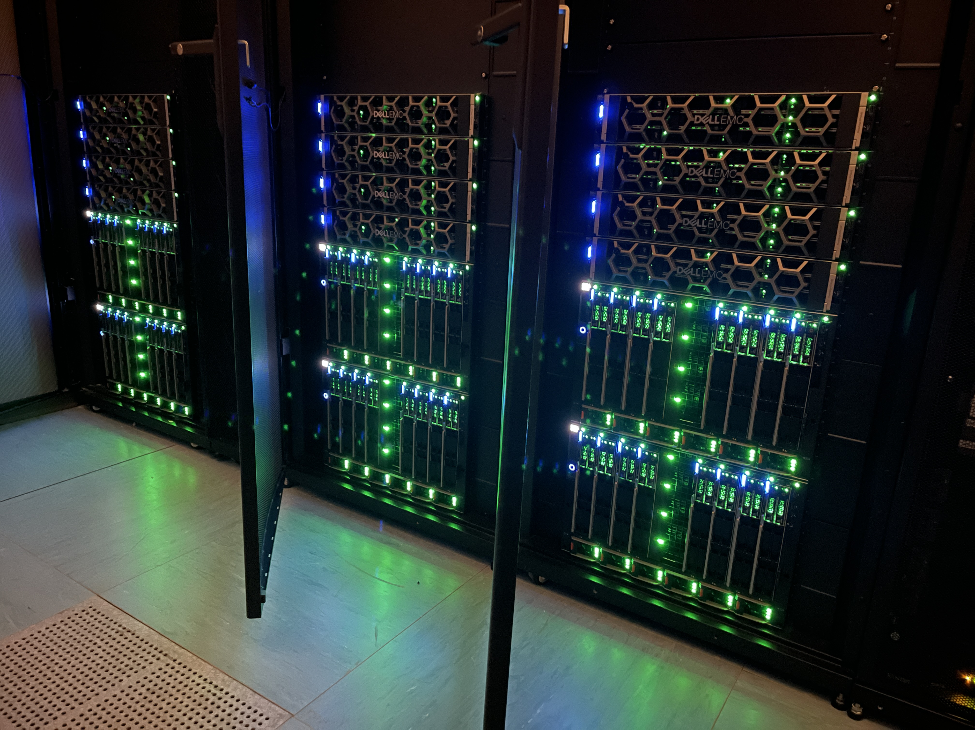
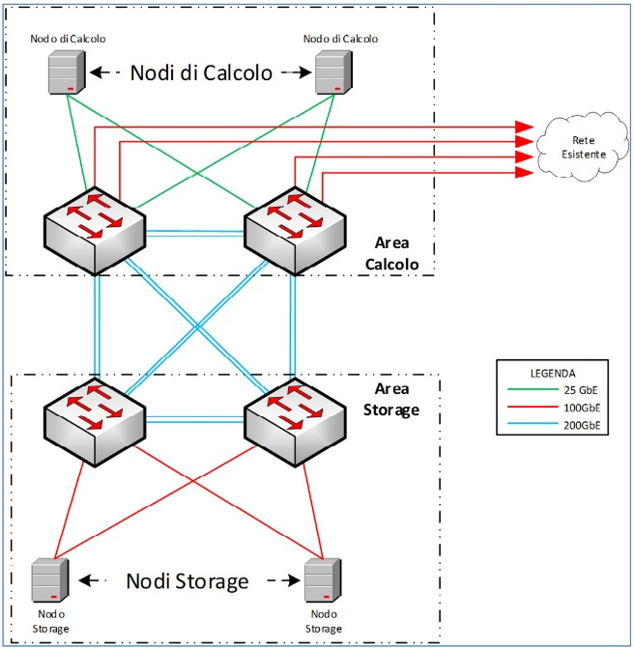
Infrastructure design from beginning to end…
Budget
(1.5 M€)
Data Center
Design
Market Research
HW Available
Technical Specification Document
Computing:
48 nodes
~2600 cpu cores
36 TB ram
GPU:
8x NVidia A100
Storage:
12 nodes
240 HDD
60 SSD
3.6 PB raw disk
Tender
Process
Software
Installation
Network Configuration
HW Installation and firmware
management

Slide 5
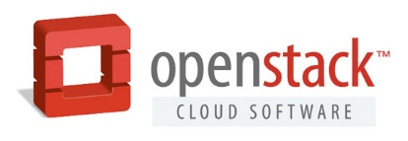
The Architecture of NEREIDE
Open-source Infrastructure-as-a-Service platform. It enables seamless scalability and flexibility in resource management.
Workflow Automation with the integration of Metal-as-a-Service and JuJu in the deployment and maintenance of physical and virtual resources.
Distributed software-defined storage engine, that offers flexible and scalable storage resources managing heavy data loads and ensuring both data security and integrity.

Slide 6
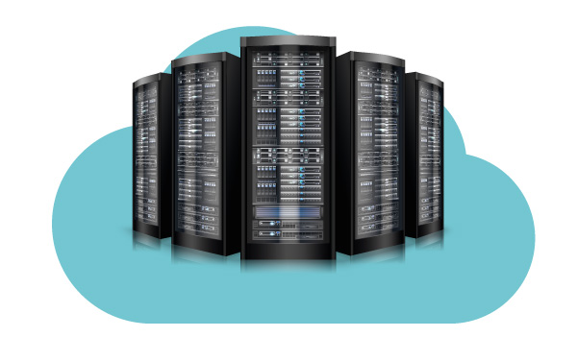
Virtual Data Centers - the Core of NEREIDE
A VDC is a managed environment designed to allow more flexibility in resource management and development process by DSs, including Virtual Machines (VMs), behind a customizable gateway with a dedicated public IP address.
Management levels
DSs possess administrative privileges over their cloud segments, enabling them to create, manage, and configure VMs, networks, firewalls, VPNs, and routing configurations autonomously.
The whole cloud infrastructure and physical data center are managed by Infrastructure Administrators (IAs), maintaining a balance between autonomy and control.
Customizable Gateway Provides DSs with a unique, customizable entry point, enhancing security and personalization.
VDC

Slide 7
Infrastructure
Administrators
Data
Scientists
End
Users
Architecture design, VDC creation
Data Services development inside VDC
Use of
Data Services

Slide 8
The Implementation of Virtual Data Centers
T0
(tenant
IAs)
VDC1
R
B
A
C
N
E
T
T1
(tenant DSs)
PROV
I DER
NET
VM01T1
GW-T1
VMnT1
VDC2
R
B
A
C
N
E
T
T2
(tenant DSs)
P
R
I
V
N
E
T
VM01T2
GW-T2
VM…Tk
VMnT2
VDCk
Tk
(tenant DSs)
R
B
A
C
N
E
T
VM01Tk
P
R
I
V
N
E
T
VM…Tk
GW-Tk
R-Tk
VM...Tk
VMnTk

Slide 9
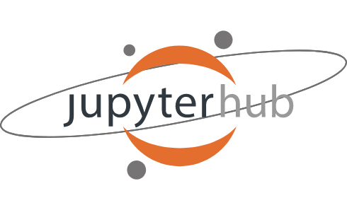
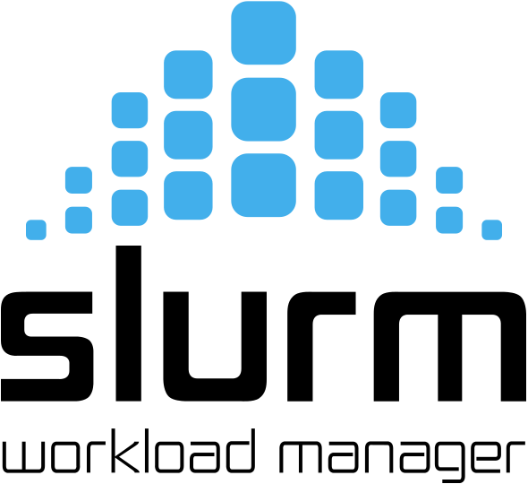
Single Tenant on Openstack Networking
T0
Tk
P
R
O
V
I
D
E
R
N
E
T
R
B
A
C
N
E
T
P
R
I
V
A
T
E
N
E
T
Just a Single Public IP!
slave
FIREWALL
ENDIAN
master
ERDDAP
slave
Private IP!

Slide 10
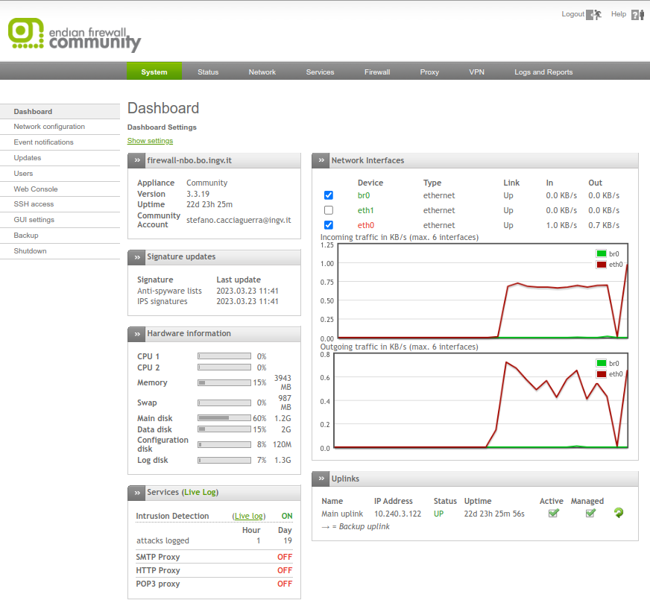
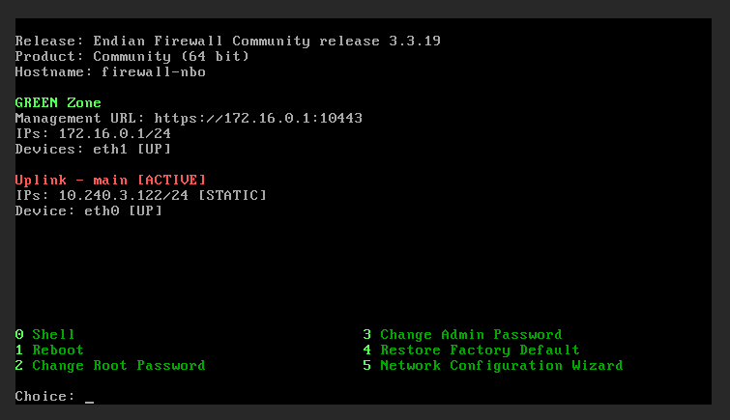
Endian Firewall as Gateway
It is an open-source router, firewall and gateway security Linux distribution
Credentials of Endian Firewall:
root of SO → Infrastructure Admins
admin of Web Dashboard → Infrastructure Admins
admin user of Web Dashboard → Data Scientists

Slide 11
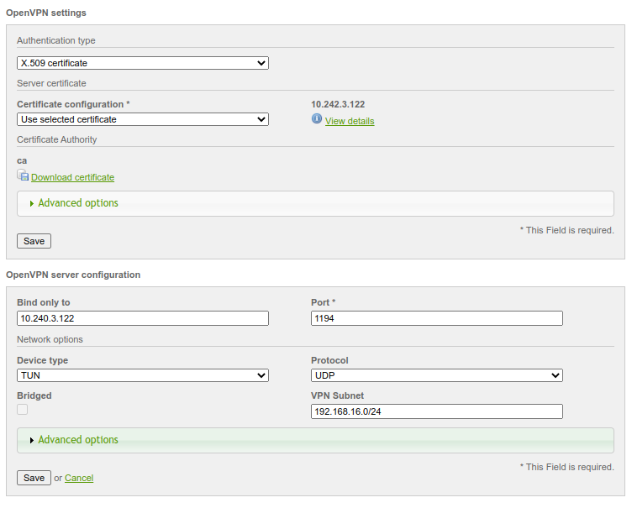
Endian Firewall Services
Port Forwarding / DNAT
to make accessible services from Internet
openVPN
to allow users to access VMs (ssh, https etc…)
Masquerading / SNAT
to allow VMs to access Internet

Slide 12
IaC inside VDCs
Goal of a faster and more efficient management VDCs integrate Infrastructure as Code to allow DSs to manage and provision Data Services through version-controlled scripts.
IaC leverages manual environment setups, automating the installation of pre-configured services (jupyterhub, ERDDAP, web portal, Elasticsearch,...) and increasing reliability and reproducibility.
With IaC, VDCs offer consistent, repeatable, and scalable environments that are ready-to-use and can be rapidly provisioned.
IaC provides the framework and definitions that make Cloud Automation and orchestration possible.

Slide 13
Conclusions
VDCs represent the evolution in the concept of virtualization, moving beyond individual virtual machines to include comprehensive data center infrastructures, ready-to-use, fully equipped with advanced tools.
The Integration with IaC fosters consistent, scalable, and rapidly deployable environments.
By facilitating easier and more effective resource management and data sharing, VDCs are accelerating the achievement of Open Science goals, simplifying the complexities of modern research.
VDCs can be integrated with other Federated Data Infrastructures (Blue Cloud) to enhance their capability for resource sharing across scientific domains.

Slide 14
Stefano Chiappini & Stefano Cacciaguerra

