Slide 1



OPEN DATA LICECYCLE MANAGEMENT WITH ONEDATA
Michał Orzechowski
ACC Cyfronet AGH

Slide 2
WHO WE ARE?
10+ years of devoted development - see github.com/onedata
Open-source, developed at the AGH University of Krakow and Cyfronet data center
We work tight with scientific communities on a case-by-case basic
Our vision is to:
  deliver a data management platform for large-scale and distributed problems,
  address the challenges of global collaborative data sharing across federated organizational domains,
  streamline data processing in heterogeneous data storage setups.
Our funding comes from Polish and European grants and partnerships

Slide 3























SUPPORTED BY SCIENTIFIC COMMUNITIES
We are always looking for new partnerships and projects in order to:
  keep the project running (of course),
  gain invaluable experience cooperating with experts, solving real usecases, and working on authentic large datasets (big files & large number of small files)
Our supporters and partnerships:

Slide 4







ONEDATA for ONEWORLD
Onezone
S3
SAML
(in prep.)
Entry
GUI
OIDC
REST APIs
NO TRUST
OAI-PMH
Kademlia
DHT (in prep.)
NO TRUST
Ceph
S3
Swift
POSIX
POSIX
CDMI
NFS
Data Mgmt. GUI
REST APIs
FTP / SFTP
WebDAV
NO TRUST

Slide 5
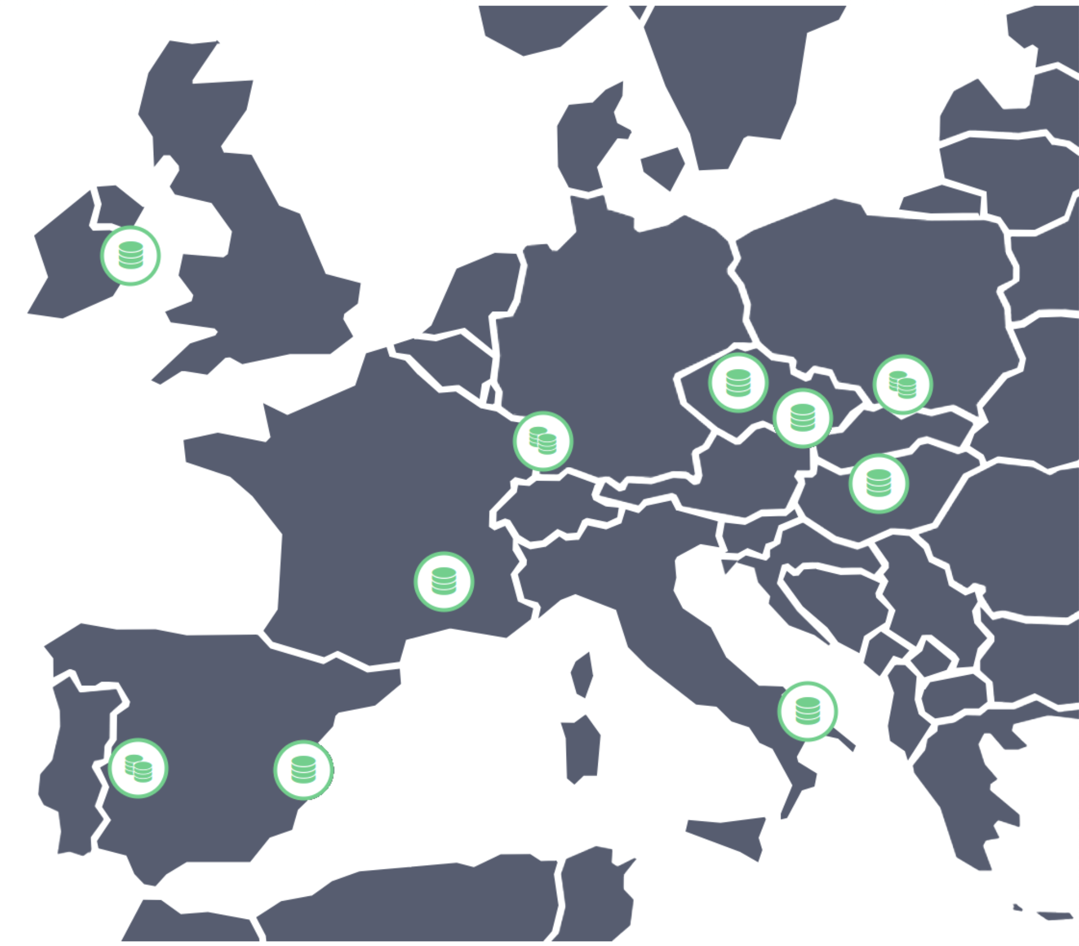
ONEDATA INSTANCES
Between 5 and 10 active Zones in Poland
and EU (depending on project lifecycles).
Several instances not maintained by us.
EGI DataHub (on the map), long haul project:
  20 sites (Oneproviders)
  2150 data spaces
  ~1.77PB total storage size
  700+ users
Archive for Polish National Museums:
  5PB of data — the current phase
  10PB of data — target scale
  ~100M files

Slide 6
PROBLEMS ADDRESED BY ONEDATA
1
Multi-protocol transparent access to data “[…] but we want POSIX”
Heterogeneity of storage technologies
Replica Management
Easy Data Sharing and publication (DOI)
Metadata Management Integrated with Data Management Platform
Flexible authentication and authorization
Easy integration using API with external services
High-throughput data processing
Access to Legacy Data Collections
Open Data Management
2
3
4
5
6
7
8
9
10

Slide 7
FIRST USECASE:
HYBRID-CLOUD SCINETYFIC WORKFLOW EXECUTION

Slide 8
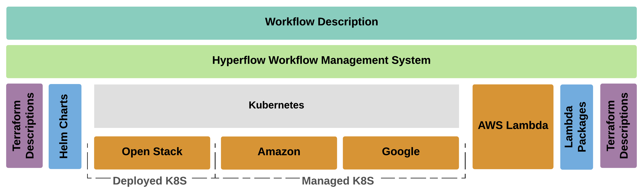
PROJECT REQUIRMENTS
Requirements:
  achieve automation using open-source DevOps tools (Ansible, Terraform etc.)
  use Kubernetes as a universal cloud API and resource manager
  use Hyperflow workflows manager schedules tasks to multiple Kubernetes clusters

Slide 9
SCINETIFIC WOKFLOW DATA MANAGEMENT
designed for geographically-local filesystem (eg. Ceph, Lustre, NFS)
required POSIX-compliant filesystem
legacy software with unknown data access patterns (sequential/random)
not designed for distributed data management or cloud-native storage systems

Slide 10
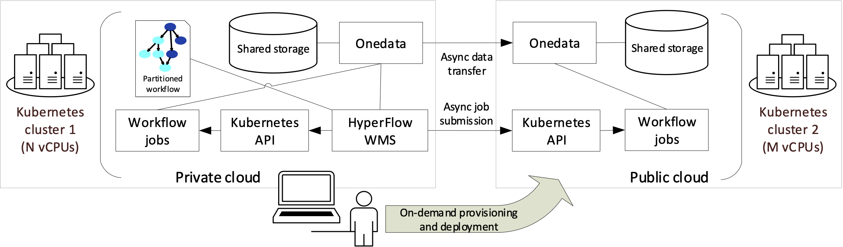
HYBRID-CLOUD DATA MANAGEMENT
deployment of Hyperflow and Onedata and Kubernetes clusters
workflow execution uses Onedata as a data-plane
on-demand replication of data on the block level

Slide 11
SOYKB GENOMIC WORKFLOW
Workflow for studying genomic variation of plants using next generation resequencing data with large-scale inputs, with following characteristics:
a large input file – the reference genome database,
two parallel stages (genotype_gvcfs and filtering_snp tasks),
a long final task that merges the outputs of previous tasks (merge_gcvf)

Slide 12
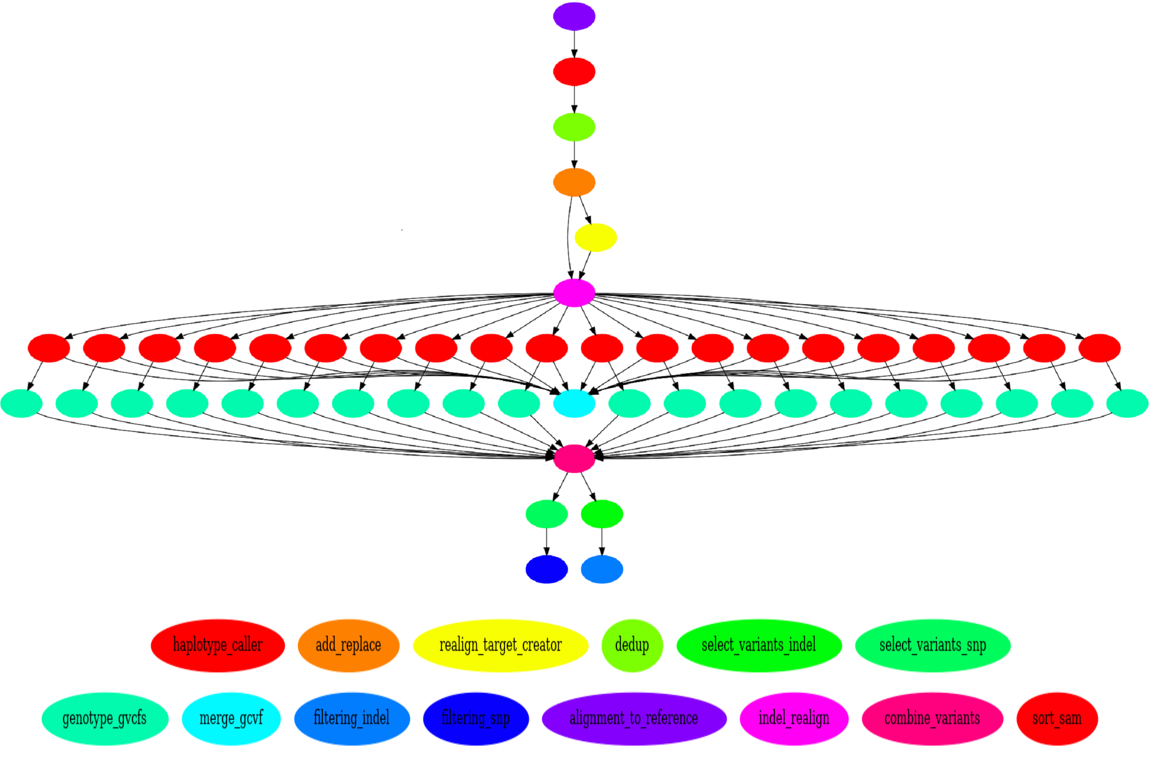
Structure of the Soykb workflow

Slide 13
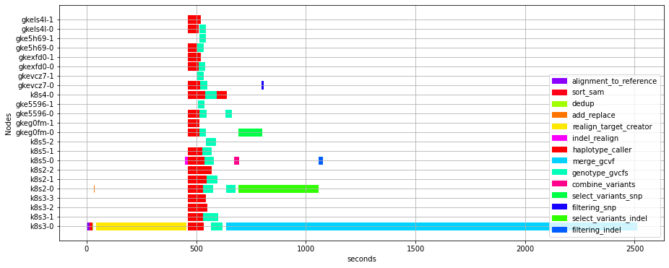
Visualization (trace) of the Soykb workflow execution on two clouds

Slide 14
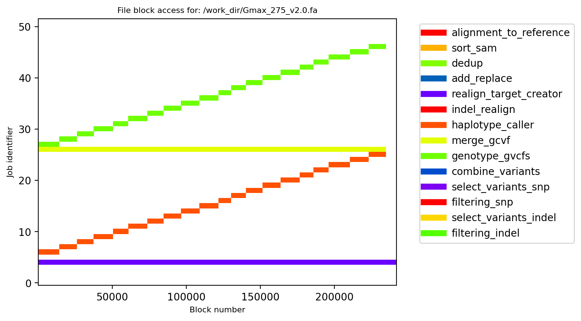
SOYKB DATA ACCESS PATTERNS
Data access pattern of the largest input file of the Soykb workflow.

Slide 15
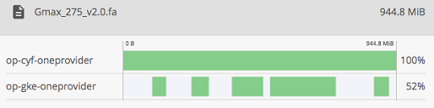
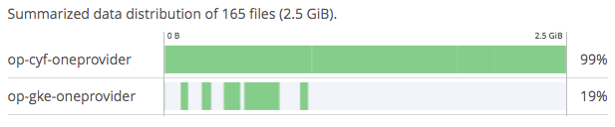
BLOCK LEVEL DATA DISTRIBUTION IN ONEDATA
Runtime data distribution between two clouds for the Soykb workflow

Slide 16
DATA DISTRIBUTION
the data in Onedata may be arbitrarily distributed among the storage backends of the supporting providers
files are made up of parts of variable sizes — file blocks
each provider holds a set of local file blocks, constituting a file replica
when a file is read on a provider and the requested blocks are not present there, the missing ones are replicated on the fly from remote providers
when a file is written on a provider, the overwritten blocks on other providers are invalidated. To read the file, the provider with invalidated blocks must once again replicate missing blocks from the provider with the newest version of the blocks

Slide 17
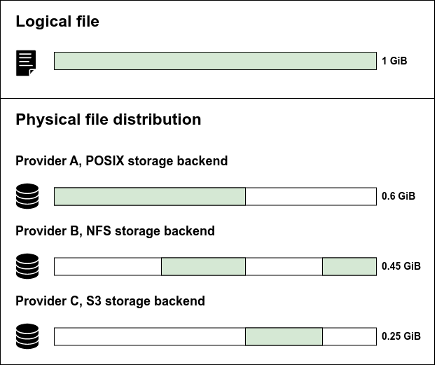
DATA DISTRIBUTION

Slide 18
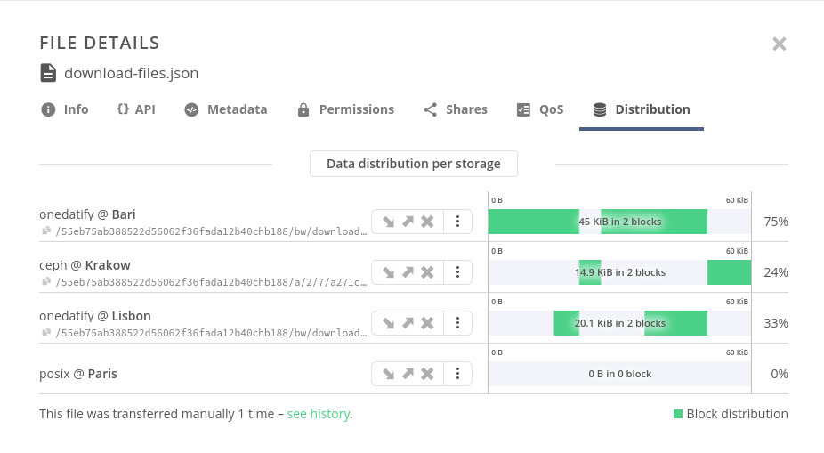

Slide 19
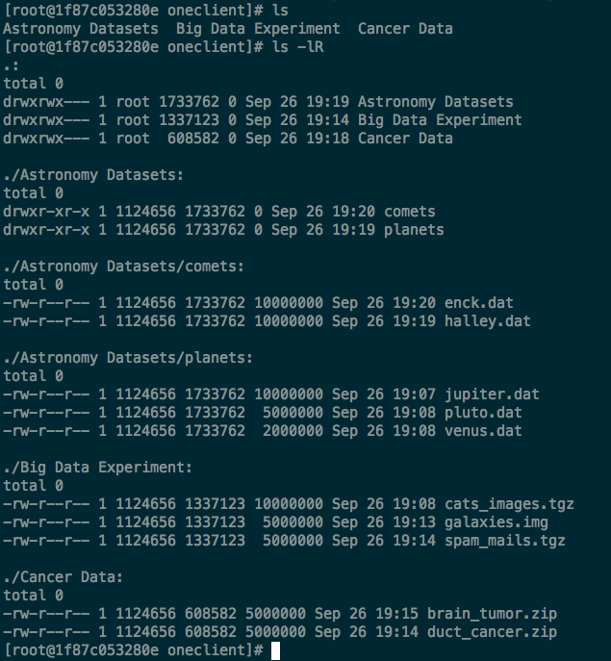
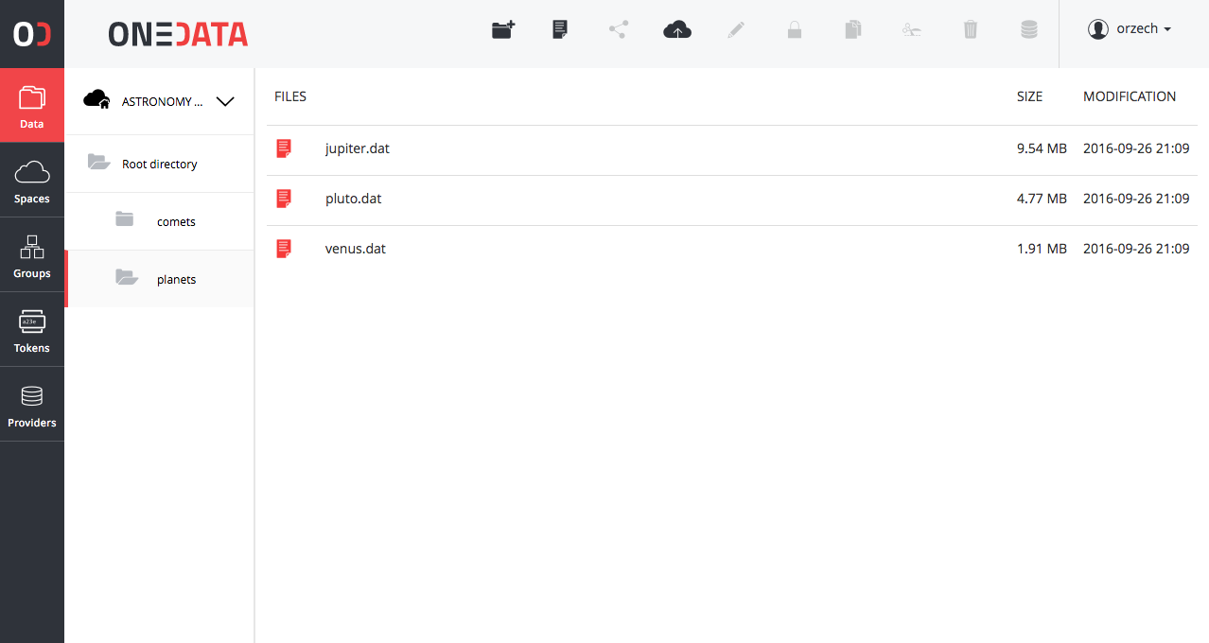
POSIX ACCESS WITH ONECLIENT
presents Onedata virtual file system as POSIX
support for most of the POSIX operations on globally distributed virtual file system
all data accessible via a unified file system mountable on virtual machines, grid worker nodes and containers

Slide 20
SECOND USECASE:
SATELITE IMAGE HOMOGENIZATION

Slide 21
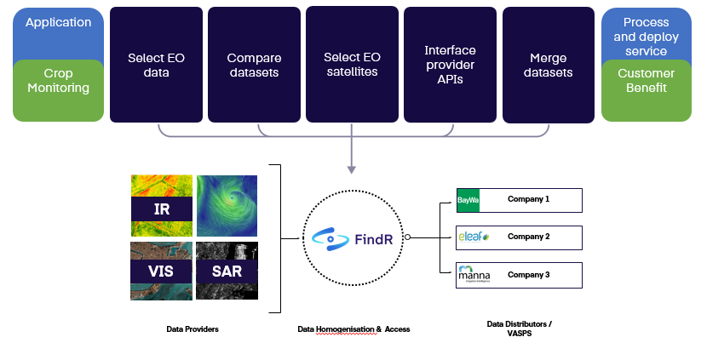
SATELITE IMAGE HOMOGENIZATION
FindR provides unified access to several Data Providers and homogenize the data to a unified format. This includes a common tiling sheme, resolution, spectral bands and other characteristics of the output to enable the integration of new data sources without effort.

Slide 22
MULTIPLE SOTRAGE BACKENDS
Storage backends are used to store the physical data. Oneprovider accesses the storage backends via "helpers" (drivers) implemented for each supported type of storage. Helpers serve as a POSIX-like abstraction, building a layer over different storage backend APIs and access methods.
Currently supported storage backends:
POSIX — any POSIX compatible filesystem accessible by Oneprovider via a mount point
NFS — filesystem exported via the NFS protocol — no need to mount it locally
S3 — Amazon S3 compatible storage
Ceph RADOS — versions 14, 15, 16
HTTP — any server exposing data via HTTP or HTTPS
XRootD — CERN's data management protocol for LHC data
WebDAV — experimental
dCache — experimental

Slide 23



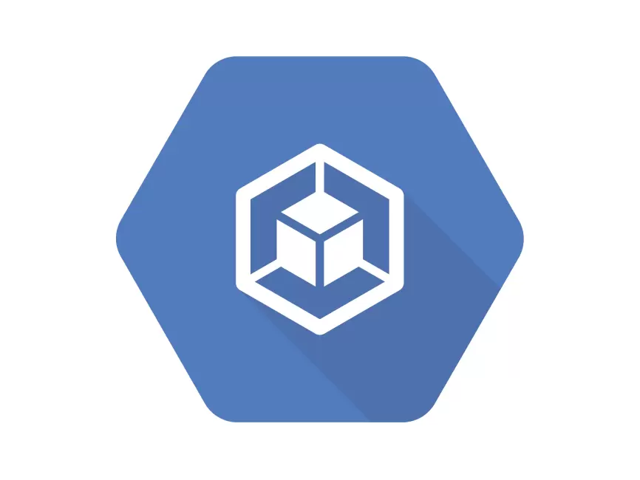


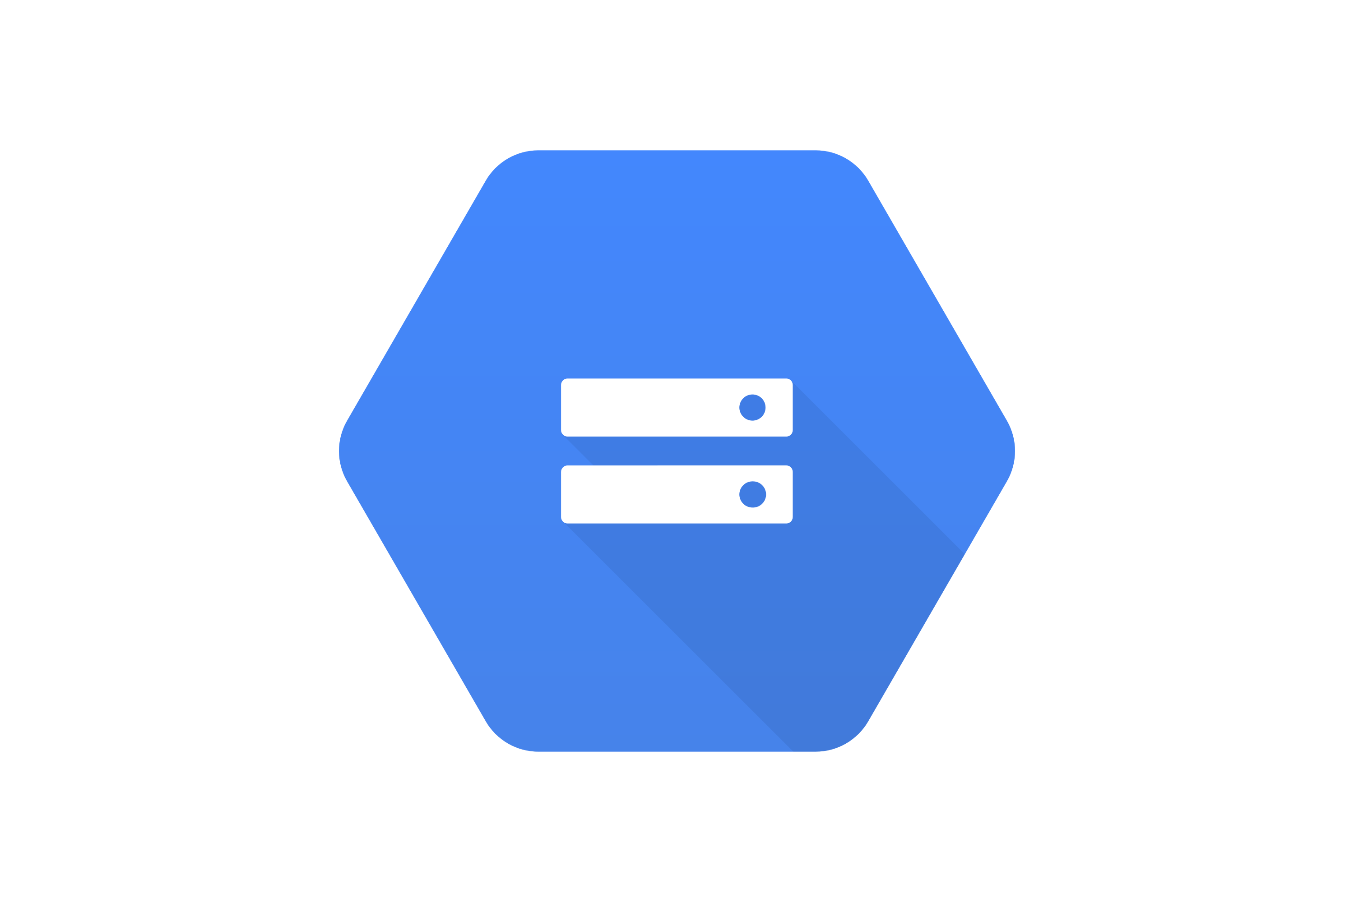
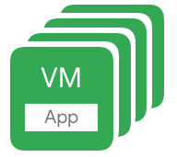


1
Request
Homogenization
Google Kubernetes Engine
HTTP
Pre-stage data
2
3
Replicate data
Submit
Oneprovider
Access data
2
4
5
Store
Replicate data
3
Execute
3
HTTP
POSIX
Autoscaling K8S Nodes

Slide 24
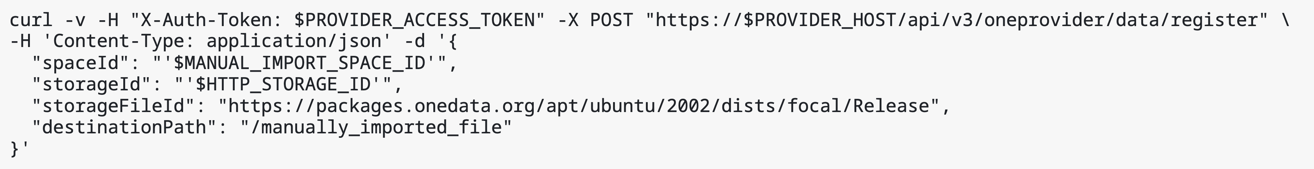
MANUAL DATA INDEXING
Manual import allows registering specific files lying on a storage backend into a Onedata
Preferred when only a part of the dataset is to be imported
Upon registration, the file becomes accessible in Onedata under the requested path
No data is copied in the process - a metadata entry is created in the space, containing a reference to the external storage.
Manual storage import is supported on the following storage backends: POSIX, GlusterFS, WebDAV, XRootD, HTTP, S3, Swift, Ceph RADOS

Slide 25
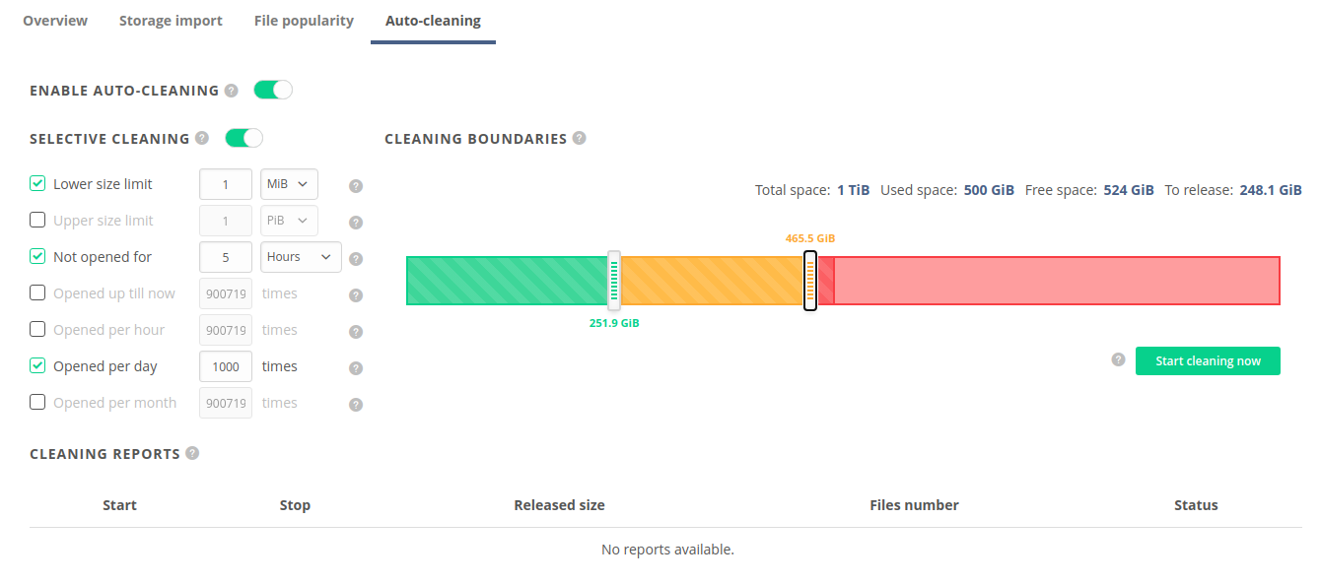
AUTO CLEANING & FILE POPULARITY

Slide 26
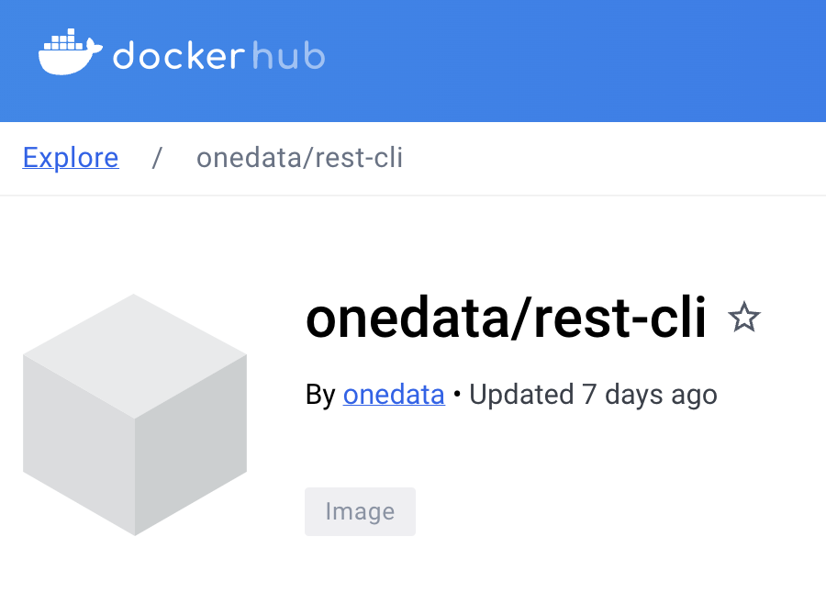
RICH COLLECTION OF APIs
Integrate external tools using rich API interfaces with data management platform and build more complex environments for data processing:
APIs for all operations
APIs for full eventually consistent integration with external systems
API for data locality and replication
Flexible permission checking for APIs
API fully described using Swagger for generation of clients
based on API specification
Easy to use simple command line clients for REST API

Slide 27
THIRD USECASE:
PROCESING OF LARGE MUSEAL DATASETS

Slide 28



NATIONAL MUSEUM IN
KRAKOW
NATIONAL DIGITAL ARCHIVE
NATIONAL LIBRARY
Number of files 4 millions 3 millions 37 millions
Number of dirs 1 33667 154578
Size 2068 TB 960 TB 13 TB
In Total: 44 million files and 3 Petabytes of data.
Planned: 100 million files and 10 Petabytes of data.

Slide 29
PROJECT REQUIRMENTS AND OBJECTIVE
Requirements:
  high availability of data (replicated across two sites)
  high availability of data access and processing services
  data processing (image compression, metadata extraction) to start as soon as possible
  data processing software requires S3 API for data access
  results available to public as soon as possible
Objective: provide a portal where general public can search and access all available data.

Slide 30


Slide 31





4
Data Access
S3 API Adapter
CEPH
Data Processing Clusters
DS1
DS2
DS3
2
3
2
Expose
Expose
Data Replication
3
Data and Metadata Replication
Oneprovider
Oneprovider
1
Data Indexing (Metadata)
NFS
CEPH
Kraków
Wrocław

Slide 32
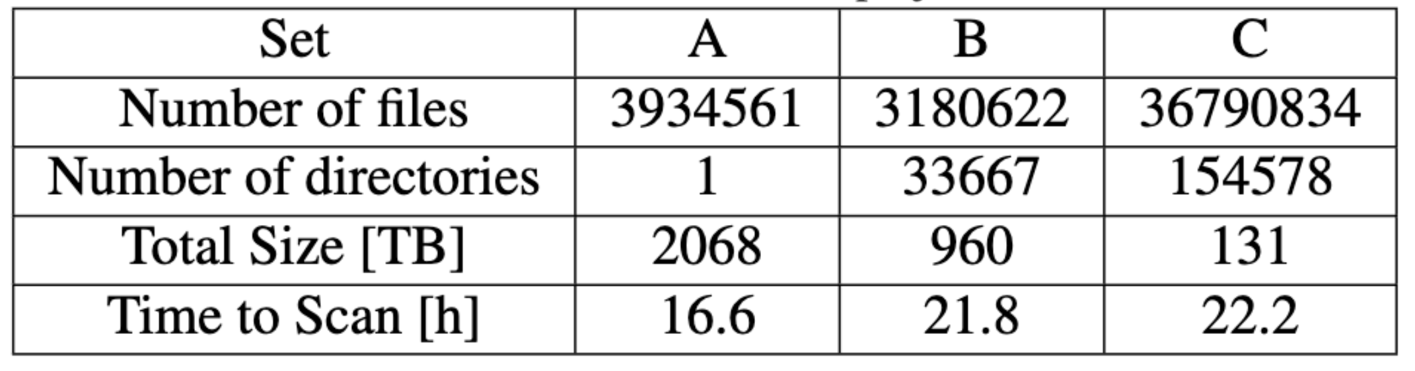
AUTOMATIC DATA INDEXING
The file indexing process does not copy any data, it simply creates the necessary metadata so that the files pre-existing on the storage are reflected and accessible in Onedata.
This functionality should be used in two setups:
There is a legacy dataset located on the storage backend
The data on storage backend is to be modified directly by third party applications, and the changes should be reflected in Onedata.
It is possible to configure the storage to:
detect consecutive data changes
manually triggering scans
re-registering files

Slide 33
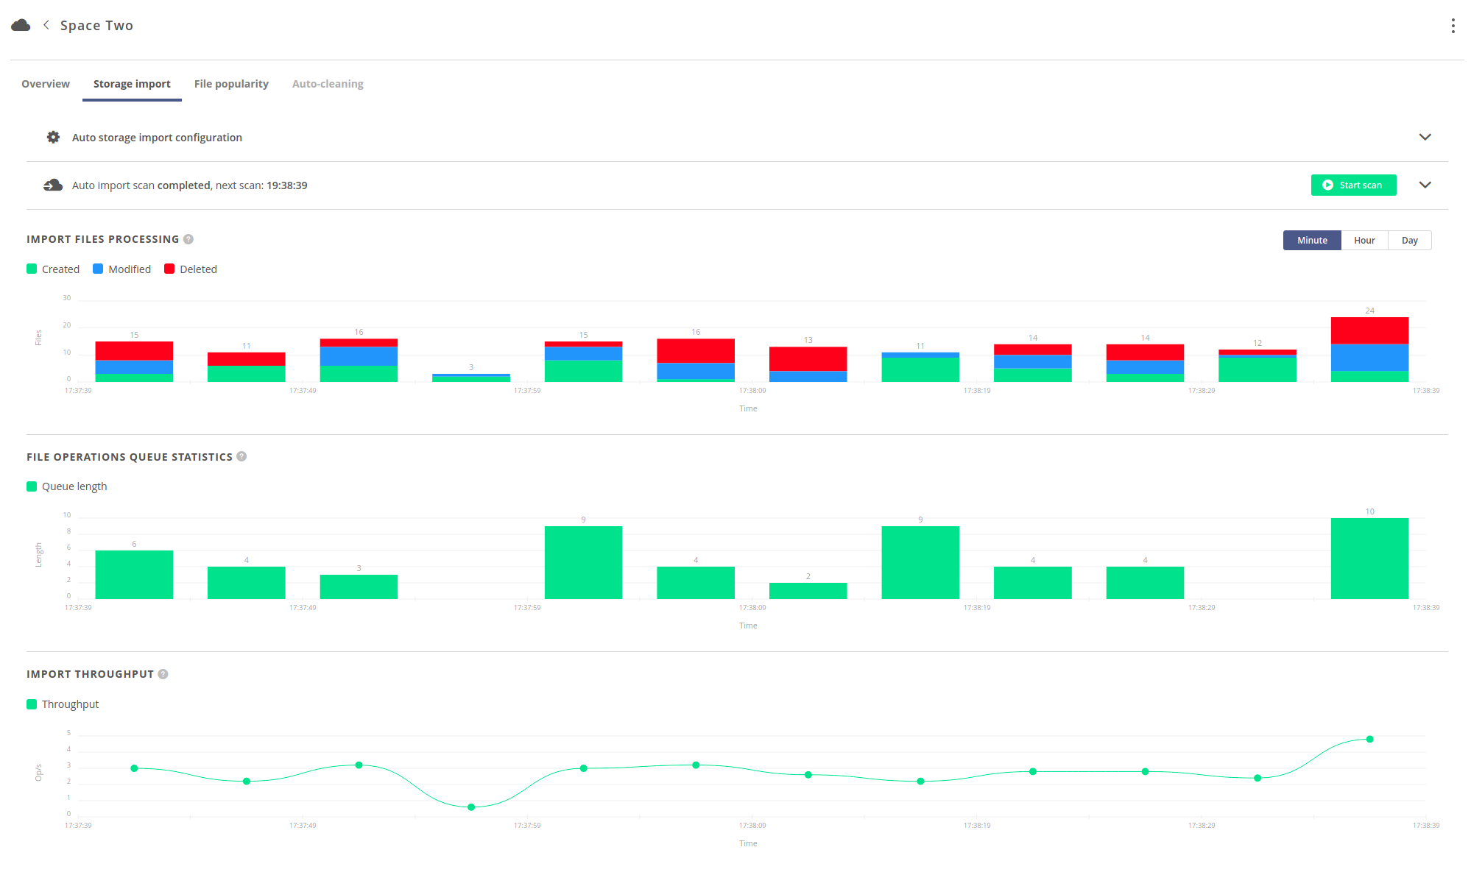
AUTOMATIC DATA INDEXING

Slide 34
DATA TRANSFERS
Replicate files on demand and on the fly.
Migrate data between sites and storage backends on demand or with simple API interface.
Easily check location of your data using GUI or API.
Types of data transfers:
replication — copying (only the missing) data to achieve a complete replica at the destination. The data is copied from one or more providers holding the missing blocks.
eviction — removing replica(s) from the specified provider. This operation is safe and will succeed only if there exists at least one replica of every block on other supporting providers.
migration — replication followed by eviction. Replicates the data to the destination provider and then evicts the replica from the source provider.

Slide 35
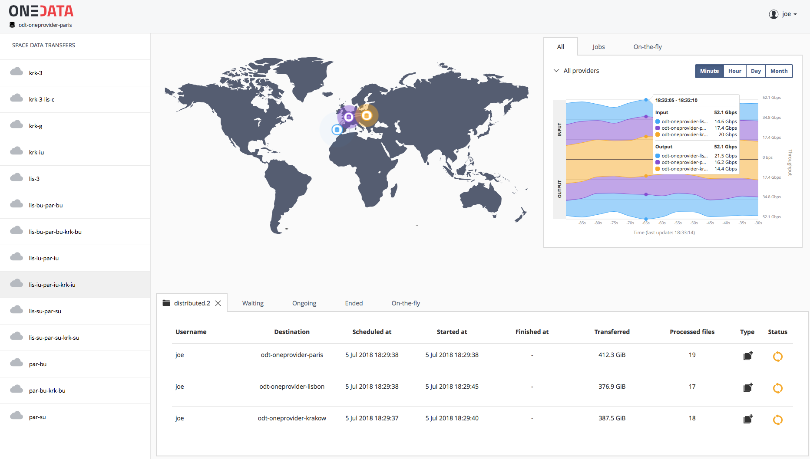
DATA TRANSFERS

Slide 36

ONE3S S3 API Adapter
OneS3 is a scalable S3 implementation:
users can access their data spaces via AWS S3 interface,
exposes storage resources managed by a specific Oneprovider,
can be scaled to any number of nodes,
it handles all data access to storage directly, while Oneprovider instances will only handle metadata management.
ASTRONOMY
Bucket

Slide 37
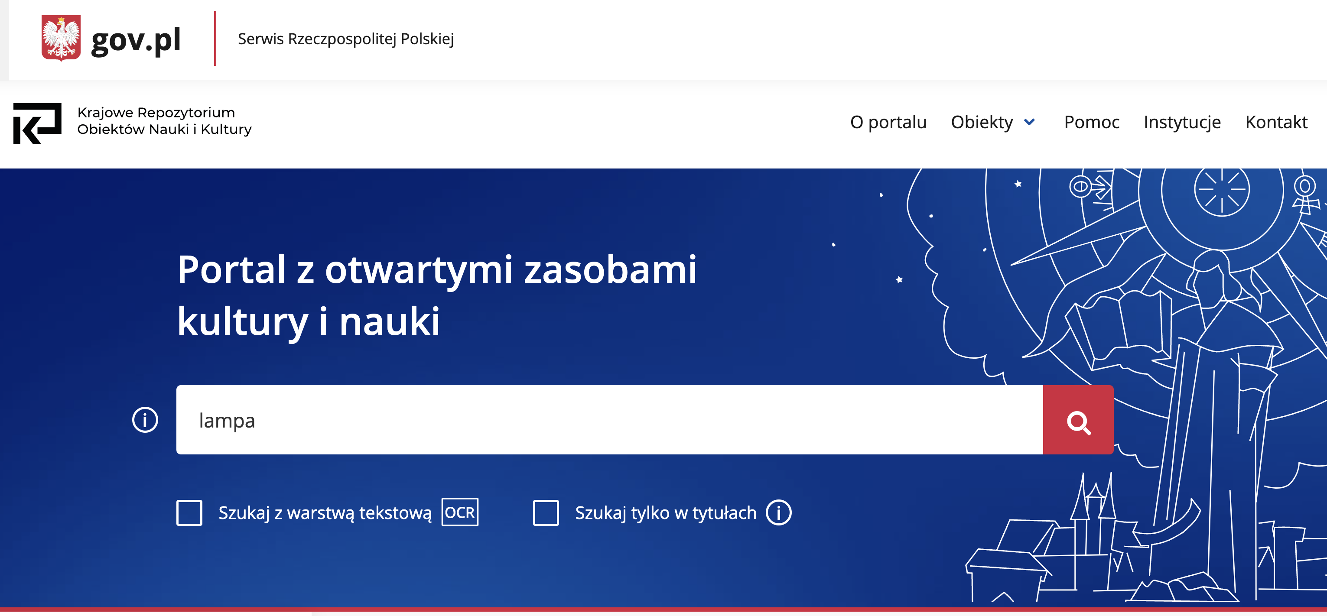
https://kronika.gov.pl

Slide 38
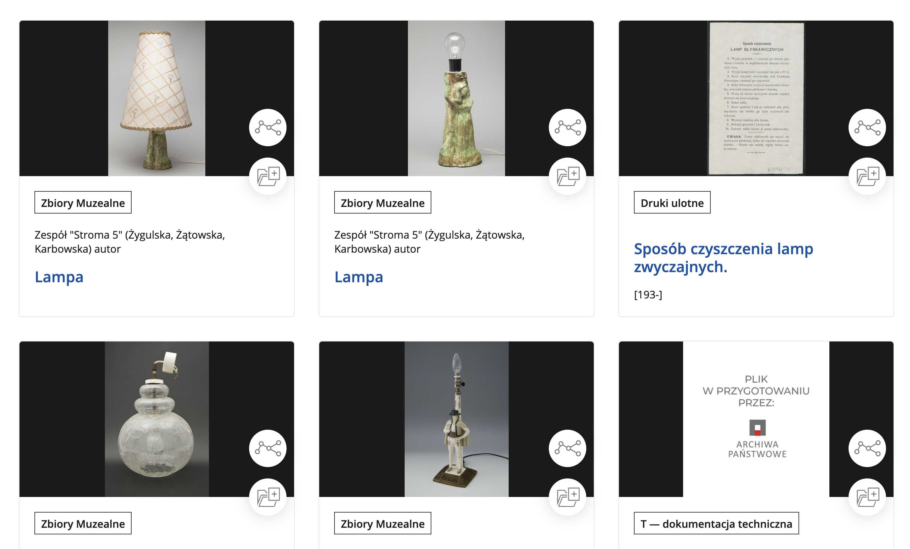
https://kronika.gov.pl

Slide 39
EXTRA RESOURCES
Improved documentation (in making) https://onedata.org/#/home/documentation
Dedicated demo mode for easy sandbox deployment:
https://onedata.org/#/home/documentation/21.02/admin-guide/demo-mode.html
Extensive training materials (4 day workshop!) covering majority of Onedata:
https://onedata.org/training
user: training
password: Oneworkshop58

Slide 40
THANK YOU!
If any of this relates to your usecases, contact us!
Let’s do some meaningful science together!
morzech@agh.edu.pl
info@onedata.org

