Slide 1
Docu-bot
Jiří Chudoba¹, Michal Chudoba², Lukáš Hejtmánek³ 1 – FZU and CESNET, 2 – Charles University, 3 – Masaryk University 3. 10. 2024 EGI Conference 2024, Lecce
Notes:
add institutions

Slide 2
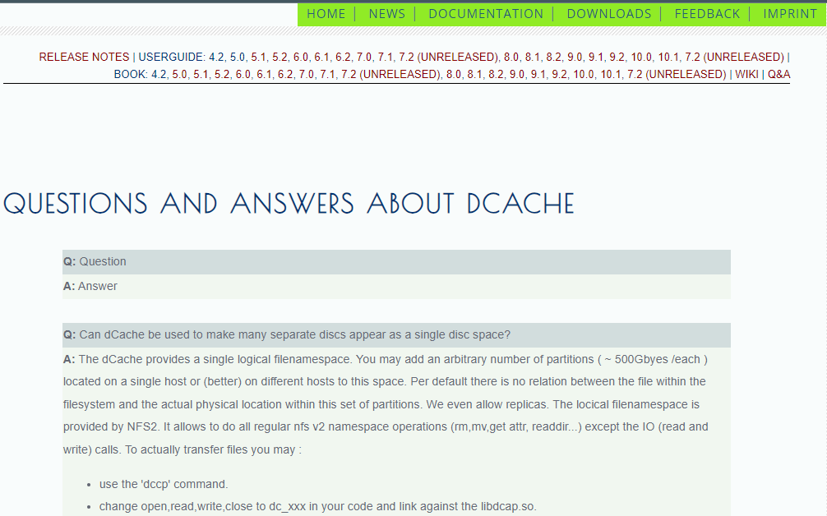
Motivation
dCache documentation quite complex
dCache book, user forum
Users ask questions that have already been answered
Difficult search in the provided documentation
Q&A, Book, Users Guide

Slide 3
AI based solution:
Retrieval Augmented Generation (RAG) bot

Slide 4
implementation
Utilize online git repositories as a source of information about a product
Add private archive of emails to dcache-forum
Use LLM to generate answers
mistralai/Mistral-7B-Instruct-v0.2
version with OpenAI models also available
must add payment method to use API, all tests < 10 USD
Vectorizer to process questions
sentence-transformers/all-MiniLM-L6-v2
OpenAI vectorizer text-embeddings-3-small
Custom prompts, more custom documents

Slide 5
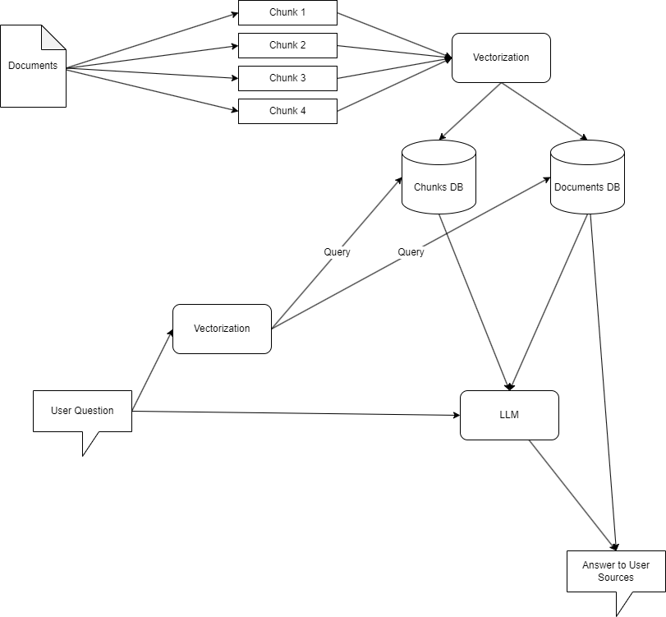
Schema

Slide 6
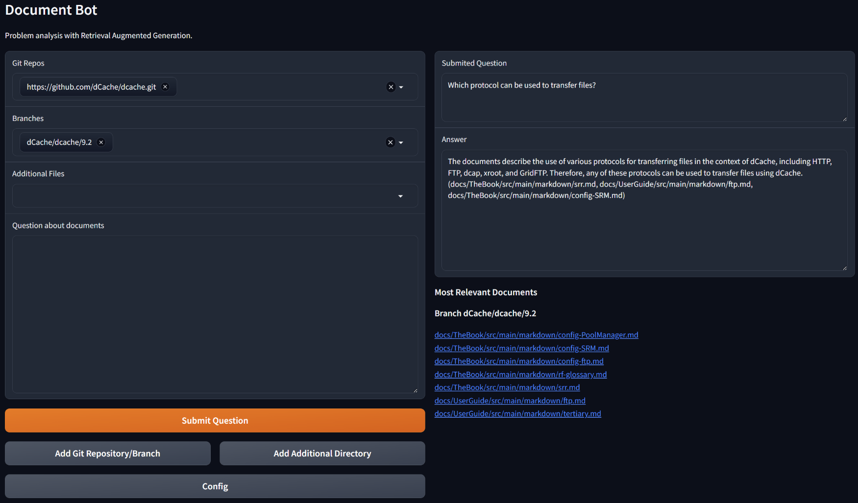
Examples

Slide 7
Examples

Slide 8
Examples

Slide 9
Examples

Slide 10
Configuration

Slide 11
Configuration

Slide 12
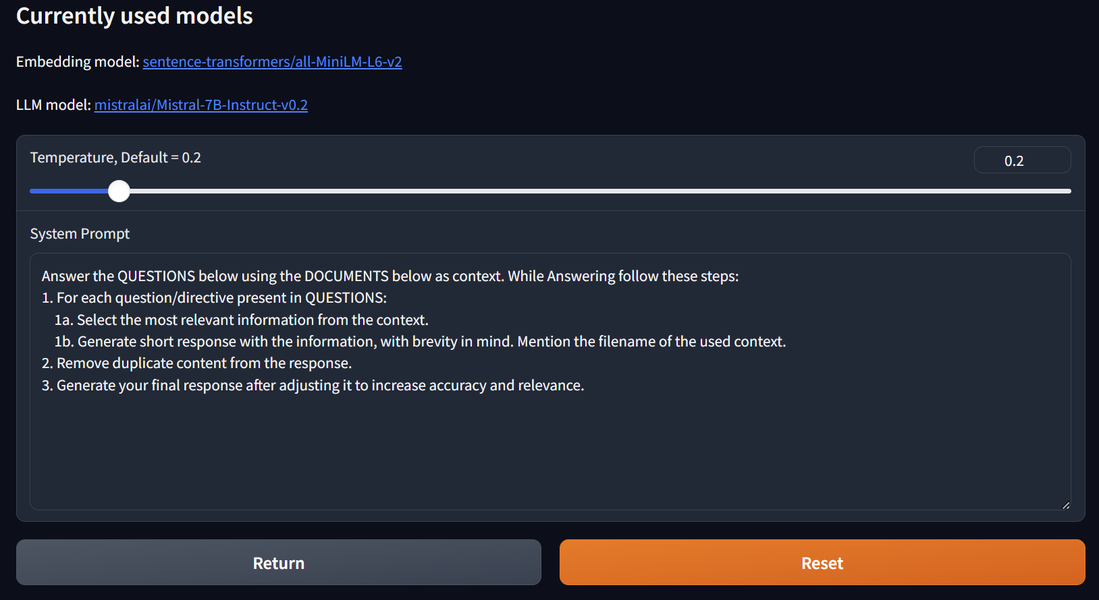
Configuration

Slide 13
Hardware

Slide 14
Hardware and Performance
Our default model LLM mistralai/Mistral-7B-Instruct-v0.2 requires at least 8 GB GPURAM
we used NVIDIA T4 with 16 GB GRAM
used GRAM: 5.4 GB
quantization: LLM 4 bits, processing in 16 bits
Bigger model Mixtral-8x7B: 80 GB (NVIDIA A100)
Response time in seconds
6.5 s (Which protocol can be used to transfer files?)
Response when running on CPU only: many tens of seconds

Slide 15
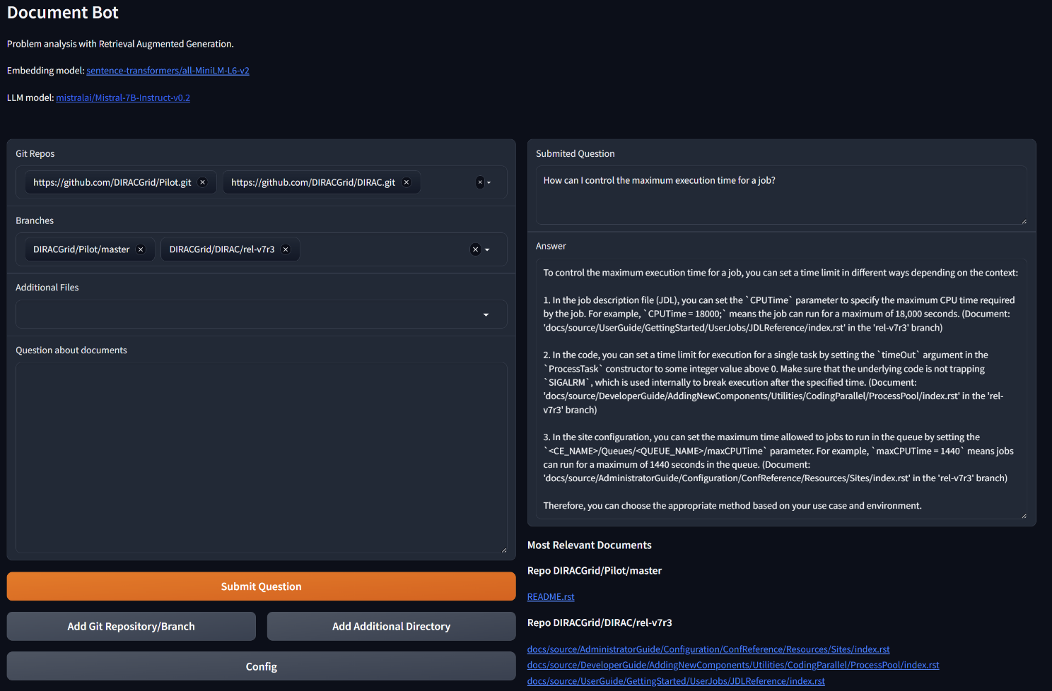
More EXAMPLES

Slide 16
More EXAMPLES

Slide 17
More EXAMPLES

Slide 18
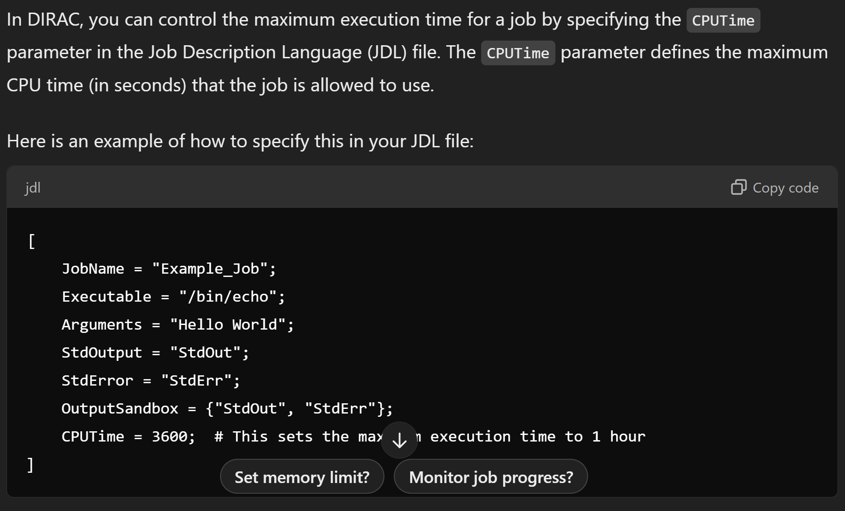
ChatGPT COMPARISON
OpenAI’s GPT-4-turbo model

Slide 19
Summary

Slide 20
Summary
Publicly available software for user support improvement
https://github.com/jinymusim/Docu-Bot/
Private documentation can be added without sharing it publicly
Dedicated LLM instance quite costly
possibility to share it with many other similar bots
OpenAI’s ChatGPT fast improvements
Running instance for tests
http://78.128.250.22:7860/
(for a limited time)

Slide 21
Backup slides

Slide 22
More EXAMPLES

Slide 23
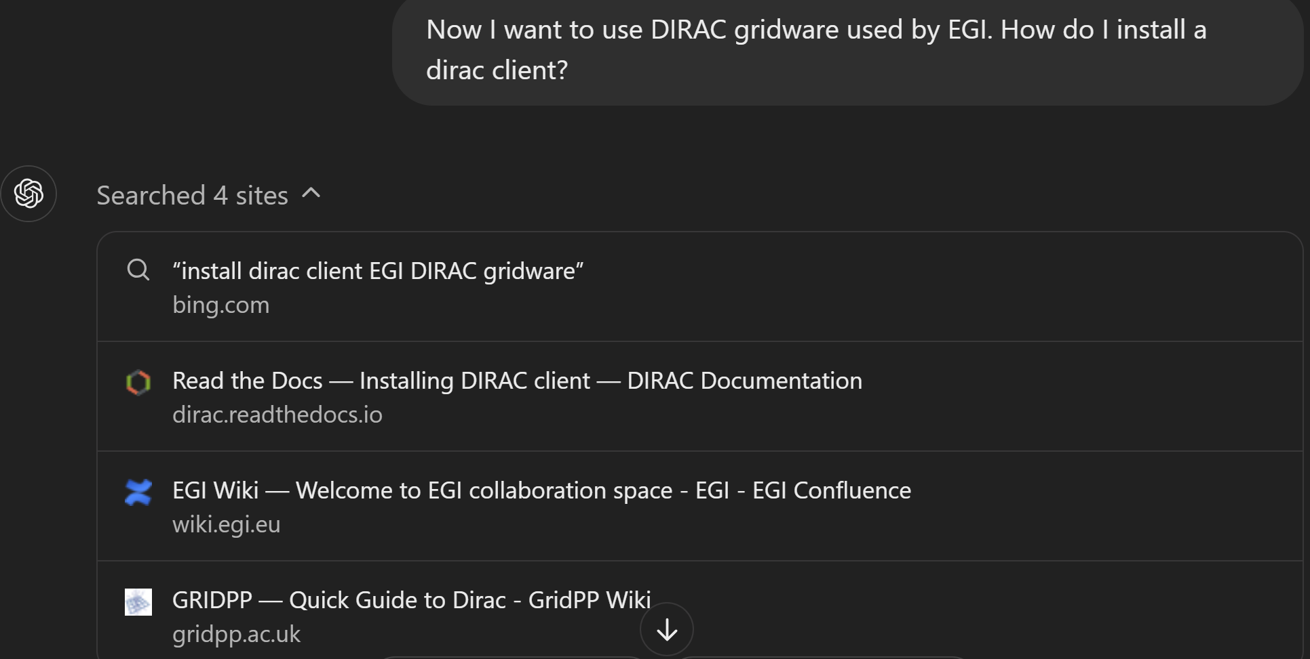
More EXAMPLES

Slide 24
Configuration

